Slide 1
Systematically Detecting Packet Validation Vulnerabilities in Embedded Network Stacks
Paschal Amusuo
Ricardo Méndez
Zhongwei Xu
Aravind Machiry
James C. Davis
Notes:
HI everyone
Thank you for coming to my talk today
I am Paschal Amusuo from Purdue University, and today, I will be discussing our paper on "Systematically detecting packet validation vulnerabilities in Embedded Network Stacks.
I recognize the contributions of my co-authors and appreciate support from our funders.

Slide 2
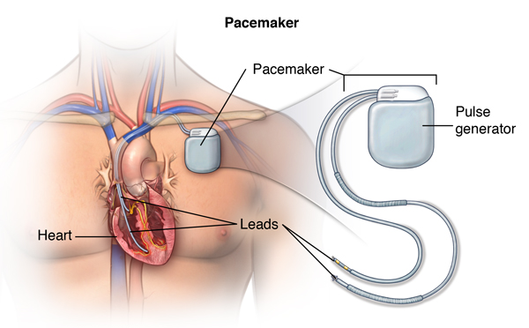
Age of the Internet of Things
Notes:
Today, devices are getting connected to the internet to make them smarter and to enhance monitoring and control.
For example, our kitchen appliances, cars and even medical devices like pace makers.
Some of the manufacturers even provide mobile applications to enable these.
Unfortunately, this level of connectivity introduces significant security risk, and that's what we will be discussing today.

Slide 3
Summary of Contributions
Failure analysis: 61 Embedded Network Stack CVEs
Designed EmNetTest, an automated systematic testing framework for ENS
Evaluated EmNetTest's vulnerability detection capabilities
Reproduced 12 known vulnerabilities
Discovered 7 new vulnerabilities
Notes:
Before we continue, here's a brief overview of what today's talk is about, and our contributions in the EmNetTest paper.
We conducted a vulnerability analysis of 61 CVEs found in Embedded Network Stacks.
Following the lessons we learnt, we designed a systematic dynamic analysis technique called EmNetTest. So far, we have detected 7 new vulnerabilities with 6 CVEs assigned.

Slide 4
Background
Notes:
Let's start with a little background

Slide 5
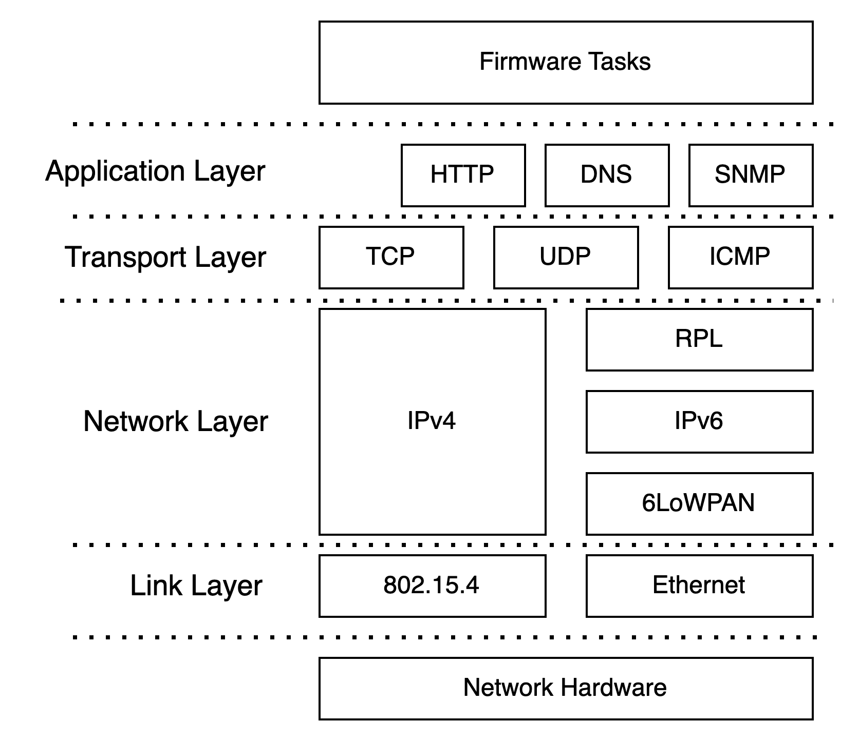
What are Embedded Network Stacks (ENS)?
ENS
vs
"regular" Network Stacks?
TCP/IP Network Stack
Notes:
To enable internet connectivity, the smart devices in the previous slide rely on an embedded network stack.
An Embedded Network Stack, or any network stack is the software component that allows an application, or embedded application, connect to the internet.
It is just a set of network protocol implementations that has been tailored for and used in embedded systems.
Here in this figure, the ENS comprises everything within this brown box, and as we can see, connects the firmware to the network hardware
But even regular operating systems, such as linux and windows, have their own network stacks.
So what makes the ENS interesting to study?
Regular operating systems such as linux has software and hardware protections that prevent the exploitation of vulnerabilities. For example, ASLR and Stack Canaries makes buffer overflow vulnerability very difficult to exploit.
Unfortunately, embedded systems do not have these protections.
Hence, there is greater need to detect and eliminate critical vulnerabilities from these systems.
Also, it is worth knowing that these ENS are closely tailored to embedded applications and operating systems, and hence, have very diverse characteristics.

Slide 6
Examples of ENS Vulnerabilities – CVE-2018-16523
MSS Option
Network packet showing Ethernet, IP and TCP headers.
Notes:
Before we look at an example of an ENS vulnerability
Here is a network packet, comprising the ethernet, IPv4 and TCP headers. Here, let's indicate one field here, the MSS option field, with a brown box

Slide 7
Examples of ENS Vulnerabilities – CVE-2018-16523
MSS Option
Division by MSS Value
Notes:
Here is a snippet of code from FreeRTOS as at 2018. FreeRTOS is an open-source embedded operating system that is currently maintained by AWS.
First, we remember the MSS field in the network packet
In the last line here, we can see that the MSS field is used as the divisor in this operation.
If that value is zero, as shown in our packet, we get a division-by-zero vulnerability which can lead to a denial of service attack. For embedded systems such as a pacemaker or a car, such a denial of service can have disastrous consequences.

Slide 8
Research Questions
Theme 1: Retrospective Vulnerability Analysis
RQ1: Types and Root Causes of ENS vulnerabilities?
RQ2: Packet sequences that trigger ENS vulnerabilities?
RQ3: Are ENS properly tested for packet validation vulnerabilities?
Theme 2: Prospective Vulnerability Detection
RQ4: Can bounded systematic testing uncover packet validation vulnerabilities?
Notes:
In order to properly understand and detect these ENS vulnerabilities, we defined the following 4 research questions.
First, we study the ENS vulnerabilities, and identify their characteristics.
With our results and findings, we design a bounded systematic detection tool that is capable of detecting these ENS vulnerabilities

Slide 9
Vulnerability Analysis

Slide 10
Methodology for Vulnerability Analysis
Name | Size (LOC) | # CVE
FreeRTOS+TCP | 42.2K | 11
Contiki-ng | 41.6K | 24
Zephyr | 95.7K | 11
PicoTCP | 32.7K | 12
LwIP | 84.3K | 1
FNET | 18K | 2
Total |  | 61
Repository Selection
6 ENS
Data Collection
66 Total, 61 PV vulnerabilities
Vulnerability Reports from NVD
Notes:
Here is our methodology. We selected 6 ENS with different and diverse characteristics.
Next, we collected and analyzed 66 vulnerability reports, related to the selected ENSs, from the National Vulnerability Database.
During our preliminary study, we noticed 61 of the 66 vulnerabilities directly relate to the processing and validation of packets. Hence, they are triggered by sending specific vulnerable packets to the ENS. We term these 61 vulnerabilities as Packet Validation Vulnerablities and they formed the focus of our study.
For each report, we studied both the characteristics of the vulnerable code, and the characteristics of the packets needed to trigger the vulnerability.

Slide 11
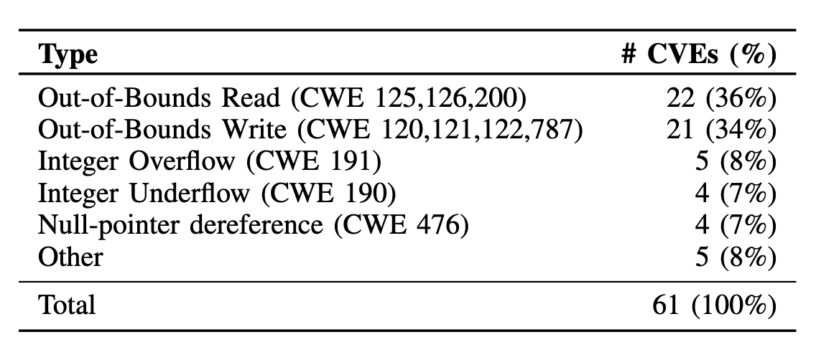
RQ1 Results: CVE Types
70% are Memory Corruption vulnerabilities
Notes:
Our first result shows the different classes of vulnerabilities in our dataset, according to their CWE classifications. At least, 70% are memory corruption vulnerabilities. We noticed these memory corruption vulnerabilities had some peculiar and interesting patterns that make them evade detection by default configurations of address sanitizers.

Slide 12
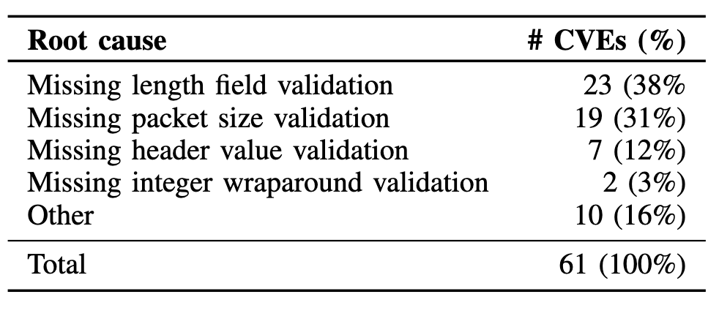
RQ1 Results: CVE Root Causes
84% of CVEs are caused by improper packet validation
Notes:
But then, we looked deeper to understand the causes of these vulnerabilities. We saw that 86% of vulnerabilities were caused by the absence of proper field validation. The remaining 10 vulnerabilities included vulnerabilities such as double-free and infinite loops.
For the vulnerabilities caused by improper field validations, we looked at the fields that resulted in the vulnerabilities. Our results showed that a total of 41 different fields were guilty.

Slide 13
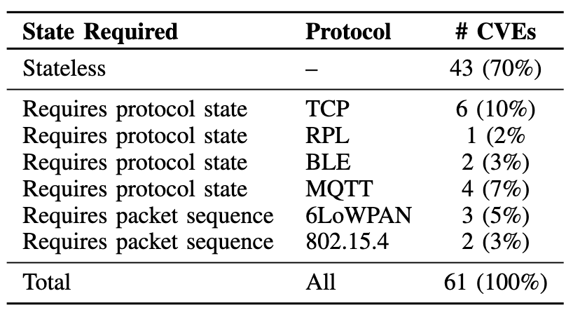
RQ2 Results: Protocol States
Notes:
Next, we analyzed the statefulness of the vulnerabilities. We found that 70% of the vulnerabilities were stateless, and the other 30% either required the protocol to be in a specific state, or required a specific sequence of packets to get triggered.
In summary, our results from the first theme shows that ENS vulnerabilities were mostly memory corruption vulnerabilities, they are caused by diverse packet fields and occur in different protocol states.

Slide 14
Vulnerability Discovery
Notes:
Given these findings, we resorted to developing a reliable approach to detect these kinds of vulnerabilities.

Slide 15
EmNetTest: Design Requirements
Req 1: Detect memory corruption
Req 2: Systematically explore all fields
Req 3: Explore all protocol states
Req 4: Work across diverse ENSs
Notes:
To aid our design, we identified the following requirements.
First, we should reliably detect memory corruption vulnerabilities.
Because of the wide range of guilty fields and guilty protocol states, we should explore all fields
Also, because ENS have diverse characteristics and dynamic analysis involves interacting with the system, we should design a system that can work easily across the various ENSs

Slide 16
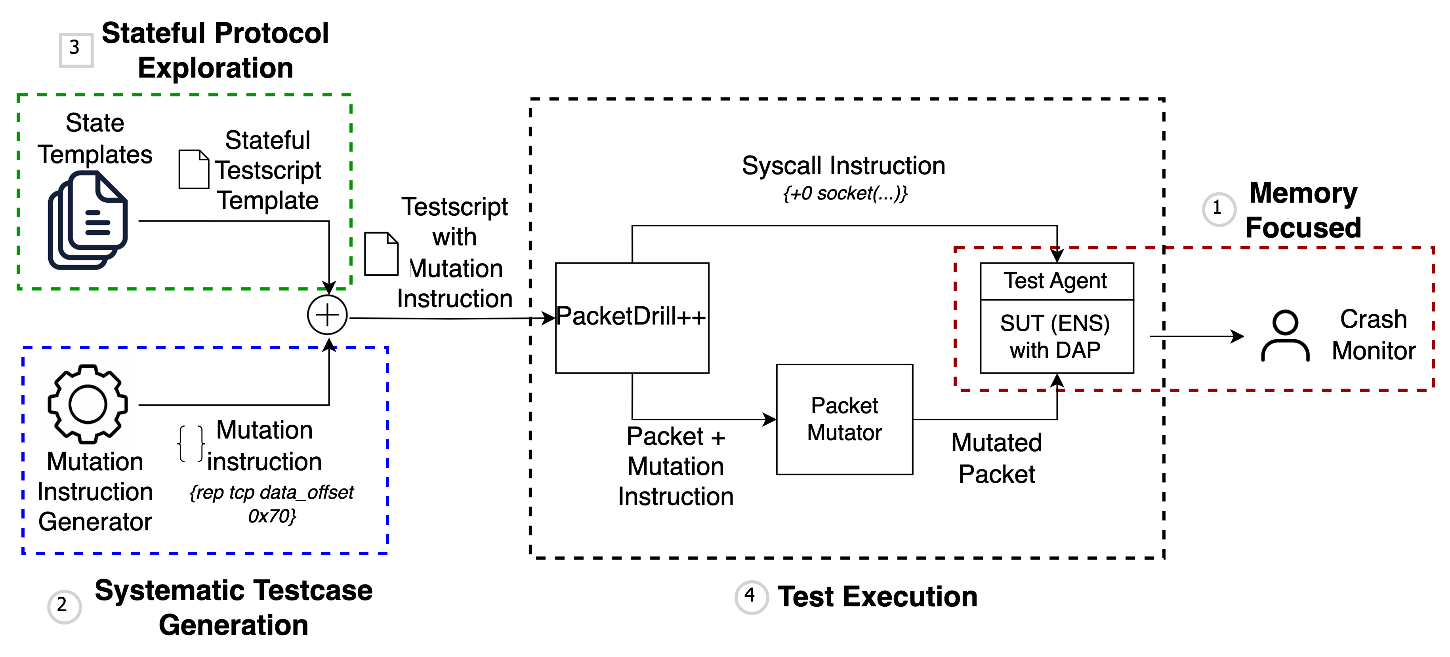
EmNetTest: Design Overview
Req 3
Req 1
Req 2
Req 4
Notes:
This figure shows our design of EmNetTest.
It satisfies all the previous requirements.
In our next slide, we will explain in detail, our main algorithm, which enables the systematic testcase generation (req 2)

Slide 17
EmNetTest: Illustrating Algorithm
Dest. MAC Addr.
IPv4 VHL Field
TCP Urgent Pointer
Notes:
Here is a network packet, comprising the Ethernet, IPv4 and TCP headers.
We can see that this packet comprises multiple fields, most are within 1– 2 bytes.
Our analysis showed that we can trigger vulnerabilities when we mutate individual fields instead of mutating the packet as a whole.
EmNetTest starts from the first field, here the destination Mac address. It samples values across the range of the field, guided by a configurable sampling stride k. It replaces this value with each sampled value and injects into the ENS.
We do this for each field in the packet.
Because many vulnerabilities were caused by multiple fields, we also take combinations of each field, starting with a combination of two fields, three fields, etc.
Our analysis showed that even a single field or a combination of two fields was sufficient to trigger 95% of the vulnerabilities.

Slide 18
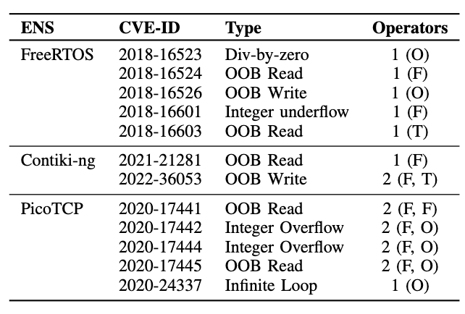
Evaluation: Vulnerabilities Reproduced
Notes:
To evaluate, first we evaluate EmNetTest’s ability to detect known vulnerabilities.
We identified the subset of vulnerabilities that affect the TCP, IP and UDP protocols currently supported by our prototype. W
There were 14 of these vulnerabilities and we recreated these vulnerabilities in their source codes. EmNetTest successfully reproduced 12 of these vulnerabilities. We couldn't reproduce the remaining 2 partly due to unsupported IPv6 features and time constraints.

Slide 19
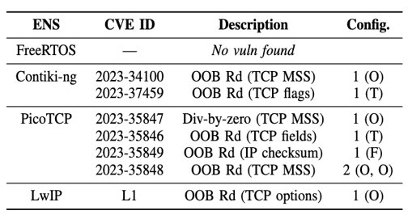
Evaluation: Vulnerabilities Discovered
Notes:
We also evaluated EmNetTest’s ability to detect new vulnerabilities.
We ran EmNettest on the latest versions of these ENSs. We discovered 7 zero-days vulnerabilities. 6 CVEs has so far been assigned.
We did not find any vulnerability in the latest version of FreeRTOS. This may be because AWS, who maintains FreeRTOS, currently uses bounded model checking, CBMC, to formally verify the memory safety of FreeRTOS.
Here, let me also discuss another interesting finding we had.
Look at the first contiki vulnerability, and the 4th PicoTCP vulnerability. They are both out-of-bound read vulnerabilities caused by an invalid MSS option length. They have similar patterns. Also, look at the first PicoTCP vulnerability and (switch slides)

Slide 20
Evaluation: Vulnerabilities Reproduced
Notes:
and the first FreeRTOS vulnerability. They also have similar patterns, being a division-by-zero vulnerability caused by the MSS option field having a zero-value.
We saw this repeated pattern of vulnerabilities across different ENSs and different protocols.

Slide 21
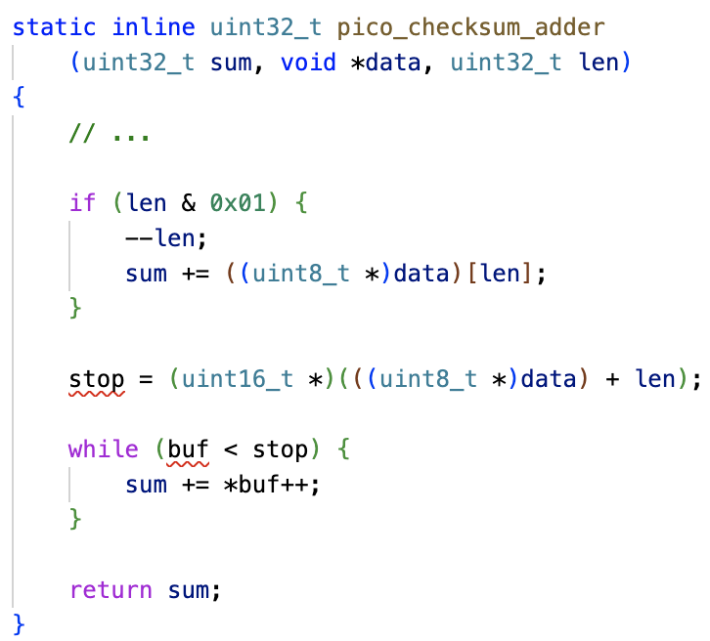
Vulnerability Case Study: CVE-2023-35849
Notes:
Here, we show an example of a vulnerability we found.
The pico_checksum_adder function is called when PicoTCP tries validating the IPv4 checksum field. The function is called with a pointer to the IP header and the IP header length gotten from the packet.
Here, it sums the bytes of the IP header. But the variable stop depends on the len variable, which is the IP header length value in the packet.
Hence, by setting the IP header length field to a higher value, this block of code can read outside the bounds of the network packet,

Slide 22
Discussions

Slide 23
Discussions
Intra and Inter-product Vulnerabilities
Improving Testing Practices for ENS
Notes:
We want to draw our attention to two observations that require further attention.
First, we found cases of repeated vulnerabilities across different ENSs. But this isnt an isolated event.
In our paper, we cited 2 papers that has conducted and reported early results on these phenomenom. We think there should be better approaches to help software engineers learn from their own mistakes and other people's mistakes, so we reduce the frequency of these repeated vulnerabilities.
Second is the aspect of testing for open-source software. Currently, Google provides infrastructure to fuzz and detect vulnerabilities in open-source software. But the problem is just, fuzzing is a non-deterministic process, and the vulnerabilities Google's OSS-Fuzz finds, is detected very late in the SDLC. Can we go back to reviewing testing practices, and developing approaches that can aid vulnerability discovery during development time?

Slide 24
Conclusion

Slide 25
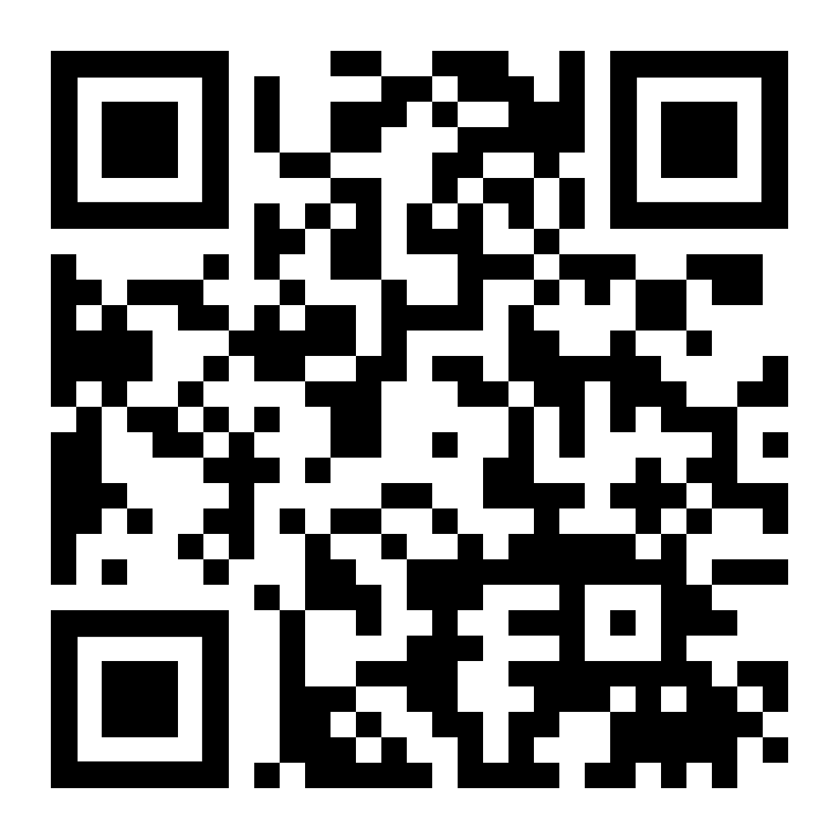
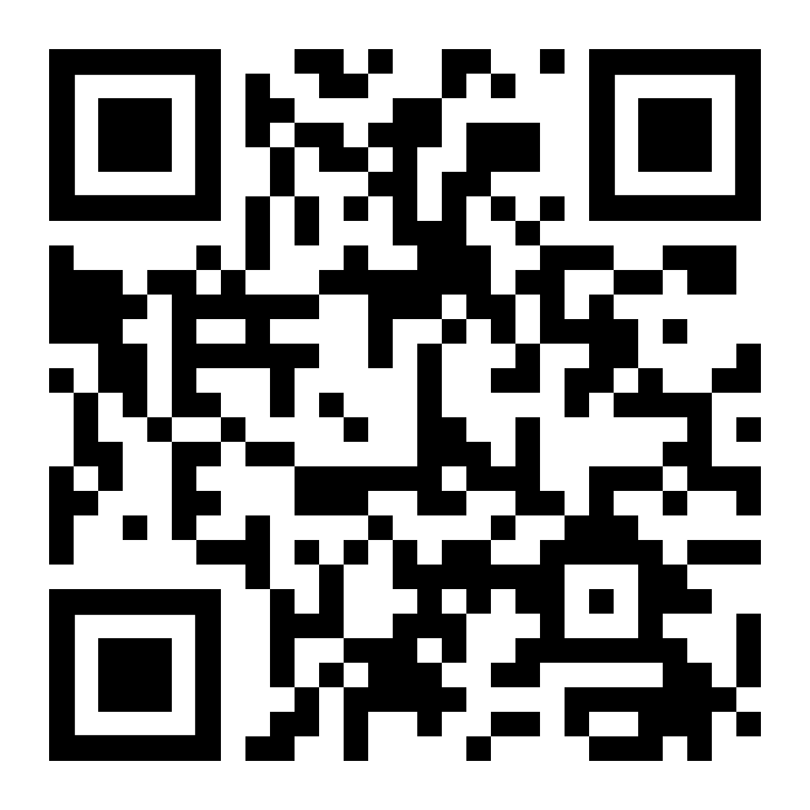
Conclusion
Studied 61 vulnerabilities
Designed EmNetTest: reproduced 12, found 7 PVV
Bounded Systematic Testing works
Preprint
Paschal C. Amusuo
Purdue University
Pamusuo@purdue.edu
Artifacts
Notes:
At this point, I'll conclude my presentation.
We studied 61 ENS vulnerabilities and designed EmNetTest to aid in detecting these vulnerabilities.
As a takeaway, we learnt that in this context, bounded systematic testing is effective at finding typical PV vulnerabilities
The preprint of our paper, as well as our artifacts are available through these QR codes.
Thank you for listening to my presentation. I will be happy to answer any question you may have, either now or after the session. I can be reached by my email address on the screen.
Thank you.

Slide 26
Bonus Slides

Slide 27
Evaluation: Test Duration
Test Duration, showing execution time when mutating 1, 2 and 3 fields at a time

Slide 28
State of Art for Vulnerability Detection
Dynamic Analysis
Static
Analysis
Formal Verification
AFL
AFLNet
TCPFuzz
CodeQL
CBMC

Slide 29
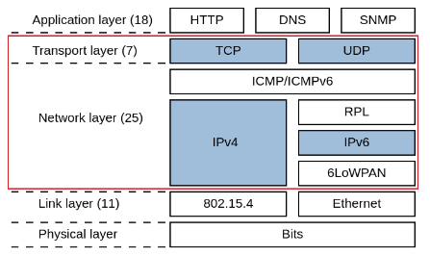
RQ1 Results: Distribution of CVEs to Protocol Layers
Figure showing layers of the TCP/IP stack. Number of analyzed vulnerabilities shown in parenthesis. Layers we covered shown in red box. Protocols we support shown in blue

Slide 30
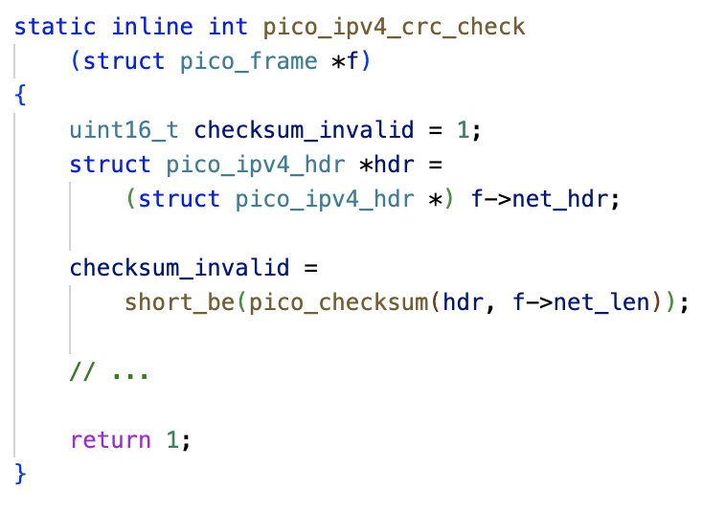
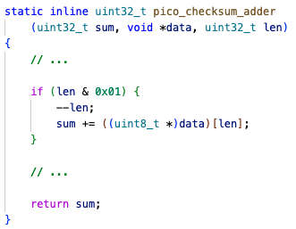
Vulnerability Case Study: CVE-2023-35849
Notes:
Here, we show an example of a vulnerability we found.
In the first frame, pico_checksum is called with a pointer to the IP header and the IP header length.
In the second frame, the fields of this IP header length is being added. But there is no check that the header length field is even valid. Hence, if you pass 100, it attempts to add 100 bytes even if the IP header only contains 20 bytes.

Slide 31
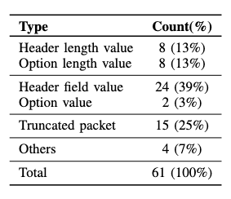
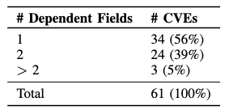
RQ2 Results: CVE-triggering fields
Distribution of CVEs by incorrect fields in the CVE-triggering packet.
Distribution of CVEs by number of dependent fields.

Slide 32
RQ3: Why did these vulnerabilities get past Testing?
We reviewed the test suites of 4 ENSs – FreeRTOS, Contiki-ng, LwIP and PicoTCP. Here are our observations.
Varying frameworks for testing.
Insufficient packet injection tests.
None of the ENSs systematically check for invalid header or option fields.
Notes:
We picked a subset of the 6 ENSs and looked at their test suites. All of them contained unit and end-to-end tests.
But our first observation is that the tests in each ENS was different. They used different frameworks for testing. They tested different aspects of the code. While these software systems all serve similar purposes, there was no uniformity in how they were being tested.
We checked if the test suites contained tests for invalid packet injection or invalid header fields.
We saw that while 2 ENSs had packet injection tests, they used a fixed and limited set of test packets. For one of the ENS, their collection of test packets were mostly regression tests for past bugs and vulnerabilities.
One of the ENS had unit tests for few invalid header fields such as the TCP data offset field, but it was neither comprehensive or systematic.

Slide 33
Evaluation: Test Coverage
Line coverage results, showing that vulnerability discovery, which happened at N=1, didn't require significant coverage increment

