Slide 1
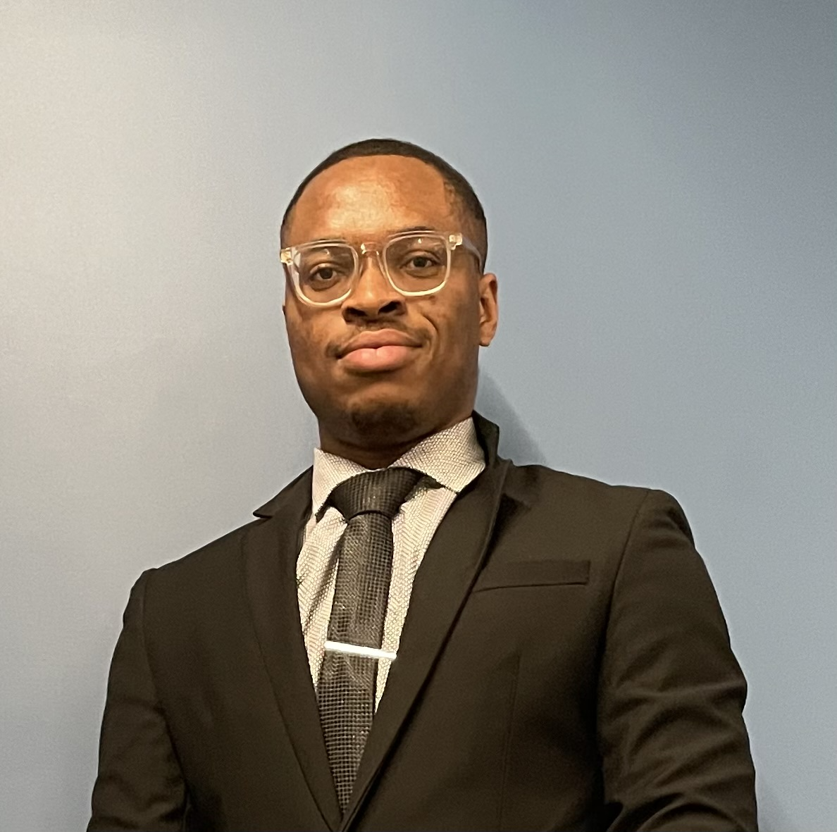
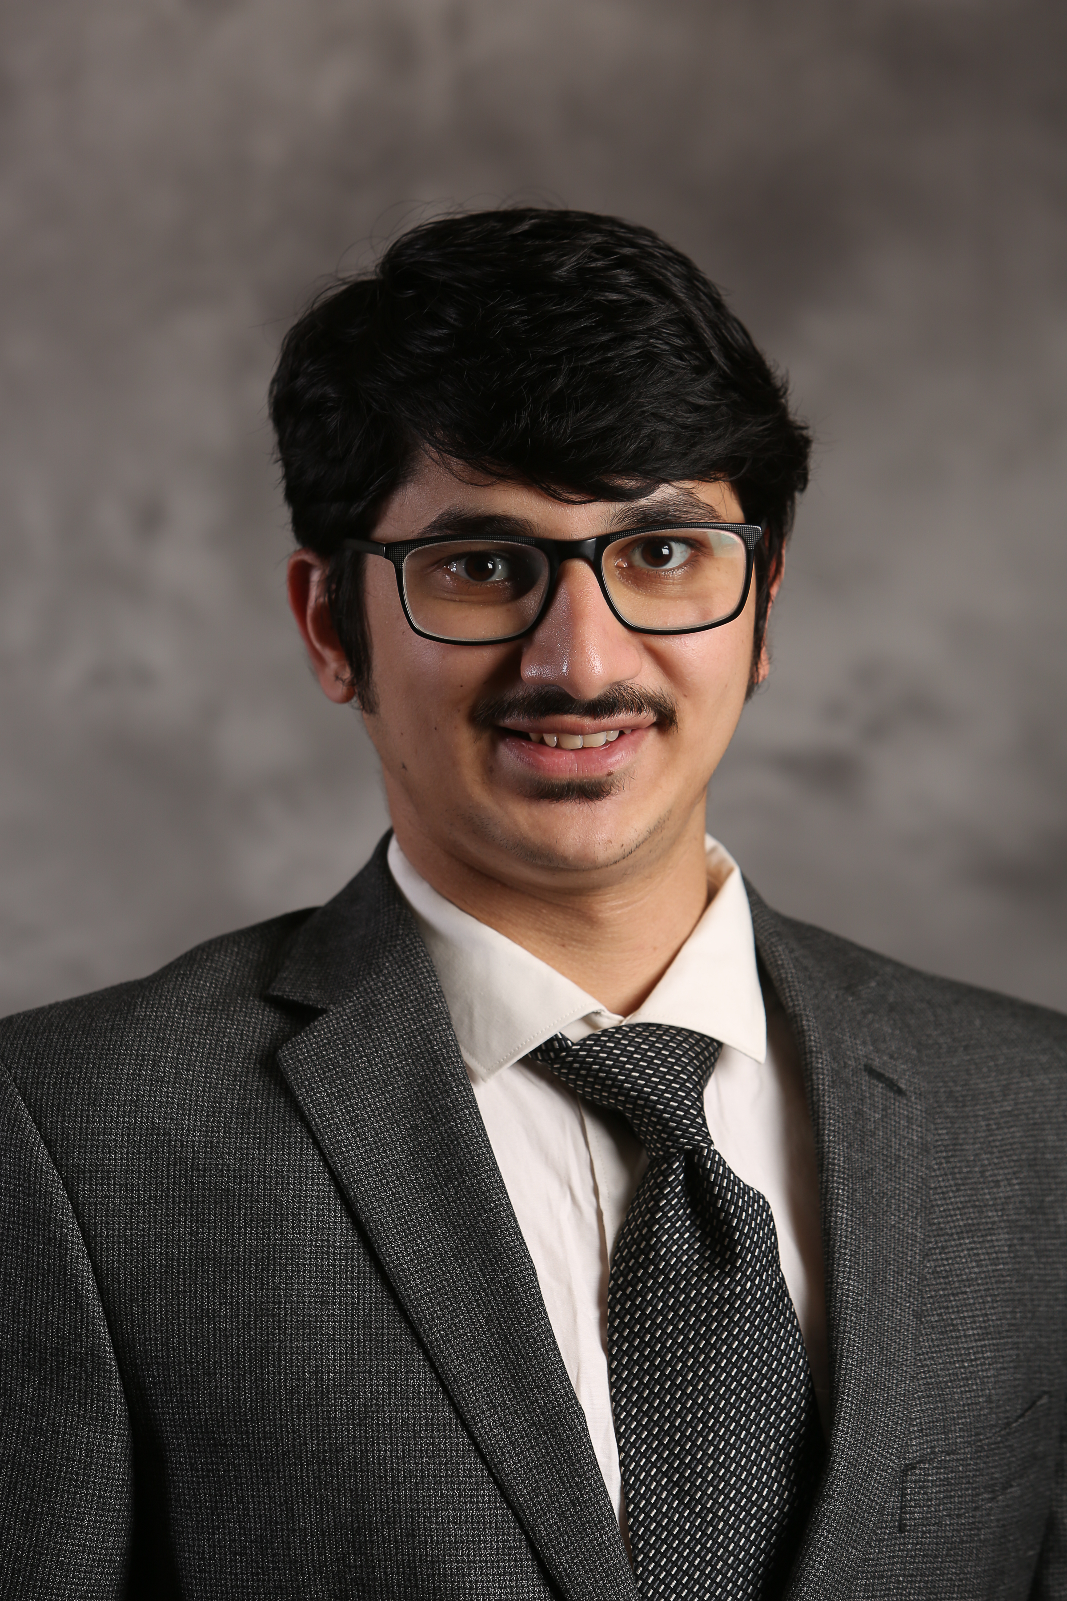
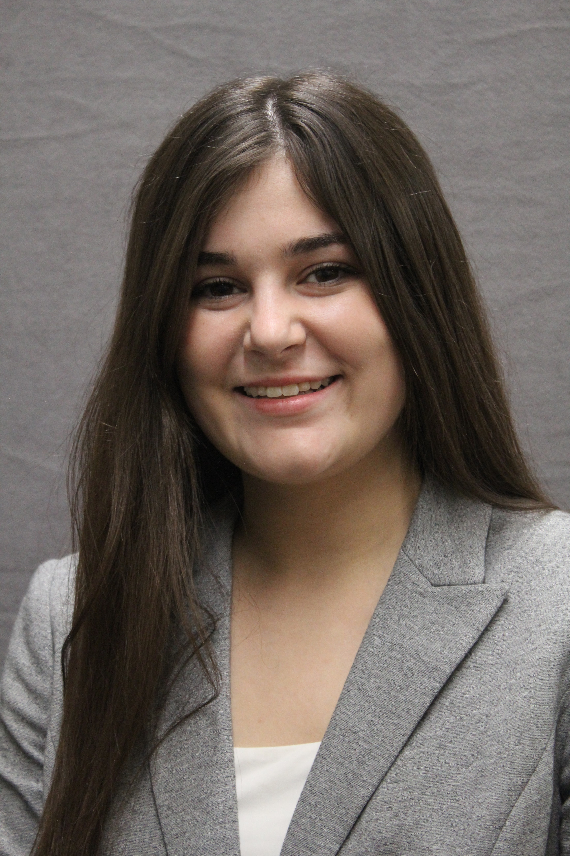
Reflections on
Software Failure Analysis
Paschal Amusuo
Siddharth Rao
Abbey Vincent
Aishwarma Sharma
James Davis
Notes:
Hi everyone,
I am Paschal Amusuo from Purdue University, and I will be presenting our work on “Reflections on Software Failure Analysis”
On the slide here are my teammates and supervisor who made this work possible.

Slide 2
Overview
Systematic literature review of 52 Software Failure Studies
9 recurring flaws
4 research directions
Notes:
In this work, we conducted a systematic literature review of 52 software failure studies. We studied the methodology employed by the authors, the software systems targeted, the replicability and recommendations made by the papers.
Through this approach, we identified several recurring flaws in the conduct of these studies.
These flaws, as we will see, are mostly due to certain limitations, and hence, we propose 4 research directions to aid the conduct of these studies.

Slide 3
Background
Notes:
Let’s start with a background about software failure studies.

Slide 4
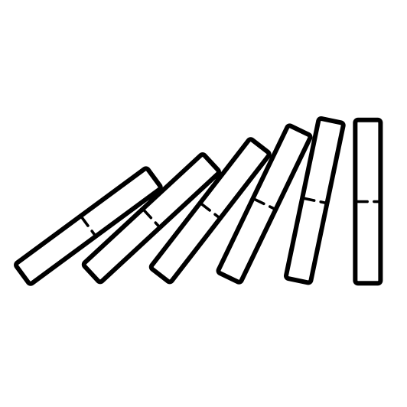
What are Failure Studies?
Plan
Develop
Validate
Operate
Lessons learned
Failure Studies
Defects
Notes:
In the software development life cycle, we plan a software project, build and validate it and everything seems to work well. But once deployed and during operation, things break, bugs happen. These bugs are undesirable.
To better understand these bugs, academic researchers or industry investigators conduct various studies – bug studies, vulnerability studies, etc – the lessons learned from these studies are expected to impact the SDLC and lead to a reduced occurrence of these bugs.
For the context of this presentation, we would be using the term “defects” to mean bugs and vulnerabilities and referring to these studies using the more general term “failure studies”. This is because in software engineering, what we report and study as bugs are reported failures in the operation or correctness or security of a software.

Slide 5
More papers about software defects every year
Search terms: (empirical OR comprehensive OR taxonomy OR characteristics) AND (bug OR bugs OR faults OR defects OR failures OR vulnerabilities) AND (study OR review)
Notes:
An insightful trend we noticed. We searched academic literature using the search terms shown on the slide. Every year since 2000, the number of failure studies reported have been steadily increasing. We also foresee this trend continuing. Hence, it is time we start investigating how these studies are conducted, if they are making the required or expected impact, and how we can ease their conduct

Slide 6
How are Failure Studies conducted?
Notes:
Failure studies generally, in most engineering disciplines, are conducted following the same process. Hence, during our SLR, we looked at each stage in this process and identified the flaws in that stage.

Slide 7
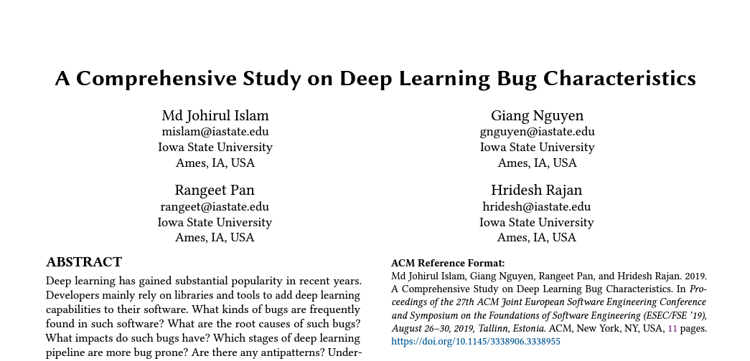
Some Failure Studies
Notes:
But are failure studies relevant?
Here are also some popular examples of failure studies
First paper studied 70 performance bugs from 8 applications. Their results enabled them to design a static analysis tool that detected 126 matches of their performance bug patterns in 29 android applications.
The second paper studied bugs in javascripts and evaluated them against static type systems. They discovered that both Flow and Typescript would have successfully detected 15% of these bugs
The third paper investigated bug characteristics in deep learning systems. They studied stack over flow posts and bug fix commits of popular deep learning libraries. Their results show the severe kinds of bugs in deep learning systems and their root causes.
As we can see, these papers all had results and made recommendations that are very significant to software engineering

Slide 8
Goal of Study: Reflect on the Conduct of Software Failure Studies
Notes:
Hence, let’s look at how they were conducted.

Slide 9
Methodology

Slide 10
Methodology
Methodology
Software
Classes
Select Primary
Studies
52 papers
Read/Extract
Data
4 researchers
Failure
Dimensions
Analyze Results
And Identify Flaws
Bug Report
Sources
Define Project
Scope
Replicability &
Impact
Data
Extraction
Study
Dimensions
Flaw
Identification
Search
Notes:
Here’s our methodology. We followed the standard for conducting a systematic literature review. We analyzed our data across 5 dimensions.
From our results, we identified recurring flaws in these dimensions and mapped them to stages in the failure study conduct model.
While we repeatedly use the word “flaws”, we do not mean to say that the studies were flawed. No
Instead, we attribute these flaws to limitations generally faced by researchers who conduct these studies. We will be looking at the various flaws in a bit and discussing their potential impact

Slide 11
Recurring Flaws in Software Failure Studies
Notes:
For want of time, we will only be looking at 3 selected flaws

Slide 12
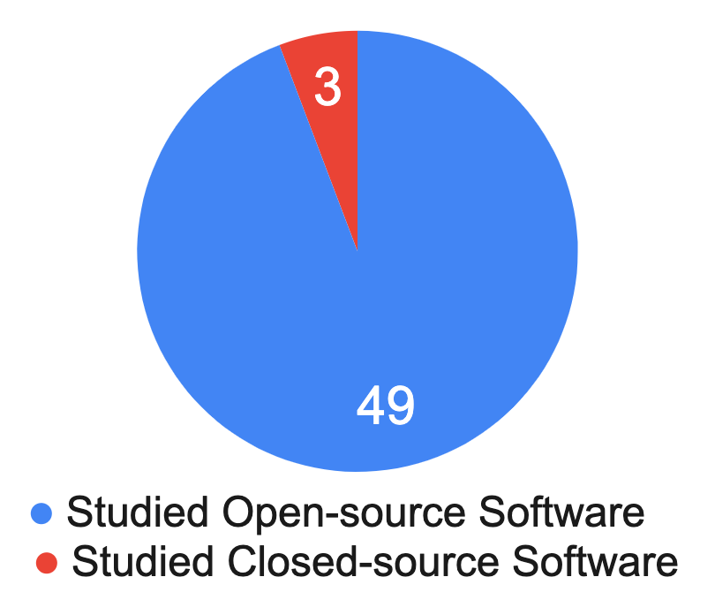
Defining Scope of Failure Studies
Bias Towards Open-Source Software Systems
Notes:
First, we observed that most failure studies were tailored towards open-source software.
In fact, only 3 of 52 papers studied defects in proprietary software. One of such papers, Mantyle et al studied the type of defects discovered in code review. Their work was done in collaboration with a company.
We understand that most failure studies are done on OSS because theie defects, source codes and evolution history are publicly available and accessible.
So here’s the question. Are the studies conducted on OSS also applicable to proprietary or commercial software?
Prior work by Mockus et al and Paulson et al already studied this phenomenom and observed there were differences between OSS and commercial projects.
Well, in software engineering, many engineers work on proprietary software, with difference set of practices, and for us to do research that also helps them, there needs to be some balance in studies conducted on OSS vs Proprietary Software

Slide 13
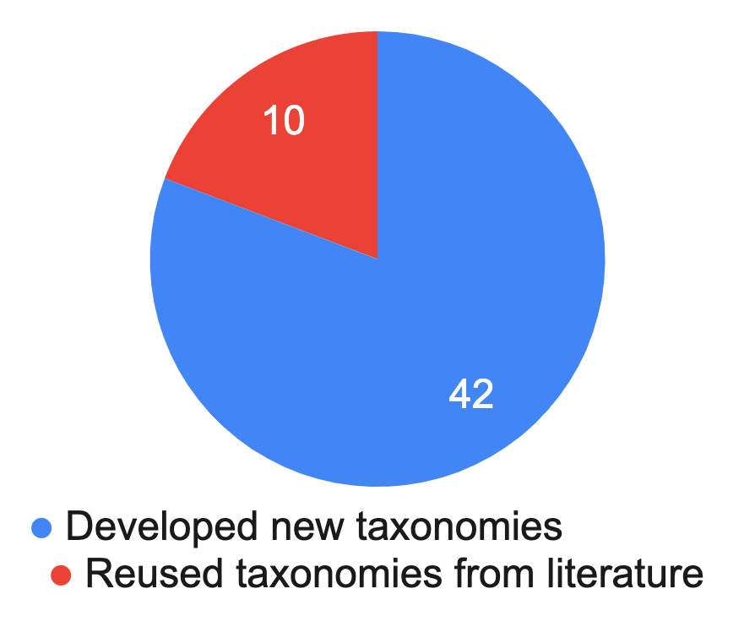
Analyzing Software Defects
Inconsistent Defect Taxonomies
Notes:
Second, we also noticed that most papers tended to develop an entirely new taxonomy when analyzing defects. This isn’t entirely bad
But then, even when papers could reuse or modify taxonomies, they developed their own. In some cases, there are multiple existing taxonomies to build on and its not clear how the authors selected what taxonomies to use. Cao et al characterized performance bugs in deep learning systems. While they built on taxonomies used in studying defects in other deep learning system, they didn’t consider already existing taxonomies used to study performance bugs in other systems such as android applications. This inconsistency makes it difficult to compare the results made by various papers.
We also noticed disagreement in terms in taxonomy. For example, The paper on bug characteristics in open source software reused taxonomies from a paper that studied defects in database management systems. But they identified in their paper that the large difference in the percentage of semantic bugs may be due to differences in the meaning of the term in the two papers.
We attribute these issues to a lack of standard in conducting these failure studies. Hence, taxonomies, terms, etc are open to definition and interpretations by the authors.

Slide 14
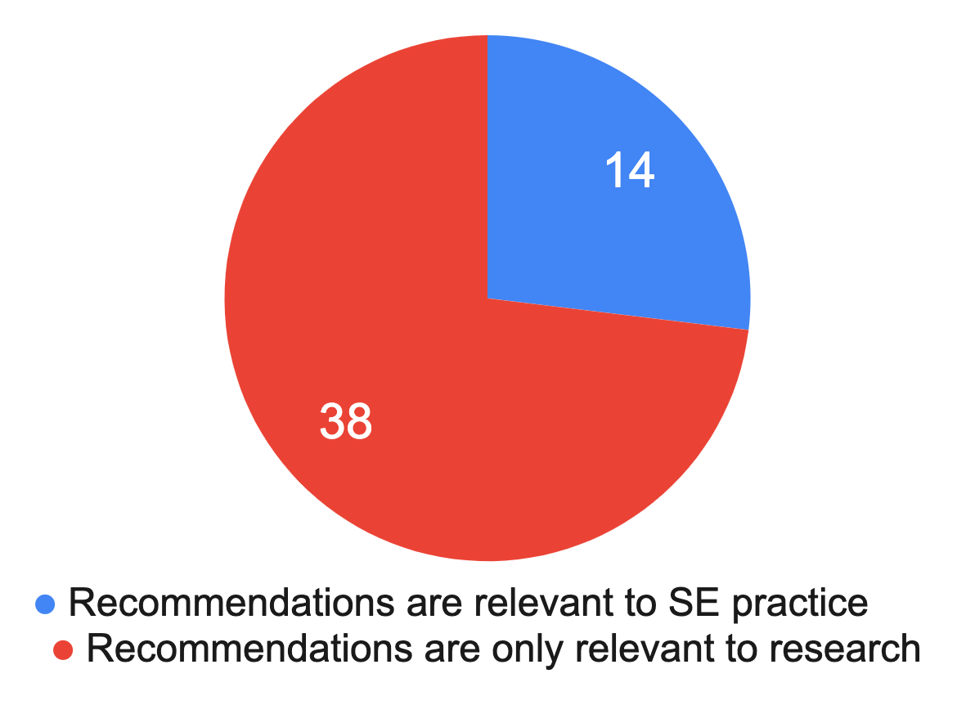
Results and Impact
Only few papers make recommendations that are relevant to practice.
With regards to Findings 4, 6, and 12, these results suggest that web application testers should also prioritize emulating DOM-related faults, as most high-impact faults belong to this category.
Moreover, researchers and developers can use the triggering conditions summarized in §IV as a checklist to test cloud systems. For example, by limiting the available memory and disk space during normal testing, eBugs that are triggered by either “out of memory” or “out of disk space” become more likely to be exposed.
Ocariza et al. A Study of Causes and Consequences of Client-Side JavaScript Bugs
Chen et al. Understanding Exception-Related Bugs in Large-Scale Cloud Systems
Notes:
The third flaw we will look at – The results and recommendations of most papers are not tailored to be relevant to practice.
Many of these papers revealed interesting characteristics of these bugs, identified the root causes of these bugs and even made recommendations on how the bugs could be detected during testing. While many of these approaches provide research directions to SE researchers, we don’t think they answer the question – What should software engineers do differently.
Here are some snapshots from Papers which tried to answer the question. In this study of client-side javascript bugs, the authors clearly suggested what type of faults should be prioritized by application testers. In the second study on bugs in cloud systems, the authors provided a checklist that can be used to test cloud systems. We think these kind of recommendations by failure study papers would also help improve the state of software engineering practice.

Slide 15
Flaws in every stage of the process
Notes:
Here is a chart of all the flaws we identified in the papers we reviewed. We can see that researchers who study bugs face similar limitations in every stage of the failure study process.

Slide 16
Proposed Research Agenda
Notes:
In the next slide, we would be discussing various ways the software engineering research community can aid the conduct of these failure studies. Some would be potential research directions, while others will be suggestions we make. We will also link each proposed agenda with the relevant flaw we identified.

Slide 17
Research Agenda
Identified Flaws Proposed Research Agenda
Bias towards open-source software
Increased collaboration with Industry Practitioners
Inconsistencies in conducting failure studies
Standardize the conduct of failure studies
Root causes are subjectively defined
Novel ways for identifying and analyzing defect causal chains​
Failure Studies are time-consuming and lack tool support​
Tool support for faster defect analysis
Notes:
First, we talked about bias towards open-source software. There are several suggestions we have. First, we suggest an increased collaboration with industry practitioners so we can also see an increased number of failure studies on proprietary systems. Another direction would be an increased focus on replication studies to verify if the results of failure studies conducted on Open-source software also hold for commercial or proprietary software. Since most software engineers work with companies and on proprietary software systems, this would ensure our research efforts are also relevant to them.
Second, we previously discussed inconsistencies in conducting failure studies and attributed it to a lack of standard. There is the empirical software engineering standards. Should be have a separately defined standard for conducting failure studies? We talked about different and inconsistent taxonomies and definitions used in failure studies. We suggest efforts towards harmonizing all these different taxonomies into a single body of taxonomy that will be easily reusable. Our peers in the security community use the CWE. Unfortunately, it seems the CWE doesn’t contain most of the weaknesses studied by the papers we reviewed and if they did, we didn’t find any paper that made any reference to the CWE.

Slide 18
Research Agenda
Identified Flaws Proposed Research Agenda
Bias towards open-source software
Increased collaboration with Industry Practitioners
Inconsistencies in conducting failure studies
Standardize the conduct of failure studies
Failure Studies are time-consuming and lack tool support​
Tool support for faster defect analysis
Root causes are subjectively defined
Novel ways for identifying and analyzing defect causal chains​
Notes:
First, we talked about bias towards open-source software. There are several suggestions we have. First, we suggest an increased collaboration with industry practitioners so we can also see an increased number of failure studies on proprietary systems. Another direction would be an increased focus on replication studies to verify if the results of failure studies conducted on Open-source software also hold for commercial or proprietary software. Since most software engineers work with companies and on proprietary software systems, this would ensure our research efforts are also relevant to them.
Second, we previously discussed inconsistencies in conducting failure studies and attributed it to a lack of standard. There is the empirical software engineering standards. Should be have a separately defined standard for conducting failure studies? We talked about different and inconsistent taxonomies and definitions used in failure studies. We suggest efforts towards harmonizing all these different taxonomies into a single body of taxonomy that will be easily reusable. Our peers in the security community use the CWE. Unfortunately, it seems the CWE doesn’t contain most of the weaknesses studied by the papers we reviewed and if they did, we didn’t find any paper that made any reference to the CWE.
Third, conducting failure studies is a manual and time-consuming process. Some papers even reported it took them over 15-24 months to collect and analyze their data. At that rate, even a replication study would be difficult. While we know we cant expect the entire process of conducting these studies to be automated, some tasks can be automated. One challenge with conducting these studies is identifying target reports, identifying and extracting relevant data from the defect reports. Well, we have already trained AI to generate code for us, fix our errors, merge bug reports, extract tasks from reviews on app stores, summarize documents, etc. If I want to study performance bugs for example, can we also explore ways AI, or NLP, can help me identify which bug reports are actually performance bugs and maybe, highlight relevant sections of the defect report/pull request that highlight interesting characteristics of the bug that I am interested in.

Slide 19
Conclusion
Notes:
So. Lets conclude

Slide 20
Conclusion
Failure studies are important
Researchers undergo various limitations when conducting failure studies
The Software Engineering community can assist the conduct of failure studies
THANK YOU
Our artifacts can be found at
https://doi.org/10.5281/zenodo.7041931
Notes:
In this talk, we have discussed the importance of failure studies and how they help reduce the occurrence of defects in software.
We have identified various limitations researchers undergo when conducting these studies. We have also made various suggestions on how the SE community can aid the conduct of these studies.

