Slide 1
Reflecting on Recurring Failures in IoT Development
Dharun Anandayuvaraj | James C. Davis
dananday@purdue.edu | davisjam@purdue.edu
Notes:
Hi everyone! I’m Dharun Anand from Purdue.
And today I’ll be presenting our study, “Reflecting on Recurring Failures in IoT Development.”

Slide 2
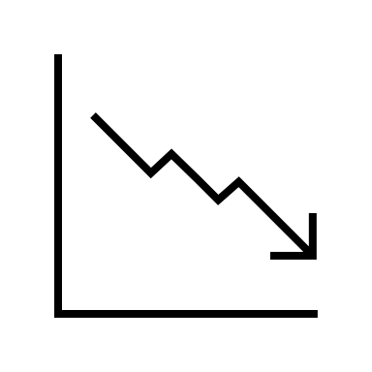
Motivation
IoT → increasingly interactive w/ physical world
Faults & defects are often safety critical
Example: Diabetes Monitor Failure^{[1]}
Server Outage
Glucose Monitor
User Not Notified
[1] A. O’Connor, “In Weekend Outage, Diabetes Monitors Fail to Send Crucial Alerts,” The New York Times, Dec. 02, 2019.
Notes:
Our motivation for the study is that Internet of Things have become pervasive and increasingly interactive with the physical world.
And since, they enable software to directly interact with the physical environment, their faults & defects can be dangerous or safety-critical.
[Click]
For example, recently, an IoT diabetes monitoring service had a cloud outage.
This system is supposed to monitor blood sugar levels, and alert users if it reaches a critical level.
And in the case of this outage, the kids and adults that relied on this service were not notified of the outage through the app, and were under a false sense of safety.
The company failed to design a fail-safe for this scenario, even though this had been a recurring incident!

Slide 3
Idea
Could past failures provide design insight?
Goal:
Characterize IoT failures to aid development
Contribution:
Systematic study of IoT failures reported in media
Notes:
So, naturally we wonder whether past failures could provide design insight.
Since IoT has diverse characteristics enabling diverse faults, our first step towards answering this question is to characterize IoT failures in the wild.
And as a first step towards this goal, we conducted a systematic study of IoT failures as reported in the media.

Slide 4
Methods
Sources
&
Years: 2015 – 2021
RQ1: Common sources of IoT failures?
RQ2: Common impacts of IoT failures?
Notes:
First, to characterize IoT failures in the wild, we would need detailed information about the failures.
And since IoT systems are proprietary, we wondered if we could collect relevant information from news sources.
So, we searched for news articles that described failures of IoT systems, published at reputable sources within recent years.
And from these articles we identified the sources, the impacts, and if available, the repair recommendations for the IoT failures.

Slide 5
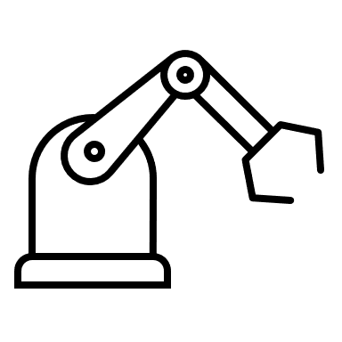
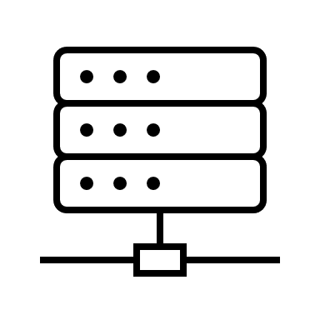
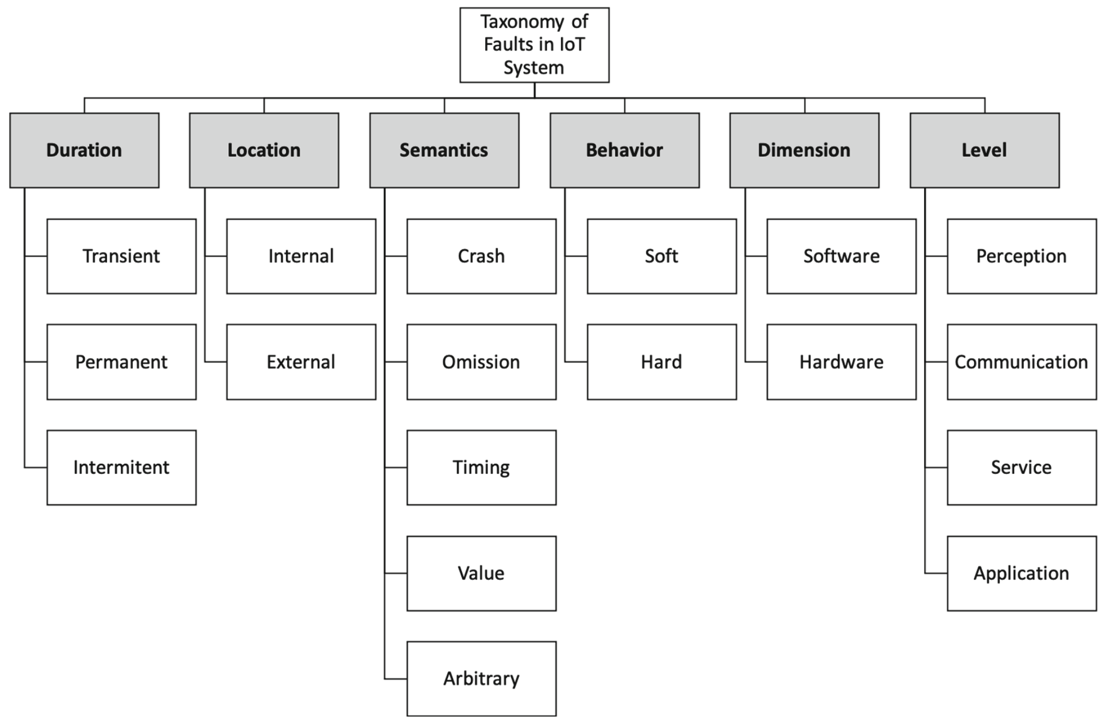
Methods
Perception
Communication
Service
Application
Framework to study IoT failures^{[2]}
IoT Architecture
[2] M. Melo and G. Aquino, “The Pathology of Failures in IoT Systems,” in ICCSA, 2021.
Notes:
Then we utilized a pre-defined framework for characterizing IoT failures.
This framework included a standard model of IoT systems, and the ways in which they fail.
[click]
We used this framework to perform a structured analysis of the qualitative news reports to code and categorize by a taxonomy of faults.

Slide 6
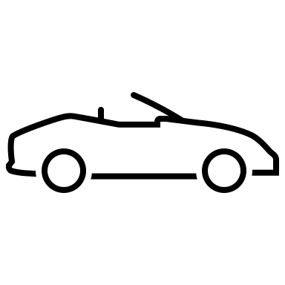
Results
22 IoT failures
5 categories of applications
Notes:
Using these methods, we studied 22 IoT failures, covering 5 categories of applications: critical infrastructure, automotive, consumer product, healthcare, and aeronautics.

Slide 7
RQ1: Common sources of IoT failures
Notes:
From these reports, we identified the common sources of IoT failures.
Let me highlight some of our more interesting findings.
[click]
From our sample, we found that the most common source of faults originated at the application level, followed by communication connectivity.
[click]
We also note that even though IoT systems compose both software and hardware, our data indicates software as the primary cause of failures.
This was regardless of whether failure-triggering events occurred from within or outside of the system.

Slide 8
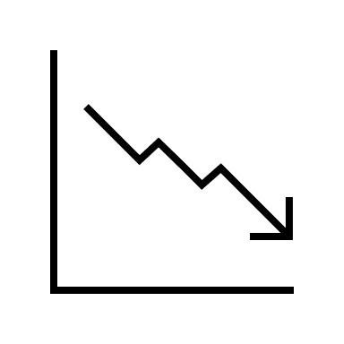
RQ1: Common sources of IoT failures
Failure trends within application domains
Failure trends across application domains
Server Outage
Monitor
Not Notified
Non-Critical Software
Critical Software
Improper Isolation
Notes:
[Click]
Furthermore, we observed failure trends within application domains.
For example, a common failure within the consumer healthcare domain was due to the lack of fail-safe systems, especially during network loss.
In one case, a baby monitoring system failed similar to the diabetes monitor example I shared earlier.
[Click]
In addition, we also observed failure trends across application domains.
For example, a common failure across the automotive and critical infrastructure domains was improper isolation between non-critical vs safety critical software, which exposed safety critical software to attackers.
We observed this across cars, oil pipelines, and powerplants.

Slide 9
RQ2: Common impacts of IoT failures
Failure trends within application domains
Compromised critical functions (6 cases)
Fatal collisions (5 cases)
Exposed safety-critical functions (3 cases)
False sense of safety (2 cases)
Notes:
So, from these examples the failure impacts of IoT systems could be significant.
We observed general trends of common impacts primarily within application domains.
Common impacts included fatal collisions & crashes, false safe assurances, and compromised critical functions that led to extensive human impact and monitory cost.

Slide 10
Reflection
News reports:
Provide system level failure information
Enable focus on faults that lead to catastrophic failures
Findings:
Problem in software & system engineering
Echoes of past failures
Recommendation:
Development processes to learn from past failures
Notes:
From our results, we reflect that news reports documenting IoT failures provided system-level information about the failures and their impacts.
Furthermore, we think that in addition to information from news reports, we might benefit learning from more detailed engineering reports, such as postmortems.
We believe that such an approach could enable engineers to focus on faults that lead to catastrophic failures in IoT systems.
[Click]
Specifically, from our data, it appears that many of these failures can be traced to problems in software and system engineering.
Additionally, we observed echoes of past failures, recurring in modern IoT systems.
For example, failures due to improper isolation of critical infrastructures, in the 1990s, have resulted in historical software engineering lessons, but they still recur in modern IoT systems.
[Click]
This indicates development challenges to address recurring failures.
To aid these challenges, we suggest development processes that place a greater emphasis on learning from past failures.

Slide 11
A Failure-Aware Software Dev Life Cycle?
Infrastructure: A Failure Encyclopedia
Process: An Empirical Basis for Postmortems
Tools: Automation
3
1
2
Notes:
We propose three research directions towards a Failure-Aware Software Development Life Cycle for IoT.
[Click]
First, to help IoT engineers anticipate failures, we believe they would benefit from an encyclopedia of previous IoT failures.
A catalog of case studies could outline the failure, the underlying fault(s), the impact, and lessons learned from a system failure.
Case studies could be built from within teams & organizations, as well as from external sources such as news reports or other organizations.
These case studies could inform software engineering judgment to build systems resilient to past failures.
[Click]
Second, we recommend research to establish an empirical basis for software failure postmortems.
Our analysis of failures was restricted because we could only observe what was reported by journalists.
But IoT engineers working on the affected products could conduct a more detailed analysis to benefit their own and other teams, through a failure postmortem.
Although postmortems are widely recommended, they are often omitted.
And we know surprisingly little about postmortems in practice.
For example, what are effective personal & team practices to collect, analyze, and document system failures?
Or how can postmortem knowledge be integrated into the SDLC, managing the tradeoff between agility and risk management?
Answering these questions are a starting point to help establish an empirical basis for software failure postmortems.
[Click]
Finally, there are many opportunities to automate elements of this research agenda.
First, we could leverage text mining techniques to extract system postmortem information from diverse representations, including news reports, user complaints, and open-source issue reports.
This would facilitate the organization of a large encyclopedia of failures.
Then, an engineering team could query this database for relevant failures to guide their system design or maintenance work.
This could be enabled by filtering cases relevant to specific contexts, or by transferring lessons across contexts.
Finally, during validation, an engineering team could scan their system model or codebase for known hazards using program analysis.

Slide 12
Conclusion
Studied real-world IoT systems
Provided insight into sources & impacts of failures
Recurring failure trends
→
Failure-Aware Software Development Life Cycle
(for IoT development)
Thank you for your attention!
Notes:
In conclusion, we studied real-world IoT systems and observed recurring failure trends both within and across application domains.
To alleviate recurring failure trends, we recommend a research agenda towards a Failure-Aware Software Development Life Cycle for IoT.
Thank you! That concludes my presentation, and I would be happy to answer any questions y’all may have.

Slide 13
Bonus slides

Slide 14
Artifacts
The following artifacts:
Raw data
Coding
Taxonomy
Are available at:

Slide 15
Sources of IoT failures

Slide 16
Taxonomy of IoT failures

Slide 17
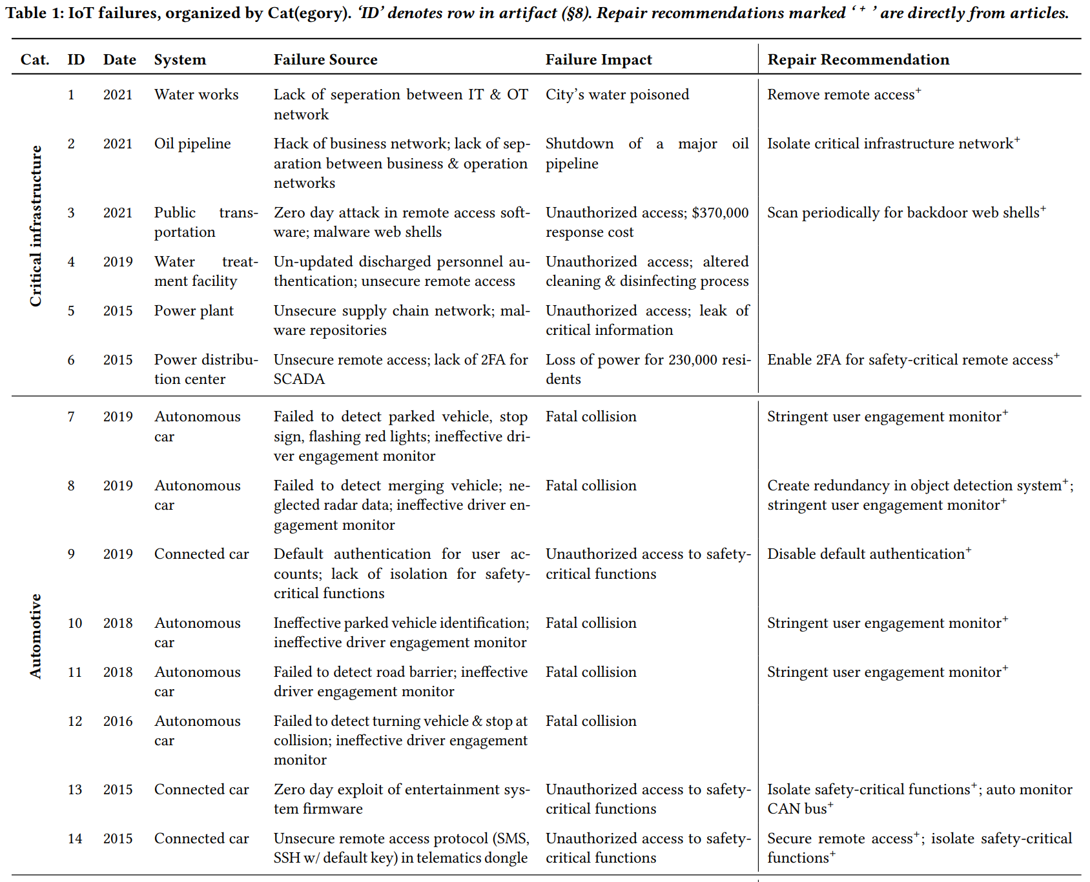

Slide 18
