Slide 1
Exploiting Input Sanitization for Regex Denial of Service
Efe Barlas*
Electrical & Computer Engineering
Purdue University
ebarlas@purdue.edu
Xin Du*
Electrical & Computer Engineering
Purdue University
du201@purdue.edu
James Davis
Electrical & Computer Engineering
Purdue University
davisjam@purdue.edu
∗Both authors contributed equally to this research.

Slide 2
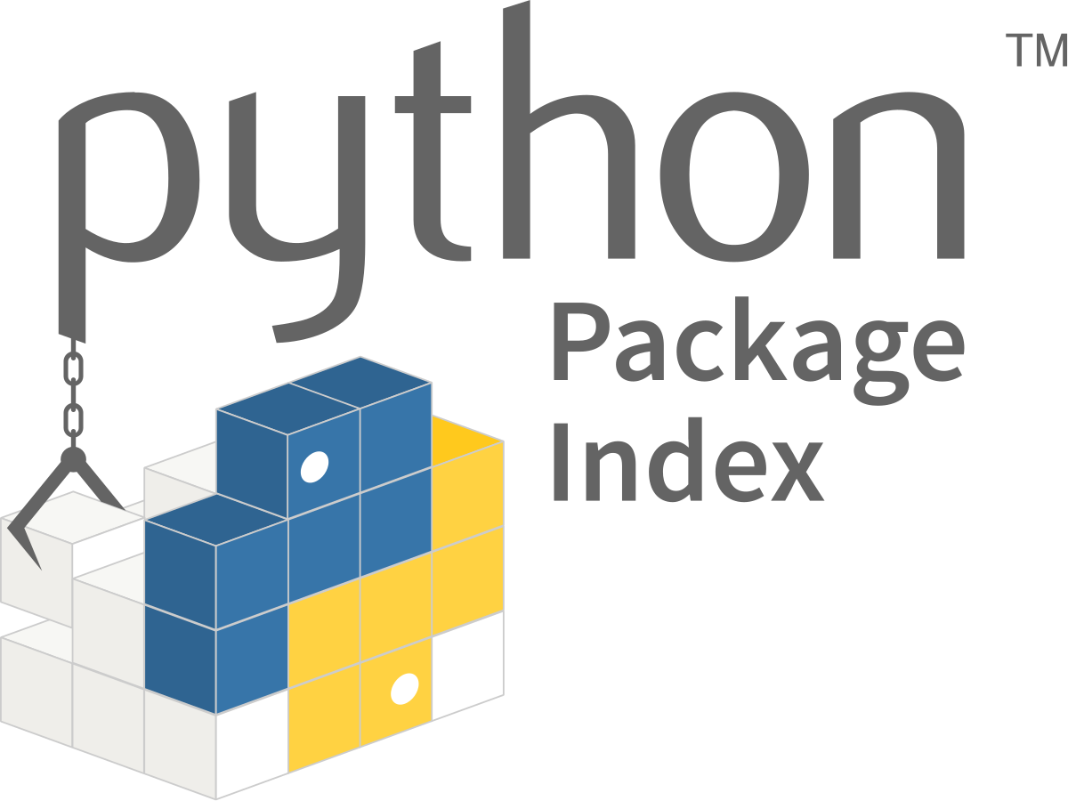
Motivation & Contributions
10% of regexes [D '19]
350 vulnerabilities in top 1 million websites [S&P '18]
10% of regexes [D '18]
ReDoS in real web services?
First black-box ReDoS measurement
ReDoS vulnerabilities in web services
Anti-ReDoS patch
Publication of found web sanitization regexes

Slide 3
Background

Slide 4
Regular Expression (Regex)
What is it?
Specify a pattern to match
~40% of software projects [C&S ‘16]
Examples
ID
[\\w-]+_[0-9a-zA-Z]+
^[a-zA-Z0-9]+(-*[a-zA-Z0-9])*$
ID

Slide 5
Not all Regular Expressions are Created Equal
Takes time to match strings
String Input
Regex
Normal String
Linear-time Regex
Malicious String
Superlinear-time Regex

Slide 6
Regular Expression Denial of Service (ReDoS)
Client-Server architecture
Superlinear-time regex
Malicious Input
Normal Input

Slide 7
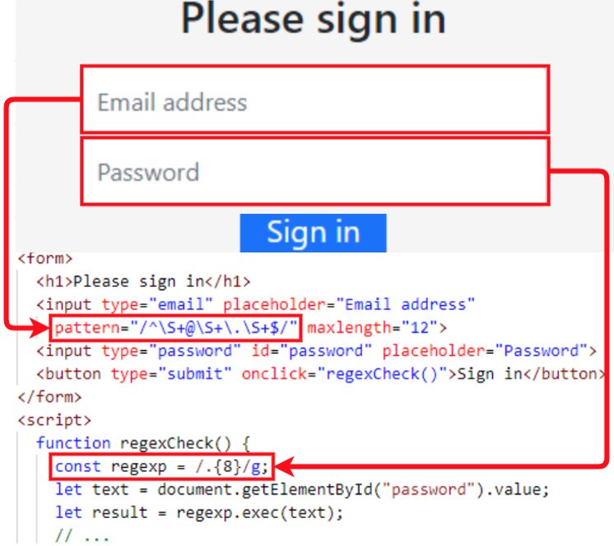
Approach 1: From Client-side to Server-side
Assumption: Server repeats client-side sanitization
Static: HTML form & Dynamic: JavaScript Files

Slide 8
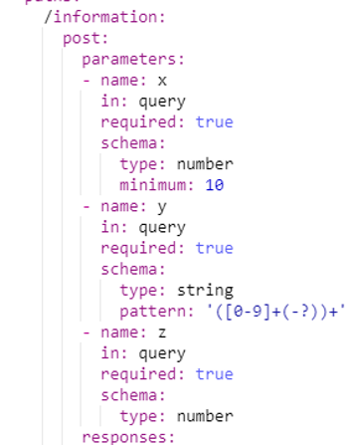
Approach 2: API Specs
Formal Specifications Published By Web Services

Slide 9
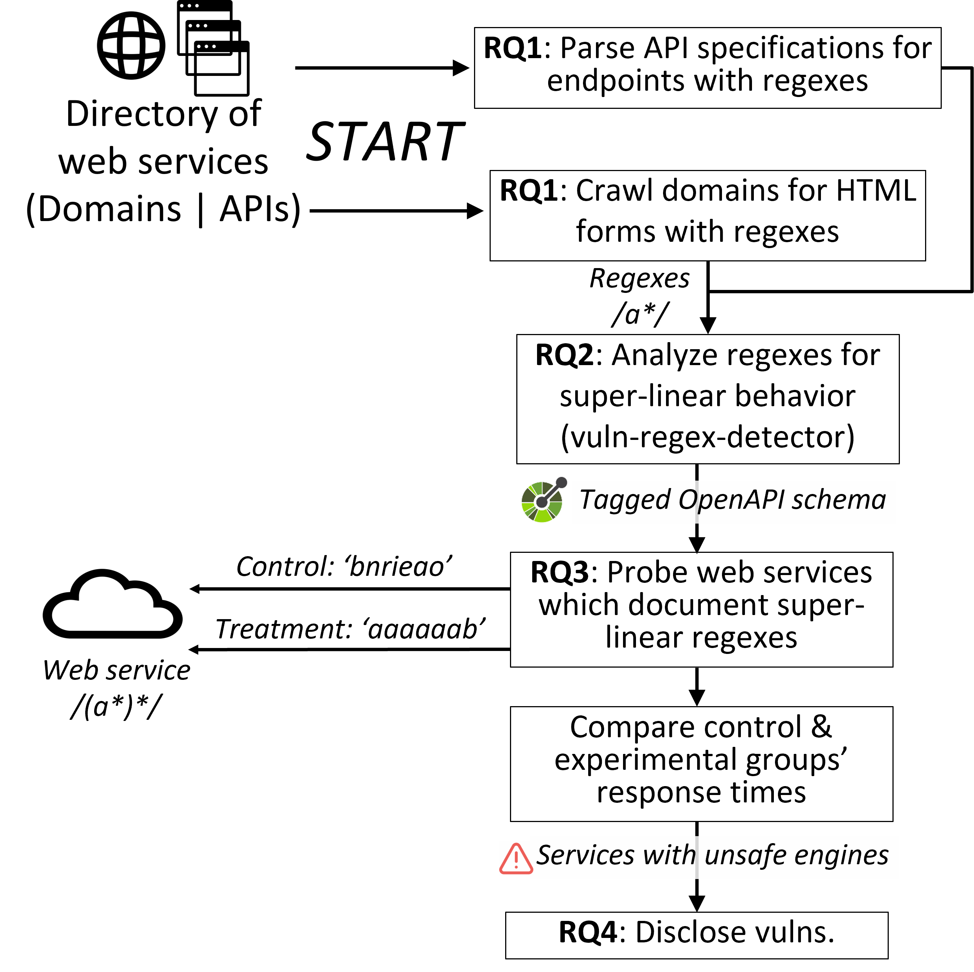
Overall RQ Structure

Slide 10
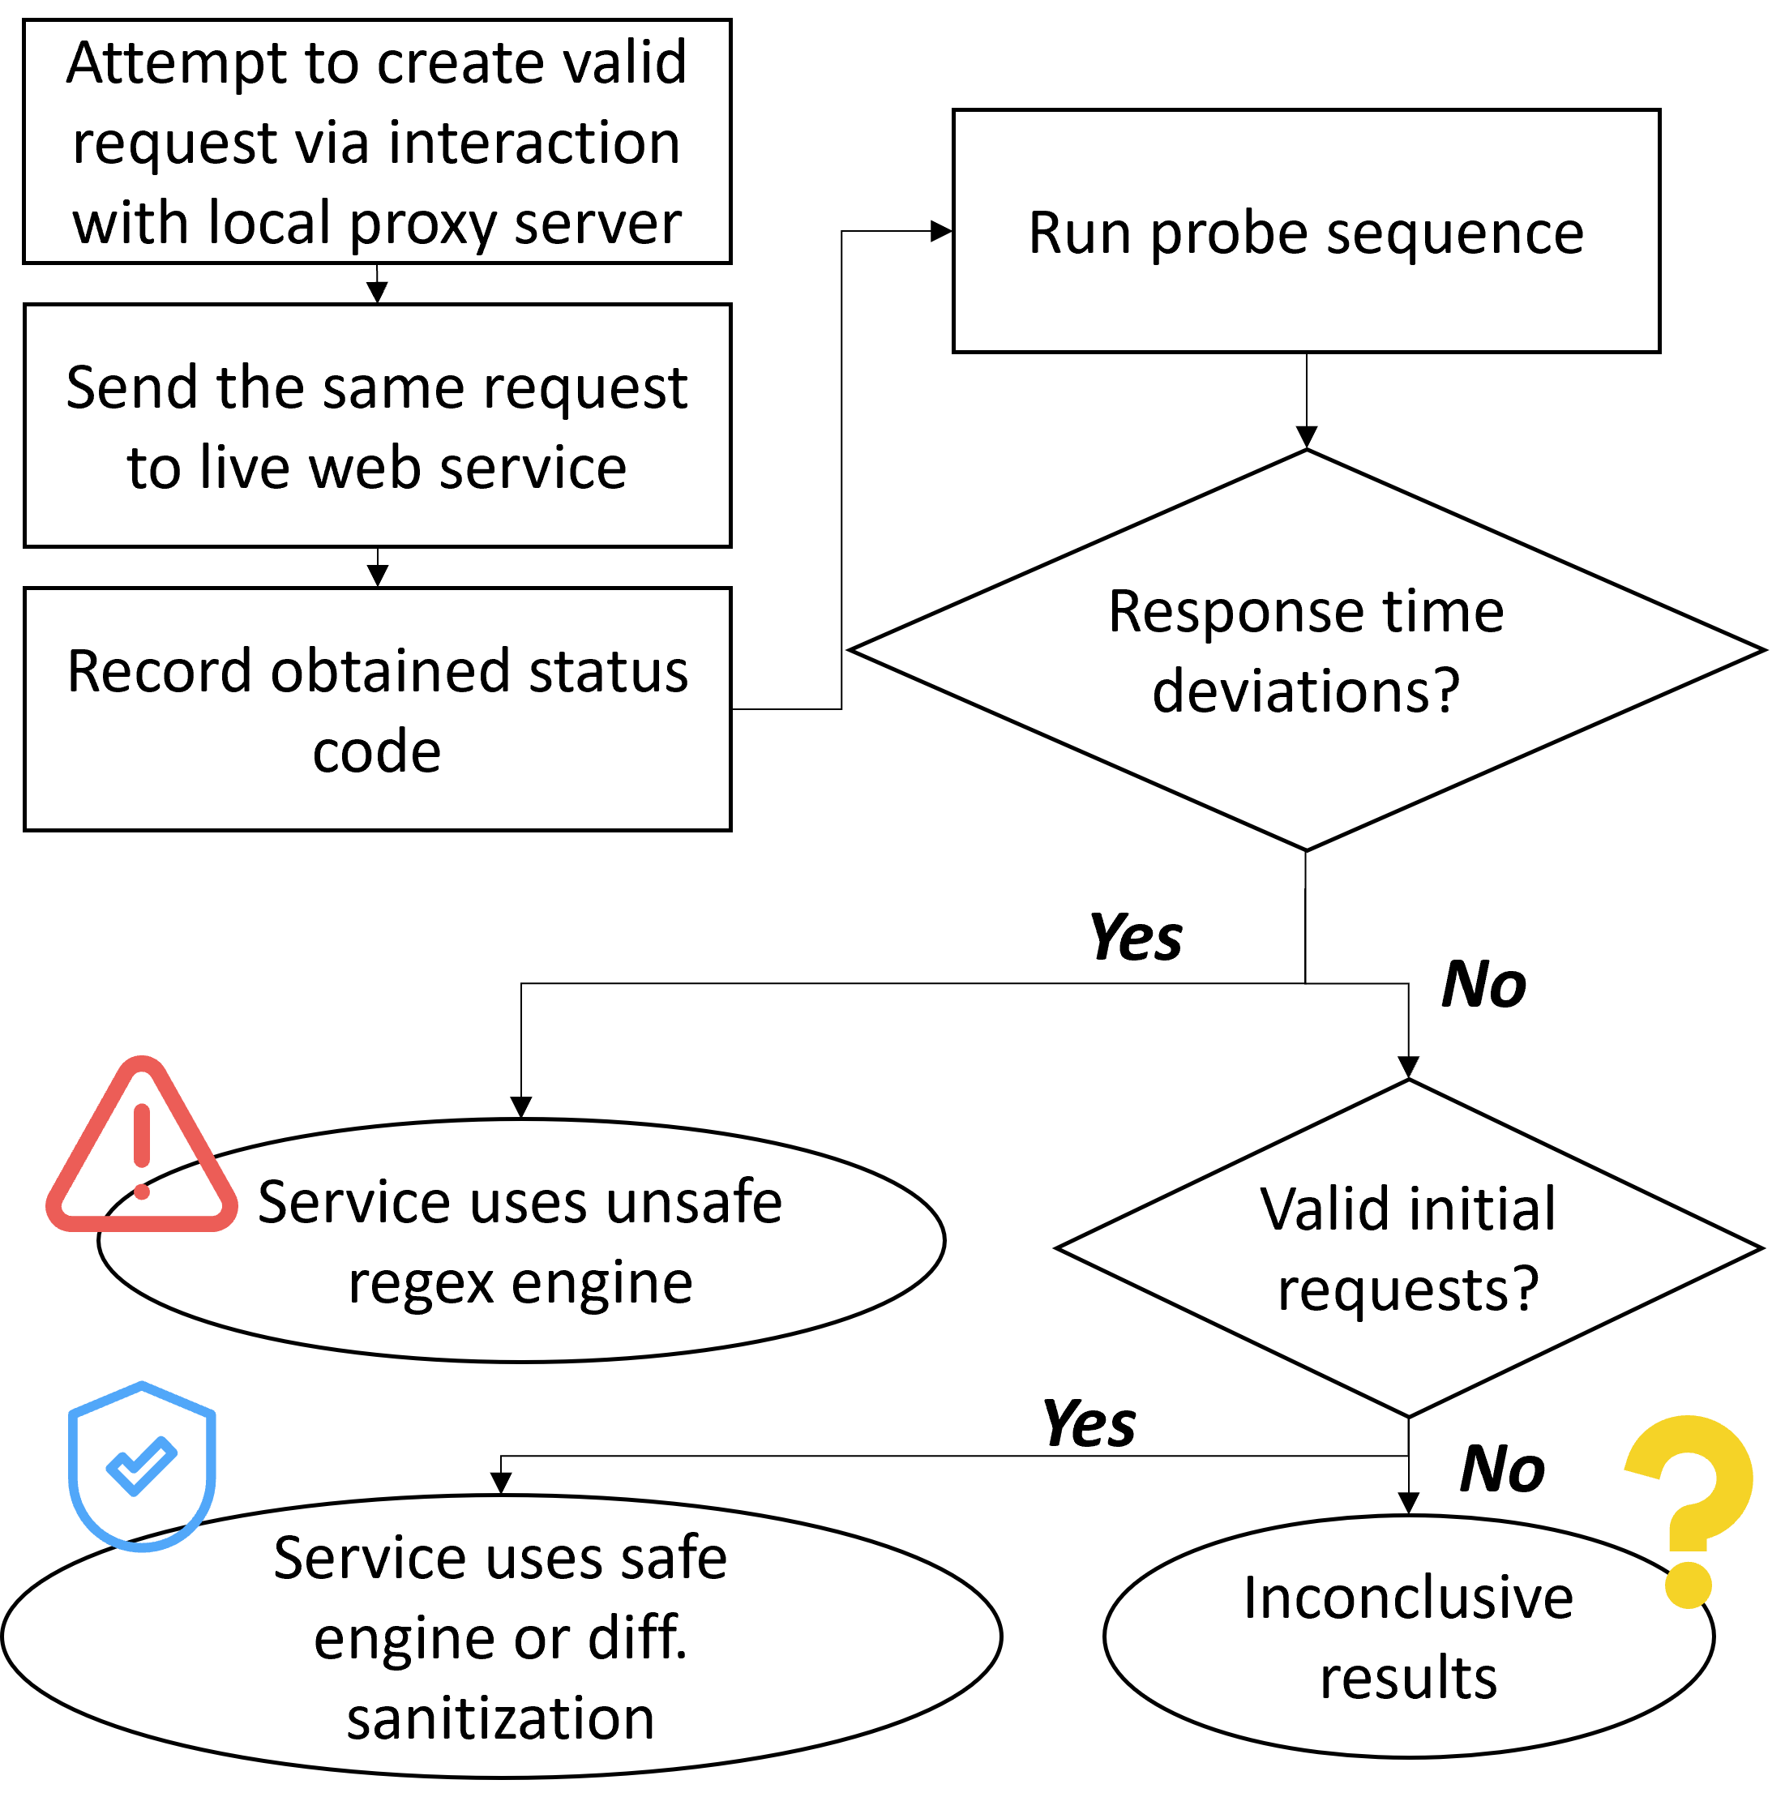
Measurement Algorithm

Slide 11
Findings

Slide 12
RQ1: Regex Use in Client-Side Sanitization
Regexes are frequently used in client-side sanitization
aws.com/index.html
“Company
practices”
savingsplans.amazonaws.com
“Team
practices”
amazonaws.com

Slide 13
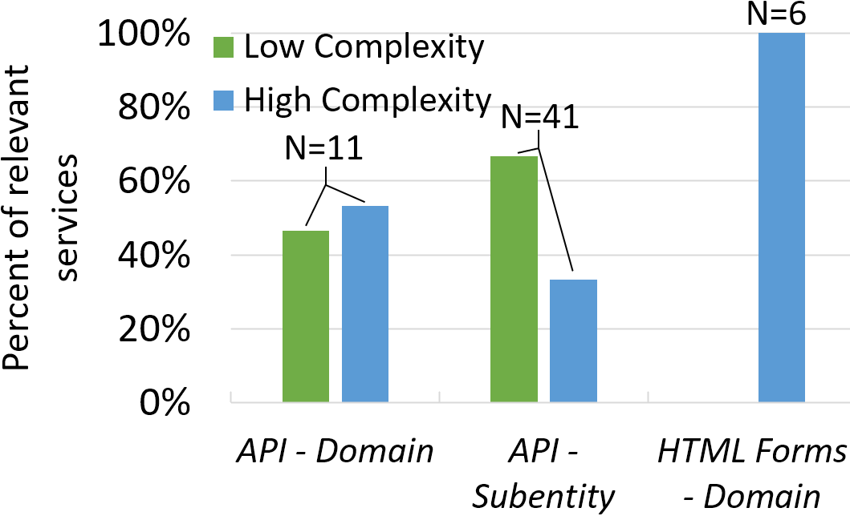
RQ2: Super-linear Regex Use
Unsafe regex use varies by interface type
out of 272
*
out of 83
*entities which have both types are under ‘high complexity’

Slide 14
RQ3: Super-linear Regex Behavior in Live Web Services
HTML: 0
API: 6 domains
(including & )
HTML: 3 domains, 3 subdomains
API: 1 domain, 13 subdomains

Slide 15
RQ3: Super-linear Regex Behavior in Live Web Services
ReDoS varies by interface type
HTML
No vulnerabilities
API
6 domains (including & )
Low-complexity regexes safer due to length checks
11 out of 13 conclusively safe subdomains only had low-complexity regexes
Caution: only 15 domains measured,
small sample size!

Slide 16
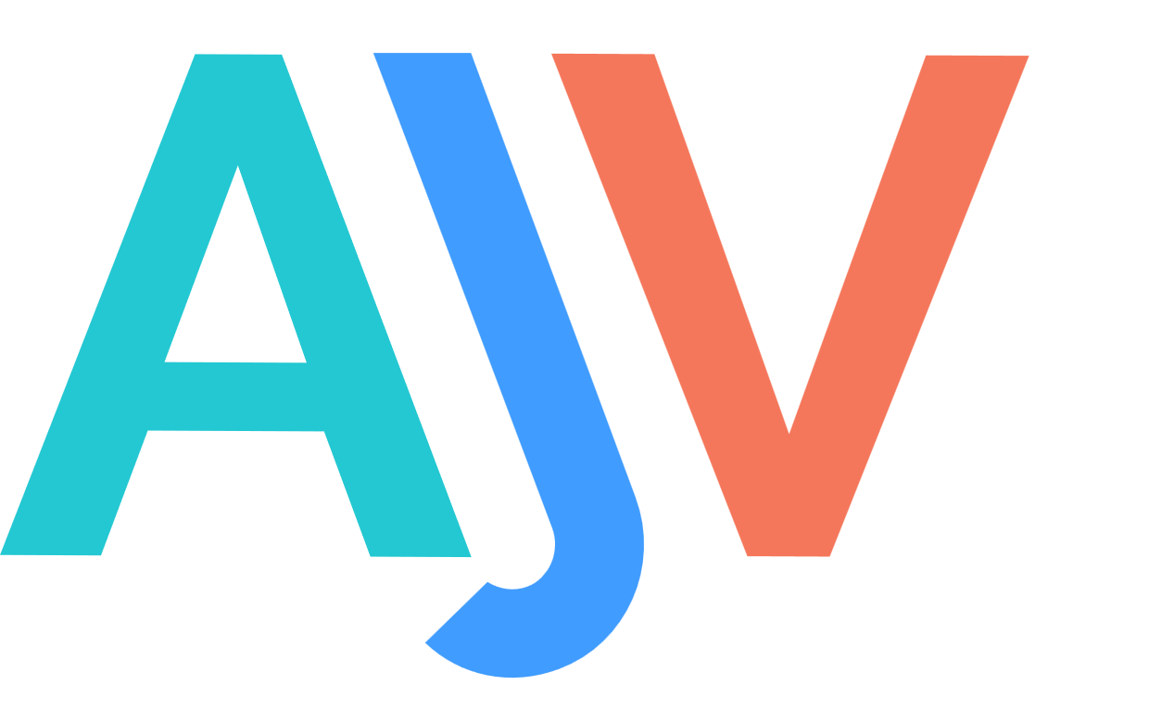
Enabling Safe Regex Engine Use for API Middleware
RQ3 Finding: APIs have higher risk of ReDoS
Set an example: Ajv patched to enable safe regex engine use
Client & server-side input sanitization
openapi-generator & 11.8M other Ajv-dependent projects
(as of Apr 2022)
Ajv: 1.02 MB Ajv + node-re2: 2.31 MB (unpacked)
engine
Let the engineer choose:
(dependency injection)

Slide 17
Remarks
>98% web services with regexes safe from black-box ReDoS analysis
Insightful for how ‘impactful’ ReDoS research is
HTML safer than API: why?
Code generation tools?
Code to specification tools?
More detailed specification -> more vulnerabilities?
Security through obscurity
Safe regex engine & safe API middleware use

Slide 18
Contributions
Design the first black-box ReDoS measurement scheme
Identify ReDoS vulnerabilities in several live web services
Contribute to a major web API input sanitization library
Share a dataset of web sanitization regexes
*This research project was made possible by the Engineering Undergraduate Research Office (EURO) at Purdue University and the Purdue University Center for Programming Principles and Software Systems (PurPL).

Slide 19
Percentage of Unsafe Web Services
(services with unsafe regex use – conclusively safe domains)/total domains with regexes
(11+6-13)/(273+83)

Slide 20
Dataset
[P’18]
HTML Forms: 1K sampled out of Tranco 1M
At least one web page crawled for 696 websites
API: 2231 documents from apis.guru
Notes:
-HTML: Others blocked the crawler, so we omit them.

Slide 21
Domains and Sub-entities
Domains
y.x.com/x
y.x.com
Sub-entities
y.x.com/z
y.x.com
HTML form
API
Results are grouped by the bold parts in the URL.

