Slide 1
A Principled Approach to GraphQL Query Cost Analysis
Alan Cha, Erik Wittern, Guillaume Baudart, James C. Davis, Louis Mandel, Jim A. Laredo
Now a professor at:

Slide 2
GraphQL is a query language for APIs and a runtime for fulfilling those queries...
Notes:
The landscape of web APIs is constantly evolving.
A recent web API model is GraphQL, which is both a query language and a runtime for fulfilling those queries.
The advantage of GraphQL is that clients can express the data they want to retrieve, and servers will respond with exactly the required data.
-----
For the last two decades or so, there has been debate over what is the best approach to designing web APIs
Some contenders are RPC, REST, SOAP
In January 2015, Facebook announced a new contender in this debate: GraphQL, the subject of this talk
-----
In January 2015 Facebook announced that its internal client APIs were being built on a new technology called GraphQL (though it had been in development in one shape or another since 2011). This is an API framework which owes a little to the RPC model, a little to REST and its use of web protocols, but also strikes out in its own direction. (https://dev.to/mikeralphson/a-brief-history-of-web-apis-47k4)

Slide 3
Hypothetical REST API
Task: get Alan’s friends’ names
GET /users/alan_cha
{
firstName: “Alan”,
lastName: “Cha”,
friendIds: [“erik-wittern“, “gbaudart”, “JamesD123”],
interests: [“graphql”, “programming”]
}
GET /users/erik-wittern
GET /users/gbaudart
GET /users/JamesD123
{
firstName: “Erik”,
lastName: “Wittern”,
friendIds: [“...”],
interests: [“...”]
}
{
firstName: “Guillaume”,
lastName: “Baudart”,
friendIds: [“...”],
interests: [“...”]
}
{
firstName: “James”,
lastName: “Davis”,
friendIds: [“...”],
interests: [“...”]
}
Notes:
To better illustrate how GraphQL works, let’s compare two hypothetical social media APIs, one using REST architecture and one using GraphQL.
Given the task of retrieving the names of a user’s friends, how would we approach this task in REST?
(Click)
First, we would make a query to the user.
(Click)
Then the API would respond with some User data...
(Click)
...including the IDs of the user’s friends.
(Click) With these IDs, we would make follow up queries.
(Click)
(Click)
Lastly, we can parse the responses in order to get the names.

Slide 4
Hypothetical GraphQL API
Task: get Alan’s friends’ names
{
user: {
friends: [
{
firstName: “Erik”,
lastName: “Wittern”
},
{
firstName: “Guillaume”,
lastName: “Baudart”
},
{
firstName: “James”,
lastName: “Davis”
}
]
}
}
POST /graphql
{
user(userId: “alan_cha”) {
friends {
firstName
lastName
}
}
}
Notes:
Alternatively, how would we approach the same task in GraphQL?
(Click)
In GraphQL, we can construct a query to obtain exactly the data that we need.
(Click 2)
(Click)
The API should respond with the names, in a data structure that reflects the query.
***
And, unlike REST, we send this query to a single endpoint.

Slide 5
Comparison
GraphQL…
reduces round trips
limits overfetching
minimizes parsing
REST API
GraphQL API
GET
/users/alan_cha
{
user: {
friends: [
{
firstName: “...”,
lastName: “...”
},
{
firstName: “...”,
lastName: “...”
},
{
firstName: “...”,
lastName: “...”
}
]
}
}
{
firstName: “Alan”,
lastName: “Cha”,
friendIds: [“...”, “...”, “...”],
interests: [“...”, “...”]
}
POST /graphql
{
user(userId: “...”) {
friends {
firstName
lastName
}
}
}
GET /users/erik-wittern
GET /users/gbaudart
GET /users/JamesD123
{
firstName: “...”,
lastName: “...”,
friendIds: [“...”],
interests: [“...”]
}
{
firstName: “...”,
lastName: “...”,
friendIds: [“...”],
interests: [“...”]
}
{
firstName: “...”,
lastName: “...”,
friendIds: [“...”],
interests: [“...”]
}
Notes:
As you can see, there are a number of advantages that GraphQL provides…
Reducing roundtrips
Limiting overfetching
Minimizing parsing
***
In REST, we queried the API four times. In GraphQL, we only queried the API once. GraphQL can reduce round trips.
In REST, we obtained lots of extraneous data such as each user’s interests. In GraphQL, we queries for exactly what we needed. GraphQL can limit overfetching.
In REST, with each round trip, we needed to parse the response data in order to prepare for the follow up queries. In GraphQL, we did not need to do that.

Slide 6
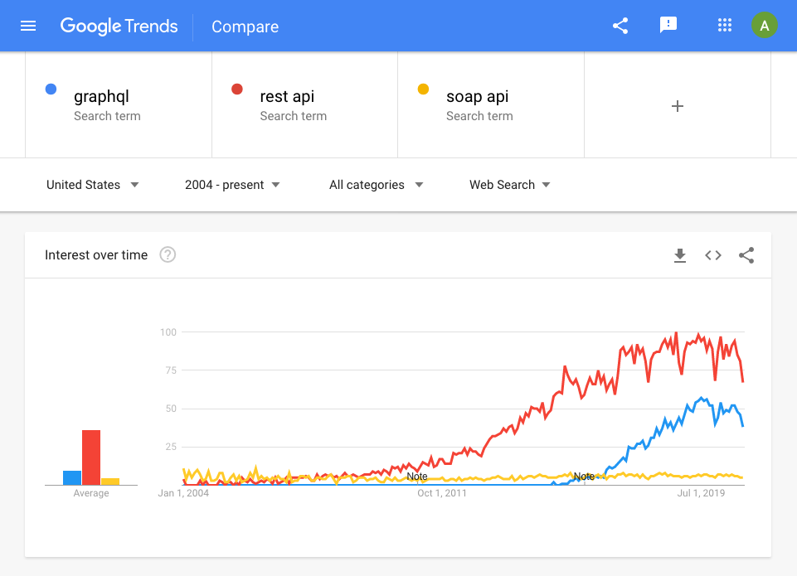
Notes:
Because of the benefits, interest in GraphQL has been increasing steadily...

Slide 7
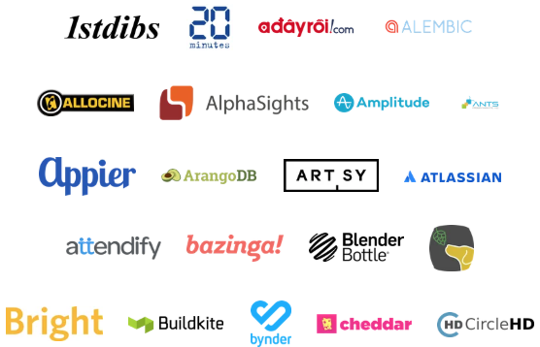
Notes:
…and many companies have begun to adopt GraphQL.

Slide 8
High-cost GraphQL queries
POST /graphql
{
user(userId: “...”) {
friends {
firstName
lastName
friends {
firstName
lastName
friends {
firstName
lastName
}
}
}
}
}
POST /graphql
{
user(userId: “...”) {
friends {
firstName
lastName
friends {
firstName
lastName
}
}
}
}
+3
POST /graphql
+3
{
user(userId: “...”) {
friends {
firstName
lastName
}
}
}
+9
1 root user
+
3 friends
=
4 users
1 root user
+
3 friends
+
3 x 3 friends of friends
=
13 users
+27
1 root user
+
3 friends
+
3 x 3 friends of friends
+
3 x 3 x 3 friends of friends of friends
=
40 users
Notes:
However, GraphQL is not strictly superior to REST
While GraphQL’s flexibility can allow clients to better describe their data requirements, it also makes it difficult to determine the resources that will be consumed by performing a certain query
For example, here we show three queries that differ in length linearly…
(Click 2)
...but the amount of data that these queries will fetch differ exponentially
(Click 2)
The reason why these queries can have exponentially large response sizes is list fields, which return a number of objects.
(Click 3)
In this case, the friends field returns multiple User objects, which in turn can query for even more User objects.
A single GraphQL query can be equivalent to potentially thousands of REST calls
In addition to performance issues, this excessive resource use can make GraphQL service providers vulnerable to a denial of service attack
***
(?) In a previous study analyzing 16 commercial GraphQL schemas and 8,399 open-source schemas on GitHub, we found that the majority allowed for high-complexity queries.
The second query is three lines longer than the first query. The third query is three lines longer than the second query.
(Click 2)
However, assuming that each user has on average, 3 friends, the second query will fetch 9 more users than the first query and the third query will fetch 27 more users than the second query.
***
High-complexity GraphQL schemas are common in practice
In a previous study, we found that...
Over 80% of the commercial or large open-source schemas had exponential worst-case behavior
40% of all schemas guaranteed linear-time queries

Slide 9
Query analysis survey
We studied the documentation for 30 public GraphQL APIs listed on APIs.guru
25 APIs (83%) do not describe any query analysis
22 APIs (73%) do not perform rate limiting
3 APIs (10%) perform rate limiting only by request frequency
Many public GraphQL APIs do not document any query analysis
Notes:
With the quick growth of GraphQL and the potential attack vector, it is natural to ask, “Are GraphQL APIs protected?”
We performed a survey using a list of publicly available GraphQL APIs on APIs.guru
We learned that the vast majority, 83%, do not describe any kind of query analysis
***
With the quick growth of GraphQL and the potential harm that high-complexity GraphQL queries can inflict, it is natural to ask, “Are GraphQL APIs protected?”
In addition, 73% do not perform rate limiting. Of the remaining, 23%, around half of those GraphQL APIs, 10%, only perform rate limiting by request frequency.
If you recall, GraphQL queries can have vastly different data requirements, and therefore, request frequency is not a sufficient form of rate limiting.

Slide 10
Existing query analyses
Dynamic
Obtains list sizes during execution
Additional runtime load
Engineering costs for integration
Accurate estimate
Accurate
Too costly
Inflexible
Static
Assumes a pathological data graph
Relies on configuration for list sizes
No backend integration
Estimate is an upper-bound
Fast
Generalizable
Primitive
Notes:
A GraphQL query cost analysis measures the cost of a query.
While GraphQL query cost analyses do exist, they do not seem to be widely used.
As a result, we set out to understand existing query cost analyses and improve upon them.
Query cost analyses falls under two camps, dynamic and static.
While dynamic analyses calculate the cost of a query as the query is being executed, static analyses calculate the cost of a query before the query is executed.
As a dynamic analysis steps through a query, it will probe the backend for exact list sizes.
However, by querying the backend potentially numerous times, the runtime cost will add up.
In addition, configuring the analysis to probe the backend will require substantial engineering effort.
In some cases, it may even be impossible.
On the other hand, a static analysis assumes a pathological data graph.
As it steps through a query, it uses an external configuration to obtain upper-bound list sizes.
Therefore, the analysis doesn’t need to be integrated into the backend.
To summarize, dynamic cost analyses are accurate. However, we argue that they are too costly in a large-scale production environment.
The engineer costs is one thing but the runtime load may even outweigh the benefits of using a query analysis.
On the other hand, static cost analyses are fast and generalizable because they don’t need to probe the backend.
It simply relies on the configuration.
As a result, we believe that a robust static cost analysis is key to helping GraphQL providers protect their APIs.
However, existing static analyses cannot handle common GraphQL conventions, have limited configurability, and only work for simple GraphQL interfaces.
***
The backend will provide an accurate list size, allowing for an accurate overall estimate.
The external configuration may contain hard-coded list values or point to places in the query where the list size can be obtained from, for example an argument value.
What we noticed about existing static analyses and what we will show later in the evaluation section is that they are “primitive”...
…and what I mean by “primitive” is that they may work for simple GraphQL schemas but not for more complex ones.
Additionally, they cannot handle common GraphQL conventions, namely pagination.

Slide 11
Contributions
Two distinct definitions of query complexity
Analysis can handle common schema conventions
Analysis built on formal GraphQL semantics
First evaluation of such an analysis on real-world APIs
Notes:
Our analysis follows the paradigm of static query analysis but differs from existing analyses in a number of ways.
We provide two distinct definitions of query complexity.
Whereas existing analyses only provide a single complexity measure, we believe that our two measures of query complexity better reflect how GraphQL queries are executed.
Our analysis can handle common schema conventions.
It can also take advantage of conventions to simplify configuration.
We build our analysis on formal GraphQL semantics
This allows us to prove that our analysis is correct and produces not just an upper-bound, but a tight one.
We perform the first evaluation of such an analysis on real-world APIs.
***
There are two popular methods of pagination. We did not find any existing analyses that could handle both methods.
However, real-world schemas may use one form of pagination, both forms, or none at all. Our analysis can handle all of these cases.
Additionally, our analysis takes advantage of naming conventions and streamlines configuration by taking advantage of regular expressions.
And in doing so, we make additional contributions by 1) publishing a corpus of 10,000 anonymized GraphQL query-response pairs that we used for the evaluation, the first of its kind, and 2) open-sourcing the GraphQL query generator that we used to create said corpus.

Slide 12
GraphQL basics
Schema
Query
Response
type Query {
user(userId: Int!): User
}
type User {
id: ID
name: String
}
{
user(userId: 1) {
name
}
}
{
"user": {
"name": "Alan Cha"
}
}
Notes:
To better illustrate how our analysis works, we need to first take a deep dive into GraphQL.
A GraphQL interface is composed of a schema and a set of resolvers.
A schema defines the shape of the data graph whereas the resolvers fetches the data.
(Click)
Let’s first look at the schema

Slide 13
GraphQL basics
Schema
Query
Response
type Query {
user(userId: Int!): User
}
type User {
id: ID
name: String
}
{
user(userId: 1) {
name
}
}
{
"user": {
"name": "Alan Cha"
}
}
Types
Notes:
The “type” keyword allows you to define object types
***
Here we define a User type as well as a Query type, which is the entry point to all queries

Slide 14
GraphQL basics
Schema
Query
Response
type Query {
user(userId: Int!): User
}
type User {
id: ID
name: String
}
{
user(userId: 1) {
name
}
}
{
"user": {
"name": "Alan Cha"
}
}
Fields
Notes:
Object types have fields
***
Object types must have at least one field
As you can see, on the Query type, you can query for a user.
And on the User type, you can query for the user’s ID as well as the user’s name.

Slide 15
GraphQL basics
Schema
Query
Response
type Query {
user(userId: Int!): User
}
type User {
id: ID
name: String
}
{
user(userId: 1) {
name
}
}
{
"user": {
"name": "Alan Cha"
}
}
Arguments
Notes:
Some fields can also have arguments
***
In this case, the user that you can query for is identified by a user ID

Slide 16
GraphQL basics
Schema
Query
Response
type Query {
user(userId: Int!): User
}
type User {
id: ID
name: String
}
{
user(userId: 1) {
name
}
}
{
"user": {
"name": "Alan Cha"
}
}
Return types
Notes:
And all fields must have a return type

Slide 17
GraphQL basics
Schema
Query
Response
type Query {
user(userId: Int!): User
}
type User {
id: ID
name: String
}
{
user(userId: 1) {
name
}
}
{
"user": {
"name": "Alan Cha"
}
}
Compose fields into queries
Notes:
Creating GraphQL queries is just a matter of composing fields
In this case, we are querying for the User with userID 1 and his name

Slide 18
GraphQL basics
Schema
Query
Response
type Query {
user(userId: Int!): User
}
type User {
id: ID
name: String
}
{
user(userId: 1) {
name
}
}
{
"user": {
"name": "Alan Cha"
}
}
Resolvers correspond to fields
Resolvers produces values
Notes:
And here is where resolvers come into play.
Each field has its own resolver and resolvers are small functions that contain arbitrary code that returns data.
In this case, the user field has some resolver that will fetch a User object
And the name field has some resolver that will extract the name field from said User object
Because of GraphQL’s robust type system, leaf fields, such as the name field, are trivial and can be omitted.
Likewise, for the rest of the talk, we will focus on distinct objects and resolvers returning objects.
***
Because of GraphQL’s robust type system, when the user field resolves to a User object.
GraphQL already knows that the next step is to resolve the fields on the User type.
Therefore, many GraphQL libraries allow you to omit these kinds of simple resolvers.
Because the function contains arbitrary code, a GraphQL server can talk to any kind of backend, be it a database, an API, a file, or even other GraphQL servers.
https://www.apollographql.com/blog/graphql-explained-5844742f195e/
Resolve functions are like little routers. They specify how the types and fields in the schema are connected to various backends, answering the questions “How do I get the data for Authors?” and “Which backend do I need to call with what arguments to get the data for Posts?”.
GraphQL resolve functions can contain arbitrary code, which means a GraphQL server can to talk to any kind of backend, even other GraphQL servers. For example, the Author type could be stored in a SQL database, while Posts are stored in MongoDB, or even handled by a microservice.
Perhaps the greatest feature of GraphQL is that it hides all of the backend complexity from clients. No matter how many backends your app uses, all the client will see is a single GraphQL endpoint with a simple, self-documenting API for your application.

Slide 19
GraphQL basics
Schema
Schema
Query
Query
Response
type Query {
user(userId: number!): User
}
type User {
id: ID
name: String
friends: [User]
}
{
user(userId: 1) {
name
friends {
name
}
}
}
{
"user": {
"name": "Alan Cha",
“friends”: [
{ name: “Louis Mandel” }
{ name: “Jim Laredo” }
]
}
}
Notes:
With a list return type, it is possible to query for much more data
For example, I added a friends field on the User type which can query for a number of Users.
(Click 2)
If list types are nested within each other, then the size of the response data as well as the number of resolvers will grow exponentially
You can begin to see how a static analysis can work.
If we know the maximum sizes of list fields from a configuration, it is possible to calculate an upper bound on the size of the response data and the number of resolvers that will be called

Slide 20
Response size
Schema
Schema
Query
Query
Response
type Query {
user(userId: number!): User
}
type User {
id: ID
name: String
friends: [User]
}
1 User
1 User
{
user(userId: 1) {
name
friends {
name
}
}
}
{
"user": {
"name": "Alan Cha",
“friends”: [
{ name: “Louis Mandel” }
{ name: “Jim Laredo” }
]
}
}
2 Users
3 Users
x3
Notes:
Say we want to calculate the maximum response size
(Click)
Assuming, the friends field will return at most 3 users, we can calculate that the query as a whole will return at most 4 users
1 from the initial user field…
(Click)
...and another 3 from the friends field
(Click)
In our response, we can verify that there are only 3 users...
(Click 2)
...which is below the aforementioned upper bound.

Slide 21
Number of resolvers
Schema
Schema
Query
Query
Response
type Query {
user(userId: number!): User
}
type User {
id: ID
name: String
friends: [User]
}
1 user
1 user
{
user(userId: 1) {
name
friends {
name
}
}
}
{
"user": {
"name": "Alan Cha",
“friends”: [
{ name: “Louis Mandel” }
{ name: “Jim Laredo” }
]
}
}
1 friends
1 friends
x3
Notes:
Given the same assumption as before…
(Click)
...we can also calculate the maximum number of resolvers
which is one user field and one friends field.
(Click 2)
In the response, it is the same.
(Click 2)
In this particular example, the maximum list size did not come into play, but with more nesting, then we would see it being utilized.

Slide 22
Complexity measures
Type complexity: size of the response Reflects the size of the data retrieved by a query
Resolve complexity: number of resolvers
Reflects the server’s query execution cost
Notes:
In the previous examples, we calculated the response size and the maximum number of resolvers.
If we assign a weight to each type and a weight to each resolver, then we can calculate two weighted recursive sums that will represent the complexity of the query.
We define the former as type complexity and the latter as resolve complexity.
***
If we assign a weight to each type when calculating the response size and if we assign a weight to each resolver when calculating the number of resolvers, then we can calculate two weighted recursive sums that will represent the complexity of the query.
With this in mind, we propose two complexity metrics intended to measure costs from the perspectives of a GraphQL service provider and a client
Resolve complexity reflects the server’s query execution cost.
Type complexity reflects the size of the data retrieved by a query.
GraphQL service providers will benefit from either measure, e.g., leveraging them to inform load balancing, threat-prevention, resolver resource allocation, or request pricing based on the execution cost or response size.
GraphQL clients will benefit from understanding the type complexity of a query, which may affect their contracts with GraphQL services and network providers, or their caching policies.
The intuition behind our analysis is straightforward.
A GraphQL query describes the size and shape of the response.
With an appropriate formalization of GraphQL semantics, an upper bound on resolve complexity and type complexity can be calculated using weighted recursive sums.

Slide 23
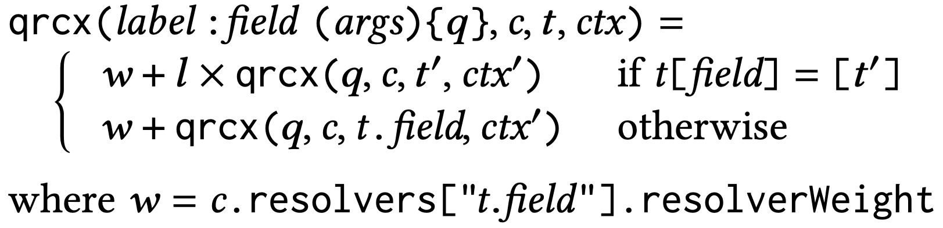
Complexity formalization
Type complexity
Maximum list size or
1 if the field is not a list
Type weight
Type complexity of sub-query
Resolve complexity
Resolve weight
Maximum list size or
1 if the field is not a list
Resolve complexity of sub-query
Notes:
Here are the formalizations of the complexities.
(Click 4)
The type complexity is the product of the maximum list size and the sum of the type weight and the type complexity of the sub-query
(Click 4)
The resolve complexity is the sum of the resolve weight and the product of the maximum list size and the resolve complexity of the sub-query
***
Here are the formulas used to calculate the type and resolve complexity.
(Click)
Focus on the highlighted expressions.
These formulas are recursive
The type complexity is equal to the l…
(Click)
the maximum size of the current list or 1 if the field does not return a list, multiplied by
(Click 2)
the sum of the type weight of the return type and the type complexity of the subquery
On the other hand, resolve complexity is the sum of the resolve weight
(Click)
and the product
(Click 2)
of l, the maximum size of the current list or 1 if the field does not return a list and the resolve complexity of the subquery
***
Type complexity must reflect the cost of instantiating every element.
Every element thus adds the weight of the returned type 𝑡 to the complexity.

Slide 24
Complexity benefits
GraphQL service providers
Interested in both complexities
Load balancing
Threat-prevention
Resolver resource allocation
Request pricing based on the response size or execution cost
GraphQL clients
Interested in type complexity
Contracts with…
GraphQL services
Network providers
Caching policies
Notes:
We believe GraphQL service providers will benefit from either measure, e.g., leveraging them to inform load balancing, threat-prevention, resolver resource allocation, or request pricing based on the response size or execution cost.
We also believe GraphQL clients will benefit from understanding the type complexity of a query, which may affect their contracts with GraphQL services and network providers, or their caching policies.

Slide 25
Pagination
Schema
Query
Response
type User {
name: String
friends: [User]
}
{
friends { name }
}
{
friends: [ { … }, { … }, { … }, { … }, { … } ]
}
None
type User {
name: String
friends(limit: Int!): [User]
}
{
friends(limit: 3) { name }
}
{
friends: [ { … }, { … }, { … } ]
}
Slicing
type User {
name: String
friends(first: Int, after: String): [UserConnection]
}
type UserConnection {
totalCount: Int
edges: [UserEdge]
nodes: [User]
}
type UserEdge {
cursor: String
node: User
}
{
friends(first: 3) {
nodes {
name
}
}
}
{
friends: {
nodes: [ { … }, { … }, { … } ]
}
}
Connection
Notes:
So, how do is the analysis configured?
Unless our analysis accounts for common GraphQL design practices, the resulting bound may not be accurate.
One particularly important practice is pagination.
How does does pagination in GraphQL work and how does our analysis handle it?
(Click)
GraphQL has two pagination conventions and they are slicing and connection.
(Click)
(Click)
If no pagination is being used, then a list field can return any number of objects.
(Click)
In this case, you can see that the friends field returns 5 users.
(Click)
(Click)
The slicing pattern uses what are known as…
(Click)
...limit arguments to bound the sizes of lists.
(Click)
(Click)
As you can see here, the limit argument forces the friends field to return at most 3 user objects.
To clarify, limit arguments can have names other than “limit”. Some other common limit arguments are “first” and “last”.
(Click)
(Click)
The connections pattern is similar to the slicing pattern but can allow for more intricate pagination.
It also uses…
(Click)
limit arguments...
(Click)
(Click)
but it also has Connection and Edge types which introduces extra levels of indirection.
(Click)
(Click)
As you can see, the friends field does not return Users but instead, a UserConnection object that contains the Users.

Slide 26
Configuration
Schema
Query
Configuration
type User {
name: String
friends: [User]
}
{
friends { name }
}
resolvers:
“User.friends”:
defaultLimit: 10
resolverWeight: 1
types:
User:
typeWeight: 1
None
type User {
name: String
friends(limit: Int!): [User]
}
{
friends(limit: 3) { name }
}
resolvers:
“User.friends”:
limitArguments: [first]
resolverWeight: 1
types:
User:
typeWeight: 1
Slicing
type User {
name: String
friends(first: Int, after: String): [UserConnection]
}
type UserConnection {
totalCount: Int
edges: [UserEdge]
nodes: [User]
}
type UserEdge {
cursor: String
node: User
}
{
friends(first: 3) {
nodes {
name
}
}
}
resolvers:
“User.friends”:
limitArguments: [first]
limitedFields: [edges, nodes]
resolverWeight: 1
types:
User:
typeWeight: 1
“/.+Connection$/”:
typeWeight: 1
“/.+Edge$/”:
typeWeight: 1
Connection
Notes:
Here we can see some sample configurations.
There is a section for resolver configuration and a section for type configuration.
Resolvers and types are identified by their names but we also allow regular expressions and wildcards.
We can assign resolverWeights and typeWeights among other properties.
(Click)
For example, for unpaginated lists fields, we can set a…
(Click)
defaultLimit that will represent the maximum number of objects that the field will return.
(Click)
(Click)
For the slicing pattern, we can…
(Click)
...identify limit arguments.
If a limit argument is used in a query, then the analysis will use the argument value as the maximum number of objects that the field will return.
(Click)
(Click 2)
Lastly, for the connections pattern, we set not only the limitArgument but also the limitedFields.
The limitedFields allows the analysis to properly handle the indirection in the connections pattern.

Slide 27
Evaluation
RQ1: Can the analysis be applied to real-world GraphQL APIs?
RQ2: Does the analysis produce cost upper-bounds?
RQ3: Are these bounds useful, i.e. close enough to the actual costs?
RQ4: Is our analysis cheap enough for use in API management?
RQ5: How does our approach compare to other solutions?
Notes:
Now that we have described our analysis and its configuration, it is time to talk about its evaluation.
We propose five research questions that can be used to understand the effectiveness of our analysis.
RQ1: Can the analysis be applied to real-world GraphQL APIs?
RQ2: Does the analysis produce cost upper-bounds?
RQ3: Are these bounds useful or close enough to the actual costs?
RQ4: Is our analysis cheap enough for use in API management?
RQ5: How does our approach compare to other solutions?

Slide 28
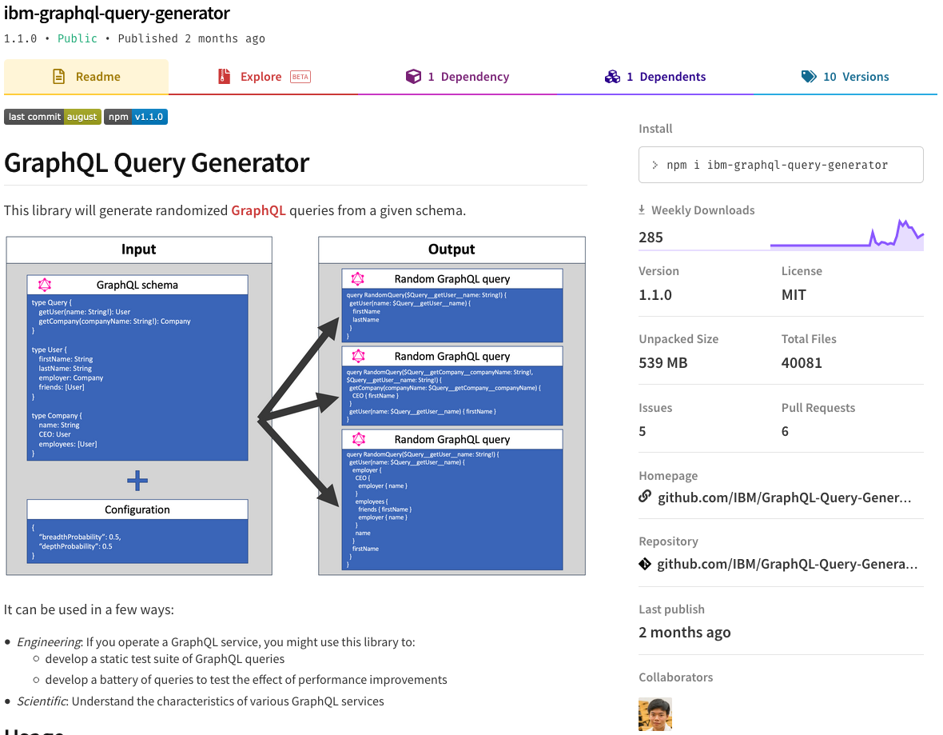
Query-response corpus
Nothing publicly available
Developed and open-sourced a GraphQL query generator
Collected 10,000 unique, anonymized query-response pairs from GitHub and Yelp GraphQL APIs
Notes:
In order to properly evaluate our analysis, we need to test our analysis on some real-world queries.
Unfortunately, we could not find a publicly available corpus.
So, we also developed and open-sourced a GraphQL query generator
And we used it to create a corpus containing 10,000 unique and anonymized query-response pairs from the GitHub and Yelp APIs
***
So, in addition to our other contributions, we also developed and open-sourced a GraphQL query generator and published a corpus of queries and responses using said query generator.

Slide 29
Answering RQ1
Can the analysis be applied to real-world GraphQL APIs?
Limit arguments:
GitHub and Yelp use consistent limit argument names
first and last for GitHub, limit for Yelp
configured with wild cards and regular expressions
Connection pattern in GitHub set using the limitedFields property
Default limits:
Required by 21 fields in GitHub and 13 fields in Yelp
Determined values using API documentation and experimental queries
API providers have these numbers readily available
Notes:
The first research question is “Can the analysis be applied to real-world GraphQL APIs?”
Because our analysis is static, we did not need to integrate it into the GitHub or Yelp backends.
We only need to provide a configuration.
We found configuring the limit arguments in the GitHub and the Yelp APIs straightforward.
Both APIs use consistent names that could be configured using wild cards and regular expressions concisely
In addition, GitHub uses the connection pattern which we configured using limitedFields
We also found configuring default limits to be straightforward
We determined appropriate values from the API documentation and experimental queries
However, for API providers, this process should be even easier as they should have these numbers readily available
Therefore, we conclude that our analysis can indeed be applied to real-world GraphQL APIs
***

Slide 30
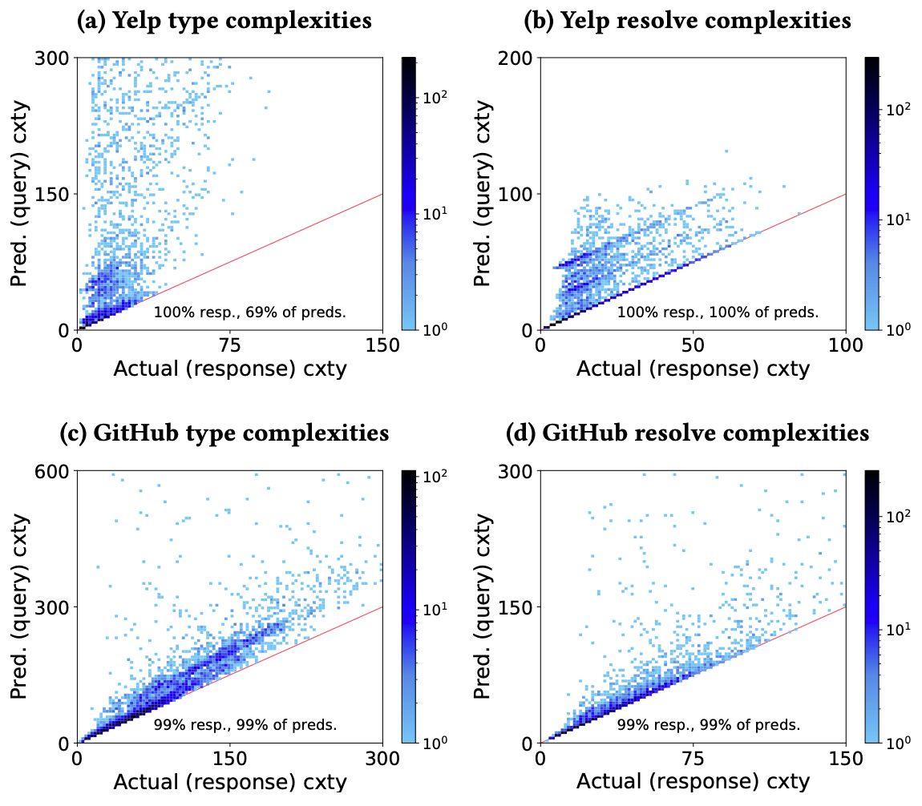
Answering RQ2
Does the analysis produce cost upper-bounds?
Notes:
The second research question is “Does the analysis produce cost upper-bounds?”
We present four charts plotting the predicted Yelp and GitHub type and resolve complexities against the actual ones.
The red line represents when the predicted complexity matches the actual complexity, in order words, a perfect prediction.
Points above the red line are overestimations while points below are underestimations.
As you can see, we have no underestimations.
Additionally, most points cluster near the red line.
Chart A has the most overestimation but overestimation can be mitigated, which we discuss in the paper.
In any case, we can conclude that the analysis does produce upper-bounds.
***
Chart A does, however, have considerably more overestimation than the other charts.
Nevertheless, there are methods to can help mitigate it.
For example, Yelp has a number of unpaginated list fields which causes our estimations to inflate quickly.
By implementing pagination, a GraphQL provider can help our static analysis produce better estimates.
Additionally, for the sake of an unbiased evaluation, we have set type weights and resolve weights equal across the board.
By tuning weights, our analysis can not only better reflect the resource consumption of a query, but also limit the effect of fields that are prone to overestimation.
The color scale is exponential and this means that the majority of prediction complexities are close to the actual values.

Slide 31
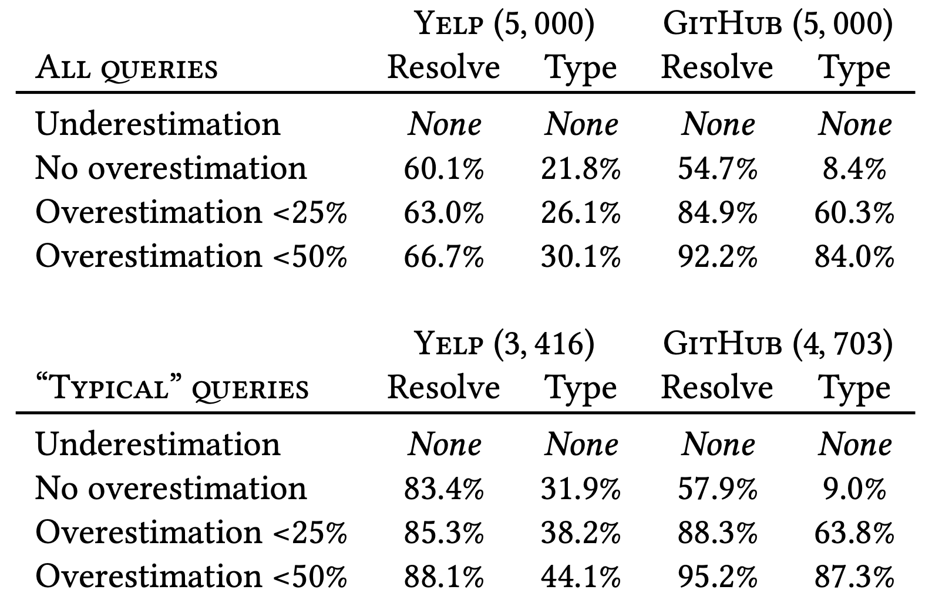
Answering RQ3
Are these bounds useful, i.e. close enough to the actual costs?
Notes:
Naturally, the next question to ask is “Are these bounds useful, i.e. close enough to the actual costs?”
The chart here shows cumulative levels of overestimation for all queries and “typical queries”, a category of queries that are similar in size to example queries provided by GitHub and Yelp.
We can see that Yelp resolve complexity and GitHub resolve and type complexity perform well.
(Click)
The majority of these complexities overestimate by less than 25%.
(Click)
A large proportion of these Yelp and GitHub resolve complexities are perfect estimates as well.
(Click)
Overestimation is present but as mentioned before, it can be mitigated.
***
Our data show that the bounds are tight enough for practical purposes, and are as tight as possible with a static, data-agnostic approach.
Our bounds are looser for more complex queries.
This follows intuition about the underlying graph: larger, more nested queries may not be satisfiable by an API’s real data.
Data sparsity leads responses to be less complex than their worst-case potential.
To prove that our estimates are as tight as possible, we present this pathological query for the GitHub API.
This cyclically queries for the same repository and issues.
As a result, the predicted complexities match the actual values, even though both are abnormally high.
This shows that the overestimation in our evaluation is due to data sparsity, not inaccuracy.
We conclude that the bounds are useful, close enough to the actual costs for providers to respond.
***
If the API data includes at least 100 issues, the predicted and the actual complexities will match, and in this case, the node repository under the nodejs organization does indeed fulfill this requirement.

Slide 32
Answering RQ4
Is our analysis cheap enough for use in API management?
2017 MacBook Pro
8-core Intel i7 processor
16 GB of memory
Median processing time
3.0 ms for queries
1.1 ms for responses
95% percentile
7.3 ms for queries
4 ms for responses
Linear time as a function
of the query and response size
Notes:
The fourth research question is “Is our analysis cheap enough for use in API management?”
We want to see if our analysis could be incorporated into existing request-response flows, like in a GraphQL client or an API gateway
We measured runtime cost on a standard 2017 MacBook Pro and we found that the vast majority of queries could be processed in 7 ms and responses in 4 ms.
Therefore, we believe that our analysis is cheap enough for API management.
***
The median processing time was 3.0 ms for queries, and 1.1 ms for responses. Even the most complex inputs were fairly cheap; 95% of the queries could be processed in < 7.3 ms, and 95% of the responses in < 4 ms.
Additionally, our analysis runs in linear time as a function of the query and response size.

Slide 33
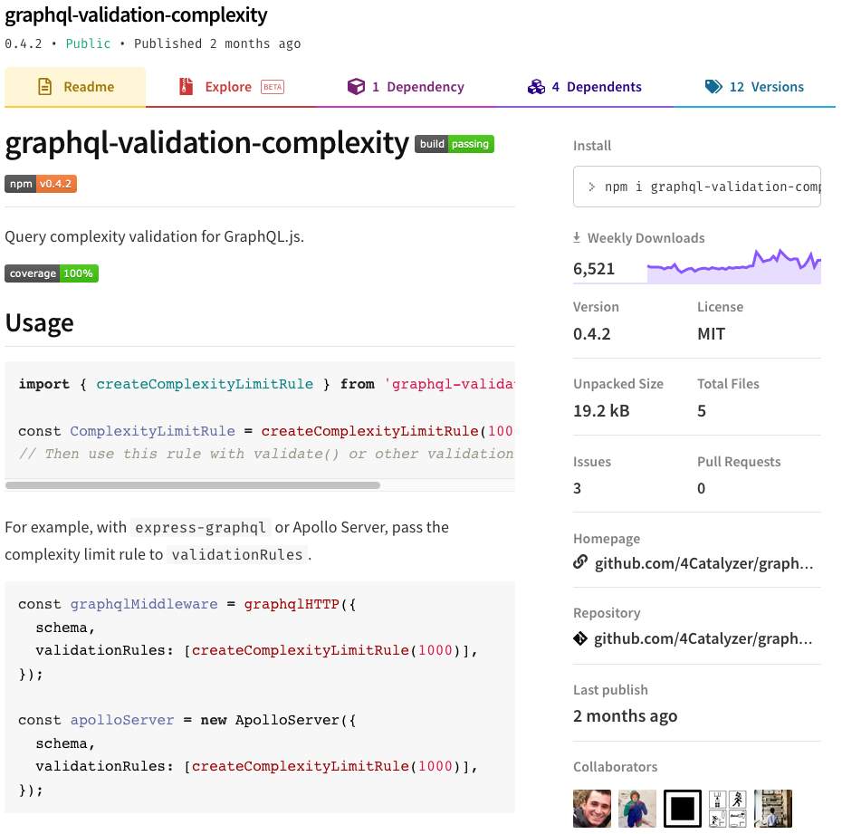
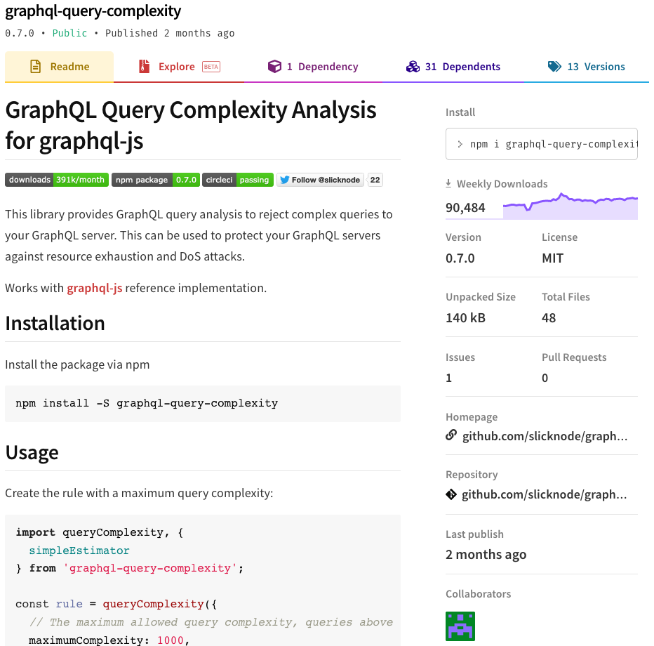
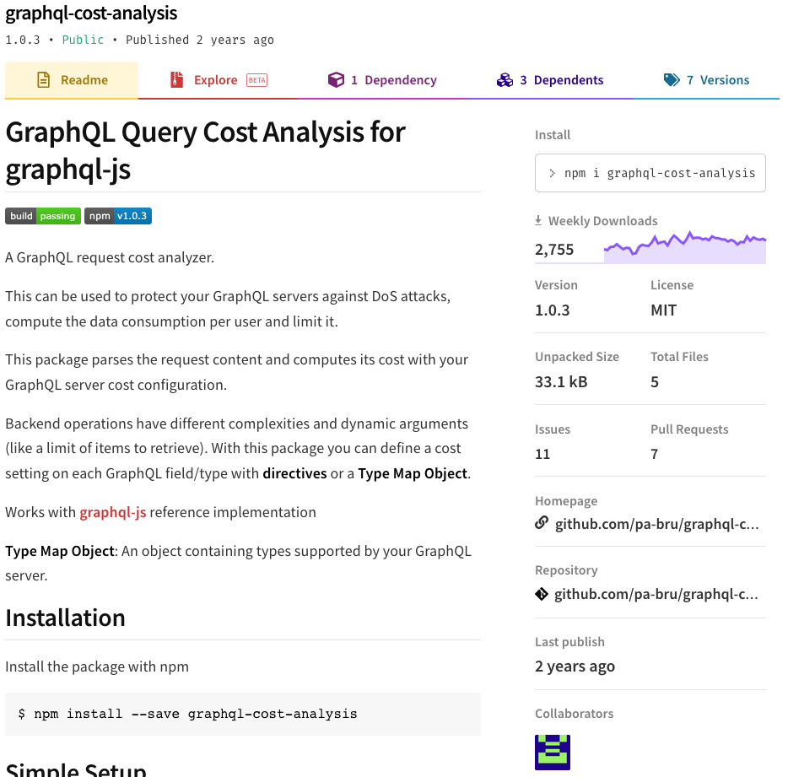
Answering RQ5
How does our approach compare to other solutions?
Library A
Library B
Library C
Open-source
Closed-source
Notes:
The final research question is “How does our approach compare to other solutions?”
We compared our analysis against the three most popular open-source GraphQL query analyses on GitHub and the strategies that GitHub and Yelp employ
We will refer to the open-source libraries as libraries A, B, and C
***
They also all happen to be static query analyses which will allow for fair comparison.
We found the three most popular open-source GraphQL query analyses on GitHub.
We will refer to them as library A, library B, and library C
In addition, we will also compare against the strategies that GitHub and Yelp employ

Slide 34
Answering RQ5
How does our approach compare to other solutions?
BQ1: How large might the response be?
BQ2: How many resolver functions might be invoked?
Notes:
For fair comparisons against the open-source libraries, we propose two practical bound questions.
BQ1: How large might the response be?
BQ2: How many resolver functions might be invoked?
BQ1 is of interest to clients and service providers, who both pay the cost of handling the response. We measure this in the number of distinct objects in the response.
BQ2 is of interest to service providers, who pay this cost when generating the response.
***
For fair comparisons against the open-source libraries, as different libraries may have different interpretations of how complexities should be measured, we propose two practical bound questions.
Various interpretations of “large” are possible, so we operationalized this as the number of distinct objects in the response.

Slide 35
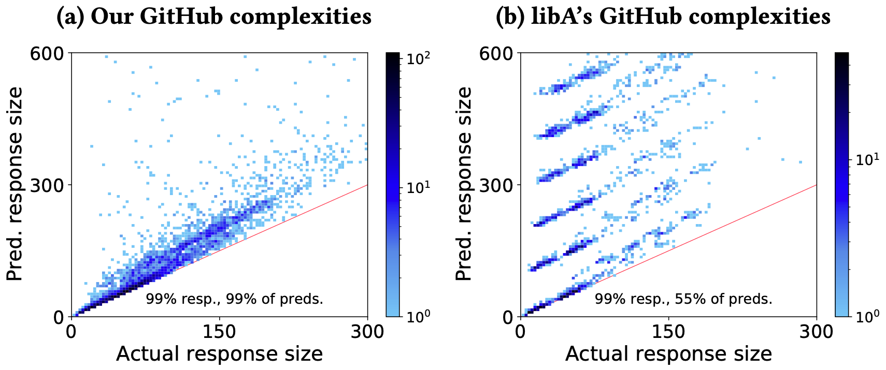
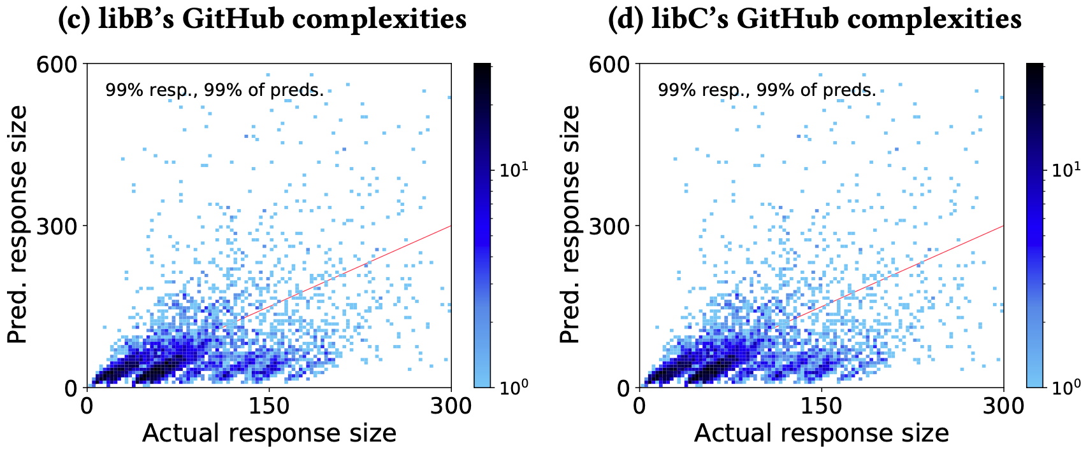
Answering RQ5
How does our approach compare to other solutions?
Notes:
Here we show our analysis and the three open-source libraries tackling the first bound question.
***
(Click)
Library A, while it doesn’t not have any underestimation, has gross overestimation and striations.
This is because it cannot use limit arguments.
As a result, it can only be configured using default limits.
Therefore, we set the default limits to 100, the maximum number of objects that GitHub will return for any particular field, leading to severe overestimation and striations.
(Click)
(Click)
Library B and C are related and hence, their charts look the same.
Both libraries show gross underestimation, which is problematic for a query cost analysis.
This is because they cannot use default limits.
As a result, unpaginated lists and paginated lists with default values are not counted properly.
Additionally, they cannot handle the connections pagination pattern causing overestimation.
(Click)
Regarding the second bound question, “how many resolver functions might be invoked?”, none of the open-source libraries can be configured to do this.
Because of the limitations of all three libraries, we can conclude that our analysis outperforms these open-source solutions.
***
Here we show our analysis and the three open-source libraries tackling the first bound question, “how large might the response be?”, with the GitHub query-response pairs.
As you can see, the differences between our analysis and the three open-source libraries are immediately apparent.

Slide 36
Answering RQ5
How does our approach compare to other solutions?
Library A Observations
Overestimation and striations
Problem: cannot define limit arguments
Workaround: only use default limits
Notes:
Library A, while it doesn’t not have any underestimation, has gross overestimation and striations.
This is because it cannot use limit arguments.
As a result, it can only be configured using default limits.
Therefore, we set the default limits to 100, the maximum number of objects that GitHub will return for any particular field, leading to severe overestimation and striations.
***
(Click)
Library B and C are related and hence, their charts look the same.
Both libraries show gross underestimation, which is problematic for a query cost analysis.
This is because they cannot use default limits.
As a result, unpaginated lists and paginated lists with default values are not counted properly.
Additionally, they cannot handle the connections pagination pattern causing overestimation.
(Click)
Regarding the second bound question, “how many resolver functions might be invoked?”, none of the open-source libraries can be configured to do this.
Because of the limitations of all three libraries, we can conclude that our analysis outperforms these open-source solutions.
***
Here we show our analysis and the three open-source libraries tackling the first bound question, “how large might the response be?”, with the GitHub query-response pairs.
As you can see, the differences between our analysis and the three open-source libraries are immediately apparent.

Slide 37
Answering RQ5
How does our approach compare to other solutions?
Library B and C Observations
Underestimation
Problem: cannot define default limits
Workaround: none possible
Overestimation
Problem: cannot handle connection pattern
Workaround: none possible
Notes:
Library B and C are related and hence, their charts look the same.
Both libraries show gross underestimation, which is problematic for a query cost analysis.
This is because they cannot use default limits.
As a result, unpaginated lists and paginated lists with default values are not counted properly.
Additionally, they cannot handle the connections pagination pattern causing overestimation.
Regarding the second bound question, “how many resolver functions might be invoked?”, none of the open-source libraries can be configured to do this.
Because of the limitations of all three libraries, we can conclude that our analysis outperforms these open-source solutions.
***
Here we show our analysis and the three open-source libraries tackling the first bound question, “how large might the response be?”, with the GitHub query-response pairs.
As you can see, the differences between our analysis and the three open-source libraries are immediately apparent.

Slide 38
Answering RQ5
How does our approach compare to other solutions?
Two static analyses
Can answer BQ1 and BQ2 with limitations
Static: Node limit analysis disregards connections pattern types
Static: Call’s score analysis only counts resolvers that return Connection types
Static and dynamic analyses
Cannot answer BQ1 or BQ2
Static: rejects queries based on levels of nesting
Dynamic: rate limits by executing queries and retroactively replenishing remaining quota
GitHub’s metrics cannot be weighted
GitHub’s focus on the connections pattern may be problematic
Rejects valid queries that have high levels of nesting
Possible to exceed Yelp’s rate limits
Notes:
Now let’s discuss the two closed-source solutions.
GitHub’s GraphQL API relies on two static analyses, which can answer BQ1 and BQ2 but with limitations
For example, their node limit analysis disregards types associated with the connections pattern
Meanwhile, their call’s score analysis only counts resolvers that return Connection types
However, we think there may be a few reasons why our analysis may outperform GitHub’s solution.
Firstly, GitHub’s static analyses cannot be weighted.
Weighting is important because arbitrary types and resolvers will have different resource footprints.
A Repository object will likely have a bigger footprint than an Issue object.
Secondly, GitHub’s overreliance on the connections pattern may be problematic.
When our study began, GitHub shared a shortcoming with library B and library C; it did not properly handle unpaginated lists.
We reported this possible denial of service vector and GitHub confirmed the issue and have since patched their analysis.
Yelp’s GraphQL API analysis has both static and dynamic components.
However, neither one of these measures can effectively answer BQ1 or BQ2.
Statically, Yelp rejects queries with more than four levels of nesting.
However, it is still possible to craft expensive queries with this limitation and it reduces the flexibility that clients have to create queries.
Dynamically, Yelp applies rate limits by executing queries and retroactively replenishing the client’s remaining rate limits according to the response complexity.
It is therefore possible to significantly exceed Yelp’s rate limits by submitting a complex query when a client has a small quota remaining.
Both of these issues can be resolved by using our analysis.
Our analysis can provide more insight into the complexity of queries than approving queries on levels of nesting alone.
In addition, our analysis can prevent users from using more than their allocated quota by determining the complexity of query before, rather than after, issuing it.
Thus, we conclude that our analysis also outperforms the close-sourced solutions.
***
When our study began, GitHub shared a shortcoming with the open-source library B and library C: it did not properly handle unpaginated lists.
We reported this possible denial of service vector to GitHub and they confirmed the issue and have since patched their analysis.
It may be because of GitHub’s overreliance on the connections pattern that this vulnerability, which does utilize the connections pattern, was allowed to exist.
There may be a number of valid queries that have more than four levels of nesting and are not resource intensive that are rejected by this strategy.
This strategy bounds the complexity of valid queries, but expensive queries can still be constructed with this restriction using large nested lists.
In addition, this is an artificial limitation that greatly reduces the flexibility with which users have to construct queries.

Slide 39
Contributions
Two distinct definitions of query complexity
Analysis can handle common schema conventions
Analysis built on formal GraphQL semantics
First evaluation of such an analysis on real-world APIs
Notes:
So, to summarize our contributions:
We provide two distinct definitions of query complexity: type complexity and resolve complexity.
They reflect how GraphQL queries are executed and are useful to both service providers and clients in the realm of API management.
Unlike existing static analyses, our analysis can handle common schema conventions.
We are able to utilize not only pagination conventions but also naming conventions, which allows our analysis to produce better estimates with less configuration.
We build our analysis on formal GraphQL semantics which allows us to prove that our analysis is correct and produces not just an upper-bound, but a tight one.
We perform the first evaluation of such analysis on real-world APIs in addition to open-sourcing a GraphQL query generator and releasing a corpus of GraphQL query-response pairs for future research efforts.

Slide 41
Hypothetical REST API
Get /users/alan_cha
{
firstName: “Alan”,
lastName: “Cha”,
friendIds: [“erik-wittern“, “gbaudart”, “jamesD123”],
interests: [“graphql”, “programming”]
}
Get /users/erik-wittern
Get /users/erik-wittern
Get /users/erik-wittern
{
firstName: “Erik”,
lastName: “Wittern”,
friendIds: [“...”],
interests: [“...”]
}
{
firstName: “Erik”,
lastName: “Wittern”,
friendIds: [“...”],
interests: [“...”]
}
{
firstName: “Erik”,
lastName: “Wittern”,
friendIds: [“...”],
interests: [“...”]
}

Slide 42
Pagination
Schema
Query
Response
type User {
name: String
friends: [User]
}
{
friends { name }
}
{
friends: [ { … }, { … }, { … }, { … }, { … } ]
}
None
type User {
name: String
friends(limit: Int!): [User]
}
{
friends(limit: 3) { name }
}
{
friends: [ { … }, { … }, { … } ]
}
Slicing
type User {
name: String
friends(first: Int, after: string): [UserConnection]
}
type UserConnection {
totalCount: Int
edges: [UserEdge]
nodes: [User]
}
type UserConnection {
cursor: string
node: User
}
{
friends(first: 3) {
nodes {
name
}
}
}
{
friends: {
nodes: [ { … }, { … }, { … } ]
}
}
Connection
Notes:
unless it accounts for common GraphQL design practices, the resulting bound may mis-estimate complexities.

Slide 43
Pagination
Schema
Query
Response
type User {
name: String
friends: [User]
}
{
friends { name }
}
{
friends: [ { … }, { … }, { … }, { … }, { … } ]
}
None
type User {
name: String
friends(limit: Int!): [User]
}
{
friends(limit: 3) { name }
}
{
friends: [ { … }, { … }, { … } ]
}
Slicing
type User {
name: String
friends(first: Int, after: string): [UserConnection]
}
type UserConnection {
totalCount: Int
edges: [UserEdge]
nodes: [User]
}
type UserEdge {
cursor: string
node: User
}
{
friends(first: 3) {
nodes {
name
}
}
}
{
friends: {
nodes: [ { … }, { … }, { … } ]
}
}
Connection
Notes:
Naturally, we must ask how the configuration works.
Unless our analysis accounts for common GraphQL design practices, the resulting bound may not be accurate.
A critical GraphQL design practice and one that is especially important to query cost analysis is pagination.
(Click)
GraphQL has two pagination conventions and they are slicing and connection.
(Click)
(Click)
First we will talk about the case in which no pagination convention is being used.
If no pagination is being used, then a field returning a list can return any number of objects.
In this case, you can see that the friends field returns 5 users.
(Click)
The slicing pattern uses what are known as…
(Click)
...limit arguments to bound the sizes of lists.
(Click)
(Click)
As you can see here, the limit argument forces the friends field to return at most 3 user objects.
To clarify, limit arguments are not limited to arguments named limit. Some other common limit arguments are first and last.
(Click)
(Click)
The connections pattern build on the slicing pattern but provides a layer of indirection that can allow for more intricate pagination.
It also uses…
(Click)
limit arguments but you can also use…
(Click 2)
a cursor in order to select the starting point of pagination.
(Click)
There are also Connection and Edge types which can provide useful information…
(Click)
such as the totalCount and the cursor of the current entity.
(Click)
Note that unlike the slicing example, the limit argument does not change what is returned by the friends field.
(Click 2)
Because of the indirection, the limit argument actually applies on the nodes field.

Slide 44
Configuration
Schema
Query
Configuration
type User {
name: String
friends: [User]
}
{
friends { name }
}
resolvers:
“User.friends”:
defaultLimit: 10
resolverWeight: 1
types:
User:
typeWeight: 1
None
type User {
name: String
friends(limit: Int!): [User]
}
{
friends(limit: 3) { name }
}
resolvers:
“User.friends”:
limitArguments: [first]
resolverWeight: 1
types:
User:
typeWeight: 1
Slicing
type User {
name: String
friends(first: Int, after: string): [UserConnection]
}
type UserConnection {
totalCount: Int
edges: [UserEdge]
nodes: [User]
}
type UserEdge {
cursor: string
node: User
}
{
friends(first: 3) {
nodes {
name
}
}
}
resolvers:
“User.friends”:
limitArguments: [first]
limitedFields: [edges, nodes]
resolverWeight: 1
types:
User:
typeWeight: 1
Connection
Notes:
Here we can see some sample configurations.
The configuration is split into two sections, one for resolver configuration and one for type configuration.
Resolvers are identified by a combination of the type name and the field name whereas types are identified by just the type name.
We also allow regular expressions and wildcards to be used to identify resolvers and types.
Within each resolver configuration, we can provide a resolverWeight, along with some other properties that we will go into later.
Within each type configuration, we can only provide a typeWeight.
(Click)
For lists that are not paginated, we can hardcode a…
(Click)
defaultLimit that will represent the maximum number of objects that the field will return.
(Click)
(Click)
For the slicing pattern, we can use the…
(Click)
LimitArguments property to specify the names of limit arguments.
When we analyze a field in a query and we can identify a limit argument from the configuration, then the analysis will use the argument value as the maximum number of objects that the field will return.
(Click)
(Click)
Lastly, for the connections pattern, we can use not only the limitArgument property but also the limitedFields property.
The limitedFields allows us to configure the analysis to properly handle the indirection that is present in the connections pattern.

Slide 45
Complexity measures
Type complexity
Maximum list size or
1 if the field is not a list
Type weight
Type complexity of sub-query
Resolve complexity
Resolve weight
Maximum list size or
1 if the field is not a list
Resolve complexity of sub-query
Notes:
Here are the formalizations of the complexities.
The type complexity is the product of the maximum list size and the sum of the type weight and the type complexity of the sub-query
The resolve complexity is the sum of the resolve weight and the product of the maximum list size and the resolve complexity of the sub-query
***
Here are the formulas used to calculate the type and resolve complexity.
(Click)
Focus on the highlighted expressions.
These formulas are recursive
The type complexity is equal to the l…
(Click)
the maximum size of the current list or 1 if the field does not return a list, multiplied by
(Click 2)
the sum of the type weight of the return type and the type complexity of the subquery
On the other hand, resolve complexity is the sum of the resolve weight
(Click)
and the product
(Click 2)
of l, the maximum size of the current list or 1 if the field does not return a list and the resolve complexity of the subquery
***
Type complexity must reflect the cost of instantiating every element.
Every element thus adds the weight of the returned type 𝑡 to the complexity.

Slide 46
Query type complexity
Configuration
Schema
Query
resolvers:
"Topic.relatedTopics":
limitArguments: [first]
defaultLimit: 10
resolverWeight: 1
"Topic.stargazers":
limitArguments: [first, last]
limitedFields: [edges, nodes]
defaultLimit: 10
resolverWeight: 1
types:
Topic:
typeWeight: 1
Stargazer:
typeWeight: 1
1 Topic
2 Topic(s)
0 scalar
1 StargazerConnection
0 scalar
2 StargazerEdge(s)
2 User(s)
0 scalar
0 scalar
Total type complexity: 8

Slide 47
Query resolve complexity
Configuration
Schema
Query
resolvers:
"Topic.relatedTopics":
limitArguments: [first]
defaultLimit: 10
resolverWeight: 1
"Topic.stargazers":
limitArguments: [first, last]
limitedFields: [edges, nodes]
defaultLimit: 10
resolverWeight: 1
types:
Topic:
typeWeight: 1
Stargazer:
typeWeight: 1
1 topic
1 relatedTopics
0 trivial
1 stargazers
0 trivial
1 edges
2 nodes
0 trivial
0 trivial
Total resolve complexity: 6
Notes:
In fact, many GraphQL libraries will let you omit resolvers this simple and will just assume that if a resolver isn't provided for a field, that a property of the same name should be read and returned.

Slide 48
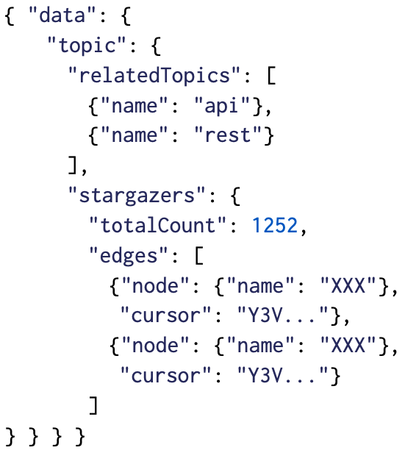
Response type complexity
Configuration
Schema
Query
resolvers:
"Topic.relatedTopics":
limitArguments: [first]
defaultLimit: 10
resolverWeight: 1
"Topic.stargazers":
limitArguments: [first, last]
limitedFields: [edges, nodes]
defaultLimit: 10
resolverWeight: 1
types:
Topic:
typeWeight: 1
Stargazer:
typeWeight: 1
1 Topic
1 Topic
1 Topic
0 scalar
0 scalar
1 StargazerConnection
0 scalar
1 StargazerEdge
1 User
1 StargazerEdge
0 scalar
1 User
0 scalar
Total type complexity: 8

Slide 49
Response resolve complexity
Configuration
Schema
Query
resolvers:
"Topic.relatedTopics":
limitArguments: [first]
defaultLimit: 10
resolverWeight: 1
"Topic.stargazers":
limitArguments: [first, last]
limitedFields: [edges, nodes]
defaultLimit: 10
resolverWeight: 1
types:
Topic:
typeWeight: 1
Stargazer:
typeWeight: 1
1 topic
1 relatedTopics
0 trivial
0 trivial
1 stargazers
0 trivial
1 edges
1 nodes
0 trivial
1 nodes
0 trivial
0 trivial
0 trivial
Total resolve complexity: 6

Slide 50
Answering RQ3
Are these bounds useful, i.e. close enough to the actual costs?
query {
organization (login: "nodejs") {
repository (name: "node") {
issues (first: 100) {
nodes {
repository {
issues (first: 100) {
nodes {
repository {
issues (first: 100) {
nodes {
repository {
issues (first: 100) {
nodes {
repository {
issues (first: 100) {
nodes {
repository {
... }}}}}}}}
Notes:
Naturally, the next question to ask is “Are these bounds useful, i.e. close enough to the actual costs for providers to respond?”
Our data show that the bounds are tight enough for practical purposes, and are as tight as possible with a static, data-agnostic approach.
Our bounds are looser for more complex queries.
This follows intuition about the underlying graph: larger, more nested queries may not be satisfiable by an API’s real data.
Data sparsity leads responses to be less complex than their worst-case potential.
The chart here shows cumulative levels of overestimation for all queries and “typical queries”, which we define as queries with estimated type complexity less than 300.
This number was determined from a survey of example queries provided by GitHub and Yelp.
We can see that Yelp resolve complexity and GitHub resolve and type complexity perform well.
The majority of these complexities overestimate by less than 25%.
A large proportion of these Yelp and GitHub resolve complexities are perfect estimates as well, where the predicted complexity matches the actual values.
Overestimation is present but as mentioned before, it can be mitigated.
To prove that our estimates are as tight as possible, we present this pathological query for the GitHub API.
This cyclically queries for the same repository and issues.
As a result, the predicted complexities match the actual values, even though both are abnormally high.
This shows that the overestimation in our evaluation is due to data sparsity, not inaccuracy.
We conclude that the bounds are useful, close enough to the actual costs for providers to respond.
***
If the API data includes at least 100 issues, the predicted and the actual complexities will match, and in this case, the node repository under the nodejs organization does indeed fulfill this requirement.

Slide 51
Answering RQ5
How does our approach compare to other solutions?
Notes:
Here we show our analysis and the three open-source libraries tackling the first bound question.
(Click)
Library A, while it doesn’t not have any underestimation, has gross overestimation and striations.
This is because it cannot use limit arguments.
As a result, it can only be configured using default limits.
Therefore, we set the default limits to 100, the maximum number of objects that GitHub will return for any particular field, leading to severe overestimation and striations.
(Click)
(Click)
Library B and C are related and hence, their charts look the same.
Both libraries show gross underestimation, which is problematic for a query cost analysis.
This is because they cannot use default limits.
As a result, unpaginated lists and paginated lists with default values are not counted properly.
Additionally, they cannot handle the connections pagination pattern causing overestimation.
(Click)
Regarding the second bound question, “how many resolver functions might be invoked?”, none of the open-source libraries can be configured to do this.
Because of the limitations of all three libraries, we can conclude that our analysis outperforms these open-source solutions.
***
Here we show our analysis and the three open-source libraries tackling the first bound question, “how large might the response be?”, with the GitHub query-response pairs.
As you can see, the differences between our analysis and the three open-source libraries are immediately apparent.

Slide 52
Answering RQ5
How does our approach compare to other solutions?
Notes:
Here we show our analysis and the three open-source libraries tackling the first bound question.
(Click)
Library A, while it doesn’t not have any underestimation, has gross overestimation and striations.
This is because it cannot use limit arguments.
As a result, it can only be configured using default limits.
Therefore, we set the default limits to 100, the maximum number of objects that GitHub will return for any particular field, leading to severe overestimation and striations.
(Click)
(Click)
Library B and C are related and hence, their charts look the same.
Both libraries show gross underestimation, which is problematic for a query cost analysis.
This is because they cannot use default limits.
As a result, unpaginated lists and paginated lists with default values are not counted properly.
Additionally, they cannot handle the connections pagination pattern causing overestimation.
(Click)
Regarding the second bound question, “how many resolver functions might be invoked?”, none of the open-source libraries can be configured to do this.
Because of the limitations of all three libraries, we can conclude that our analysis outperforms these open-source solutions.
***
Here we show our analysis and the three open-source libraries tackling the first bound question, “how large might the response be?”, with the GitHub query-response pairs.
As you can see, the differences between our analysis and the three open-source libraries are immediately apparent.

Slide 53
Discussion
Configuration and applicability:
Our analysis is configurable to work with two real-world GraphQL APIs
It is static and does not depend on any interaction with backend systems
Three strategies for managing over-estimation
Unpaginated list field
Tuning weights
Hybrid static/dynamic system to leverage the graph data at runtime

Slide 54
Discussion
Formalization and data-driven software engineering
Our formal analysis gives us provably correct bounds
We benefited from an understanding of GraphQL
Pagination
Naming conventions
Incorporated pagination into our formalization
Supported both of the widely used pagination patterns in our configuration
Naming conventions inspired our support for regular expressions

