Slide 1
Testing Regex Generalizability and its Implications
James Davis
Daniel Moyer
Ayaan Kazerouni
Dongyoon Lee
Notes:
Good morning! My name is James Davis, and I’m here to tell part two of the regex story.
I will prsent a project I did with Daniel, Ayaan, and Dongyoon.
Our work is called Testing Regex Generalizability and its Implications.
This project is about methodology and measurements.
We don’t describe any (particularly) new techniques or shocking results.
Instead, we took a step back and rigorously evaluated
First, whether the methodologies followed by different regex researchers are comparable, and
Second, whether their results can be generalized to new places.
I know this isn’t particularly glamorous, but remember, this is how science happens.
We explore, we replicate, and we generalize.
------------
This talk immediately follows Mischa’s talk on Regexes Are Hard.
20-minute block
17 talk
3 Q&A

Slide 2
ASE’19
Regexes are Hard!
ICST’10, ICST’16, ICSTW’18,
SCAM’18, FSE’18, FSE’19
How can we help?
(This talk)
What do real
regexes look like,
anyway?
Notes:
As Louis just said, software engineers told us that Regexes Are Hard
*Now, we’d love to help with better tools and regex engines.
In the past few years, we and others have begun exploring this space.
But we want to make sure that the support we offer actually helps real software engineers with their real regexes.
*This raises the question: What do real regexes look like, anyway?
If we can confidently say what typical regexes look like, then the community can develop tools and regex engines to support them.
For example:
Tool developers could target support for the most common features first, and
Regex engine developers could optimize for common regexes
We consulted the literature to determine the characteristics of regexes as they are used in practice.
We realized that:
Although empirical researchers have taught us something about real regexes…
their experiments have been limited
To be confident about what typical regexes look like,
we need to know whether previous regex research generalizes.
First, do prior findings generalize to regexes in other software?
Second, do prior findings generalize to regexes in other programming languages?
Hence the title of our paper: “Testing Regex Generalizability”
---
*Consider visual about the stuff I'm talking about
*Took too long!
*Revisit "How does this work help them?" at the end -- the takeaways for tool and engine devs.

Slide 3
Background and Motivation
Notes:
Now, in case you’re not familiar with this research area…

Slide 4
How software engineers use regexes
jd
@
vt
.
edu
Notes:
One common way that software engineers use regexes in practice is to perform web form input validation on the client and on the server side.
Here we have a function that tests whether form input is an email,
*and this function uses a regex
This regex matches emails: things that begin with a username, then an @, then a domain name.
For example, this regex will match one of my email aliases:
*jd *@ *vt * . *edu
Widely used JavaScript and Python modules identify emails using regexes similar to this one.

Slide 5
What empirical work tells us about regexes
“These results may not generalize to other languages.”
Widely used…
…for many purposes
Varying feature use
Under-tested
Security vulnerability
ISSTA’16
FSE’18 a
“unknown whether our findings will hold for other languages”
ISSTA’16
→ ASE’17
FSE’18 b
→ SANER’19
“﻿The regexes reflect one language”
FSE’19
Notes:
Empirical regex usage has primarily been studied by Katie Stolee’s lab at NC State, and my team at Virginia Tech.
*Stolee’s team said regexes are widely used. They appear in about a third of Python projects
*My team reported that engineers use regexes in diverse contexts for diverse purposes, including:
input validation
server-side rendering
*Stolee’s team reported on which features are more popular
which guided the design of their regex comprehension experiment.
*Stolee’s team also reported that regexes are under-tested,
which motivated their work on regex evolution.
*This year, my team reported that up to 10% of regexes could lead to security vulnerabilities if used on untrusted input.
Clearly we know some things about the properties of real regexes, and how engineers use them.
Our teams have also been pretty honest about the threats to validity:
*These results may not generalize to other languages
*Unknown whether our findings will hold for other languages
*The regexes reflect only one language
Next we’ll take a deeper look at the regex corpuses (population samples) on which these findings are based.

Slide 6
What do our regex corpuses look like?
Corpus | Languages, # projects | Extraction method
ISSTA’16 | 4K | Static analysis
FSE’18 a | ~400K | Static analysis
FSE’18 b | 1K | Prog. instrumentation
FSE’19 | 8 languages, ~200K | Static analysis
Does programming language affect results?
Does extraction method affect results?
Notes:
Remember, we want to build tools and regex engines to accommodate all regex uses.
So how representative are the community’s regex corpuses?
Well, the first three don’t look particularly representative.
They consider
*1-2 programming languages,
*and two focus on a small number of projects.
That’s troubling, because we’ve based most of our work so far on these corpuses.
It’s also worth noting that the final corpus could be representative.
It covers 200,000 software projects from 8 programming languages.
But we don’t know whether its extraction method might bias it.
------
This table summarizes the regex corpuses from which we’ve learned most of our results.
For example, findings about feature use and regex comprehension are based on Chapman & Stolee’s regex corpus from ISSTA 2016, which was obtained using static analysis on 4000 Python projects.
How might this affect the community’s regex results?
First, these corpuses cover only three programming languages
Engineers may choose a programming language based in part on their task, and some tasks may have greater call for pattern matching. It is not unreasonable to suppose that the characteristics of the regexes used to solve these problems may likewise vary by programming language.
- Second, different extraction methods could yield different regexes. To illustrate this, let’s look at the next figure.

Slide 7
Potential bias #1: Programming language
Population
Relevant regexes
ISSTA’16
FSE’18 b
Sample
FSE’18 a
Notes:
Let’s look at the first potential bias.
Suppose this is the population of all regexes.
Now, most corpuses have sampled from
*Java projects,
*JavaScript projects,
and
*Python projects.
But what about regexes from projects in other programming languages?

Slide 8
Potential bias #2: Extraction methodology
ISSTA’16, FSE’18 a, FSE’19
Static analysis-based
ExpressionStatement
/abc/
FSE’18 b
Program instrumentation-based
Test suite
Notes:
Let me illustrate this sampling bias.
*Which we then walk for regex creation sites

Slide 9
Research outline
Notes:
Now that we understand the risks facing prior research,
let’s talk about how we tested its generalizability.

Slide 10
Research outline
Two generalizability hypotheses
Sample
Population
Eight regex metrics
Two experiments
to test hypotheses
“Relatively generalizable”
Implications
Notes:
Here’s the research strategy we followed.
First, we formulated two regex generalizability hypotheses based on the methodology and assumptions of prior research
To test these hypotheses, we needed a way to characterize a regex across several dimensions.
We combined metrics used in prior studies into eight metrics that characterize a regex across three dimensions.
Then we developed measurement instruments for these metrics.
Next, we designed experiments to test the generalizability hypotheses
Our findings generally support these hypotheses: prior research is “relatively generalizable”
One of our hypotheses held in all cases.
The other failed in a few cases.
But remember, our goal is to guide regex tool and engine developers, and both hypotheses held well enough to do that.
Finally, I’ll talk about the some of the implications of our findings for regex tools and regex engines

Slide 11
Generalizability hypotheses
Sample
Population
H-EM: The Extraction Methodology does not matter.
H-PL: The Programming Language does not matter.
Notes:
*H-EM: Extraction methodology
- Static analysis and program instrumentation will yield similar regex corpuses.
*H-PL: Programming language
- Regexes from different programming languages will be similar.
*These are fairly natural hypotheses.
- For extraction methodology…If you look at source code, you'll see that most regexes are declared inline, where either static analysis or program instrumentation can find them.
- For programming language… Using regexes ourselves, reading textbooks, and looking at Stack Overflow posts: it seems natural that the kinds of problems people solve with regexes won't seem too much -- they are STRING OPERATIONS, which are fairly general. So we would expect the regexes to look similar across programming languages.
If both of these hypotheses hold, researchers can generalize results from one extraction methodology in one programming language to all programming languages – that would be great!
If either fails, we will need to be more cautious in generalizing our findings.
Either way, with these hypotheses tested we can move on from the task of laying an empirical regex foundation to the more practical tasks of building tools and regex engines to help developers.
-----
It's uncommon to see regexes defined in unreachable code (where PI couldn't find them) or in external files (where static analysis couldn't find them).

Slide 12
Regex metrics
Dimension | Implications | Metric
Regex representation | Comprehension | Pattern length
 |  | Features used
 |  | NFA size
Language diversity | Test-ability | NFA simple paths
Evaluation complexity | Performance Security | DFA blow-up
 |  | Super-linear behavior
 |  | NFA density
 |  | Extended features
Notes:
We developed eight metrics across three dimensions:
*the representation of the regex
*the size of the string language it describes
*the complexity of evaluating it in typical regex engines
We based these metrics on those used in prior research.

Slide 13
Experimental methodology
1. Extracting regexes
FSE’19
H-EM
75K projects
Both extraction methodologies
H-PL
200K projects
Static extraction
2. Measuring regexes
14
regex
corpuses
/a/
Measured corpuses
Notes:
First we extract regexes, then measure them, then test hypotheses.
*H-EM:
Static analysis: standard tools for each programming language
e.g. JavaParser framework for Java, ast/astor for Python
Program instrumentation:
Same tools to instrument the code
Then we had to build and run as many of the 75K projects as we could
Overall
We obtained regexes from about 40% of projects statically,
and about 15% of projects using program instrumentation.
*H-PL
Because H-EM didn’t find any difference, we re-used the 8-language corpus from our prior work.
------
JavaScript: npm
Java: Maven and Gradle, including all versions of Android
Python: Less standardization. 5 popular build systems

Slide 14
Data analysis
1. Extract regexes
2. Measure regexes
3. Statistical comparisons
Sample 1
Sample 2
Treatment variables: Extraction mode, programming language
Dependent variables: Regex metrics
Hypothesis tests: Kruskal-Wallis (non-parameteric ANOVA)
Effect size: Non-parametric Cohen’s d_{r}
Notes:
The distributions of our metrics are not normal, nor were the variances homogeneous.
So we used a non-parametric test: the Kruskal-Wallis test.
----
https://en.wikipedia.org/wiki/Kruskal%E2%80%93Wallis_one-way_analysis_of_variance
..
So, after performing the Kruskal-Wallis hypothesis test, we calculated effect sizes for pairwise differences between groups. Because the distributions of regex characteristics do not meet the conditions assumed by parametric statistical tests, we applied a nonparametric difference effect size measurement dr derived from the commonly used Cohen’s d [67]. The dr measure is a scaled robust estimator of Cohen’s d proposed by Algina et al. [68], and shown to be robust to non-normal and non-homogeneous data [69]. It takes on scaled values indicating the size of the difference between two samples, ranging from 0 (no difference) to 1 (large difference).

Slide 15
Findings
H-EM
Minimal evidence to reject
H-PL
Some evidence to reject
4/8 features
Notes:
We found minimal evidence to reject H-EM
Hypothesis tests failed because N is large in our dataset - we had a lot of statistical power.
But when we measured the effect sizes, we found only a small to negligible effect for each metric.
Some evidence to reject H-PL
Here the hypothesis tests failed as well.
Measuring the effect sizes, for half of the features there was a medium or large effect size in perl, javascript, and ruby.
*Although there are differences between some treatments,
we think that the trends for each metric are consistent to be useful for tool builders and engine developers.
Next we’ll look at one visualization for each hypothesis.

Slide 16
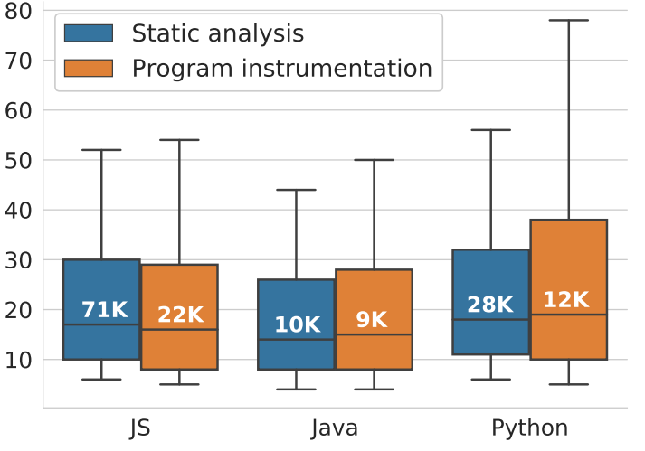
H-EM: Minimal evidence to reject
Regex length by prog lang
Length
“Significant” differences → Negligible effect sizes
Notes:
We found minimal evidence to reject the Extraction Methodology hypothesis.
I’ll share one representative finding.
This chart shows the distributions of regex length by
programming language (x axis) and
extraction methodology (blue static, orange instrumentation)
The whiskers are 10/90, outliers not shown.
*For this hypothesis, we’re comparing the pairs within each programming language.
*Our hypothesis tests reported a significant difference in medians, but the effect sizes are negligible here. Note how close together the medians are.
This is a representative figure; the other 7 metrics have similar properties.
----
This means we could find no practical difference between the samples obtained using the two extraction methodologies.
→ We interpret this to mean that in terms of the regexes themselves, the extraction methodology you use does not matter. That’s good news – static analysis is a lot less work.
Intersection:
About 50% of prog. instr. also found using static analysis
20K unique to prog instr, 20K overlap

Slide 17
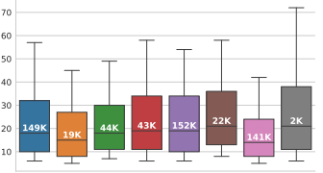
H-PL: Difference #1: <
Regex pattern lengths
Length
Notes:
We found some evidence to reject the Programming Languages hypothesis.
For some metrics, a few languages were outliers.
I’ll share one finding.
This chart again shows the distributions of regex length, by programming language (x axis)
*For this hypothesis, we’re comparing across programming languages.
In this case, between most pairs of languages there was no difference.
*But Perl regexes tend to be shorter than those used in Go, Rust (medium effect size).
3 of the other 7 metrics had significant differences.
See paper for details.

Slide 18
Implications
Notes:
I'll close by talking about a few implications of our findings.
For scientists, we’ve shown that
The extraction methodology used to build a corpus doesn’t have a measurable effect on its contents, but
There are some measurable differences between regexes in different programming languages
So you should take this into consideration when designing your experiments.
Now, here are some of the implications of our measurements for regex tool builders and engine developers.

Slide 19
Re-use candidates are
hard to find
Generating inputs
is hard
Automatic generation
is feasible
Notes:
Tools first.
*Developers told Mischa that re-use candidates are hard to find.
, and suggested that using quality metrics to build a regex re-use database might be a solution.
So, Mischa, I have good news:
*We are halfway to the metric-based ranking system developers asked for.
We have identified eight possible quality metrics, and our instruments can be used to measure new metrics as needed.
*Developers told Mischa that generating inputs is hard.
I have good news for them too.
*One of our metrics was about the number of inputs needed to characterize a regex.
MOST of our regexes can be automatically characterized by just 10 strings.
These and other observations in our paper hint at promising areas of future research.

Slide 20
10-40% of regexes
could lead to REDOS
Could use a DFA
Notes:
Now for regex engines.
We urge regex engine developers to address the REDOS security problem.
*We estimated that 10-40% of the regexes in a given programming language could lead to REDOS if used improperly.
(And in Mischa’s work, he found that most developers don’t know about REDOS!)
But we also have some insights on how to address this.
*For example, regex engine developers could use a DFA as a principled way to avoid REDOS.
Although DFAs can theoretically have exponential size, this blow-up affects less than 10% of real regexes.
Optimizing for the common case can eliminate many of these REDOS vulnerabilities entirely.
-------
Another opportunity: super-linear features are used <5% of the time, and are therefore a potential deprecation candidate. Rust and Go have already deprecated them. Other programming languages could follow suit.
DFA: This observation is made by GREP, but not being used in any prog langs AFAIK

Slide 21
Conclusions

Slide 22
Regexes generalize. Regex research generalizes.
https://doi.org/10.5281/zenodo.3424960
Notes:
In closing, let me emphasize two things.
1. Regexes generalize. The regex extraction methodology you follow doesn’t matter, and regexes look similar across programming languages
2. Regex research generalizes, too. Although I didn’t talk about it today, through additional experiments we were able to replicate most prior findings.
Our data offer many promising avenues for future work in data-driven regex tools and regex engines.
*Thank you for your attention! I’d be happy to answer any of your questions.
-------
H-EM Regex extraction method doesn’t matter
H-PL Regexes moderately different by programming language

Slide 23
Bonus slides

Slide 24
More potential sampling biases
Applications vs. modules
Test vs. production
Specialized sub-domains (e.g. firewall rules)
Notes:
After all this talk of generalizability, I would be remiss if I didn’t point out the biases in this generalizability study.

Slide 25
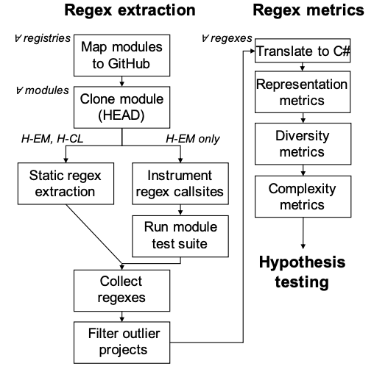
Methodology
Notes:
This is not enough for clarity.

Slide 26
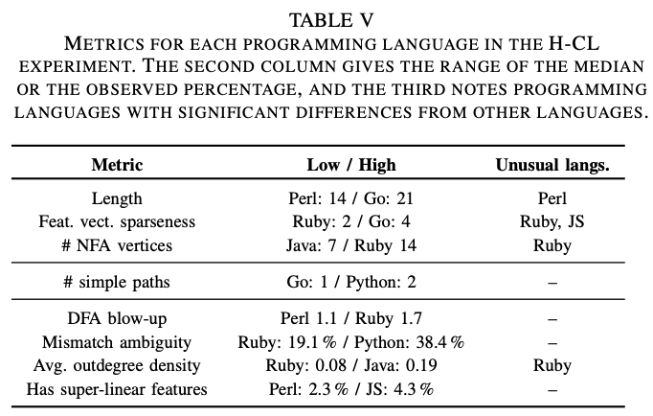
H-PL results
Notes:
Length (Perl [mod] shorter)
Feature vector sparseness (Ruby [lg], JS [mod] use fewer features)
NFA vertices (Ruby [mod] larger)
Outdegree density (Ruby [mod-lg] smaller)
We used
2nd column: median or observed percentage
3rd column: significant differences by PL (medium to large effect size)

Slide 27
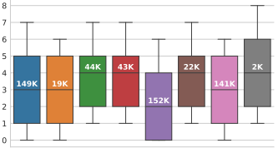
H-PL: Difference #2: <
Distinct regex features used (e.g. *, +, \1)
Notes:
Ruby, JS tend to be use fewer features than PHP, Python, Go, Rust
Effect sizes:
Ruby – large
JS – moderate

Slide 28
Artifact for reproducibility
Measurement instruments
Measured corpuses
FSE’18
FSE’19a
FSE’19b
CHANGE SYMBOL
https://doi.org/10.5281/zenodo.3424960
Notes:
Measurement image:

Slide 29
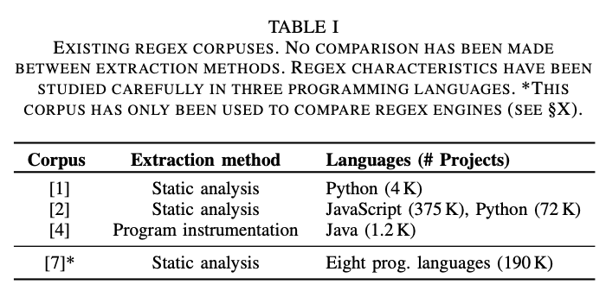

Slide 32
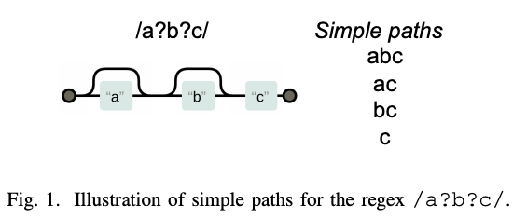

Slide 33
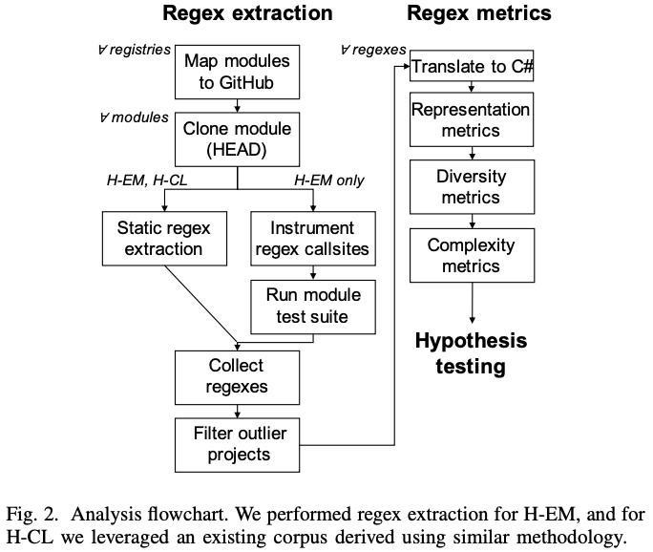

Slide 35
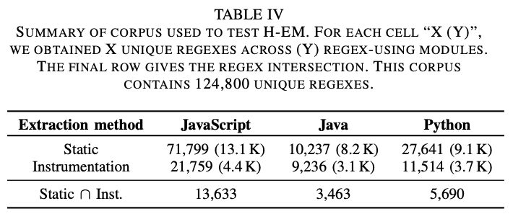

Slide 36
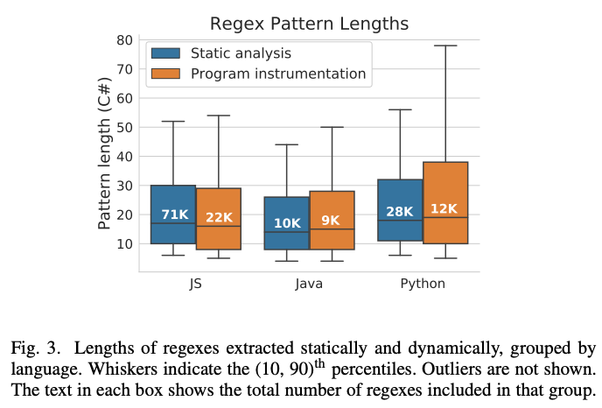

Slide 37
Notes:
Discussion about statistical significance vs. practical differences https://stats.stackexchange.com/a/125758

Slide 38
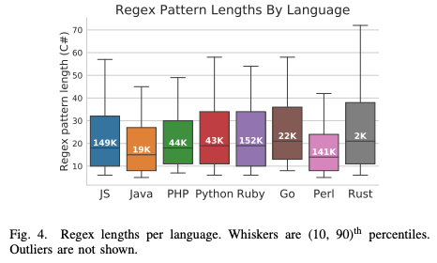

Slide 39
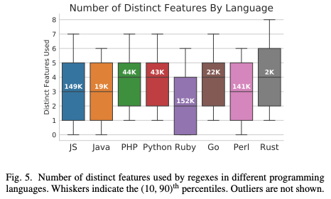

Slide 40
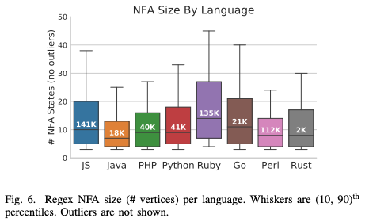

Slide 41
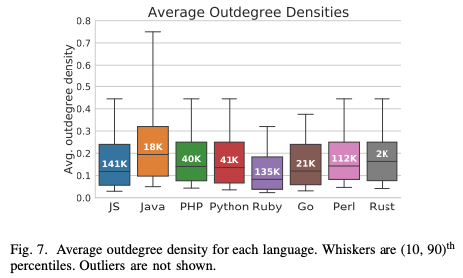

Slide 42
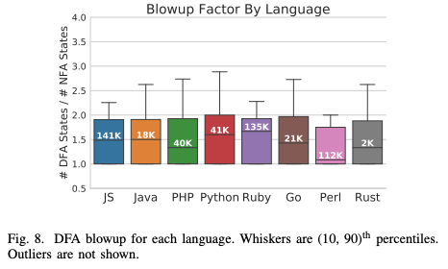

Slide 43
Potential bias #1: Extraction methodology
ISSTA’16, FSE’18 a, FSE’19
Static analysis-based
Population
All regexes
used in practice
ExpressionStatement
Sample
Regex corpus
/abc/
FSE’18 b
Program instrumentation-based
Test suite
Notes:
This version starts from the whole population again, but this seems needless

Slide 44
Potential bias #1: Extraction methodology
Static analysis-based
Population
All regexes
used in practice
ExpressionStatement
/abc/
Program instrumentation-based
Sample
Test suite
Notes:
This version uses PL colorings. Confusing.

Slide 45
How do we know what we know about regexes?
Generalize → regex practices and needs
Critical regex features
Extent of security issues
Copy-paste practices
Regex corpus
ISSTA’16
FSE’18 a
FSE’19
Notes:
Regex researchers rely on a regex corpus.
These corpuses are constructed by extracting the regexes from
*different software projects
(regexes marked as highlighted lines)
*And combining them into a regex corpus, a collection of real regexes.
*You can imagine how a regex corpus can then be used to develop all sorts of insights to benefit regex tool builders and regex engine developers, for example:
*Which regex features are critical to support?
*How common are regex-based security vulnerabilities?
*How easy are regexes to re-use?
Let's observe, though, that drawing conclusions from a regex corpus in this manner is
fundamentally an act of generalizing from a sample.

Slide 46
Generalizing assumes sample is representative
Population
Relevant regexes
Sample
Regex corpus
Notes:
Generalizing from a regex corpus to a population assumes that the corpus – a sample – is representative of the population of interest.
TODO XXX

Slide 47
Image credits 1
http://clipart-library.com/ruler-cliparts.html
https://www.iconfinder.com/icons/2193256/body_child_height_kid_measure_measuring_student_icon
https://www.vectorstock.com/royalty-free-vector/line-drawing-cartoon-weighing-scale-vector-24151282
http://clipart-library.com/free/tools-clipart-png.html
http://clipartmag.com/toy-train-clipart

Slide 48
Image credits 2
https://favpng.com/png_view/programmer-programmer-computer-programming-clip-art-png/UdkqbWTG
http://www.romolagarai.org/pl/948847/
https://www.pinterest.com/pin/127226758202620054/
A. Rodin
https://icon-library.net/icon/web-icon-white-3.html
http://clipart-library.com/clipart/1944444.htm

Slide 49
Primer on Regular Expressions (Regexes)
Concept
Sample Features
Pattern lang. for strings
a+ a, aaa
a | b a, b
[a-z] a, x, z
> 30 features
Notes:
Regexes encode a string language: a (useful) subset of all possible strings
- e.g. valid credit card numbers or RFC-compliant email addresses
This is a (small) subset of all the available regex features, just a taste.

Slide 50
Some regex examples
/.+$/ ← “Chars”
/\d{1,3}\.\d{1,3}\.\d{1,3}\.\d{1,3}/ ← IPv4
/^[a-zA-Z0-9]+([._]?[a-zA-Z0-9]+)*$/ ← Username
Super-linear “ReDoS regex”
Notes:
To give you a few more examples,
here are some regexes we mined from real software available on GitHub.
This last one is interesting because it has “super-linear” – i.e. worse-than-linear – match behavior on some inputs.
In fact, it has exponential worst-case behavior in most programming languages.

Slide 51
ReDoS @ CloudFlare – July 2019
CPU utilization (all machines)
100%
75%
50%
25%
0%
(?:(?:\"|'|\]|\}|\\|\d|(?:nan|infinity|true|false|null|undefined|symbol|math)|\`|\-|\+)+[)]*;?((?:\s|-|~|!|{}|\|\||\+)*.*(?:.*=.*)))
Notes:
What effect can super-linear behavior have in practice?
The CDN company CloudFlare had an outage in July that was caused by a super-linear regex evaluation.
This regex was used for XSS payload detection and was applied to all of the packets processed by their servers.
*When they deployed the regex, it began to exhibit cubic behavior, burning up all of their CPU cores
This led to a 27 minute service outage, the first they had had in years.
*Here’s the regex in all of its super-linear glory.

Slide 52
Why modules?
Modules are critical infrastructure
Modules are comparable building blocks
Strings
Math
Command-line scripting aids
Graphics

Slide 53
Why not applications?
Open-source applications may not be representative of code in industry
Module ecosystems are shared by open-source and industry
Modules are sometimes authored by industry as a way to give back to the open-source community

Slide 54
What’s a regex corpus, and why do I want one?
Q: How to extract regexes?
Typical regex practices
Popular and unpopular features
Extent of super-linear regexes
→ Tool builders, regex engine devs.
Notes:
*We’d like to understand how software engineers use regexes in practice.
*To make sure our results aren’t biased, we can’t just look at one project – we’ll need to look at a bunch.
*Suppose we have a magic means of extracting regexes from software projects.
Then we can build a collection of all of the regexes people use in the wild.
*We can use this for…
→ “all sorts of insights that will benefit regex tool builders and regex engine developers
*So – how should we extract regexes?

Slide 55
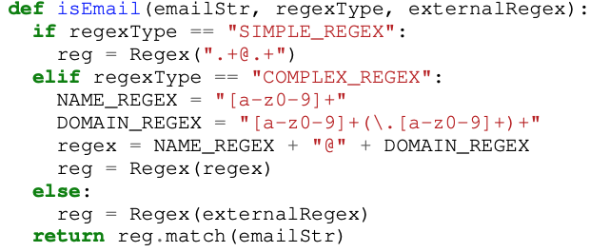
How have researchers built regex corpuses?
Programming language ←
Software ← Applications, modules
Extraction methodology ← “Static” and “Dynamic”
Notes:
Note that static extraction is fairly straightforward, while “dynamic extraction” – instrument the program or runtime, then execute the software – is more difficult to scale to many projects and multiple languages.

Slide 56
How do we know what we know about regexes?
Programming language ←
Software ← Applications, modules
Extraction methodology ← “Static” and “Dynamic”
Notes:
Note that static extraction is fairly straightforward, while “dynamic extraction” – instrument the program or runtime, then execute the software – is more difficult to scale to many projects and multiple languages.

Slide 57
Why might extraction methodology matter?
Notes:
So why might extraction methodology matter? Let’s look at an illustration:
1. Explain what this code does.
2. Static analysis vs. program instrumentation
Static analysis: Find the regex-creating callsites and identify the regexes without running the code.
Program instrumentation: Rewrite the regex-creating callsites to print the regexes while the code is running.
Some researchers have suggested that more complex regexes are more likely to be constructed from constituent parts or external sources.
These regexes are harder to handle using static extraction techniques.
So it’s possible that a static-only approach would bias the corpus towards simpler regexes, and thus not give a full representation of regex usage in practice.
----
Depending on the complexity of the static analysis, it might not be possible to extract regexes from all three of these callsites.
Depending on the program instrumentation approach, we likewise might get regexes from none or all of these callsites.
Note that static extraction is fairly straightforward, while “dynamic extraction” – instrument the program or runtime, then execute the software – is more difficult to scale to many projects, many test frameworks, and many programming languages.
-------
Callsite-only analysis provides the SIMPLE_REGEX
Intra-function analysis provides the COMPLEX_REGEX
Inter-function analysis provides the externalRegex

Slide 58
Experimental design
Programming language ←
Software ← Important open-source modules
Extraction methodology ← Let’s try both!
Research question: Does it matter which extraction methodology we follow?
Notes:
More formally, we want to know whether there is a measurable difference between regexes extracted using one methodology or the other.

Slide 59
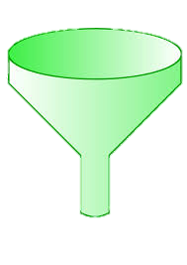
Regex collection methodology (125K regexes)
Module regex extraction
Module selection
. . .
Static analysis
Prog. Instr.
“Important”
Top 25K
Notes:
We collected regexes like this.
For each language, we identified the largest module registry.
We mapped those modules to GitHub and sorted them by the number of GitHub stars they have, which gave us a registry-independent measurement of importance.
*For each of the top 25K modules, we applied both previously-used regex extraction techniques to build sets of regexes extracted one way or the other.
*After we repeat this for 25K modules, these can BOTH rightly be said to be a JavaScript regex corpus. But is there any difference?
For this we need to characterize a regex, preferably quantitatively.
The next part of our project was collecting a set of metrics to characterize a regex across three dimensions considered in prior work.

Slide 60
Regex metrics
Representation
String length
Features used
NFA size
Language diversity – matching strings
Complexity
DFA size
Super-linear behavior (“ReDoS regexes”)
Use of advanced features

