Slide 1
Low-Power Multi-Camera Object Re-Identification using Hierarchical Neural Networks
Abhinav Goel, Caleb Tung, Xiao Hu, Haobo Wang, James C. Davis, George K. Thiruvathukal,
Yung-Hsiang Lu
Presenter:
Abhinav Goel
Ph.D. Student

Slide 2
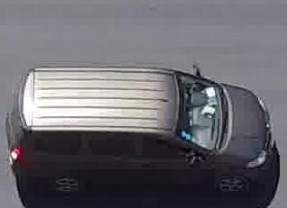
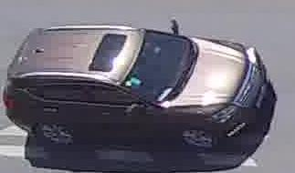
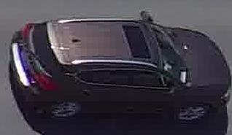
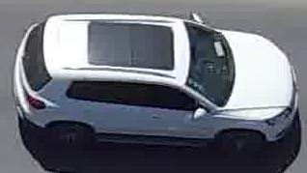
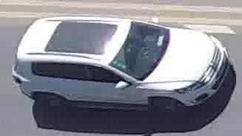
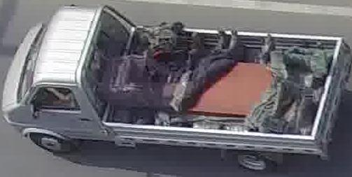
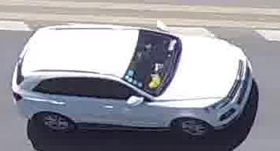
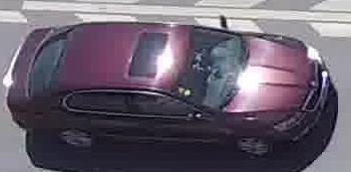
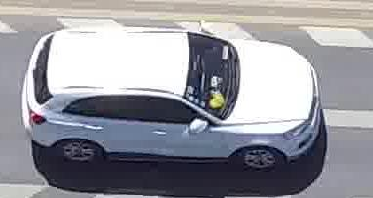
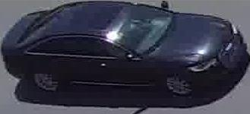
Object Re-identification
Gallery Images
Query Image
(a) (b) (c)
(d) (e) (f)
(h) (i) (j)
Notes:
Object reID is another CV task.
Given a query image that contains an object, the goal is find the gallery images that contain the same object.

Slide 3
Existing Object Re-identification Techniques
Query Feature Vector
Query Image
Large DNN
M. Ye, J. Shen, G. Lin, T. Xiang, L. Shao and S. C. H. Hoi, "Deep Learning for Person Re-identification:
A Survey and Outlook," in IEEE Transactions on Pattern Analysis and Machine Intelligence 2021

Slide 4
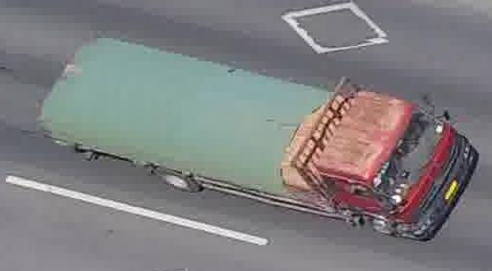
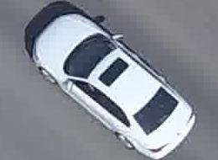
Existing Object Re-identification Techniques
Gallery Feature Vector a
Query Feature Vector
Gallery Feature Vector b
Gallery Feature Vector c
Gallery Feature Vector d
…
Gallery Feature Vector n
M. Ye, J. Shen, G. Lin, T. Xiang, L. Shao and S. C. H. Hoi, "Deep Learning for Person Re-identification:
A Survey and Outlook," in IEEE Transactions on Pattern Analysis and Machine Intelligence 2021
Notes:
Compare the FV with every single gallery feature vector to obtain a rank list of gallery images based on their distance from the query

Slide 5
Existing Object Re-identification Techniques
Gallery Feature Vector a
Gallery Feature Vector b
Query Feature Vector
Gallery Feature Vector c
Gallery Feature Vector d
…
Gallery Feature Vector n
M. Ye, J. Shen, G. Lin, T. Xiang, L. Shao and S. C. H. Hoi, "Deep Learning for Person Re-identification:
A Survey and Outlook," in IEEE Transactions on Pattern Analysis and Machine Intelligence 2021
Notes:
Compare the FV with every single gallery feature vector to obtain a rank list of gallery images based on their distance from the query

Slide 6
Existing Object Re-identification Techniques
Gallery Feature Vector a
Gallery Feature Vector b
Gallery Feature Vector c
Query Feature Vector
Gallery Feature Vector d
…
Gallery Feature Vector n
M. Ye, J. Shen, G. Lin, T. Xiang, L. Shao and S. C. H. Hoi, "Deep Learning for Person Re-identification:
A Survey and Outlook," in IEEE Transactions on Pattern Analysis and Machine Intelligence 2021
Notes:
Compare the FV with every single gallery feature vector to obtain a rank list of gallery images based on their distance from the query

Slide 7
Existing Object Re-identification Techniques
Gallery Feature Vector a
Gallery Feature Vector b
Gallery Feature Vector c
Gallery Feature Vector d
Query Feature Vector
…
Gallery Feature Vector n
M. Ye, J. Shen, G. Lin, T. Xiang, L. Shao and S. C. H. Hoi, "Deep Learning for Person Re-identification:
A Survey and Outlook," in IEEE Transactions on Pattern Analysis and Machine Intelligence 2021
Notes:
Compare the FV with every single gallery feature vector to obtain a rank list of gallery images based on their distance from the query

Slide 8
Existing Object Re-identification Techniques
Rank List
1
2
3
4
. . .
n
Gallery Feature Vector a
(c)
Gallery Feature Vector b
(b)
Gallery Feature Vector c
(d)
Gallery Feature Vector d
(a)
…
Gallery Feature Vector n
Query Feature Vector
(n)
M. Ye, J. Shen, G. Lin, T. Xiang, L. Shao and S. C. H. Hoi, "Deep Learning for Person Re-identification:
A Survey and Outlook," in IEEE Transactions on Pattern Analysis and Machine Intelligence 2021
Notes:
Compare the FV with every single gallery feature vector to obtain a rank list of gallery images based on their distance from the query

Slide 9
Efficient Object Re-identification with Attribute Labels
A white car with a sunroof
Query Image
Gallery Images
(a)
(b)
(c)
(d)
Notes:
These techniques are inefficient because they use a large DNN to reID the query object in large gallery.
If I were to manually reID this object, I will use the information that it is a white car with a sunroof. So I will only compare my query with other white cars with sunroofs.

Slide 10
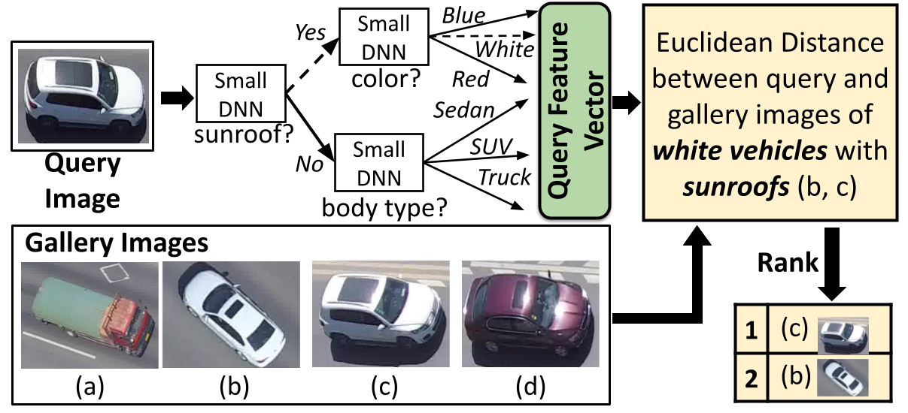
Proposed Hierarchical Object Re-Identification Technique
Goel, Tung, Hu, Wang, Davis, Thiruvathukal, and Lu., “Low-Power Multi-Camera Object Re-Identification with Hierarchical Neural Networks.” ACM/IEEE International Symposium on Low Power Electronics and Design (ISLPED ‘21).
Notes:
We use a hierarchical DNN to do this.
Each small DNN of the hierarchy identifies an attribute to reduce te gallery size and simplify the reID problem.
Thus, we can use a few small DNNs to process the query and reID the object efficiently.

Slide 11
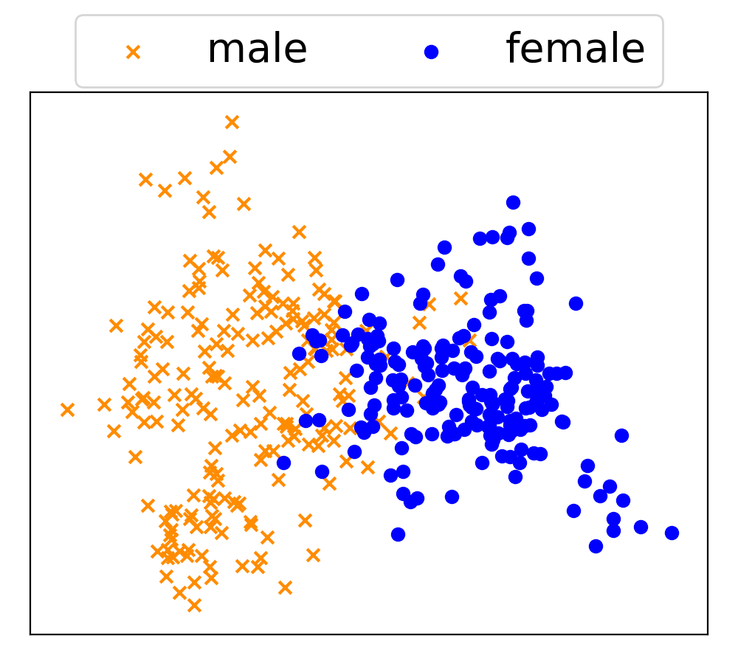
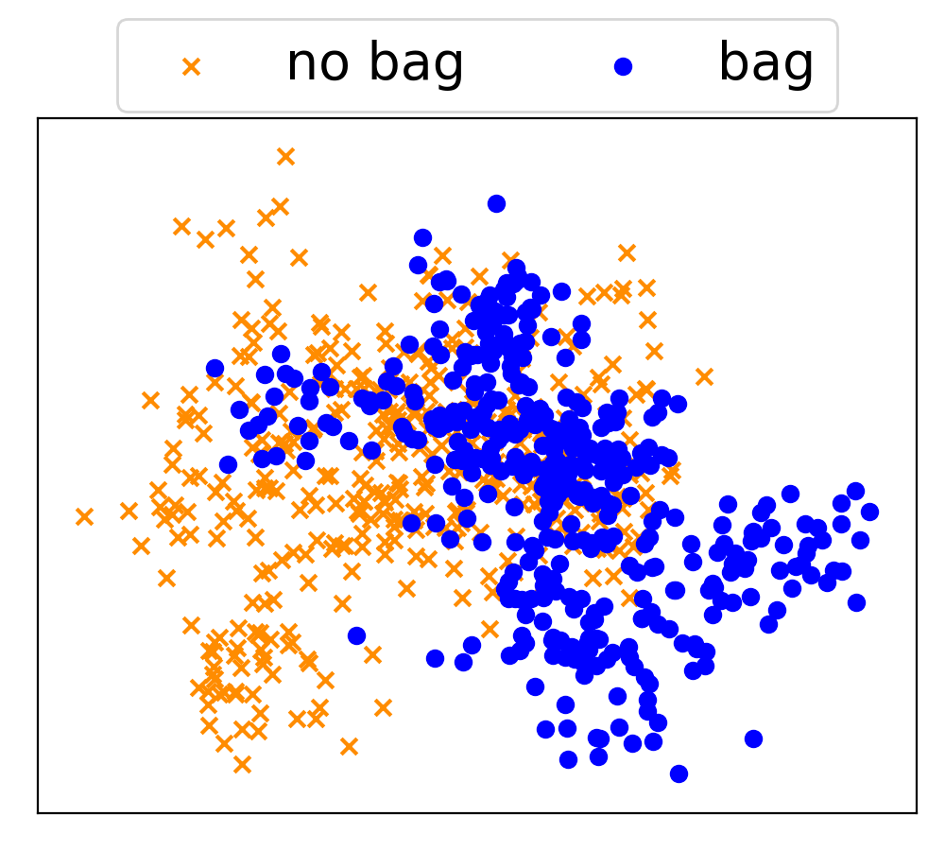
Proposed Methods for Hierarchy Construction
Quantify the difficulty of attribute identifications.
Obtain attribute correlations.
Long
hair
Back-
pack
Shoulder
bag
Long
pant
Male
Female
Male
Female
Long hair
Backpack
Shoulder bag
Long pant
1.00 | 0.00 | 0.01 | 0.30 | 0.10 | 0.44
0.00 | 1.00 | 0.75 | 0.22 | 0.13 | 0.33
0.02 | 0.98 | 1.00 | 0.23 | 0.13 | 0.31
0.00 | 1.00 | 0.83 | 1.00 | 0.14 | 0.14
0.35 | 0.65 | 0.48 | 0.00 | 1.00 | 0.64
0.65 | 0.35 | 0.26 | 0.21 | 0.09 | 1.00
Notes:
Our paper discusses two factors that need to be considered when constructing this hierarchy.
These are the difficulty of att idens and correlations.

Slide 12
Experimental Results
Dataset | Technique | Model Size (MB) | FLOPs | Rank-1 | mAP
VRAI | RAM-VGG | 528 | 15,483 M | 0.720 | 0.573
 | Multi-Task | 351 | 11,172 M | 0.803 | 0.786
 | DenseNet | 77 | 4,340 M | 0.671 | 0.700
 | Random Tree | 25 | 2,026 M | 0.631 | 0.585
 | Proposed Method | 14 | 1,082 M | 0.781 | 0.737
Market-1501 | Pyramidal | 184 | 9,757 M | 0.928 | 0.821
 | Auto ReID | 55 | 2,050 M | 0.938 | 0.834
 | DG-Net | 101 | 4,029 M | 0.896 | 0.745
 | Random Tree | 257 | 1,736 | 0.788 | 0.535
 | Proposed Method | 14 | 808 M | 0.885 | 0.699
 | Raspberry Pi 3 B+ |  | NVIDIA Jetson Nano
 | Query Time (s) | Energy (J) | Query Time (s) | Energy (J)
DenseNet | - | - | 2.55 | 18.18
DARE | 11.41 | 55.83 | 1.09 | 7.92
Random Tree | 4.39 | 19.83 | 0.77 | 5.72
Proposed Method | 2.13 | 10.33 | 0.35 | 2.70

Slide 13
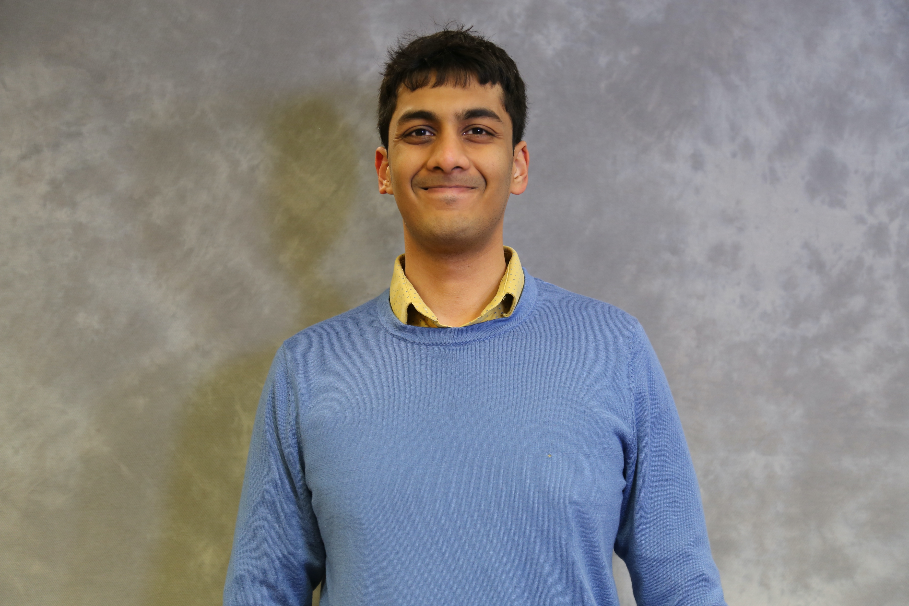
Contact
Abhinav Goel
Ph.D. Student
Purdue University
West Lafayette, IN, USA 47906
email: goel39@purdue.edu
website: abhinav-goel.com
code: https://github.com/abhinavgoel95/Object-ReID-Hierarchical-Neural-Networks

