Slide 1
Improving Developers' Understanding of Regex Denial of Service Tools through Anti-Patterns and Fix Strategies
Sk Adnan Hassan Zainab Aamir Dongyoon Lee James C. Davis Francisco Servant
skadnan@vt.edu {zaamir,dongyoon}@cs.stonybrook.edu davisjam@purdue.edu fservant@uma.es
Notes:
Thanks for the introduction.
Hello, everybody! I am glad to see all of you this morning. I am Adnan.
The work I am going to present today was done as part of my master’s thesis. So let’s start.

Slide 2
Problem
Notes:
I will begin by giving a brief description about the problem we are trying to solve.

Slide 3
Problem: Regular Expression Denial of Service (ReDoS)
Denial of Service
Backtracking based matching
Worst-case execution time
Ambiguity in regex
/^[a-zA-Z0-9]+([._]?[a-zA-Z0-9]+)*$/
Microsoft
“aaa…aaaa!”
“Normal User”
Notes:
The Regular expression Denial of Service otherwise known as ReDoS (Click) is a Denial of Service attack. It exploits that most Regular Expression engines which use a backtracking matching algorithm, may reach extreme situations that cause them to work very slowly due to ambiguity in regex.
Here’s an example of a ReDoS regex that was found in Microsoft email server.
When an attacker crafts a malicious input for this regex (click), it runs slowly on the server. Imagine doing that from thousands of places around the world at the same time. it might even take 100% of the CPU resources.
This will create a denial-of-service situation which means
Click
when a normal user comes, the user will not get any service as all the CPU resources are taken. (Click)
This is how Regular expression denial of service works.

Slide 4
Problem: Regular Expression Denial of Service (ReDoS)
Denial of Service
Backtracking based matching
Worst-case execution time
Ambiguity in regex
High-impact Outages:
/^[a-zA-Z0-9]+([._]?[a-zA-Z0-9]+)*$/
Microsoft
CloudFlare
27 mins
StackOverflow
34 mins
“aaa…aaaa!”
“Normal User”
Notes:
Some high impact outages include the outage in Stack overflow which caused a 34 mins outage and a recent one Cloudflare that caused a 34 mins outage.

Slide 5
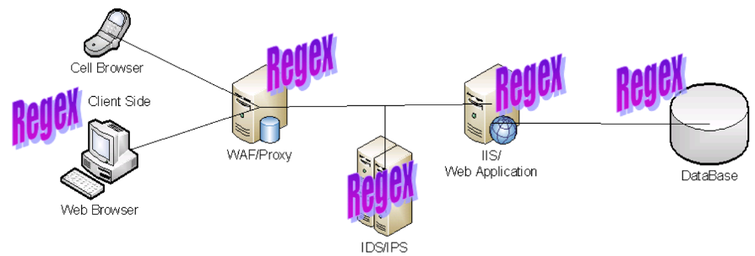
Problem: Regular Expression Denial of Service (ReDoS)
Denial of Service
Backtracking based matching
Worst-case execution time
High-impact Outages:
/^[a-zA-Z0-9]+([._]?[a-zA-Z0-9]+)*$/
Microsoft Cloudflare StackOverflow
27 mins 34 mins
“aaa…aaaa!”
Regexes can be anywhere in the Web stack
“Normal User”
Notes:
Also as the web is regex based, Regexes are used all over the stack. Therefore, ReDoS can happen at so many places.

Slide 6
Previous Work
Notes:
Next, we will see some previous works in this domain.

Slide 7
Previous Work: Detection and Fixing Techniques
Detecting vulnerable regexes
Automatically fixing vulnerable regexes
[Van Der Merwe’17, Li’20, Chida’22]
Automatic Techniques
[Weideman’17, Wusholtz’17, Shen’18, Li’ 21]
Anti-patterns [Davis’18]
Usability? [ Johnson’13 ]
Notes:
Given the severity and prevalence of ReDoS, many approaches have been proposed to address the ReDoS problem. Our work builds on those that try to detect and fix regexes. In this vein, some proposed tools to (Click) detect vulnerable regexes which includes automatic techniques and anti-patterns, some researchers also proposed to fix (Click) those vulnerable regexes.
All of these approaches have been evaluated solely via automatic experiments.
however, the literature shows that developer tools may not be adopted if they lack usability.

Slide 8
Our Contribution
Notes:
Now let’s see how we improve on the past works

Slide 9
Our Work: Anti-patterns and Fix Strategies to provide high usability to Existing Detection and Fixing Techniques
+
Fix Strategies
+
Anti-patterns
Detecting Vulnerable Regexes
Automatically Fixing Vulnerable regexes
Automatic Techniques
[Weideman’17, Wustholz’17, Shen’18, Li’ 21]
Anti-patterns [Davis’18]
[Van Der Merwe’17, Li’20, Chida’22]
Usability!
Notes:
The goal of this work is to improve the usability of existing ReDoS defenses . Our insight is that the usability of existing tools to detect and fix regexes will improve if we complement (Click) detection tools with anti-patterns that explain what part of a regex makes it vulnerable to ReDoS and complement fixing tools (Click) with fix strategies that developers used in the past, so that they can choose a fix that they will understand better. We specifically aim to improve developer understanding of the outcome of the tools

Slide 10
Our Work: Anti-patterns and Fix Strategies for ReDoS
+
Anti-patterns
+
Fix Strategies
Notes:
to be able to produce our anti-patterns and fix strategies, we first built a novel ambiguity theory (Click).

Slide 11
Our Work: Anti-patterns and Fix Strategies for ReDoS
+
Anti-patterns
+
Fix Strategies
+
Ambiguity Theory
Notes:
to precisely and completely model the regexes that are vulnerable to ReDoS

Slide 12
Our Work: Anti-patterns and Fix Strategies for ReDoS
6 anti-patterns:
Concat 1
Concat 2
Concat 3
Star 1
Star 2
Star 3
5 Fix strategies:
F1: Delimiter
F2: Reduce one
F3: Reduce all
F4: Remove repetition
F5: Replace
+
Anti-patterns
+
Fix Strategies
+
Ambiguity Theory
Concat
Star
Alternation
Notes:
The core three operations engineers use to encode regex operations are: (Click)
* Concatenation/Concat, * repetition/Star, * Alternation
By building the theory, we found only Concat and Star can lead to infinite ambiguity (Click). Therefore, (click) So, we designed our anti-patterns around the concat and star operations
Also we developed (Click) five fix strategies those can be applied to any of the anti-patterns.

Slide 13
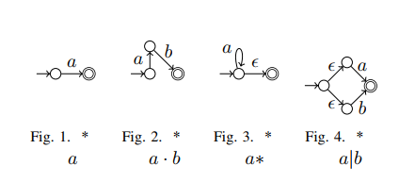
Our Work: Anti-patterns and Fix Strategies for ReDoS
6 anti-patterns:
Concat 1
Concat 2
Concat 3
Star 1
Star 2
Star 3
5 Fix strategies:
F1: Delimiter
F2: Reduce one
F3: Reduce all
F4: Remove repetition
F5: Replace
+
Anti-patterns
+
Fix Strategies
+
Ambiguity Theory
Concat
Star
Alternation
Notes:
For time constraints we will not be talking about our ambiguity theory and how we prove our theorems.

Slide 14
Anti-patterns and Fix Strategies
Notes:
Now let’s see a brief overview of our anti-patterns

Slide 15
Our Work: Anti-patterns and Fix Strategies for ReDoS
6 anti-patterns:
Concat 1
Concat 2
Concat 3
Star 1
Star 2
Star 3
5 Fix strategies:
F1: Delimiter
F2: Reduce one
F3: Reduce all
F4: Remove repetition
F5: Replace
+
Anti-patterns
+
Fix Strategies
+
Ambiguity Theory
Concat
Star
Alternation
Notes:
As you have seen before we have developed 6 anti-patterns and 5 fix strategies.
In today’s presentation we will only show one concat and one Star anti-pattern and We will show how can we fix these anti-patterns with two of our fix strategies.

Slide 16
Our Work: Anti-patterns and Fix Strategies for ReDoS
6 anti-patterns:
Concat 1
Concat 2
Concat 3
Star 1
Star 2
Star 3
5 Fix strategies:
F1: Delimiter
F2: Reduce one
F3: Reduce all
F4: Remove repetition
F5: Replace
+
Anti-patterns
+
Fix Strategies
+
Ambiguity Theory
More in Paper
Concat
Star
Alternation
Notes:
You can find more in our paper.

Slide 17
Our Work: Anti-patterns for ReDoS
Concat 1
\w*\d*
Star 1
(\w|\d)*
..P*Q*..
(P|Q|..)*
\w*
\d*
\w
\d
[0-9a-zA-z_]*
[0-9]*
[0-9a-zA-z_]
[0-9]
[0-9]
[0-9]
Both can Match
Both can Match
Malicious Input: 66666….!
Notes:
Now let’s see two of anti-patterns. We will start with Concat 1 (Click)
It states that “If a regex has a sub-regex (Click) P*Q* and The two quantified parts P* and Q* can match some shared string then Regex will be vulnerable to ReDoS”
If P here is (Click) \w* and Q here is (Click)\d*. The resulting regex would be (click) — now \w means it can match any alphaneumeric characters and \d means it can match any digits
now, Both of these quantified part can match [0- 9] (Click).
If we have a malicious input like this one which is thousands of 6 and something that is not 6. For each of these 6 we can use either \w or \d as the regex engine has options to use either of them. Incase of the mismatch it tries all the options to match.
That’s how the regex matching overloads the CPU causing denial of service.
Now let’s see another anti-pattern Which is called Star 1
If we have a regex with a star and inside star element there are bunch of alternations and there is an intersection between any two alternates, which means both match some shared strings S (Click)
Like we saw previously if P here is \w (click) and Q here is \d. The resulting regex would like this (Click). And we already know what this character classes can match (click)
And both of these can match digits (Click)
Now for the same input we have seen before, For each of these 6 we can use either \w or \d as the regex engine has options to use either of them. Incase of the mismatch it tries all the options to match.
That’s how the regex matching overloads the CPU causing denial of service.

Slide 18
Our Work: Fix Strategies for ReDoS
Concat 1 Star 1
…P*Q*…
(P|Q|..)*
Original Vulnerable regex
\w*\d* (\w|\d)*
[a-zA-Z_]*\d* ([a-zA-Z_]|\d)*
\w{,15}\d{,10} (\w|\d){,10}
Notes:
Now let’s see how we can fix those anti-patterns we just saw.
If you remember the previous slide, we saw two anti-patterns (click), concat 1 and star 1 (Click)
And these are the vulnerable regexes we saw for those anti-patterns (Click)
Our first fix is ….. (click)
And these is how we will fix those anti-pattens… (Click)
Our second fix is … (click)
And these is how we will fix those anti-pattens… (Click)

Slide 19
Evaluation 1: Effectiveness of Anti-Patterns
Evaluation 2: Usability of Anti-Patterns and Fix Strategies
Notes:
So, we evaluated our anti-patterns and fix strategies in multiple ways. I will present two experiments, but there are more in the paper. Evaluation 1 studies whether our anti-patterns accurately identify vulnerable regexes, and Evaluation 2 studies whether our anti-patterns and fix strategies help developers better understand the outcome of detection and fix tools

Slide 20
Evaluation 1: Effectiveness of Anti-Patterns
Evaluation 2: Usability of Anti-Patterns and Fix Strategies
Notes:
Let’s see the first evaluation

Slide 21
Evaluation 1: Effectiveness. Research Method.
Davis‘18
SOA
209k
Regexes
[Davis’19]
Dataset
Techniques
Our
Anti-patterns
Precision
Weideman’17
Ground
Truth
Metrics
Recall
Notes:
For Dataset (Click), we use a dataset of 209k regexes (Click)
We collected the ground truth (Click) of whether a regex is vulnerable or not using Weideman's automatic tool (Click). With this, we study whether our anti-patterns are as accurate as automatic tools at identifying vulnerable regexes.
In this experiment, we compare our anti-patterns to the state of the art anti-patterns by Davis et al. Although anti-patterns are expected to be used manually by humans, we applied each set of anti-patterns automatically using scripts, to be able to study a large number of regexes
(Click) We measure precision and recall of both the techniques.

Slide 22
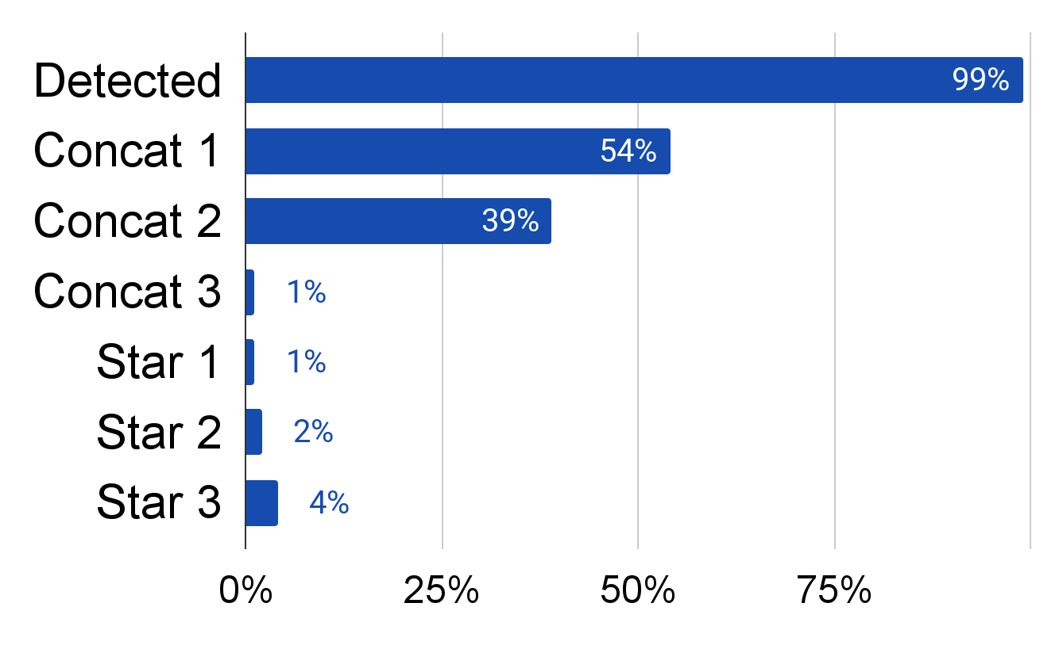
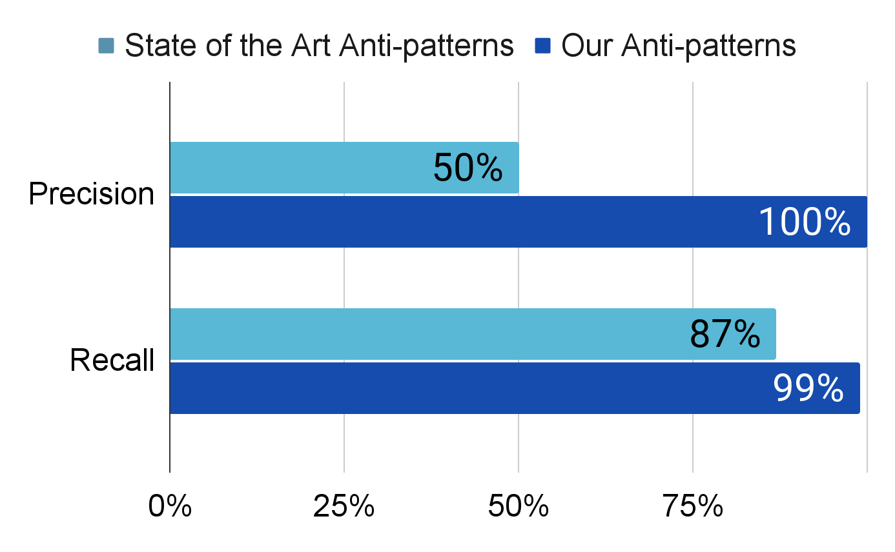
Evaluation 1: Effectiveness. Results.
Our Anti-patterns were almost as effective as existing detection tools
Our Anti-patterns provided higher precision and recall than the SOA anti-patterns
Notes:
and this is what we found!
…….Stop here….
we report the results for our studied anti-pattern families. It shows that our proposed IA anti-patterns provided a substantial improvement in both precision (100% compared to 50%) and recall (99% compared to 87%) when compared to the SOP anti-patterns. After taking a closer look, we found that the main reason why our IA anti-patterns provided much higher precision than the SOP anti-patterns is that we reduced the number of false positives. Similarly, the main reason why the IA anti-patterns provided higher recall is that we reduced the number of false negatives for IA regexes, e.g., for regexes like (a|b)*(ab)* and (a|b|ab)*, where the SOP anti-patterns would not find any overlap between (ab) and (ab) and would not label them as IA. In contrast, our concat 1 and star 2 anti-patterns, respectively, would label both as IA

Slide 23
Evaluation 1: Effectiveness. Results.
Our Anti-patterns were almost as effective as existing detection tools
Our Anti-patterns provided higher precision and recall than the SOA anti-patterns
Notes:
our anti-patterns as a group are almost effective as the automatic detection tools as they detected 99% of all the vulnerable regexes detected by the automatic tool.
…….Stop here….
we report the results for our studied anti-pattern families. It shows that our proposed IA anti-patterns provided a substantial improvement in both precision (100% compared to 50%) and recall (99% compared to 87%) when compared to the SOP anti-patterns. After taking a closer look, we found that the main reason why our IA anti-patterns provided much higher precision than the SOP anti-patterns is that we reduced the number of false positives. Similarly, the main reason why the IA anti-patterns provided higher recall is that we reduced the number of false negatives for IA regexes, e.g., for regexes like (a|b)*(ab)* and (a|b|ab)*, where the SOP anti-patterns would not find any overlap between (ab) and (ab) and would not label them as IA. In contrast, our concat 1 and star 2 anti-patterns, respectively, would label both as IA

Slide 24
Evaluation 1: Effectiveness. Results.
Our Anti-patterns were almost as effective as existing detection tools
Our Anti-patterns provided higher precision and recall than the SOA anti-patterns
Notes:
Also, our anti-patterns as a group provided very high precision (100% altogether) and very high recall compared to State of the art anti-patterns. …….Stop here….
we report the results for our studied anti-pattern families. It shows that our proposed IA anti-patterns provided a substantial improvement in both precision (100% compared to 50%) and recall (99% compared to 87%) when compared to the SOP anti-patterns. After taking a closer look, we found that the main reason why our IA anti-patterns provided much higher precision than the SOP anti-patterns is that we reduced the number of false positives. Similarly, the main reason why the IA anti-patterns provided higher recall is that we reduced the number of false negatives for IA regexes, e.g., for regexes like (a|b)*(ab)* and (a|b|ab)*, where the SOP anti-patterns would not find any overlap between (ab) and (ab) and would not label them as IA. In contrast, our concat 1 and star 2 anti-patterns, respectively, would label both as IA

Slide 25
Evaluation 1: Effectiveness of Anti-Patterns
Evaluation 2: Usability of Anti-Patterns and Fix Strategies
Notes:
Now let’s see how we performed our usability study

Slide 26
Evaluation 2: Usability. Research Method.
Tasks
9 Developers
Detection
Tool
+
Anti-patterns
Subjects
vs
+
Fix Strategies
vs
Fix
Tool
Treatments
Understanding
Metrics
Notes:
For this experiment: (Click) We asked 9 open source software developers (Click) to perform real world ReDoS detection and fixing. They performed tasks over their own regexes from open-source projects that they have contributed.
We had two type of tasks (click) Detection and Fixing (Click)
For Treatments (Click),
They first used only an automatic tool, and then (Click) the tools combined (Click) with our anti-patterns for detection and our fix strategies (for fixing)
We measured(click) the success of our anti-patterns or fix strategies as the increase in (Click) understanding that our subjects reported after applying them.

Slide 27
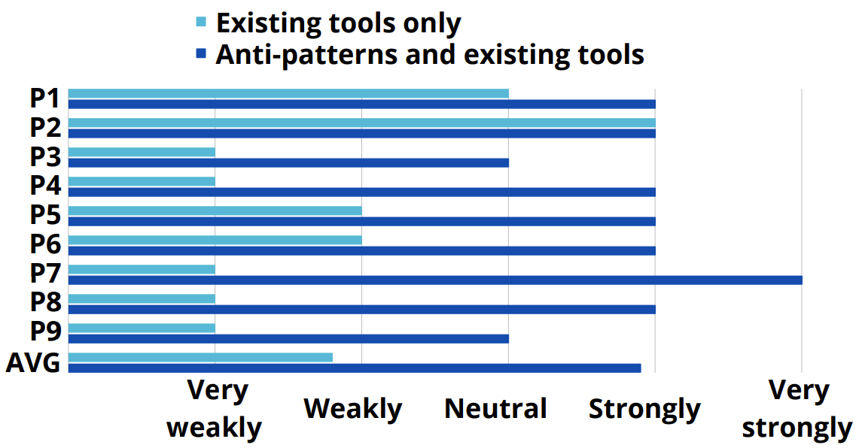
Evaluation 2: Usability. Results.
Our Anti-patterns increased developer understanding of the detection tools from very weakly to strongly
Notes:
For detection, we asked them how strongly they understood what makes the regex vulnerable, using a Likert scale of: “Very strongly”, “Strongly”, “Neutral”, “Weakly”, and “Very weakly” understanding, and “N. Subjects using existing tools only reported (Click) median “very weekly ” understanding and When they use our anti-patterns in addition to the existing tools the self-reported understanding improved to median “Strongly” understanding.

Slide 28
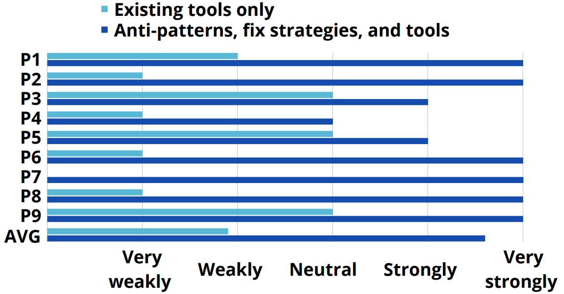
Evaluation 2: Usability. Results.
Our Anti-patterns increased developer understanding of the fixing tools from very weakly to very strongly
Notes:
For fixing, we asked them how strongly they understood what makes the resulting fixed regex not vulnerable, using the same scale
Subjects reported median “Very weakly” understanding using existing tools . On the other hand when they used our anti-patterns and fix strategies to complement existing tools the reported median understanding improved to “Very strongly”.
In summary, Subjects using our IA antipatterns and fix strategies to complement existing tools reported much higher understanding when fixing.

Slide 29
Supplementary Materials: https://shorturl.at/aCFIV
Notes:
We first saw REDOS is a serious problem.
For solving the issue, We provide a novel approach to improve the usability of existing detection and fixing tools
Our contribution has the form of an ambiguity theory, anti-patterns to detect and patterns to fix vulnerable regexes with high understandability
In our evaluation we show that Our anti-patterns have very high precision and recall.
Also we show that Our anti-patterns and fix strategies provide much higher understandability when detecting or fixing vulnerable regexes
With that I would like to conclude my presentation and I can take questions now.

Slide 30
Bonus Slides

Slide 31
The Risk Factor with ReDoS
Cloudfare outage
SO outage ^.*\s+
Image: owasp.org
Notes:
In every layer of the WEB there are Regular Expressions, that might be a ReDoS Regex. An attacker can hang a WEB-browser (on a computer or potentially also on a mobile device), hang a Web Application Firewall (WAF), attack a database, and even stack a vulnerable WEB server.
For example, if a programmer uses a Regex to validate the client side of a system, and the Regex contains an Evil Regex, the attacker can assume the same vulnerable Regex is used in the server side, and send a well-crafted input, that stacks the WEB server.
There are some real-world examples of ReDoS.
There was one on Stack overflow in 2016 which caused a 34-minute outage.
Cloudfare: For about 30 minutes on July 02, 2019. Unfortunately, one of these rules contained a regular expression that caused CPU to spike to 100% on their machines worldwide
Therefore, vulnerable regexes can mess up anywhere in the stack

Slide 32
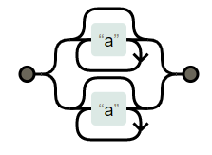
Theorem1: Ambiguity of OR
For the example:
a*|a*, for input ‘a’
R1= a*
R2 = a*
Both are unambiguous
Path 1
Path 2
Figure: NFA of a*|a*
Always two paths, can not be infinitely ambiguous, only can be finitely ambiguous
Notes:
So, the theorem is:
Click
State the theorem:
Now let’s see how this theorem can proved by showing an example
Click
R1
Click
R2
Now let’s see how they run in the NFA
For the input a,
You can either take the first path (Click)
Or the second path (Click)
Thus, the number of paths are always limited there with alternation we can only get finite ambiguity when there is an intersection.

Slide 33
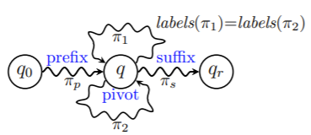
Theorem 2: Ambiguity of Concat (Key Observations)
Key Observation 1: Concat ambiguity can be both finite and infinite.
Supporting example (finite): (a|ab)(bc|c) for ‘abc’ there can be 2 accepting paths
Supporting example (infinite): a*a* , for input ‘aaaa……’ there can be polynimally infinite paths.
Key Observation 2: Concatenation of two unambiguous regexes can only lead to IDA.
Can not generate R1*R2* from EDA
R1* R2*
Notes:
Before stating the next theorem, we start by showing two key observations
The first one is : (click) state KO 1 from slide
Explain the examples from the slide.
The second key observation is : (click) state KO2 from slide
Now infinite ambiguity in the NFA can be of two types EDA or IDA.
In EDA there are two loops for the same transition in the same loop.
So, regexes like R1*R2* can not be EDA.
But it be IDA as we can get the two loops from it.

Slide 34
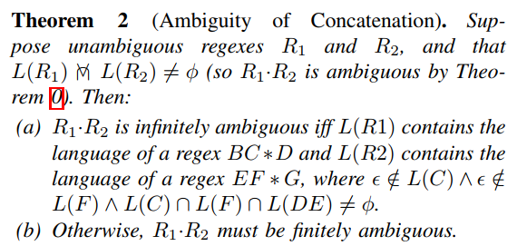
Theorem 2: Ambiguity of Concat (Proof Insight)
C*
F*
B
DE
G
Notes:
Now let’s take a look at the theorem: state the theorem from slide start by saying R1 and R2
Then map all bc*def*g in the IDA.
Also show the condition for labels equalling.

Slide 35
Theorem 3: Ambiguity of star (Proof insight)
Simple ReDoS regex /^(a+)+$/
NFA
Malicious input “aaaaaaaaaa…aa!”
Recurrence relation
T(n) = 2*T(n-1)
= 2*(2*T(n-2))
= O(2^{n})
Mismatch
Exponential paths
Notes:
Theorem 3 says given unambiguous R, R* is infinitely ambiguous if there is an overlap between language of R and R*.
We can show the proof insight by showing the same example we did previously. For each a there will 2 possible paths which will increase exponentially depending the length of the input.

Slide 36
Thm 4: Finite to Infinite ambiguity
We have learnt that finite ambiguity can appear in two ways:
OR: \w|\d – both can match [0-9]
Concat: (ab|a)(bc|c) – ‘abc’ can be created in two ways
It can be proven if you just cover the finitely ambiguous part with a quantifier(* or +) it can lead to infinite ambiguity
OR: (\w|\d)*
Concat: ((ab|a)(bc|c))*
Both of the regexes are exponentially ambiguous
Notes:
Read from the slide.

Slide 37
SL vs IA
SL vs. IA Regexes: Infinite ambiguity is a necessary but insufficient condition for super-linear behavior.
For example, the regex (a*)*.* is IA but not SL.
Its final sub-regex .* accepts any string, so no mismatch-triggering suffix exists.

Slide 38
Experiment 2: Setup
20 Participants
5 Regex Composition Tasks for both set of anti-patterns
*Novice: Knows what repetition operators like * and + do
*Intermediate: have used more sophisticated features like non-greedy quantifiers /a+?/ and character classes / \d | \w | [abc] | [^\d]/
Notes:
We evaluated whether our anti-patterns help developers when used in practice to compose regexes — if developers can understand them and apply them in practice. (Click) For that goal, we recruited 20 software developers and (click) asked them to perform 5 regex composition tasks. (Click). We asked them to use our anti-patterns to avoid introducing IA regexes in those tasks. As baseline, we also asked them to perform the same tasks using the same state-of-the-practice (SOP) anti-patterns that we studied in Experiment 1. We measured how many developers correctly assessed whether their composed regex was IA, for each family of anti-patterns and task

Slide 39
Experiment 2: Results
Our anti-patterns allowed 100% of the participants to correctly identify whether their composed regex was Infinitely ambiguous or not
Notes:
Task 1 was an easy task, as warm-up, to get participants familiar with the structure of the experiment. We designed the remaining 4 tasks to evaluate 4 specific scenarios. Tasks 2, 3, and 4 targeted limitations that we identified in each of the three SOP anti-patterns, to learn if our IA anti-patterns are more effective in those scenarios. Task 5 targets a scenario in which the SOP anti-patterns are not limited, to learn if our IA anti-patterns are not worse in such scenario. We expected both sets of anti-patterns to perform equally in tasks 1 and 5, and our IA anti-patterns to be more effective in tasks 2, 3, and 4.
Our proposed IA anti-patterns allowed 100% of participants to correctly identify whether their composed regex was IA, for all tasks, and for all orderings. This is not surprising given that they are derived from our theory .

Slide 40
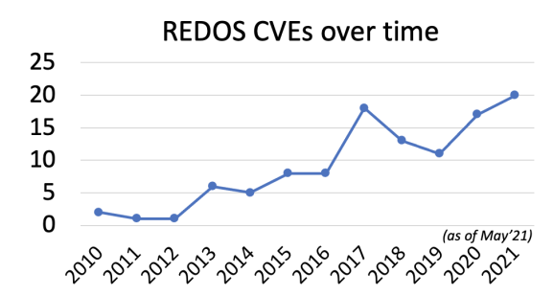

Slide 41
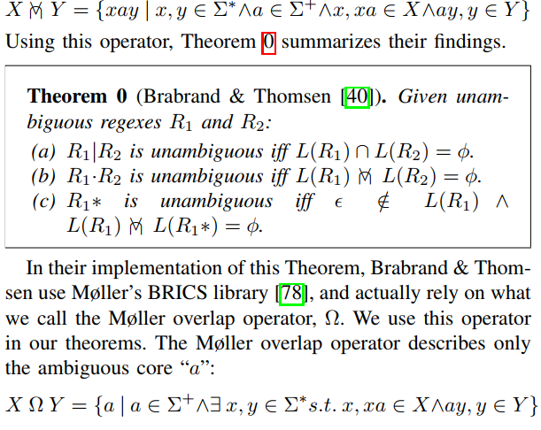
Theorem 0

Slide 42
Experiment 2 (Simple Regexes)
The draft solutions that we anticipated for our tasks (and that our participants composed) had similar complexity to typical real-world regexes.
For example, drafts had length 6-11 (median regex length in Java: 15) and used 2-3 operators (Java: median 3).

