Slide 1
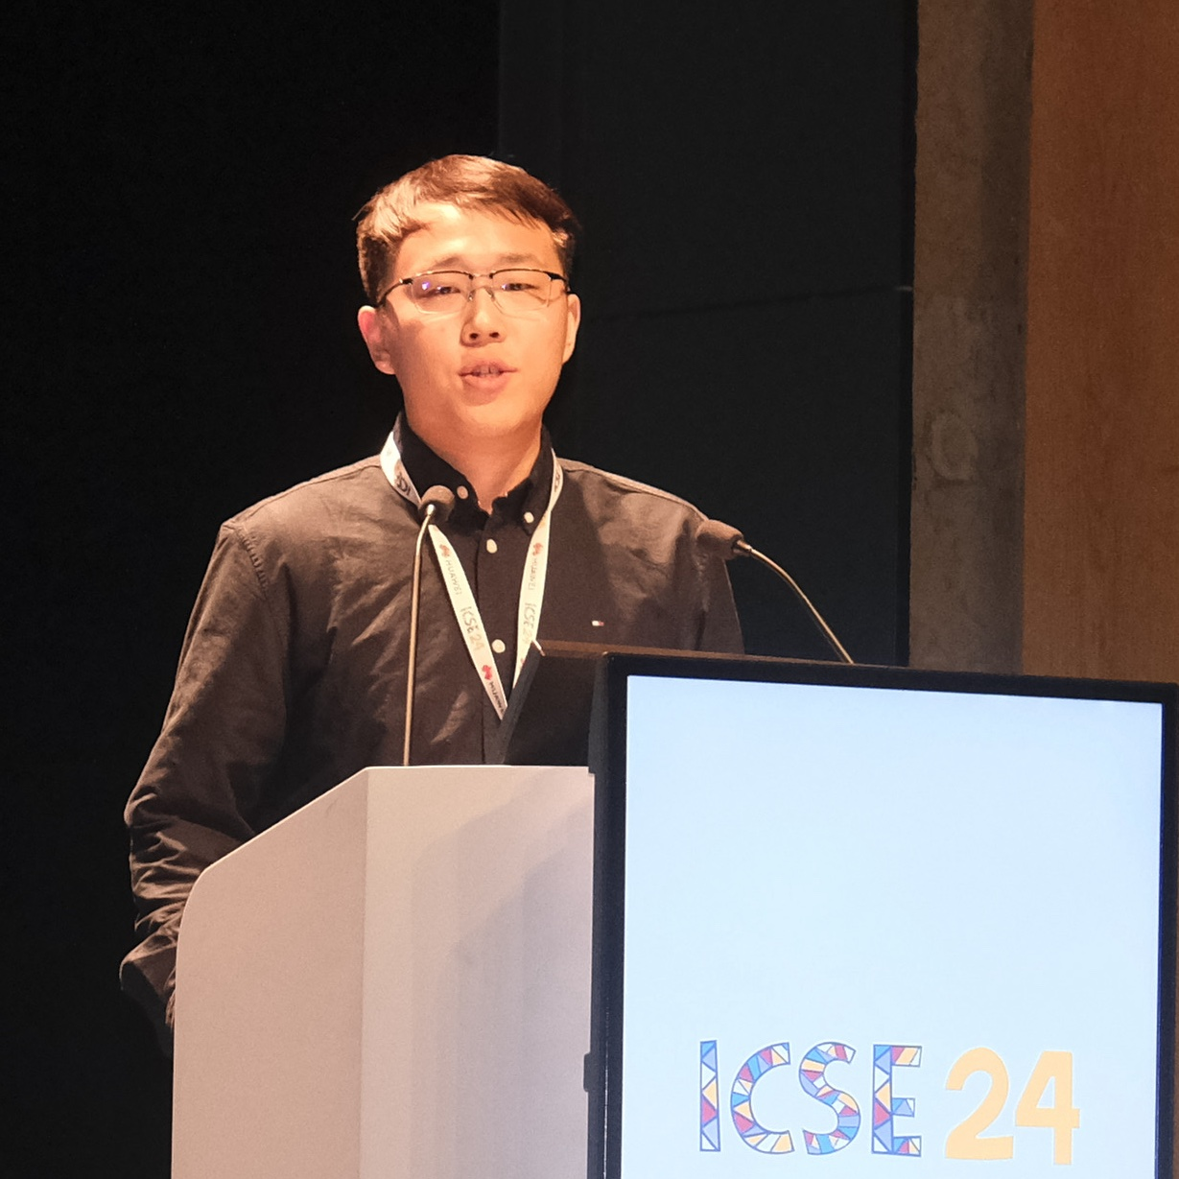
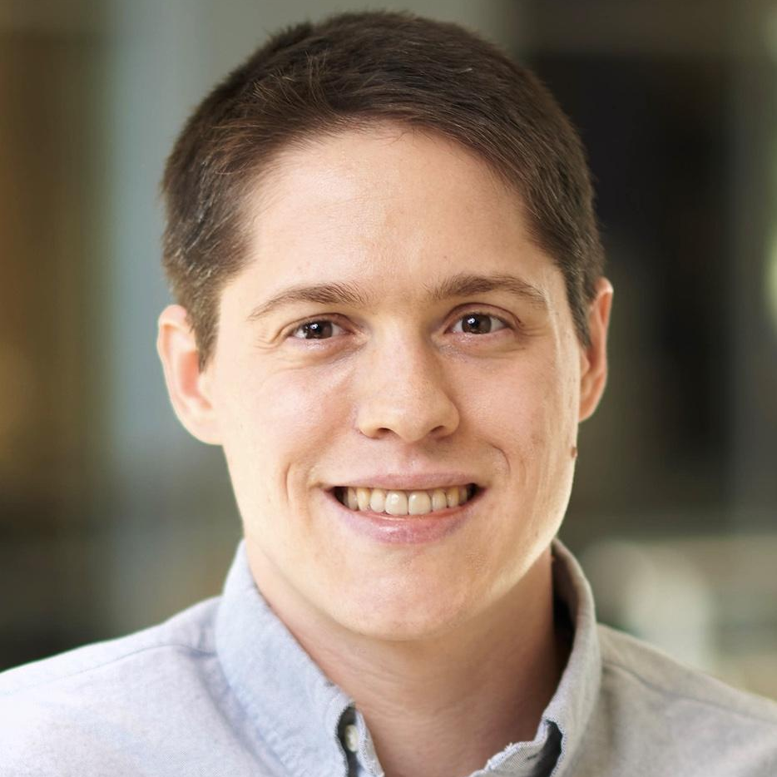
Challenges and Practices of Deep Learning Model Reengineering: A Case Study on Computer Vision
Vishnu Banna Naveen Vivek Abhinav Goel
Nicholas Synovic George K. Thiruvathukal James C. Davis
Wenxin Jiang
*Published at
Empirical Software Engineering (EMSE)
Notes:
Hi, I am Wenxin Jiang from Purdue University, where I am completing my PhD with Dr. James Davis.
I am glad here to present our work titled “Challenges and Practices of DL Model Reengineering: A Case Study on Computer Vision”
Our work is in collaboration with Loyola University Chicago. We thank Cisco, Google, and the US NSF for their support.
(Click)

Slide 2
Contributions
First study with a “process” view of DL reengineering
Understand reengineering defect characteristics & strategies
Failure analysis of 348 defects from 27 GitHub repos.
6 practitioner interviews
Two-year reengineering effort partnered with Google
Future directions for Automated SE research.
Notes:
After Item 2:
We synthesized results as a reengineering process workflow

Slide 3
Background and Motivation

Slide 4
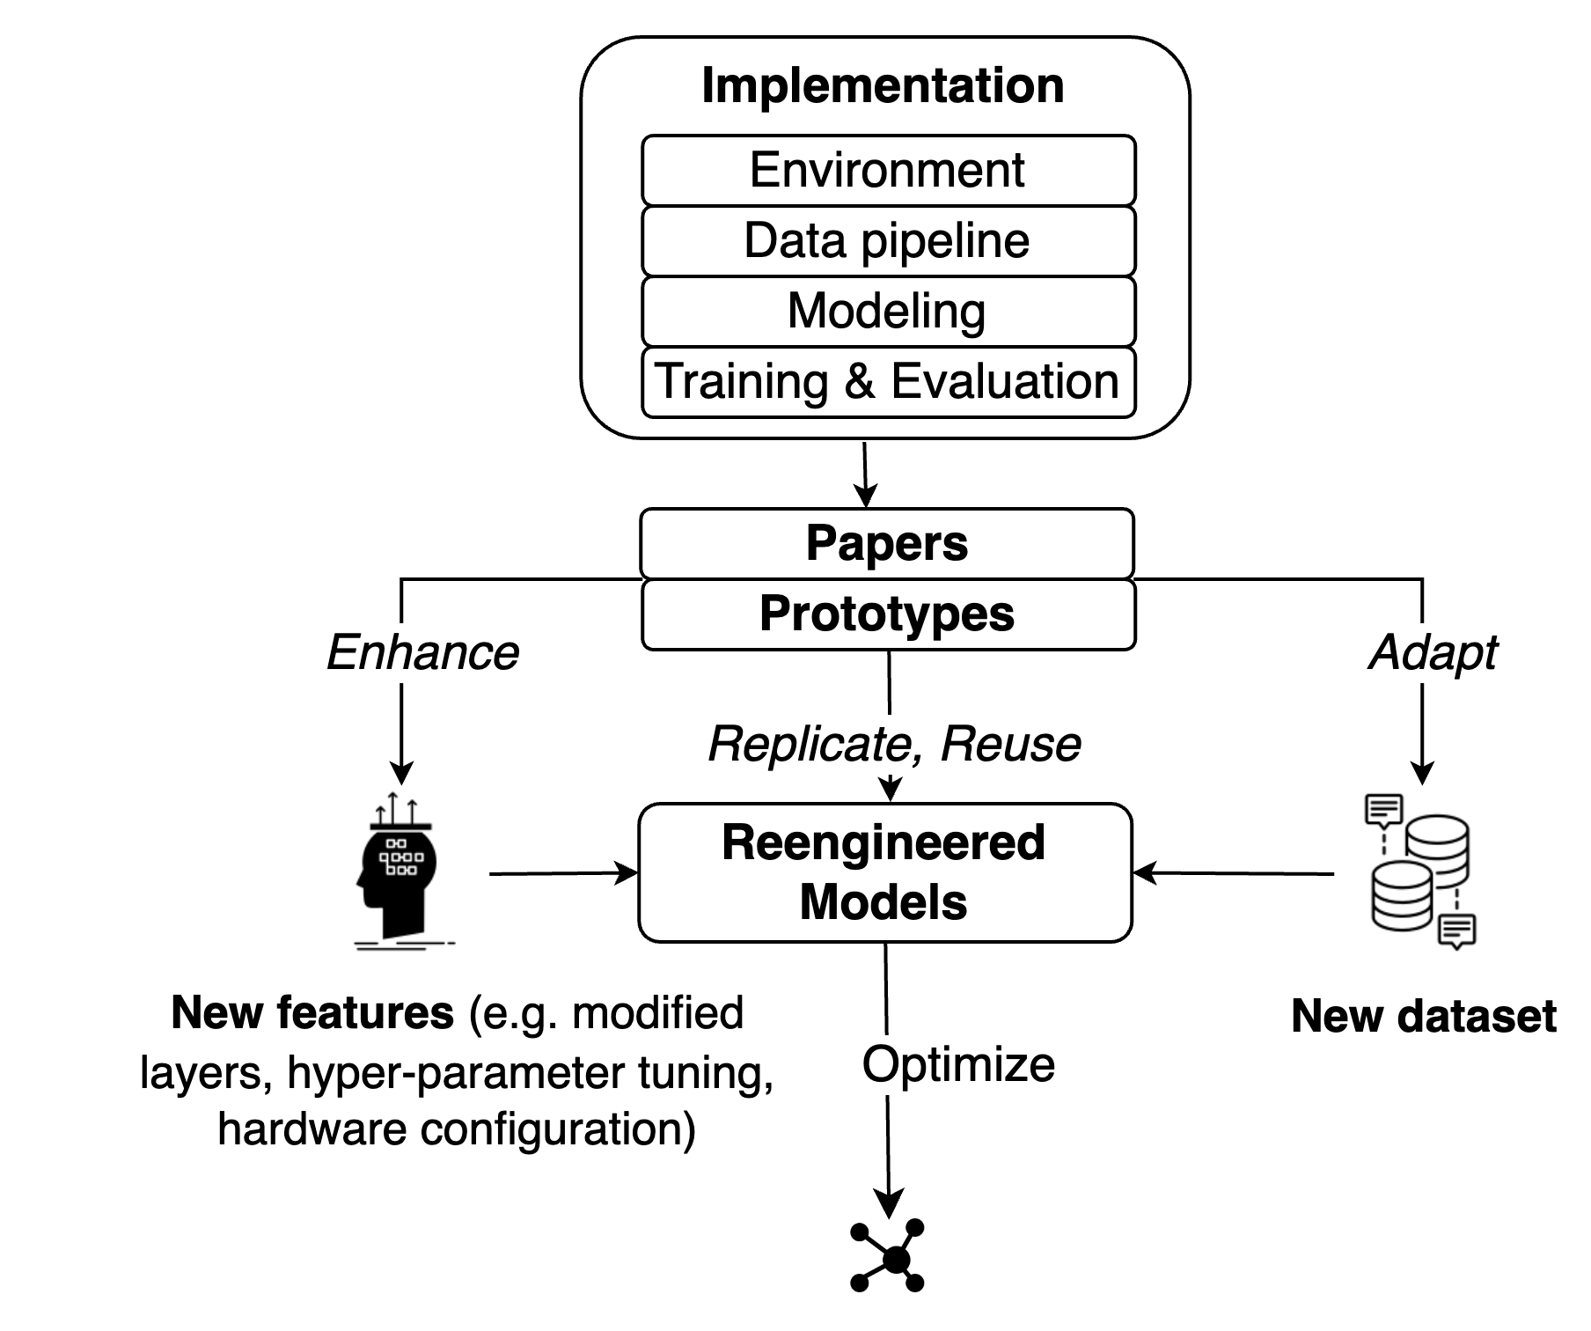
DL Model Engineering Life Cycle
Model engineering
(focus of prior work)
“Product” view
Model reengineering
(focus of our study)
“Process” view
“Beyond-the-product” interpretation of failures
→ better understanding how defects arise
Notes:
Prior work (blue box) may have accidentally captured reengineering activities, but it did not describe reengineering activities as a distinct activity and was generally from “product” view. We specifically focus on model reengineering activities and “process” view (red box).
Prior work conducted a literature review of existing failure studies and revealed a gap in the understanding of the causal chain of defects. This gap suggests the need for failure analysis approaches that go beyond simply analyzing the product itself. A “beyond-the-product” interpretation of failures is needed to gain a more detailed understanding of how defects arise.
To this end, a “process” view encapsulates the practices, activities, and procedures undertaken in the course of software development (Pressman 2005). It illuminates the steps followed, strategies employed, and challenges encountered during the process of creating software.
While the “product” view focuses on the resulting defects in a DL system, the “process” view would allow us to understand the steps that led to those defects (Leveson 2016, 1995) and the practices that contributed to their resolution.

Slide 5
Definition of DL Reengineering (4 kinds)
Reuse: same code + same dataset
Replicate: same algorithm, data, configuration, in distinct implementation
Adapt: different dataset
Enhance: add new feature
Notes:
We define DL model reengineering process as: engineering activities for reusing, replicating, adapting, or enhancing an existing DL model.
Re-user Uses same code and same dataset.
Adaptor Adapts code to other tasks (different dataset) and finds inconsistency compared to expectations.
Enhancer Adds new features (e.g.,layer modification, hyper-parameter tuning, multi-GPU training configuration).
Replicator Uses same algorithm, data, and configuration, in distinct implementation (e.g.,TensorFlow vs. PyTorch)

Slide 6
Why DL Reengineering?
Common practice but challenging!
Under-documented reference models
Changing requirements (SW, HW)
High cost of implementation and testing
Different specializations (e.g., software engineering, data science)
Liu et al. [FSE’20], Pham et al. [ASE’20], Pineau et al. [NeurIPS’21]
https://ai.meta.com/blog/how-the-ai-community-can-get-serious-about-reproducibility/
https://www.amazon.science/publications/on-challenges-in-machine-learning-model-management
Notes:
Though DL develop fast recently. Much attention has been paid to its technical potential [ 22 ], but relatively little attention has been paid to associated software engineering activities [12 ].
After researchers demonstrate the potential of a DL approach in solving a problem, engineering organizations may incorporate the model into their products. Practitioners often encounter problems in the process of reengineering DL models [35 , 75 ]. This task is challenging for reasons including under-documented reference models, changing requirements in both SW and HW, and the high cost of model training and evaluation [ 30 ]. In addition, personnels may have different specializations (e.g., software engineering, data science), and teams must collaborate to succeed.

Slide 7
Research Questions & Methods

Slide 8
Research questions
Theme 1: Quantitative - Understanding defect characteristics
RQ1: Common defect manifestation?
RQ2: Frequent general programming defects?
RQ3: Common symptoms?
RQ4: Common DL-specific defects?
Theme 2: Qualitative - Underlying challenges and practices
RQ5: Practices and challenges?
Notes:
The RQs are all for Reengineering defects and activities

Slide 9
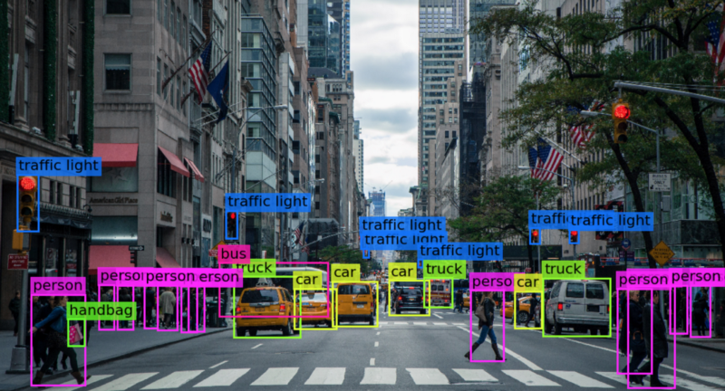
A Case Study on Computer Vision
Why Computer Vision?
Major application of DL
Techniques are shared between computer vision and other applications of deep learning
The engineering process is consistent across different domains
Generalizable?
Notes:
the process is still similar so majority of our findings are still generalizable but we expect some nuance in LLM reengineering because of the reuse methods (prompt engineering and few shot learning) are different

Slide 10
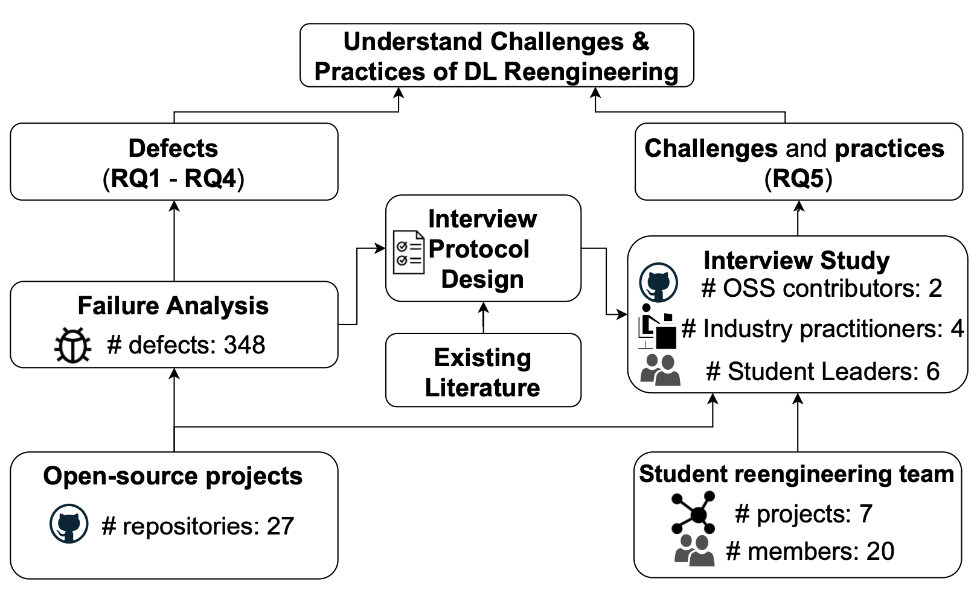
Methodology - Overview
Notes:
CV OS projects
CV reengineering team and open-source practitioners
Overview: This is the relationship between our questions and methods.
We used a mixed-method approach that combine two perspectives
We first explore qualitative insights by interviewing practitioners
Then we substantiate our findings with interview studies

Slide 11
Theme 1 - Quantitative
Understanding defect characteristics
Notes:
This is a 60-page journal article so I will briefly talk about the methods and results.
I have a lot of details if you want to ask me questions later

Slide 12
Relationship between Reengineering Repositories
Research
prototypes
1.2K forks
Replications
User “forks”
1.6K forks
4.1K forks
Notes:
Research Prototype: an original implementation of a model.
Major Replication: a replication (and possible evolution) of the research prototype, with ≥ 1K GitHub stars.
User “fork”: a fork or clone where users try to reuse or extend a model from the previous two types.
We also consider the kind of reporters, and we distinguished between re-user, adaptor, enhancer and replicator.
The definition of reporter types are similar to our definition of “DL Reengineering”.
Re-user: Uses same code and same dataset.
Adaptor: Adapts code to other tasks (different dataset) and finds inconsistency compared to expectations.
Enhancer: Adds new features (e.g., layer modification, hyper-parameter tuning, multi-GPU training configuration).
Replicator: Uses same algorithm, data, and configuration, in distinct implementation (e.g., TensorFlow vs. PyTorch).

Slide 13
Methodology - Quantitative Study (RQ1-RQ4)
Repository Selection
+
19 Solo Repositories 8 Zoo Repositories
Issue Selection
334 issues → 348 defects
Reengineering Issue Examples:
Non-reengineering Issue Examples:
Non-defect Issue Examples:
Issue Analysis
Notes:
Repository Selection
19 Solo Repositories:
Either the research prototype from the authors or an independent replication.
Source: Modelzoo.co
2-5 projects of the same model in GitHub.
8 Zoo Repositories:
A collection of models and can contain both prototypes and replications.
E.g., tensorflow/models, torch/vision, facebook/detectron
# Stars: 1.8K–71.8K
# forks: 300+
# Closed issues: 53 – 5560
Issue selection:
Issue status is closed with an associated fix
Issue has ≥10 comments
We distinguished the reengineering-related issues per our definition.
Issue analysis:
Adapt prior taxonomies to categorize the issues
Multi-reader checks

Slide 14
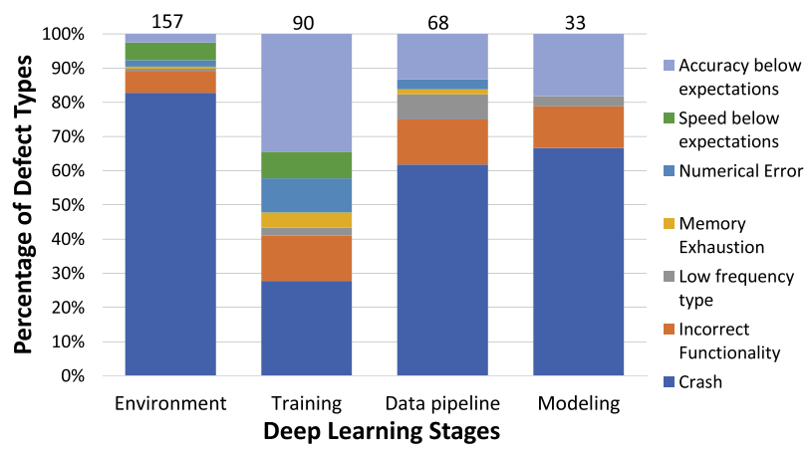
Results – Symptoms: most defects in training didn’t result in crashes
Notes:
Across the environment, data pipeline, and modeling stages, the most frequent symptom is crash (62-83%). Training appears to be the most challenging stage, where Accuracy below expectations accounts for the largest proportion (34%) of defects.
§85% defects result in crashes in three stages.
§71% of defects in the training stage do not result in crashes (34% affect accuracy).

Slide 15
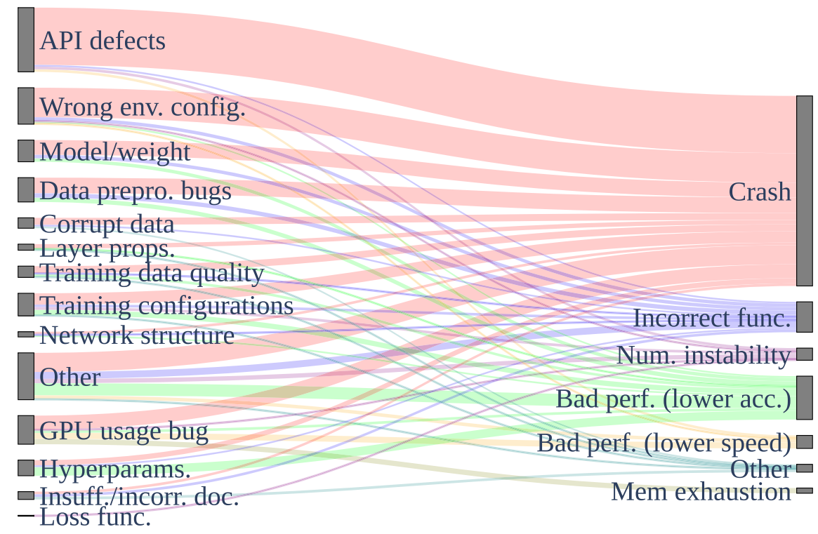
Results – DL-Specific Defects: distinct root causes for the observed symptoms
DL-specific defect types
Symptoms
Notes:
Sankey Diagram showing the relationship between DL-specific reengineering defect types (left side) and symptoms (right side). DL reengineering defects are hard to diagnose because of the many distinct root causes for most of the observed symptoms

Slide 16
Theme 2 - Qualitative
Underlying challenges and practices

Slide 17
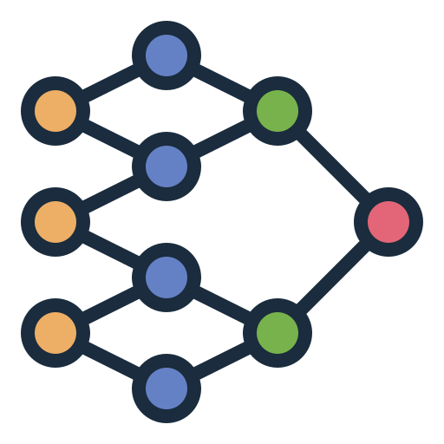
Method of Theme 2 - Qualitative Study (RQ5)
7 Internal interview subjects — Student Reengineering Team (2-year effort)
✖️
7,643 LOC
$105K total
$15K/model
“An Experience Report on Machine Learning Reproducibility: Guidance for Practitioners and TensorFlow Model Garden Contributors”
“A Partial Replication of MaskFormer in TensorFlow on TPUs for the TensorFlow Model Garden”
7 models
Notes:
We wanted a rich experience, and recognized that finding external interview subjects would be challenging because of the specificity of the phenomenon being analyzed”
in some sense this part of the work is auto-ethnographic
Purdue’s Computer Vision Reengineering Team
The goal of this team is to provide high-quality implementations of state-of-the-art DL models, porting these models from research prototypes (implemented in the PyTorch framework) to Google’s TensorFlow framework.
Their work was supervised and approved by Google engineers over weekly sync-ups.
The team’s industry sponsor (Google) uses the team’s replication of 7 models in production in their ML applications, and has published them open-source in one of the most popular zoo repository we studied in §5.1, the TensorFlow Model Garden
*Our study also collect the notes from weekly team meetings as one of our data source.
Inspired by the method of measuring software experiences in the software engineering laboratory
*Most team members are third- and fourth-year undergraduate students.
Summary:
7,643 lines of code
$105K ($15K/model, $5K VM and storage, $60K for HW accelerator)

Slide 18
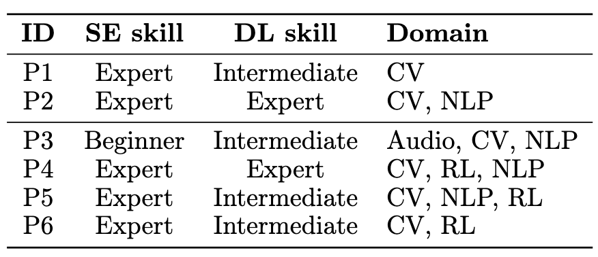
Method of Theme 2 - Qualitative Study (RQ5)
6 External Interview Subjects
2 open-source contributors recruited from theme 1 projects
4 practitioners recruited from social media platforms
Notes:
Our reengineering work informed the interview study

Slide 19
Results – DL Reengineering Challenges
Model operationalization
“Understanding the previous work is often the most difficult part ...translating that information and transmitting that information in an efficient way can be very hard”
“The only way to validate that your model is correct is to...train it, but the pitfall is that many people only write the code for the model without any training code...That, in my opinion, is the biggest pitfall.”
Other challenges:
Performance Debugging, Portability of DL Operations, and Customized Data Pipeline
We also asked about mitigations, one highlight was the difficulty in testing, details are in the paper
Jajal, Jiang, et al. "Interoperability in Deep Learning: A User Survey and Failure Analysis of ONNX Model Converters." Proceedings of the 33rd ACM SIGSOFT International Symposium on Software Testing and Analysis (ISSTA). 2024.
Notes:
Challenges: The four main challenges in the DL reengineering process are model operationalization, performance debugging, portability of DL operations, and customized data pipeline
VERBAL ONLY IS BELOW.
^ Verbally note that we have an ISSTA paper about portability and give the cite at the bottom, it’s cool to have multiple related works like this

Slide 20
Summary and Conclusions

Slide 21
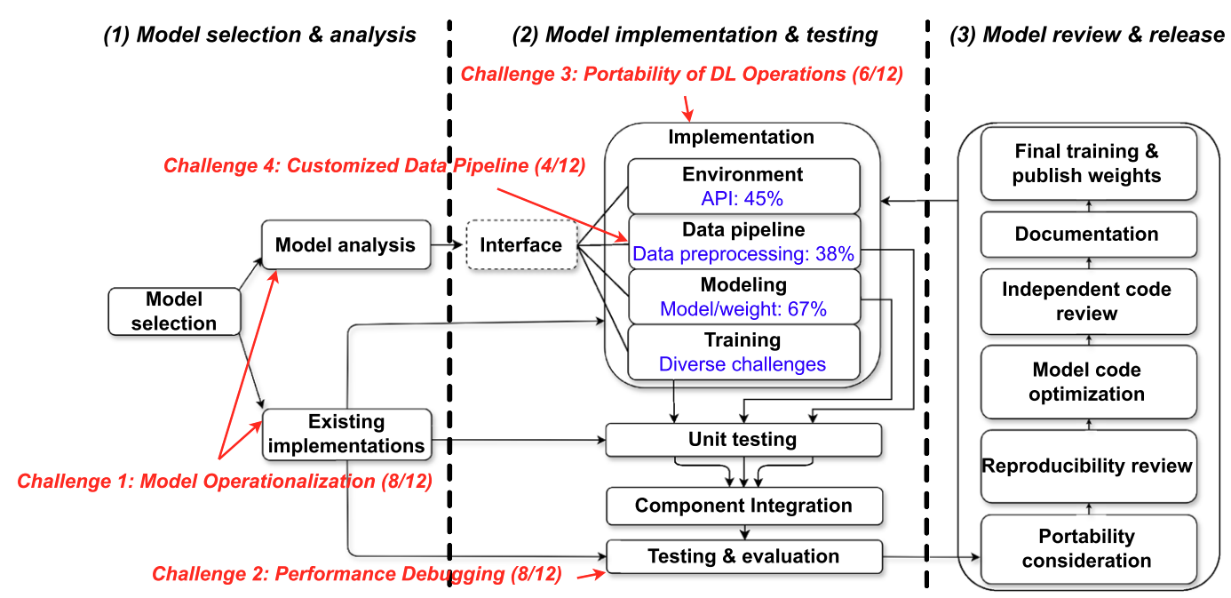
DL Reengineering Workflow
Notes:
The reader may note the relative linearity of the model given in Fig. 12. Our findings from both the failure analysis and the interview study suggest that during DL reengineering, the system requirements and many design elements are well understood, reducing the need for iteration

Slide 22
Future Directions
Standardized Practices
Support for Reengineering Validation
Beyond manual reengineering
Further empirical work
‹#›
Notes:
Direction 1: Standardized Practices : The state of practice in DL reengineering involves many challenges that can be tied to inadequate documentation and tooling. These challenges might be addressed with standardized documentation, checklists for replication, and automation that analyzes repositories and connects them to research papers.
Direction 2:Support for Reengineering Validation :The reengineering challenges we identified emphasize the need for better validation and debugging tools tailored to specific stages of DL reengineering. We observed particular gaps in the stages of Data Pipeline (e.g., for data quality and augmentation defects) and Training (e.g., for performance defects), as well as in the efficient development of unit and differential tests.
Direction 3: Beyond manual reengineering: We found that practitioners perform DL model reengineering by hand, with limited automated support. Future work could examine automated model conversion from framework to framework, automated model component extraction for reuse, and domainspecific languages for DL mathematics.
Direction 4: Further empirical work: We found substantial disagreement between our results and prior work on DL failures, suggesting that our “process” focus may yield different results than a traditional “product”-focused failure analysis. Through the lens of DL reengineering, our study exposed many areas for deeper study, such as how individual classes of DL reengineering failures should be solved, and the compounding effect of discrepancies in upstream models. New datasets of DL models should simplify further study in this topic

Slide 23
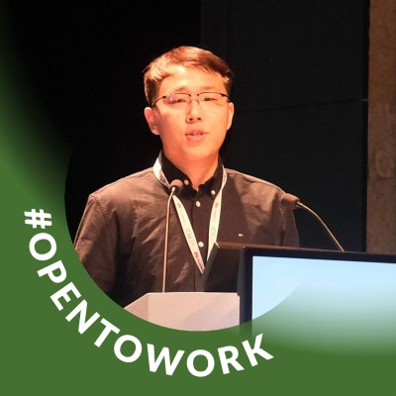
In summary…
DL Reengineering is a challenging process…
but could be more efficient with more work on standardization, validation, and automated tools!
Read More!
https://doi.org/10.1007/s10664-024-10521-0
Thank you for your attention!
Contact: jiang784@purdue.edu
Website: wenxin-jiang.github.io
https://github.com/Wenxin-Jiang/EMSE-CVReengineering-Artifact
Notes:
By the way, I’m on the job market this year!

Slide 24
Bonus slides
‹#›

Slide 25
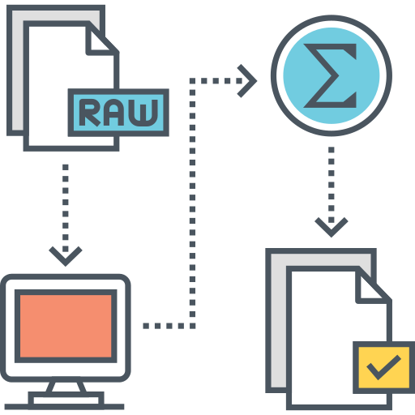
Generalizability from CV to Other DL Domains
Language processing
Audio processing
Computer vision
Generalizable?
Reinforcement learning
Notes:
the process is still similar so majority of our findings are still generalizable but we expect some nuance in LLM reengineering because of the reuse methods (prompt engineering and few shot learning) are different

Slide 26
Purdue’s Computer Vision Reengineering Team
Purdue’s Computer Vision Reengineering Team
All team leaders contributed to at least two reengineering projects. All team members received team-specific training via our team’s 6-week onboarding course on DL reengineering.
The team leaders were fourth-year undergraduates, sometimes working for pay and sometimes for their senior thesis.
Team leaders typically worked for 15-20 hours per week over their 2 years on the team.
Google uses the team’s replication and published in TFMG
‹#›

Slide 27
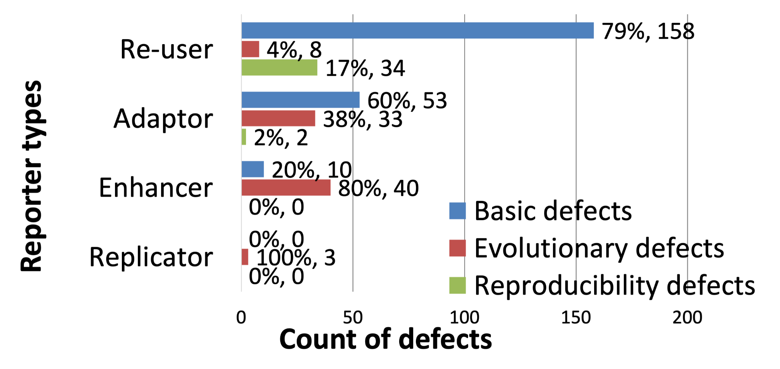
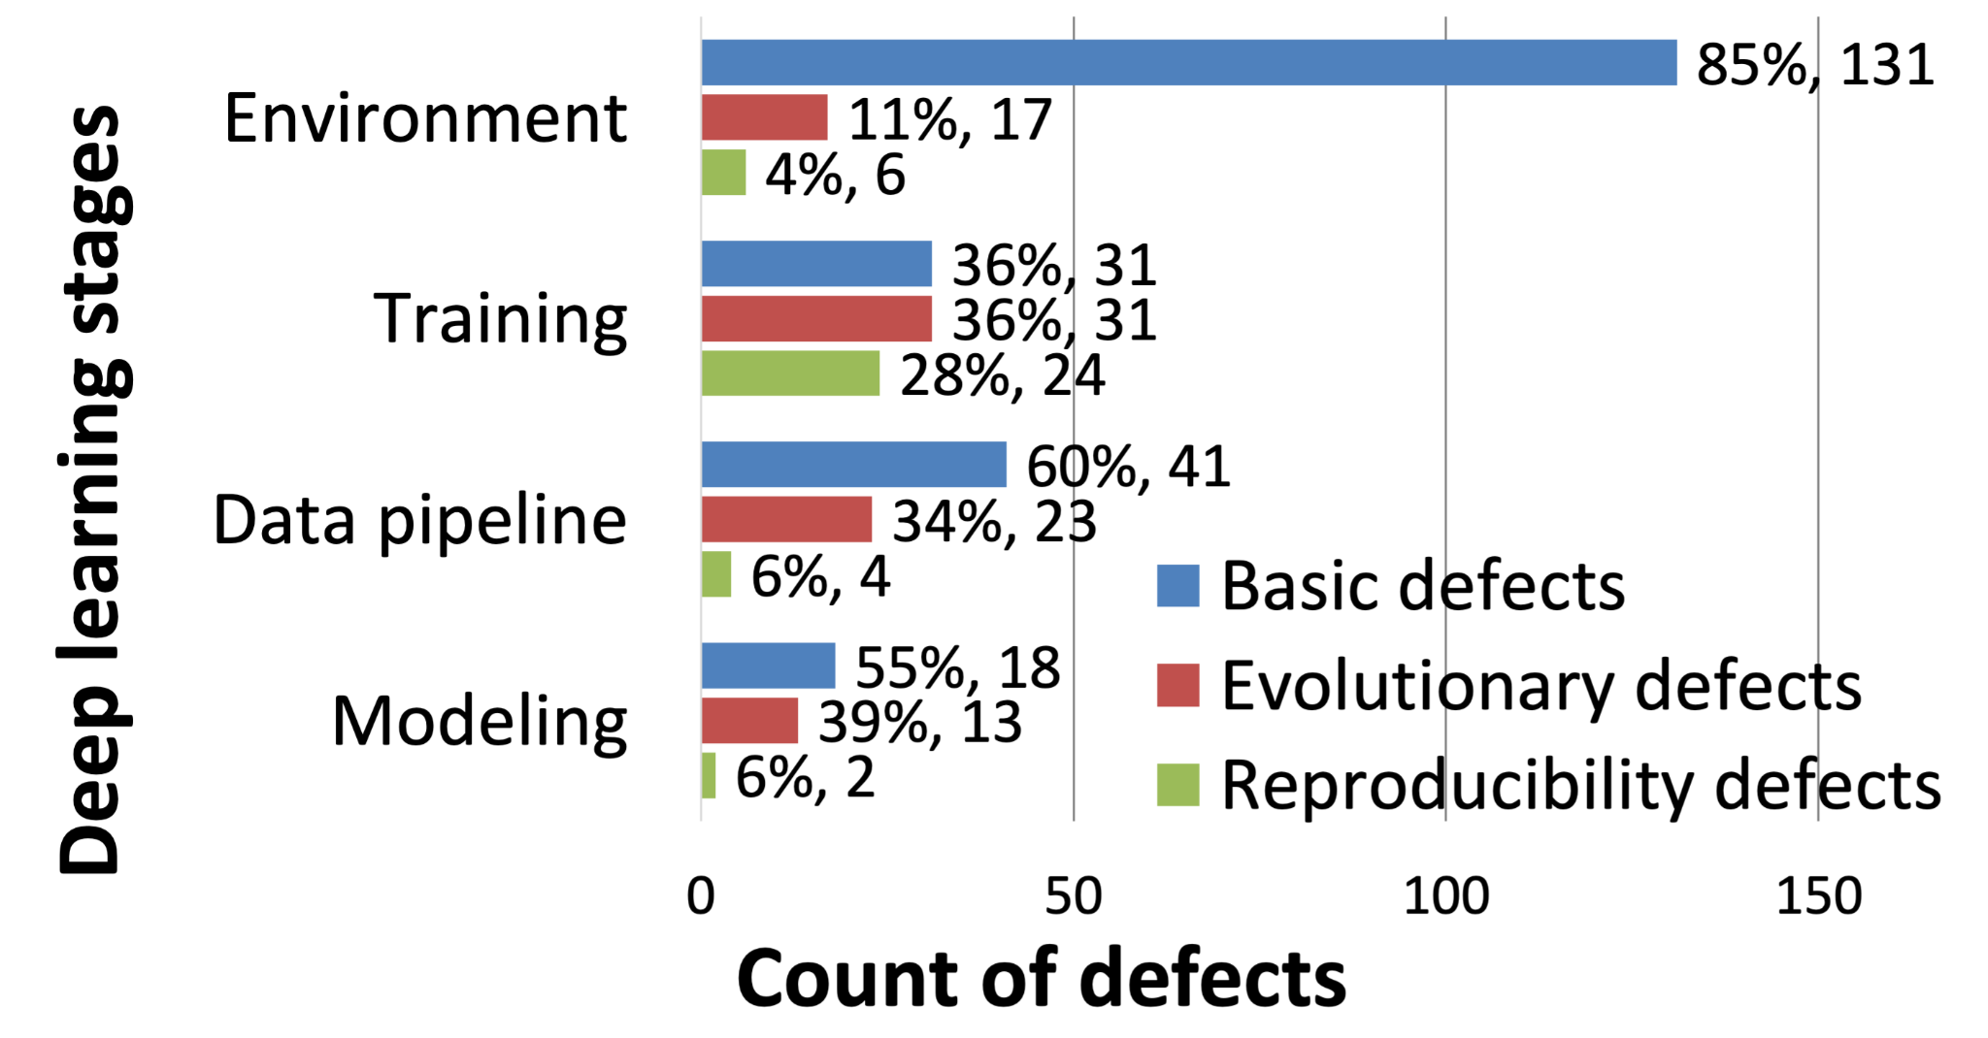
RQ1 Manifestation: highly relevant to reporter type and DL stages
Most reproducibility defects are reported by re-users
Most reproducibility defects are in training
Notes:
§Almost all reproducibility defects are reported by re-users.
§The absence of reproducibility defects from replicators was more surprising.
Second Figure:
We also consider different DL stages, and we distinguished between environment, training, data pipeline, modeling.
§90% defects are reported in environment, training, and data pipeline.
§The vast majority (67%) of reproducibility defects are in the training stage.
§Data pipeline and modeling are less likely to have reproducibility defects.

Slide 28
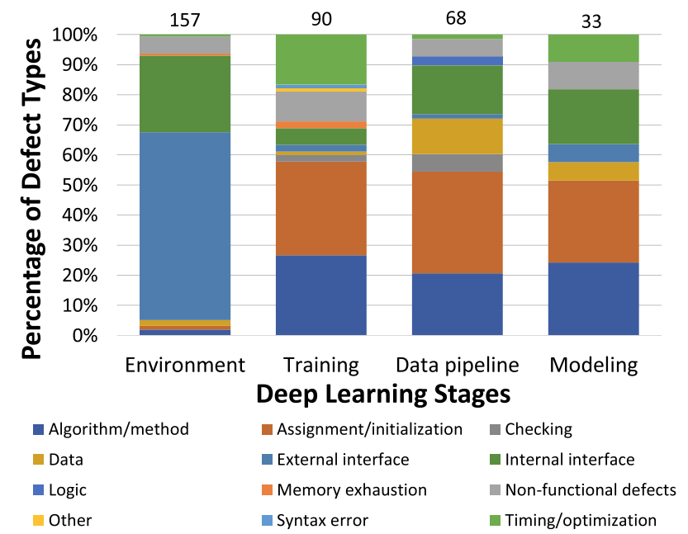
RQ2 General Programming Defect Types: four categories cover most of the defects
Notes:
Most Environment defects are interface defects (88%). The Data Pipeline and Modeling stages have similar distributions oriented towards assignment/initialization defects. Training defects are diverse.
The teal, blue, red, and orange bars cover most of the defects.
Environment: 88% of the defects in the environment configuration are interface defects.
Definition:
External interface: the user interface or the interfaces with other systems, e.g. DL frameworks and APIs
Internal interface: the interface between different system components, including files and datasets
Assignment/initialization, Algorithm/method account for ~50% of defects in the other three stages.
Training: more timing/optimization defects.
Data pipeline and modeling: internal interface defects are another major type of defects

Slide 29
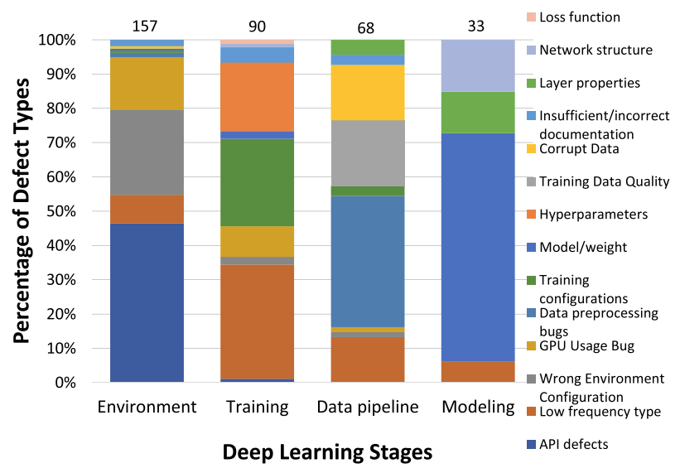
DL-specific Defect Types: notably different causes in different stages
Notes:
Most Environment defects are caused by API defects (46%, 73/157). In the Data Pipeline, data preprocessing defects predominate (38%, 26/68). Most Modeling defects are due to model/weight operations (67%, 22/33). Training defects have diverse causes
§Environment: API bugs, Environment configuration, GPU usage.
§
§Data pipeline: data preprocessing, corrupt data, data quality.
§
§Modeling: model/weight, network structure, layer properties.
§
§Training: configuration, hyper-parameter tuning.

Slide 30
RQ5 DL Reengineering Challenges
Model operationalization
“Understanding the previous work is often the most difficult part ...translating that information and transmitting that information in an efficient way can be very hard”
Performance Debugging
“Performance bugs are silent bugs. You will never know what happened until it goes to deployment.”
Portability of DL Operations
“The biggest problem that we encounter now is that some methods will depend on certain versions of the software...When you modify the version, it will not be reproducible”
Customized Data Pipeline
“[Data pipeline] is the most challenging part because it’s not like there’s a formula of things that you can do...When it comes to data pipeline, it’s more of an art than science”
Notes:
Challenges: The four main challenges in the DL reengineering process are model operationalization, performance debugging, portability of DL operations, and customized data pipeline

Slide 31
RQ5 — DL Reengineering Practices
Start from interface
“We will define the API for our own interface first. In such case, if something goes wrong during the CI, we will easily localize the defect.”
“We look for implementations which are very quick to start with, which have a very good API to start”
Testing
“Unit testing is easier than always trying to differentiate your test and match it with some other model”
“One of the big challenges is that the data pipeline is not deterministic, it’s random. So it’s hard to make test cases for it nor to see if it matches the digital limitation”
Performance Debugging
“The biggest thing is logging the accuracy after every single change”
“If your data format is complicated, then the code around it would also be complicated and it would, eventually, lead to some hard to detect bugs.”
Notes:
Practices:
(Interface): Interface can help unify and automate model testing, especially testing of component integration.
(Testing): Validation was a common emphasis. Team employed complementary testing techniques (i.e., unit, differential, and visual testing).
(Debugging): Comparing evaluation metrics after just 25% of training is a shortcut.

Slide 32
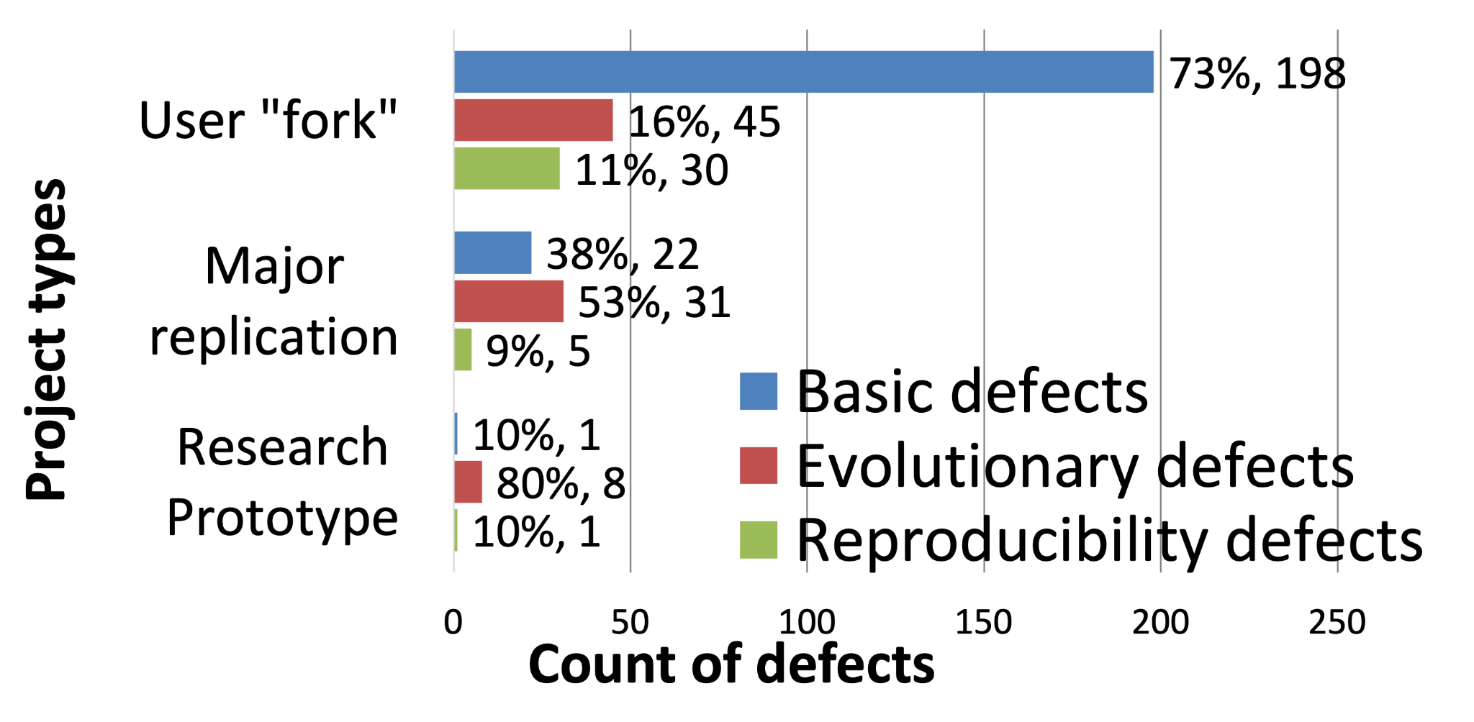
RQ1 — Manifestation: most defects are identified in user “forks”
Notes:
One of the ways we analyzed this data was to consider the kind of defect, and we distinguished between basic defect, evolutionary defect, and reproducibility defects.
Basic defects: the code does not run (e.g., it crashes, behaves very incorrectly, or runs out of memory).
Reproducibility defects: the code using the same data runs without basic defects, but does not match the documented performance (e.g., accuracy, latency).
Evolutionary defects: the code and/or data has been changed to adapt to the user’s needs. It runs without basic defects, but does not match the specification/desired performance.
§Most defects are identified in user “forks”.
§Most of the basic defects in user ”forks” are due to the misunderstanding, miscommunication, or insufficient documentation.

Slide 33
Method of Theme 1 - Quantitative Study (RQ1-RQ4)
8 Zoo repos + 19 Solo repos
348 reengineering defects
Stars ranged from 1.8K to 71.8K
All had at least 300 forks
# Closed issues ranged from 53 – 5560
78% (334/427) samples are reengineering issues
334 issues -> 348 defects
Adapt prior taxonomies to categorize the issues

