Slide 1
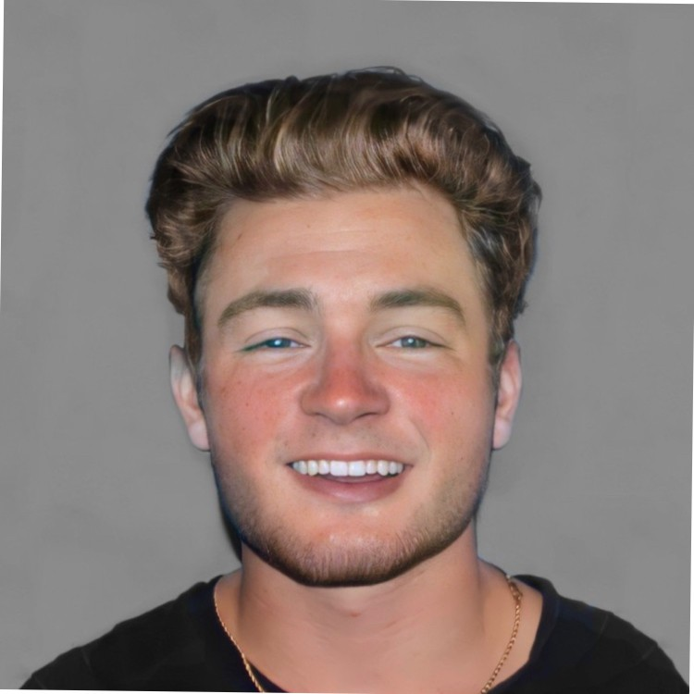
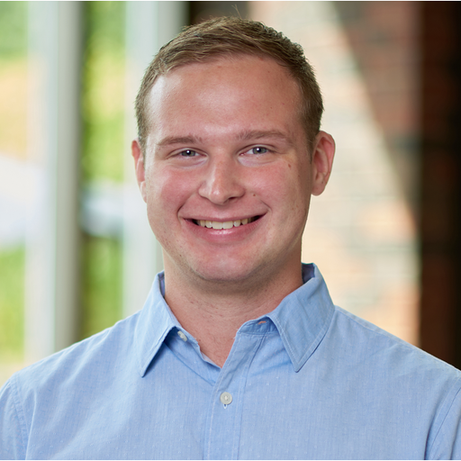
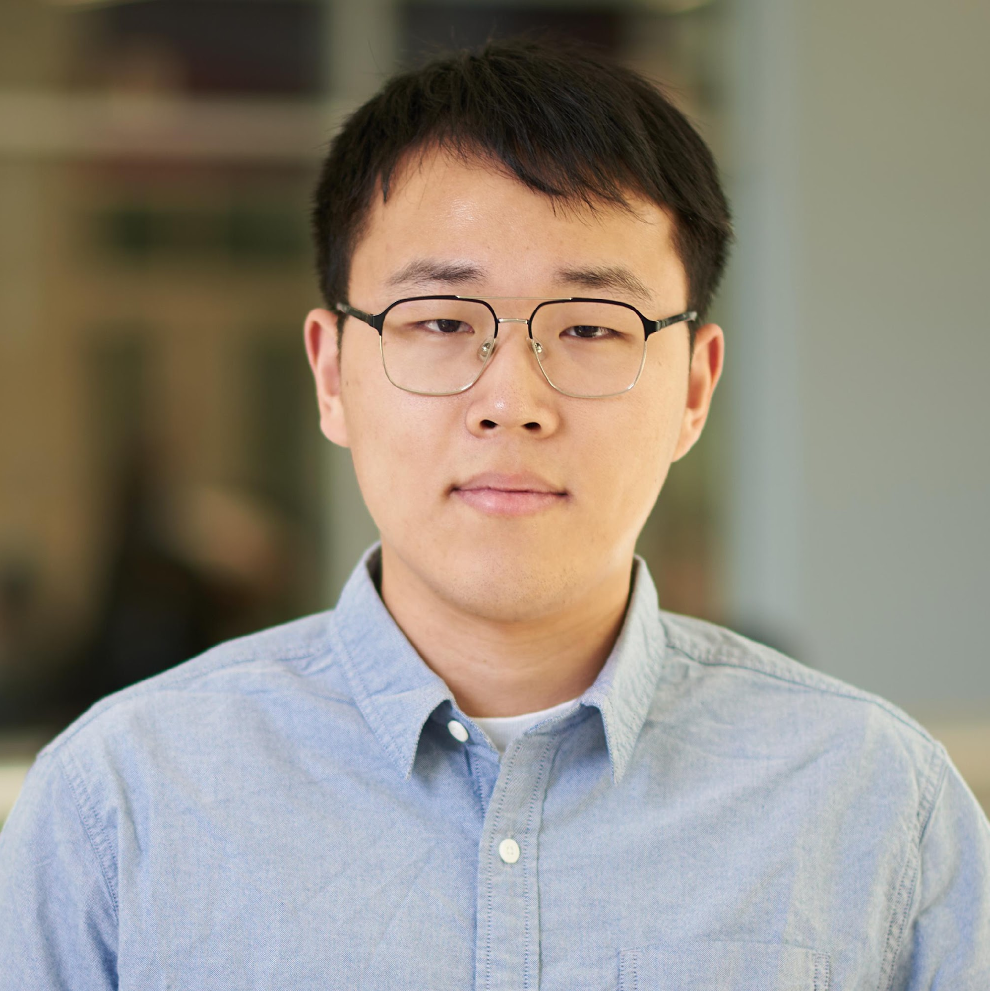
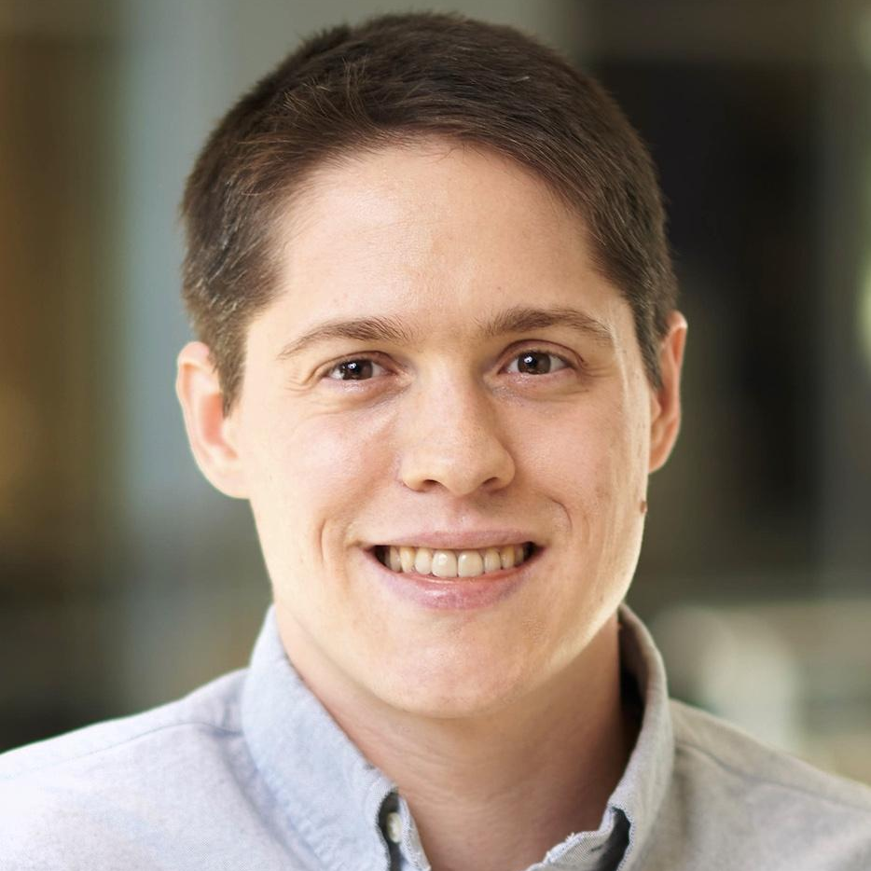
An Empirical Study of Pre-Trained Model Reuse in the Hugging Face Deep Learning Model Registry
Nicholas Synovic* Matt Hyatt Taylor R. Schorlemmer
Rohan Sethi Yung-Hsiang Lu
George K. Thiruvathukal James C. Davis
Wenxin Jiang
Notes:
Hi, I am Wenxin Jiang from Purdue University.
I am glad here to present our empirical study of PTM reuse in the HF DL model registry.
Our work is in collaboration with Loyola University Chicago. We thank Cisco, Google, and the US NSF for their support.
We are taking a system perspective about the human factors and process on PTM reuse.
(Click)

Slide 2
Contributions
Identify unique properties of PTM package reuse to guide future research
Summarize a decision-making workflow for PTM reuse, identify reuse attributes and challenges
Measure potential risks in Hugging Face
Publish HFTorrent dataset of 63,182 PTM packages for future analysis (Dataset paper at MSR’23 - PTMTorrent)
Notes:
Our contributions are:
First, we identified the unique properties of PTM package reuse to guide future research.
Second, we summarized a decision-making workflow for PTM reuse. We also identified some helpful attributes and challenges for PTM reuse.
Third, we systematically measured potential risks in HF.
Finally, we created HFTorrent which is a dataset of 63 thousand PTM packages. An improved version of our dataset named PTMTorrent can be found in MSR.
(Click)

Slide 3
Background and Motivation

Slide 4
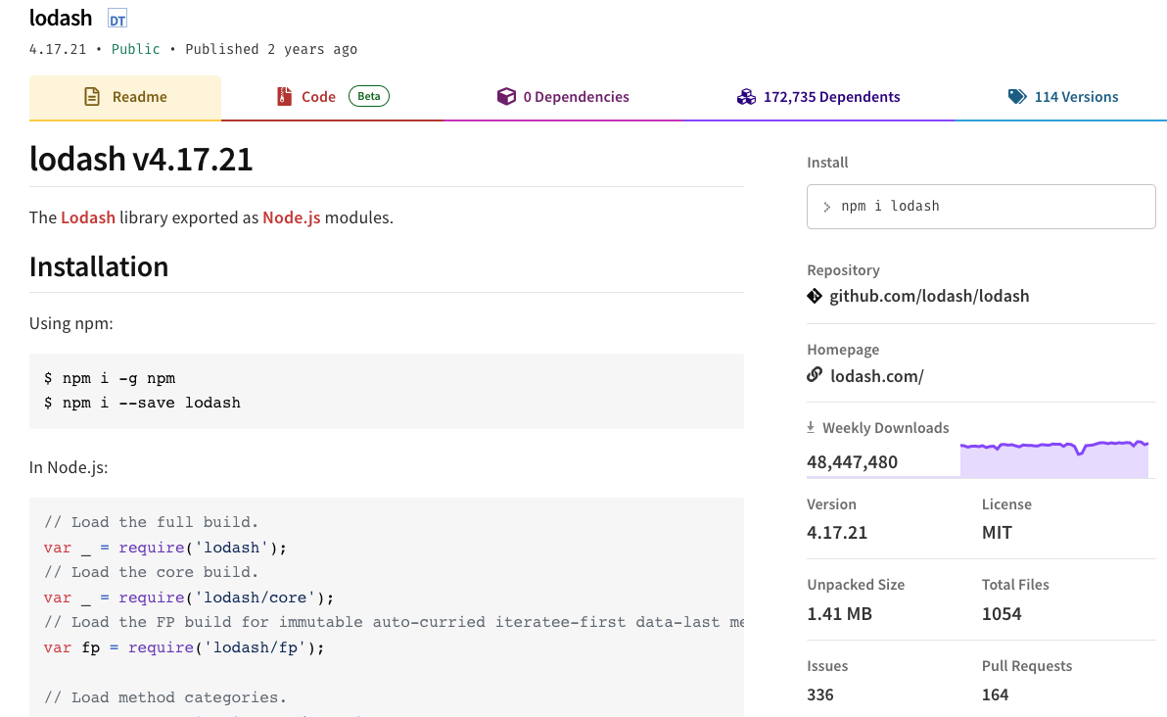
Traditional Software Packages
Notes:
We’re probably all familiar with traditional software packages and the registries that hold them.
For example, here is the LODASH package hosted by the NPM registry for JavaScript software.

Slide 5
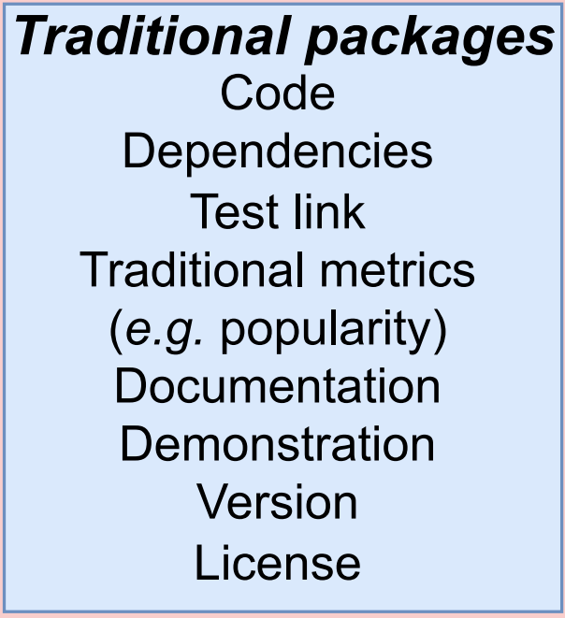
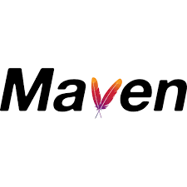
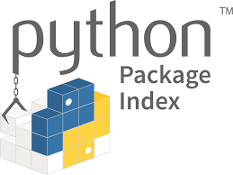
Traditional Software Packages: Components
Notes:
Here are some components of a traditional package.

Slide 6
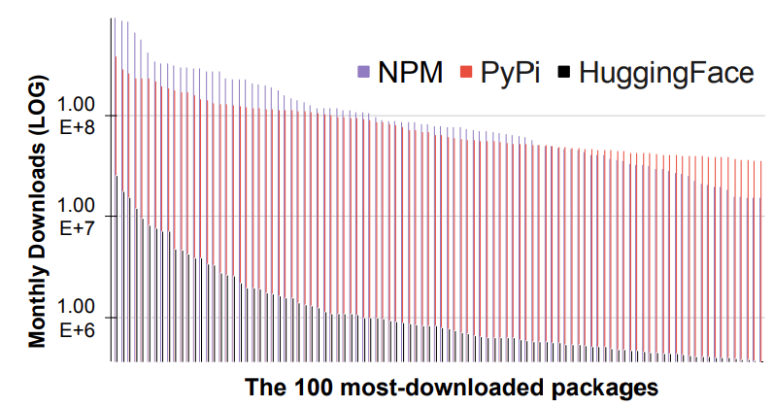
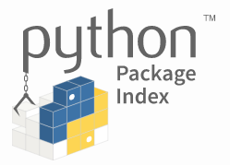
Deep Learning Model Registry
Compared to traditional package registries
1,000,000+
Notes:
DL Model Registries:
Modeled from traditional package registries
Goal: help engineers better reuse these costly artifacts
(click)
Compared to traditional package registries:
HuggingFace is the largest model registry.
(click)
The downloaded rates of HF are comparable to the popular packages in npm and Pypi
(click) The most popular PTMs has over 1 million monthly downloads.

Slide 7
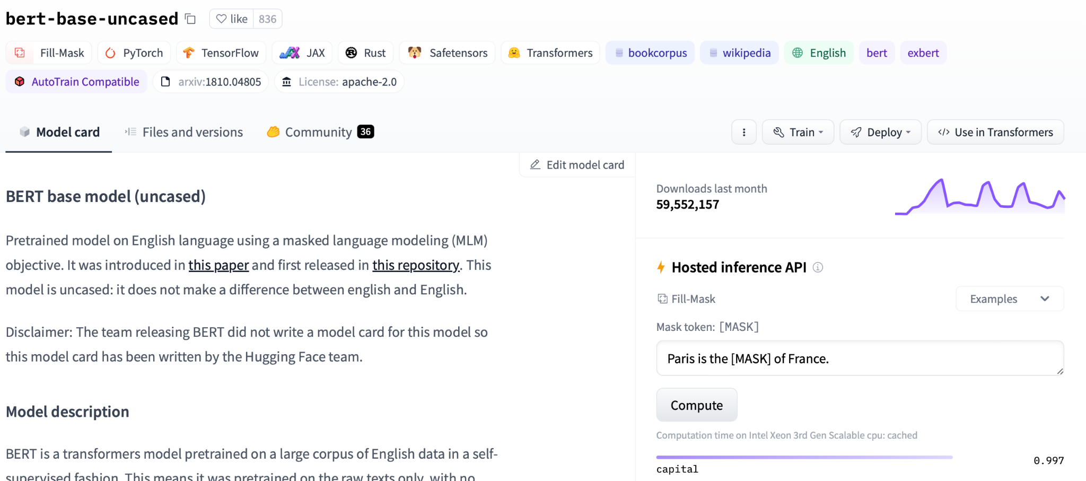
New (Pre-Trained Model) Software Packages
Notes:
ML Models (especially Deep Neural Networks) are also being packaged for re-use. There are also registries that hold these!
For example, here is the BERT-BASE-UNCASED package hosted by the HuggingFace registry for DL software.

Slide 8
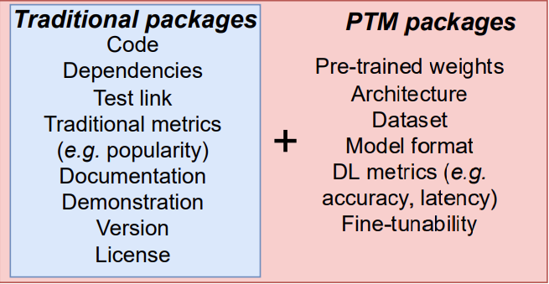
What’s in a Pre-trained Model Package (PTM)?
Package components:
Notes:
A PTM package is similar to traditional packages,
But it can include some DL-specific parts.
(Click)
E.g. pre-trained weights, training datasets, DL-specific metrics
(Click)
There are several model hubs/registries that provide PTM packages
HF, Pytorch hub, ONNX model zoo, modelhub
Due to the different reuse scenarios of PTM packages (e.g. complicated model selection process, and costly evaluation loop)
The characteristics of PTM packages are different from traditional software packages
And few studies have explored this topic yet

Slide 9
Usage Example of PTM Package
→
Upstream PTM
Downstream Tasks
Plug in
Transfer learning (fine-tuning)
Knowledge distillation
Dataset labeling
…
→
roberta-base (Fill-mask)
roberta-base-squad2
(Question Answering)
Hugging Face
Deepset

Slide 10
Lack of Knowledge
How is this similar to / different from regular packages?
Little literature about DL software packages (PTMs)
Reuse and trust are unexamined in DL model registries
No dataset available for conducting further analysis
Notes:
The goal of this work is to:
discover the similarities and differences between PTM packages and regular software packages.
(Click)
There are mainly three gaps in this problem domain:
Little work has studied DL software packages, which are PTMs.
The potential reuse and trust problems are unexamined in DL model registries.
There is no dataset available for conducting future analysis for PTM specifically.

Slide 11
Research questions
How do engineers select PTMs?
What PTM attributes facilitate PTM reuse?
What are the challenges of PTM reuse?
To what extent are the risks of reusing PTMs mitigated by Hugging Face defenses?

Slide 12
Methodology - Overview
Notes:
Overview: This is the relationship between our questions and methods.
We used a mixed-method approach that combine two perspectives
We first explore qualitative insights by interviewing practitioners
Then we substantiate our findings with systematic measurements in HF ecosystem

Slide 13
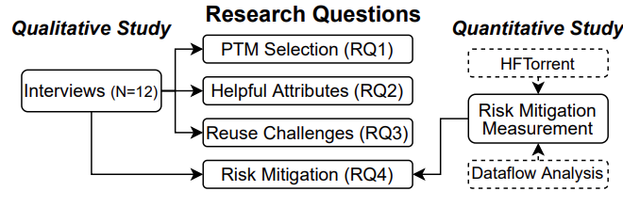
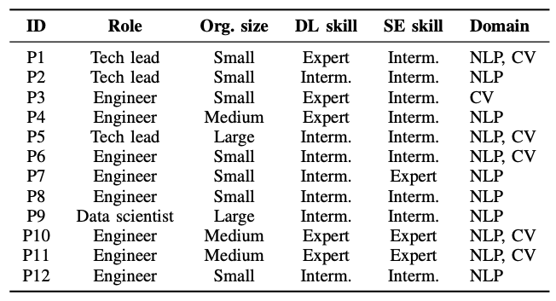
Methodology - Qualitative Study (RQ1-RQ3)
Interviews with PTM reusers
Four-step process
(framework analysis method)
Framework Identification
Interview Design
Interview protocol
Recruitment
12 PTM users
Analysis
Notes:
TODO: Animation, slide number
Our interview follows a four-step process modeled on the framework analysis methodology
First, we identified a framework including three themes: model selection, helpful PTM attributes, and PTM trustworthiness.
Each of the themes were mapped to our RQs.
Then, we created an interview protocol.
We recruit 12 PTM reusers from HF and then conduct the analysis
(Click)
Here are the demographic information of our interview participants.
These PTM users are from different size of organizations and have at least intermediate skills in both DL an SE
Their work also covers different problem domain, including NLP and CV.
============
Framework analysis is a qualitative method that is aptly suited for applied policy research. Framework analysis is better adapted to research that has specific questions, a limited time frame, a pre-designed sample and a priori issues. In the analysis, data is sifted, charted and sorted in accordance with key issues and themes using five steps: familiarization; identifying a thematic framework; indexing; charting; and mapping and interpretation. Framework analysis provides an excellent tool to assess policies and procedures from the very people that they affect.

Slide 14
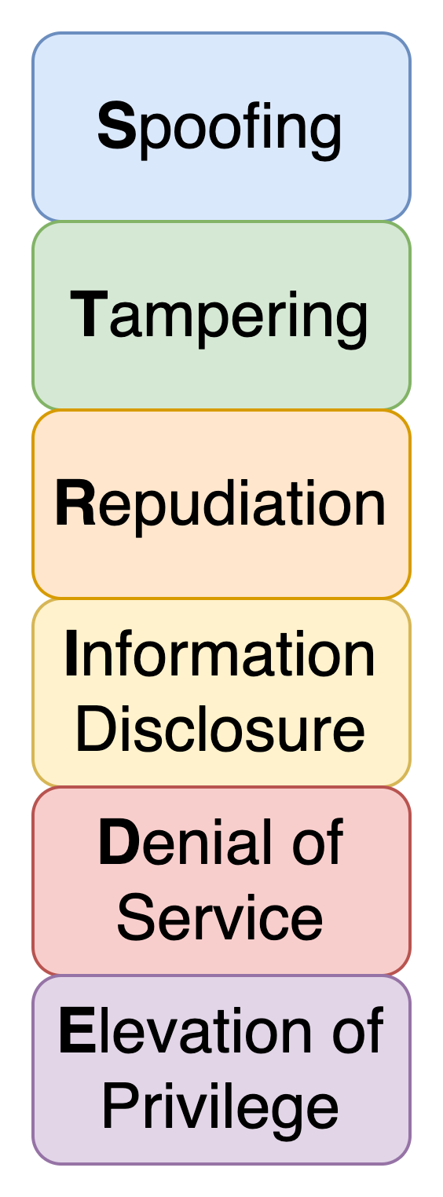
Data Collection – Quantitative Study (RQ4)
Risk Mitigation Measurement
Two-step process (STRIDE)
Dataflow diagram
HF’s public documentation
Trust boundary → STRIDE threats
Available data source → STR--E
Notes:
Our qualitative findings identified a variety of challenges and risks in PTM reuse.
We substantiate our findings with a risk mitigation measurement in the HF ecosystem using STRIDE methodology for threat modeling and risks assessment
STRIDE analysis focuses on trust assumptions related to data, making it suitable for PTMs.
**STRIDE: Spoofing involves impersonating a user or system, Tampering involves unauthorized modification of data, Repudiation refers to denying involvement in an action, Information disclosure is the exposure of sensitive information, Denial of service disrupts normal operations, and Elevation of privilege allows unauthorized access to restricted resources.
Spoofing: Involves illegally accessing and then using another user's authentication information, such as username and password
Tampering: Involves the malicious modification of data.
Repudiation: Associated with users who deny performing an action without other parties having any way to prove otherwise
Information Disclosure: Involves the exposure of information to individuals who are not supposed to have access to it
Denial of Service: Denial of service (DoS) attacks deny service to valid users
Elevation of Privilege: An unprivileged user gains privileged access and thereby has sufficient access to compromise or destroy the entire system.

Slide 15
Results

Slide 16
Decision-Making: How to select a PTM?
Reusability Assessment
Downstream Evaluation
Model Selection
Model Deployment
Notes:
TODO: One sentence for each stage.
Animation
In our interview data, ...
To understand how engineers select PTMs, we asked participants to summarize their decision-making processes. We found similarities between participant responses.
Our model contains 4 stages:
Reusablity assessment
Model selection
Model deployment
Downstream evaluation

Slide 17
Reuse Challenges: Why PTM reuse is hard?
Missing attributes: 10/12, 83%
“Missing details of models”
“Performances of the published models are unclear”
“Different authors process data differently, so it cannot be easily compared”
Discrepancies: 9/12, 75%
“Some of the models are over-promising”
“Model names are not named correctly and sometimes the provided scripts are broken”
Security and Privacy Risks: 3/12, 25%
“The model deployment and data transmission are not in their control”
“It is hard to know what exactly generated the model because most training logs are missing”
“If the model is trained with malicious intents. It could have a lot of consequences in the real world”

Slide 18
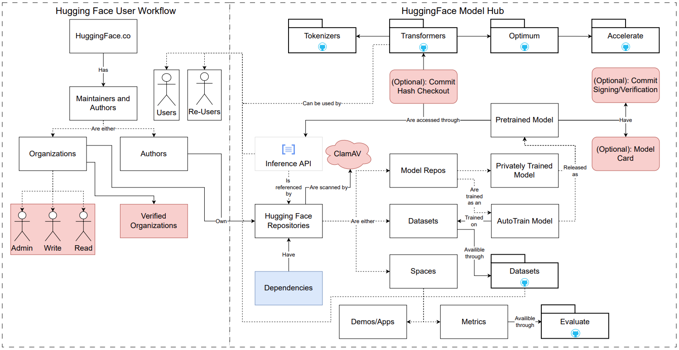
What Risks Exist in Model Registries?
Dataflow diagram for PTMs on Hugging Face
Notes:
Remind method: We used STRIDE analysis to measure the risks on HF. The frist step is to depict a dataflow based on HF documentation.
The diagram include two sides, HF user workflow and HF components.
Here we will show you an example:
The users contribute models to HF.
We examine the points where HF is mitigating threats. Let's talk about three of them:
- TODO: This is to mitigate the ..., then the problem we observed.
With verified organizations. out of 6K organizations, only 200 were verified. 3%.
ClamAV: Out of all the packages, HF puts a warning label for the pacakges with a virus/malware. However, our measurement shows that none of them were flagged. No packages are actually flagged and we also know that this is only checked by traditional code, not neural network.
Commit signing:
Number: only 3% of all models adopted this feature.
The limited usage of GPG commit signing exposes models hosted on Hugging Face to Tampering. These models face the risk of Tampering because attackers could contribute malicious code or edit commit history.
====================
Org verification -> The low adoption rate raises the risk of Spoofing: malicious users may masquerade as real organizations, similar to typosquatting
ClamAV -> elevation of previledge
Commit signing:
The limited usage of GPG commit signing exposes models hosted on Hugging Face to Tampering. These models face the risk of Tampering because attackers could contribute malicious code or edit commit history.
Title: Six Mitigations...(bold)not adopted
==
Although Hugging Face offers mitigations for many risks, these mitigations are incomplete or not widely adopted (Table IV)
These risks make the existence of malicious models possible in the model registries.
User permission model
One shortcoming of the permission model is that Hugging Face organizations violate the principle of least privilege [81]: an organization member with Write privilege can modify any PTM owned by the organization. Therefore, an attacker could contribute malicious code, thereby raising the risk of Elevation of Privileges.
Organization verification:
We counted the number of verified organizations via web scraping. Out of 6,243 organizations, only 199 (3.19%) were verified.
The low adoption rate raises the risk of Spoofing: malicious users may masquerade as real organizations, similar to typosquatting
ClamAV
Commit hash checkout:
It is not easily measured (performed by users on their own machines), we measured the use and scope of the others within the Hugging Face ecosystem
GPG commit signing
The limited usage of GPG commit signing exposes models hosted on Hugging Face to Spoofing, Tampering, and Repudiation risks. First, unsigned Hugging Face models are vulnerable to Spoofing since attackers could make commits under the alias of a legitimate maintainer. Second, these models face the risk of Tampering because attackers could contribute malicious code or edit commit history. Finally, unsigned models could also risk repudiation since a lack of verified commit history allows an individual to deny actions within a repository.
Model cards: I will talk more details in the next two slides.
Dependencies
Figure: Number of models trained on a specific dataset (blue) and trained with a specific model architecture (orange).
**1,207 models were trained on the most popular dataset. 1,673 models depend on the most popular architecture.
many models depend on the works of others that can be maliciously tampered with. In tampering with these dependencies, BadNets [59] and unethical models [77] can be created, which could affect downstream PTMs.
PTM Documentation
Figure: The proportion of models with standardized claims (Hugging Face’s YAML format) for each type of PTM

Slide 19
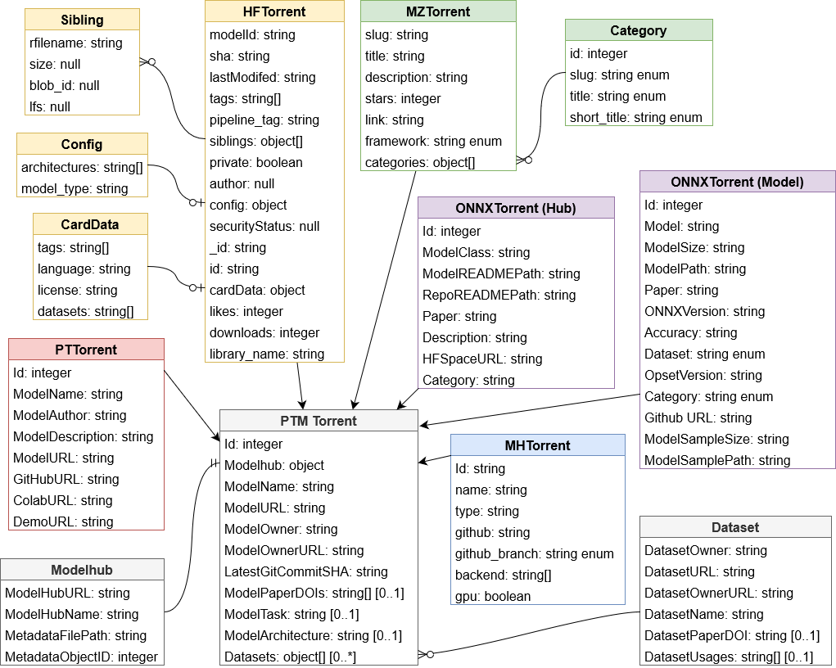
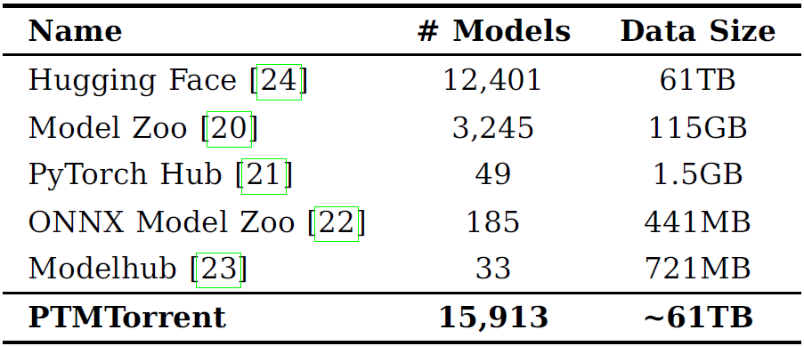
PTMTorrent Dataset
Motivation
PTMs are distributed in many places
Accessibility issues (git-lfs, rate limits, etc.)
→ PTMTorrent: PTM packages from many model hubs
[1] Jiang et al, PTMtorrent: A dataset for mining open-source pre-trained model packages, MSR’23
19
Notes:
The PTM are distributed in many places and the model hubs provide different APIs to facilitate model reuse. There is no one-stop shop to compare PTMs from different model hubs.
PTMs can be really big! Some model hubs, they rate limits on accessing PTMs to prevent server overloads and service disruptions. This makes it harder to access a large amount of PTMs.
We would like to keep long-term data to support the scientific replicability of our work
Motivation:
- PTMs can be really big! Some model hubs, they rate limits on accessing PTMs to prevent server overloads and service disruptions. This makes it harder to access a large amount of PTMs.
- We would like to keep long-term data to support the scientific replicability of our work

Slide 20
In closing…

Slide 21
Comparison to Traditional Package Registries
Decision-making process:
very different assessment + costly iterations
Attributes:
popularity + DL-specific attributes
Potential risks:
traditional + PTM
21

Slide 22
Future Directions
Model audit
Infrastructure
22
Notes:
Model audit
Large-scale measurement and tools supporting model audit-> Model transparency
Infrastructure
Model registries like HF should provide better infrastructure and measure the helpful attributes
Hard to compare PTMs -> PTM recommender to support model selection and fine-tuning process

Slide 23
In summary…
Aspects of PTM reuse are different from traditional packages
Contact: jiang784@purdue.edu
Website: wenxin-jiang.github.io
https://github.com/PurdueDualityLab/ICSE-23-PTM-Artifact
Notes:
In summary:
Aspects of PTM reuse are different from traditional packages.
Let’s research more on PTM packages!!!
That's all for my talk!
Here are my contact information and our artifact. Thanks for your attention!

Slide 24
Bonus slides
24

Slide 25
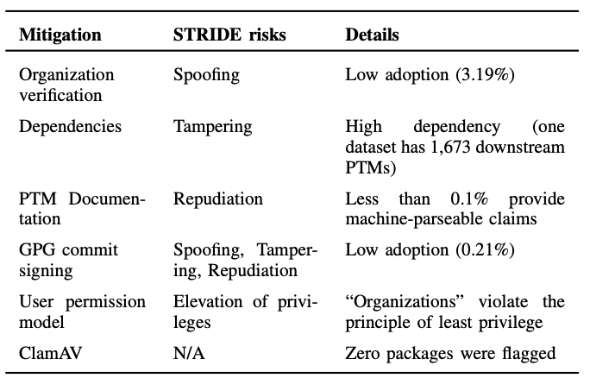
What Risks Exist in Model Registries?
25
Notes:
Organization verification:
Out of 6,243 organizations, only 199 (3.19%) were verified. The low adoption rate raises the risk of Spoofing: malicious users may masquerade as real organizations, similar to typosquatting
Dependencies
many models depend on the works of others that can be maliciously tampered with. In tampering with these dependencies, adversarial attacks or unethical models [77] can be created, which could affect downstream PTMs.
PTM Documentation
The missing attributes and unstructured documentations reduce the transparency of the PTMs, which also reduces the trustworthiness of the models and increase the potential risks of malicious models
GPG Commit Signing
The limited usage of GPG commit signing exposes models hosted on Hugging Face to Spoofing, Tampering, and Repudiation risks.
** First, unsigned Hugging Face models are vulnerable to Spoofing since attackers could make commits under the alias of a legitimate maintainer. Second, these models face the risk of Tampering because attackers could contribute malicious code or edit commit history. Finally, unsigned models could also risk repudiation since a lack of verified commit history allows an individual to deny actions within a repository.
User Permission Model
One shortcoming of the permission model is that Hugging Face organizations violate the principle of least privilege [81]: an organization member with Write privilege can modify any PTM owned by the organization. Therefore, an attacker could contribute malicious code, thereby raising the risk of Elevation of Privileges.
ClamAV:
It is a tool used to detect malware. But zero package were flagged and it doesn’t really work for PTM packages.
==============================
Spoofing: Involves illegally accessing and then using another user's authentication information, such as username and password
Tampering: Involves the malicious modification of data.
Repudiation: Associated with users who deny performing an action without other parties having any way to prove otherwise
Information Disclosure: Involves the exposure of information to individuals who are not supposed to have access to it
Denial of Service: Denial of service (DoS) attacks deny service to valid users
Elevation of Privilege: An unprivileged user gains privileged access and thereby has sufficient access to compromise or destroy the entire system.

Slide 26
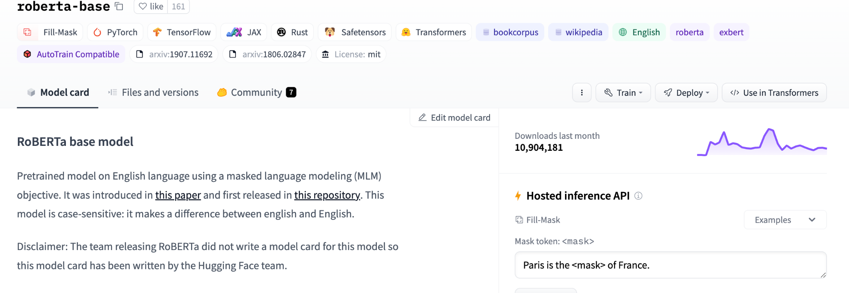
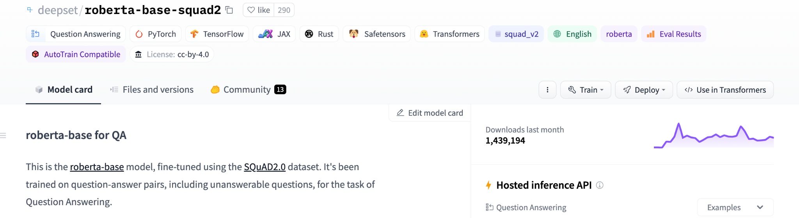
Usage Example of PTM Package

Slide 27
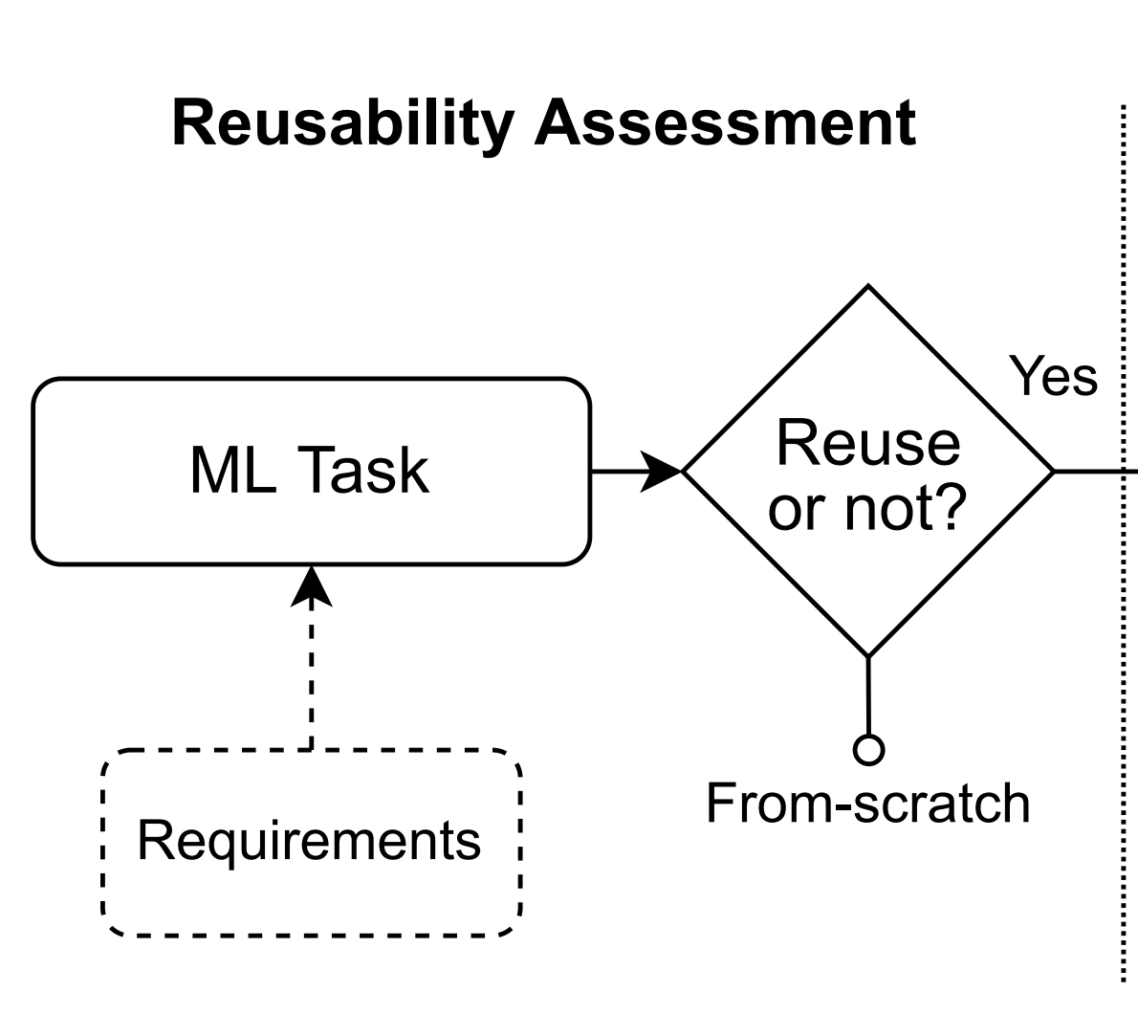
RQ1: PTM Selection
Reusability Assessment:
“PTMs do not work for every use case”
“Do not have enough computational resources”
“[PTMs are] easy to use and test” because of the provided inference APIs
27
Notes:
To understand how engineers select PTMs, we asked participants to summarize their decision-making processes. We found similarities between participant responses.
Our model contains 4 stages:
***Finding 1: The participants share a similar decision-making process (Figure 4). Among the four PTM reuse scenarios in the research literature, our participants reported using only two: transfer learning and quantization techniques. When reusing, participants find PTMs from DL model registries easier to adopt than PTMs from GitHub projects.
*Reuse or not?

Slide 28
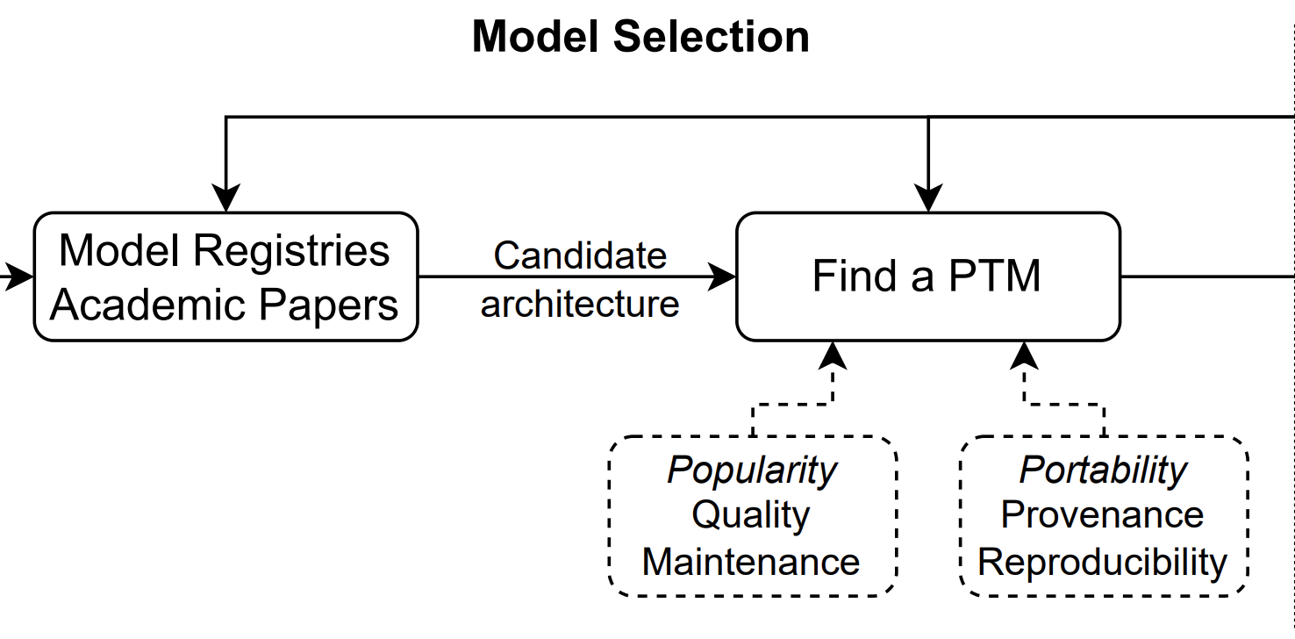
RQ1: PTM Selection
Model Selection:
Search for candidate architectures “built for the problem”
“Plug and play”
“Ease of use is very important”
“Popularity indicates [community] trust in the model”
28

Slide 29
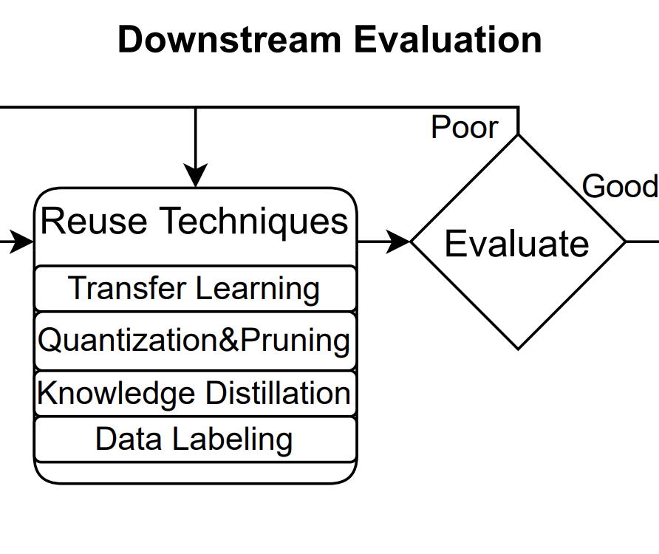
RQ1: PTM Selection
Downstream Evaluation
“Download 🡪 fine-tune 🡪 test 🡪 compare”
29
Notes:
”Some models don’t really work too well directly, even with their own dataset”

Slide 30
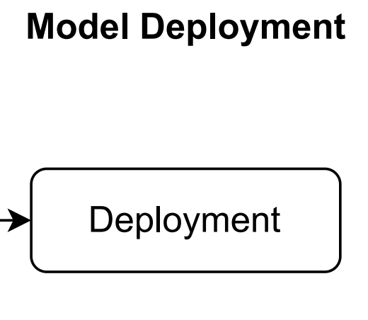
RQ1: PTM Selection
Model Deployment
Model characteristics: model size, framework
Deployment environments
30

Slide 31
RQ2: Helpful Attributes
Traditional Attributes: Popularity, Quality, Maintenance
“PTM with lots of downloads means that it could be a good starting point.”
“Popularity usually goes side-by-side with maintenance and can indicate the quality”
“maintenance and quality are less useful in downstream tasks”
“it is really hard to modify some PTMs because they are too large”
→ Popularity is the most helpful
→ Quality and Maintenance are not very helpful
DL-specific Attributes
Provenance: dataset details, performance table, architecture details, training logs
“visualization of model architecture”
“how the PTM was generated”,
“explanation of changes”
Reproducibility: training scripts, hyper-parameters, demos, environment image
“a badge indicating reproducibility or way to run the model prior to download”
“a pre-built docker image” or “a notebook demo” can help validate a model
Portability: hardware specification, framework support, quantized model
“[Quantized models] are helpful for continuous deployment and fine-tuning”
“licensing should be explicit to industry users”
→ All of them should be considered
31
Notes:
A notebook demo -> validate a model with minimal set up.

Slide 32
RQ4: Risk Mitigation
Dataflow diagram for PTMs on Hugging Face
32
Notes:
TODO: 30sec explain the diagram
Remove the dotted lines, expand the figure.
Bouncing ball to show the dataflow. Just one flow. (Here we will show you an example of )
Remind method: We used STRIDE analysis to measure the risks on HF. The frist step is to depict a dataflow based on HF documentation.
The diagram include two sides, HF user workflow and HF components.
The users contribute models to HF.
We examine the points where HF is mitigating threats. Let's talk about three of them:
- TODO: This is to mitigate the ..., then the problem we observed.
With verified organizations. out of 6K organizations, only 200 were verified. 3%.
ClamAV: Out of all the packages, HF puts a warning label for the pacakges with a virus/malware. However, our measurement shows that none of them were flagged. No packages are actually flagged and we also know that this is only checked by traditional code, not neural network.
Commit signing:
Number: 3%
====================
Org verification -> The low adoption rate raises the risk of Spoofing: malicious users may masquerade as real organizations, similar to typosquatting
ClamAV -> elevation of previledge
Commit signing:
The limited usage of GPG commit signing exposes models hosted on Hugging Face to Tampering. These models face the risk of Tampering because attackers could contribute malicious code or edit commit history.
Title: Six Mitigations...(bold)not adopted
==
Although Hugging Face offers mitigations for many risks, these mitigations are incomplete or not widely adopted (Table IV)
These risks make the existence of malicious models possible in the model registries.
User permission model
One shortcoming of the permission model is that Hugging Face organizations violate the principle of least privilege [81]: an organization member with Write privilege can modify any PTM owned by the organization. Therefore, an attacker could contribute malicious code, thereby raising the risk of Elevation of Privileges.
Organization verification:
We counted the number of verified organizations via web scraping. Out of 6,243 organizations, only 199 (3.19%) were verified.
The low adoption rate raises the risk of Spoofing: malicious users may masquerade as real organizations, similar to typosquatting
ClamAV
Commit hash checkout:
It is not easily measured (performed by users on their own machines), we measured the use and scope of the others within the Hugging Face ecosystem
GPG commit signing
The limited usage of GPG commit signing exposes models hosted on Hugging Face to Spoofing, Tampering, and Repudiation risks. First, unsigned Hugging Face models are vulnerable to Spoofing since attackers could make commits under the alias of a legitimate maintainer. Second, these models face the risk of Tampering because attackers could contribute malicious code or edit commit history. Finally, unsigned models could also risk repudiation since a lack of verified commit history allows an individual to deny actions within a repository.
Model cards: I will talk more details in the next two slides.
Dependencies
Figure: Number of models trained on a specific dataset (blue) and trained with a specific model architecture (orange).
**1,207 models were trained on the most popular dataset. 1,673 models depend on the most popular architecture.
many models depend on the works of others that can be maliciously tampered with. In tampering with these dependencies, BadNets [59] and unethical models [77] can be created, which could affect downstream PTMs.
PTM Documentation
Figure: The proportion of models with standardized claims (Hugging Face’s YAML format) for each type of PTM

Slide 33
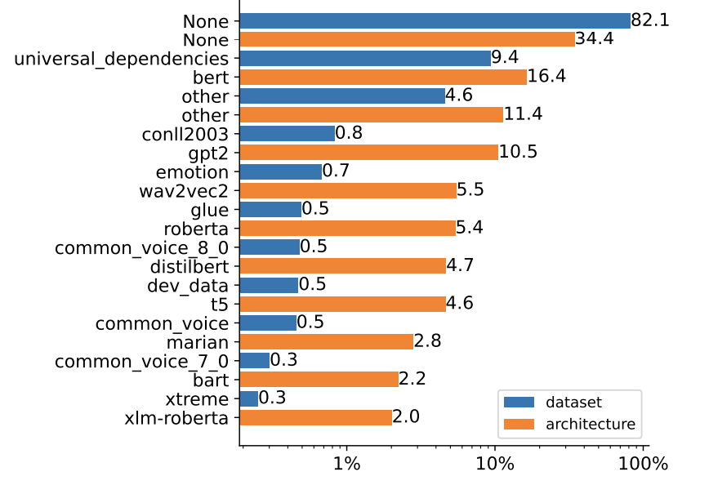
RQ4: Risk Mitigation
Dependencies
Notes:
Dependencies
Figure: Number of models trained on a specific dataset (blue) and trained with a specific model architecture (orange).
**1,207 models were trained on the most popular dataset. 1,673 models depend on the most popular architecture.
many models depend on the works of others that can be maliciously tampered with. In tampering with these dependencies, BadNets [59] and unethical models [77] can be created, which could affect downstream PTMs.
PTM Documentation
Figure: The proportion of models with standardized claims (Hugging Face’s YAML format) for each type of PTM
Organization verification:
We counted the number of verified organizations via web scraping. Out of 6,243 organizations, only 199 (3.19%) were verified.
The low adoption rate raises the risk of Spoofing: malicious users may masquerade as real organizations, similar to typosquatting
GPG commit signing
The limited usage of GPG commit signing exposes models hosted on Hugging Face to Spoofing, Tampering, and Repudiation risks. First, unsigned Hugging Face models are vulnerable to Spoofing since attackers could make commits under the alias of a legitimate maintainer. Second, these models face the risk of Tampering because attackers could contribute malicious code or edit commit history. Finally, unsigned models could also risk repudiation since a lack of verified commit history allows an individual to deny actions within a repository.
User permission model
One shortcoming of the permission model is that Hugging Face organizations violate the principle of least privilege [81]: an organization member with Write privilege can modify any PTM owned by the organization. Therefore, an attacker could contribute malicious code, thereby raising the risk of Elevation of Privileges.

Slide 34
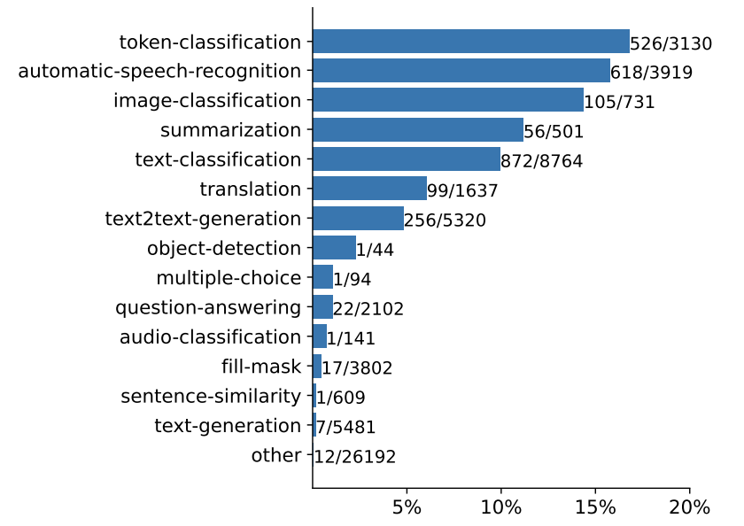
RQ4: Risk Mitigation
PTM Documentation
34
Notes:
PTM Documentation
Figure: The proportion of models with standardized claims (Hugging Face’s YAML format) for each type of PTM
Due to the sparse usage of performance claim reporting, there can be potential risks of Repudiation: model performance can be obscured, misreported, or misleading.
Some models report their performance in plain texts or tables, and are hard to identify by the users.
The lack of transparency reduces the trustworthiness of the models and increase the potential risks of malicious models.

Slide 35
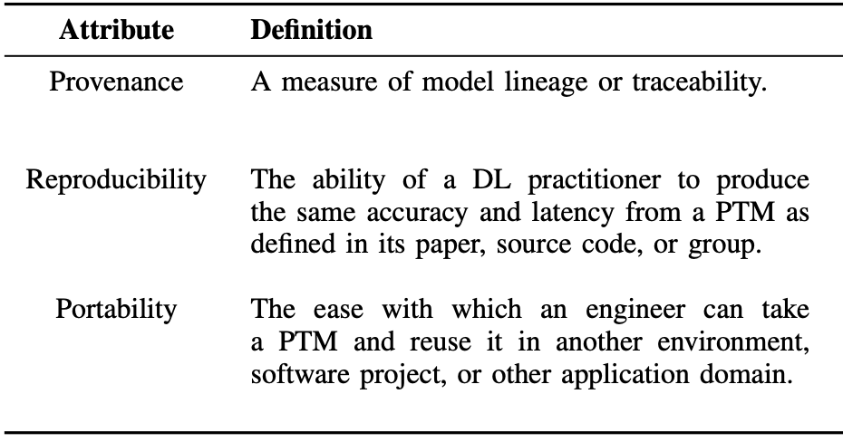
Data Collection – Qualitative Study (RQ1-RQ3)
Interviews with PTM reusers
Four-step process
(framework analysis method)
Framework Identification
Model selection
Model hub
Factors
Challenges
PTM attributes
Traditional
DL-specific
PTM trustworthiness
Interview Design
3 pilot interviews
30-45 min
35
Notes:
Our interview follows a four-step process modeled on the framework analysis methodology
*Framework analysis is a qualitative method that is aptly suited for applied policy research. Framework analysis is better adapted to research that has specific questions, a limited time frame, a pre-designed sample and a priori issues. In the analysis, data is sifted, charted and sorted in accordance with key issues and themes using five steps: familiarization; identifying a thematic framework; indexing; charting; and mapping and interpretation.

