Slide 1
A QUANTITATIVE COMPARISON OF PRE-TRAINED MODEL REGISTRIES TO TRADITIONAL SOFTWARE PACKAGE REGISTRIES - MSc Defense
Jason Jones
April 16, 2024
Notes:
Hello, thank you for coming to my thesis defense.
My name is Jason Jones, I am a Master’s thesis student under the guidance of Professor Jamie Davis.
On my advisory council is Professor David Inouye and Professor Yung-Hsiang Lu

Slide 2
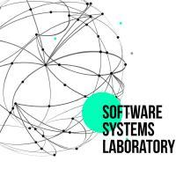
Acknowledgements
Notes:
I would like to thank contributors from the RISE lab from QUeen’s University in Quebec,
as well as contributors from the Software Systems Laboratory from Loyola Chicago.
Also, I would like to thank everyone from the Purdue Duality for all of their help giving me advice and guidance during my time as a graduate student.

Slide 3
Agenda
Introduction
Background
Deep Neural Networks and Pre-Trained Models
Software Supply Chains and Software Package Registries
Pre-Trained Model Supply Chains and HuggingFace
PeaTMOSS: My contributions to this publication (MSR ‘24) – The dataset infrastructure
A Quantitative Comparison of Pre-Trained Model Registries to Traditional Software Package Registries (in preparation)
Future Work
Review and Questions
Notes:
First I will introduce my motivation, thesis statement, and contributions
Then i will walk through the background of relevant information needed to understand my work
I will then discuss my major contributions:
PeaTMOSS: A dataset describing Pre-Trained Models in Open Source software

Slide 4
Focus Papers
Introduction
PeaTMOSS: Mining Pre-Trained Models in Open-Source Software
Jiang*, Jones*, Yasmin*, Synovic, Sashti, Chin, Thiruvathukal, and Davis
Published as Technical Report on arXiv
PeaTMOSS: A Dataset and Initial Analysis of Pre-Trained Models in Open-Source Software
Jiang, Yasmin, Jones, Synovic, Kuo, Bielanski, Tian, Thiruvathukal, and Davis
Proceedings of the 21st Annual Conference on Mining Software Repositories (MSR’24)
A Quantitative Comparison of Pre-Trained Model Registries to Traditional Software Package Registries
Jones, Jiang, and Davis.
In preparation for the 18th ACM/IEEE International Symposium on Empirical Software Engineering and Measurement (ESEM ‘24)
Notes:
I contributed to the following papers:
PeaTMOSS 1: This was a submission to MSR’s 2024 Mining Challenge that was later submitted as a technical report on arXiv
PeaTMOSS 2: This was a rework of PeaTMOSS 1 that included improvements to the PeaTMOSS dataset
It was accepted to
Quantitative Comparison: This work utilizes PeaTMOSS to make a comparison between traditional software and PTM registries
ESEM 2024, the 18th ACM/IEEE International Symposium on Empirical Software Engineering and Measurement

Slide 5
Introduction

Slide 6
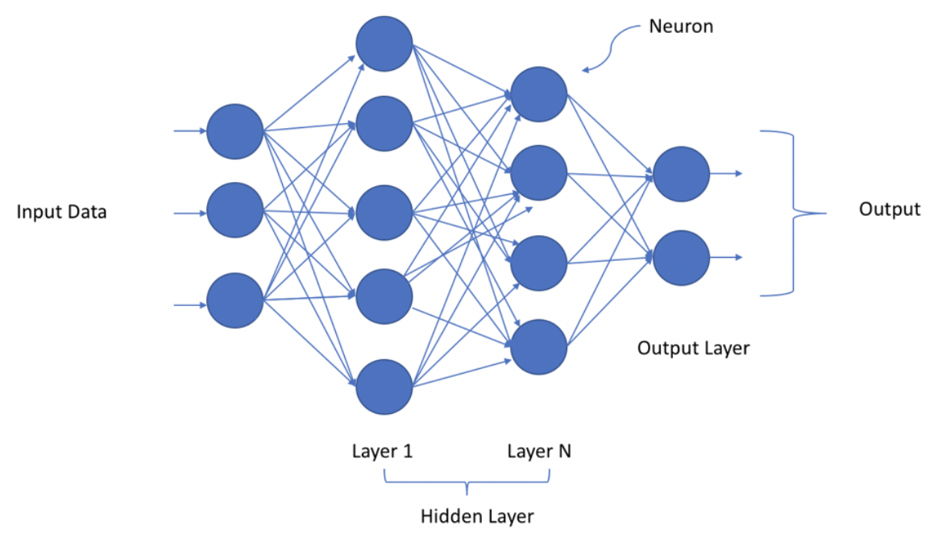
Motivation
Introduction
Deep Neural Networks (DNNs) are emerging as engineering tools
Pre-Trained Model (PTM) focused platforms are becoming popular
We have limited understanding of engineers interacting w/ these platforms to reuse PTMs
Notes:
Deep Neural Networks (DNNs) are an emerging class of software with novel applications as an engineering tool
They achieve State-of-the-art (SOTA) results in Natural Language Processing (NLP), Computer Vision (CV), Audio Recognition (AR)
The high cost of training DNNs means that many people reuse them as a Pre-Trained Model
Platforms that focus on distributing Pre-Trained Models such as HuggingFace and PyTorch are increasing in popularity
Understanding of how engineers interact with these platforms to reuse these PTMs is limited, there are only a handful of papers on the subject compared to 100s written on traditional software package registries

Slide 7
Thesis Statement
Introduction
Deep Neural Networks are a new kind of software. Software engineers solve new problems / known problems in new ways.
Therefore, the contribution, evolution, and reuse of Deep Neural Networks as Pre-Trained Models is unique compared to traditional software.
Understanding these differences will inform the transferability of prior knowledge, evaluation tools, and frameworks of understanding from traditional software to PTMs.

Slide 8
Contributions
Introduction
A dataset describing PTMs and their downstream relationships (PeaTMOSS)
A set of metrics that quantifies attributes of various software package registries, including adaptations specific to PTM registries
A comparison of representative package registries
Notes:
I have three major contributions in this thesis:
I contribute PeaTMOSS, a dataset that describes PTMs and their downstream relationships
I contribute a set of metrics that quantifies attributes of various software package registries. This set of metrics includes adaptations to allow for specific applications to PTM registries
I contribute the application of this set of metrics to representative traditional software and PTM registries, along with a comparison to evaluate the similarities and differences

Slide 9
Background

Slide 10
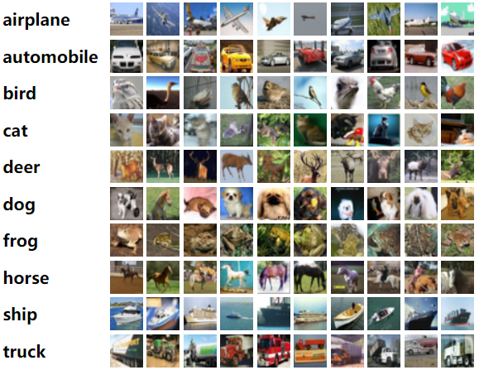
Deep Neural Networks (DNNs)
Deep Neural Networks and Pre-Trained Models
DNNs: Collections of Neurons that are connected together
Capable of learning, SOTA in Natural Language Processing, Computer Vision, Audio Processing, etc. that traditional software struggles to handle
https://vitalflux.com/deep-learning-neural-network-explained-simply-layman-terms/
https://www.cs.toronto.edu/~kriz/cifar.html
Notes:
Neural Networks are a kind of AI/ML model approach that approach problem solving differently than traditional software
Rather than explicitly describing with code the desired behavior, you describe inputs and desired outputs, then train a collection of weakly connected neurons to “learn” behaviors
Example: I train a neural network on the CIFAR 10 dataset, which contains a large amount of photos categorized into one of 10 creatures:
Airplane, automobile, bird, cat, deer, dog, frog, horse, ship, truck
They are capable of achieving SOTA in tasks such as Natural Language Processing, Computer Vision, Audio Processing, etc.
Deep Neural Networks are Neural Networks with a lot of hidden layers, as a result they take a lot of time and resources to train to be usable

Slide 11
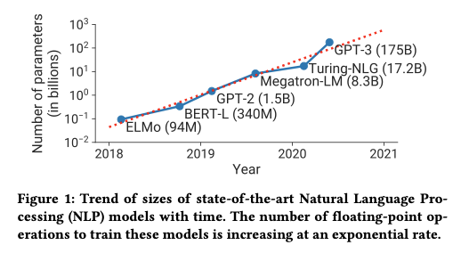
Deep Neural Networks (DNNs)
Deep Neural Networks and Pre-Trained Models
As time goes on, the size of DNNs is ballooning
The cost of training a DNN is correlated with the number of Parameters the model has
As a result, the ability of engineers to train SOTA models from scratch decreases
Efficient large-scale language model training on GPU clusters using megatron-LM | Proceedings of the International Conference for High Performance Computing, Networking, Storage and Analysis
Notes:
The more parameters a DNN has, the greater its performance (generally)
As a result, the size of DNNs has ballooned
In 2018 SOTA DNNs had 94 M parameters, in 2020, they had 175B, it’s been estimated that GPT-4 has 1.8 Trillion parameters according to a report by SemiAnalysis in June of 2023 https://the-decoder.com/gpt-4-architecture-datasets-costs-and-more-leaked/
This ballooning is expense: the cost of training a DNN, both monetary and time, is correlated with the number of parameters a model has
As a result, as the number of parameters required to achieve SOTA increases, the ability of engineers to train SOTA models from scratch decreases
Computation isn’t free.
$$: Strubell et al., 2019: https://arxiv.org/pdf/1906.02243.pdf
-The direct financial cost of the requisite GPUs and compute servers, whether owned or rented through the cloud, is $100Ks and up.
-As of 2019, the approximate carbon footprint of training and optimizing one state-of-the-art DNN model is comparable to flying a full jet from NY to SF.
-Per the figure on this slide, that cost has gone up multiple orders of magnitude since then

Slide 12
Pre-Trained Models (PTMs)
Deep Neural Networks and Pre-Trained Models
Pre-Trained Model: A DNN that is already parameterized for an application
Provide a checkpoint of the DNN for reuse
https://www.cs.toronto.edu/~kriz/cifar.html
Notes:
Pre-Trained Models are DNNs that have been trained to perform a specific task already
What this means is that they have already been trained on a dataset, and as a result are a “checkpoint” which is a transferable description of the model.
This checkpoint can be transferred and transported and distributed easily
These Pre-Trained models are helpful for 2 reasons
They are usable for the task they were trained on
Example: I train a model on the CIFAR 10 dataset to identify photos with dogs in them, then publish the PTM
Someone else uses that same model to identify photos with cards in them
Different aspects of the PTM are reusable in different ways to gain new functionality without creating a new model from scratch
Someone takes my model and fine tunes it to identify insects

Slide 13
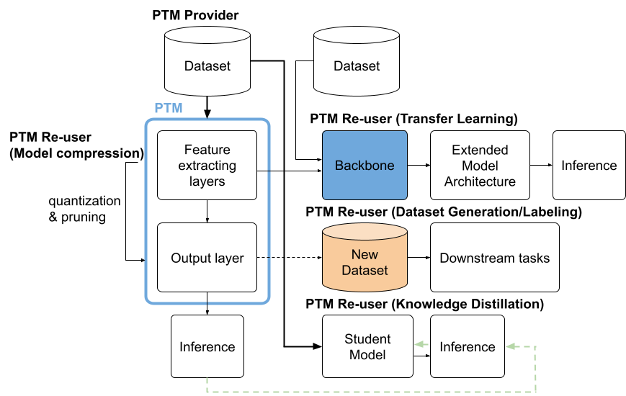
PTMs improve the accessibility of DNNs
Deep Neural Networks and Pre-Trained Models
Jiang et. al: An Empirical Study of Artifacts and Security Risks in the Pre-trained Model Supply Chain. Scored’22.
Notes:
This chart shows several ways DNNs can be reused
4 major ways:
Transfer Learning
Model Compression
Knowledge Distillation
Dataset Generation/Labeling

Slide 14
PTMs improve the accessibility of DNNs
Deep Neural Networks and Pre-Trained Models
Jiang et. al: An Empirical Study of Artifacts and Security Risks in the Pre-trained Model Supply Chain. Scored’22.
Notes:
Transfer Learning is the example I used earlier, where a model that has been trained on a task is “fine tuned” aka re-trained, on a new set of data.
The hope here is that the general patterns that the model has learned to identify can be transferred to a new context.

Slide 15
PTMs improve the accessibility of DNNs
Deep Neural Networks and Pre-Trained Models
Jiang et. al: An Empirical Study of Artifacts and Security Risks in the Pre-trained Model Supply Chain. Scored’22.
Notes:
Model compression involves the reduction in parameters of a model to improve portability and speed with a minimal impact to performance

Slide 16
PTMs improve the accessibility of DNNs
Deep Neural Networks and Pre-Trained Models
Jiang et. al: An Empirical Study of Artifacts and Security Risks in the Pre-trained Model Supply Chain. Scored’22.
Notes:
Knowledge distillation involves using a model as a “teacher” of a “student” model, allowing for the student model to learn more quickly than it normally would
This allows smaller applications and systems with limited computational capacity to learn complicated patterns from a larger network

Slide 17
PTMs improve the accessibility of DNNs
Deep Neural Networks and Pre-Trained Models
Jiang et. al: An Empirical Study of Artifacts and Security Risks in the Pre-trained Model Supply Chain. Scored’22.
Notes:
Finally, we have dataset generation and labeling, which uses a model to either create new data, or to label existing data.
This increases the quantity of data available, and can result in a high degree of accuracy dependent on the models performance
We’ve talked about PTMs, let’s talk about where they fit into the bigger picture

Slide 18
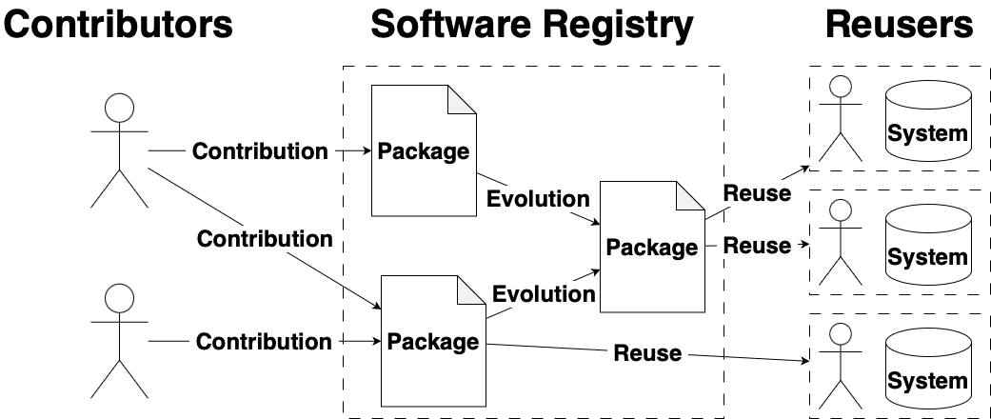
Software Supply Chains
Software Package Registries and Software Supply Chains
Notes:
Modern software development relies on the reuse of third party dependencies made available through software supply chains.
Software Supply chains describe the connections between upstream software package contributors, downstream reusers, and the packages themselves
A key component of Software Supply chains are software Package Registries, which bring together contributors, reusers, and packages within a shared ecosystem.
They are a hotspot of interaction between these relevant actors in the software supply chain

Slide 19
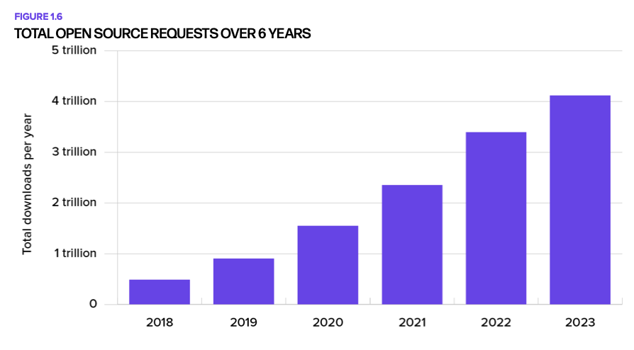
Software Supply Chain Growth
Software Package Registries and Software Supply Chains
https://www.sonatype.com/state-of-the-software-supply-chain/introduction
Notes:
Shown here is the growth of software supply chains over time
In 2018, the total number of open source requests over time was half a trillion
In 2023 that number was over 4 trillion

Slide 20
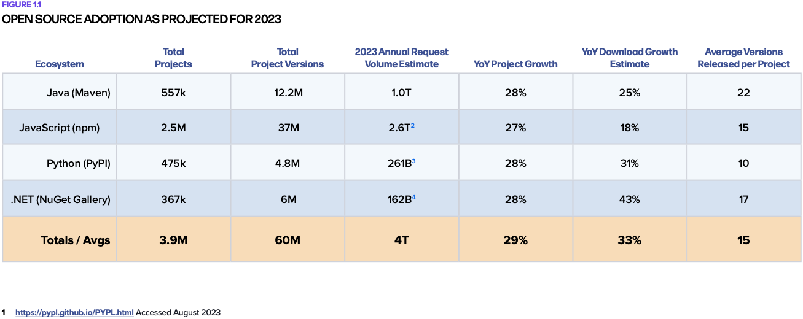
Software Package Registry Growth
Software Package Registries and Software Supply Chains
Notes:
Individual Software Package registries have grown over time as well
All listed registries host projects in the 100s of thousands and in NPM’s case, millions
These registries all experience a high amount of growth in both package contribution and total downloads
2 Figure estimated using npm download counts to from January to August 2023 as queried from https://github.com/npm/registry/blob/master/docs/download-counts.md
3 YoY growth estimated based on known PyPI downloads from January to August 2023 as queried from https://console.cloud.google.com/marketplace/product/gcp-public-data-pypi/
4 YoY growth estimated based on known NuGet Gallery downloads from January to August 2023 as queried from https://www.nuget.org/stats

Slide 21
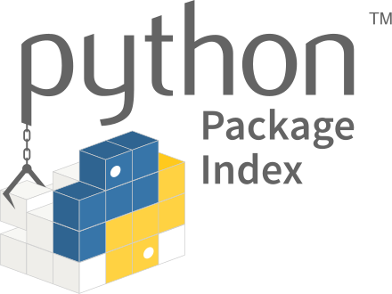
Software Package Registries
Software Package Registries and Software Supply Chains
Notes:
A key component of Software Supply chains are software Package Registries, which bring together contributors, reusers, and packages within a shared ecosystem.
They are a hotspot of interaction between these relevant actors in the software supply chain
These registries also track and make available important metadata about packages, including information about package contributors, package popularity, and other context-dependent information.
As a result, registries are fantastic resources for understanding the contribution, evolution, and reuse of packages
Registries are well studied, with their results revealing important information about supply chain security, the evolution of packages, the patterns of contribution, among others

Slide 22
Software Package Registries
Software Package Registries and Software Supply Chains
Notes:
2 representative package registries are the Python Package Index and NPM, which host packages related to Python and Javascript
These are some of the most studied and most popular registries.

Slide 23
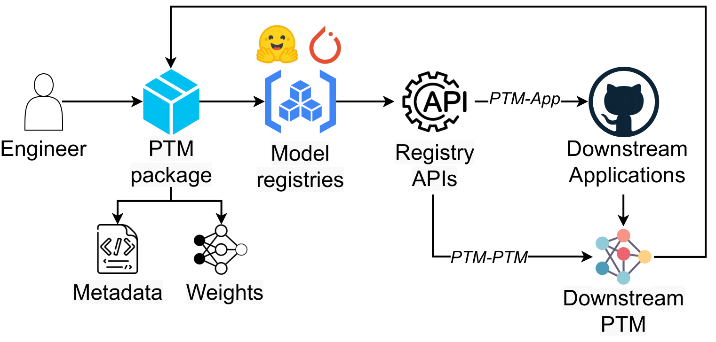
PTM Supply Chains
Pre-Trained Model Supply Chains and HuggingFace
Jiang et. al: PeaTMOSS: A Dataset and Initial Analysis of Pre-Trained Models in Open-Source Software
Notes:
There exists a supply chain for PTMs as well
Largely resembles that of a traditional software supply chain
Fundamental difference is the kind of software package being distributed
PTM packages are like improv in that they are a “yes and” package: They contain everything a traditional software package would, plus additional attributes unique to PTMs
Just like in traditional SSC, PTM Supply chains have package registries to facilitate PTM contribution, evolution, and reuse
These model zoos have been categorized as either
Open: No restrictions on Contribution, open source models
Gated: Some restrictions on Contribution, open source models
Commercial: No Contribution except from company employees, closed source models
A particular model zoo of interest is HuggingFace, I’ll get to why on the next slide

Slide 24
HuggingFace
Pre-Trained Model Supply Chains and HuggingFace
HuggingFace has been the focus of several recent studies
Engineers believe that the reuse process is different compared to traditional software
Interviews with engineers who reuse PTMs described several patterns of reuse distinct from traditional software
Quantitative work characterizing the evolution of models on the hub has also described patterns of reuse that are distinct from traditional software
huggingface.co
Notes:
HuggingFace has been the focus of several recent studies that have examined its role in the reuse of PTMs
These studies have been mostly qualitative, and have found that engineers believe that the reuse process is different compared to traditional software
They described several patterns:
Engineers preferred to search for candidate models through registries, claiming that the domain classification of the registries (Computer Vision, NLP) combined with their task (image classification, text generation) levels simplified searching
Most participants used popularity to select a model
Quantitative studies have also been performed to characterize the evolution of models on the hub. They suggested that the lifecycle of PTMs is distinct from traditional software
HuggingFace is an Open Model Zoo, a kind of model zoo that allows for open contribution from anyone
This is in contrast to other model zoos which are either gated, only allowing contributions from verified members,
Or
Commercial, not allowing any outside contributions

Slide 25
Summary
Software Supply Chains describe the connections between contributors, packages, and users
PTMs have novel applications and attributes compared to traditional software, and have a distinct Supply Chain as a result
Prior work has established that software engineers claim the reuse of PTMs is different than traditional software, however, we have yet to verify these claims with quantitative data
Notes:
Software Supply Chains describe the connections between creators, packages, and users
Software registries are collaborative platforms that unite contributors, users, and packages, and streamline package management processes
The introduction of PTMs to the Software Supply Chain is only beginning to be examined
PTMs have novel applications and attributes compared to traditional software
Prior work claims that the reuse of PTMs is different than traditional software
However, we have yet to verify these claims with quantitative data

Slide 26
Restatement of Contributions
A dataset describing PTMs and their downstream relationships (PeaTMOSS)
A set of metrics that quantifies attributes of various software package registries, including adaptations specific to PTM package registries
A comparison of representative package registries

Slide 27
Research Approach
In order to address the established gaps in knowledge, I created a dataset descriptive of PTMs (Contribution 1)
I then developed a set of metrics that could be used to compare traditional software and PTM registries (Contribution 2)
This set of metrics was then applied to representative traditional software and PTM registries in order to draw a comparison between them (Contribution 3)

Slide 28
PeaTMOSS: Pre-Trained Models in Open Source Software
A Quantitative Comparison of Pre-Trained Model Registries to Traditional Software Package Registries

Slide 29
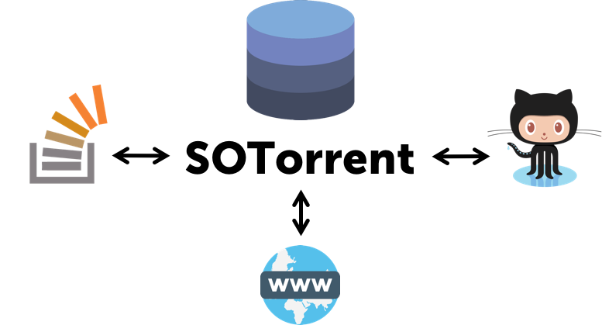
Motivation
PeaTMOSS
Notes:
In order to improve our understanding of the software engineering practices and challenges surrounding PTM reuse, a dataset was needed
Prior work in traditional software has utilized mining Software Repositories to further ecosystem understanding.
Large-scale open-source software datasets, such as
GHTorrent
SOTorrent
TravisTorrent
And World of Code
offer long-term data availability and allow for in-depth analysis of a snapshot of a registry
These datasets have been instrumental in improving our understanding of software engineering,
\eg of practices in
continuous integration
static analysis
software development
and
Testing
unfortunately current datasets on PTMs are lacking, which leaves a gap in knowledge
There are two existing PTM datasets: PTMTorrent and HFCommunity
Both provide data included in the Hugging Face model registry, offering insights into PTMs.
However, both lack queryable PTM metadata and do not cover downstream applications.
This absence of information impedes our ability to derive a coherent picture of PTMs' impact and usage in software engineering.
PeaTMOSS addresses both limitations by including additional content, \eg extracted metadata from model cards and links to downstream GitHub repositories.

Slide 30
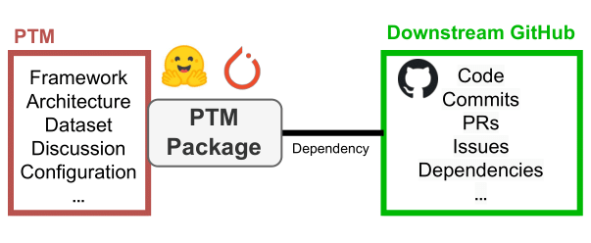
Contribution and Statement of Ownership
PeaTMOSS
The PeaTMOSS Dataset
281,638 Models
28,575 GitHub Repositories
44,357 links connecting them
Owned:
Basic PTM metadata gathering
PTM snapshot retrieval
Creation of SQLite3 database
Notes:
To address this gap, PeaTMOSS was created
PeaTMOSS enables mining of PTMs, the software projects that use them, and the interactions between PTMs and downstream use.
PeaTMOSS contains a snapshot of:
(1) 280k PTMs,
(2) 28k open-source software repositories that use PTMs
(3) 44k mappings between PTMs and downstream GitHub repositories.
The metadata for models, repositories, and links is provided in a queriable SQLite3 database,
whose Schema is on the next slide,
with snapshots of the most popular models (top 15k) and all github repositories stored on a globus share
In this project I contributed to the retrieval of basic PTM metadata along with snapshots of PTMs
I was also responsible for creating the database to store all the information

Slide 31
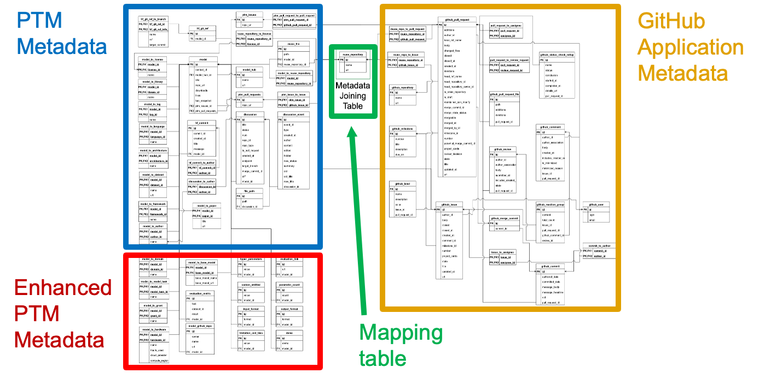
Notes:
There are four regions:
tables for PTMs (basic and enhanced),
tables for GitHub projects,
and
a table of PTM-Application dependency relations.
Tables link to PTM and GitHub snapshots in a Globus share.
Our artifact has a navigable version

Slide 32
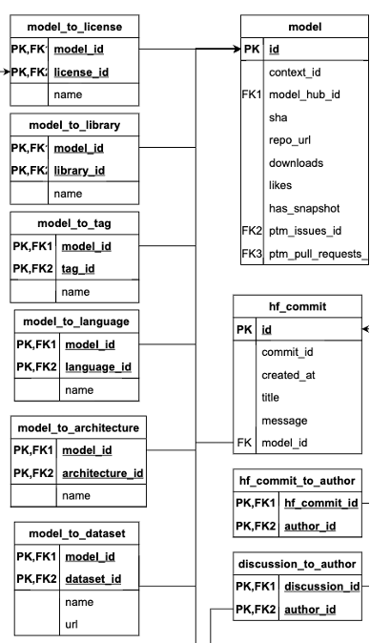
Database Schema - Basic PTM Metadata
PeaTMOSS
Example metadata:
-Downloads
-Commits
-Authors
-License
-Library
-Model tag
-Language
-Architecture
-Dataset
…
Notes:
Basic PTM metadata is metadata that describes social dynamics of models, as well as basic model config information
Social dynamics I mean who contributed, how much is a model downloaded, what icenses does the model have
Basic config information refers to the library used to create the model, the datasets used to train it, the architecture of the model

Slide 33
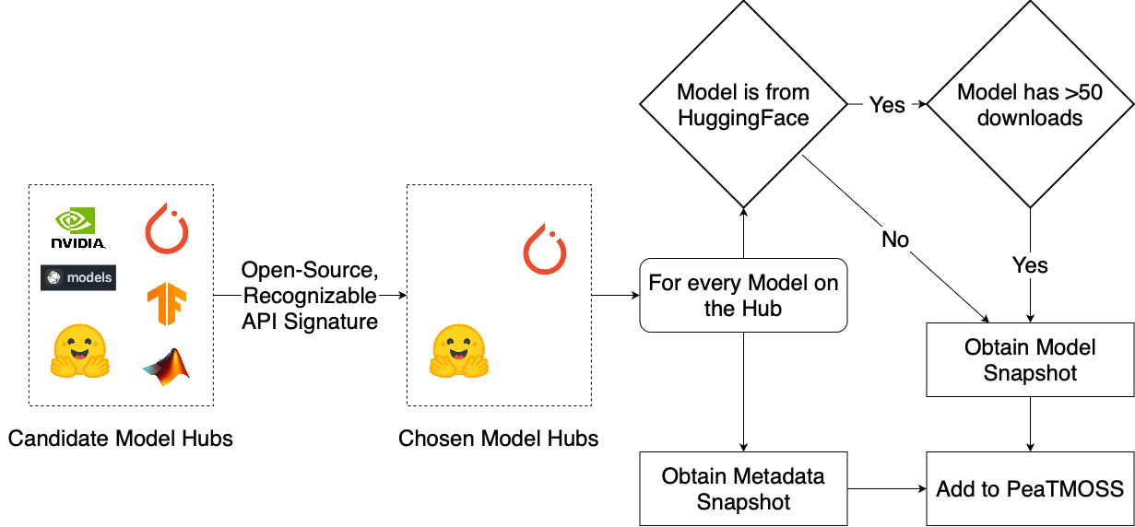
Basic PTM Metadata Gathering
PeaTMOSS
Notes:
First, we must identify the model registries whose PTMs we will collect.
Of these, only the open and gated types are open-source.
For mining, we need registries that have APIs with recognizable signatures, allowing us to trace PTM-App dependencies (details in~\cref{sec:DataCollection-Linking}). %, ensuring identifiable signatures for tracing PTM-App dependencies.
Considering these criteria, we selected the most popular example from each open-source category that utilizes APIs.
Thus, we included PTMs from Hugging Face (an open registry) and PyTorch Hub (a gated registry).
Hugging Face contains far more PTMs than PyTorch Hub, which influenced several decisions we made in creating \DatasetNickname.

Slide 34
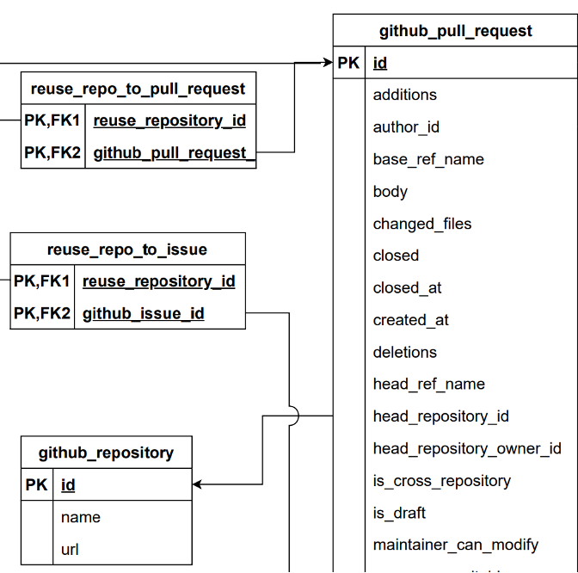
Database Schema - GitHub Project Metadata
PeaTMOSS
Example metadata:
-PRs
-Issues
-Commits
-Label
-License
-…
Notes:
Github Project metadata contains downstream collaborative information that describes the contributions made to the repository
This includes Pull Requests, Issues, Discussions, labels

Slide 35
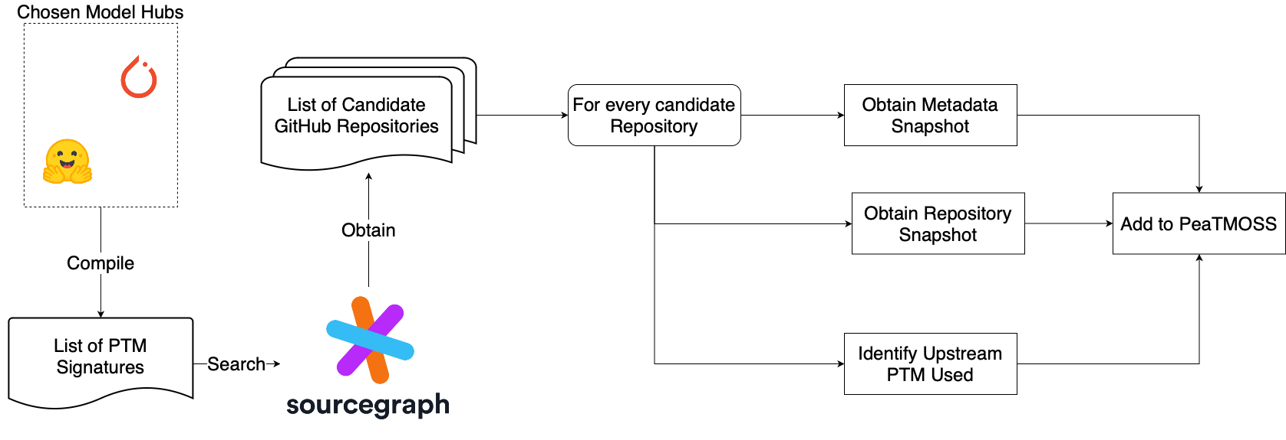
GitHub Project Metadata Gathering
PeaTMOSS
This work was done by Jerin Yasmin from the RISE lab from Queen’s University, in Quebec Canada
Notes:
This work was done by Jerin Yasmin from the RISE lab from Queen’s Univeristy in Quebec
As a brief overview, the chosen model hubs had their distinct signatures of reuse identified
These signatures were used to identify downstream repositories that might reuse a PTM from one of the platforms
For each repository, a snapshot of the metadata and repository was obtained
And a static analysis was performed to attempt to identify the Upstream PTM used

Slide 36
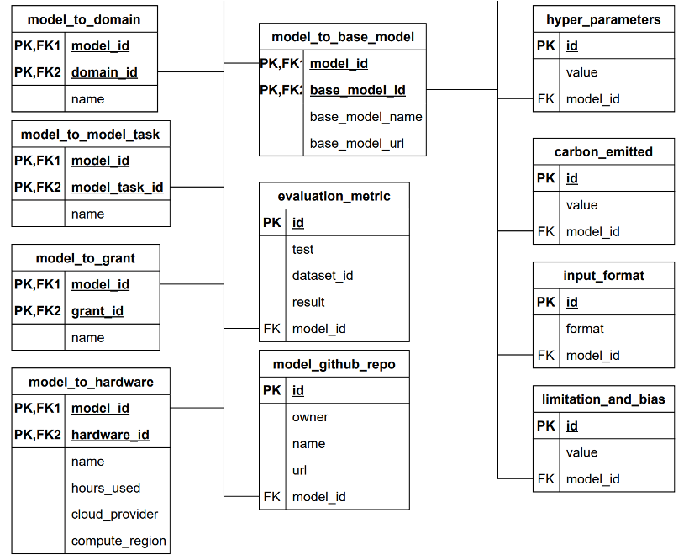
Database Schema - Enhanced PTM Metadata
PeaTMOSS
Example metadata:
-Base/upstream model
-Hyper parameters
-Carbon emitted
-Evaluation metrics
-Hardware requirements
-Parameter count
-Input/output format
-…
Notes:
Enhanced PTM metadata involves advanced information about model config
This involves more performance and evaluation based metrics
These describe the actual attributes of the model itself, rather than its structure

Slide 37
Enhanced PTM Metadata Gathering
PeaTMOSS
This work was performed by Shen Kuo from Purdue’s Duality Lab
Notes:
An LLM pipeline was used to extract this information
It was fed Model Cards, which are the readmes of PTMs, as well as config files to extract the informaiton

Slide 38
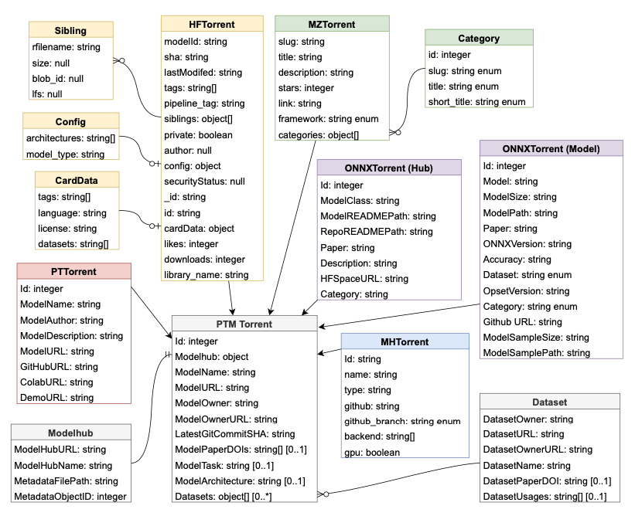
Data Schema Creation
PeaTMOSS
PTMTorrent’s Data Schema made it difficult to compare across Model Zoos
Priority: Handle metadata from diverse sources while preserving information in a way that supports inter-source comparison.
Used core “model” table and layers of indirection
Improved
Data integrity
Schema's flexibility
Notes:
PeaTMOSS was an evolution of PTMTorrent
PTMTorrent’s Data Schema made it difficult to compare across Model Zoos
A priority of mine when designing PeaTMOSS’s was to handle metadata from diverse sources while preserving information in a way that supports inter-source comparison.
To achieve this, I began with a core “model” table that contained fundamental model info, common across all selected model registries
Any extra model info would be expressed with layers of indirection
This design improved data integrity and significantly enhanced the schema's flexibility to incorporate new information or metadata attributes seamlessly
It also resulted in a smaller dataset size

Slide 39
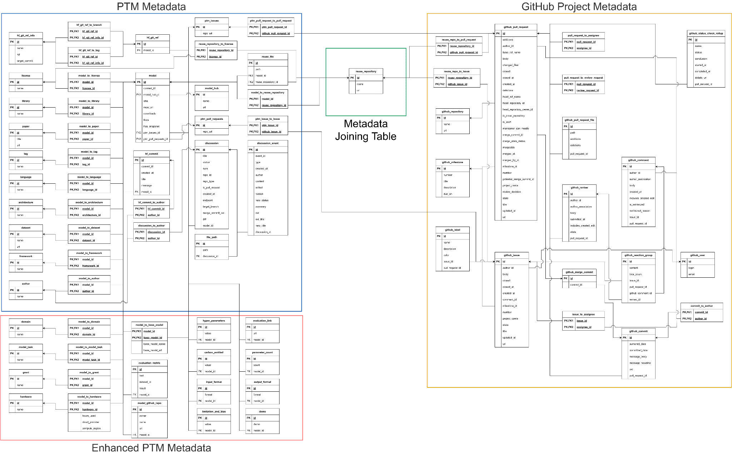
Data Schema
Notes:
Red is the core Model table, Orange is every indirection table used

Slide 40
PeaTMOSS: Pre-Trained Models in Open Source Software
A Quantitative Comparison of Pre-Trained Model Registries to Traditional Software Package Registries

Slide 41
Thesis Restatement
Introduction
Deep Neural Networks are a new kind of software. Software engineers solve new problems / known problems in new ways.
Therefore, the contribution, evolution, and reuse of Deep Neural Networks as Pre-Trained Models is unique compared to traditional software.
Understanding these differences will inform the transferability of prior knowledge, evaluation tools, and frameworks of understanding from traditional software to PTMs.

Slide 42
Overview
Introduction
Notes:
As mentioned earlier, prior work has indicated clear gaps in knowledge in our understanding of PTM reuse
We have an understanding of traditional software registries, and an understanding of PTM registries, but we have yet to make a direct comparison between them

Slide 43
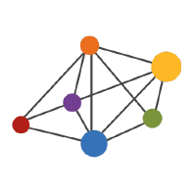
Overview
Introduction
Packages
PeaTMOSS
Notes:
To bridge this gap, I employed PeaTMOSS to provide a quantitative analysis of PTM reuse, setting the stage for a direct comparison with traditional software reuse practices
This methodical approach allows for a structured evaluation of PTM contribution, evolution, and reuse dynamics
Traditional software packages were described using the Packages dataset from the Open Source Collective

Slide 44
Study Design

Slide 45
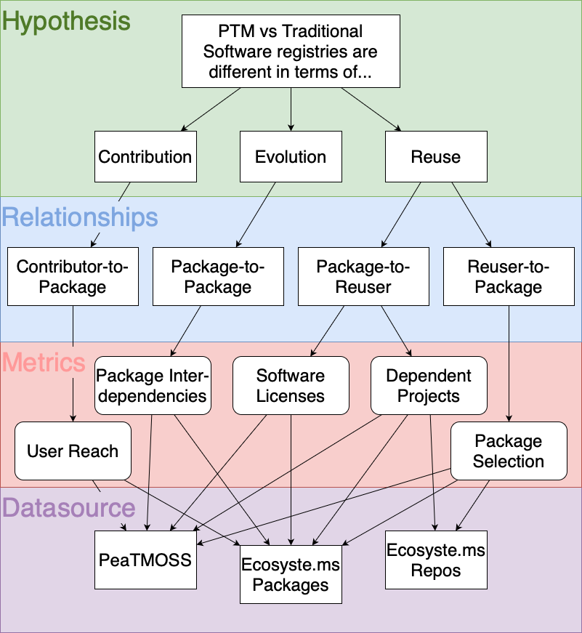
Study Structure
Research Questions
This study is structured using the goal, question, metrics (GQM) structure which defines a measurement model on 3 levels:
Conceptual Level (Goal)
Operational Level (Question)
Quantitative Level (Metric)
Notes:
I structured the study using the Goal Question Metrics Structure
1. Conceptual level (Goal)
A goal is defined for an object, for a variety of reasons, with respect to various models of quality, from various points of view and relative to a particular environment.
2. Operational level (Question)
A set of questions is used to define models of the object of study and then focuses on that object to characterize the assessment or achievement of a specific goal.
3. Quantitative level (Metric)^{[8]}
A set of metrics, based on the models, is associated with every question in order to answer it in a measurable way.

Slide 46
Hypothesis
Research Questions
The
Contribution
Evolution, and
Reuse
of Deep Neural Networks as Pre-Trained Models is unique compared to traditional software
Notes:
The goal was to compare traditional software and PTMs in three categories:
Contribution
Evolution
And Reuse

Slide 47
Relationships
Research Questions
To reach our goal – testing the hypothesis – we ask the following questions about relationships on each registry:
How are…
Contributor-to-Package (Contribution)
Package-to-Package (Evolution)
Package-to-Reuser (Reuse); and
Reuser-to-Package (Reuse)
relationships different between traditional software and PTM registries?
Notes:
These categories were defined further into 4 questions:
Contributor-to-Package (Contribution)
Package-to-Package (Evolution)
Package-to-Reuser (Reuse); and
Reuser-to-Package (Reuse)

Slide 48
Metrics
Methodology
For each question, we answer it using the following metrics:
Contributor-to-Package
User Reach
Package-to-Package
Package Interdependencies
Package-to-Reuser
Software Licenses
Dependent Downstream Projects
Reuser-to-Package
Package Selection
Notes:
Each Question had a metric or set of metrics defined in order to provide quantitative results.
Contributor-to-Package
User Reach
The impact users have on an ecosystem
Package-to-Package
Package Interdependencies
The amount packages rely on each other
Package-to-Reuser
Software Licenses
The permissions granted to software reusers
Dependent Downstream Projects
The amount packages are being reused
Reuser-to-Package
Package Selection
The turnover and choice of packages

Slide 49
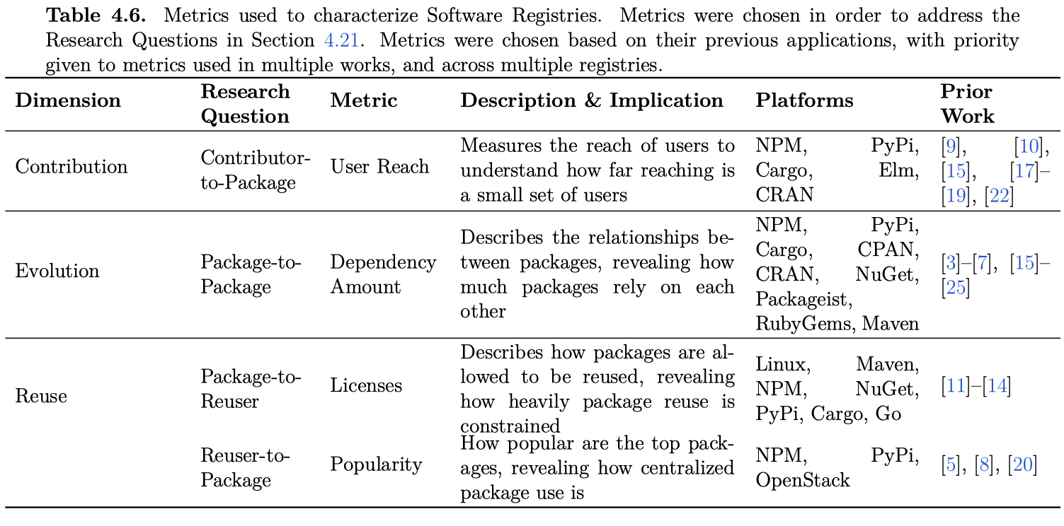
Metrics
Methodology
Notes:
Summarized in this table are the selected metrics, along with the prior work they come from and the traditional software registries they have been used to describe

Slide 50
Package Contribution
Methodology
User Reach:
A measure of how far reaching a single user is
Found by summing the number of packages a user had either owned or contributed to
Notes:
User reach was found by simply summing the number of packages that a maintainer had contributed to at some point in time, or owned.
It was calculated as follows:
Let $P_{contributed}$ be the set of packages a user has contributed to, and $P_{owned}$ be the set of packages owned by the user.
The User's Reach, $U_{reach}$, avoiding double counting of packages that are both contributed to and owned, is given by the formula:
\begin{equation}
U_{reach} =\|P_{contributed} \cup P_{owned}\|
\end{equation}
Here, $\|A \cup B\|$ represents the cardinality of the union of sets $A$ and $B$, which includes all unique packages either contributed to or owned by the user, without double counting any overlap.

Slide 51
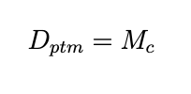
Package Evolution
Methodology
Package Interdependencies:
A measure of how much packages rely on each other
Found by totalling the number of direct dependents a package had
For PTMs, a dependency was defined as a model that a checkpoint was taken and trained from
Notes:
To measure \ptp relationships, dependencies were examined.
In the context of PTMs, dependencies exist not as a persistent connection to another PTM, but as a checkpoint from which a model was taken from.
However, the idea of a dependency tree remains the same.
In the PeaTMOSS dataset, the table "model\_to\_base\_model" connects models to the original model that they diverged from.
This table was created using the DARA pipeline, as mentioned in \cite{jiang_peatmoss_2024}.
The graphs are generated as follows:
The number of dependent packages ($D_p$) is the number of direct dependents ($N_d$) that a package has:
\begin{equation}
D_p = N_d
\end{equation}
The number of dependent packages for a PTM ($D_{ptm}$) is the number of models that use it as a checkpoint to train from ($M_c$):
\begin{equation}
D_{ptm} = M_c
\end{equation}

Slide 52
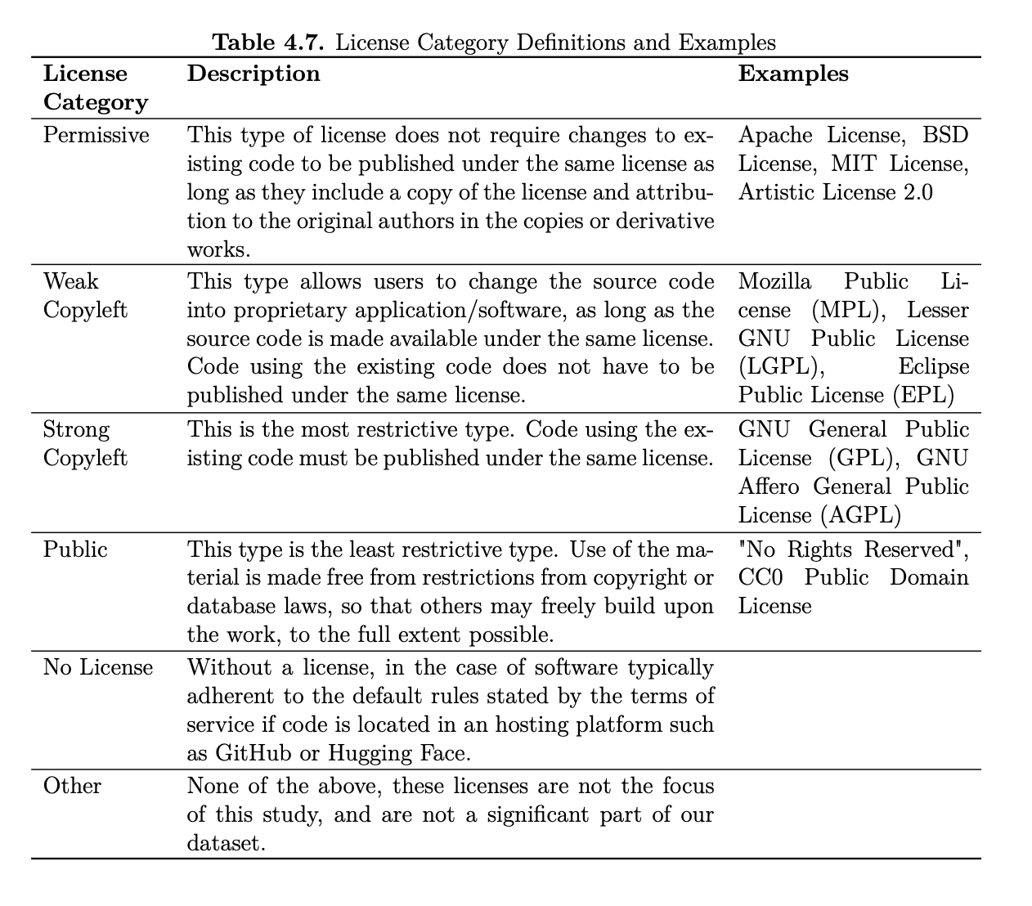
Package Reuse
Methodology
Software Licenses
Measures the permissions that a package is allowed to be reused under
Found by categorizing package licenses into one of 5 categories
Notes:
Licenses are categorized as shown in \ref{tab:licenses}.
The raw licenses for each platform are available in both the Packages and PeaTMOSS datasets.
For each platform, the licenses from the top 10\% of packages were gathered, along with their frequency.
The licenses were then consolidated based on the embeddings generated, in order to simplify classification.
Licenses were approached this way because of the lack of standardization in reporting practices for software licenses.
This resulted in a large amount and variety of raw license data.
As an example, PyPi had 9,340 different licenses within its top 10\% of packages, with licenses such as
Apache 2.0, Apache Software License, Apache License 2.0, Apache-2.0, "Apache License, Version 2.0", Apache, and Apache License Version 2.0 all being counted differently.
Using this method, the number of unique licenses on PyPi was consolidated down to 400, which allowed for a more in-depth manual review of license classifications.
While it has not been done specifically in the realm of license names, prior work has used embeddings compared pair-wise using cosine similarity to classify things \cite{mathur_putting_2019, zhang_bertscore_2019, kim_evaluating_2022, quan_efficient_2019}.
After doing it this way and manually reviewing, I found that the consolidation was \TODO{XX\%} effective.
This consolidation was done as follows:
% \JD{It is unclear why you are doing it this way as opposed to a more formal/sound approach. Give some rationale for the use of LLMs and cosine embeddings. (What else did you consider? Why did you do it this way? Has anyone else done it this way? Why doesn't other people's approach work for you?)}
Given a series of software licenses, for each license $L_i$, the process is as follows:
\begin{enumerate}
\item Obtain the first up to 40 characters of each software license $L_i$:
\[ L_{i,40} = \text{first 40 characters of } L_i \]
\item Generate embeddings for each license excerpt $L_{i,40}$:
\[ E_i = E(L_{i,40}) \]
Where $E_i$ is the embedding for the $i^{th}$ license's excerpt.
\item Compute the cosine similarity between embeddings $E_i$ and $E_j$ for licenses $i$ and $j$:
\[ C(E_i, E_j) = \frac{E_i \cdot E_j}{\|E_i\|\|E_j\|} \]
\item Licenses are consolidated if the cosine similarity is 0.60 or greater:
\[\text{ If } C(E_i, E_j) \geq 0.60, \text{then licenses } i \text{ and } j \text{ are consolidated.} \]
\end{enumerate}
After consolidating licenses, the licenses were then given to an LLM that had been prompted with the information in Table \ref{tab:licenses}, in order to be classified.
Once every license had been categorized, the count of each category was summed.

Slide 53
Package Reuse
Methodology
Dependent Downstream Projects
A measure of how often a package is used in downstream projects
Found by totalling the number of directly dependent projects
Notes:
\subsubsection{Dependent Repositories}
The number of dependent repos ($R_d$) is the number of repositories that directly include the package ($R_i$), whether it is traditional software or a PTM :
\begin{equation}
R_d = R_i
\end{equation}

Slide 54
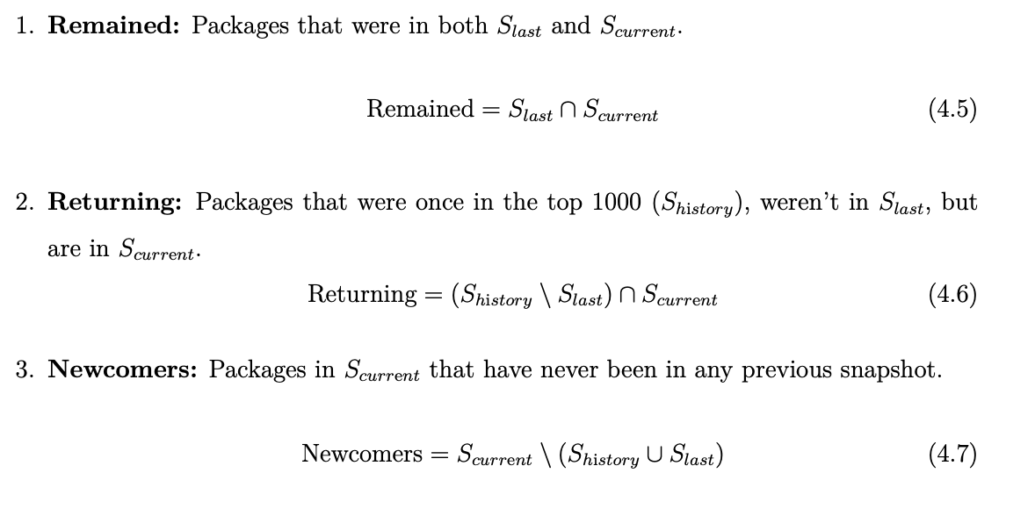
Package Reuse
Methodology
Package Selection
A measure of how stable the most popular packages are over time
Found by examining snapshots of each registry and grouping the models within each into 1 of 3 categories: Remained, Returning, and Newcomers
Notes:
Popularity is measured by looking at the change in top packages over time for each registry.
In order to obtain the historical data, previous dumps of the Packages dataset were obtained dating back to August 2022.
However, the earliest snapshot that contain download information was in October 2022.
For HuggingFace, a dataset with historical data from June 2022 was used, along with PTMTorrent, a previous iteration of PeaTMOSS with data from May 2023, and a current snapshot of HuggingFace from April 2024.
The turnover for each registry is defined as follows:
Let $S_{current}$ be the set of top 1000 packages in the current snapshot, $S_{last}$ be the set of top 1000 packages in the last snapshot, and $S_{history}$ be the set of packages that have appeared in any snapshot before the last snapshot. We categorize the packages in $S_{current}$ into three categories, and evaluate the number of packages in each set:
\begin{enumerate}
\item \textbf{Remained:} Packages that were in both $S_{last}$ and $S_{current}$.
\begin{equation}
\text{Remained} = S_{last} \cap S_{current}
\end{equation}
\item \textbf{Returning:} Packages that were once in the top 1000 ($S_{history}$), weren't in $S_{last}$, but are in $S_{current}$.
% \JD{The set notation is cardinality (size of the set), but the definition in prose is the set itself. Which is it? You might need to change the prose to ``Number of packages...'' for this definition and the next two}
\begin{equation}
\text{Returning} = (S_{history} \setminus S_{last}) \cap S_{current}
\end{equation}
\item \textbf{Newcomers:} Packages in $S_{current}$ that have never been in any previous snapshot.
\begin{equation}
\text{Newcomers} = S_{current} \setminus (S_{history} \cup S_{last})
\end{equation}
\end{enumerate}
The count of packages in the Remained, Newcomers, and Returning sets were graphed for each snapshot.

Slide 55
Data Source
Methodology
PeaTMOSS
Used for HuggingFace metrics
Ecosyste.ms Packages and Repos
Used for Traditional Software metrics

Slide 56
Results

Slide 57
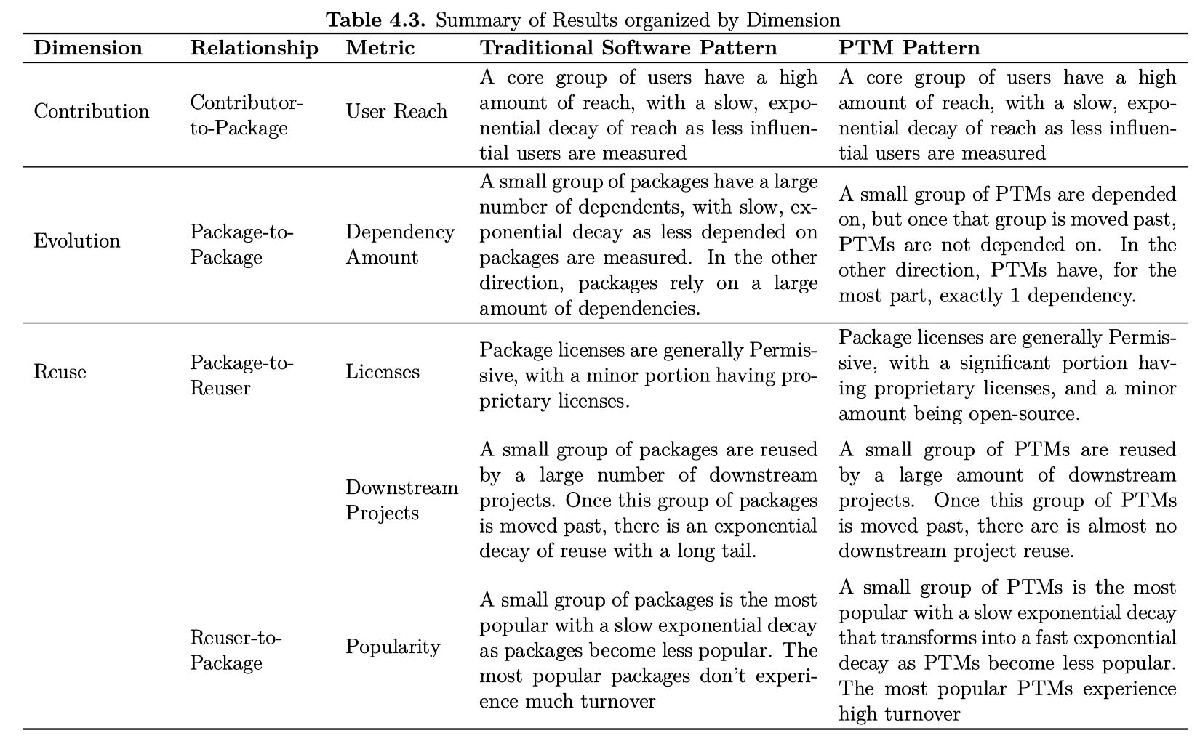
Summary
Results

Slide 58
Summary
Results
Same
Different
Both

Slide 59
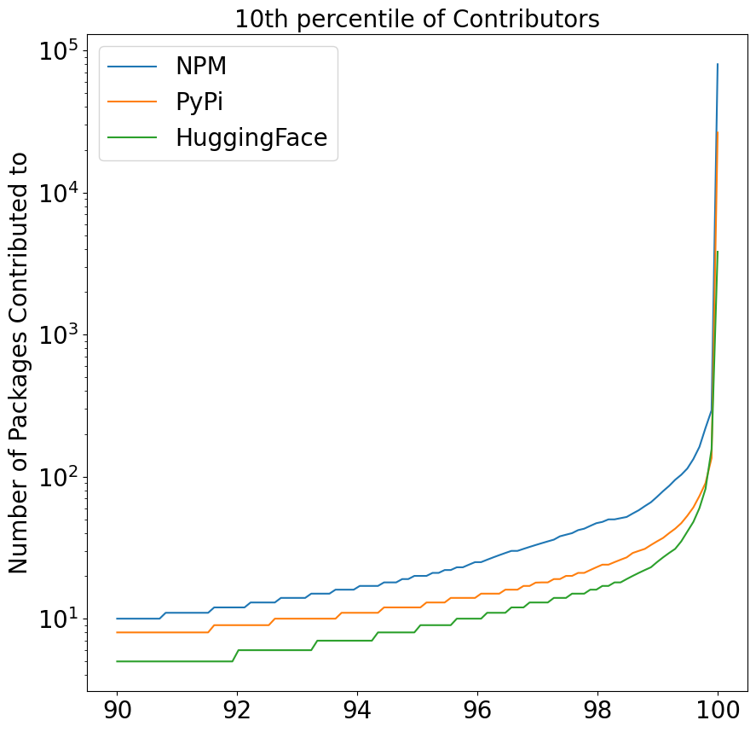
User Reach (Contribution) - Similar
Results
All three repositories demonstrate the same exponential curve
Notes:
The top 10\% of Contributors on NPM, PyPi, and HuggingFace organized by the number of Packages they either own or contribute to.
Note that the representative traditional software package registries (NPM and PyPi and Blue and Orange respectively) and the representative PTM registry (HuggingFace in green) both demonstrate the same exponential curve shape.
The shape of these curves indicates that there is a small concentration of ``power users`` that have a significant reach and influence on the registries.
This group of power users appears to be proportional to the registries as well, since the drop off appears to occur at around the same percentile across all three registries.

Slide 60
User Reach (Contribution) - Similar
Results
All three repositories demonstrate the same exponential curve
Notes:
The top 10\% of Contributors on NPM, PyPi, and HuggingFace organized by the number of Packages they either own or contribute to.
Note that the representative traditional software package registries (NPM and PyPi and Blue and Orange respectively) and the representative PTM registry (HuggingFace in green) both demonstrate the same exponential curve shape.
The shape of these curves indicates that there is a small concentration of ``power users`` that have a significant reach and influence on the registries.
This group of power users appears to be proportional to the registries as well, since the drop off appears to occur at around the same percentile across all three registries.

Slide 61
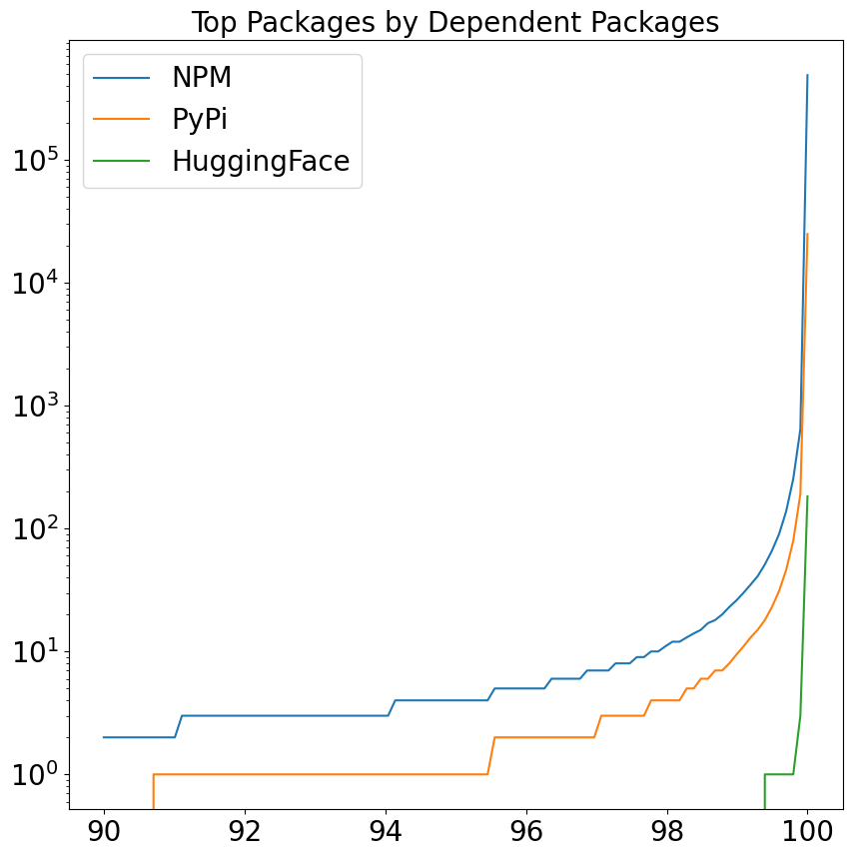
Dependent Packages (Evolution) - Different
Results
Both NPM and PyPI share the same curve while HuggingFace drops off immediately
Notes:
The Top 10\% of Depended on Packages for representative traditional software package registries(NPM in Blue, PyPi in Orange) and the representative PTM registry HuggingFace.
This figure ranks by the number of inter-package dependencies.
Both NPM and PyPi demonstrate a similar curve and drop-off of dependents, while HuggingFace experiences an incredibly rapid drop off.

Slide 62
Dependent Packages (Evolution) - Different
Results
Both NPM and PyPI share the same curve while HuggingFace drops off immediately
Notes:
The Top 10\% of Depended on Packages for representative traditional software package registries(NPM in Blue, PyPi in Orange) and the representative PTM registry HuggingFace.
This figure ranks by the number of inter-package dependencies.
Both NPM and PyPi demonstrate a similar curve and drop-off of dependents, while HuggingFace experiences an incredibly rapid drop off.

Slide 63
Dependent Packages (Evolution) - Different
Results
Both NPM and PyPI share the same curve while HuggingFace drops off immediately
Notes:
The Top 10\% of Depended on Packages for representative traditional software package registries(NPM in Blue, PyPi in Orange) and the representative PTM registry HuggingFace.
This figure ranks by the number of inter-package dependencies.
Both NPM and PyPi demonstrate a similar curve and drop-off of dependents, while HuggingFace experiences an incredibly rapid drop off.

Slide 64
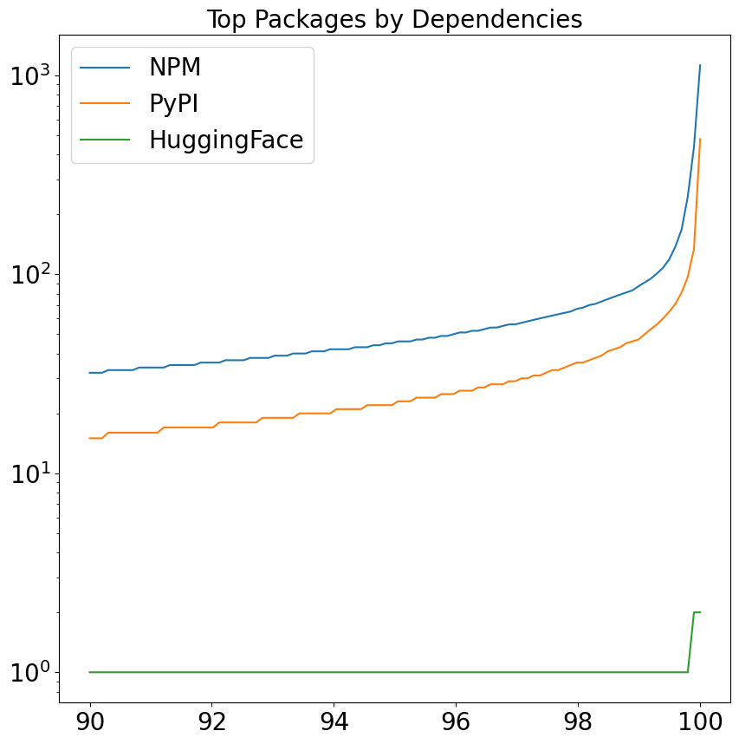
Dependencies (Evolution) - Different
Results
Both NPM and PyPI share exponential curves while HuggingFace immediately drops to a flat line
Notes:
The Top 10\% of Depended on Packages for representative traditional software package registries(NPM in Blue, PyPi in Orange) and the representative PTM registry HuggingFace. This figure ranks by the number of inter-package dependencies. Both NPM and PyPi demonstrate a similar curve and drop-off of dependents, while HuggingFace experiences an incredibly rapid drop off.

Slide 65
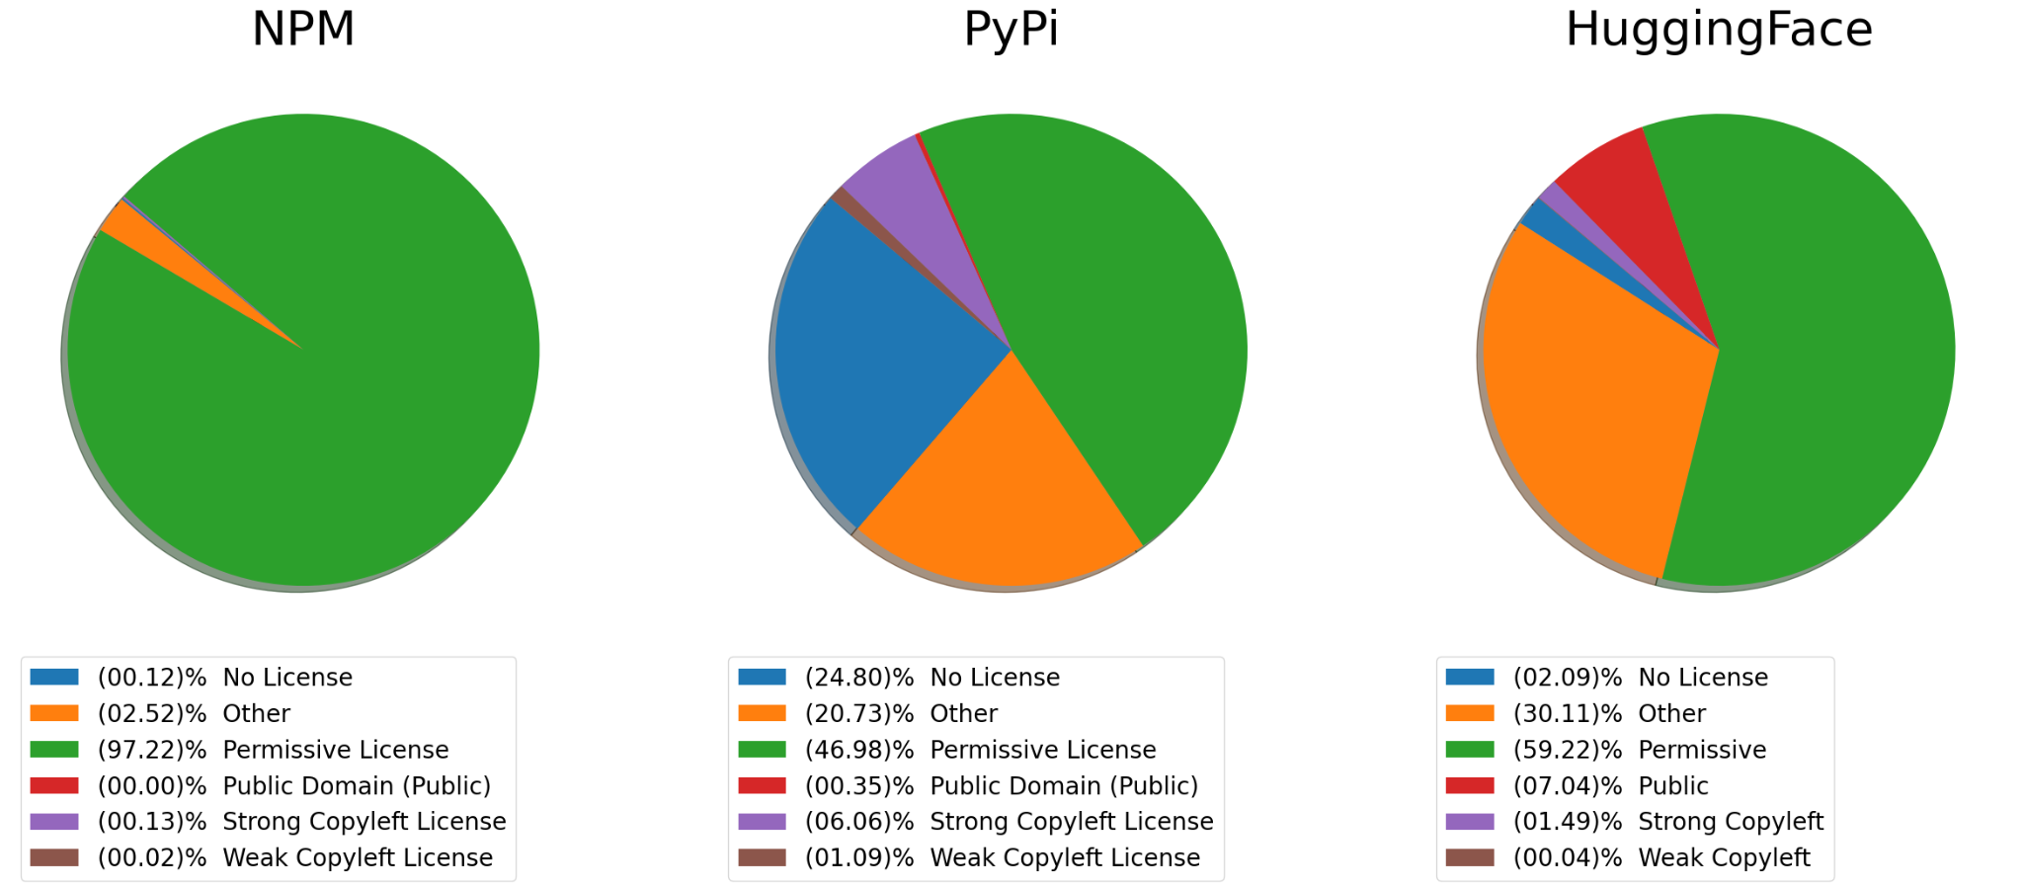
Package Reuse: Similar and Different
Results
Software Licenses
Notes:
Distribution of Software License Categories across NPM, PyPi, and HuggingFace.
NPM is the most explicitlty permissive platform, but all three platforms license packages permissively.
There are some differences, however.
While it appears as though PyPi is the least permissive platform, a large reason for that is the significant number of unlicensed packages.
When considered as Permissive Licenses, PyPi is more permissive as a platform than HuggingFace is.

Slide 66
Software Licenses (Reuse) - Similar
Results
Software Licenses
Notes:
Distribution of Software License Categories across NPM, PyPi, and HuggingFace.
NPM is the most explicitlty permissive platform, but all three platforms license packages permissively.
There are some differences, however.
While it appears as though PyPi is the least permissive platform, a large reason for that is the significant number of unlicensed packages.
When considered as Permissive Licenses, PyPi is more permissive as a platform than HuggingFace is.

Slide 67
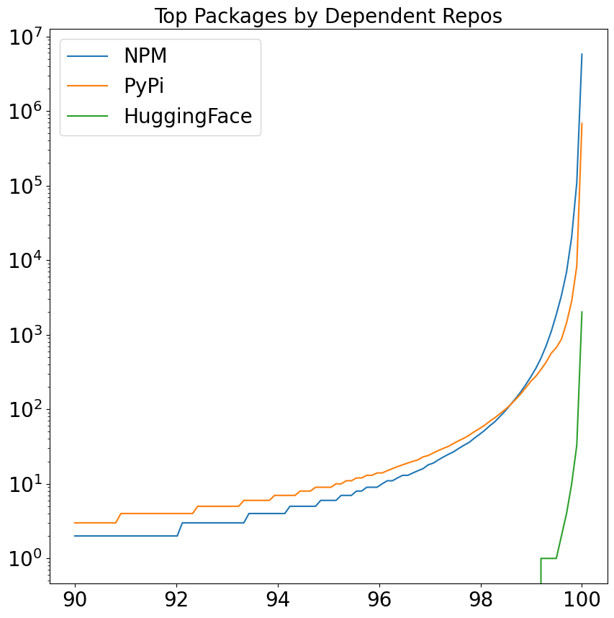
Downstream Projects (Reuse) - Different
Results
Both NPM and PyPI share the same curve while HuggingFace drops off immediately
Notes:
The Top 10\% of Depended on Packages for representative traditional software package registries (NPM in Blue, PyPi in Orange) and the representative PTM registry HuggingFace. This figure ranks by the number of downstream repositories that include the package. Both NPM and PyPi demonstrate a similar curve and drop-off of dependents, while HuggingFace experiences an incredibly rapid drop off.

Slide 68
Downstream Projects (Reuse) - Different
Results
Both NPM and PyPI share the same curve while HuggingFace drops off immediately
Notes:
The Top 10\% of Depended on Packages for representative traditional software package registries (NPM in Blue, PyPi in Orange) and the representative PTM registry HuggingFace. This figure ranks by the number of downstream repositories that include the package. Both NPM and PyPi demonstrate a similar curve and drop-off of dependents, while HuggingFace experiences an incredibly rapid drop off.

Slide 69
Downstream Projects (Reuse) - Different
Results
Both NPM and PyPI share the same curve while HuggingFace drops off immediately
Notes:
The Top 10\% of Depended on Packages for representative traditional software package registries (NPM in Blue, PyPi in Orange) and the representative PTM registry HuggingFace. This figure ranks by the number of downstream repositories that include the package. Both NPM and PyPi demonstrate a similar curve and drop-off of dependents, while HuggingFace experiences an incredibly rapid drop off.

Slide 70
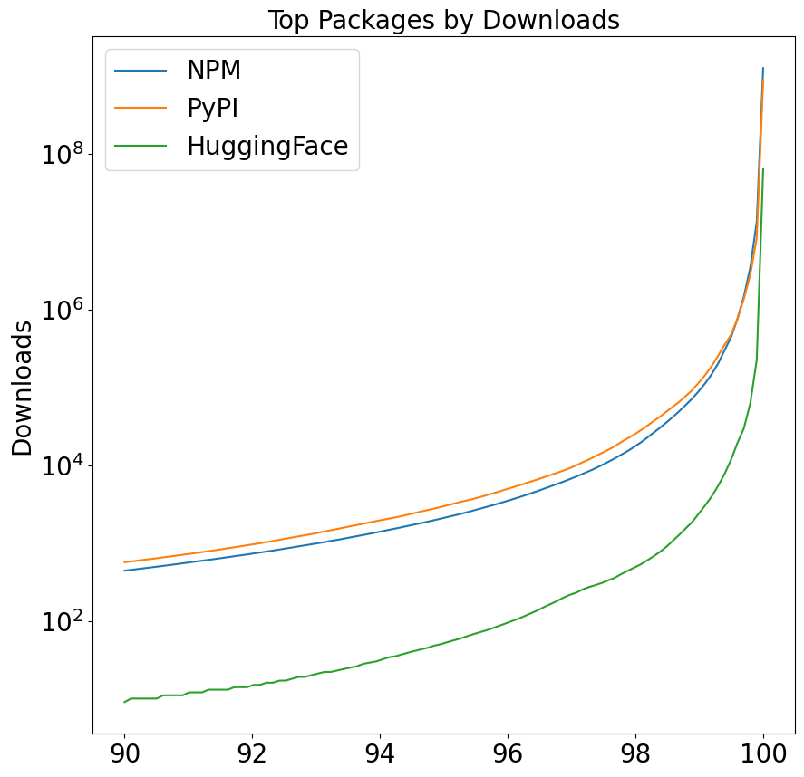
Package Selection (Reuse) - Different
Results
NPM and PyPi experience the same shape, a small group of highly used Packages, with a slow exponential decay in popularity as more packages are considered
HuggingFace has a much faster initial decay, as well as an elbow that marks another increase in dropoff

Slide 71
Package Selection (Reuse) - Different
Results
NPM and PyPi experience the same shape, a small group of highly used Packages, with a slow exponential decay in popularity as more packages are considered
HuggingFace has a much faster initial decay, as well as an elbow that marks another increase in dropoff

Slide 72
Package Selection (Reuse) - Different
Results
NPM and PyPi experience the same shape, a small group of highly used Packages, with a slow exponential decay in popularity as more packages are considered
HuggingFace has a much faster initial decay, as well as an elbow that marks another increase in dropoff

Slide 73
Package Selection (Reuse) - Different
Results
NPM and PyPi experience the same shape, a small group of highly used Packages, with a slow exponential decay in popularity as more packages are considered
HuggingFace has a much faster initial decay, as well as an elbow that marks another increase in dropoff

Slide 74
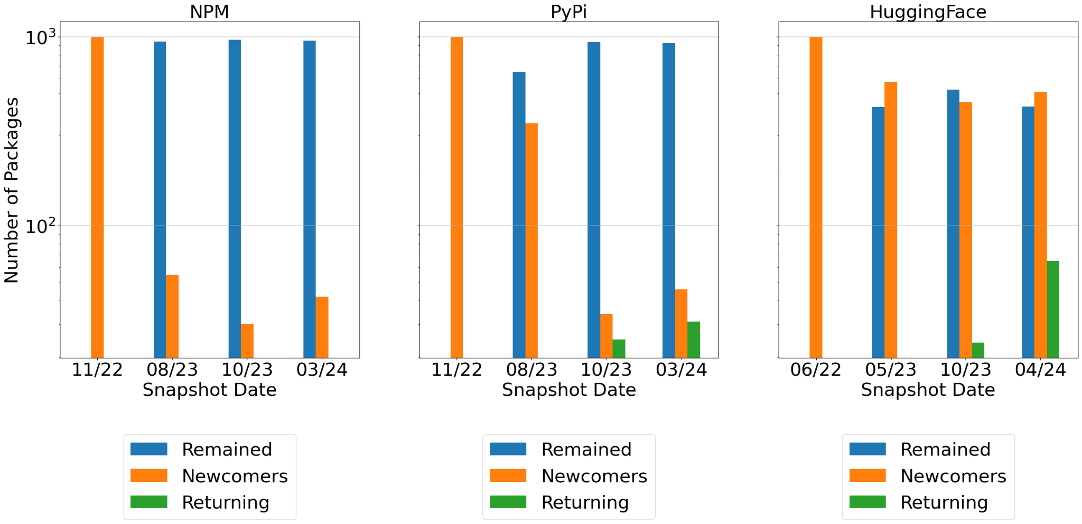
Turnover (Reuse) - Different
Results
NPM and PyPI remain stable at the top, with most of their packages remaining in the top 100 over time, while HuggingFace shows high turnover throughout
Notes:
The turnover of the top-1000 Packages on HuggingFace, NPM, and PyPi. Note that in traditional software package registries NPM and PyPi, the level of turnover is low. Most of the Top 1000 packages remain the same across the snapshots we examined, as indicated by the large blue bars in the second and third snapshots. In contrast, in the representative PTM registry HuggingFace, there is a much higher level of turnover, shown by the orange bar being larger than the blue bar in the second and fourth snapshots. Additionally, HuggingFace has a much larger amount of packages re-enter the Top 1000 as shown by the larger green bars in the second and fourth snapshot compared to NPM and PyPi, who have almost no returners, as shown by the relative lack of green bars.

Slide 75
Summary
Results
Notes:
This work confirms those patterns
The most popular models are the most widely used downstream
Additionally, the idea that the domains and tasks are used to filter out which models to use supports the high turnover rate of packages
Model Selection Once engineers decide to reuse a model,
they must select an existing architecture and an associated
PTM. Engineers search for candidate architectures “built for
the problem that [they are] trying to solve”, browsing model
registries or relevant papers. Most study participants prefer to
search through model registries. For example, participants (P1,
P4, P6) said they can “easily find a model” in model registries
due to classification at the domain (e.g., computer vision,
natural language processing) and task (e.g., text generation,
image classification) levels. P10 noted that standardizing PTM
reuse increases model registries’ popularity.
Once engineers select a candidate architecture, they must
find a particular PTM to use. All study participants, including
those who select architectures from papers, prefer PTMs from
model registries. “Ease of use is very important” to engineers
that do not think it is worth “spend[ing] much time on trying
to understand the script[s] from the GitHub models”. P8 noted
models from Hugging Face are “plug and play.” Since multiple
PTMs might implement the same architecture, engineers select
from among candidates based on PTM attributes (ÅòVII).
For example, most participants use popularity as a factor to
select a PTM because it indicates “[community] trust in the
model”. As another example, multiple participants (P2, P3,
P8, P11) choose NLP PTMs trained on appropriate datasets
(e.g., models trained on datasets with the correct language).

Slide 76
Comparison to Prior Work
Results
This work confirms those patterns
The most popular models are the most widely used downstream
Additionally, the idea that the domains and tasks are used to filter out which models to use supports the high turnover rate of packages
Notes:
Model Selection Once engineers decide to reuse a model,
they must select an existing architecture and an associated
PTM. Engineers search for candidate architectures “built for
the problem that [they are] trying to solve”, browsing model
registries or relevant papers. Most study participants prefer to
search through model registries. For example, participants (P1,
P4, P6) said they can “easily find a model” in model registries
due to classification at the domain (e.g., computer vision,
natural language processing) and task (e.g., text generation,
image classification) levels. P10 noted that standardizing PTM
reuse increases model registries’ popularity.
Once engineers select a candidate architecture, they must
find a particular PTM to use. All study participants, including
those who select architectures from papers, prefer PTMs from
model registries. “Ease of use is very important” to engineers
that do not think it is worth “spend[ing] much time on trying
to understand the script[s] from the GitHub models”. P8 noted
models from Hugging Face are “plug and play.” Since multiple
PTMs might implement the same architecture, engineers select
from among candidates based on PTM attributes (ÅòVII).
For example, most participants use popularity as a factor to
select a PTM because it indicates “[community] trust in the
model”. As another example, multiple participants (P2, P3,
P8, P11) choose NLP PTMs trained on appropriate datasets
(e.g., models trained on datasets with the correct language).

Slide 77
Future Work

Slide 78
Improving PTM-focused Datasets
Future Work
This work contributed PeaTMOSS, a dataset descriptive of PTMs and their downstream relationships.
However, there are several aspects of it that could be improved on by future work:
Increased Description of Reuse
Automation of dataset creation and updates
Snapshot Retrieval
Metadata Querying assistance
Notes:
PeaTMOSS is a good starting point for datasets describing PTM metadata and downstream reuse
However, there are several aspects of it that could be improved on by future work
Increased Description of Reuse
Right now the connections between PTMs and downstream reuse don’t describe how the downstream repos reuse the ptms, just that they do
An evolved version of PeaTMOSS with classifications on how downstream repos reuse the ptms (as in how they reuse it) as well as whether or not version pinning is utilized would be awesome
Automation of dataset creation and updates
Much of the data gathered for PeaTMOSS was done with human guidance and oversight
Automation of tools to gather this data would improve its relevance and ensure a relevant and up-to-date description of PTM reuse
Snapshot Retrieval
The current method of retrieving snapshots involves downloading a large tar file and extracting out the files you want
Could be more elegant
Metadata Querying assistance
THe fractured database is great for storage but newcomers to the database might struggle to reveal the relationships
Improving assistance by providing views for users to query would make the dataset more accessible
Different Database Format
SQLite3 is the most portable database format
However, it lacks in QOL features that other database formats have
Having either an alternative format, or a dump file that is loadable into a format of your choosing would be helpful

Slide 79
Understanding the PTM Supply Chain
Future Work
This work identified several aspects of PTM contribution, evolution, and reuse that are deserving of further study
Contributor Patterns
Dependency Networks
Package Lifespan
Software Licenses
Package Registry Maturity
Notes:
This work identified several sections where future work could continue to illuminate the PTM domain.
Contributor Patterns
Despite the aspects of contribution between PTMs and traditional software packages being fundamentally different, the overall larger pattern of contribution remained the same.
Future work explaining how this similarity occurs in different contribution processes would be interesting.
Dependency Networks
The fundamental difference in PTM was made apparent in the difference in dependency networks among registries.
However, there are further attributes of a PTM that were not studied that might fit a definition of a dependency (Dataset, tools used to create the model, model framework, model architecture).
Future work that examines the relationships between models using a more complete definition of a dependency would help strengthen that comparison.
Software Licenses
Despite there being a much larger amount of debate around how AI models should be used, what is and isn’t ethical, whether they should or should not be regulated, that has not resulted in a vastly different set of licenses for PTMs.
Further study into the kinds of licenses that are used would help understand how Open Source PTM contributors permit reuse.
Package Lifespan
The turnover of top PTMs is much greater than that of top traditional software packages.
Work that examines why this is the case would help downstream software engineers get a sense of whether or not they should allow a PTM to live past a certain period of time.
Package Registry Maturity
I acknowledge that HuggingFace may be immature as a platform for reuse.
At the time that the data was taken, HuggingFace had 281k PTMs, it now has 602k
As a result, it is possible that the differences in metrics is due to immaturity as a platform, rather than a true domain difference that sets it apart from traditional software package repositories.
I leave the examining of these metrics in the context of its age as a platform, and the comparison to the metrics of other traditional software packages at their age to future work.

Slide 80
Overview and Questions

Slide 81
Overview
Overview and Questions
This work showed that some aspects of traditional software practices used to characterize and understand traditional software reuse can be applied to the PTM domain. However, the unique attributes of PTMs require a new set of frameworks to understand this new domain.
Thank you!
Questions?
Jason Jones
jone2078@purdue.edu

Slide 82
Thank you for listening!

