Slide 1
What do we know about Hugging Face? A systematic literature review and quantitative validation of qualitative claims
Jason Jones, Wenxin Jiang, Nicholas Synovic
George K. Thiruvathukal, James C. Davis
Notes:
Hello, my name is Jason Jones
I recently graduated with my Master’s degree from Purdue University’s College of Electrical and Computer Engineering.
My advisor was Professor James Davis, and I worked in his Duality Lab at Purdue.
Today I am going to be presenting my Master’s thesis work:
What do we know about Hugging Face? A systematic literature review and quantitative validation of qualitative claims

Slide 2
Summary
Systematic Literature Review:
12 distinct claims about PTM Reuse on Hugging Face
4 claims lacked large-scale quantitative evidence
Gives lay of the land for future work on PTM Supply Chain
Quantitative validation:
Only some claims were supported by quantitative validation
Results reveal best practices for engineers and areas of future work for researchers
Notes:
In this study, we conducted a comprehensive analysis of Pre-Trained Model (PTM) reuse on the Hugging Face platform.
Our study, consisted of two main parts, a Systematic Literature Review (SLR), followed by a Quantitative validation of the qualitative claims we discovered.
What did we find?
Well, from the Systematic Literature Review (SLR) we found:
- 12 distinct claims about pre trained model reuse on Hugging Face from existing literature, organized into 5 categories
- Importantly, we found that 4 of these claims lacked large-scale quantitative evidence.
When quantitatively verifying these claims, our findings supported 2 of the claims, found ambivalent evidence for another, and determined that one was too imprecise to operationalize.
Our results revealed best practices for engineers, and areas of future work for researchers.
Now to get into the background

Slide 3
Background

Slide 4
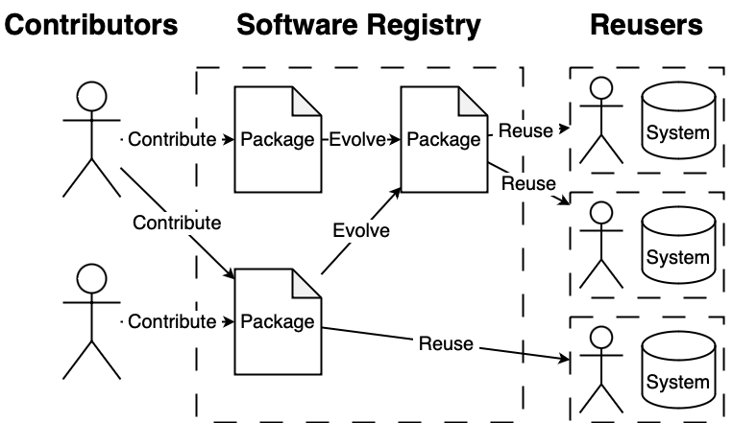
Software Package Registries (npm, pypi, cargo…)
Traditional
1M models
4.7M JS pkgs
8k models
612K Python pkgs
785 models
156K Rust pkgs
Traditional Software
Deep Neural Networks (DNNs)
(as of Oct. 2024)
Notes:
Let's dive into Software Package Registries. These platforms are crucial in connecting package contributors with reusers, streamlining the software reuse process.
On the left, we have Contributors. Software package registries provide them with tools that help them manage their packages through the entire lifecycle:
They can easily bundle their code
Manage different versions
Host their packages centrally
Receive feedback through ratings and comments
In the middle, we see the Software Registry itself. This acts as a central hub, storing and organizing all these packages, making it possible for contributors to contribute and reusers to reuse.
On the right are the Reusers. Software package registries assist them by:
Offering powerful search functionality
Providing package metadata and quality indicators
Facilitating easy retrieval and integration of packages
This ecosystem accelerates development by allowing software engineers to build on existing components rather than starting from scratch.
This isn’t a niche ecosystem either. Traditional software package registries are widely used:
NPM for JavaScript hosts a staggering 4.7 million packages, while
PyPI for Python and Cargo for Rust host 612 and 156 thousand, respectively
Now, in the realm of Deep Neural Networks, we have Pre-Trained Model registries.
These registries allow engineers to reuse or fine-tune existing models instead of training from scratch, dramatically reducing development time and computational resources. For context, training a large model like the 70 billion parameter version of Llama-2 from scratch would require 1.72 Million GPU hours.
<Insert joke here if time… I don’t know about y’all but I can’t wait that long just to get a model that tells me whether a sentence is rude or kind>
Just like traditional software package repositories, Pre Trained model registries are widely used. Hugging Face, the star of our show and indicated by the hugging face emoji, hosts over 1 million models. Other platforms like Kaggle and NVIDIA NGC, while smaller, are also significant.
So, why do we care about these package registries?

Slide 5
Quantifying Software Package Registries yields insights
Construct | Example Metric
User reach | The amount of ecosystem controlled by a fraction of its maintainers. [VL/HCC'17, MSR'19, ICSE'20 x2, ICSME'23,]
Dependency degree | The number of dependencies among software packages. [ICSME'14, MSR'16, ICSME'18, MSR'19, SANER'19, SEP'19, APSEC'20, ICSE'20, ICSE'22, ICSE'23, MSR'23]
Popularity | The frequency of use for top packages, indicating the concentration of usage. [MSR'16, SANER'19, ICSE'20]
Technical lag | The delay in adopting new updates. [MSR'16, ICSME'18, SANER'19, SEP'19, APSEC'20, MSR'23]
Notes:
Well, traditional software registries are an important part of the broader software supply chain, and have been studied extensively to better understand the supply chain.
This table illustrates the extensive research that has gone into quantifying traditional Software Package Registries. Each row represents a different aspect of SPRs that researchers have measured, and the conference citations demonstrate the breadth and depth of this work over time.
Quantifying SPRs has led to several positive outcomes:
It's provided developers with insights for better package selection and reuse strategies.
It's helped registry maintainers improve their platforms and policies.
It's deepened our understanding of software supply chains and ecosystem dynamics.
It's informed better practices for package maintenance and dependency management.
However, when we look at Pre-Trained Model registries, we see a significant research gap. While these registries are becoming increasingly important in the AI and machine learning landscape, they haven't been studied with the same rigor as traditional registries.
Prior research has largely focused on qualitative observations and small-scale quantitative studies. This is understandable as the field is newer, but it means we have been missing out on the kinds of insights that have been so valuable in traditional software engineering.
This work addresses this gap. We have applied similar quantitative approaches to Pre trained model registries, allowing us to draw comparisons with traditional registries and uncover the unique characteristics and challenges of pre trained model ecosystems.
By doing so, we hope to provide the same level of insight for pre trained model registries that has proven so valuable in traditional software engineering contexts.
Now then, let me break down the study structure a bit more.

Slide 6
Quantifying Software Package Registries yields insights
Guided developers to better package selection and reuse strategies
Helped registry maintainers improve their platforms and policies
Informed better practices for package maintenance and dependency management
Deepened our understanding of software supply chains and ecosystem dynamics
?
Notes:
Quantifying traditional software package registries has led to several positive outcomes for contributors, reusers, and registry maintainers, and has furthered our knowledge of the software supply chain
However, when we look at Pre-Trained Model registries, we see a significant research gap. While these registries are becoming increasingly important in the AI and machine learning landscape, they haven't been studied with the same rigor as traditional registries.
Prior research has largely focused on qualitative observations and small-scale quantitative studies. This is understandable as the field is newer, but it means we have been missing out on the kinds of insights that have been so valuable in traditional software engineering.
This work addresses this gap. We have applied similar quantitative approaches to Pre trained model registries, allowing us to draw comparisons with traditional registries and uncover the unique characteristics and challenges of pre trained model ecosystems.
By doing so, we hope to provide the same level of insight for pre trained model registries that has proven so valuable in traditional software engineering contexts.
Now then, let me break down the study structure a bit more.

Slide 7
Study Structure

Slide 8
Study Structure
Standout results
RQ1: Systematic Literature Review
What claims about package reuse on Hugging Face are made by prior research?
RQ2: Qualitative Claim Validation
Do the qualitative claims about package reuse (PTM) on Hugging Face hold up when quantified?
Notes:
In this study, we conducted a comprehensive analysis of Pre-Trained Model (PTM) reuse on the HuggingFace platform.
Our method, consisted of two main parts, a Systematic Literature Review (SLR), in which we surveyed the landscape of prior work for papers related to Pre Trained model registries, then distilled these papers into a set of distinct claims.
Followed by a Qualitative Claim Validation process, where we identified any claims that lacked quantitative validation, developed metrics for them, then leveraged existing datasets to test these claims where possible.
Today i will present the results of paper selection and claim extraction, as well as highlight a standout result of verifying these claims
Now for part 1, the systematic literature review, or SLR,

Slide 9
Study Part 1: Systematic Literature Review
RQ1: What claims about package reuse on Hugging Face are made by prior research?

Slide 10
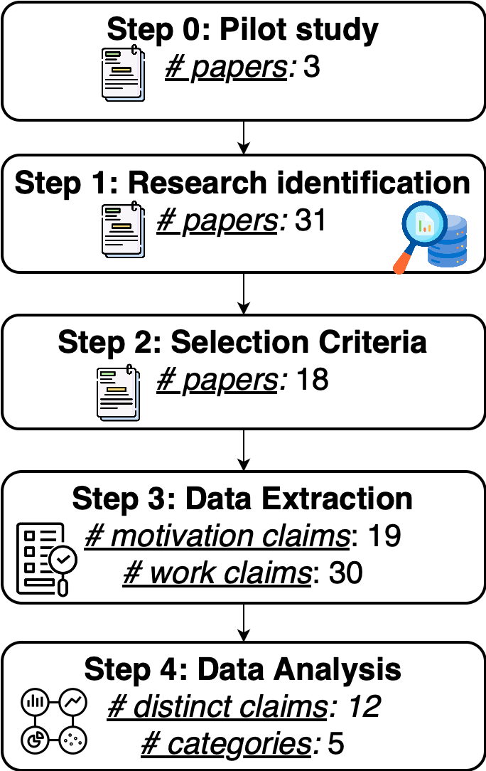
Systematic Literature Review (SLR) Methodology
“pre-trained model reuse”
Hugging Face, HuggingFace,
Pre Trained Model Hub|registry|repository|zoo|...
Inclusion:
Recent peer-reviewed research on PTM registry reuse practices
Exclusion:
Implementation papers, non-primary sources, unsubstantiated claims
256 claims
Motivation: justifies research done
Work: presents findings
49
“Naming models is inconsistent and can in-adequately represent model architectures.”
Notes:
Let's walk through our Systematic Literature Review methodology, which followed a five-step process:
The first step, step 0, can you tell I’m a software engineer? Was a pilot study.
We began with a focused Google Scholar search using the key phrase 'pre-trained model reuse'. This initial search yielded three pivotal papers that shaped our study's direction by highlighting Hugging Face as the primary popular pre trained model registry, hosting the largest number of packages and offering robust tools for reuse. This insight led us to narrow our focus specifically to Hugging Face for examining the PTM supply chain.
What Is the Intended Usage Context of This Model? An Exploratory Study of Pre-Trained Models on Various Model Repositories
An Empirical Study of Pre-Trained Model Reuse in the Hugging Face Deep Learning Model Registry
An empirical study of artifacts and security risks in the pre-trained model supply chain
Our next step was to identify all relevant research
Building on our pilot study, we expanded our search criteria. We used a comprehensive query that included terms intended to pick up papers about Hugging Face, along with a more generic search term that included various synonyms for registries.
This broader search initially gave us 45 papers, which we then refined to 31 unique papers after removing duplicates. We verified our search strategy by ensuring it captured all the key papers from our pilot study, confirming its comprehensiveness.
The next step was to apply our selection criteria, broken into inclusion and exclusion criteria.
Inclusion criteria required papers to focus on PTM reuse within Hugging Face, be peer-reviewed, and published within the last five years.
We excluded papers that merely applied PTMs without discussing reuse, as well as non-primary sources like literature reviews. We also excluded studies with unsubstantiated claims. This careful filtering process narrowed our pool to 18 high-quality, relevant studies.
During this step, authors met to agree on both inclusion and exclusion criteria, and to ensure agreement at various stages.
The next step was Data Extraction. We analyzed the 18 selected papers to extract claims, involving multiple rounds of review and discussion between co-authors.
We initially extracted a total of 256 claims related to PTM reuse. Through multiple rounds of discussion between co-authors, we refined this to 49 key claims, categorized as either 'motivation claims' or 'work claims'.
Motivation claims articulated the rationale behind a study, while work claims were assertions based on the study's data and analyses. It was the work claims that we focused on for our next step of data analysis.
Example motivation claim: The reuse of pre-trained models introduces large costs and additional problems of checking whether arbitrary pre-trained models are suitable for the task-specific reuse or not.
Example work claim: Engineers follow specific naming practices and encounter challenges that are specific to PTM naming.
In this final step, we consolidated overlapping claims and organized them thematically. This process resulted in 12 distinct claims spread across 5 categories, providing a comprehensive yet focused overview of the current state of knowledge on PTM reuse in Hugging Face.
This example claim belongs to the documentation and understanding category.
This methodical approach ensured a thorough review of the literature, providing a solid foundation for our subsequent quantitative analysis. In the next slide, we'll dive deeper into the results of our last step.

Slide 11
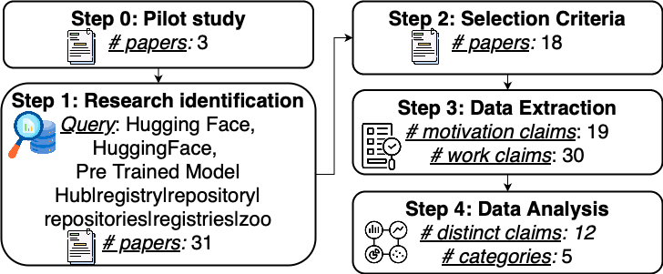
Systematic Literature Review (SLR) Methodology
Inclusion:
Exclusion
“pre-trained model reuse”
256
49
Notes:
Let's walk through our Systematic Literature Review methodology, which followed a rigorous five-step process:
Step 0: Pilot Study We began with a focused Google Scholar search using the key phrase 'pre-trained model reuse'. This initial search yielded three pivotal papers that shaped our study's direction. These papers highlighted Hugging Face as the primary open and popular PTM registry, hosting the largest number of packages and offering robust tools for PTM reuse. This insight led us to narrow our focus specifically to Hugging Face for examining the PTM supply chain.
Step 1: Research Identification Building on our pilot study, we expanded our search criteria. We used a comprehensive query including terms like 'Hugging Face', 'HuggingFace', 'Pre-Trained Model', and various synonyms for registries and repositories such as 'hub', 'zoo', and so on. This broader search initially gave us 45 papers, which we then refined to 31 unique papers after removing duplicates. We verified our search strategy by ensuring it captured all the key papers from our pilot study, confirming its robustness and comprehensiveness.
Step 2: Selection Criteria Here, we applied rigorous inclusion and exclusion criteria to ensure the quality and relevance of our sources. Inclusion criteria required papers to focus on PTM reuse within Hugging Face, be peer-reviewed, and published within the last five years. We excluded papers that merely applied PTMs without discussing reuse, as well as non-primary sources like literature reviews. We also excluded studies with unsubstantiated claims. This careful filtering process narrowed our pool to 18 high-quality, relevant studies.
Step 3: Data Extraction In this critical step, we meticulously analyzed the 18 selected papers. Our process involved multiple rounds of review and discussion between co-authors. We initially extracted a total of 256 claims related to PTM reuse. Through careful consideration and discussion, we refined this to 49 key claims, categorized as either 'motivation claims' or 'work claims'. Motivation claims articulated the rationale behind a study, while work claims were assertions based on the study's data and analyses.
Step 4: Data Analysis In our final step, we consolidated overlapping claims and organized them thematically. This process resulted in 12 distinct claims spread across 5 categories, providing a comprehensive yet focused overview of the current state of knowledge on PTM reuse in Hugging Face.
This methodical approach ensured a thorough and unbiased review of the literature, providing a solid foundation for our subsequent quantitative analysis. In the next slide, we'll dive deeper into the results of our data analysis.

Slide 12
From 30 work claims emerge 12 distinct claims
Themes | Claims | Claim Basis
Trends in Design | A small group of contributors owns popular models. | Large-Scale Measurement
 | The Transformers library increases the accessibility of PTM creation and downstream reuse. | Large-Scale Measurement, Case Study
 | The Transformers library improves the process of PTM evolution. | Case Study
 | Forking repositories introduces low severity vulnerabilities. | Large-Scale Measurement
Selection Considerations | DL-specific attributes such as model architecture, performance, reproducibility, and portability affect PTM selection and reuse. | Interviews
 | The traditional attribute of Popularity affects PTM selection and reuse more than Maintenance and Quality. | Interviews
Repository Lifecycle and Maintenance | Models receive perfective maintenance over time, with high-maintenance models tending to be more popular, larger, and better documented. | Large-Scale Measurement
Documentation and Understanding | Model properties are under-documented across Hugging Face. | Small-Scale Measurement Large-Scale Measurement, Survey
 | Documentation quality impacts model selection. | Survey, Case Study
 | Naming models is inconsistent and can in-adequately represent model architectures. | Large-Scale Measurement, Survey
 | Dataset documentation is correlated with dataset popularity. | Small-Scale Measurement
Downstream Usage | Hugging Face is an exponentially growing platform. | Large-Scale Measurement
Qualitative
Notes:
Now, I know this slide is a lot of text, it in fact is designed to overwhelm and impress y’all, so I’ll do my best to highlight the important parts.
To reiterate the results of the last step:
We initially identified 30 work claims from literature
Which were then consolidated to 12 distinct claims through multiple rounds of iteration between co-authors
This consolidation suggests a convergence of findings in the field
Also indicates a need for validation through replication studies
The basis for claims were defined as either quantitative or qualitative. The Quantitative basis were
Large-Scale Measurement: Studies covering over 10% of population
Small-Scale Measurement: Studies with less than 10% coverage
While qualitative basis were
Surveys: Data gathered through questionnaires
Interviews: In-depth conversations with experts or users
Case Studies: Detailed analysis of specific instances
From this systematic literature review, we discovered a trend towards more data-driven, large-scale analysis in PTM reuse research. However, there were still gaps in our knowledge.
4 out of 12 claims lack quantified verification, with the gaps mainly being in design trends, selection considerations, and documentation practices
While the immediate outcome of this systematic literature review was to motivate our quantitative validation, it also indicates that research on Hugging Face has moved beyond the exploratory phase.
We know where Engineers go to reuse pre trained models, we know their general reuse process, we know the pain points in this process, and we have preliminary results in exploring several facets of this reuse in more detail.
Any researchers interested in furthering our understanding of either Hugging Face or the Pre-trained model supply chain should concentrate their efforts in either selection considerations or documentation and understanding, which is where we saw the most interest from downstream reusers, as well as the largest gaps in knowledge.
Now, back to this work.
Of the 12 claims, 4 lacked quantitative validation, leading us to the part 2 of the study.

Slide 13
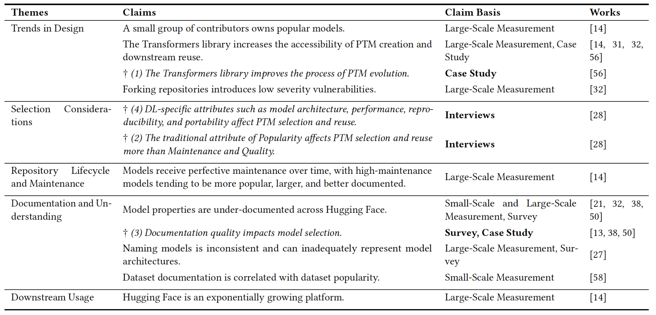
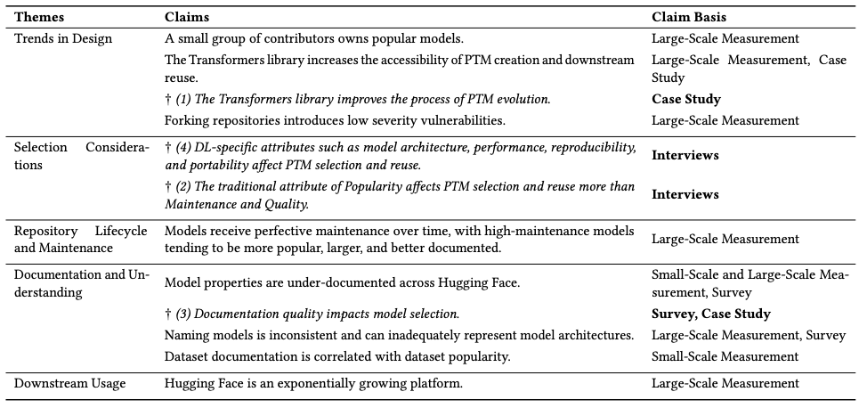
From 30 work claims emerge 12 distinct claims
A
D
Qualitative
C
Notes:
Process and significance:
Initially identified 30 work claims from literature
Consolidated to 12 distinct claims through analysis
This consolidation suggests a convergence of findings in the field
Also indicates a need for validation through replication studies
Claims basis categories:
Large-Scale Measurement: Studies covering over 10% of population
Small-Scale Measurement: Studies with less than 10% coverage
Surveys: Data gathered through questionnaires
Interviews: In-depth conversations with experts or users
Case Studies: Detailed analysis of specific instances
Key findings:
4 out of 12 claims lack quantified verification
Research gaps mainly in design trends, selection considerations, and documentation practices
Trend towards more data-driven, large-scale analysis in PTM reuse research
Implications:
For researchers: Provides a roadmap for future quantitative studies
For practitioners: Offers insights to guide PTM selection and implementation
Emphasizes critical importance of documentation in PTM ecosystem
Next steps:
We'll examine each claim and its evidence basis in more detail
Focus on how these findings shape our understanding of PTM reuse
Transition to next section:
We've identified these 12 distinct claims and their basis
However, 4 claims still lack quantitative validation
This gap leads us to our next crucial step: Quantitative validation of these qualitative claims
In the following slides, we'll explore how we approached this validation
We'll see how data-driven analysis can support or challenge these claims

Slide 14
Study Part 2: Qualitative Claim Validation
RQ2: Do the qualitative claims about package reuse (PTM) on Hugging Face hold up when quantified?

Slide 15
12 Distinct Claims, 4 Lack Quantified Verification
A
D
B
C
Notes:
Focus on unverified claims:
Out of 12 distinct claims, 4 lack quantified verification
These claims are highlighted in red on the slide
Unverified claims:
"The Transformers library improves the process of PTM evolution."
Current basis: Case Study
Needs quantitative validation
"DL-specific attributes such as model architecture, performance, reproducibility, and portability affect PTM selection and reuse."
Current basis: Interviews
Requires data-driven analysis
"The traditional attribute of Popularity affects PTM selection and reuse more than Maintenance and Quality."
Current basis: Interviews
Needs empirical verification
"Documentation quality impacts model selection."
Current basis: Survey, Case Study
Requires large-scale quantitative analysis
Importance of verification:
These claims represent key areas in PTM reuse research
Quantitative validation will strengthen or challenge existing assumptions
Results may guide future research directions and industry practices
Next steps:
We'll discuss our approach to validating these claims
Explain the metrics and methods used for quantification

Slide 16
Claim Validation: Methodology
Qualitative Claim | Metric | Hypothesized Result
C₁: The Transformers library improves the process of PTM evolution. | Preservation rate of Libraries to descendents. | The preservation of Transformers as a library to its descendents will be greater than that of other libraries.
C₂: The traditional attribute of Popularity affects PTM selection and reuse more than Maintenance and Quality. | Turnover of top Packages over time [18]. | Models with high popularity remain popular over time ("rich get richer").
 | Descendent amount of models | Models with high popularity have a larger number of descendent models.
C₃: Documentation quality impacts model selection. | Popularity of PTMs based on their documentation quality. | Models with more information are more discoverable and therefore more popular [59].
C₄: DL-specific attributes such as model architecture, performance, reproducibility, and portability affect PTM selection and reuse. | Popularity of PTMs based on their Attributes [59]. | Popular architectures, high performance, description of where the PTM came from, ease of use, and size all impact model popularity.
While we derived metrics for all 4 claims, only claims C₁, C₂, and C₃ had metrics precise enough to measure. The metric for C₄ was too imprecise to operationalize, we leave it for further work to explore
Notes:
Here we re-state our set of 4 claims that lacked quantitative validation.
We developed metrics to measure each claim, along with a hypothesized result for the outcome of applying each metric to the associated claim. We drew from widely recognized and frequently cited metrics implemented across various traditional software registries, and where no direct analog existed, we used the Goal-Question-Metric process to derive a metric. This approach was grounded in established software engineering practices
Now, while we derived metrics for all 4 claims, only claims 1 2 and 3 had metrics that precise enough to measure. Claim 4’s metric was too imprecise to operationalize, so we leave if for future work to explore further
In the rest of this presentation, I will highlight the outcome of quantitatively verifying claim 2 using the turnover metric, as well as provide a brief overview of the results of validating the other claims.

Slide 17
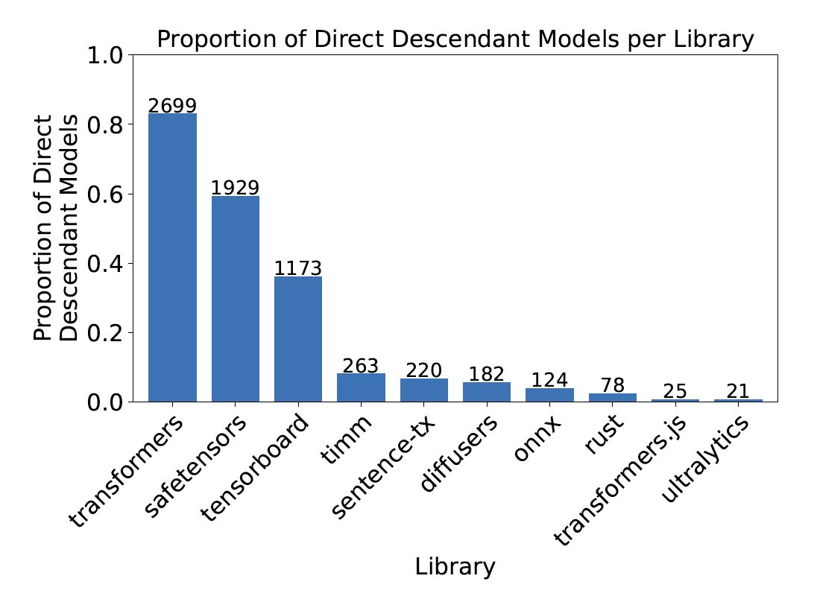
Claim Validation: Claim 1
Qualitative Claim | Metric | Hypothesized Result
C₁: The Transformers library improves the process of PTM evolution. | Preservation rate of Libraries to descendents. | The preservation of Transformers as a library to its descendents will be greater than that of other libraries.
80%
L: Library
B: the set of base models that use L and at least 1 other library
D_{B}: The set of descendent models from a base model B
S(d,L): returns 1 if descendent d supports library L, otherwise 0
60%
Notes:
Introduction: "Let's begin with Claim 1: The Transformers library improves the process of PTM evolution."
Methodology:
"We measured this using the preservation rate of libraries to descendants."
"Our formula considers: L (Library), B (base models), Db (descendant models), and S(d,L) (support function)."
"This metric shows how often descendants continue using a library."
Results:
"Looking at the graph, we see the Transformers library has the highest preservation rate at 80%."
"SafeTensors follows at 60%, while other libraries show significantly lower rates."
"This strongly supports our claim about the Transformers library."
Key Findings:
"The Transformers library is clearly the preferred choice for descendant models."
"Interestingly, SafeTensors' high rate suggests a shift towards prioritizing security."
"This contradicts previous claims about PyTorch's dominance in the field."
Implications:
"For developers: Consider using Transformers and SafeTensors in your PTM projects."
"For platforms: There's an opportunity to enhance security features and compatibility."
"For researchers: Investigate why certain libraries are preferred in the evolution process."
Conclusion: "Claim 1 is strongly supported by our data. The Transformers library does indeed improve PTM evolution."
Transition: "Now, let's move on to Claim 2, which focuses on the role of popularity in PTM selection."

Slide 18
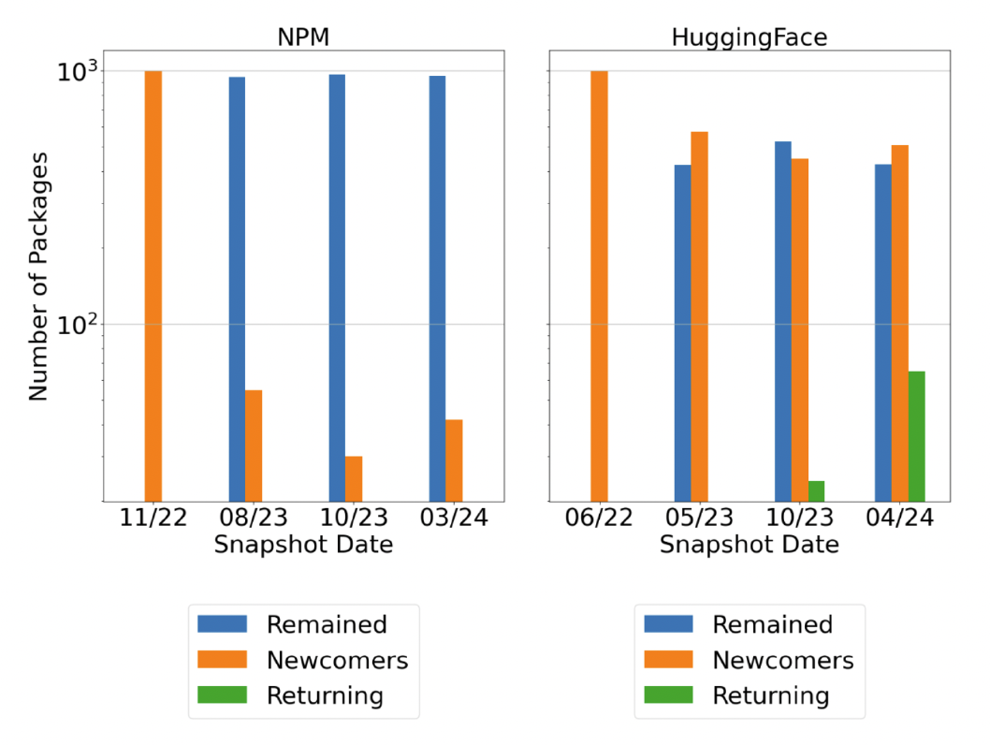
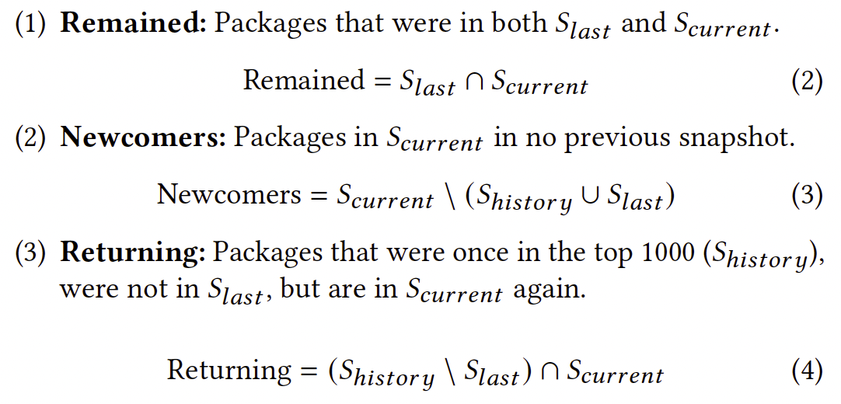
Result of verifying claim 2 using the turnover metric
Qualitative Claim | Metric | Hypothesized Result
C₂: The traditional attribute of Popularity affects PTM selection and reuse more than Maintenance and Quality. | Turnover of top Packages over time [18]. | Models with high popularity remain popular over time ("rich get richer").
Hugging Face has a higher turnover of top packages over time than traditional software package registries
S_{current}: the set of K-most popular packages in the current snapshot
S_{last}: the set of K-most popular packages in the last snapshot
S_{history}: the set of packages in any snapshot before S_{current}
Notes:
Here we present the result of verifying claim 2 using the turnover metric
We used the turnover of top packages over time to verify this claim, and expected to find that models with high popularity remain popular over time. The rich get richer. This would be consistent with traditional software package registries, in which widely used packages remain widely used over time.
While the screen may now look like it is showing something very complex here, this is simply a formalism of a relatively straightforward concept. Across snapshots of the top 1000 packages in a given repository, packages either remain in the top 1000, enter the top 1000 for the first time, or re-enter the top 1000 after leaving it previously. All we did was keep track of the models within each of these groups across multiple snapshots.
What we found using this metric was a stark contrast between Hugging Face and NPM. NPM shows significant stability in its top packages. At no point in time did it ever have more than 50 packages leave the top 1K from one snapshot to another. In contrast to this, Hugging Face has very high turnover in its top 1k - about 50% of its top packages change each snapshot. Additionally, hugging face has a sizable population of models that re-enter the top 1K after leaving it.
What does this mean?
For starters, our hypothesized result was incorrect. Speaking more broadly, for the Pre trained model supply chain, this suggests a very dynamic environment. It indicates that needs and preferences change rapidly, and that a model may go through several cycles of rising popularity, day in the sun, then being abandoned for a new model.
For engineers, this would indicate that should should design Pre-Trained model integrations with volatility in mind. Unlike traditional dependencies where you might stick with one package for a long time, Pre-trained model reuse requires building flexible abstraction layers that can accommodate frequent model updates and changes while maintaining consistent interfaces for your application.
Next we briefly discuss the high level results of quantitatively validating the other claims

Slide 19
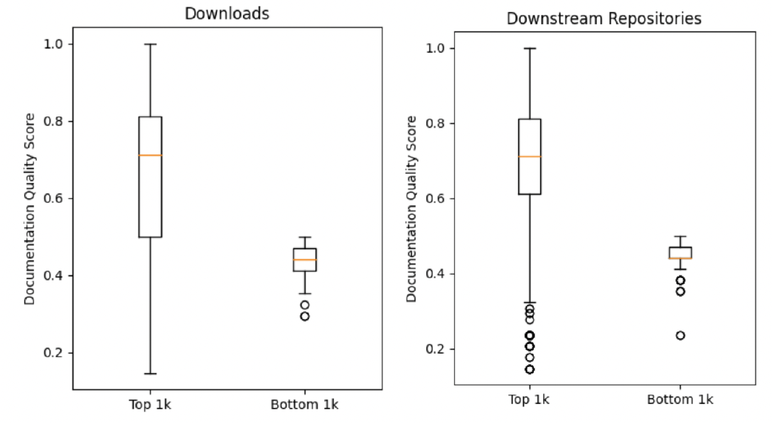
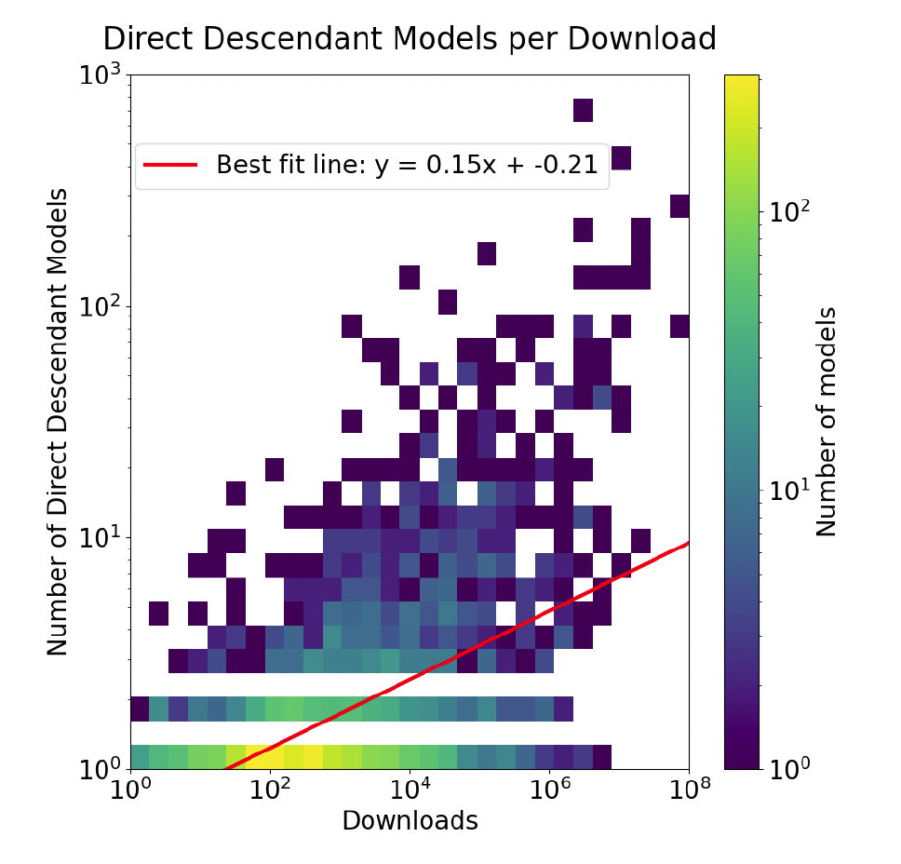
Other Validated Claims, see paper for full details
p < 0.01
C₃: Documentation quality impacts model selection.
80%
60%
C₂: The traditional attribute of Popularity affects PTM selection and reuse more than Maintenance and Quality.
C₁: The Transformers library improves the process of PTM evolution.
Notes:
Starting with claim 1, that the transformers library improves the process of pre-trained model evolution.
We measured this by examining what happens when models are fine-tuned or otherwise descended from a base model. On Hugging Face, models are made available for reuse through libraries such as Transformers, SafeTensors, sentence-transformers, diffusers, etc, with it being possible for a model to be available through multiple libraries. When a model is fine-tuned or reused to create a new descendent model on Hugging Face, it will also be made available through one or more of the libraries that its base model used. To measure this claim, we looked at the preservation rate of libraries through this process. Our findings strongly confirmed the claim - we found that Transformers was by far the most preserved library when a model was descended from another one, with a preservation rate of 80%, much higher than the second place library SafeTensors at 60%.
For the second claim - that the traditional attribute of popularity affects pre-trained model selection and reuse more than maintenance and quality - we measured this using the descendent amount of models. Our expectation was that models with higher popularity would have a greater number of models descended from them. Our findings supported this, showing a weak correlation between model popularity and number of descendent models.
Finally, we quantitatively validated that documentation quality impacts model selection. Our metric for this was comparing the popularity of models based on their documentation quality. What we found was that between the top and bottom 1000 models (ranked by both downloads and downstream repository usage), there was a statistically significant difference in their documentation quality scores. This strongly supported our expectation that better documented models would be more popular.

Slide 20
Claim Validation: Claim 2
Qualitative Claim | Metric | Hypothesized Result
C₂: The traditional attribute of Popularity affects PTM selection and reuse more than Maintenance and Quality. | Descendent amount of models | Models with high popularity have a larger number of descendent models.
Descendent models: downstream models fine-tuned from original base models
Popularity was measured by number of downloads
NOTE: This lacks a direct comparison to traditional software
Considered several analogs: Forks, Branches, Dependencies
Notes:
Speaker Notes:
Continuation: "Our second metric for Claim 2 examines the number of descendent models."
Methodology:
"We defined descendents as downstream models fine-tuned from original base models."
"Popularity was measured by the number of downloads."
"We used data from the PeaTMOSS dataset, covering the 15,000 most popular PTMs."
Results:
"The graph shows a weak positive correlation between downloads and number of descendents."
"Note the best fit line: y = 0.15x + -0.21, and the logarithmic scales."
"Popular models tend to have more descendants, but the relationship isn't strong."
Interpretation:
"This partially supports our claim, but not as strongly as we expected."
"The spread of data suggests other factors influence model reuse beyond popularity."
Implications:
"For platforms: Develop more sophisticated recommendation systems."
"For users: Consider factors beyond popularity when choosing models to build upon."
"For researchers: Investigate what other factors contribute to a model's reusability."
Conclusion for Claim 2:
"Combining both metrics, we see a complex picture."
"Popularity plays a role in PTM selection and reuse, but it's not as straightforward as in traditional software."
"The PTM ecosystem is more dynamic, with multiple factors influencing reuse."
Transition: "Now, let's examine our final claim about the impact of documentation quality."

Slide 21
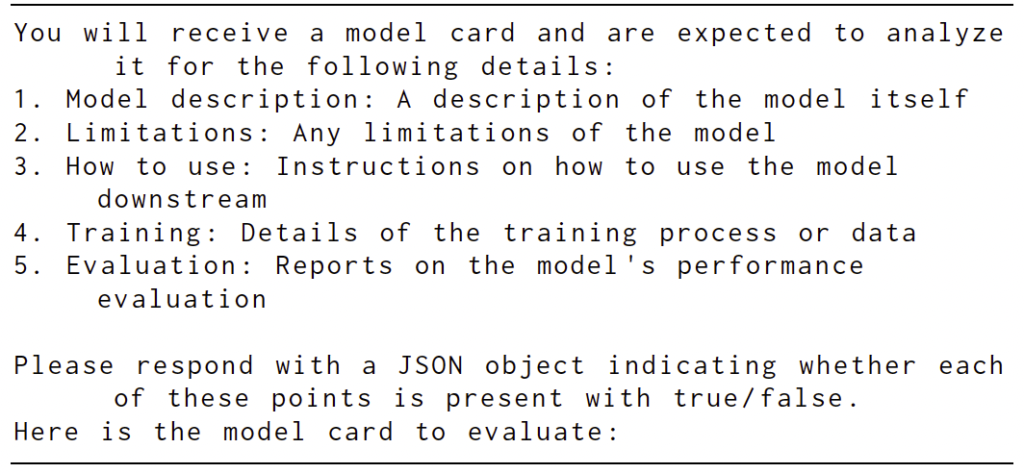
Claim Validation: Claim 3
Qualitative Claim | Metric | Hypothesized Result
C₃: Documentation quality impacts model selection. | Popularity of PTMs based on their documentation quality. | Models with more information are more discoverable and therefore more popular [59].
p < 0.01
ChatGPT-4 prompt for evaluating model cards. The availability of metadata was also evaluated and added to the documentation score.
Notes:
Speaker Notes:
Introduction: "Our final claim states that documentation quality impacts model selection."
Methodology:
"We assessed documentation quality based on model card completeness and metadata availability."
"Model cards were scored on five key sections using ChatGPT-4 for analysis."
"Metadata availability was assessed using the PeaTMOSS dataset."
"We compared the top 1000 and bottom 1000 models out of the 15,000 most popular."
Results:
"The box plots show a clear difference in documentation quality between top and bottom models."
"This difference is statistically significant, with p < 0.01."
"The trend holds for both download counts and downstream repository usage."
Key Findings:
"Top 1000 models consistently have better documentation quality."
"This relationship is strong and consistent across different popularity measures."
Interpretation:
"These results strongly support our claim that documentation quality impacts model selection."
"Better documented models are more likely to be popular and widely used."
Implications:
"For developers: Prioritize creating high-quality documentation for your models."
"For platforms: Consider emphasizing or incentivizing better documentation."
"For the community: Develop tools and standards to improve documentation quality."
Future Directions:
"Investigate the causative relationship between documentation and popularity."
"Explore which specific aspects of documentation have the most impact."
"Develop automated tools to assist in creating better model documentation."
Conclusion: "Our analysis provides strong evidence that documentation quality is crucial in PTM selection and popularity."

Slide 22
Conclusion
Thank you for listening!
The state of research on Hugging Face:
Research on Hugging Face has moved beyond the exploratory phase
Future work should build on the pre-existing work to further our understanding of the Pre-Trained Model Supply Chain
Takeaways:
Engineers should design PTM integrations with volatility in mind.
Researchers looking to improve the PTM supply chain should focus on improving model selection and discovery mechanisms
Future work:
Research into DL-specific attributes influencing model reusability and adaptability
Develop specialized tools for PTM version control and lineage tracking
Continue to compare Hugging Face and traditional software package registries
Paper
https://arxiv.org/abs/2406.08205
Notes:
In conclusion, our systematic literature review shows that research on Hugging Face, and by extension the pre-trained model supply chain, has matured beyond the exploratory phase. Researchers have uncovered a multitude of claims about Pre trained model reuse, and validated these claims both quantitatively and qualitatively. We have clear directions for future research into the pre trained model supply chain.
From this work, we have two critical takeaways. For engineers, our findings about high model turnover rates suggest you need to design your PTM integrations with volatility in mind. This means building flexible abstraction layers that can handle model updates while maintaining consistent interfaces for your applications.
For researchers, our work highlights that the next crucial challenge is improving model selection and discovery mechanisms. While we've validated that documentation quality correlates with adoption, we need more sophisticated ways to help engineers evaluate and select models beyond just popularity metrics or documentation quality.
Finally, we identify several areas for future work. In this work we did not quantitatively verify claim 4, it remains an open problem for anyone interested.
(Deep Learning specific attributes such as model architecture, performance, reproducibility, and portability affect PTM selection and reuse)
We also identified a need for specialized tools for Pre trained model version control and lineage tracking, given the unique dynamics we've observed. Finally, we should continue comparing Hugging Face with traditional software package registries to better understand how PTM reuse differs from traditional software reuse.
Thank you again for your attention, the full paper is available via the QR code shown here, and I'm happy to take any questions.

Slide 23
Thank you for listening!
https://arxiv.org/abs/2406.08205
Notes:
The third part of our study focuses upon so-called “deeper cause”.
In summary, we attempt to study converters by attempting to convert different types of models, and by analyzing characteristics of ”failing” models.

Slide 24
Summary
Systematic Literature Review:
12 distinct claims about PTM Reuse on HuggingFace
4 claims lacked large-scale quantitative evidence
Quantitative validation:
Defined metrics to verify claims
Transformers is the dominant library (80% of models)
HuggingFace has a higher turnover rate than traditional SPRs
Model popularity correlates with descendent count
Documentation quality correlates with model popularity
Notes:
In this study, we conducted a comprehensive analysis of Pre-Trained Model (PTM) reuse on the HuggingFace platform.
Our study, consisted of two main parts, a Systematic Literature Review (SLR), followed by a Quantitative validation of claims discovered.
What did we find?
From the Systematic Literature Review (SLR):
- We identified 12 distinct claims about PTM reuse on HuggingFace from existing literature, organized into 5 categories
- Importantly, we found that 4 of these claims lacked large-scale quantitative evidence.
From the Quantitative validation:
- We developed metrics to verify these claims rigorous,
using existing datasets to provide measurements for unquantified and under-quantified claims.
Our analysis supported 2 of the claims, found ambivalent evidence for another, and determined one was too imprecise to operationalize.
- The Transformers library was dominant, used by 80% of models.
- HuggingFace had a higher turnover rate of popular models compared to traditional Software Package Registries.
- We found correlations between model popularity and number of descendants, as well as between documentation quality and model popularity.
Now to get into the background

Slide 25
Bonus Slides

Slide 26
Examples

Slide 27
Analyzing the Evolution and Maintenance of ML Models on Hugging Face | Cantonese to Written Chinese Translation via HuggingFace Translation Pipeline
Notes:
Hugging Face (HF) has established itself as a crucial platform for the development and sharing of machine learning (ML) models. This repository mining study, which delves into more than 380,000 models using data gathered via the HF Hub API, aims to explore the community engagement, evolution, and maintenance around models hosted on HF, aspects that have yet to be comprehensively explored in the literature. We first examine the overall growth and popularity of HF, uncovering trends in ML domains, framework usage, authors grouping and the evolution of tags and datasets used. Through text analysis of model card descriptions, we also seek to identify prevalent themes and insights within the developer community. Our investigation further extends to the maintenance aspects of models, where we evaluate the maintenance status of ML models, classify commit messages into various categories (corrective, perfective, and adaptive), analyze the evolution across development stages of commits metrics and introduce a new classification system that estimates the maintenance status of models based on multiple attributes. This study aims to provide valuable insights about ML model maintenance and evolution that could inform future model development strategies on platforms like HF.
Cantonese, a low-resource language [5] that has been used in Southeastern China for hundreds of years, with over 85 million native speakers worldwide, is poorly supported in the mainstream language model for existing translation platforms such as Baidu, Google and Bing. This paper presents a large parallel corpus of 130 thousand Cantonese and Written Chinese pairs. The data are used to train a translation model using the translation pipeline of the Hugging Face Transformers architecture, a dominant architecture for natural language processing nowadays [18]. The BLEU score and manual assessment evaluate the performance. The translation results achieve a BLEU score of 41.35and chrF++ score of 44.88on the entire validation set. The model also works reasonably well with long sentences of over 20 Chinese characters. It achieves a BLEU score of 48.61and chrF++ score of 39.87on long sentences. Those results are comparable with the existing Baidu Fanyi and Bing Translate. We also establish a Cantonese sentence evaluation metric to classify the quality of the source Cantonese sentence by professional translators. We then compare the BLEU and chrF++ scores with the corresponding evaluation score and found that the better the quality of the source sentence, the higher the BLEU and chrF++ scores. Last, we proved that our corpus enabled the Cantonese translation capability of the Chinese BART pre-trained model.

Slide 28
Figures

Slide 30
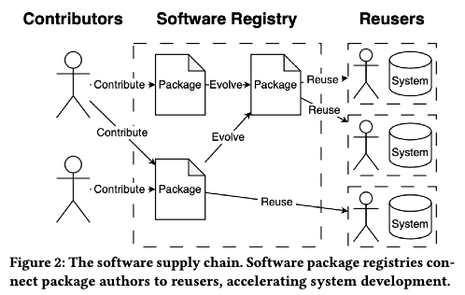

Slide 31
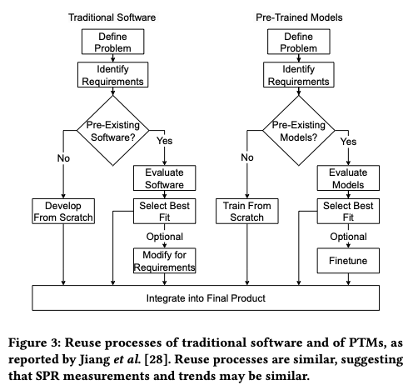

Slide 32
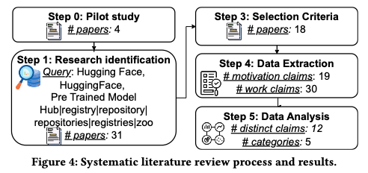

Slide 33
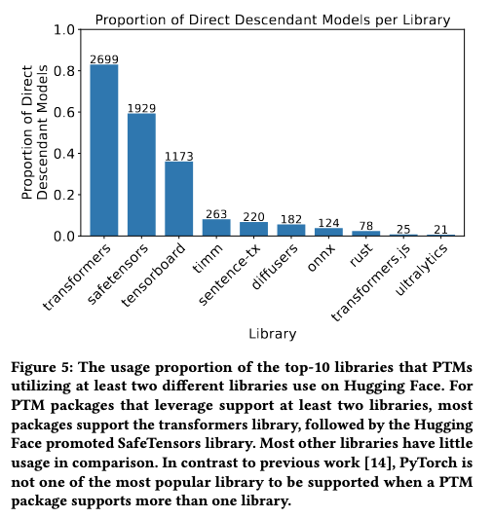

Slide 34
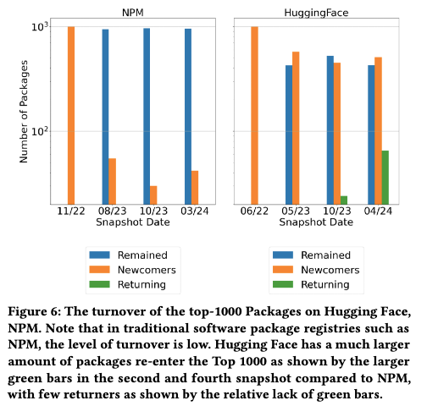

Slide 35
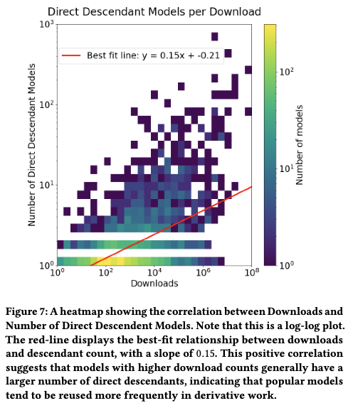

Slide 36
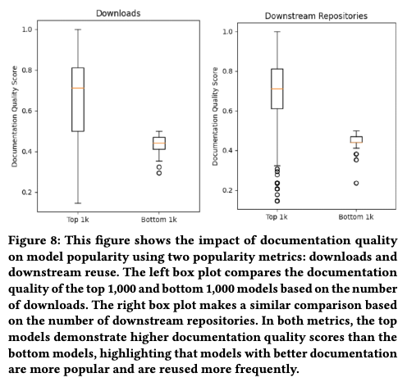

Slide 37
Tables

Slide 40
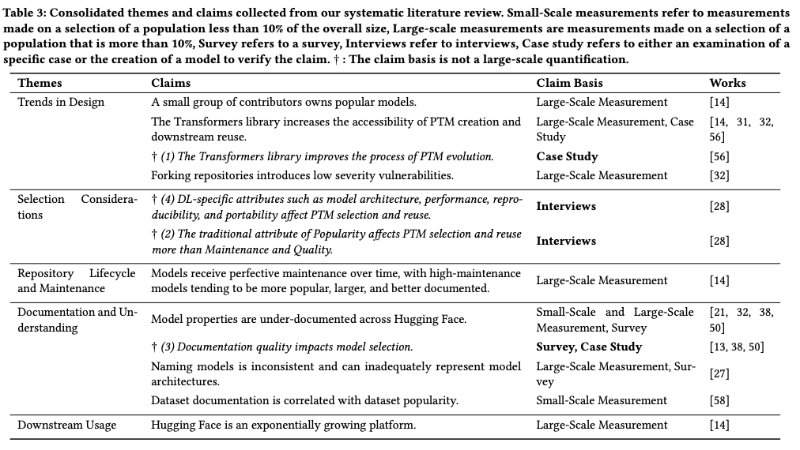

Slide 41
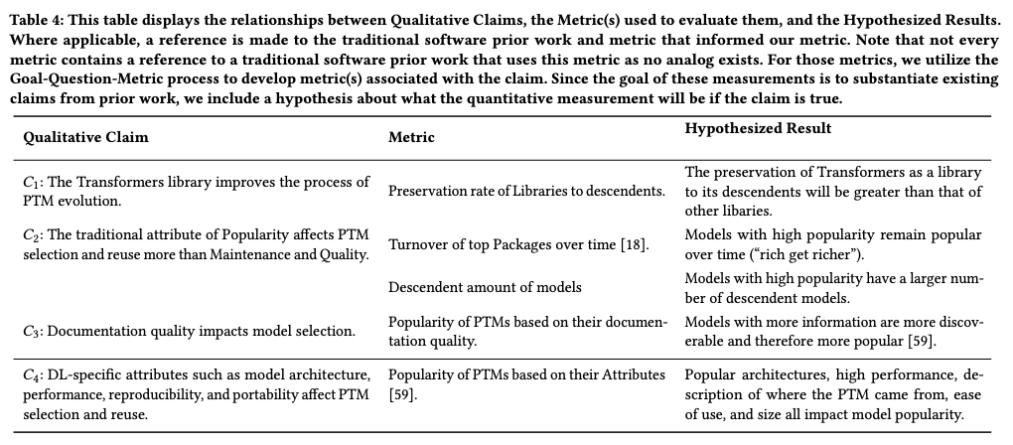

Slide 42
Listings

Slide 44
Findings

Slide 45
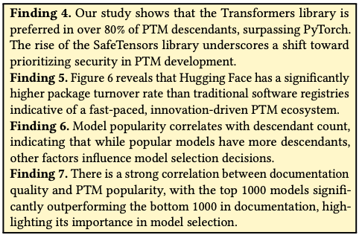
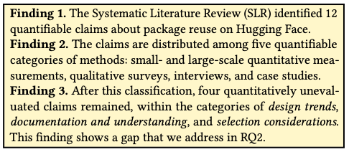

Slide 46
Threats
Notes:
Construct Threats are potential limitations of how we operationalized concepts. In the systematic literature review (RQ1), we manually extracted claims from papers, which might introduce potential bias to our results. As a mitigation, to improve objectivity two authors worked together on the process and the filtering of claims. In the validation of non-quantified claims, we proposed metrics that seemed suitable based on our judgment. To mitigate, we used multiple measures and leveraged existing metrics.
Internal threats are those that affect cause-effect relationships.
We emphasize that our approach for RQ2 is of the form: “If claim 𝐶
is true, then measurement 𝑀 should show us that...”. In each case the
measurement produced the expected result. However, this result is
correlative, not causative — there may be a latent variable in each
case, or the causative relationship may be reversed.
For example, in Figure 8 we found that better documentation
correlates with greater popularity. It may be that the latent variable
is performance, such that models become popular because they
have good performance, and they accrue documentation because
they are popular. When qualitative and quantitative claims agree,
as is the case in this study, we learn both “Why?” and “How much?”.
External threats may impact generalizability. We recognize
both immediate and longitudinal threats in this regard. Immediately,
we were interested in studying PTM reuse, but we only examined
one registry for PTMs: the Hugging Face platform. While this is
by far the most popular and feature-rich platform, other platforms
exist, such as PyTorch Hub (less popular), PapersWithCode (fewer
features), and GitHub (not PTM-specific). In terms of longitudinally,
keep in mind that Hugging Face is itself relatively young — created
in 2016 and only seeing major use beginning in 2020 — so developer
practices may not have stabilized. Lastly, we consider that the
technologies and platforms that support PTMs are rapidly evolving,
so current claims (whether qualitative or quantitative) may
change over time and require ongoing reassessment. As indicated
in the discussion, this property suggests an opportunity for further
research, but it also means that our findings may be unstable.

Slide 47
Notes:
Construct Threats are potential limitations of how we operationalized concepts. In the systematic literature review (RQ1), we manually extracted claims from papers, which might introduce potential bias to our results. As a mitigation, to improve objectivity two authors worked together on the process and the filtering of claims. In the validation of non-quantified claims, we proposed metrics that seemed suitable based on our judgment. To mitigate, we used multiple measures and leveraged existing metrics.
Internal threats are those that affect cause-effect relationships.
We emphasize that our approach for RQ2 is of the form: “If claim 𝐶
is true, then measurement 𝑀 should show us that...”. In each case the
measurement produced the expected result. However, this result is
correlative, not causative — there may be a latent variable in each
case, or the causative relationship may be reversed.
For example, in Figure 8 we found that better documentation
correlates with greater popularity. It may be that the latent variable
is performance, such that models become popular because they
have good performance, and they accrue documentation because
they are popular. When qualitative and quantitative claims agree,
as is the case in this study, we learn both “Why?” and “How much?”.
External threats may impact generalizability. We recognize
both immediate and longitudinal threats in this regard. Immediately,
we were interested in studying PTM reuse, but we only examined
one registry for PTMs: the Hugging Face platform. While this is
by far the most popular and feature-rich platform, other platforms
exist, such as PyTorch Hub (less popular), PapersWithCode (fewer
features), and GitHub (not PTM-specific). In terms of longitudinally,
keep in mind that Hugging Face is itself relatively young — created
in 2016 and only seeing major use beginning in 2020 — so developer
practices may not have stabilized. Lastly, we consider that the
technologies and platforms that support PTMs are rapidly evolving,
so current claims (whether qualitative or quantitative) may
change over time and require ongoing reassessment. As indicated
in the discussion, this property suggests an opportunity for further
research, but it also means that our findings may be unstable.

