Slide 1
Discovering U.S. Government Threat Hunting Processes and Improvements
William “Trey” Maxam

Slide 2
Outline
Introduction
Background
Research Questions
Methodology
Results
Discussion and Future Work
Questions

Slide 3
Introduction

Slide 4
Office of Personnel Management Breach
Took 11 months to discover
22 million records stolen

Slide 5
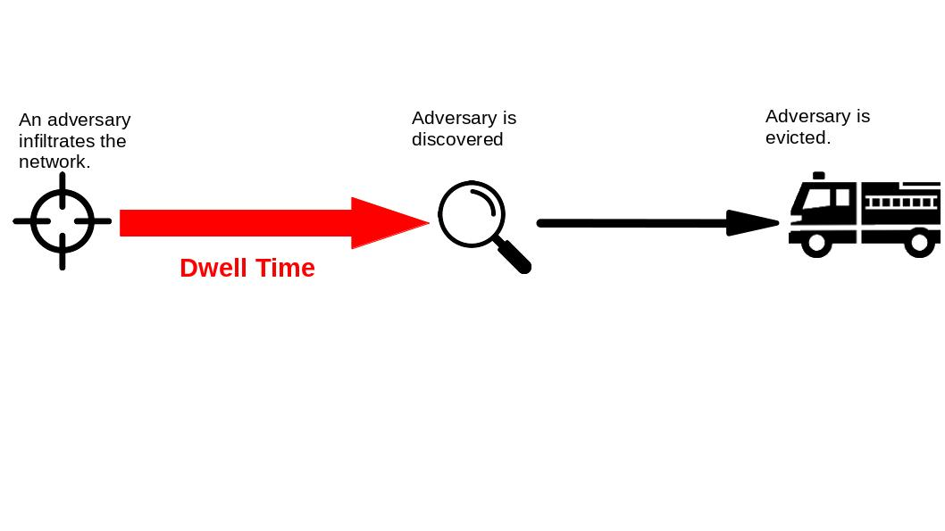
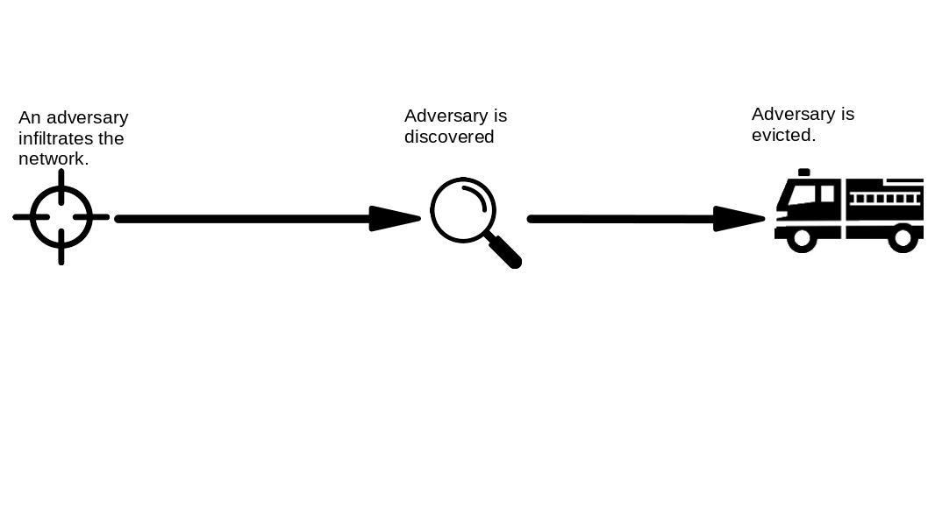
Timeline of an attack
Dwell Time
Response Time

Slide 6
Timeline of an attack
Dwell Time
Response Time

Slide 7
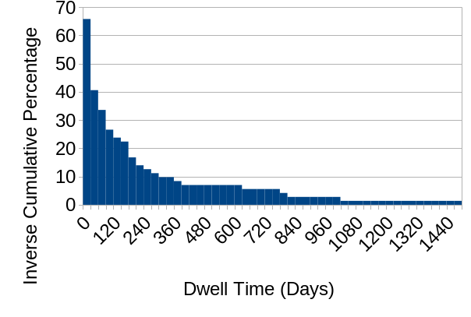
Distribution of Dwell Times
Source: D. E. Brink, “Quantifying the Value of Time in Cyber-Threat Detection and Response,” en, Aberdeen Group, Tech. Rep. 15218, Jan. 2017.

Slide 8
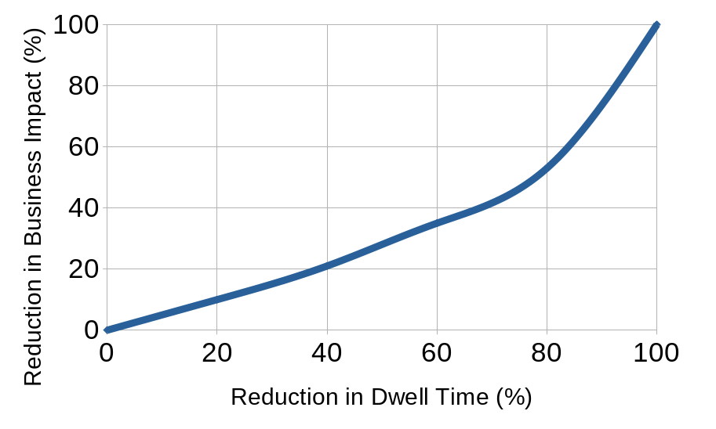
Less Dwell Time = Lower Cost of Intrusion
Source: D. E. Brink, “Quantifying the Value of Time in Cyber-Threat Detection and Response,” en, Aberdeen Group, Tech. Rep. 15218, Jan. 2017.

Slide 9
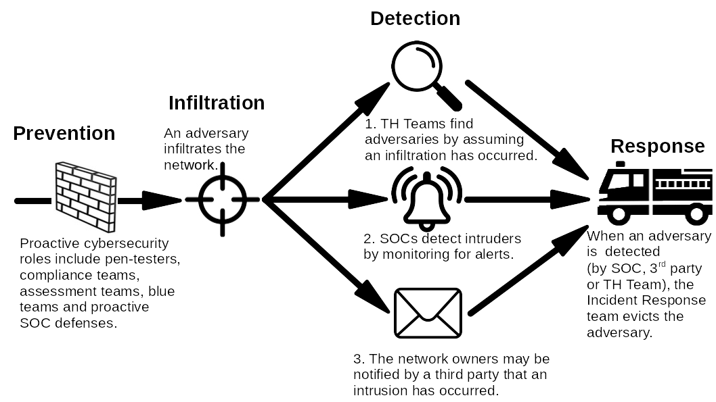
Three Paths to Adversary Discovery

Slide 10
Three Paths to Adversary Discovery

Slide 11
Three Paths to Adversary Discovery

Slide 12
Three Paths to Adversary Discovery

Slide 13
Private Sector TH teams

Slide 14
Government TH Teams

Slide 15
Background

Slide 16
TH Frameworks
Lockheed Kill Chain
What does an adversary do?
Source: S. Commerce, “A "Kill Chain" analysis of the 2013 target data breach,” in The Target Store Data Breaches: Examination and Insight, Jan. 2014, pp. 41–60.

Slide 17
TH Frameworks
Lockheed Kill Chain
Mitre ATT&CK
What does an adversary do?
Source: S. Commerce, “A "Kill Chain" analysis of the 2013 target data breach,” in The Target Store Data Breaches: Examination and Insight, Jan. 2014, pp. 41–60.

Slide 18
TH Frameworks
Lockheed Kill Chain
Mitre ATT&CK
Hypothesis Checking
What are we looking for?

Slide 19
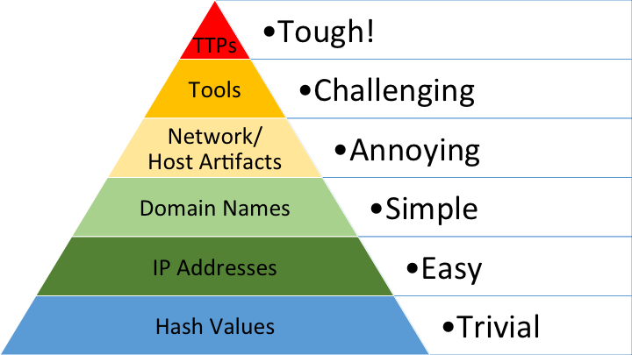
TH Frameworks
Lockheed Kill Chain
Mitre ATT&CK
Hypothesis Checking
Pyramid of Pain
What hurts the adversary? the most?
Source: Davidjbianco, Enterprise Detection & Response: The Pyramid of Pain, Mar. 2013. [Online]. Available: https://detect-respond.blogspot.com/2013/03/the-pyramid-of-pain.html .

Slide 20
TH Maturity Model
“Organizations at HMM0 are not considered to be capable of hunting.”
Source: D. Bianco, A Simple Hunting Maturity Model, en, Blog. [Online]. Available: http://detect-respond.blogspot.com/2015/10/a-simple-hunting-maturity-model.html .

Slide 21
Most TH Teams Operate Ad Hoc (n=306)
Source: W. R. Lee and R. M. Lee, The Hunter Strikes Back: The SANS 2017 Threat Hunting Survey, en, 2017.

Slide 22
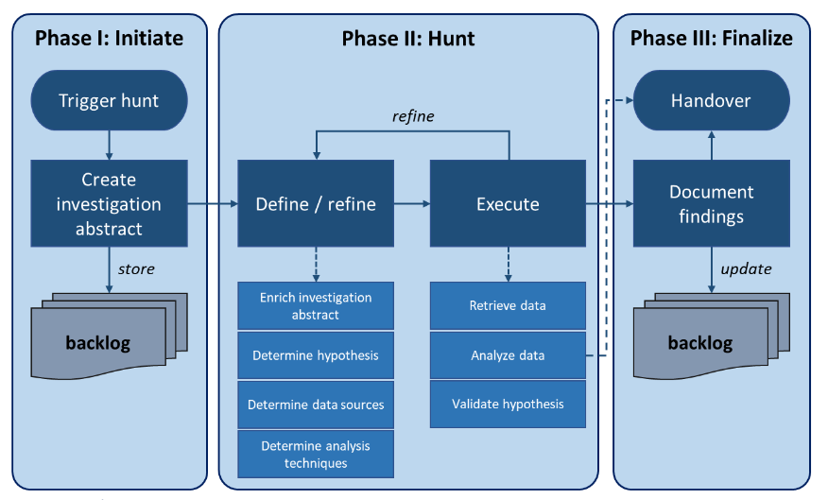
Targeted Hunting integrating Threat Intelligence (TaHiTI)
Source: R. van Os, M. Bakker, R. Bouman, M. D. van Leeuwen, M. van der Kraan, and W. Mentges, TaHiTI: A threat hunting methodology, Dec. 2018. [Online]. Available: https://www.betaalvereniging.nl/wp-content/uploads/TaHiTI-Threat-Hunting-Methodology-whitepaper.pdf .

Slide 23
Government TH Teams

Slide 24
Modelling the Cognitive Work of CPTs (Trent et al.)
Source: S. Trent, R. R. Hoffman, D. Merritt, and S. Smith, “Modelling the Cognitive Work of Cyber Protection Teams,” The Cyber Defense Review, vol. 4, no. 1, pp. 125–136, 2019, Publisher: Army Cyber Institute, issn: 2474-2120. [Online]. Available: http://www.jstor.org/stable/26623071 .

Slide 25
Cyber security turnover
Source: Cyber Security Analyst Demographics And Statistics In The US. [Online]. Available: https://www.zippia.com/cyber-security-analyst-jobs/demographics/ .

Slide 26
Research Questions

Slide 27
Theme #1: Process
RQ1.1: What processes are currently used by government TH teams?
RQ1.2: What shortcomings exist with current government TH processes and what can be done to alleviate these shortcomings?

Slide 28
Theme #2: New Members
RQ2.1: How do newer members fit into government TH processes?
RQ2.2: How could government TH process changes facilitate the integration of less expert members?
RQ2.3: What features indicate expertise to government TH team members?

Slide 29
Methodology

Slide 30
Methodology
Semi-structured interviews

Slide 31
Methodology
Semi-structured interviews
Requested hand-drawn process diagrams

Slide 32
Methodology
Semi-structured interviews
Recruitment

Slide 33
Methodology
Semi-structured interviews
Recruitment
12 subjects
Position | # Subjects
Leadership | 4
Team Leads | 4
Analysts | 4

Slide 34
Methodology
Semi-structured interviews
Recruitment
12 subjects
Organization | # of Subjects
Coast Guard Cyber Command | 10
CISA | 3
Sandia National Labs | 1
Private Sector | 1

Slide 35
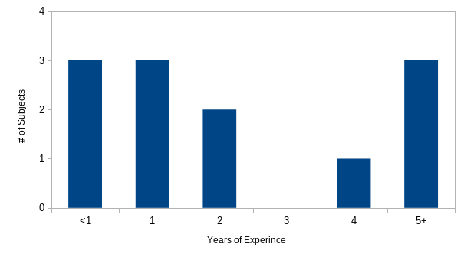
Methodology
Semi-structured interviews
Recruitment
12 subjects

Slide 36
Methodology
Semi-structured interviews
Recruitment
Interview instrument

Slide 37
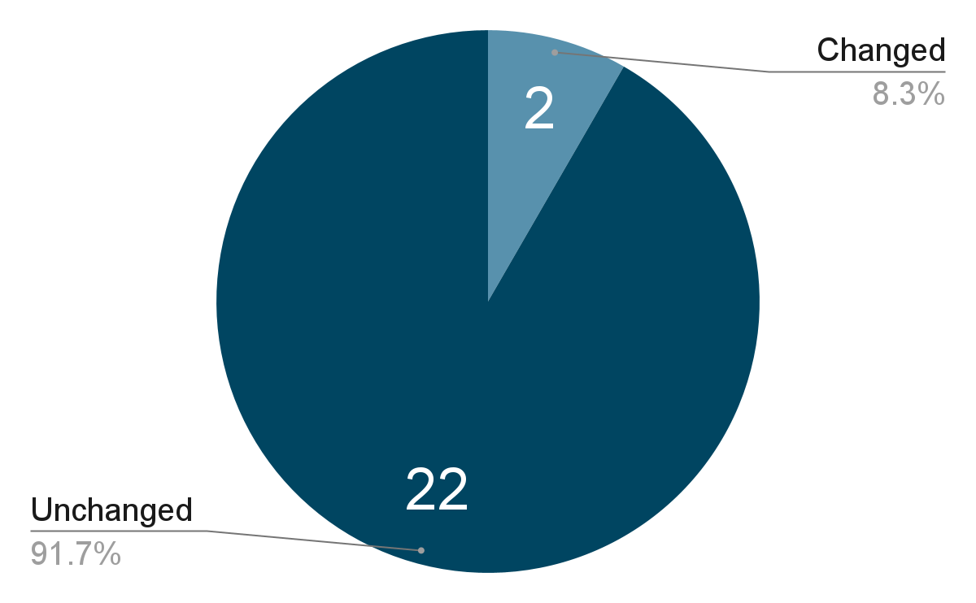
Methodology
Semi-structured interviews
Recruitment
Interview instrument
2 internal pilots
Iteratively developed

Slide 38
Methodology
Semi-structured interviews
Recruitment
Interview instrument creation
2 internal pilots
Iteratively developed
9 follow up questions added
What is a good measure of a member’s expertise?
Experience?
Certifications?
Personality?
Willingness to put in own time?
Is this different for potential?

Slide 39
Methodology
Semi-structured interviews
Recruitment
Interview instrument creation
Conduct interviews

Slide 40
Methodology
Sanitization

Slide 41
Methodology
Sanitization
National Security/Classification
Anonymization

Slide 42
Methodology
Sanitization
Thematic Coding

Slide 43
Methodology
Interviewer: Question?
Anonymized Subject: Answer. Answer. Answer. Answer. Answer. Answer. Answer. Answer. Answer.
Answer. Answer. Answer. Answer. Answer. Answer. Answer. Answer. Answer. Answer.
Interviewer: Question?
Anonymized Subject: Answer. Answer. Answer. Answer. Answer. Answer. Answer. Answer. Answer.
Answer. Answer. Answer. Answer. Answer. Answer. Answer. Answer.
Sanitization
Thematic Coding

Slide 44
Methodology
Interviewer: Question?
Anonymized Subject: Answer. Answer. Answer. Answer. Answer. Answer. Answer. Answer. Answer.
Answer. Answer. Answer. Answer. Answer. Answer. Answer. Answer. Answer. Answer.
Interviewer: Question?
Anonymized Subject: Answer. Answer. Answer. Answer. Answer. Answer. Answer. Answer. Answer.
Answer. Answer. Answer. Answer. Answer. Answer. Answer. Answer.
Sanitization
Thematic Coding
636 Memos
Memo: If there is Intel then the CPT has a focus when beginning the process

Slide 45
Methodology
Interviewer: Question?
Anonymized Subject: Answer. Answer. Answer. Answer. Answer. Answer. Answer. Answer. Answer.
Answer. Answer. Answer. Answer. Answer. Answer. Answer. Answer. Answer. Answer.
Interviewer: Question?
Anonymized Subject: Answer. Answer. Answer. Answer. Answer. Answer. Answer. Answer. Answer.
Answer. Answer. Answer. Answer. Answer. Answer. Answer. Answer.
Memo #1
Sanitization
Thematic Coding
636 Memos
Memo #2
Memo #3

Slide 46
Methodology
Memo #1
Sanitization
Thematic Coding
636 Memos
58 Themes
Process Creation
Memo #2
Hypothesis Method
Memo #3

Slide 47
Methodology
Interviewer: Question?
Anonymized Subject: Answer. Answer. Answer. Answer. Answer. Answer. Answer. Answer. Answer.
Answer. Answer. Answer. Answer. Answer. Answer. Answer. Answer. Answer. Answer.
Interviewer: Question?
Anonymized Subject: Answer. Answer. Answer. Answer. Answer. Answer. Answer. Answer. Answer.
Answer. Answer. Answer. Answer. Answer. Answer. Answer. Answer.
Sanitization
Thematic Coding
636 Memos
58 Themes
Process Creation
Hypothesis Method

Slide 48
Methodology
Interviewer: Question?
Anonymized Subject: Answer. Answer. Answer. Answer. Answer. Answer. Answer. Answer. Answer.
Answer. Answer. Answer. Answer. Answer. Answer. Answer. Answer. Answer. Answer.
Interviewer: Question?
Anonymized Subject: Answer. Answer. Answer. Answer. Answer. Answer. Answer. Answer. Answer.
Answer. Answer. Answer. Answer. Answer. Answer. Answer. Answer.
Sanitization
Thematic Coding
636 Memos
58 Themes
Process Creation
Hypothesis Method

Slide 49
Methodology
Sanitization
Thematic Coding
Interrater Agreement

Slide 50
Methodology
Interviewer: Question?
Anonymized Subject: Answer. Answer. Answer. Answer. Answer. Answer. Answer. Answer. Answer.
Answer. Answer. Answer. Answer. Answer. Answer. Answer. Answer. Answer. Answer.
Interviewer: Question?
Anonymized Subject: Answer. Answer. Answer. Answer. Answer. Answer. Answer. Answer. Answer.
Answer. Answer. Answer. Answer. Answer. Answer. Answer. Answer.
Sanitization
Thematic Coding
Interrater Agreement
Process Creation
Hypothesis Method

Slide 51
Methodology
Interviewer: Question?
Anonymized Subject: Answer. Answer. Answer. Answer. Answer. Answer. Answer. Answer. Answer.
Answer. Answer. Answer. Answer. Answer. Answer. Answer. Answer. Answer. Answer.
Interviewer: Question?
Anonymized Subject: Answer. Answer. Answer. Answer. Answer. Answer. Answer. Answer. Answer.
Answer. Answer. Answer. Answer. Answer. Answer. Answer. Answer.
Sanitization
Thematic Coding
Interrater Agreement
6 transcript sections
56 coded texts
Process Creation
?
Hypothesis Method

Slide 52
Methodology
Code #1
Interviewer: Question?
Anonymized Subject: Answer. Answer. Answer. Answer. Answer. Answer. Answer. Answer. Answer.
Answer. Answer. Answer. Answer. Answer. Answer. Answer. Answer. Answer. Answer.
Interviewer: Question?
Anonymized Subject: Answer. Answer. Answer. Answer. Answer. Answer. Answer. Answer. Answer.
Answer. Answer. Answer. Answer. Answer. Answer. Answer. Answer.
Code #2
Sanitization
Thematic Coding
Interrater Agreement
6 transcript sections
56 coded texts
Kappa .82
Code #3
Code #4
?
Code #5
Code #6
Code …
Code #58

Slide 53
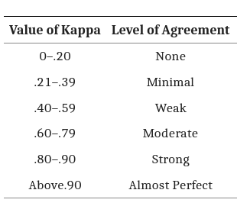
Methodology
Sanitization
Thematic Coding
Interrater Agreement
6 transcript sections
56 coded texts
Kappa .82
Source: McHugh ML. Interrater reliability: the kappa statistic. Biochem Med (Zagreb). 2012;22(3):276-82. PMID: 23092060; PMCID: PMC3900052.

Slide 54
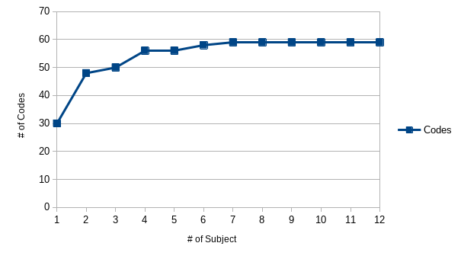
Cumulative Number of Codes After Each Interview

Slide 55
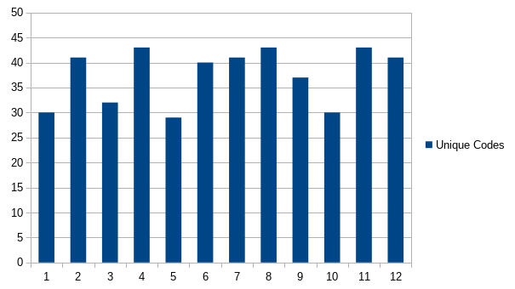
Unique codes observed at each interview

Slide 56
Limitations
A sample size of 12 is small
Not uncommon
Sufficiently large for homogenous populations
One researcher did most of the work
Kappa .82
Self reported
Used best practices
Limited generalizability
Only seeking to describe what was observed within government teams

Slide 57
Results

Slide 58
Theme #1: Process
RQ1.1: What processes are currently used by government TH teams?
RQ1.2: What shortcomings exist with current government TH processes and what can be done to alleviate these shortcomings?

Slide 59
RQ1.1: What processes are currently used by government TH teams?

Slide 60
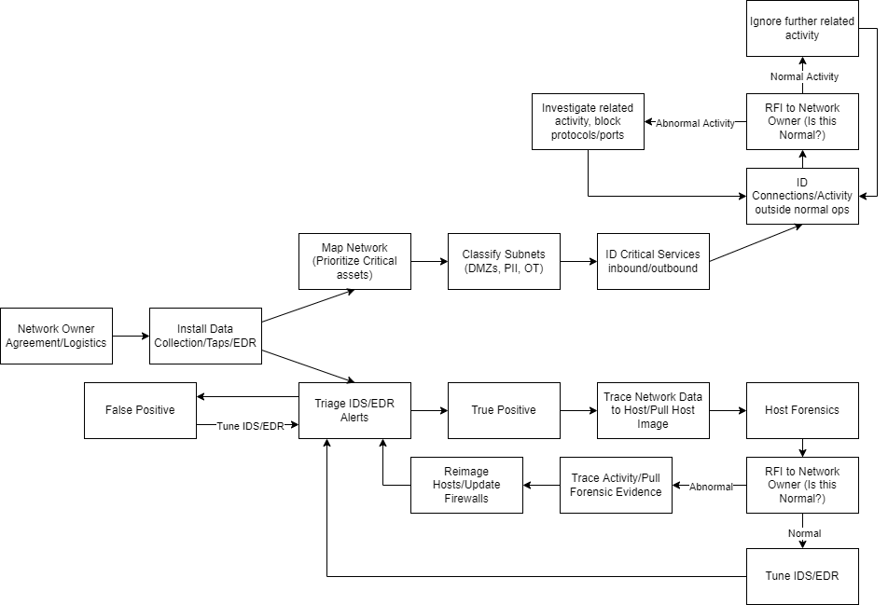
Drawn Diagrams

Slide 61
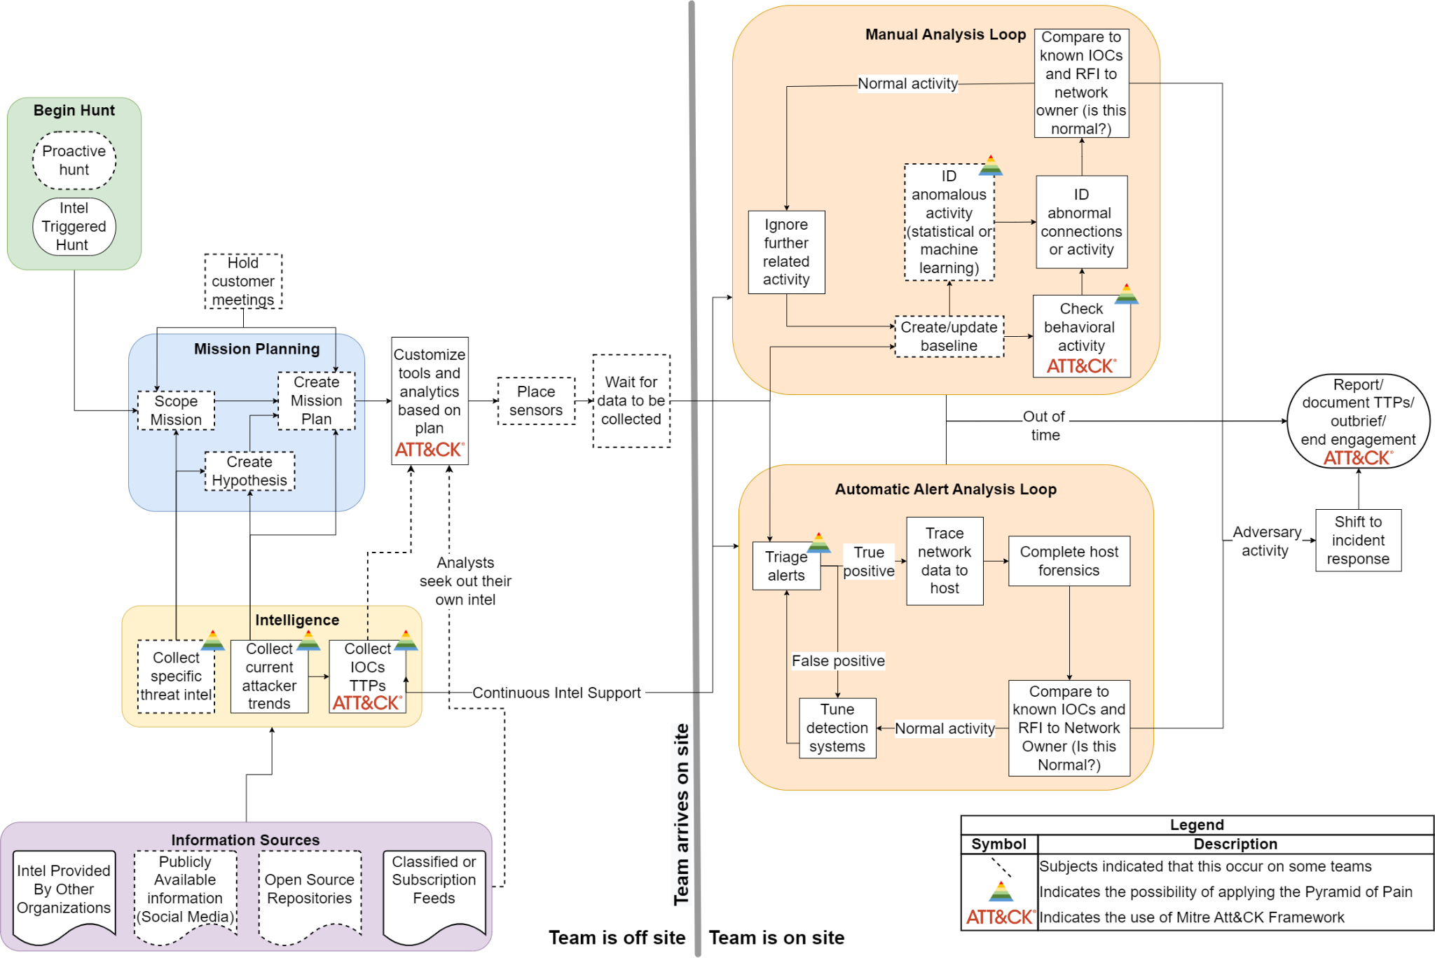
The Observed Process

Slide 62
From Data to Process

Slide 63
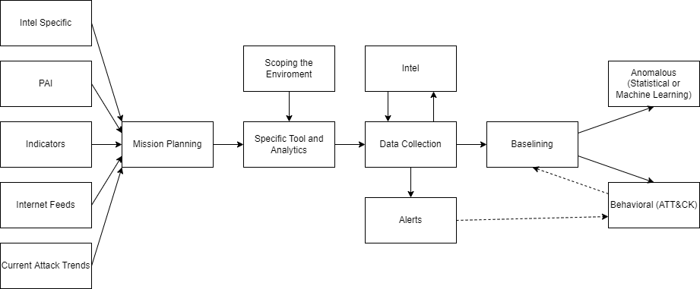
From Data to Process
We may have Intel … like current events, if there's like a current prevalent, exploit that's being used, that you're seeing in the news, something that everyone would know about.

Slide 64
Comparison to TaHiTI and Trent et al.

Slide 65
The Observed Process

Slide 66
The Observed Process

Slide 67
The Observed Process

Slide 68
The Observed Process

Slide 69
The Observed Process

Slide 70
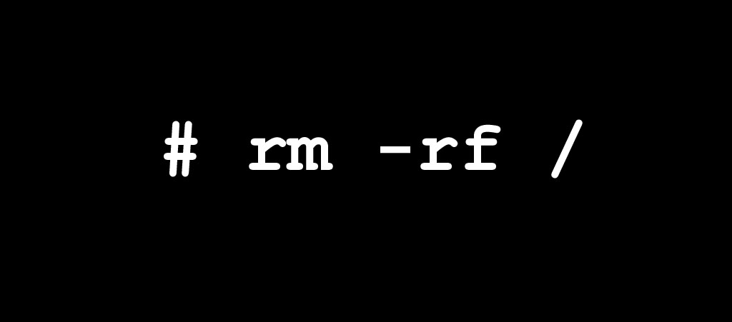
The Observed Process

Slide 71
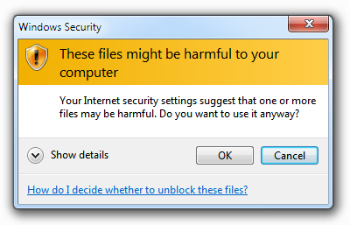
The Observed Process

Slide 72
The Observed Process

Slide 73
Maturity of interviewed organizations
“Organizations at HMM2 are able to learn and apply procedures developed by others”
Source: D. Bianco, A Simple Hunting Maturity Model, en, Blog. [Online]. Available: http://detect-respond.blogspot.com/2015/10/a-simple-hunting-maturity-model.html .

Slide 74
Frameworks incorporated
TH Frameworks | # Subjects who used the framework (# of organizations)
Mitre ATT&CK | 11 (3)
Hypothesis Checking | 8 (3)
Lockheed’s Kill Chain | 3 (2)
Pyramid of Pain | 2 (2)

Slide 75
RQ1.2: What shortcomings exist with current government TH processes and what can be done to alleviate these shortcomings?

Slide 76
RQ1.2: Process shortcomings
Shortcoming | # Subjects (# organizations)
Too little automation | 7 (3)
Poor threat intelligence | 5 (2)
Teams lack needed data | 5 (2)
Insufficient process detail | 5 (2)
Side-tracked analysts | 4 (2)
High turnover | 4 (2)
Inaccurate task tracking | 4 (1)

Slide 77
Too little automation
7 subjects had this complaint
Not enough time (3 subjects)
Lack of personnel (3 subjects)
Lack of expertise (2 subjects)
2 subjects were hesitant
“We’re fairly new to all of this so having that baseline knowledge ... from a mature organization is isn’t there. We will grow into it, but having people thrown in from all over the place with very little knowledge kind of hinders the whole process [of automation].”

Slide 78
Poor threat intelligence
5 subjects had this complaint
Intel was not helpful (3 subjects)
Intel seemed random (2 subjects)
Intel personnel did not understand the mission (1 subject)
5 subjects mentioned intelligence and did not complain
“We have the [intelligence component] gather the Intel for us before we go on a mission. Usually, I honestly don’t know how they do it because it doesn’t make sense. ... It seems like they just randomly pick out APTs [Advanced Persistent Threats] to go after.”

Slide 79
Theme #2: New Members
RQ2.1: How do newer members fit into government TH processes?
RQ2.2: How could government TH process changes facilitate the integration of less expert members?
RQ2.3: What features indicate expertise to government TH team members?

Slide 80
RQ2.1: How do newer members fit into government TH processes?

Slide 81
RQ2.1: How new members fit into the process
Simple tasks (3 subjects)
Used for feedback (3 subjects)
Sometimes a hindrance (1 subject)

Slide 82
RQ2.1: How new members fit into the process
Simple tasks (3 subjects)
Used for feedback (3 subjects)
Sometimes a hindrance (1 subject)
Factor | # Subjects (# Organizations)
Cybersecurity Education & Experience | 5 (3)
Computer & Networking Basics | 5 (1)
Number of missions | 4 (1)

Slide 83
RQ2.2: How could government TH process changes facilitate the integration of less expert members?

Slide 84
RQ2.2: Facilitating the integration of less expert members
Recommendation | # Subjects (# Organizations)
Pairing Members | 7 (3)
Process Documentation | 6 (3)
Task Separation | 4 (1)
Training | 3 (2)
Personnel Issues | 2 (1)

Slide 85
Pairing Members
7 subjects recommended this practice
2 critical subjects
Slows down the process
Must be interactive
“One of the things we did ... that I thought was really useful is doing a threat hunt with fellow [team] member. They kind of had experience looking [at] a lot of the data and the host forensic side of things and so I was able to learn a lot from them ... I think like a lot of shoulder surfing kind of experiences, I think that would be useful.”

Slide 86
Process Documentation
6 subjects recommended this practice
Ensuring a standard quality of work (2 subjects)
Providing guidance (4 subjects)
1 critical subject
Concerned about coverage
“I think having the [documentation] will help them be more effective, faster, because it will give them a guideline of what to do. … So instead of sitting there: ‘I don’t even know where to start.’ It’s: ‘I’m looking for connections on odd ports. That’s my first thing. And that’s how I’m gonna learn to build my first queries.’”

Slide 87
RQ2.3: What features indicate expertise to government TH team members?

Slide 88
RQ2.3: Features that indicate expertise
Feature | # subjects who spoke positively (# orgs) | # subjects who spoke negatively (# orgs)
Experience and number of missions | 6 (3) | 5 (2)
Certifications | 2 (1) | 7 (3)
Doing cybersecurity work in personal time | 7 (2) | 1 (1)
Training | 3 (2) | 4 (2)
Personality | 5 (2) | 2 (1)

Slide 89
Experience and number of missions
6 subjects spoke positively of this as a metric for expertise
Spoke hesitantly - indicating a general rule not an unbreakable law
5 subjects were critical
Often gave examples of individuals
“You … have people who’ve been on a hundred missions and they just don’t have the aptitude or the thought ability. You also have people who have never been on a mission who have the aptitude and who are gonna outperform people who have been on 20 missions. … The biggest <hesitates> there is a correlation between number of missions and analyst success. I would say there’s very little correlation between … [lists other factors]“

Slide 90
Certifications
2 subjects spoke positively of this as a metric for expertise
Should only be used as a baseline
7 subjects were critical
Even as a baseline (1 subject)
“I don’t put personally a lot of weight into certifications because I think a lot of times those are very test based and I don’t know that they have a lot of application with the real world.”

Slide 91
Doing cybersecurity work in personal time
7 subjects spoke positively of this as a metric for expertise
4 potential expertise
2 actualized expertise
1 both potential and actual expertise
1 subject was critical of off the clock work as a measure for expertise
“Maybe this is more like a personal thing, but sometimes I like to see or hear, if they’re doing it on their own time. If they’re doing like any kind of CTFs [Capture the Flags] or something on their own time or researching stuff. ... Even if they may not be super proficient, they’re at least willing to learn and put some extra time into it. ... That’s definitely more of a potential thing.”

Slide 92
Discussion and Future Work

Slide 93
For Researchers: Process Evaluation
Source: D. Bianco, A Simple Hunting Maturity Model, en, Blog. [Online]. Available: http://detect-respond.blogspot.com/2015/10/a-simple-hunting-maturity-model.html .

Slide 94
For Researchers: Cyber Threat Intelligence
Source: D. Bianco, A Simple Hunting Maturity Model, en, Blog. [Online]. Available: http://detect-respond.blogspot.com/2015/10/a-simple-hunting-maturity-model.html .

Slide 95
For Researchers: Cyber Threat Intelligence
Source: D. Bianco, A Simple Hunting Maturity Model, en, Blog. [Online]. Available: http://detect-respond.blogspot.com/2015/10/a-simple-hunting-maturity-model.html .

Slide 96
For Researchers: Develop Automation
Source: D. Bianco, A Simple Hunting Maturity Model, en, Blog. [Online]. Available: http://detect-respond.blogspot.com/2015/10/a-simple-hunting-maturity-model.html .

Slide 97
For Researchers: Develop Automation
Source: D. Bianco, A Simple Hunting Maturity Model, en, Blog. [Online]. Available: http://detect-respond.blogspot.com/2015/10/a-simple-hunting-maturity-model.html .

Slide 98
For Practitioners: Use TH Frameworks
TH Frameworks | # Subjects who used the framework (# of organizations)
Mitre ATT&CK | 11 (3)
Hypothesis Checking | 8 (3)
Lockheed’s Kill Chain | 3 (2)
Pyramid of Pain | 2 (2)

Slide 99
For Practitioners: Use TH Frameworks
TH Frameworks | # Subjects who used the framework (# of organizations)
Mitre ATT&CK | 11 (3)
Hypothesis Checking | 8 (3)
Lockheed’s Kill Chain | 3 (2)
Pyramid of Pain | 2 (2)

Slide 100
For Practitioners: Use TH Frameworks
Source: Davidjbianco, Enterprise Detection & Response: The Pyramid of Pain, Mar. 2013. [Online]. Available: https://detect-respond.blogspot.com/2013/03/the-pyramid-of-pain.html .

Slide 101
For Practitioners: Use TH Frameworks
Source: D. Bianco, A Simple Hunting Maturity Model, en, Blog. [Online]. Available: http://detect-respond.blogspot.com/2015/10/a-simple-hunting-maturity-model.html .

Slide 102
For Practitioners: Use TH Frameworks
Source: D. Bianco, A Simple Hunting Maturity Model, en, Blog. [Online]. Available: http://detect-respond.blogspot.com/2015/10/a-simple-hunting-maturity-model.html .

Slide 103
For Practitioners: Use TH Frameworks
Source: Davidjbianco, Enterprise Detection & Response: The Pyramid of Pain, Mar. 2013. [Online]. Available: https://detect-respond.blogspot.com/2013/03/the-pyramid-of-pain.html .

Slide 104
For Practitioners: Balance Resources

Slide 105
For Practitioners: Balance Resources

Slide 106
For Practitioners: Balance Resources

Slide 107
For Practitioners: Balance Resources
Source: D. Bianco, A Simple Hunting Maturity Model, en, Blog. [Online]. Available: http://detect-respond.blogspot.com/2015/10/a-simple-hunting-maturity-model.html .

Slide 108
Questions?
Thank you for your attention

Slide 113
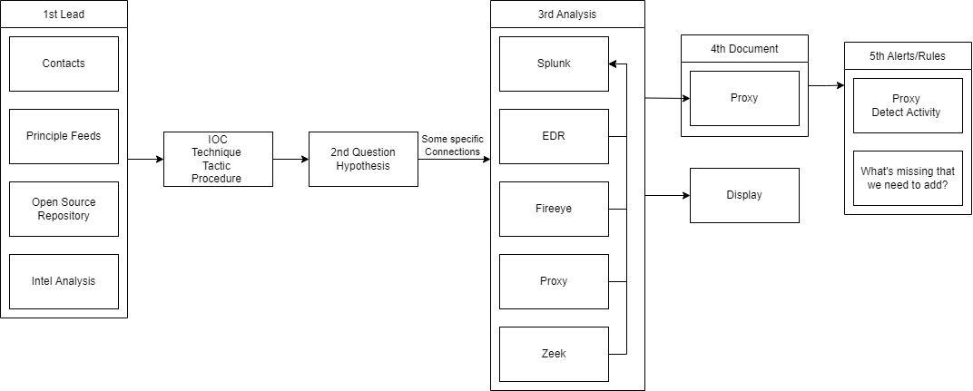

Slide 120
Methodology
Sanitization
Thematic Coding
Process Coding

Slide 121
Methodology
Interviewer: Question?
Anonymized Subject: Answer. Answer. Answer. Answer. Answer. Answer. Answer. Answer. Answer.
Answer. Answer. Answer. Answer. Answer. Answer. Answer. Answer. Answer. Answer.
Interviewer: Question?
Anonymized Subject: Answer. Answer. Answer. Answer. Answer. Answer. Answer. Answer. Answer.
Answer. Answer. Answer. Answer. Answer. Answer. Answer. Answer.
Sanitization
Thematic Coding
Process Coding

Slide 122
Methodology
Interviewer: Question?
Anonymized Subject: Answer. Answer. Answer. Answer. Answer. Answer. Answer. Answer. Answer.
Answer. Answer. Answer. Answer. Answer. Answer. Answer. Answer. Answer. Answer.
Interviewer: Question?
Anonymized Subject: Answer. Answer. Answer. Answer. Answer. Answer. Answer. Answer. Answer.
Answer. Answer. Answer. Answer. Answer. Answer. Answer. Answer.
Sanitization
Thematic Coding
Process Coding
Code #1
Code #2
Not in TaHiTI

Slide 123
Methodology
Interviewer: Question?
Anonymized Subject: Answer. Answer. Answer. Answer. Answer. Answer. Answer. Answer. Answer.
Answer. Answer. Answer. Answer. Answer. Answer. Answer. Answer. Answer. Answer.
Interviewer: Question?
Anonymized Subject: Answer. Answer. Answer. Answer. Answer. Answer. Answer. Answer. Answer.
Answer. Answer. Answer. Answer. Answer. Answer. Answer. Answer.
Sanitization
Thematic Coding
Process Coding
Code #1
Code #2
Not in TaHiTI

Slide 124
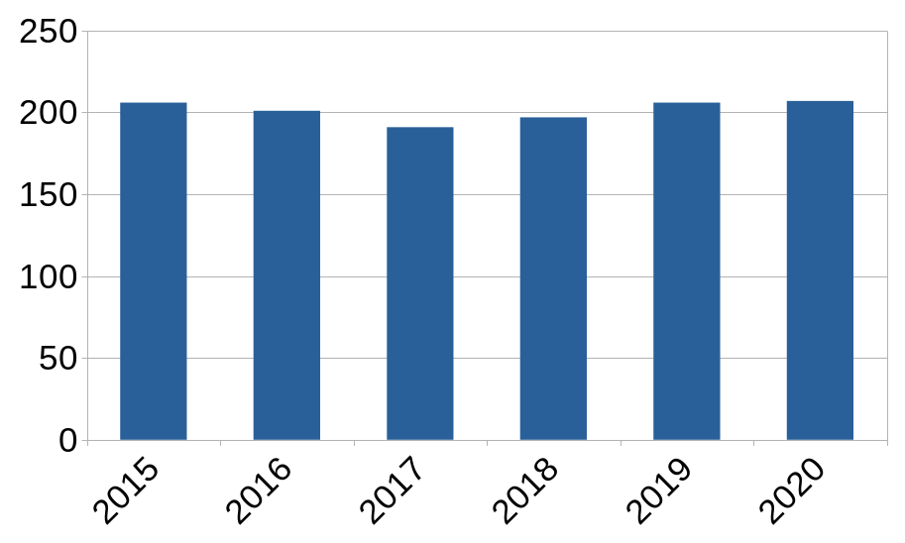
Days to Identify Data Breaches Remains Constant
Source: “Cost of a Data Breach Report 2020,” en, IBM Security, Tech. Rep., Jul. 2020. [Online]. Available: https://www.ibm.com/security/digital-assets/cost-data-breach-report/1Cost%20of%20a%20Data%20Breach%20Report%202020.pdf .

