Slide 1
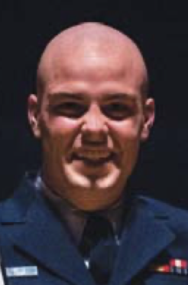
An Interview Study on Third-Party Cyber Threat Hunting Processes in the U.S. Department of Homeland Security
Paper!
To be presented at USENIX Security 2024
William P. Maxam III
US Coast Guard
James C. Davis
Purdue University
Lab website
Notes:
Hi, James Davis. Assistant professor of ECE @ Purdue University. Work in software engineering and cybersecurity.
Acknowledge Trey, the lead author, who graduated and is now an instructor at the US Coast Guard Academy and couldn’t get back for the symposium ☺.
This talk is about cyber threat hunting, which is an emerging discipline of cybersecurity operations. Cyber Threat Hunting (TH) looks for potential compromises missed by other cyber defenses. Has been indicated or mandated in White House executive orders for certain classes of organizations. Unlike other kinds of cybersecurity operations, the practices and challenges of TH have not yet been documented. We help to address this gap through an interview study of threat hunt practitioners, focused on third-party hunters in the US DHS.
Our findings will be presented at USENIX Security 2024.

Slide 2
Talk overview
Threat Hunt and the landscape of cyber ops
Knowledge gaps and research questions
Method
Results
Takeaways

Slide 3
Talk overview
Threat Hunt and the landscape of cyber ops
Knowledge gaps and research questions
Method
Results
Takeaways

Slide 4
If hacked, hopefully you discover the break-in
Adversary infiltrates the network
Adversary is discovered
Adversary is evicted

Slide 5
Dwell time: How long did it take you to discover the adversary?
Adversary infiltrates the network
Adversary is discovered
Adversary is evicted
Dwell Time

Slide 6
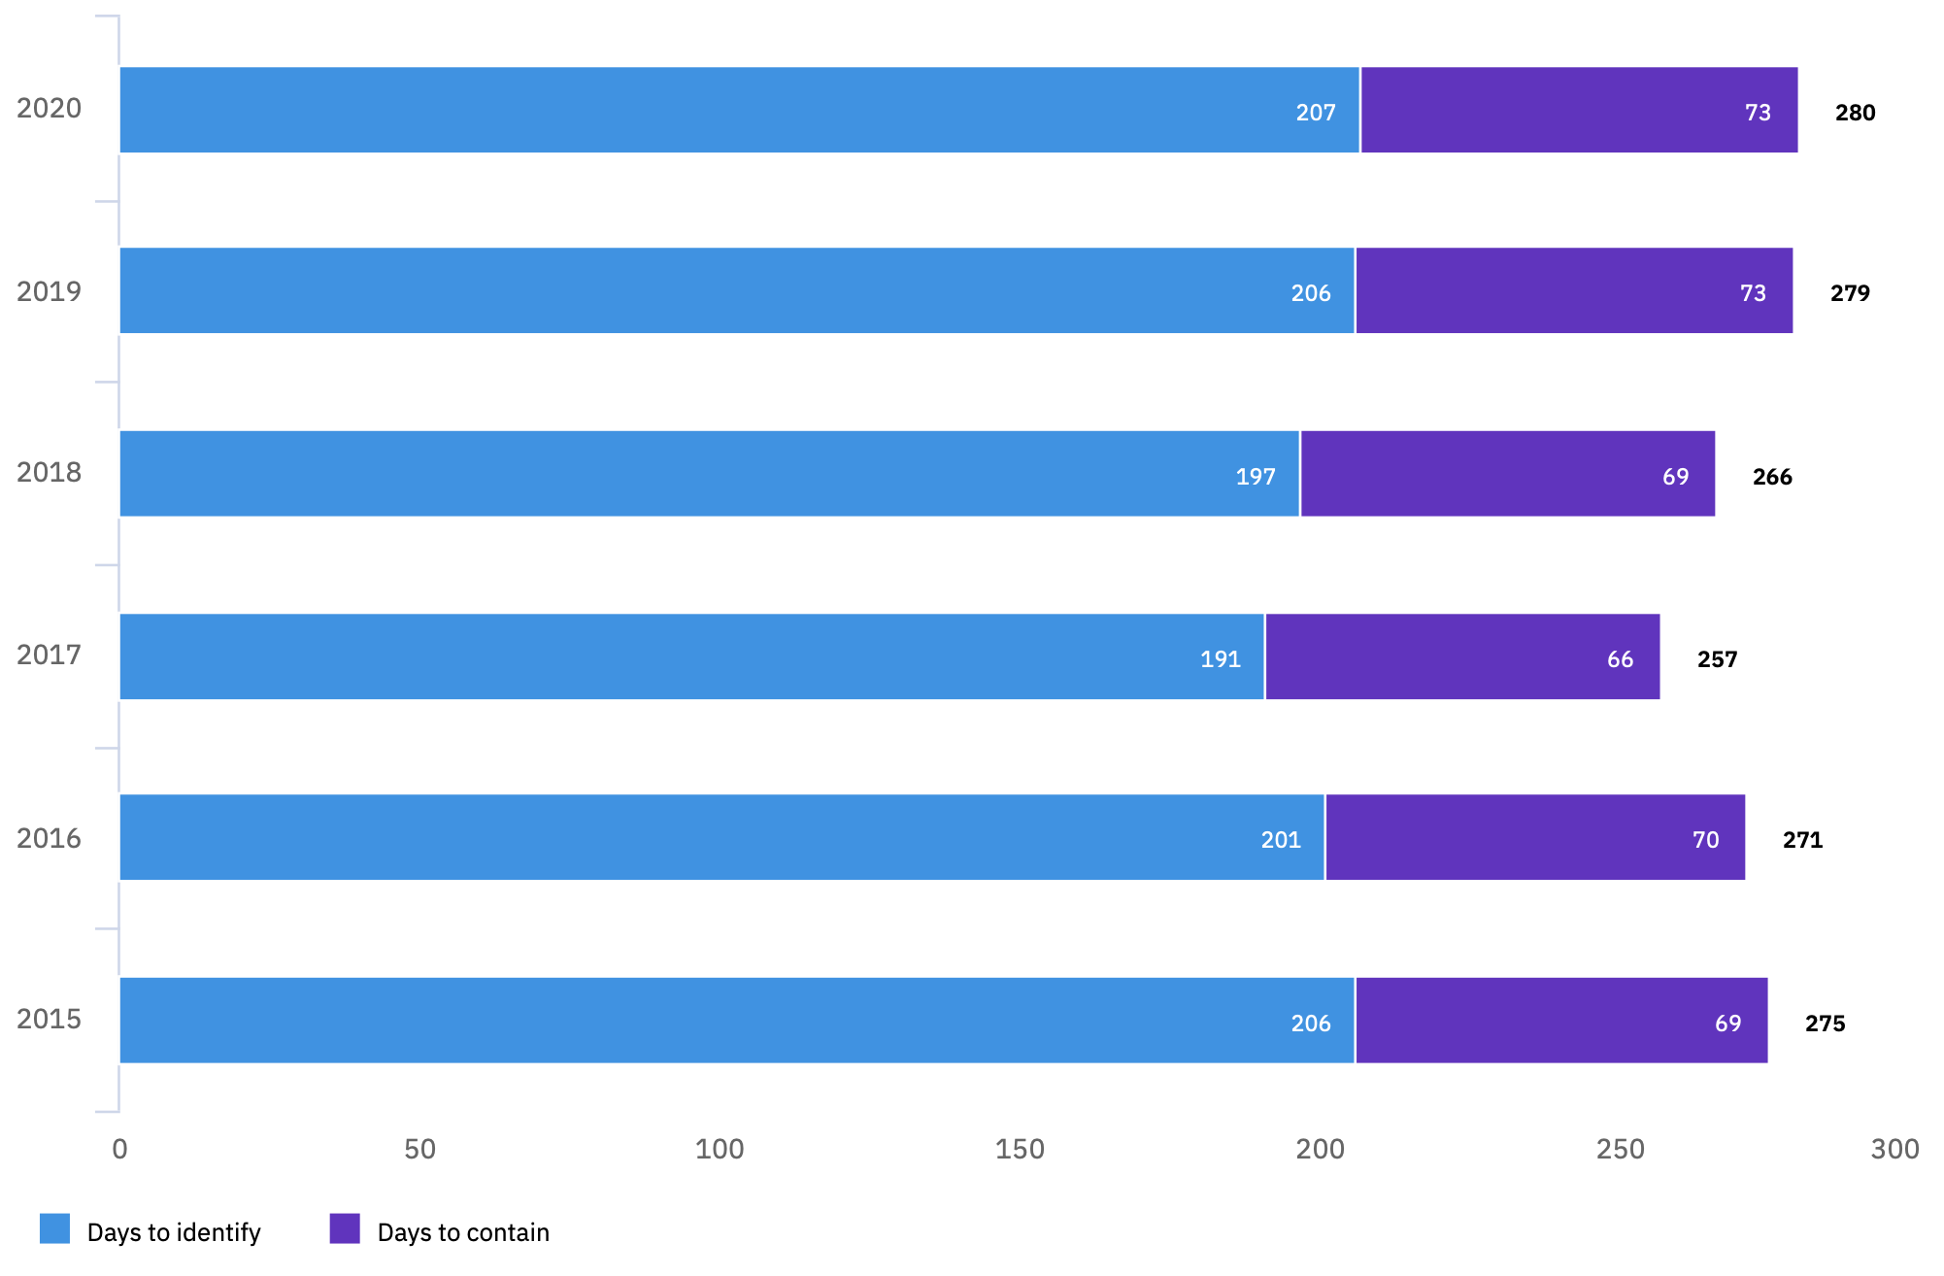
Average dwell times are ~200 days
Time to detect (blue) and evict (purple) adversaries
2020
2019
2018
2017
2016
2015
0
50
100
150
200
250
Dwell time (days)
Eviction time (days)
Notes:
IBM data (2020 Cost of a data breach report)
Average cost of a data breach was ~$4 million USD across 500 organizations worldwide.
Many sectors surveyed, including healthcare, energy, technology, manufacturing, entertainment, retail, hospitality.
https://www.ibm.com/security/digital-assets/cost-data-breach-report/1Cost%20of%20a%20Data%20Breach%20Report%202020.pdf
Attackers primarily accessed customer PII (eg for fraud), intellectual property, and anonymized customer records (eg to triangulate fraud, or to reverse engineer business analytic models)
For organizations with a high level of network automation, this reduced dwell times a bit…
”High automation”: Dwell times averaged 175 days
“Moderate automation”: 202 days
“Minimal to no automation”: 228 days
===
The distribution of dwell times appears to be broad. About half of attacks are detected within a week. The other half can take weeks, months, or years.

Slide 7
Three common paths to adversary discovery
(3) Detection
(2) Compromise
(1) Prevention
(4) Response

Slide 8
Third-party Threat Hunt in private sector and government
Notes:
Threat Hunt programs can be divided into internal and third-party.
Internal are often part of the SOC (security operations center) and the lines between SOC and TH blur in those cases.
Third-party TH is the focus of our study. These groups deploy teams to customer networks specifically to search for threats. They are more or less probing in the dark, working on an unfamiliar network and trying to understand whether any network flows or behaviors have indications of adversaries.
They are not auditors (though the customer SOC sometimes perceives them as such), but rather complementary to existing work by the SOC.
Private-sector: Talos, Crowdstrike, Booz|Allen|Hamilton
Government: Including US Coast Guard Cyber Command, CISA (Cybersecurity & Infrastrucutre Security Agency); and Sandia

Slide 9
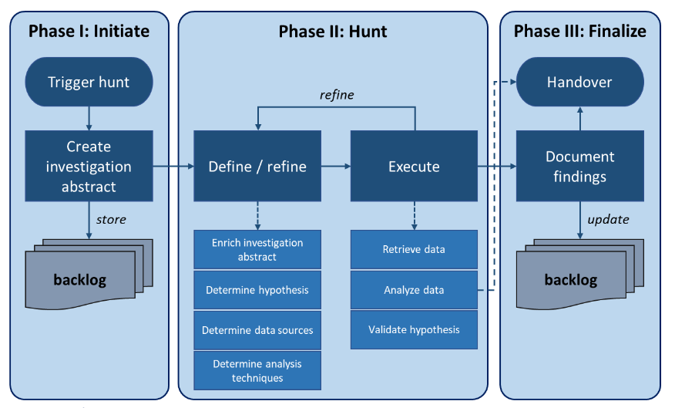
Existing Process Models of Threat Hunt: TaHiTI
Notes:
Describe:
What this shows
Context in which it was developed – internal TH teams at several Dutch banks
Why we need more than this – more detail, when it might be adapted, and hot spots
TaHiTI: Targeted Hunting integrating Threat Intelligence (TaHiTI)

Slide 10
Example Threat Hunt Frameworks: Kill Chain, ATT&CK
…
…
Notes:
Kill Chain: Traditional physical military concept, applied to information security by Lockheed Martin in 2017.
MITRE attack maps actual attack techniques to each step in the “kill chain”
Both of these are used by TH teams … (Discuss relationship between a TH process and a TH framework)

Slide 11
Talk overview
Threat Hunt and the landscape of cyber ops
Knowledge gaps and research questions
Method
Results
Takeaways
Notes:
Given the importance of TH teams to corporate and national security, we were curious about what these teams do, so that we can help optimize their processes or propose new ones.
However, we were stymied at the first step: it turns out there is very little data available on TH team processes and process challenges.

Slide 12
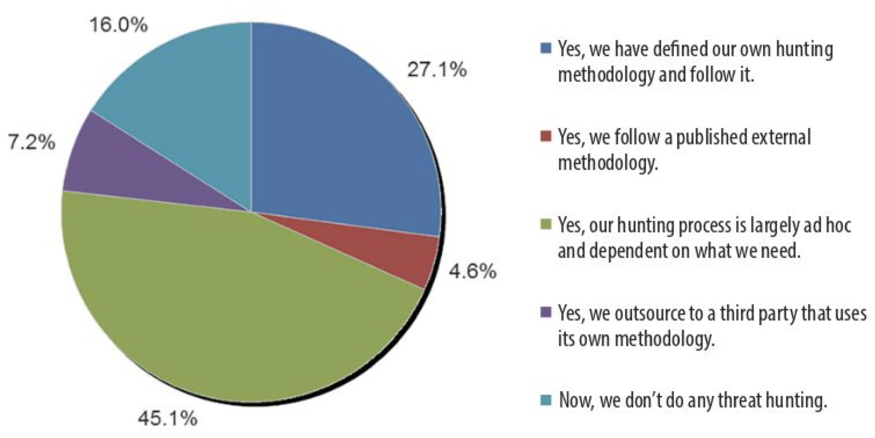
Gap #1: In practice, TH is ad hoc
Around half of surveyed organizations use “ad hoc” hunting (No defined process)
Notes:
Data from a survey by the SANS institute
Source: W. R. Lee and R. M. Lee, The Hunter Strikes Back: The SANS 2017 Threat Hunting Survey, en, 2017.

Slide 13
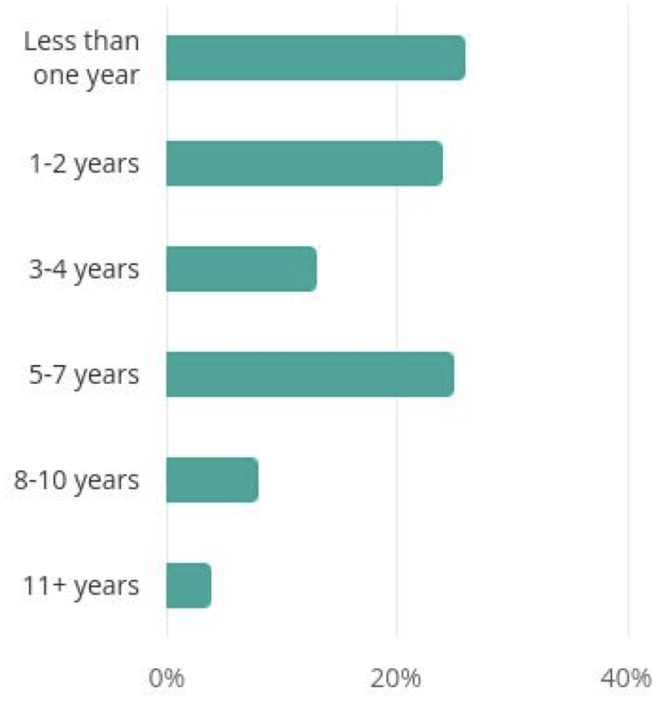
Gap #2: Ad hoc is ineffective if your hunters keep leaving
Time in role for cyber security analysts (US data)
Notes:
This is national statistical data about data
Source: Cyber Security Analyst Demographics And Statistics In The US. [Online]. Available: https://www.zippia.com/cyber-security-analyst-jobs/demographics/ .

Slide 14
Research questions
Theme 1: Process
What processes are currently used by 3rd-party government TH teams?
What challenges do they observe in these processes?
Theme 2: Addressing turnover
What factors indicate expertise?
How are new members integrated?

Slide 15
Talk overview
Threat Hunt and the landscape of cyber ops
Knowledge gaps and research questions
Methods
Results
Takeaways

Slide 16
Interview protocol
Topic | Example questions
Demographics | How many missions have you done? How many found an adversary?
Threat Hunt Process | Draw your team’s TH process What parts are problematic? What role do hypotheses play?
New members | How long does it take a new member to become productive? How do you evaluate expertise?
Notes:
Guided by previous TH literature and the gaps noted earlier, we asked about analysis frameworks and process automation [27, 40, 98].
Based on the fre- quency of personnel turnover, we also had a line of questions about incorporating new members
TH process: Also includes critical incidents (“Tell us about a time when the process failed”)
Questions shared in advance so subjects could prepare.
11 questions about TH process; 6 questions about new members.
All interviews were conducted by Trey Maxam (not me!), who had security clearance and prior professional TH experience. Interviews lasted 1 hour.
The interviewer reminded each subject of the unclassified nature of the research. All auio was reviewed and scrubbed of any sensitive information before being used for analysis.
===
Following best practices [41], we conducted two mock interviews. The primary researcher (who has TH experience) was interviewed by the other researchers. The protocol was tuned for clarity. Tran- scripts from these mock interviews were not used in analysis.
After the mock interviews, we divided the real interviews into two stages. In the first stage, we held two interviews to pilot our protocol, one with a CGCYBER team lead and one with a CISA team lead. After these interviews we reviewed the transcripts, assessed validity, and made changes as needed. Following this pilot, we added 2 questions and 3 follow-up questions, and re-worded one follow-up question. Over the course of the entire study, 92% of the main questions (22/24) were held constant. As there was little change in the instru- ment, our results include the 2 pilot interviews. Further details are in Appendix H.2.
The final semi-structured interview protocol is summarized in Table 2 and detailed in Appendix B.

Slide 17
Subject recruitment and demographics
Position | # Subjects
Leadership | 4
Team lead | 4
Analyst | 3
Organization | # Subjects
DHS Org. #1 | 10
DHS Org. #2 | 3
Notes:
Government Threat Hunting teams are a difficult group of practitioners to study due to the small size of the teams and the sensitive information they often deal with. One author’s US government security clearance and previous TH duties allowed us access to these TH team members and helped ensure no sensitive information was disclosed.
Participants were recruited for interviews through the authors’ professional network. Emails were sent to TH members with varying experience and roles. At both organizations, subjects were representative of multiple internal teams and analyst populations, including primary organizational divisions. The response rate from direct contacts was 59% (10/17). One additional subject offered to be interviewed after hearing about the study. 6 out of the 11 participants had previously worked with one author as a peer (1), subordinates (3), or managers (2). Participants were uncompensated volunteers to avoid conflict of interest with their colleague (the interviewer).
We tried to go beyond our professional network, but recruitment was challenging. We contacted TH analysts from other agencies (DOE and DOD) and received one response. We ultimately excluded the other organizations from the study and focused on the agency to which we had access.
The distribution of subjects by organization and by position is shown here
Some subjects had operated on teams in multiple organizations within the last three years so the count in Table 1 exceeds 11.
As precise titles could de-anonymize subjects, subjects are mapped to three general job roles: Leadership, Team Lead, and Analyst.
From Table 8:
Years of experience:
2 subjects < 1 year
5 subjects 1-3 years
3 subjects 4-5 years
2 subject > 5 years
Number of missions
1 subject had 0 (just finished training)
6 subjects had 1-3 missions
4 subjects had >= 5 missions

Slide 18
Talk overview
Threat Hunt and the landscape of cyber ops
Knowledge gaps and research questions
Methods
Results
Takeaways

Slide 19
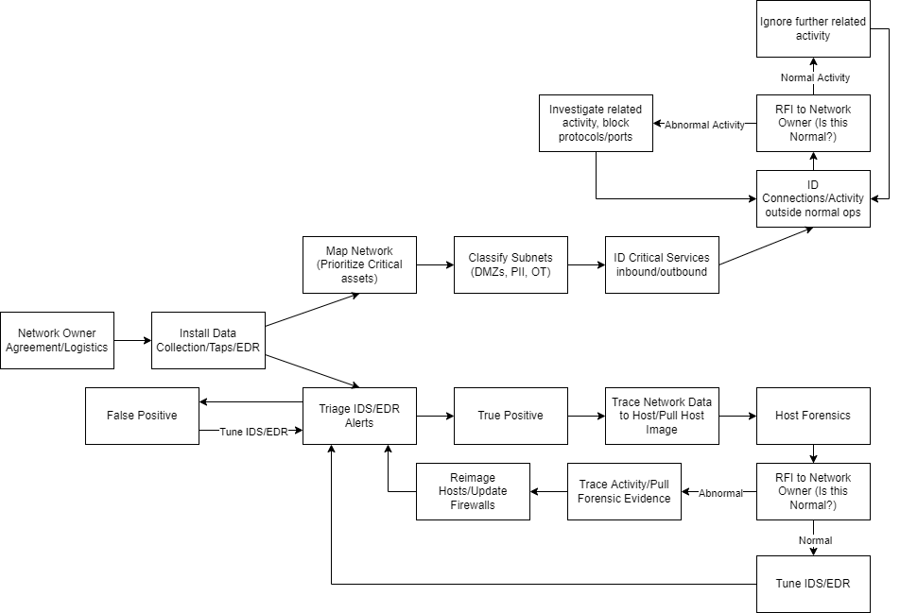
Range of TH process diagrams
19
Notes:
Here are the simplest and most complex diagrams from individual subjects.
[Ask the audience – show of hands]
Which one do you think came from the most experienced hunter?
Which one do you think came from the newest hunter (fresh out of training)?

Slide 20
(Simplified) Unified TH model
Notes:
Model developed via process modeling.
A pre-existing process is represented in a codebook used to analyze (code) a transcript. We created a codebook from TaHiTI and a similar document from the US Air Force.
The subjects’ descriptions of their TH process were then coded against these process codebooks to assess fit. 2
In our results (§4.1), these models were *not* a good fit. So, we induced a TH process model from the interview data.
First, all nodes from all subject diagrams were placed into one interconnected diagram. Similar nodes were combined. When possible, more precise nodes took precedence over general nodes. If a node was only on one diagram and not mentioned in multiple subjects’ interviews, that node was removed.
This figure shows the simplified result.

Slide 21
(Full) Unified TH model
Notes:
Having this model, we and future researchers can identify hot spots, opportunities for automation, contract out specific capabilities, etc.
Note that some of these activities occurred on all teams, while other activities occurred only on some teams.
Two example hot spots are in red boxes: the “Mission planning” box (blue) and the “Intelligence” box (yellow)
Mission planning: All of the sub-tasks (scope mission; meet with customer in advance; create mission plan and hypotheses) were “optional”, i.e. at least some studied team did not do this. The mission plan document and the associated attack hypotheses was not always shared with analysts, who then felt a bit unfocused or out of the loop.
Intelligence: Dashed line says “Analysts seek out their own intel” because on some teams, the intel feeds were viewed as so inadequate or unreliable that the analysts felt it was better to pull data directly from places such as social media and open-source repositories of attack kits.

Slide 22
Challenges: Process
Challenge | # subjects mentioning
Insufficient(?) automation | 6
Teams need more/different data | 5
Inappropriate process detail | 4
Notes:
For this part, we used thematic coding.
Automation: Many subjects felt they needed more automation, but there was some disagreement by the more experienced members.
One team lead did not want the automation to become a crutch. Another leader had a philosophical concern: “Hunting...should start where automation stops. That’s...the whole premise of hunting...the sophisticated actor already bypassed all that [automation] and now you have to apply manual techniques to...find them... It’s good to automate [repetitive] things, maybe like deploying kit. But I think most of the analytical work should...rely on human factor.”
Data: Third-party hunters face a particular problem – they don’t own the network they operate on.
Many teams would only begin collecting data when the team arrived on site. This created an issue because the team was forced to start hunting before much baseline data had been collected. Without data, threat hunting is virtually impossible or as one experienced team lead said: “you can’t find anything without data”. One team lead said: “We did a threat hunting engagement...for about two weeks, but we plugged sensors in on Day One of those two weeks. When you do that, you don’t have a baseline of what even one work week looks like much less a couple...we ... didn’t have the baseline to actually do real analysis on the network.
Seven subjects either mention this issue or said that they have learned to deploy sensors ahead of time to combat it. This is something that needs to be negotiated with each customer and can be a pain point.
Once teams do have network access, these networks are huge and the volume of data can be overwhelming. One experienced member of leadership suggested more precise scoping – e.g., via clearer mission planning – as a possible solution. They said: “We go into these environments, you see a lot of guest networks, or IOT devices, like cameras and security badges and stuff. It’s stuff that we don’t necessarily need to monitor ...and then it just fills up our sensors ...[queries] take forever to get results. Let’s concentrate on one thing, but do more in depth work. Concentrate on quality, I guess, versus quantity.”
Process detail: Note that I didn’t say too much or too little, because…
View–More detailed process documentation
Four sub- jects requested or supported more detailed process documen- tation. “I think having the [detailed process documentation] will help [new members] be more effective, faster, because it will give them a guideline of what to do. So instead of sitting there not knowing what the first step to take, at least they know a general network to look in. So instead of sitting there: ‘I don’t even know where to start.’ It’s: ‘I’m looking for con- nections on odd ports. That’s my first thing. And that’s how I’m gonna learn to build my first queries.’ ”
View–Less detailed process documentation:
In contrast, four subjects spoke in favor of less detailed process documen- tation.
One subject said their team’s process was too detailed: “For the current experience level of [my team], I would like it to see it a bit more vague... [subject gave an example of a VPN checklist item for a network without VPN] ...It’s too specific, you know? ...[We should] make that more abstract “ and say like, ‘Hey, why don’t [you] just look for any remote access software?’”.
One organization addresses this conflict by giving team leads autonomy: “[Team leads] are respon- sible for their mission...They are given leeway to adjust as things happen.”

Slide 23
Challenges: New members
Challenge | # subjects mentioning
Poor measures of expertise | 6
High turnover | 3
(Inappropriate process detail) | 4
Notes:
More thematic coding.
Expertise
TH team leaders want to assign members different tasks depending on the members’ expertise. Many indicators of expertise exist — three common indicators are external certifications, internal certifications, and training. Subjects seemed to dislike these. Instead, they used ad hoc indicators such as experience and time spent working off-hours
Six subjects did not believe certifications were a good measure of expertise. One subject was skep- tical that certifications measured even baseline knowledge: “It’s really hard to define what a baseline of cybersecurity understanding is ... You can’t really say it’s having a cer- tain certification because there’s plenty of people that have certifications that don’t know what they’re talking about.”
One organization maintains an in- ternal certification as mentioned by five subjects. One subject stated that it helped the team be interoperable with other government TH teams. Three subjects voiced dissatisfaction with the certification stating it was irrelevant or poorly imple- mented: “ I have some mixed feelings on [the certification]...It doesn’t ...apply to us all that well and the proficiency needed to complete it isn’t ...much either.”
Experienced subjects were cautious about the value of training as an indicator of expertise. For example, one said: “There is a mild or weak correlation between number of training courses and analyst success”. Four subjects spoke unfavorably of training as an indicator of expertise. A team lead said “having a [certain] course under your belt or any other course, usually doesn’t give me immediate confidence.”
Alternative measures proposed by some subjects, though each was opposed by at least one other subject:
The importance of time with the tools was a theme that often accompanied discussions about train- ing, as an indicator of expertise or a tactic to integrate newer members. When subjects discussed the value of training, they often spoke in terms of whether it let them improve their skills with their tools. For example, one subject said: “looking at the [training]... it’s a good experience but... they don’t use the tools we currently use...It doesn’t provide the training that we need per se, for the tools that we use.”
Working on personal time Working off-hours was viewed more positively than training or certifications. Five subjects said doing cybersecurity activities on personal time was a good metric for potential or expertise. Subjects made comments like: “I can’t really put my finger on a single thing that...explains our expertise. I would say, a big part of it is just being willing to kind of play around with the tools and even in their own time”. Others mentioned capture the flag-type activities. We note that not all analysts will be able to devote free time and that making this an indicator of expertise could have undesired ef- fects such as marginalizing certain otherwise high performing analysts as has happened in similar cyber security fields
Ten subjects mentioned experience (e.g., the number of missions) in the context of expertise. Five subjects were generally positive about experience as an indicator of expertise, while four demurred. For example, the positive subject quoted earlier also said “You...have people who’ve been on a hundred missions and they just don’t have the aptitude or the thought ability. You...have people who have never been on a mission who have the aptitude and who are gonna outperform people who have been on 20 missions.
Turnover
Three subjects mentioned the negative effects of turnover.
One subject said: “our biggest problem right now is turnover ... [at] any given time, you maybe have a quarter to a third of your team, [that] has been on more than one mission”. They mentioned a case where their entire team was replaced with new members.
To help bring new members onboard, six subjects recommended pairing new members with expert members. One less experienced subject found it quite helpful, saying “[Observing more experienced members] was nice because I was basically able to look over the shoulder over all the missions that have happened so far and see where I fit in the puzzle piece of Threat Hunting.”.
Two more experienced subjects agreed that pairing members can help, but voiced warnings. One spoke about short- vs. long-term payoffs: “It’s a balance between, do we need to succeed in this mission or do we need train our junior ana- lysts to succeed in the next mission?”
Process documentation
Five subjects described good process documentation as important for assisting new members.
Some subjects felt that process documentation helps a team meet a minimum standard, e.g., “I think defin- ing...baselines...really well so you have the minimum standards and a clear task list... What [are] the 10 steps that you absolutely will do before going deeper? And if you have that well defined and built into your tools with automations when possible, that makes it...easier for people to come on board and get up to speed.”
One analyst described the creation of a spreadsheet documenting the task that had to be completed on a TH mis- sion: “We didn’t really know what we were looking for before spreadsheet. ... I took the idea of the spreadsheet by looking at Mitre ATT&CK and seeing what we could look for. ... so it helped [new members] focus on each task at a time.”
(This helps illustrate the difference between a TH process and a TH framework like ATT&CK, as discussed at the beginning of the talk)
These baselines are helpful to prevent a phenomenon called ”rabbit hole-ing”, which was mentioned by several subjects.
Here, inexperienced analysts get stuck in one part of their TH process (eg network mapping) and lose sight of the bigger picture and priorities given their time constraints.

Slide 24
Talk overview
Threat Hunt and the landscape of cyber ops
Knowledge gaps and research questions
Methods
Results
Takeaways

Slide 25
Lessons learned for 3rd-party government TH teams in the DHS
Improve planning
Revisit the automated alert loop
Formalize apprenticeship
Many open questions remain
Especially, sharing across DOD, Sandia, etc.?
Paper
Lab website
Notes:
Improve planning:
Although many subjects focused on the TH activities after deploying to a customer site, about half of our unified TH process (Figure 2) occurs before deploy- ment. We were surprised by the range of planning activities and formality reported by subjects.
→ We recommend that all TH teams create mission planning documents and share the objectives with everyone on the team. Following the advice of one subject: “plan the mission...your high-level goals...and push that into...specific tools and analytics.”
Revisit the automated alert analysis loop:
Our subjects reported that their automated alert loops rarely find adversary activity. Out of the subjects that had detected adversaries on hunt missions (7/11), none of their examples described activity found by the automated alert loop. There are many possible causes, including redundant automation (e.g., already applied by SOC teams), human error (e.g., important alert is forgotten and not uploaded to tool) and absent automation (e.g., zero-day exploits). We recommend either making the automated alert loop more effective or reducing the resources devoted to it.
The ineffectiveness of automated alerts might be related to flaws in threat intelligence. One analyst, describing adversary detec- tion on a previous mission, was surprised that there was no alert for the activity. They said: “I don’t think there was an alert on it. Which is odd thinking about it now...you definitely would think that [tool] would contain some...but I don’t think there was.” Eight subjects claimed that their intelligence com- ponent supplies the team with at least some of the alerting rules used during a hunt. Perhaps TH teams should revisit the trust they place in these turnkey automated rules.
If TH teams do not revisit their automated alert strategy, then they might re-evaluate how many resources they in- vest in it. For example, one subject estimated that intelli- gence/alerting only accounts for “maybe a tenth” of adversary detections. If the amount of resources put into this analytic loop exceeds 10%, this could indicate an inefficiency.
Formalize apprenticeship.
Many subjects voiced concern about the quality of existing TH training and certifications.
Some teams addressed this by pairing new and experienced members. Although they didn’t use this language, these teams are applhing the concept of apprenticeship, which is a typical educational strategy for disciplines that are more art than science [1]. There is much literature on the virtues and shortcomings of apprenticeship [38, 81] and apprenticeship is currently being used with success in cybersecurity [89, 91].
Since subjects seem to agree that pairing is a good way to integrate new mem- bers, teams may benefit from a more robust apprenticeship program. According to subjects, this should include provid- ing time while on mission, since hunting with trainees takes longer. We recommend ensuring trainees not just watch others hunt, but rather interact with data and tools under supervision (the “side saddle” process suggested by one subject).
Open questions
How do we tailor automation to TH team needs? Each deployment seems to be unique. ML methods may be suitable. Some recent work from Ericsson research on automated hypothesis development (Boubakr Naur), but it’s unclear how to apply these methods in a third-party context.
Automation vs. analyst? Measuring whether, and under what conditions, au- tomation reduces team effectiveness would provide useful data for TH decision-maker
Process formalism or flexibility? In §4.2.4, subjects re- quest more detailed TH process documentation. However, in that section, an example is given of a process that was too precise, becoming a hindrance to the team. A second sub- ject indicates that they wish the process were more vague. Some teams deal with this tension by allowing team leads to make process changes. It is possible that this tension is inherent to a creative and open-ended activity, but tracking and measuring it may be helpful.
Measuring team effectiveness? Subjects did not agree on metrics for measuring TH team effectiveness. The goal of TH is to reduce adversary dwell time [98]. However, this metric may not be applicable to the TH teams we studied because they act in a third-party capacity and do not necessarily revisit organizations. Additionally, organizations may be compromised so infrequently that measuring dwell times does not provide a TH team with actionable feedback. Other researchers have recommended measuring whether a TH team “adds value” by identifying vulnerabilities or security blind spots. An objective measure of this kind of effectiveness may help evaluate the quality of a TH process. However, the benefit of these metrics has not been systematically evaluated in practice.
Measuring TH expertise? It’s not clear yet how to do this. Subjects had many ideas. The studied organizations should prioritize this to ensure teams have the right staff.

Slide 26
Bonus slides

Slide 27
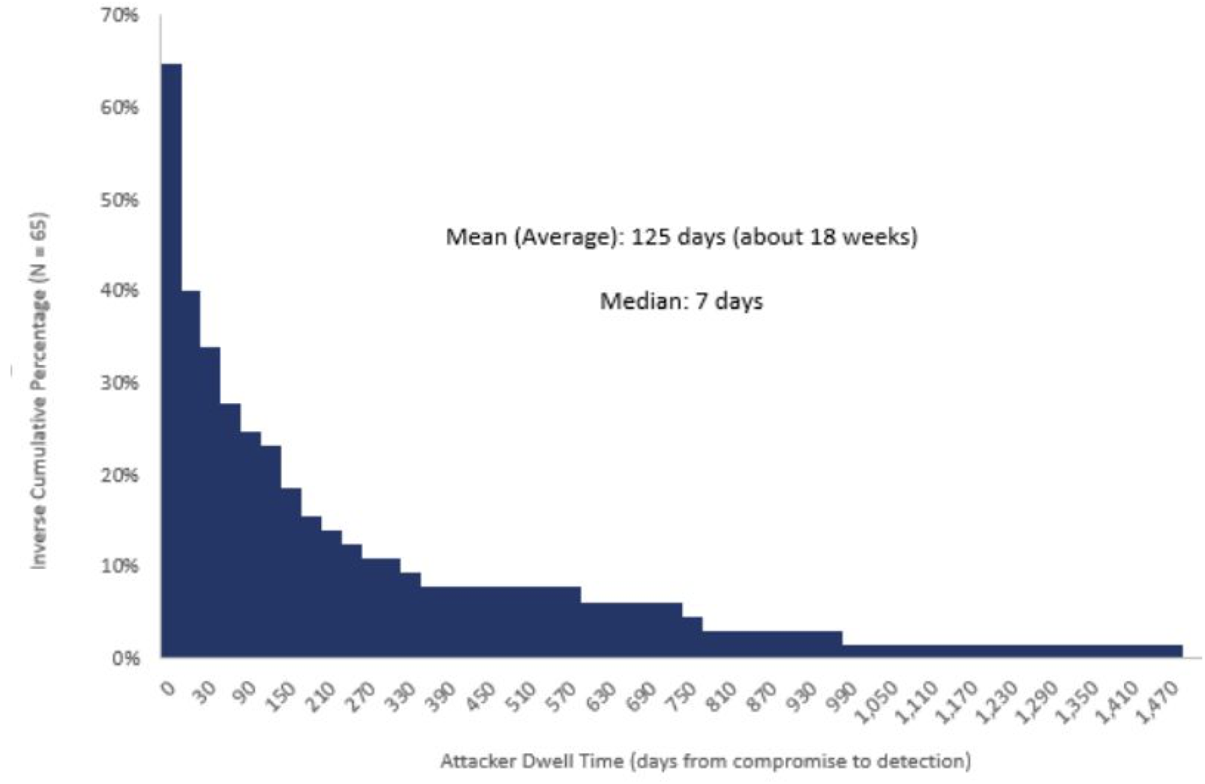
NB: Dwell times: Averages != medians – Still, not good
Mean (Avg): 125 days (18 weeks)
Median: 7 days
Inverse cumulative percentage (N=65)
Attacker dwell time (days from compromise to detection)
Notes:
Go through this VERY quickly
Source: D. E. Brink, “Quantifying the Value of Time in Cyber-Threat Detection and Response,” en, Aberdeen Group, Tech. Rep. 15218, Jan. 2017.

Slide 28
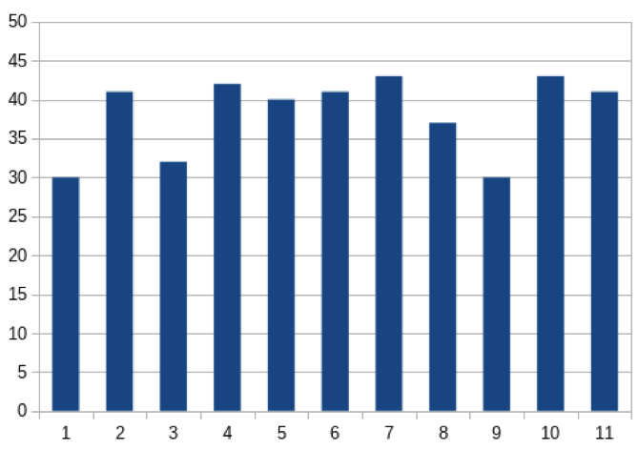
The data is saturated (so we could stop interviewing)
Cumulative
unique codes observed
Unique codes by subject
# Codes
# Codes
Saturation
Subject ID
Subject ID

Slide 29
No observed variation in themes by job role
# mentions by subjects

Slide 30
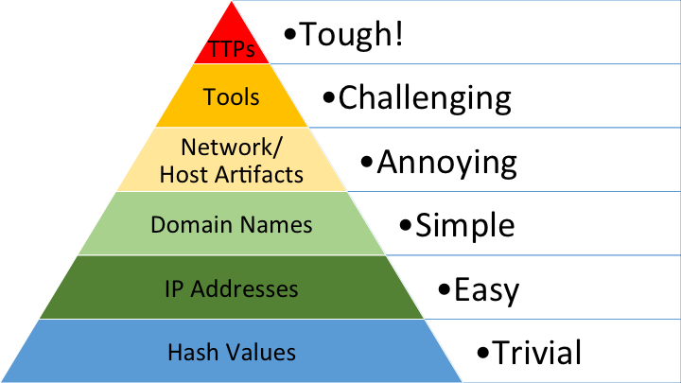
Bianco’s Pyramid of Pain – Another framework for TH

Slide 31
Threat Hunt maturity model (Bianco)

Slide 32
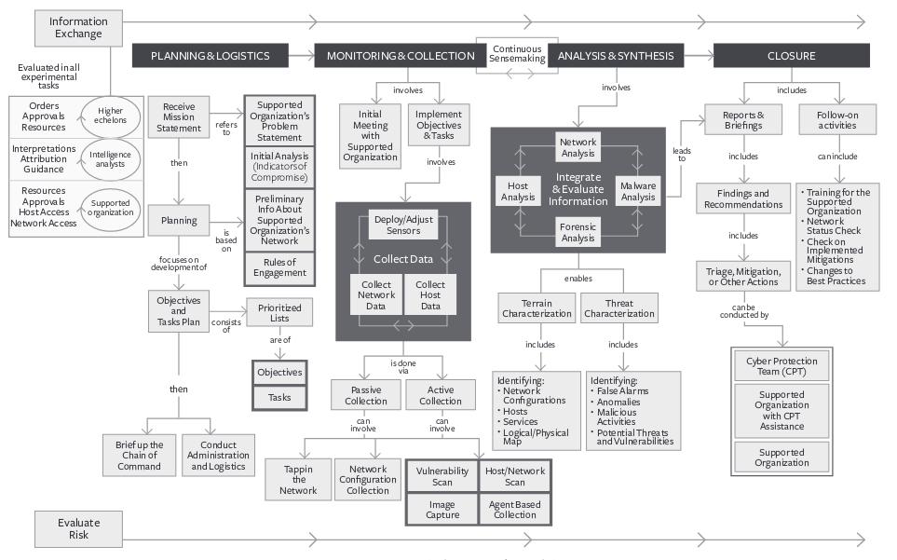
Closest military equivalent: cognitive modeling for cyber protection teams/CPTs (Trent et al.)

