Slide 1
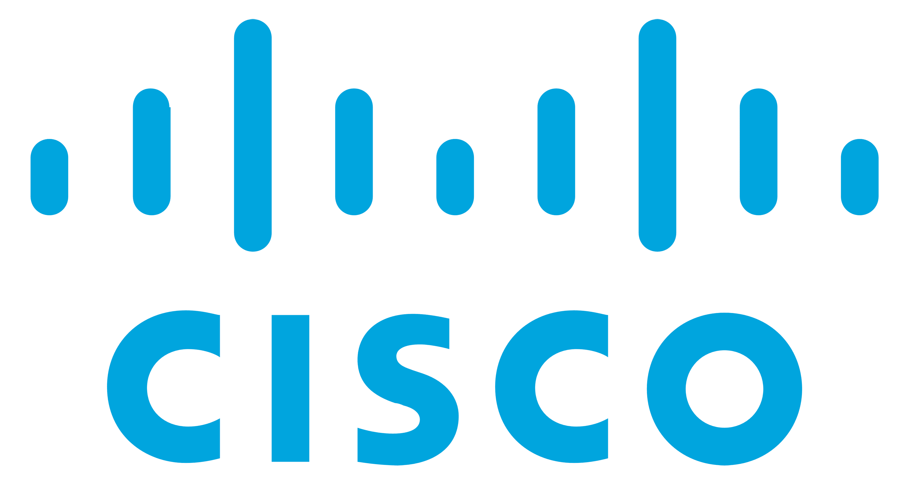
SoK: Analysis of Software Supply Chain Security by Establishing Secure Design Properties
Chinenye Okafor*
okafor1@purdue.edu
Taylor R. Schorlemmer*
tschorle@purdue.edu
Santiago Torres-Arias santiagotorres@purdue.edu
James C. Davis
davisjam@purdue.edu
∗Both authors contributed equally to this research.
Notes:
Chinenye introduces herself.
Taylor introduces himself.
We would like to acknowledge the support from the national science foundation, cisco for making this work possible.
We’d also like to thank the Purdue military research institute for allowing me(taylor) to attend & present at this workshop.

Slide 2
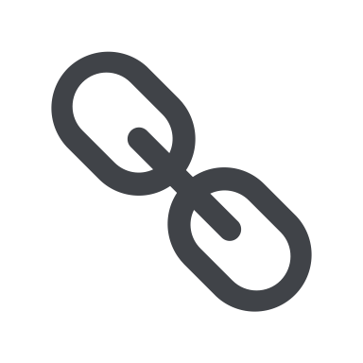
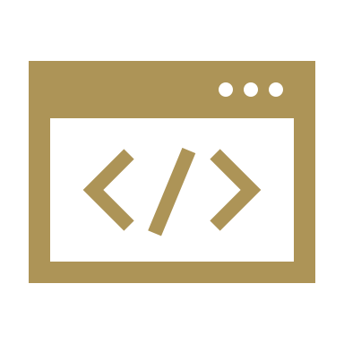
Background
The software supply chain
Links
Software
Product
The chain is composed of
Actors
Artifacts
Operations
Notes:
A software supply chain is made-up activities linked together to produce and deliver a software product.
The chain comprises of 3 main components – Actors manipulate artifacts and operations within the supply chain to produce an output. Artifacts include the third-party libraries, product team's code, software infrastructure, and dependencies. Operations are productive steps such as fetching dependencies or compiling software, building the source code, and publishing steps such as deployment or distribution.
An actor controlling any step in the supply chain can intentionally or maliciously sabotage downstream users hence the essence of supply chain security which aims to protect these components and ensure that the final software product is tamper-free.

Slide 3
Background
Mitigation efforts across academia, industry and open source
Knowledge of how supply chains can be compromised
- Taxonomy of Attacks – Ladisa ‘18
- Ecosystem Analysis - Zimmermann ‘19, Decan ‘18
System designs to improve security
- In-toto - Torres-Arias ‘19
- Reproducible Builds – Lamb ‘22
Best practices for a secured supply chain
- Google's Supply-chain Levels for Software Artifacts (SLSA)
- Microsoft's System for Cross-domain Identity Management (SCIM)
- Cloud Native Computing Foundation (CNCF)
Notes:
Various efforts across various disciplines and domains aim to achieve this goal.
Some researchers have provided structured knowledge on how current supply chains can be attacked. The taxonomy of attacks by Ladisa et al. yields an attack tree that helps us understand the various vectors through which supply chain attacks can happen.
We have researchers that have carried out various ecosystem analyses to help us understand how the structure of dependencies in the chain can make us more or less vulnerable when selecting external dependencies.
There are efforts focused on developing systems and mechanisms to mitigate these attack vectors. We have likes of In-toto and Sigstore that attempt to provide a layer of security to the current operations in the software supply chain.
There are best practice models that describe a combination of mechanisms and configurations that can provide a strong security posture against software supply chain attacks.

Slide 4
Problem
No standard for comparing security techniques
Difficult to audit security coverage of a supply chain
Finding gaps in supply chain security solutions is difficult
Notes:
But there is no overall way to know how these all fit together. And there is no way to equally compare them. For instance, how does the mitigation technique of Torres et al. compare to that of Cappos et al.? How do I ascertain the level of coverage each implementation provides my supply chain?
This comparison is difficult because no principles contrast one work with another, which makes it difficult to audit the security coverage of a supply chain and consequently difficult to identify gaps in the security of the supply chain.

Slide 5
Desired Solutions
A common understanding of supply chain attacks would:
Tell us what is/isn’t a supply chain attack
Help us mitigate these attacks
Principles describing a secure supply chain would:
Tell us what the ideal security posture looks like
Allow us to audit our current security techniques
Highlight security shortcomings in software pipeline
Notes:
We should know exactly what a supply chain attack is. Know your enemy.
We should know exactly what a secure supply chain looks like. Have the end-state in mind.

Slide 6
Our Contributions
An Attack Pattern for software supply chain attacks
Principles for secure software supply chains
Mapping principles to current security practices
Notes:
So we'll be leaving you with three things:
First, An attack pattern for a software supply chain attacks
Secondly, the design principles that exist for a secured supply chain
Finally, an analysis of how current security practices map to these principles

Slide 7
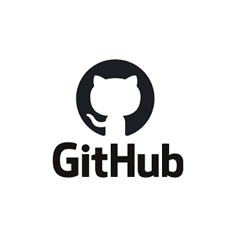
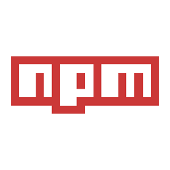
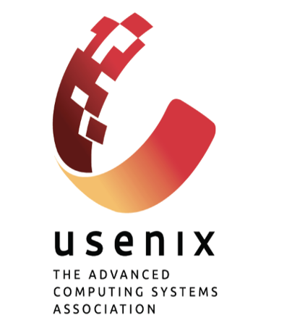
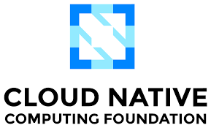
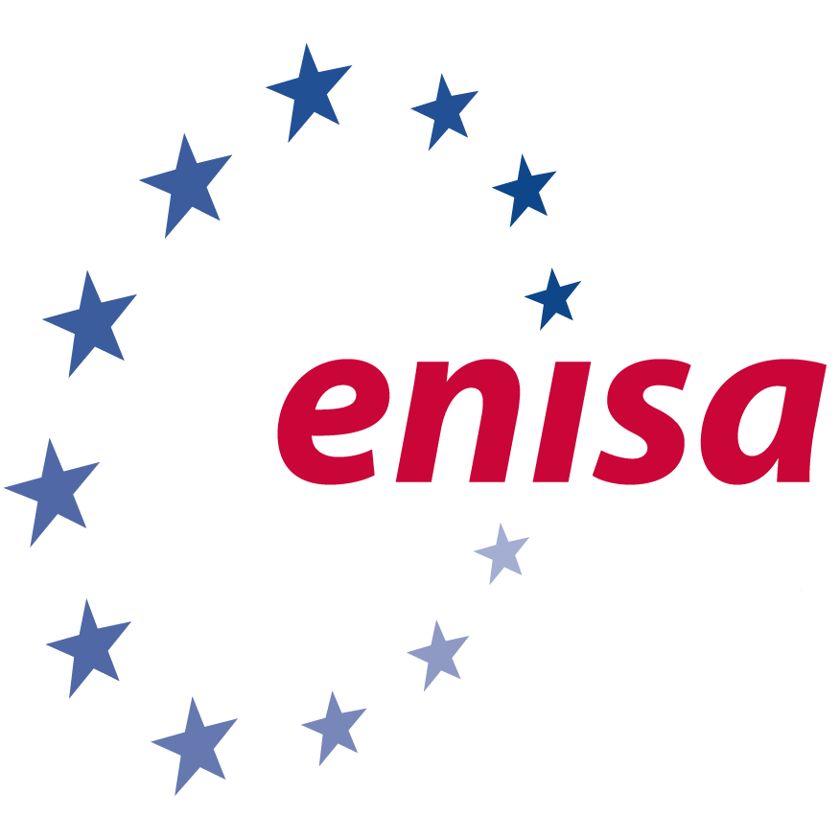
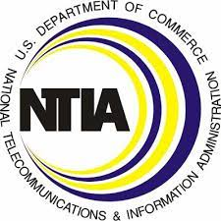
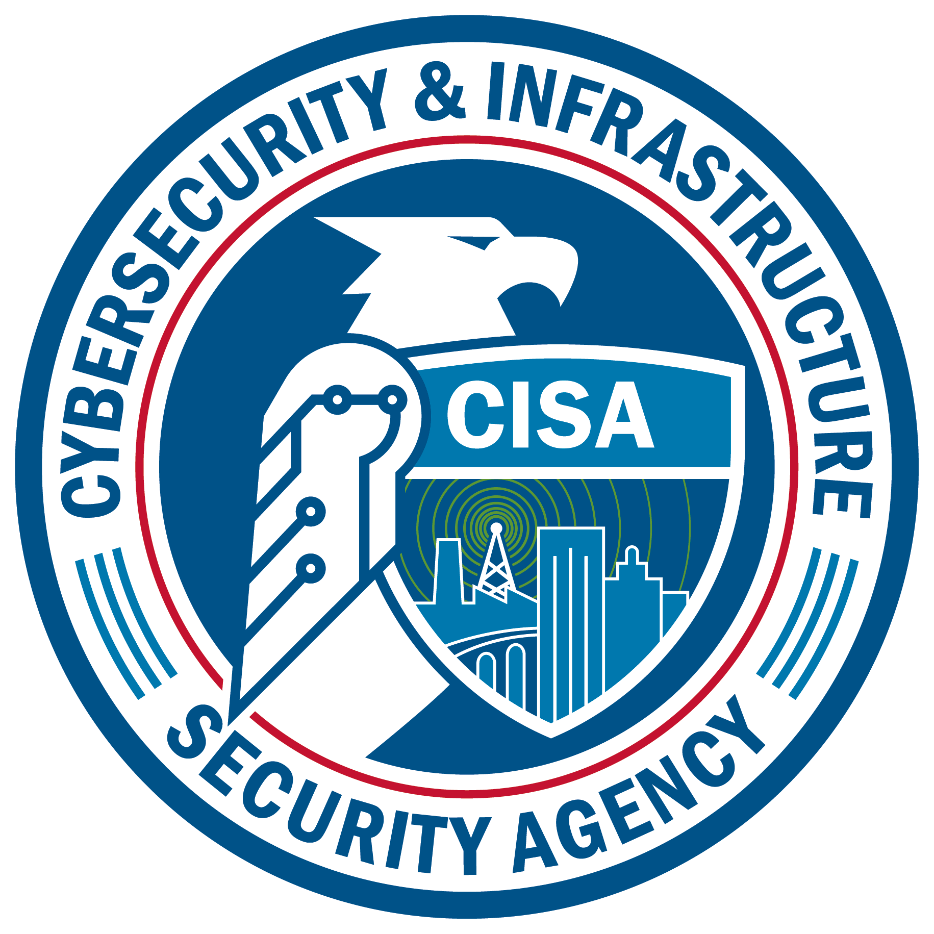
Methodology
Academic
Industry
Government
Notes:
We reviewed literature from sources across academia, industry and the government for this research.
National Telecommunications and Information Administration (NTIA)
Cybersecurity and Infrastructure Security Agency (CISA)
National Institute of Standards and Technology (NIST)
European Union Agency for Cybersecurity (ENISA)
Cloud Native Computing Foundation (CNCF)

Slide 8
Attack Pattern
Notes:
The difference between software supply chain attacks and other software attacks, is not clearly defined in literature. There are multiple definition of what a supply chain attack is, which we have identified in the paper. We asked the question – is an attack a supply chain attack just because the software exists within the context of a supply chain? Is existing vulnerability exploitation a supply chain attack? Our answer is NO.
A supply chain attack is one that follows these 4 distinct stages.

Slide 9
Attack Pattern
Compromise – Attacker compromises an existing weakness
2. Alteration – Attacker alters the software supply chain
3. Propagation – The alteration propagates through the chain
4. Exploitation – The attacker exploits the alteration

Slide 10
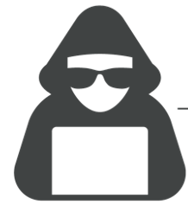
Attack Pattern
Eslint Incident
Compromise
Alteration
Exploitation
Propagation
Attacker
Compromised maintainer credentials
Published malicious versions of the eslint-scope package
Users
Stole access tokens for publishing to NPM
Notes:
This is an incident where an attacker compromised the npm account of an ESLint maintainer and published malicious versions of the eslint-scope and eslint-config-eslint packages ( postinstall script that steals a user's access token to publish to NPM and sends it to the attacker. ) to the npm registry. This got distributed to users during update. On installation, the malicious packages executed code which sent the user's access token to publish to NPM to the attacker.
You can agree with me that if at least of one the first 3 stages was eliminated, the attack wouldn't happened.

Slide 11
Security Principles
Notes:
Now we have a common understanding of what a software supply chain attack is.
We need a set of principles that show how we can defend against such an attack.
Something like the CIA triad, but specific to the software supply chain.

Slide 12
Security Principles
Transparency
Validity
Separation
Notes:
We attempted to abstract all observed techniques into a few principles.
After examining the literature, we settled upon 3 security principles
We believe these are comprehensive – more on this later
This is exactly what a secure supply chain looks like.
In same way as CIA – not necessarily binary – but to some degree

Slide 13
Transparency | Validity | Separation
Information flow throughout the supply chain.
Which actors exist in the supply chain?
What artifacts exist in the supply chain?
What operations happen in the supply chain?
What connections exist in the supply chain?

Slide 14
Transparency | Validity | Separation
Integrity and authentication across the supply chain.
Are actors authenticated?
Do artifacts maintain integrity?
Do operations maintain integrity?
Do connections maintain integrity?

Slide 15
Transparency | Validity | Separation
Minimized dependencies in the supply chain.
Are actors compartmentalized?
Are artifacts compartmentalized?
Are operations compartmentalized?
Which connections are necessary?

Slide 16
Are the principles comprehensive?
Transparency
Validity
Separation
Notes:
Are our principles comprehensive? Do they prevent an attack?
To prevent an attack – stop before stage 4
We developed the attack pattern somewhat independently from the principles – but found there is a good mapping between them.
Primary connections:
Transparency allows actors to “see” weaknesses in the supply chain – preventative measures to stop the compromise stage
Validity prevents alterations from occurring – no change made – stops second stage
Separation prevents propagation – no bad changes can reach downstream
In real scenarios there is a bit of overlap

Slide 17
Mapping Principles

Slide 18
Principles in Practice: SLSA
Supply-chain Levels for Software Artifacts (SLSA) Level 4
Transparency
Validity
Separation
Provenance attestation files
Version Control
Provenance integrity
Isolated builds
Hermetic build process
Notes:
SLSA – walk through each principle

Slide 19
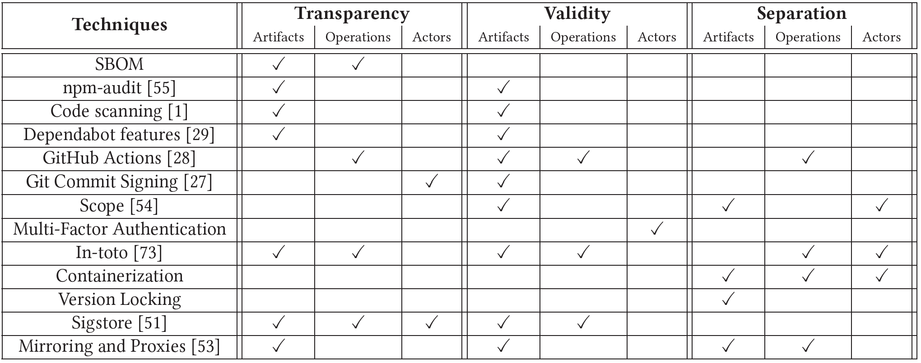
Applying Security Principles
Emphasis on securing artifacts
Under-emphasis on securing operations and actors
Notes:
Presenting this table may be overwhelming :/

Slide 20
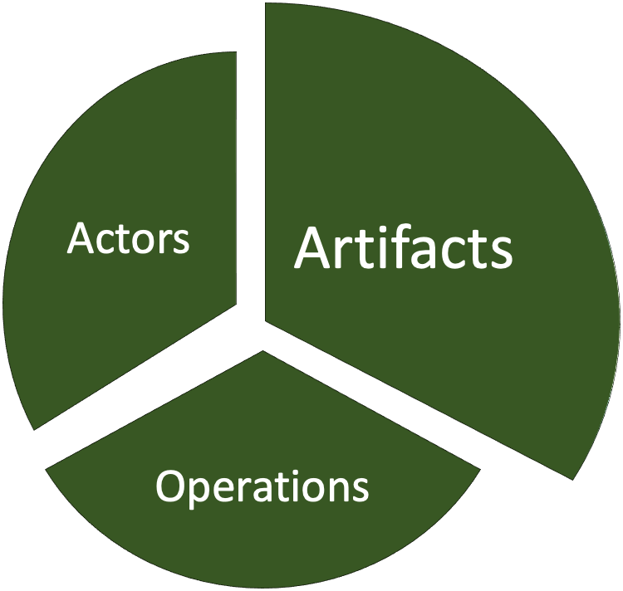
Future Work
Techniques to increase actor and operation security
Methods to increase transparency of actor's risk
Notes:
We need more techniques to increase actor/operation security - New frameworks could use these principles to self-audit coverage
We should be able to tell how risky adding a new component is
Future analysis could use these principles to provide more detailed analysis on specific systems

Slide 21
Summary
Defined a software supply chain attack pattern
Proposed principles for a secure software supply chain
Mapped these principles to current security practices
Thank you! Questions?
Chinenye – okafor1@purdue.edu
Taylor – tschorle@purdue.edu

Slide 22
Bonus Slides

Slide 23
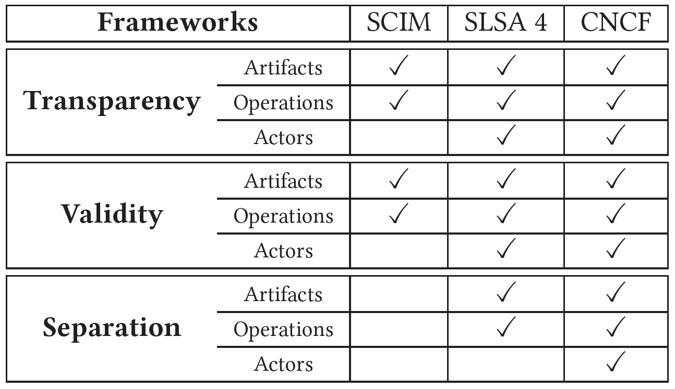
Applying Security Principles
Frameworks provide good coverage
Notes:
This could be a cool table to present? Maybe alongside the SLSA example?

Slide 24
Principles in Practice: NPM
Node Package Manager (NPM)
Transparency
Validity
Separation
package.json
NPM-Audit
Secure Authentication
NPM-Audit
Scope
Private Proxy
Notes:
Here’s an example

