Slide 1

Cross-Sight: Recommending Pre-trained Models using Transformers
Masters Thesis Defense
Parth Patil
December 12, 2025
Advisor: Dr. James C. Davis
Committee : Dr. Qi Guo, Dr. George K. Thiruvathukal
Notes:
Welcome: Introduction to the thesis defense on "Cross-Sight," a method for recommending pre-trained models using Transformers.

Slide 2
Outline
Outcomes
Problem Overview
Background and Related Works
Understanding Model Spider (SOTA)
Cross Attention vs Self Attention
Part 1: Vision for PTM Recommendation
Gaps in the current landscape
Hardware aware PTM Recommendation
Part 2: Cross-Sight
Existing Challenges and Key novel contributions
Walkthrough of the pipeline and experimental setup
Results and comparisons
Limitations and Future Work
Conclusion and Discussion
Notes:
Agenda: The presentation will cover:
Overview: Background and motivation for the problem.
Vision: The proposed long-term vision for solving model recommendation.
Cross-Sight: Deep dive into the specific approach developed (Cross-Sight).
Future Prospects: Next steps and future work.

Slide 3
Outcomes
Thesis Related
Recommending Pre-Trained Models for IoT Devices
Parth V. Patil, Wenxin Jiang, Huiyun Peng, et al. 2025 IEEE/ACM 47th International Conference on Software Engineering: 7th International Workshop on Software Engineering Research & Practices for the Internet of Things (SERP4IoT), Ottawa, Canada, 2025
Cross-Sight [Working Title]
[In preparation] Parth V. Patil …
Other Projects
A Unit Proofing Framework for Code-level Verification: A Research Agenda
Paschal C. Amusuo, Parth V. Patil, Owen Cochell, et al.
2025 IEEE/ACM 47th International Conference on Software Engineering: New Ideas and Emerging Results (ICSE-NIER), Ottawa, ON, Canada, 2025
Do Unit Proofs Work? An Empirical Study of Compositional Bounded Model Checking for Memory Safety Verification.
Paschal C Amusuo, Owen Cochell, Taylor Le Lievre, Parth V Patil, et al.
48th IEEE/ACM International Conference on Software Engineering (ICSE) 2026.
Notes:
Research Output: This research at Purdue has resulted in several publications:
SERP4IoT (ICSE): Published "Recommending Pre-Trained Models for IoT Devices."
ICSE-NIER: Contributed to a paper on unit proofing frameworks.
ICSE: Additional paper contributions.

Slide 4
Thesis Summary
Given Zoo + New Dataset + Constraints, which PTM to use?
“Too many” Pre-Trained Models (PTMs) available on HuggingFace, Kaggle, or other Model Hubs (~2M).
Identified key-short comings in current leading approach.
Proposed a vision for integrating additional constraints into selection pipeline.
Conducted a pilot study demonstrating measurable improvements over SOTA methods, along with detailed evaluation results.
Notes:
Core Question: The fundamental question this thesis addresses is: Given a Model Zoo, a Target Dataset, and specific Constraints, which Pre-Trained Model (PTM) should be used?
The Challenge: There are over 2 million PTMs available on hubs like Hugging Face. This creates a massive search space for ML engineers.
Contribution: We identified shortcomings in state-of-the-art (SOTA) approaches, proposed a vision for integrating hardware constraints, and conducted a pilot study (Cross-Sight) showing measurable improvements over current methods (Model Spider).

Slide 5
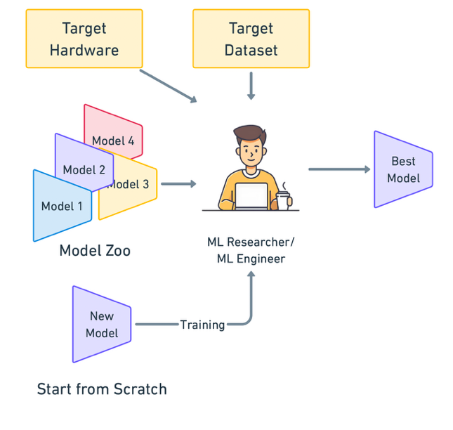
Overview
Notes:
The Workflow: An ML engineer usually has two choices: train a model from scratch or select one from a Model Zoo.
Constraints: The decision is heavily influenced by:
Target Dataset: Is it structured, labeled, or unsupervised?
Target Hardware: Are there constraints like IoT limitations, or is it a high-resource cloud environment?
The Goal: To find a singular "best model" that, when fine-tuned on the target dataset, yields the highest performance.

Slide 6
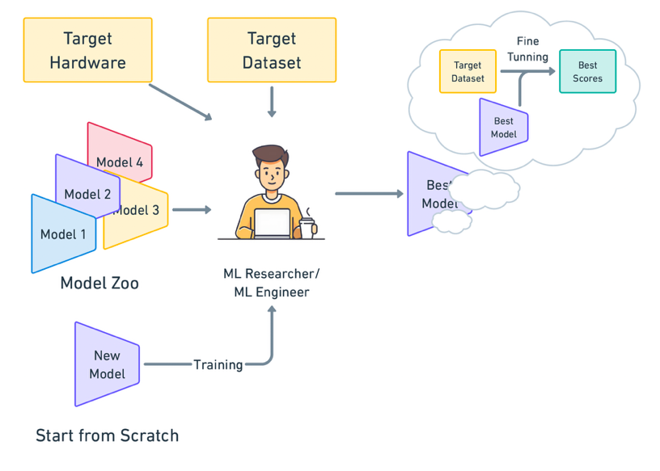
Overview

Slide 7
Problem Overview
Problem: Too many Models
Problem: Fine-tuning is costly
Problem: Hardware & Architecture Selection
Notes:
The Bottlenecks: The current supply chain for selecting models has three major avenues of difficulty:
Too many models: The "Paradox of Choice."
Cost: Fine-tuning is computationally and temporally expensive.
Selection Difficulty: Identifying the right hardware and architecture is error-prone.

Slide 8
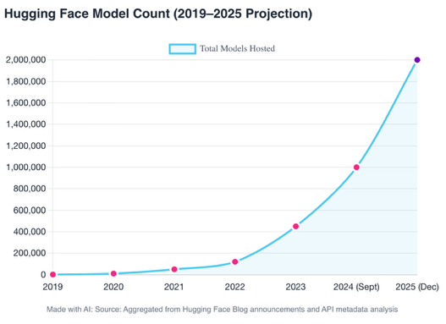
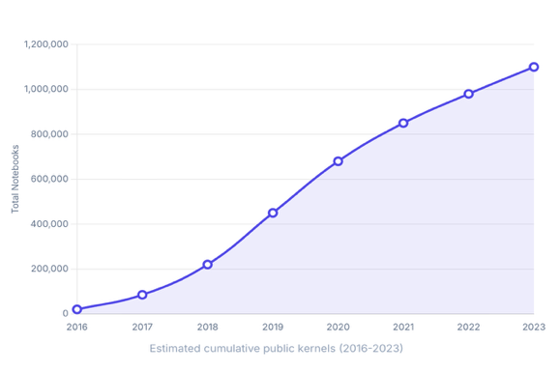
Problem: Too many Models
[1] Celeb on X (Twitter): https://x.com/calebfahlgren/status/1839311565524185347
Hugging Face has 2,261,609 PTMs (2025)
Model sizes usually ~ GB(s)
Made with AI
Hugging Face 🤗 [1]
Kaggle
Notes:
Exponential Growth: Hugging Face now hosts over 2 million models. Kaggle has grown from ~1,000 kernels in 2016 to over 1.5 million.
Impact: This volume makes manual selection impossible.

Slide 9
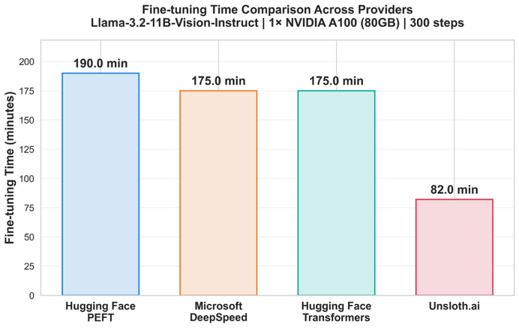
Problem: Fine-tuning is costly
Ghatak, Saifee 2025: Fine-Tuning LLMs in 2025: When It Makes Sense and How to Do It Efficiently
Takes hours to fine-tune on a new dataset
Average ~ 100 minutes per model
For 100 models = 10000 minutes ~ 200 hours ~ 7 days
Additional setup time of pipeline for each unique model.
Notes:
Time Cost: Fine-tuning a single modern model (e.g., Llama 3.2) takes ~100 minutes. To test 100 candidates, an engineer would need ~7 days of continuous training.

Slide 10
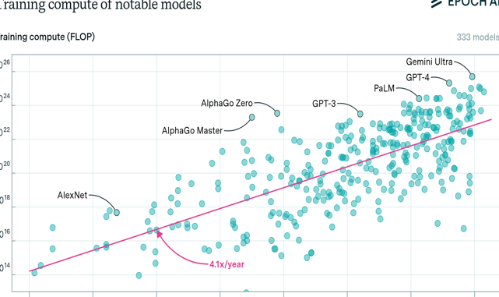
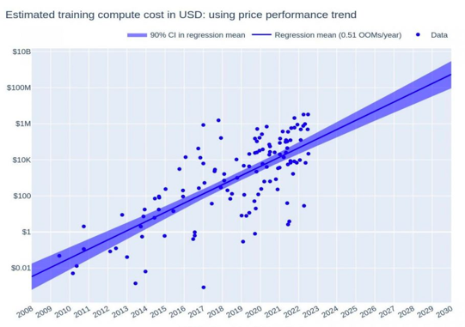
Problem: Fine-tuning is costly
Epoch AI 2023: Training Compute of Frontier AI Models Grows by 4-5x per Year
Yalalov 2023: AI Model Training Costs Are Expected to Rise from $100 Million to $500 Million by 2030
Higher price ($) to fine-tune 100’s of large models
Also, applies to starting from scratch.
Notes:
Monetary Cost: The cost of compute is rising. Projections show training costs reaching billions by 2030, making "trial and error" financially unviable.

Slide 11
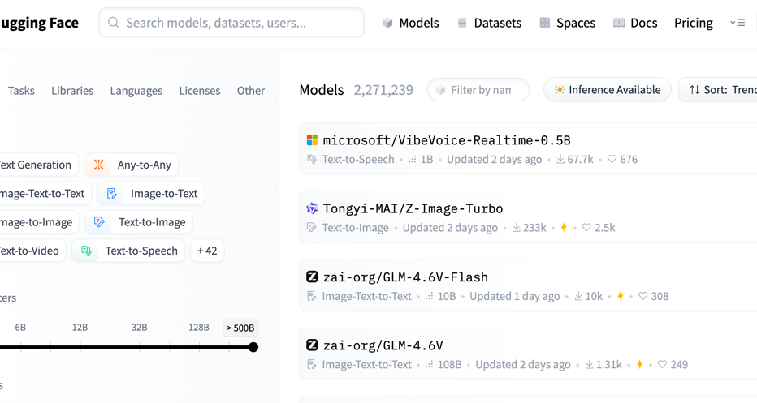
Problem: Hardware & Architecture Selection
[1] Jiang, et. Al. 2023 : An Empirical Study of Pre-Trained Model Reuse in the Hugging Face Deep Learning Model Registry
Notes:
Blind Spots: Current recommendation methods focus purely on accuracy, ignoring hardware constraints (latency, energy).
Reliability Issues: Engineers currently rely on "ReadMe" files and self-reported metrics, which may be outdated, inaccurate, or irrelevant to their specific use case.

Slide 12
3. Background and Related Works

Slide 13
Background
Heuristics Based Approaches:
These methods introduce a novel heuristic or score to rank PTMs
They use some combination of forward pass, source dataset, and source labels to construct a score.
Learning Based Approaches:
Employ ML techniques to eliminate the need for forward passes, on source PTMs.
Encodes both the PTM and target dataset into a latent space, and makes comparisons in the Latent space.
Notes:
Heuristic-Based: Uses static scores (e.g., Log Likelihood, correlations) derived from forward passes or dataset properties.
Learning-Based: Uses ML models to "learn" how to rank other models.

Slide 14
Background
Heuristics Based Approaches:
LEEP, N-LEEP, NCE, H-Score, PAC-Tran, LogME
Learning Based Approaches:
Model Spider, EMMS, Fenne

Slide 15
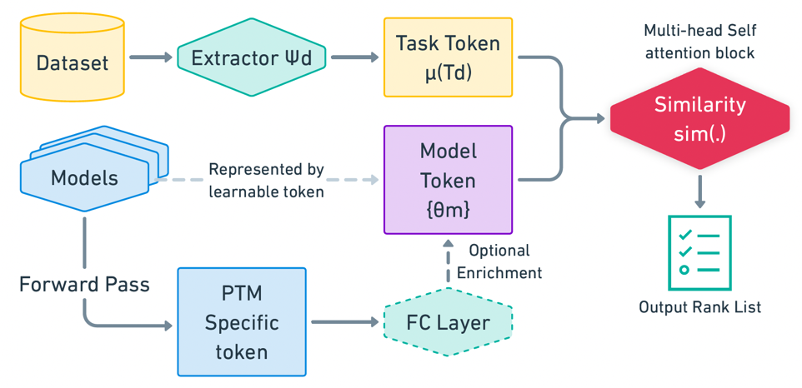
SOTA - Model Spider
Zhang, et al 2023: MODELSPIDER: Learning to Rank Pre-Trained Models Efficiently
Extract tasks token from the dataset with encoder
Model token from Zoo
(Learned while training)
Perform Forward Pass for top k models
Notes:
Architecture: This is the current state-of-the-art. It uses a Transformer with Self-Attention.
Mechanism: It concatenates "Dataset Tokens" (from image samples) and "Model Tokens" (learnable vectors) and passes them through a single-layer self-attention block to predict rankings.
Enrichment Layer: The diagram also shows an optional "Enrichment" step (bottom path). This involves performing a real forward pass to get better data, but because this is computationally expensive, it is typically only done for the top-k candidates rather than the full zoo⁸.
Limitation: It uses a fixed model zoo. The model tokens are hard-coded vectors (e.g., Model 1 is Vector 1). It cannot generalize to predict rankings for a model it hasn't seen during training.

Slide 16

Notes:
Architecture Overview: This video illustrates the pipeline of Model Spider, which is the current state-of-the-art approach for model recommendation.
Novelty: It was the first approach to introduce a Transformer-based learning method for this problem, specifically utilizing a Self-Attention block².
The Input Mechanism:
Dataset Tokens: We extract features from the target dataset using an encoder (Extractor $\Psi_d$) to create "Dataset Tokens" ($\mu(T_d)$)³. This involves sampling representative images from each class in the dataset.
Model Tokens: We also have "Model Tokens" ($\{\theta_m\}$) representing the candidate models in the zoo.
The Process:
These two sets of tokens (Dataset and Model) are concatenated and passed through a Multi-head Self-Attention block⁵.
The transformer calculates the similarity between the dataset requirements and the available models.
The Output: The output is a probability distribution over the model tokens, which allows us to generate a ranked list of the best models for the task⁶.
Key Limitation (Crucial for later): A major limitation here is that the Model Tokens are learnable vectors linked to a fixed Model Zoo⁷. They are essentially hard-coded IDs learned during training (e.g., Vector 1 is always Model A). There is no direct way to translate a new model's weights into a token, meaning this pipeline cannot recommend models outside of the specific set it was trained on.

Slide 17
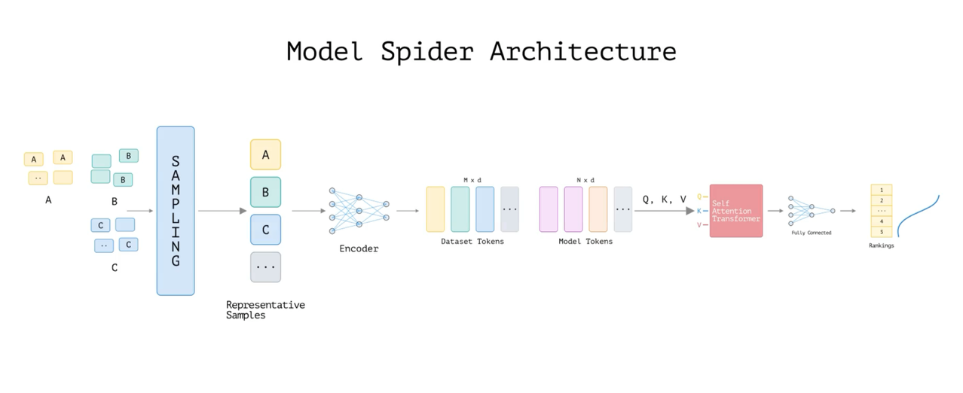
Notes:
Summary slide for the video in last slide.

Slide 18
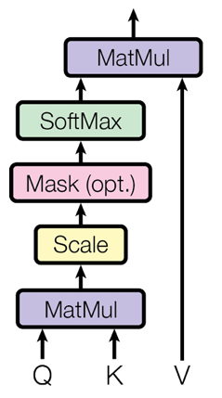
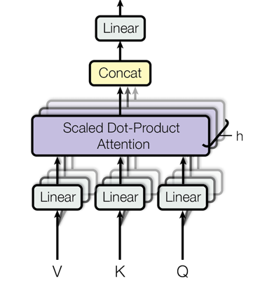
Cross Attention vs Self Attention
[1] Vaswani, et. Al. 2017 : Attention is All you Need
Scaled Dot Product Attention [1]
Multi-Head Attention Block [1]
Notes:
Slide 17-21: Attention Mechanisms (Cross vs. Self)
Self-Attention (GPT/BERT): Input and output are in the same domain (e.g., English to English). This is what Model Spider uses.
Cross-Attention (Transformer Encoder-Decoder): Designed for domain translation (e.g., English to French).
Relevance: Since "Dataset Tokens" (images) and "Model Tokens" (weights/architecture) belong to two different domains, Cross-Attention is theoretically better suited for this problem than Self-Attention.

Slide 19
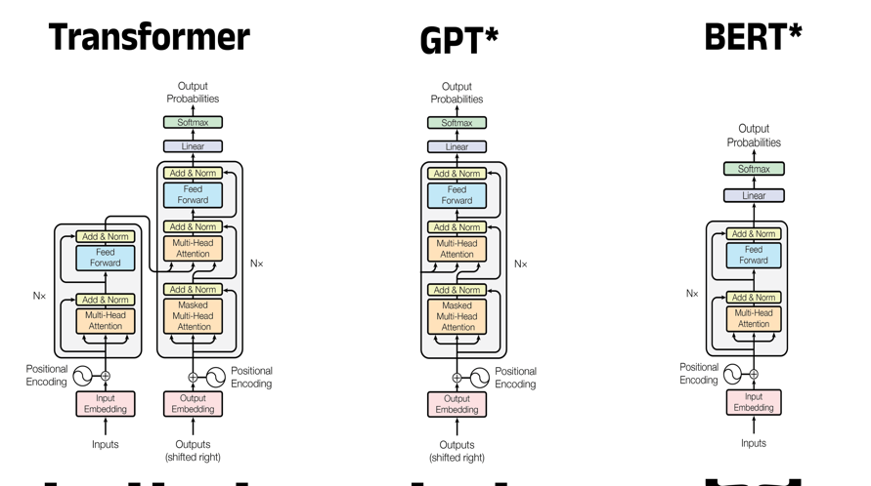
Cross Attention vs Self Attention
[1] Bradney Smith 2024: A Complete Guide to BERT with Code

Slide 20
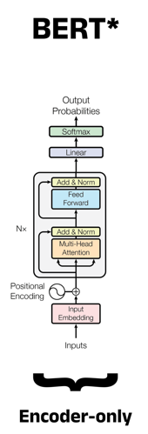
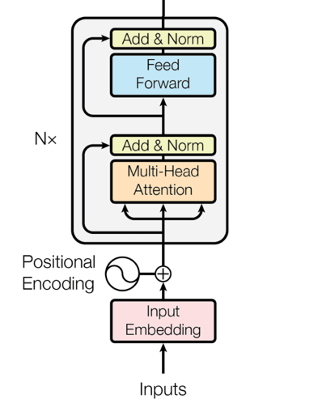
Self Attention (Encoder only)
[1] Bradney Smith 2024: A Complete Guide to BERT with Code

Slide 21
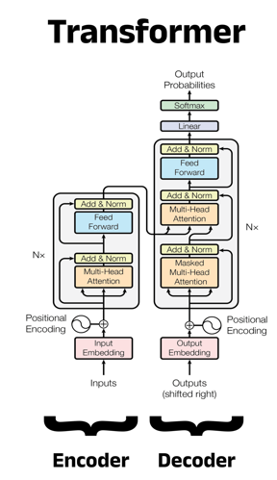
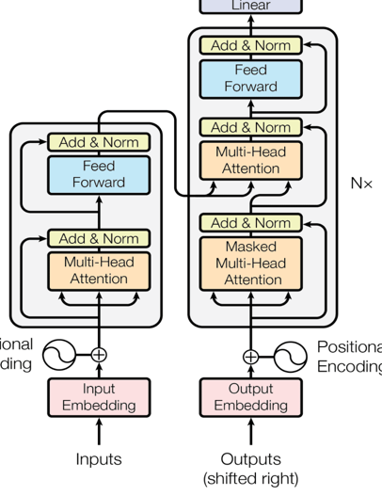
Cross Attention (Encoder – Decoder)
[1] Bradney Smith 2024: A Complete Guide to BERT with Code

Slide 22
4. Vision for PTM Recommendation
From the SERP4IoT Paper
“Recommending Pre-Trained Models for IoT Devices”
Parth Patil, et al.

Slide 23
Gaps in the current landscape
Gap 1: Lack of constraints beyond accuracy
Fail to consider the hardware performance implications when selecting models
No room to consider multiple constraints at the same time.
Gap 2: Lack of Ground truth PTM rankings for devices
No empirical data is widely available to be used as ground truth.
Prevents finding patterns or correlations, or training ML.
Notes:
Identified Gaps:
Lack of constraints beyond accuracy (Hardware, Energy).
Lack of "Ground Truth" datasets (No unified dataset tracks model performance across different hardware).

Slide 24
Hardware aware PTM Recommendation
Proposed two unique methods to make the Model recommendation hardware aware.
Approach 1: Model Spider Fusion
Approach 2: Model Spider Shadow
Notes:
Proposed Solutions:
Model Spider Fusion: Augmenting task tokens with hardware tokens.
Model Spider Shadow: A dual-pipeline approach where one transformer ranks for accuracy and another for hardware, combined via a ranking algorithm.

Slide 25
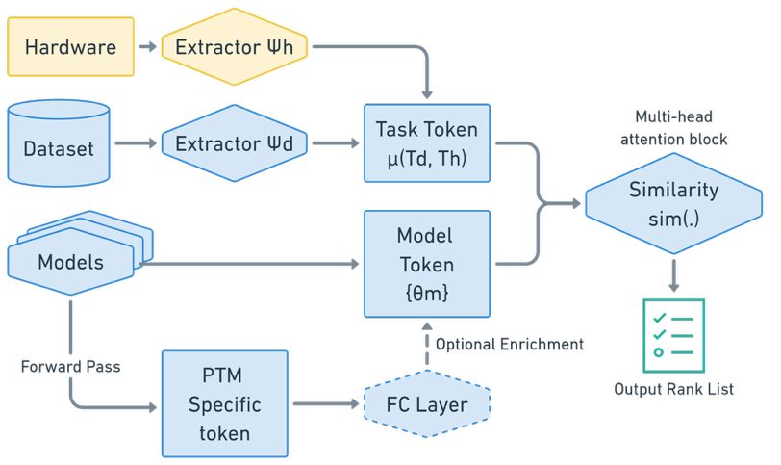
Model Spider Fusion

Slide 26
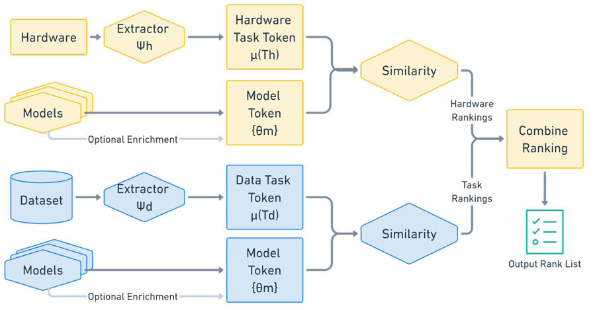
Model Spider Shadow

Slide 27
Hardware aware PTM Recommendation
Currently, there is a lack of datasets that track model performance along with hardware specifications.
To address this shortfall, we put forth a roadmap to make a ground truth dataset by:
Define important metrics
Propose methodology to collect data.
Convert data into model rankings.
Notes:
Ground Truth Roadmap
Metrics: We propose a dataset that tracks Execution Time, Memory Utilization, and Carbon Footprint alongside standard accuracy metrics.

Slide 28
5. Cross-sight
A) Challenges and Key contributions

Slide 29
Hypotheses
H1: Using Cross attention would yield substantial improvement.
Since the model and dataset token belong to two different domains, this problem is better suited for Cross attention based architectures, compared to self attention based transformers.
H2: Model Token can be generated using model weights and biases
Instead of relying on learnable model token (which limits the model zoo only to the models used while training), token can be generated with an encoder.
Notes:
H1: Using Cross-Attention will yield improvements over Self-Attention because the input (dataset) and output (model) are different domains.
H2: We can generate Model Tokens directly from model weights and biases (Architecture-to-Vector), rather than using fixed learnable tokens. This theoretically allows handling models outside the training zoo.

Slide 30
Key novel contributions
Key Improvements over Model Spider:
Uses cross attention-based transformer (encoder-decoder type)
Use a six-layered transformer block, instead of the single layer.
Introduces a pipeline for PTM-to-Vector encoder, which enables an open model zoo rather than a closed one
Notes:
Key Contributions
Switched from Single-layer Self-Attention to 6-Layer Cross-Attention.
Introduced a Model-to-Vector pipeline to encode model architecture dynamically.

Slide 31
5. Cross-sight
B) Walkthrough and experimental setup

Slide 32
Notes:
Walkthrough
Model Token Generation:
Extract weights/biases.
Use clustering to normalize layer dimensions.
Concatenate into a large vector.
Use an Auto-Encoder to compress this into a "Model Token."
Dataset Token Generation: Similar to Model Spider, but added clustering for unstructured datasets to support broader data types.
Pipeline: These two distinct tokens are fed into the Cross-Attention Transformer to predict the probability distribution (rankings).

Slide 33
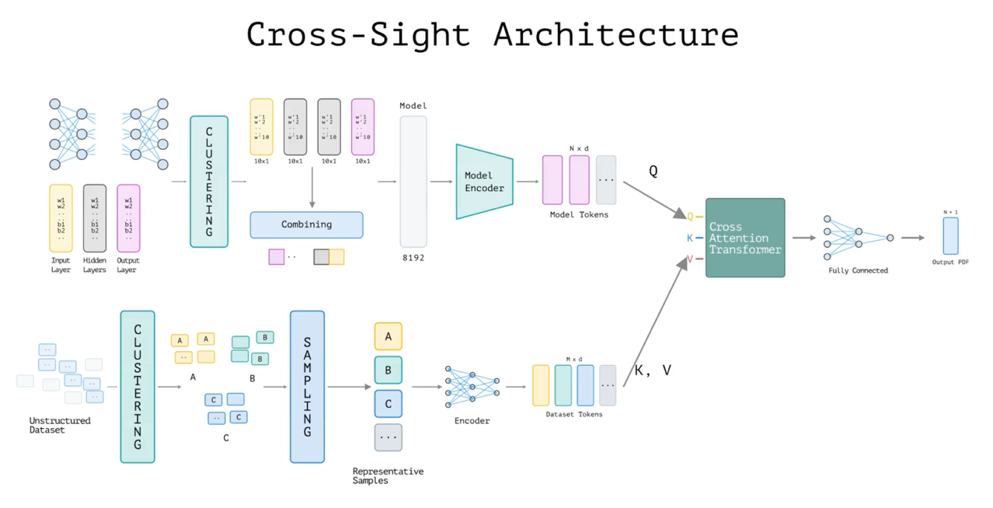
Notes:
Summary slide for the video in last slide

Slide 34
Preliminary Experimental Setup
Goal: Evaluate cross-attention and model pipeline
For training:
11 Labeled dataset from three domains
Digits (MNIST, ..) , Fashion (Fashion MNIST, ..) , Generic (ImageNet-1k, ..)
31 Models in the Zoo.
Each model is trained on one of the dataset.
Ground truth rankings are obtained by combining reported accuracy and similarity between datasets.

Slide 35

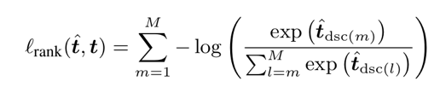
Preliminary Experimental Setup
Ground Truth Ranking
a_{dt,mk} – Self reported score on the training dataset
σ(d_{t} , d_{b}) – Similarity between training and target dataset (manually initialized)
S_{k} – ground truth score for k^{th} model.
π – Ground truth ranking computed with scores and small noise (ε) as a tie breaker.
Loss Function
Goal: Make whole order of the predicted ranks close to the ground-truth rankings
Directly use the score outputs and use actual rank to arrange them in the sum, allowing the gradients to flow during training.
Notes:
Ground Truth: Generated "fictitious" ground truth rankings using self-reported accuracy + similarity scores (to prove the pipeline works before investing in massive compute).

Slide 36
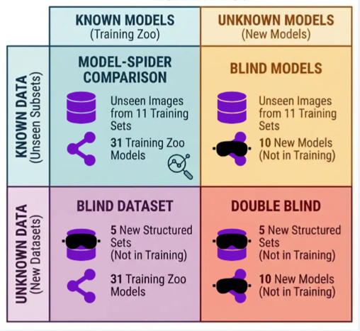
Preliminary Experimental Setup
For testing:
Model-Spider Comparison:
Unseen Images from 11 Dataset used for training
31 Models in the training Model Zoo
Blind Dataset:
5 Labeled dataset not used for training
31 Models in the training Model Zoo
Blind Models:
Unseen Images from 11 Dataset used for training
10 Models not used for training
Double Blind:
5 Labeled dataset not used for training
10 Models not used for training
Notes:
The Four Quadrants: We tested across four scenarios to validate generalization:
Model-Spider Comparison: Known Models + Known Datasets (Unseen images).
Blind Dataset: Known Models + New Datasets.
Blind Models: New Models + Known Datasets.
Double Blind: New Models + New Datasets.

Slide 37
5. Cross-sight
C) Results and comparisons

Slide 38
Kendall's Rank Correlation
This is the Metric used for comparing the ranking results
Kendall's Tau (τ) is a statistic used to measure the ordinal association between two measured quantities
The Metric Range: -1 to 1
Kendall's Tau is normalized. It counts the number of pairs that agree in order (Concordant) (+1) versus those that disagree (Discordant) (-1).
Weighted Tau (τ_{w}):
This variant of Kendall's Tau is used to compare results.
applies a hyperbolic weighting function. Differences at the top of the list (Rank 0, 1, 2) contribute significantly to the score, while differences deep in the list have negligible impact.
Notes:
Weighted Kendall’s Tau: Measures rank correlation (-1 to 1). Weighted to prioritize correctness at the top of the list (finding the best model is more important than ranking the worst ones correctly).

Slide 39
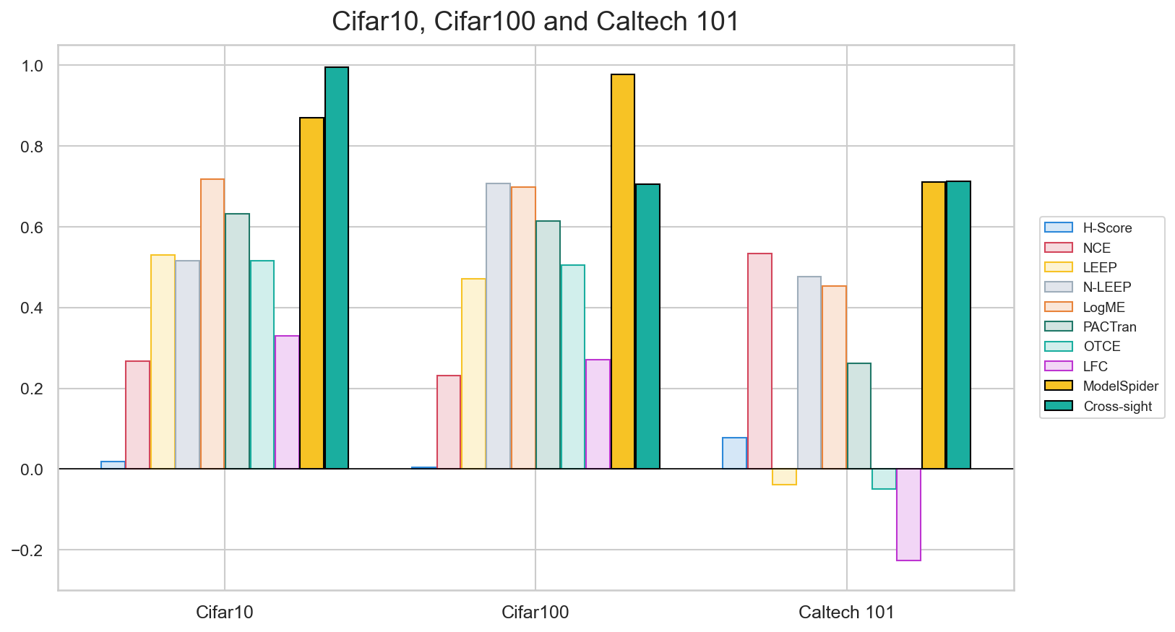
Model-Spider Comparison
All approaches expect Cross-Sight
Uses 10 images per class per Dataset
Cross-sight only uses 1 image per class
Also others use only 10 models in their zoo
Cross-sight uses 31 models in zoo
τ_{w}
Notes:
Success: Cross-Sight (Green bars) consistently outperforms or matches Model Spider (Yellow bars) and significantly beats classical heuristic methods.
Note: Cross-Sight achieved this using only 1 image per class, whereas Model Spider used 10, indicating higher data efficiency.

Slide 40
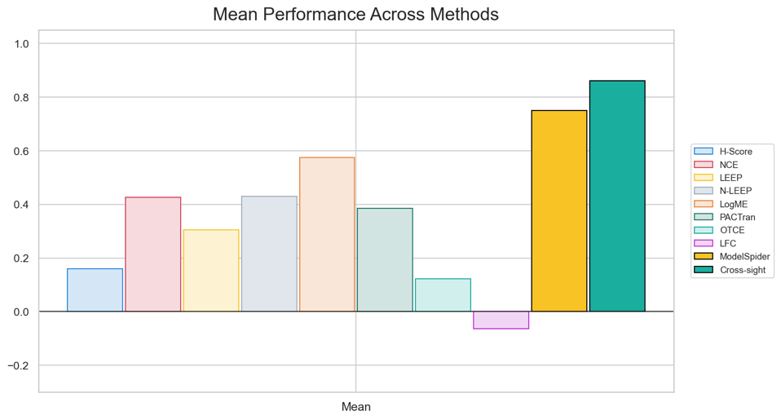
Model-Spider Comparison
τ_{w}

Slide 41
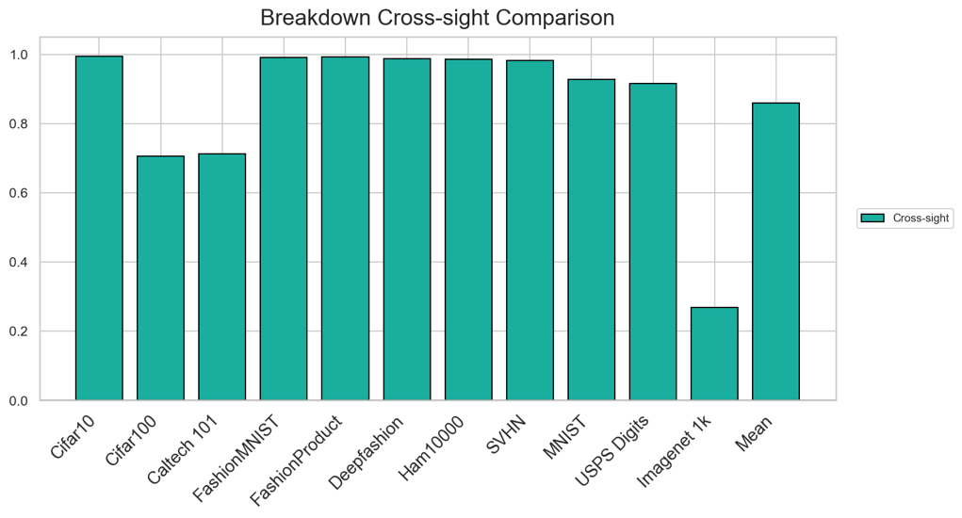
Model-Spider Comparison
τ_{w}

Slide 42
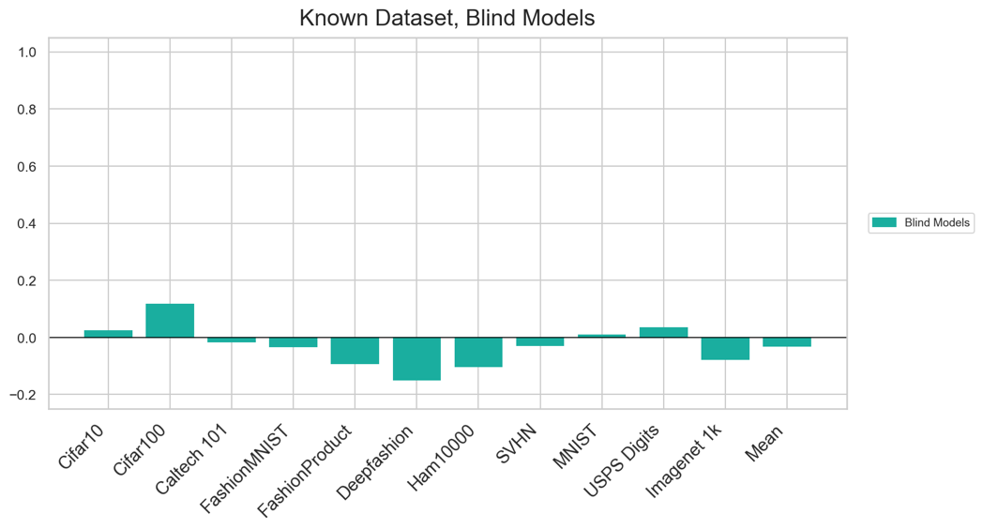
Blind Models
τ_{w}
Notes:
The Drop: When testing on Blind Models (models not in the training zoo), performance drops to near zero (random guessing).
Implication: While the Cross-Attention hypothesis (H1) holds, the Model-to-Vector generalization (H2) struggles to encode unseen architectures effectively.

Slide 43
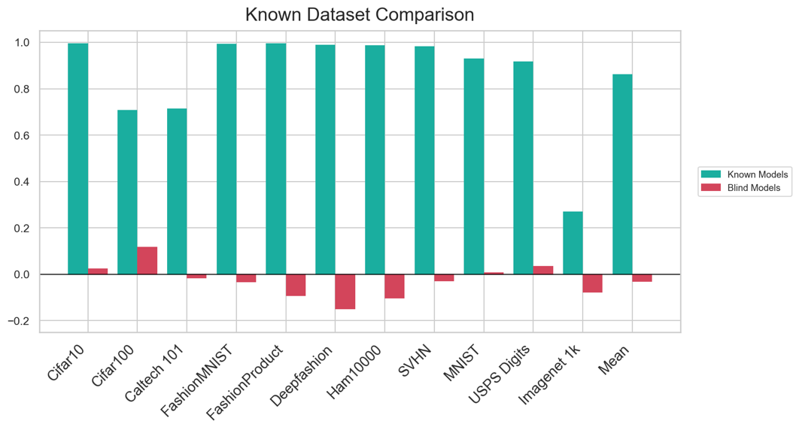
Known Datasets
τ_{w}

Slide 44
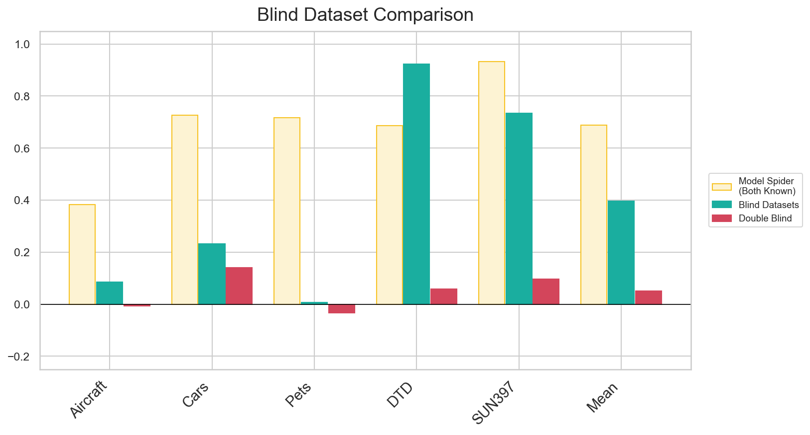
Blind Dataset
τ_{w}
Notes:
Generalization: Performance on Blind Datasets (New data, known models) is lower than the baseline but significantly better than Blind Models.

Slide 45
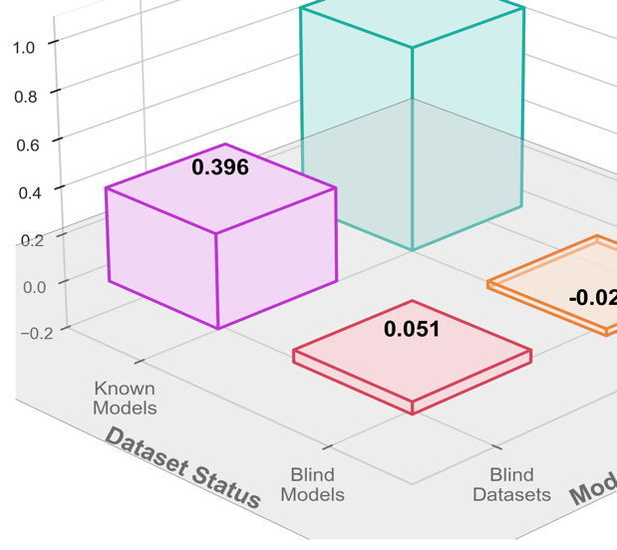
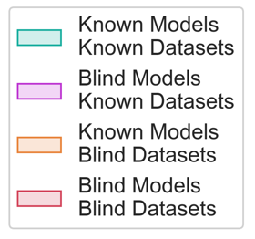
Overall Performance of Cross-Sight
τ_{w}
Note: All the results are based on the estimated ground truth ranking, which rely on reported accuracies
Notes:
Visual Summary:
Known/Known: 0.860 (Excellent).
Known Model/Blind Data: 0.396 (Decent).
Blind Model/Known Data: -0.029 (Failed).
Double Blind: 0.051 (Failed).

Slide 46
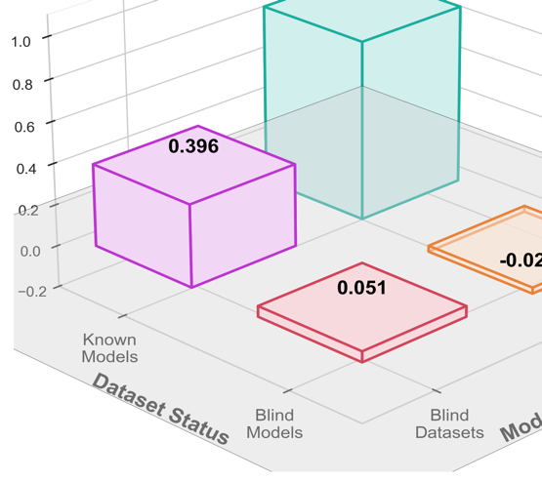

Conclusions
H1:
Using cross attention did increase the performance
Even performs decent on unseen dataset.
τ_{w}
H2:
Able to use the generated model token as a replacement for learnable token.
But the pipeline doesn’t generalize for unseen models.
Notes:
Conclusions
H1 Validated: Cross-Attention significantly increases performance on known model spaces.
H2 Partially Validated: We successfully generated model tokens from weights (removing the need for hard-coded IDs), but the current pipeline does not yet generalize to unseen model architectures.

Slide 47
6. Limitations and Future Work

Slide 48
Limitations and Future Work
Improvements to the Model-To-Vector pipeline
Introduce encoding model structure in model token
Incorporate Model Card info and Meta-Data
Ablate the encoder (not just autoencoder)
End to End (Co-Learning):
Train both Encoder and Transformer together, so the ranking loss can flow to train the model encoder as well
Notes:
Pipeline Improvements: Incorporate Model Card metadata and hybrid learning (train the Encoder and Transformer together) to fix the unseen model generalization.
Multi-Objective Ranking: Implement the "Fusion" and "Shadow" visions to rank based on Hardware + Accuracy.

Slide 49
Limitations and Future Work
Introduce additional ranking dimensions
Introduce proposed pipelines Model Spider Fusion and Model Spider Shadow to study ranking based on different constraints.
Train on Ground-Truth Rankings: Create Dataset
Collect actual fine-tune performance
Collect performance information for specific hardware
Notes:
Real Data: Move from fictitious ground truth to a real-world, empirically collected dataset.

Slide 50
7. Conclusion and Discussion

Slide 51
Conclusion and Discussion
This work put forth a broad vision for the future of PTM recommendation. The preliminary experiments shows significant promise for the proposed Cross-sight approach.
Questions?
Notes:
This work establishes a broad vision for Hardware-Aware PTM recommendation and demonstrates that Cross-Attention is a promising architectural shift for this domain.

Slide 52
Thank you

Slide 53
Appendix

Slide 54

1. Number of Kaggle notebooks
The data points for the "Cumulative Public Kernels (Est.)"are estimated based on analysis of the official Meta Kaggle Dataset and high-level growth figures released in platform updates.
Year | Estimated Cumulative Public Kernels (Used in Chart) | Primary Data Source Context
2016 | 20,000 | Early growth figures often referenced in Kaggle's blog posts following major user milestones.
2017 | 85,000 | Reflects acceleration after the introduction of free GPU/TPU environments.
2018 | 220,000 | Post-acquisition growth and maturity of the Kernels feature (then "Scripts").
2019 | 450,000 | Strong community engagement and adoption of advanced frameworks (TensorFlow/PyTorch).
2020 | 680,000 | Accelerated growth due to global remote work trends and increased interest in data science.
2021 | 850,000 | Steady platform growth.
2022 | 980,000 | Approaching the 1 Million mark.
2023 | 1,100,000+ | Official milestone confirmed by Kaggle platform announcements and tracking via the public dataset.

Slide 55
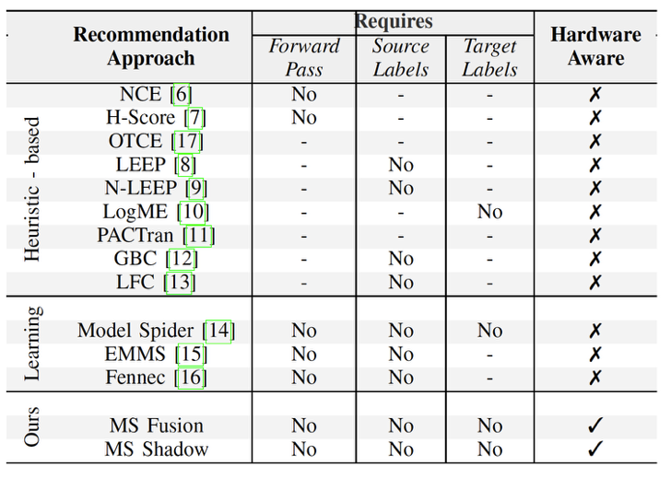
Background
Compares current model recommendation approaches and their requirements.
Model Spider is notably efficient, not requiring a forward pass on the target dataset
Though none address hardware constraints
Notes:
The Gap: As shown in the comparison table (Slide 15), existing approaches (like Model Spider) do not account for hardware awareness, which is a key gap this thesis aims to address.

Slide 56
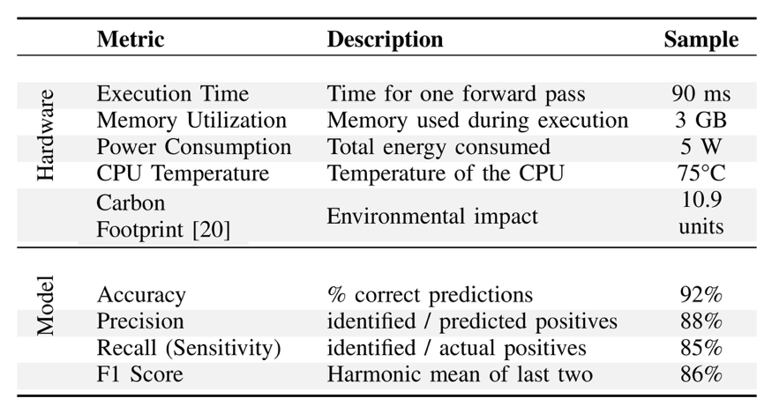
Hardware aware PTM Recommendation

Slide 57
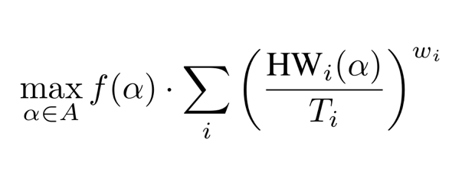
Hardware aware PTM Recommendation
Proposed approach to combine rankings for Shadow Approach
ω_{i} - weight assigned to a metric rank
f(α) - model performance for configuration α HW_{i}(α) - hardware performance for configuration α
T_{i -} Normalization term for i-th hardware metric (HW_{i})

Slide 58
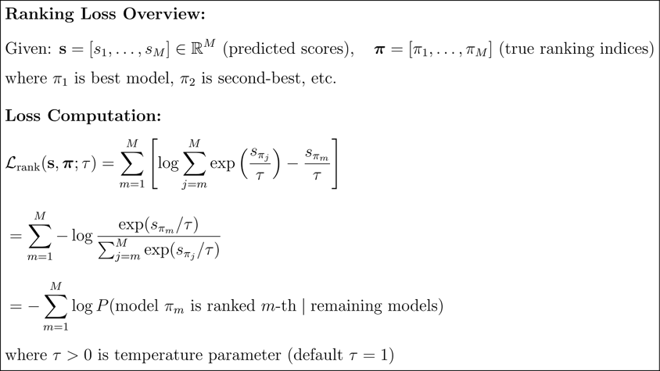
Ranking Loss details

Slide 59
Dataset Similarity
 | MNIST | SVHN | USPS Digits | Fashion MNIST | Deepfashion Inshop | Fashion Product | ImageNet 1k | CIFAR-10 | CIFAR-100 | Caltech-101 | HAM10000 | Aircraft | SUN397 | Cars | DTD | Pets
MNIST | 1 | 0.6 | 0.85 | 0.4 | 0.1 | 0.1 | 0.05 | 0.2 | 0.1 | 0.15 | 0.05 | 0.15 | 0.15 | 0.15 | 0.1 | 0.1
SVHN | 0.6 | 1 | 0.65 | 0.3 | 0.1 | 0.1 | 0.05 | 0.25 | 0.15 | 0.2 | 0.05 | 0.2 | 0.2 | 0.2 | 0.1 | 0.1
USPS Digits | 0.85 | 0.65 | 1 | 0.35 | 0.1 | 0.1 | 0.05 | 0.15 | 0.1 | 0.15 | 0.05 | 0.15 | 0.15 | 0.15 | 0.1 | 0.1
Fashion MNIST | 0.4 | 0.3 | 0.35 | 1 | 0.4 | 0.45 | 0.15 | 0.25 | 0.2 | 0.35 | 0.2 | 0.3 | 0.25 | 0.3 | 0.35 | 0.25
Deepfashion Inshop | 0.1 | 0.1 | 0.1 | 0.4 | 1 | 0.8 | 0.35 | 0.3 | 0.25 | 0.45 | 0.25 | 0.4 | 0.35 | 0.4 | 0.45 | 0.3
Fashion Product | 0.1 | 0.1 | 0.1 | 0.45 | 0.8 | 1 | 0.4 | 0.35 | 0.3 | 0.5 | 0.3 | 0.45 | 0.4 | 0.45 | 0.5 | 0.3
ImageNet 1k | 0.05 | 0.05 | 0.05 | 0.15 | 0.35 | 0.4 | 1 | 0.65 | 0.8 | 0.6 | 0.3 | 0.75 | 0.75 | 0.7 | 0.7 | 0.75
CIFAR-10 | 0.2 | 0.25 | 0.15 | 0.25 | 0.3 | 0.35 | 0.65 | 1 | 0.75 | 0.55 | 0.25 | 0.6 | 0.55 | 0.55 | 0.6 | 0.65
CIFAR-100 | 0.1 | 0.15 | 0.1 | 0.2 | 0.25 | 0.3 | 0.8 | 0.75 | 1 | 0.65 | 0.25 | 0.7 | 0.65 | 0.65 | 0.65 | 0.7
Caltech-101 | 0.15 | 0.2 | 0.15 | 0.35 | 0.45 | 0.5 | 0.6 | 0.55 | 0.65 | 1 | 0.35 | 0.8 | 0.7 | 0.75 | 0.65 | 0.8
HAM10000 | 0.05 | 0.05 | 0.05 | 0.2 | 0.25 | 0.3 | 0.3 | 0.25 | 0.25 | 0.35 | 1 | 0.25 | 0.25 | 0.2 | 0.3 | 0.2
Aircraft | 0.15 | 0.2 | 0.15 | 0.3 | 0.4 | 0.45 | 0.75 | 0.6 | 0.7 | 0.8 | 0.25 | 1 | 0.65 | 0.8 | 0.6 | 0.6
SUN397 | 0.15 | 0.2 | 0.15 | 0.25 | 0.35 | 0.4 | 0.75 | 0.55 | 0.65 | 0.7 | 0.25 | 0.65 | 1 | 0.6 | 0.75 | 0.55
Cars | 0.15 | 0.2 | 0.15 | 0.3 | 0.4 | 0.45 | 0.7 | 0.55 | 0.65 | 0.75 | 0.2 | 0.8 | 0.6 | 1 | 0.5 | 0.6
DTD | 0.1 | 0.1 | 0.1 | 0.35 | 0.45 | 0.5 | 0.7 | 0.6 | 0.65 | 0.65 | 0.3 | 0.6 | 0.75 | 0.5 | 1 | 0.55
Pets | 0.1 | 0.1 | 0.1 | 0.25 | 0.3 | 0.3 | 0.75 | 0.65 | 0.7 | 0.8 | 0.2 | 0.6 | 0.55 | 0.6 | 0.55 | 1

Slide 60

Creating Ground Truth Rankings
Step 1: Load Raw Data
Step 4: Add Tie-Breaking Epsilon
Step 5: Argsort to Get True Ranks
Step 2: Compute Weighted Scores
Step 3: Build Score Vector
Notes:
“Good morning — I’m Parth Patil. Today I’ll present my master’s thesis: Cross-Sight: Recommending Pre-trained Models using Transformers.”
Quick caption: advisor & committee names, and date (Dec 12, 2025). Transition: “Here’s the outline of what I’ll cover.”

Slide 61
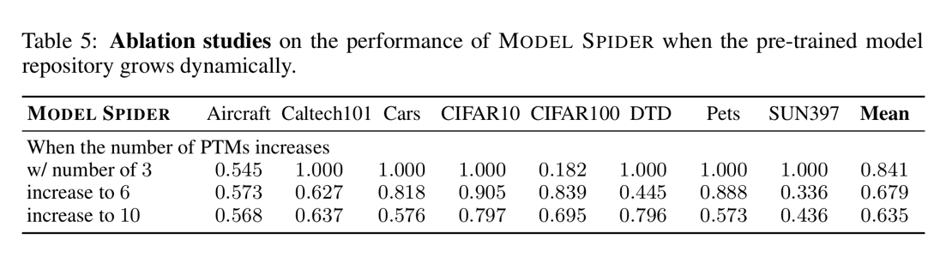
Model Spider Results for increasing models
Zhang, et al 2023: MODELSPIDER: Learning to Rank Pre-Trained Models Efficiently

Slide 62
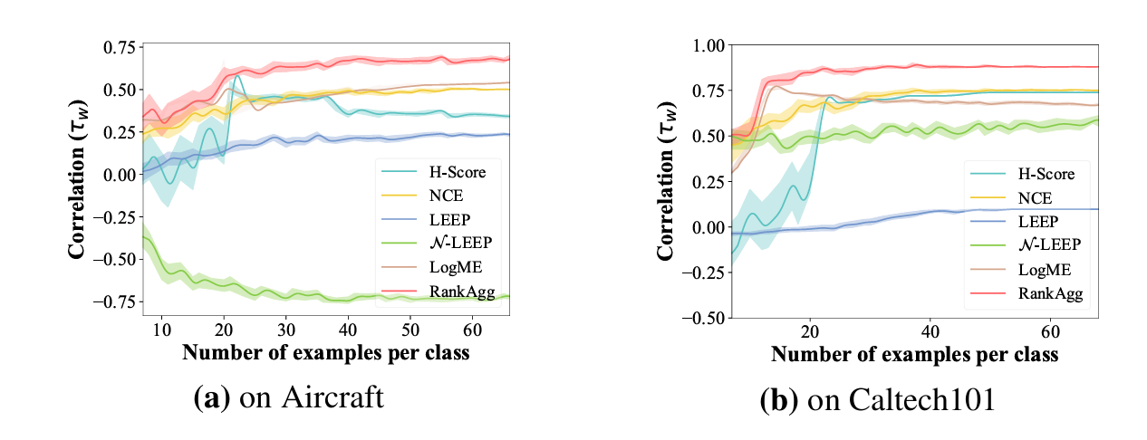
Variation of number of samples per classes
Zhang, et al 2023: MODELSPIDER: Learning to Rank Pre-Trained Models Efficiently

Slide 63
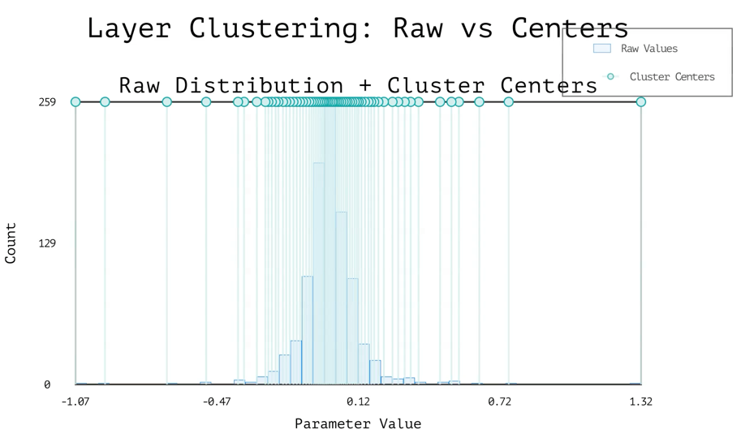
Clustering for Model Layer

Slide 64
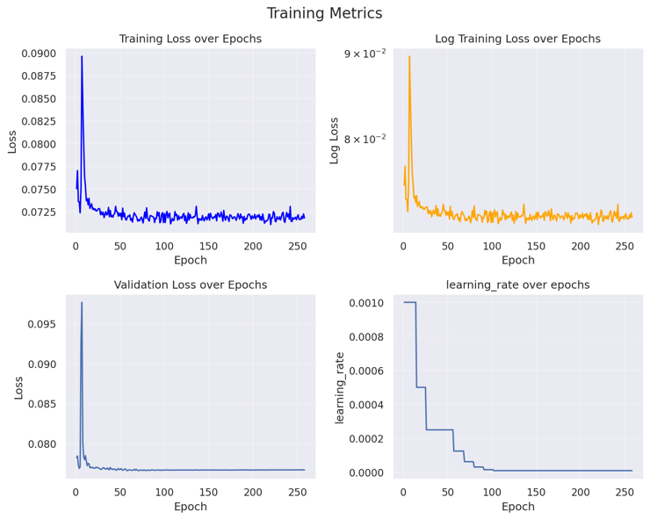
Training Metrics for Model Auto Encoder

Slide 65
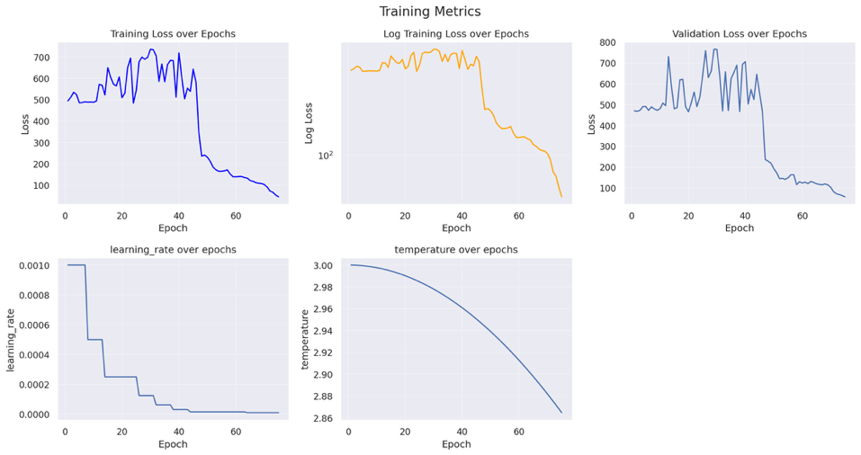
Training Metrics for Cross-Sight

Slide 66
Training for Cross-Sight
Trained on Purdue’s Gautschi.
CPU: 64 core
GPU: NVIDIA L40S 40GB
Training Time: ~10 hours
Total steps per epoch: 37904
Total epochs: 300 ~ 400∫

Slide 67
Comparison with Hardware performance predictors
Lee, et al 2025: Forecasting GPU Performance for Deep Learning Training and Inference
NeuSight, a forecasting framework to predict the performance of a diverse range of deep learning models, for both training and inference, on unseen GPUs
Key difference only comment on Pre-trained performance and not on fine-tuned performance.
But this can be used generate Hardware Task token in the new Proposed approaches Model Spider Fusion and Shadow

Slide 68
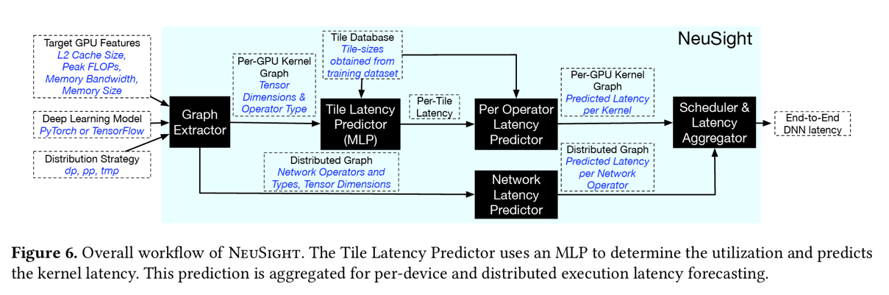
Comparison with Hardware performance predictors
Lee, et al 2025: Forecasting GPU Performance for Deep Learning Training and Inference

