Slide 1
Recommending Pre-Trained Models for IoT Devices​
Parth V. Patil, Wenxin Jiang, Huiyun Peng, Daniel Lugo,
Kelechi G. Kalu, Josh LeBlanc, Lawrence Smith, Hyeonwoo
Heo, Nathanael Aou
James C. Davis
Notes:
Hello, I’m Parth Vinod Patil. I’m a graduate student at Purdue pursuing my master’s in electrical engineering, under the guidance of Professor James Davis. Today, I will be presenting our paper on “Recommending Pre-trained models for IoT Devices.”

Slide 2
Overview
Identify key gaps in hardware-aware model recommendation
Propose new methods to make the existing Model recommender hardware aware.
Outline future directions for developing hardware-aware recommendation systems.
Notes:
In this paper, we talk about existing approaches for recommending pre-trained models and identify gaps hindering hardware-aware PTM recommendations. In this paper, we also propose ways to overcome these hurdles. And further broadening the horizon, we discuss future directions and propose research questions to make model recommendations more hardware-aware.

Slide 3
Background Terms and Definitions
Notes:
Let’s begin by breaking down the paper title first.

Slide 4
Recommending Pre-Trained Models for IoT Devices

Slide 5
Pre-trained models
Def: PTMs are neural network models that have been trained on a large dataset to perform a specific task, such as object recognition or language translation.
Benefits:
Fine‑tunable
Saves Training Time
Saves computing resources
Requires less data to retrain
Notes:
What is a pre-trained model? We can define a pre-trained model as a neural network model that has been trained on a large-scale dataset to perform a specific task. An ML model has two aspects, model architecture and weights. PTM is a combination of both. For example, an ImageNet can have different weights for different tasks and all these pairs would be considered as a unique PTM. Some benefits of using a PTM are that it saves training time, and we can fine-tune existing models very quickly compared to training from scratch.Also works for smaller datasets.

Slide 6
Recommending Pre-Trained Models for IoT Devices

Slide 7
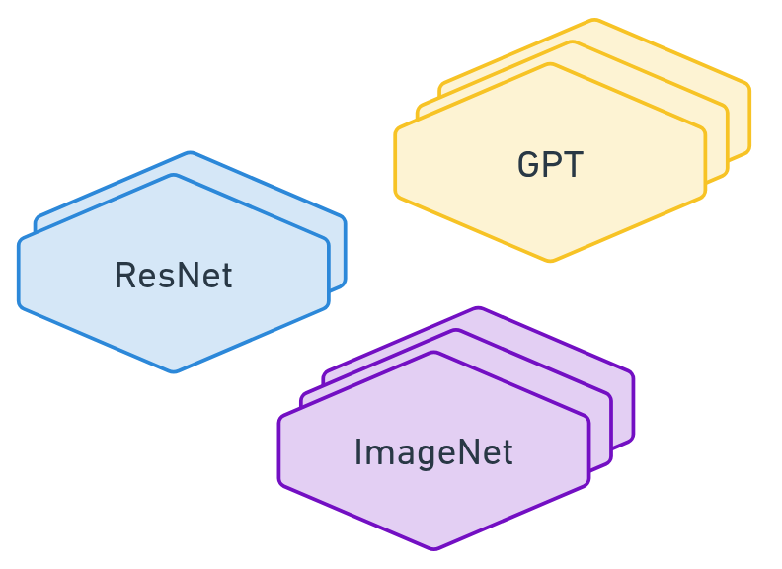
Recommending Pre-trained models
Problem: Too many Models
Hugging Face has 1,642,585 PTMs (2025)
Model sizes usually ~ GB(s)
Problem: Fine-tuning is hard
Takes hours to fine-tune on a new dataset
Problem: Task Domain
Different tasks, like classifications and segmentation, require different pipelines.
Requires domain expertise to set up.
Notes:
Now let’s understand the recommending part of the title. We can introduce the recommendation problem with three main points. First with the advent Model Hubs like Hugging Face engineers can access huge number of PTMs, and thus it is hard to choose k and would be quite time-consuming. Also, different task domains require different pipelines and domain expertise to understand all the nuances of model performance.

Slide 8
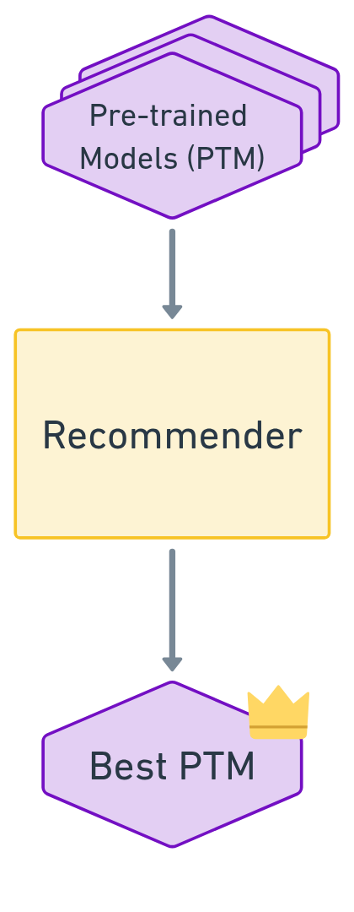
Recommending Pre-trained models
Most approaches try to
Identify the best PTM for a task before fine-tuning.
Domain | Models | No. of PTMs
NLP | BERT, RoBERTa, GPT | 92,617
Classification | ResNet, CNNs, ViTs | 16,746
Segmentation | U-Net, DeepLabV3, SegFormer | 1,338
Notes:
There has been quite a lot of research in order to tackle this problem. The crux of the recommendation lies in trying to find the best PTM without actually fine-tuning the model on the downstream task. What is down stream task? If we go over the next slide, you can see that the PTM is trained on some task, also known as the source dataset. Then we try to fine-tune the model on a different dataset called the target or downstream task.

Slide 9
Recommending Pre-trained models (Flow)

Slide 10
Categorizing Recommenders
Recommendation algorithms can be broadly classified into two groups.
Heuristic-Based Recommenders
Learning-Based Recommenders
Notes:
Moving on, the recommender algorithms can be broadly classified into two categories. Heuristic-based and Learning Based.

Slide 11
Heuristic-Based Recommenders
These methods introduce a novel heuristic or score to rank PTMs.
They use some combination of forward pass, source dataset, and source labels to construct a score.
Example: LEEP¹, N-LEEP², LogME³, PACTran⁴
1. C. Nguyen et al.: LEEP: A new measure to evaluate transferability of learned representations
2. Y. Li et al.: N-LEEP: Ranking neural checkpoints 3. K. You et al.: LogME: Practical assessment of pre-trained models for transfer learning
4. N. Ding et al.: PACTran: PAC-Bayesian metrics for estimating the transferability of pretrained models to classification tasks
Notes:
The heuristic-based approaches tend to define a metric or a heuristic from the characteristics of the model or the dataset. They use this number to identify trends. Example are LogME, LEEP, N-Leep. Let’s take a close look at LogME.

Slide 12
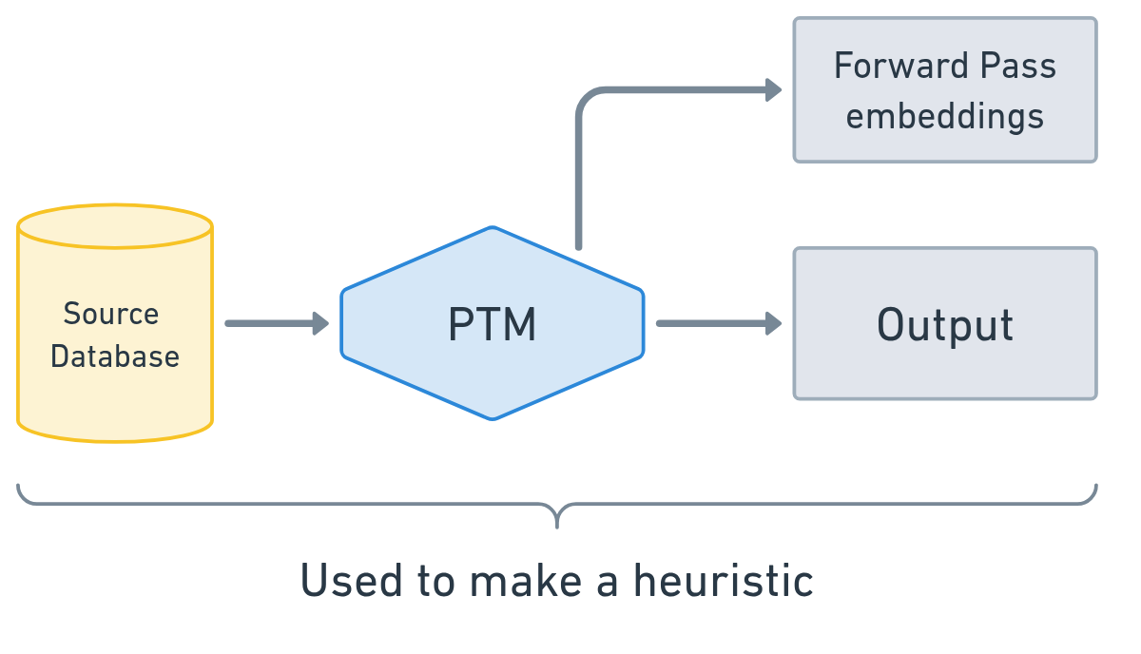
Heuristic-Based Recommenders

Slide 13
Example: LogME
Computes the Logarithm of Maximum Evidence (LogME) of labels given features extracted by each PTM
Workflow:
Extract features from the target data via each PTM (forward pass)
Compute LogME score per model
Rank models by descending LogME for selection
Notes:
In this we take a logarithm of Maximum Evidence. I know this might not make much sense. But evidence is a concept in probability. We can imagine this to be just a number or a formula made up from extracted features from the target dataset. It does some fancy math to figure out which model has the best likelihood of identifying the class for a target dataset, but also gauges how well it encodes the target dataset. Uses this number to rank Models.

Slide 14
Learning-Based Recommenders
Employ ML techniques to eliminate the need for forward passes, on source PTMs.
Encodes both the PTM and target dataset into a latent space, and makes comparisons in the Latent space.
Examples: Model Spider¹, EMMS², and Fennec³
1. Y.-K. Zhang et al.: Model spider: Learning to rank pre-trained models efficiently
2. F. Meng et al.: Foundation model is efficient multimodal multitask model selector
3. J. Bai et al.: Pre-trained model recommendation for downstream fine-tuning
Notes:
Then we have learning based model recommenders. In this class, we we machine learning techniques to first encode model and dataset information into a latent space. Then, further use ML models to make observations in this latent space. Some examples are Model Spider, EMMS, and Fennec. Let’s take a look at Model Spider, as our paper makes heavy use of this approach.

Slide 15
Example: Model Spider
Extract tasks token μ(T_{d}) using an encoder (Ψ_{d}) from the dataset.
Encodes the model parameter to θ.
Uses multi-head attention to get the similarity between task token and PTM model tokens.

Slide 16
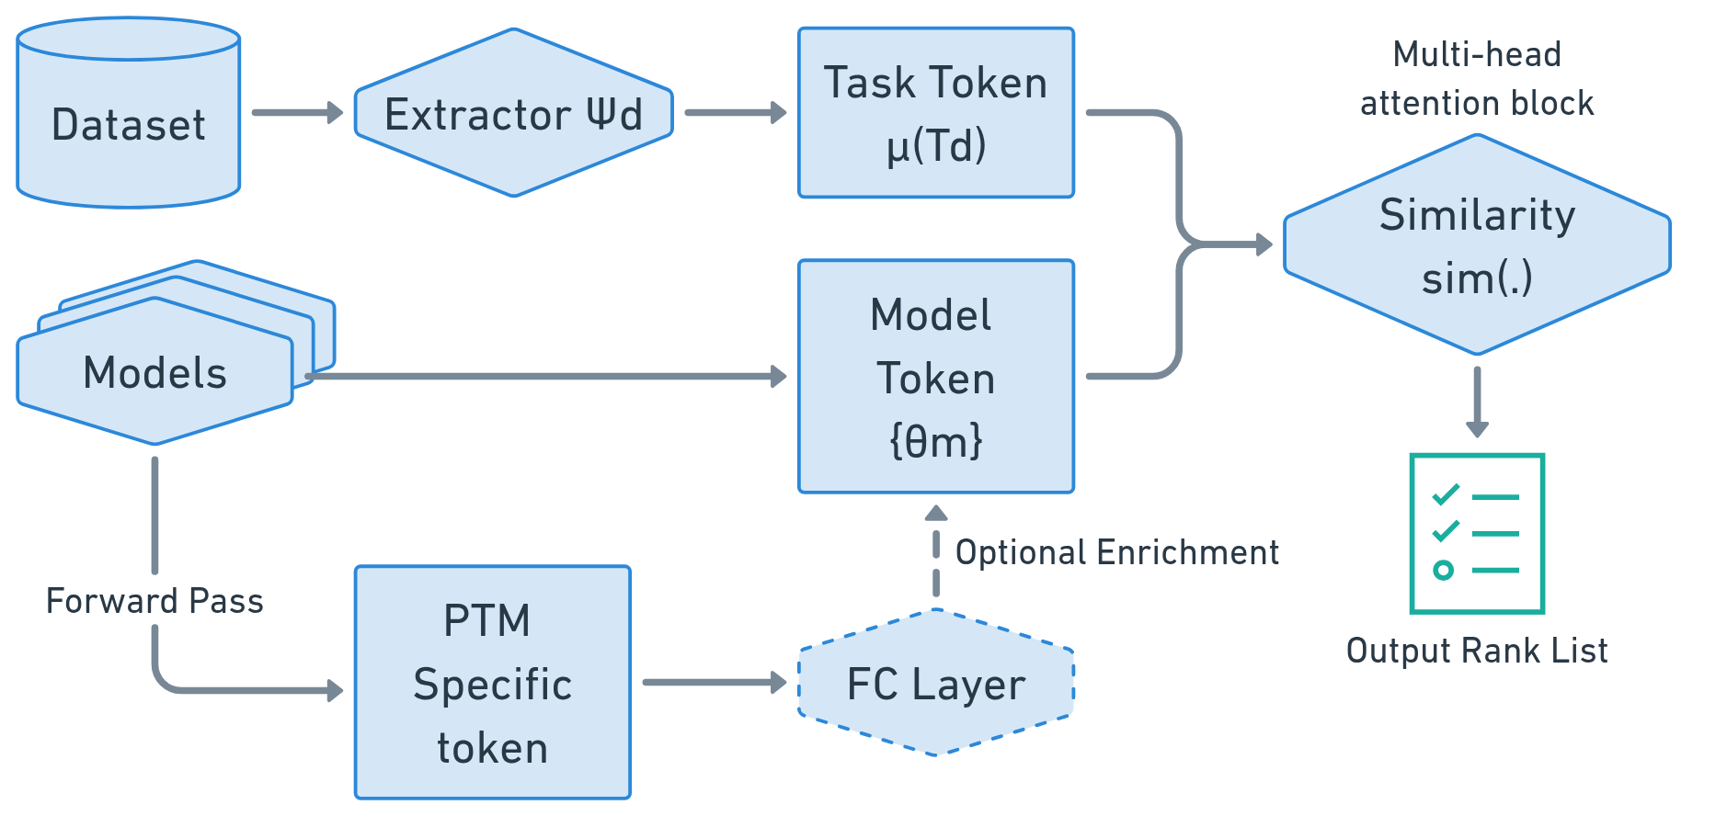
Example: Model Spider
Notes:
To understand the model spider, we should take help from a diagram. In a nutshell, the model spider encodes the dataset in something called a task token. Imagine this token to be a 1024 X 1 vector. And it also encodes the model into model tokens again, 1024 x 1. The it uses a multihead attention block to gauge the similarity between these two vectors. The authors of this paper claim to have gotten very good results using this for model recommendation.

Slide 17
Recommending Pre-Trained Models for IoT Devices

Slide 18
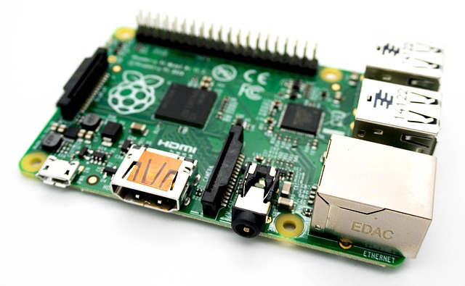
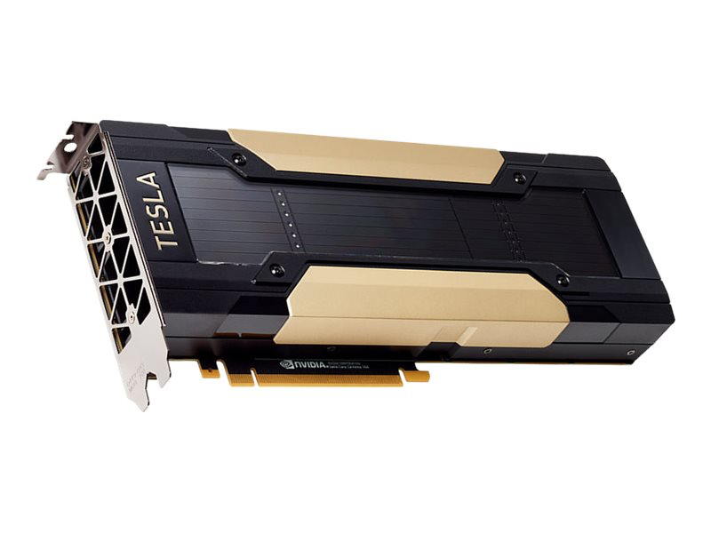
IoT Devices
Avg GPU used for ML
Name | Raspberry Pi 4B | Jetson Nano | Nvidia Tesla v100
GPU | VideoCore VI | NVIDIA Maxwell | -
Cores/CU | 4 | 128 | 5120 Cuda / 640 Tensor
RAM | 1 / 2 / 4 / 8 GB | 4 GB | 16 GB
Power | 15W | 10W | 250W
Notes:
ML is growing in popularity and has been used in IoT applications ranging from autonomous driving cars to smart home speakers. The IoT devices that are mentioned are somewhat on the powerful side, like Raspberry Pi, Jetson Nanos. But still, these devices fall short compared to the hardware used regularly in the wider ML space.

Slide 19
Recommending Pre-Trained Models for IoT Devices

Slide 20
Gaps in existing approaches
Gap 1: Lack of IoT-specific inputs
Fail to consider the hardware performance implications while selecting models
Gap 2: Lack of Ground truth PTM rankings for IoT devices
No empirical data is widely available to be used as ground truth.
Prevents finding patterns or correlations, or training ML.
Notes:
Now that we finally understand what the title of the paper means, let’s dive more deeply into what are the limitations of existing model recommendation approaches. And how they fall short of being hardware aware. We identified two gaps.First being, most of the recommendation approaches never focus on hardware; they usually focus on task performance, and never consider hardware limitations. The problem with this is we can have let’s model M1 > M2 > M3, but M1 can be large and slow to run on RPI, so M2 could end up being the actual better choice. And taking a closer look at this, we realized the second gap in the domain is the lack of actual ground truth data, which could be used for training or drawing correlations. We propose methodologies to address both of these gaps. A point to note, this paper only puts forth the ideas and doesn’t show any experimental data for the effectiveness of these.

Slide 21
Addressing Gap 1: Lack of IoT-specific inputs
We propose two possible methods to make the Model recommendation hardware aware.
Approach 1: (SOTA) Model Spider Fusion
Approach 2: (SOTA) Model Spider Shadow
Notes:
We address the first gap by introducing two novel hardware-aware variants of the model spider approach. We name these Model Spider Fusion and Model Spider Shadow.

Slide 22
Model Spider Fusion
Introduces a hardware-specific token (Ψ_{h}).
Combines this Ψ_{h} with the task token.
Uses multi-head attention to get the similarity between task token and PTM model tokens.

Slide 23
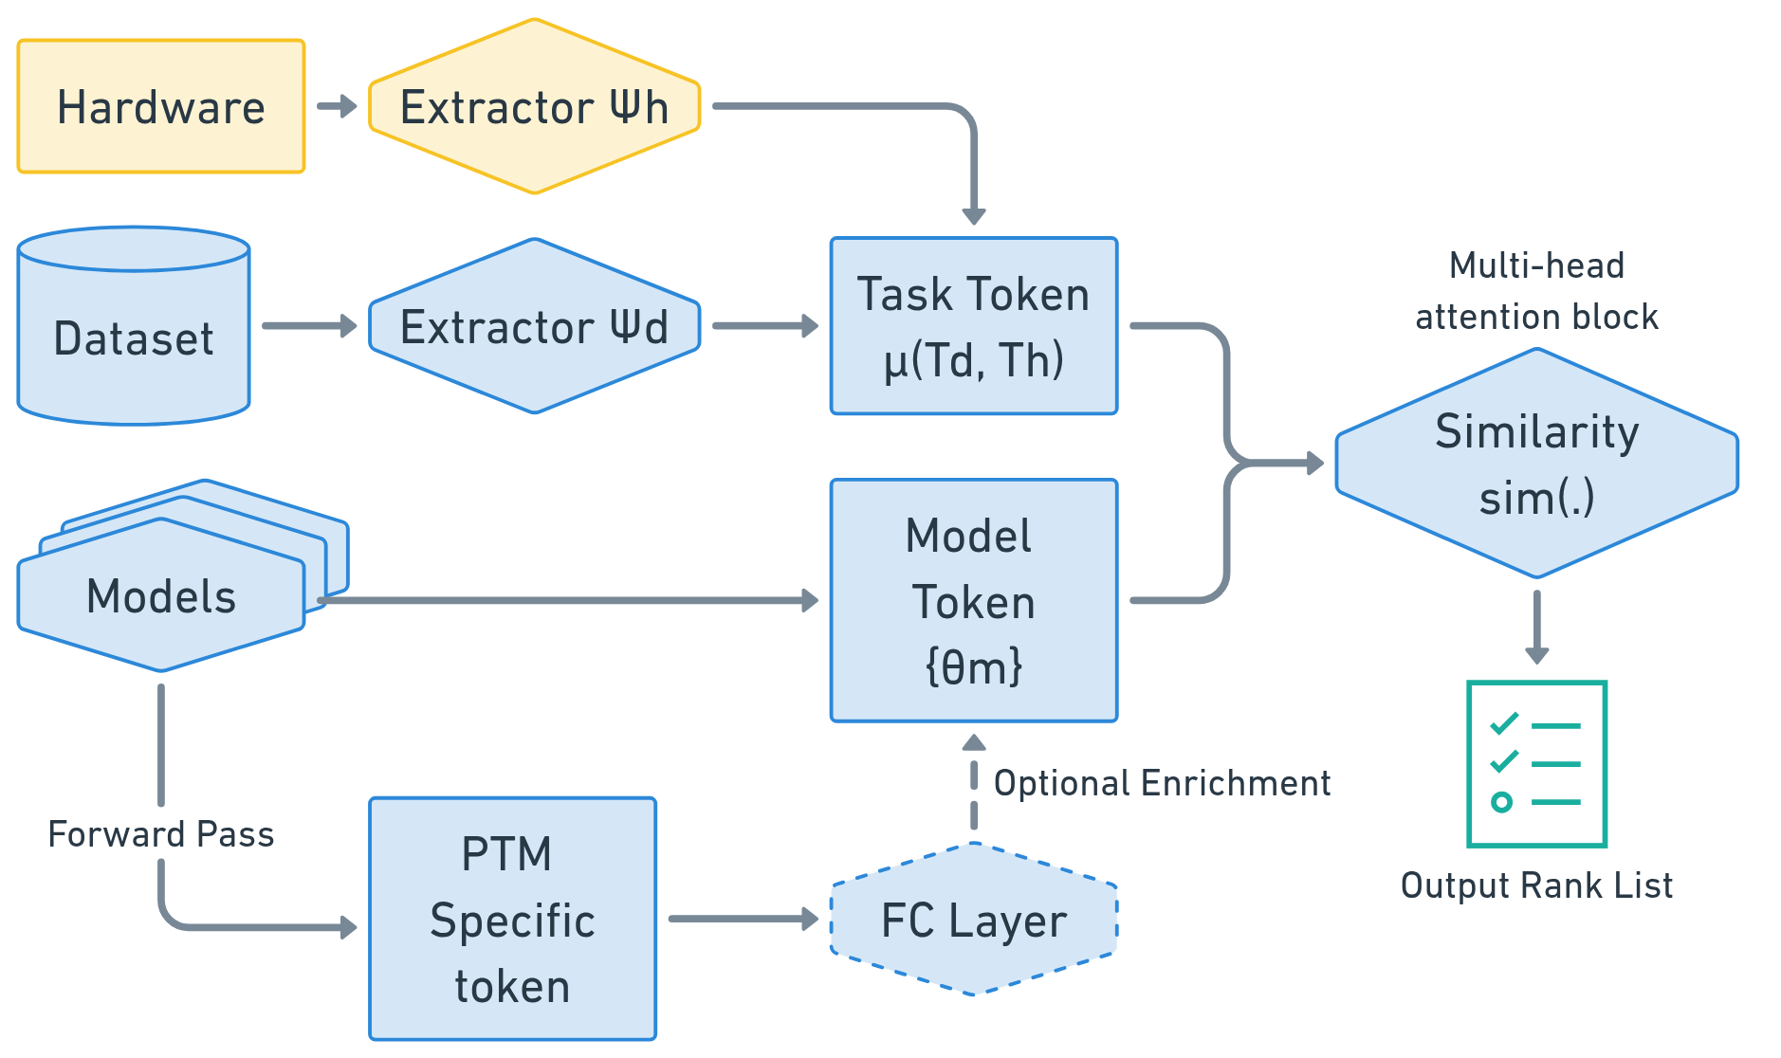
Model Spider Fusion
Notes:
In MS Fusion, we propose to add a new hardware token extraction layer. This is similar to the dataset encoding as earlier discussed. The idea here is to incorporate a hardware token in the task token vector. This would help the multi-head attention block with hardware-specific context. The model tokens are left unchanged here.

Slide 24
Model Spider Shadow
Introduces a second separate pipeline to rank models on hardware tasks.
Uses a separate extractor to create hardware tasks μ(T_{h})
Combines rankings from the hardware task and the downstream task, using Copeland’s method (rank combining algorithm).

Slide 25
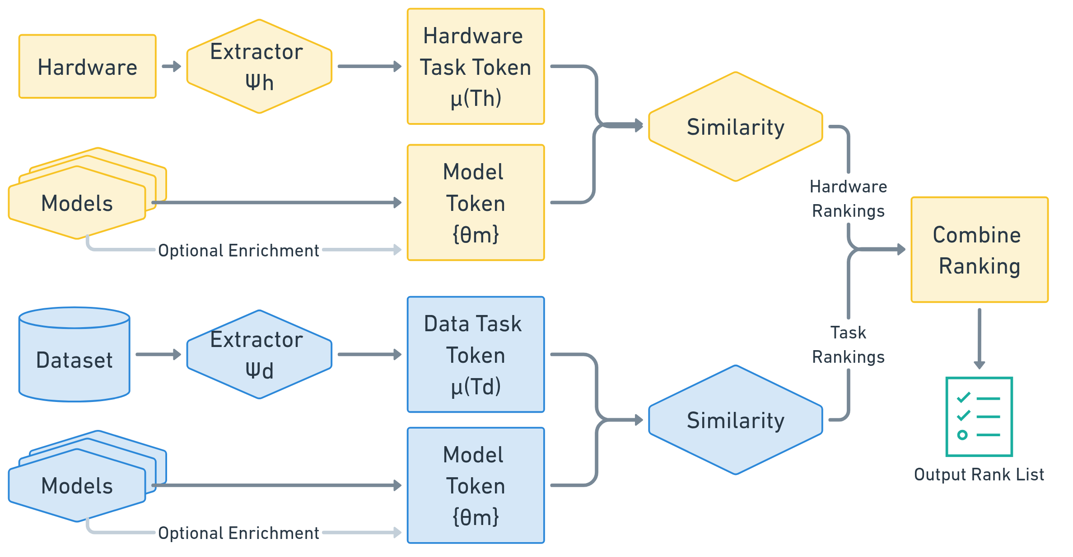
Model Spider Shadow
Notes:
Further we also propose a different approach of having a duplicate or a shadow pipeline, specific to hardware ranking. This pipeline with be specific to the hardware task and rank the PTM only based on that. We can then use classic rank combining algorithms to get a combined ranking based on task and hardware performance.

Slide 26
Addressing Gap 2: Lack of Ground Truth
Currently, there is a lack of datasets that track model performance along with hardware specifications.
To address this shortfall, we put forth a roadmap to make a ground truth dataset by:
Define important metrics
Propose methodology to collect data.
Convert data into model rankings.

Slide 27
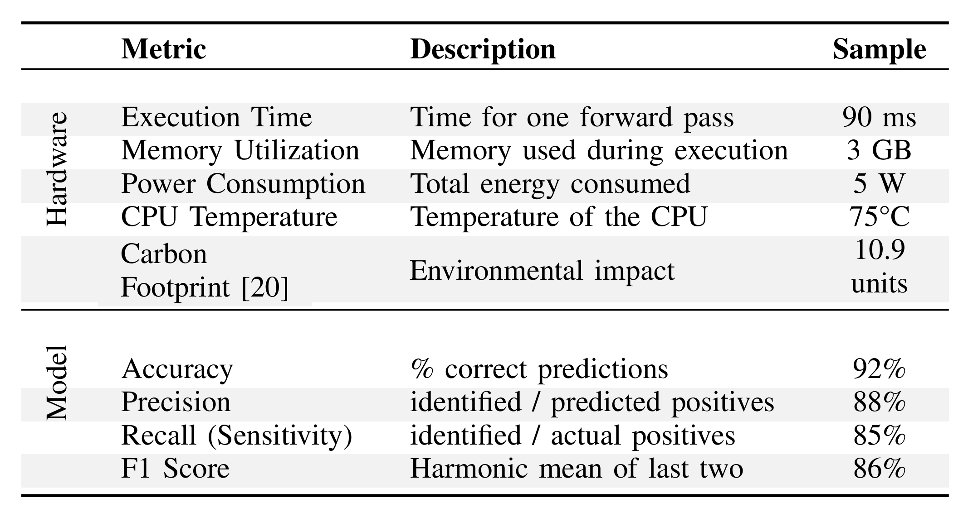
Creating a Ground Truth dataset
Identified Important Metrics

Slide 28
Creating a Ground Truth dataset

Slide 29
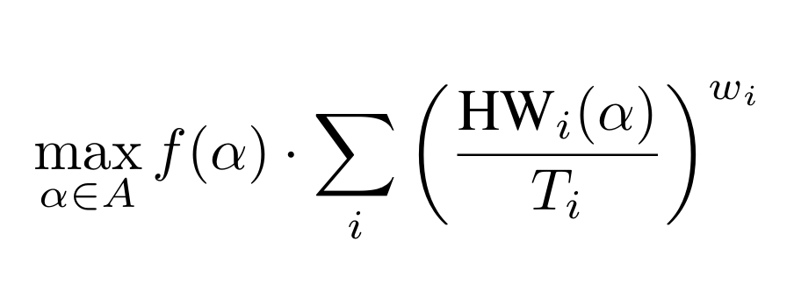
Creating a Ground Truth dataset
Proposed approach to combine rankings
ω_{i} - weight assigned to a metric rank
f(α) - model performance for configuration α HW_{i}(α) - hardware performance for configuration α
T_{i -} Normalization term for i-th hardware metric (HW_{i})

Slide 30
Research Question
Gap 1:
RQ1: How can different parameters be weighted to tailor recommendations? Specifically, can the solution be tuned to prioritize speed, cost-efficiency, or energy efficiency?
RQ2: How do model optimization techniques, such as quantization and distillation, impact model rankings in the context of hardware-aware recommendations?

Slide 31
Research Question
Gap 2:
RQ3: Can specific trends be identified between hardware specifications and model performance?
RQ4: Is there a significant correlation between hardware resources and model characteristics, such as parameters, architecture, or problem type?

Slide 32
Future and Beyond ...
Broader Deep Learning Systems
Extend beyond classification tasks
More complex model reuse scenarios
Reuse in generative problems (LLM, GANs, etc.)
Computer Vision – segmentation, object detection.

