Slide 1
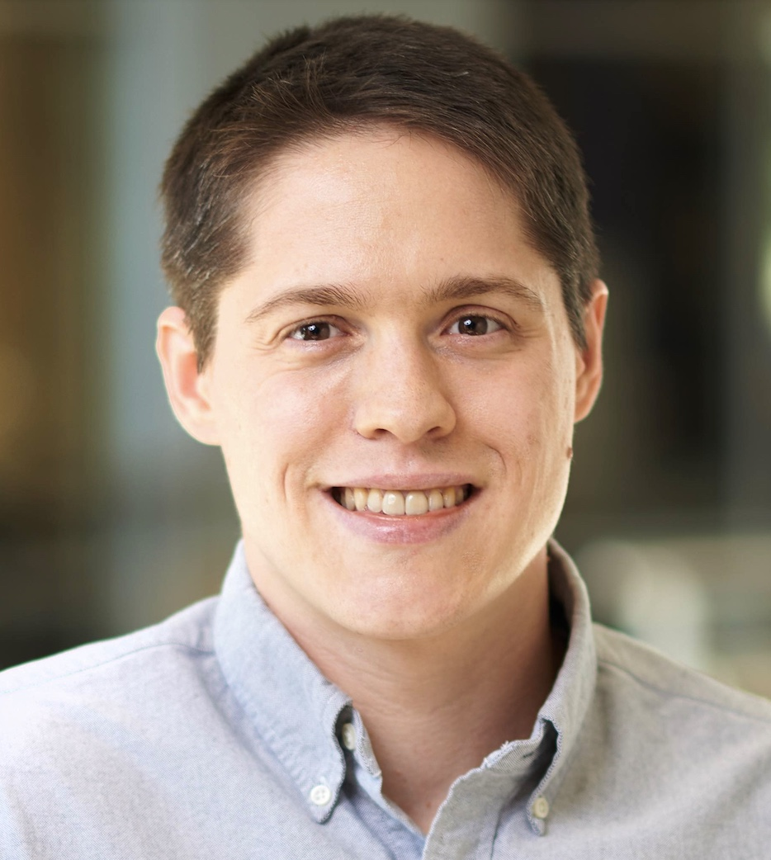
MAGE
Model-Based
Agentic (Software) Engineering
A Case Study in Document Accessibility
Slides for this talk are available here: https://davisjam.github.io/model-based-agentic-software-engineering/talks.html
MAGE materials and book are available here: https://davisjam.github.io/model-based-agentic-software-engineering
James C. Davis
https://davisjam.github.io
Notes:
• A case study, not an AI-hype talk: a real accessibility system built with agents.
• Slides + the MAGE book are linked here — flag them and move on.
• Through-line for the whole talk: realization is getting cheap; judgment is not.

Slide 2
Talk outline
Who am I and why am I here
The problem: Trustworthy GenAI for consequential work
The shift: Intelligence changes the engineering bottleneck
MAGE: Model-Based Agentic Engineering
What this means
Notes:
• The arc in five beats: who/why -> the problem -> the shift -> MAGE -> what it means.
• Promise the trajectory here; don't argue it yet.

Slide 3
Talk outline
Who am I and why am I here
The problem: Trustworthy GenAI for consequential work
The shift: Intelligence changes the engineering bottleneck
MAGE: Model-Based Agentic Engineering
What this means
Notes:
• Section tracker: we're on 'who am I and why am I here.'
• Bio is credibility — keep it under a minute.

Slide 4
Biosketch
2012-2017: Software QA, IBM GPFS / Spectrum Scale
2018: Summer at IBM Research @ Almaden, CA
2019: Summer at Microsoft Research @ Redmond, WA
2020-present: Assistant Professor, ECE @ Purdue
March 2026 – present: Saturator of 4 Claude Max 20x accounts
I am here to explain how to do this without compromising on quality
Notes:
Willard E. Davis
Willard J. Davis
Robert Willard Davis
and me!

Slide 5
Talk outline
Who am I and why am I here
The problem: Trustworthy GenAI for consequential work
The shift: Intelligence changes the engineering bottleneck
MAGE: Model-Based Agentic Engineering
What this means
Notes:
• Section tracker: entering 'the problem' — trustworthy GenAI for consequential work.
• Tee up ADA document remediation as the concrete, high-stakes case.

Slide 6
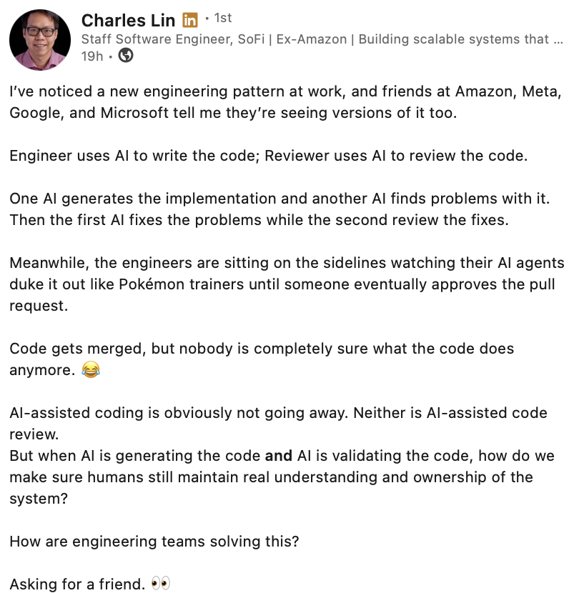
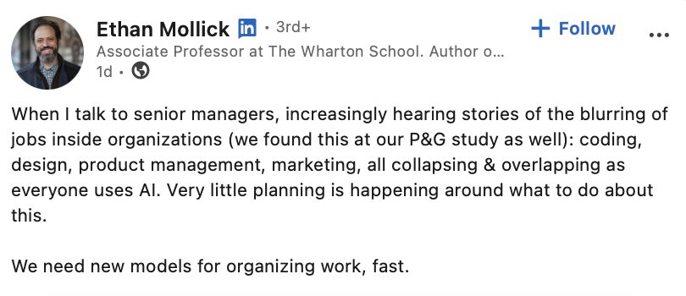
GenAI is collapsing our understanding of complex systems
Notes:
• The core worry in one line: agents generate and modify faster than we can understand or govern.
• Land it: the danger isn't bad code — it's ungoverned code we no longer understand.

Slide 7
What is engineering, again?
Engineering. The profession in which a knowledge of the mathematical or physical sciences gained by study, experience and practice is applied with judgement to develop ways to utilize, economically, the materials and forces of nature for the benefit of mankind
ABET and IEEE
Engineering. The discipline of exercising informed control over consequential systems and accepting responsibility for their outcomes. Control means retaining sufficient command of a system to understand and direct it, evaluate the evidence for its consequential properties, recognize when its assumptions fail, and intervene when necessary. Responsibility means remaining answerable for the consequential decisions made under one's authority and for the resulting system. Engineering does not require personally performing every act of implementation, and work may be delegated to other humans or to machine intelligence. Davis, 2026, The MAGE Book
Engineering requires that we understand complex systems
Notes:
• Contrast the ABET/IEEE definition with the MAGE one: control + responsibility.
• Key move: engineering does NOT require personally implementing — work may be delegated to humans OR machines.
• That reframing is what licenses the rest of the talk.

Slide 8
Context and motivating question
Notes:
• Divider: now ground the abstract worry in a real, expensive problem.

Slide 9
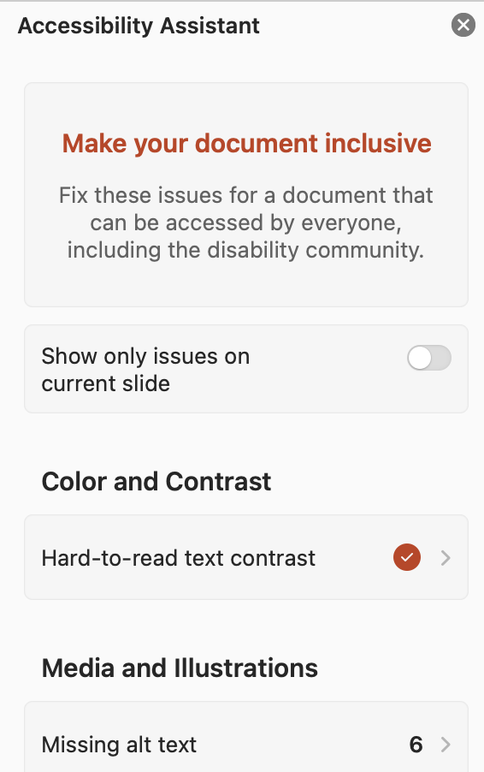
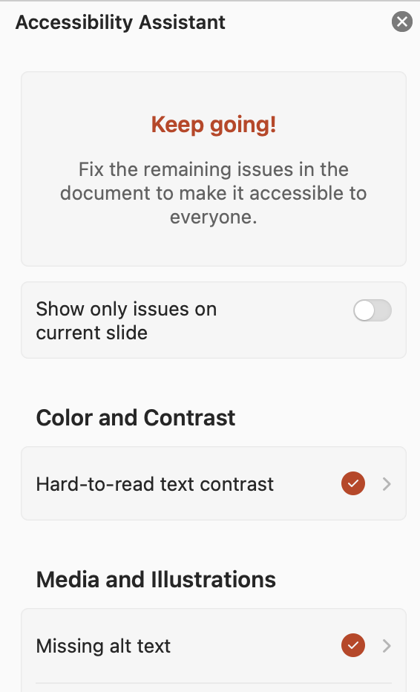
The US DOJ’s electronic-era update to the ADA
1990: ADA
2024: DOJ: ADA += "digital”
4/2026: Compliance deadline
4/2027: Revised compliance deadline
Notes:
• The 2024 DOJ rule: public web content and documents must meet WCAG 2.1 AA, with hard deadlines.
• Every public school and university is on the hook — enormous scope.

Slide 10
Manual remediation: Some back-of-envelope math
Given:
  Professor or teacher salary of $50K – $200K → hourly rate?
  16 weeks/semester x 3 slide decks/week
  2 readings per week (PDF format)
  3 hours per slide deck and 5 hours per PDF * L. Schumacher reported spending a week on one PDF
Find:
  How many hours to remediate a course?
  How much does it cost the university to remediate a course?
Given:
  Purdue has 3000 courses in its catalogue
Find:
  How much does it cost the university to become compliant by hand?
Multiply by every public K-12 school (99,297) and university (1,600) nationwide
https://nces.ed.gov/ccd/tables/202324_summary_3.asp, https://nces.ed.gov/fastfacts/display.asp?id=1122
Notes:
…
In 2020, automating this sort of thing would be impossible.
The DOJ’s standard is “substantially equivalent experience” for someone using accessibility tools, and computers could not make sense of images.
But GenAI is here and now they can. So the question is: Can engineers build it?

Slide 11
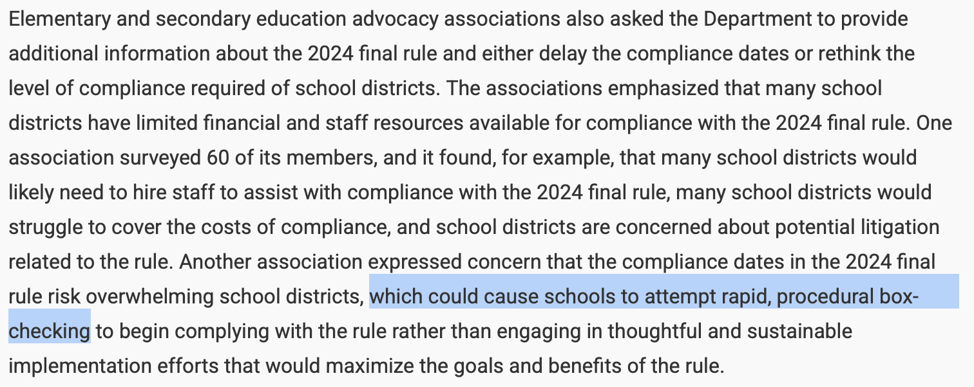
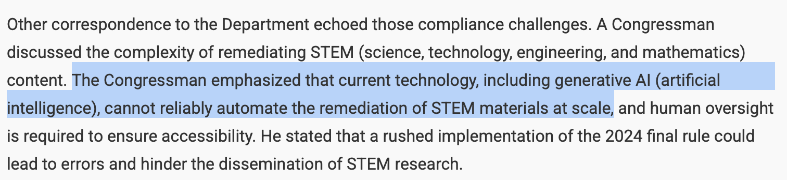
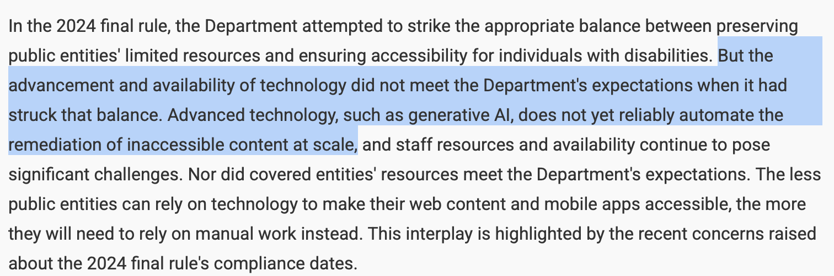
Why did the DOJ extend the deadline?
Notes:
• Setup for the tension: the compliance deadline slipped.
• Two official explanations are coming and they contradict — hold that.

Slide 12
Question of this talk
Is this a problem of technology or of engineering?
“[C]urrent technology…cannot reliably automate the remediation of STEM materials….”
vs.
“The…availability of technology did not meet the Department’s expectations”
Question: How does one answer such a question?
Notes:
• The question of the talk. Read both DOJ quotes aloud — technology-not-ready vs expectations-not-met.
• Land: 'how does one even answer such a question?' That act of answering is engineering.

Slide 13
Answering the question
Notes:
• Divider: we answer it by actually building the system and seeing what breaks.

Slide 14
Scope of work
Q: What will an ADA Automator need to do?
  (Please surface responses in Teams chat or at least ponder it yourself)
Input: A document
Output: A document with the following properties:
  Is minimally changed for non-assistive use
  Provides “substantially equivalent experience” using assistive technology (WCAG 2.1 Level AA)
    Alt-text on figures
    Reading order established
    Scans transcribed
    Media captioned
    Fonts large enough and with enough color-contrast on their backgrounds
Target formats:
Plaintext formats: LaTeX, Typst, HTML
Structured document formats: Office, LibreOffice
The accumulated arbitrary madness of decades: PDF
Clearly we can ask our favorite LLM to do most of these things for us.
The engineering challenge: (1) Can we rely on its answers, and (2) Can we cheaply build a system?
Notes:
• What an ADA automator must do: alt-text, reading order, transcription, captions, adequate contrast.
• Formats escalate: plaintext -> Office -> PDF ('the accumulated arbitrary madness of decades').
• An LLM can do most of these individually. The two real questions: (1) can we rely on it, (2) can we cheaply build the system.

Slide 15
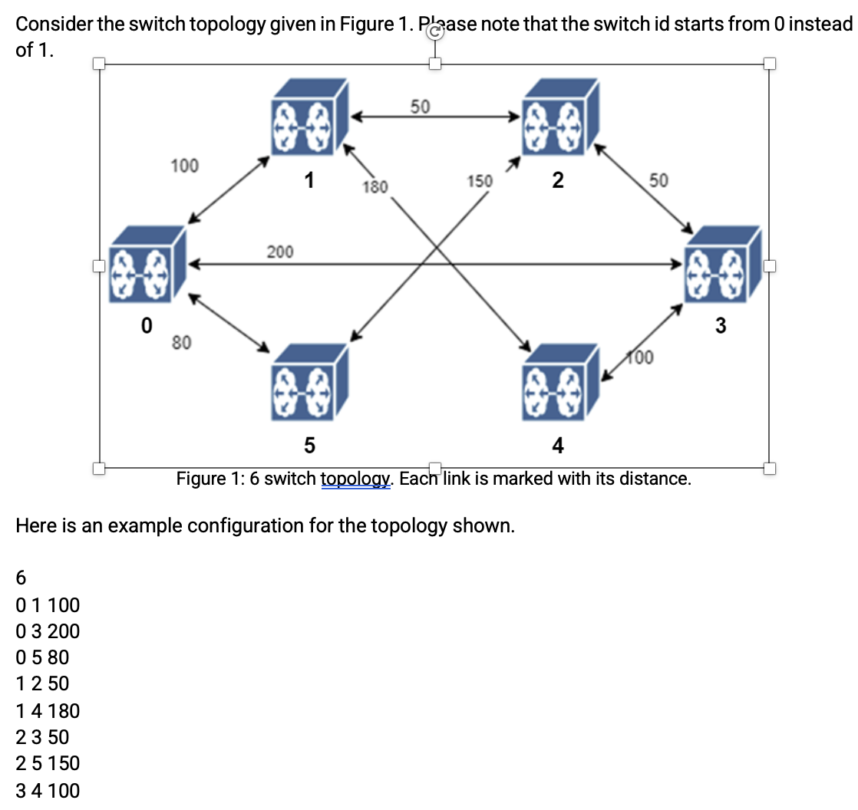


(1) Relying on its answers?
Diagram showing a directed weighted graph with six nodes labeled 0 to 5, each represented by a blue cube with a drone icon. Arrows indicate connections between nodes with weights ranging from 50 to 200, illustrating distances or costs between nodes for pathfinding or network analysis.
Network diagram showing six switches labeled 0 through 5, with bidirectional links between them.
Each link is annotated with its distance: switch 0 connects to switch 1 with distance 100, to switch 5 with 80, and to switch 3 with 200; switch 1 connects to switch 2 with 50 and to switch 4 with 180; switch 2 connects to switch 3 with 50 and switch 5 with 150; switch 4 connects to switch 3 with 100 and to switch 5 with 150.
Answer: Yes – if the LLM has appropriate representations for reasoning
Notes:
• The pathfinding-graph example: the LLM is right WHEN it has the right representation to reason over.
• Answer: yes — given appropriate representations. That word 'representations' is the seed of MAGE.

Slide 16

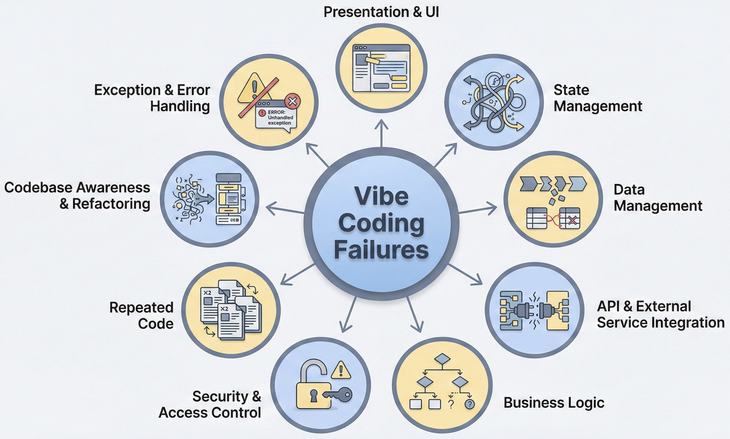
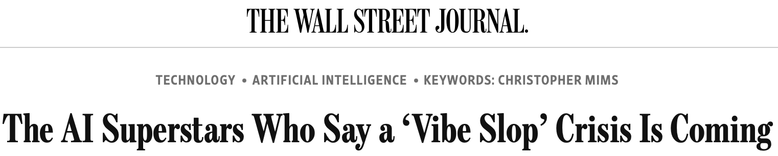
(2) Cheaply build a system?
Feb. 2025
Jan. 2026
May 2026
https://daplab.cs.columbia.edu/general/2026/01/07/why-vibe-coding-fails-and-how-to-fix-it.html
https://daplab.cs.columbia.edu/general/2026/01/08/9-critical-failure-patterns-of-coding-agents.html
https://www.wsj.com/tech/ai/vibe-coding-slop-ai-tools-e6a99394
Notes:
• Counterpoint headlines (2025-2026): vibe-coding fails; recurring agent failure patterns.
• So raw agents do NOT cheaply build reliable systems — something is missing.

Slide 17
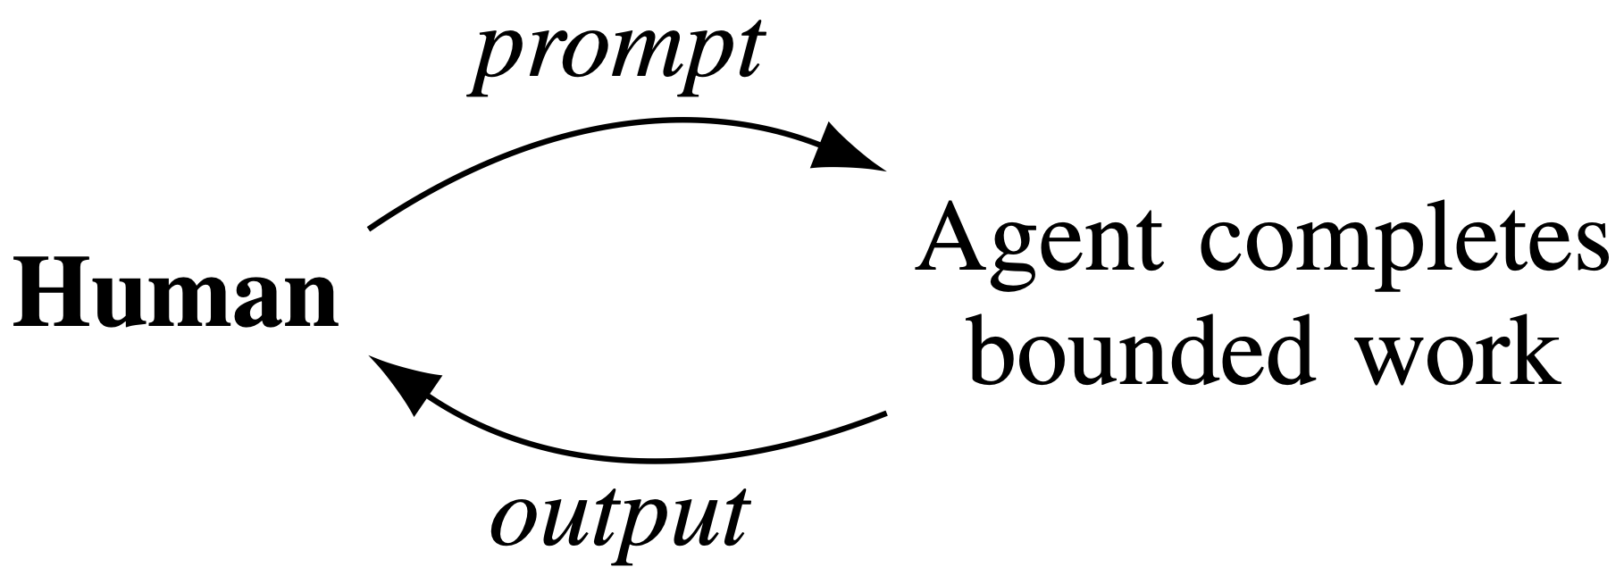
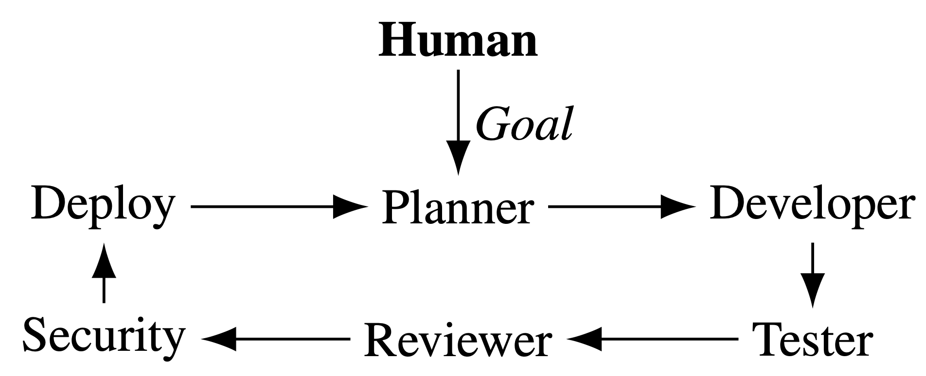
The obvious answers: More oversight, more process
Oversight
Process imitation
“My job is now code review”
Personas, e.g., Yegge’s Gastown
Does not scale / DevExp
Process is not judgment
Q: How do we retain agentic velocity while preserving engineering judgment & oversight?
A: Introduce appropriate representations for LLM to reason over
Notes:
• The obvious fixes: more oversight ('my job is now code review') and process imitation (personas, Gastown).
• Both fail: oversight doesn't scale; imitating process isn't judgment.
• Land the pivot: instead, give the LLM representations to reason over — that's the answer.

Slide 18
Talk outline
Who am I and why am I here
The problem: Trustworthy GenAI for consequential work
The shift: Intelligence changes the engineering bottleneck
MAGE: Model-Based Agentic Engineering
What this means
Notes:
• Section tracker: leaving 'the problem', entering how we actually built it.

Slide 19
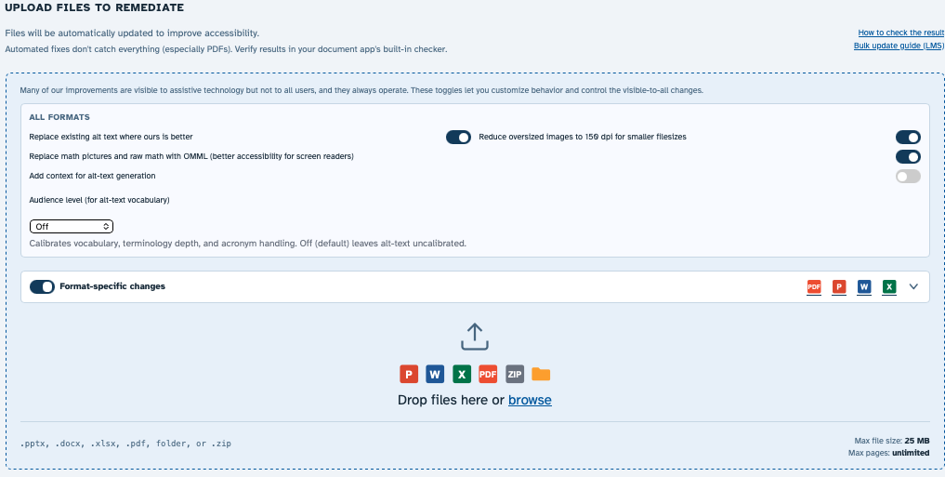
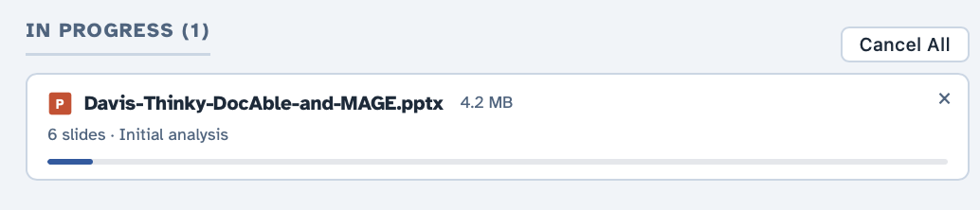
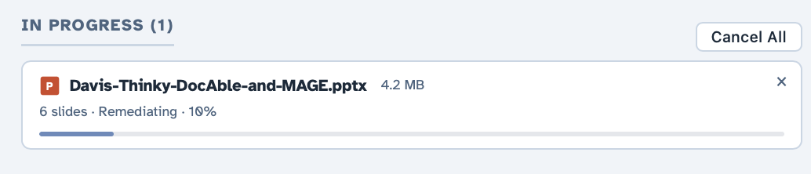
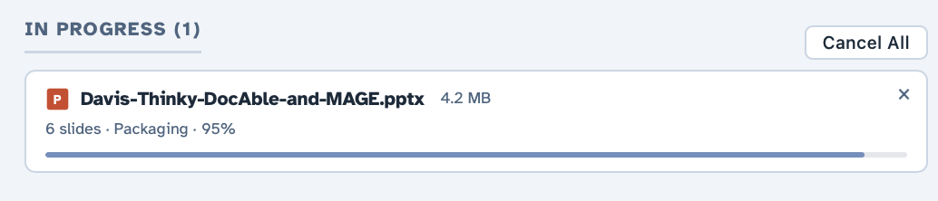
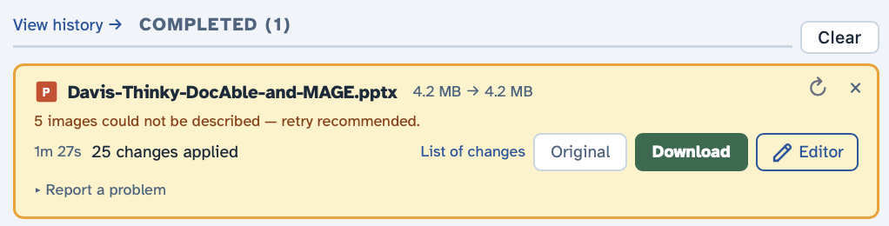

With GenAI, can one engineer/SME build a remediation system?
$0.11
Notes:
• Yes — one engineer plus agents built it, and the marginal cost is $0.11 per document.
• Say the number and let it sit: this is what usually takes a team.

Slide 20
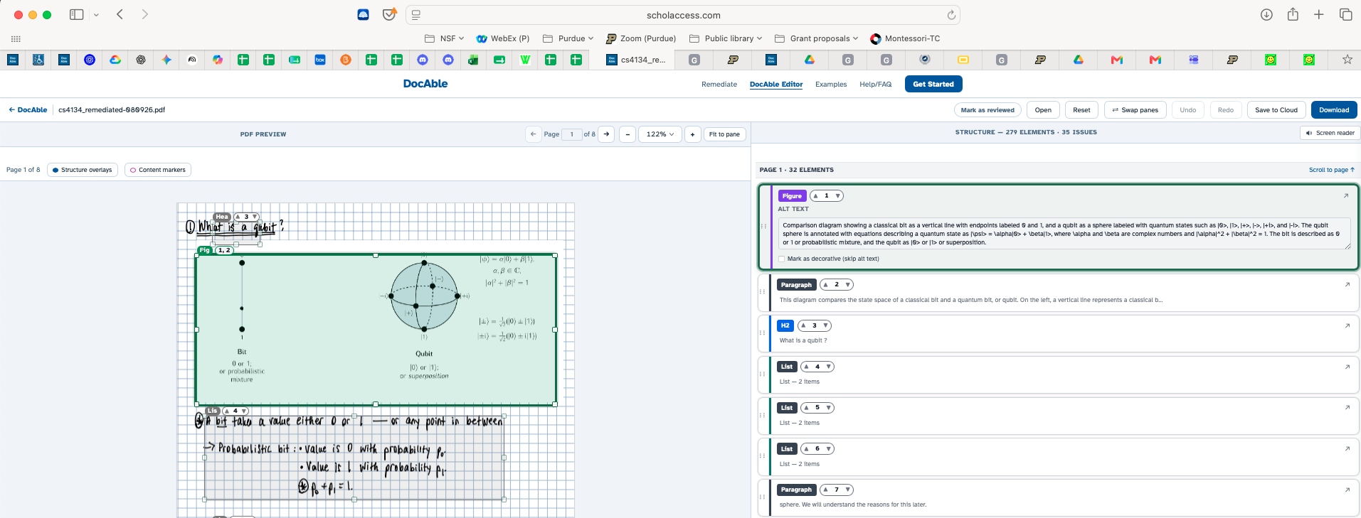
DocAble: And don’t forget an editor!
Notes:
Here, discuss why PDF is (much) harder than O365

Slide 21
How much engineering effort is this?
Category | Code lines | × prod
Production code | 554,116 | 1.00
Infrastructure as code | 35,864 | 0.06
System-model meta-files | 42,340 | 0.08
Support apparatus | 1,649,901 | 2.98
Quality apparatus | 1,273,947 | 2.30
Tests | 628,712 | 1.13
Lints | 308,908 | 0.56
Documentation (active) | 336,327 | 0.61
Agent infrastructure | 146,724 | 0.26
Tools | 229,230 | 0.41
Documentation (snapshot / history) | 1,011,406 | —
System-wide: 3,309,703 code + 975,073 comment + 790,312 blank = 5,075,088 lines across 17,938 files
Markdown 1.36M / Python 940K / C# 623K / TypeScript 138K
Comparison point: My product at IBM had ~3MLOC and had taken hundreds of person-years
(between 10 and 100 employees over a 20-year period)
Notes:
This isn’t a toy.
For calibration, the product I worked on at IBM was about three million lines and represented hundreds of person-years of accumulated engineering.

Slide 22
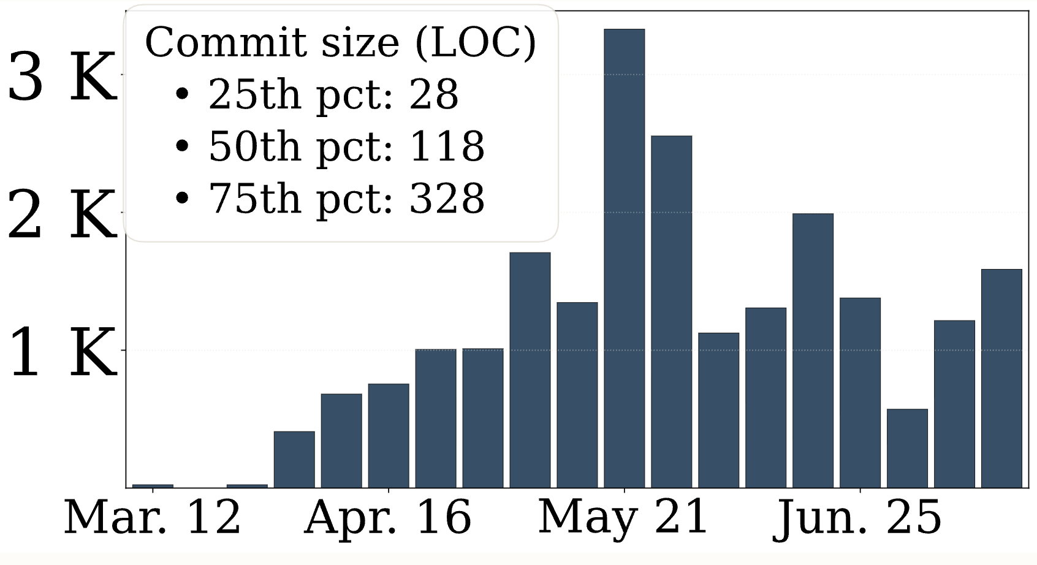
What velocity is involved?
Notes:
• Divider: how fast did this actually go?

Slide 23
Does it work?
Exceeds the capabilities of the commercial tool that Purdue licensed
Works on my files
Currently in use at Purdue Engineering, where some interesting edge cases are being discovered (and automatically fixed by Claude)
One colleague remediated his entire class, ~10 PPTX, ~500 slides total
  He spent 5-10 minutes per slide deck reviewing the result, and then promised me a beer
  Total cost: $10 + his time (90 minutes, call it $100) + the promised beer
Notes:
• Evidence, not claims: it beats the commercial tool Purdue licensed; it's in real use at Purdue Engineering.
• A colleague remediated ~500 slides, ~90 min reviewing, total cost ~$10 plus a promised beer.
• Land: real engineering value, cheaply — edge cases surface and get auto-fixed.

Slide 24
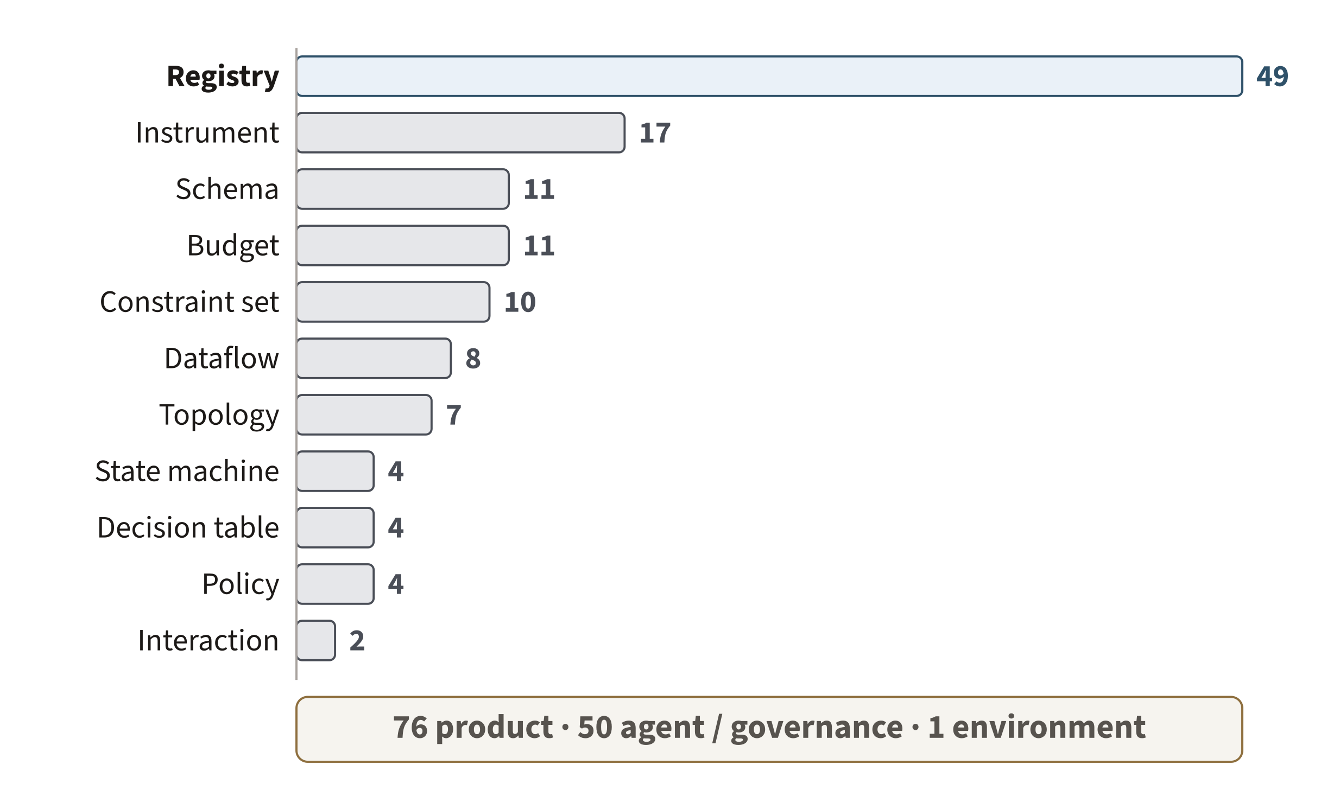
DocAble has 127 system models
“Model” is not one universal representation. Different engineering questions need different reductions of the system.
MODEL_KIND = what it views · MODEL_FORM = the formalism it is expressed in
Notes:
• Breadth as evidence: 127 models across 11 representation forms — not diagrams made for this talk.
• The point isn't 'look how many' — it's that 'model' is not one universal representation.
• State the distinction: MODEL_KIND (what it views) vs MODEL_FORM (the formalism it's expressed in).

Slide 25
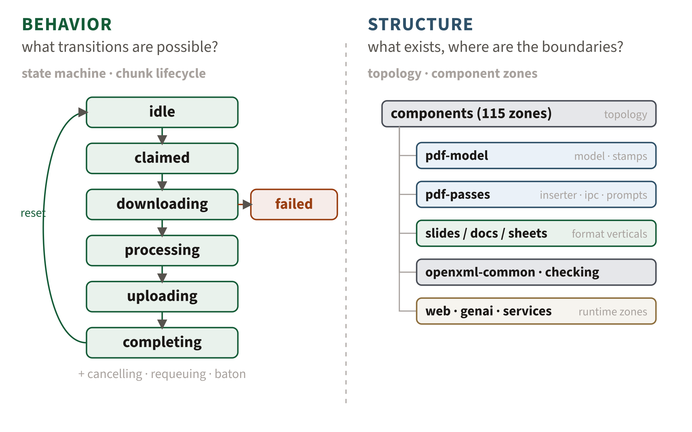
One system, different questions, different models
Same system. Different questions. Different representations.
These aren’t documentation — the engineering environment consumes them.
Notes:
• State-machine (behavior) beside topology (structure): same system, different questions, different representations.
• Killer line: these aren't documentation — the engineering environment CONSUMES them (drives audit zones, imports transitions).

Slide 26
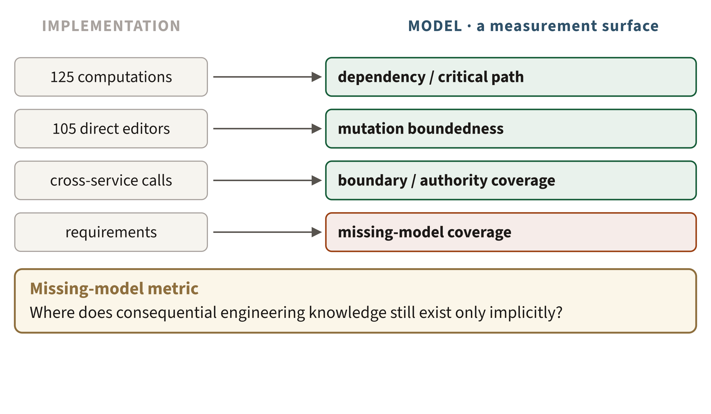
Engineering with models
Once the system is represented explicitly, the representation becomes a measurement surface.
Models let us measure the system. Missing-model metrics let us measure the models.
Notes:
• Once the system is represented explicitly, the representation becomes a measurement surface.
• Feature the new metric class: the missing-model metric — where does consequential knowledge still exist only implicitly?
• Land: models let us measure the system; missing-model metrics let us measure the models.

Slide 27
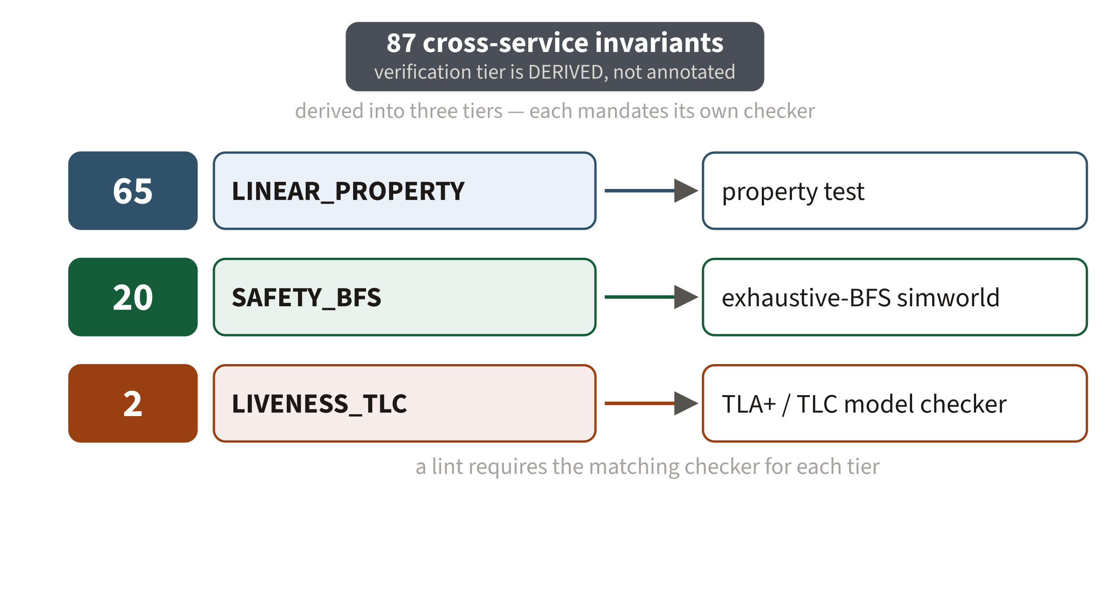
The models carry obligations
The model determines what evidence the environment requires.
The agent doesn’t get to decide that its own answer is good enough.
Notes:
• Zoom into the state machine: 87 cross-service invariants, tier DERIVED not hand-annotated (linear -> property test, safety -> BFS, liveness -> TLC).
• The representation determines what evidence is required — and a lint enforces the right checker.
• Land: the agent doesn't get to decide its own answer is good enough.

Slide 28
Talk outline
Who am I and why am I here
The problem: Trustworthy GenAI for consequential work
The shift: Intelligence changes the engineering bottleneck
MAGE: Model-Based Agentic Engineering
What this means
Notes:
• Section tracker: we've shown the phenomenon — now name it. This is MAGE.

Slide 29
The bottleneck moved
Commodity intelligence makes realization cheaper.
It does not make engineering knowledge, evidence, or judgment free.
MAGE treats this as a change in the economics of engineering — not a better programming tool.
DocAble forced us to externalize engineering knowledge because agents repeatedly needed it.
Once externalized, that knowledge could govern the next agent’s work.
Notes:
• Commodity intelligence makes realization cheap — it does NOT make knowledge, evidence, or judgment free.
• MAGE = a change in the economics of engineering, not a better programming tool.
• Bridge: DocAble forced us to externalize knowledge because agents kept needing it; once external, it governs the next agent's work.

Slide 30
Technology moves engineering bottlenecks
Goldratt’s Theory of Constraints / Amdahl’s Law:
Removing one constraint exposes the next
Technology | Makes abundant | Relatively scarce resource
Steam engine | Mechanical power | Control & Coordination
Factory | Physical production | Control & Coordination
Integrated circuit | Computation | Control & coordination
Coding agents | Knowledge-work implementation | Control & coordination
Notes:
Coding agents are not eliminating engineering. They’re making one input to engineering—implementation—abundant. And when a constraint moves, engineering reorganizes around what remains scarce.
Engineering reorganizes when a constraint moves. Steam made mechanical power far cheaper; integrated circuits did the same for computation; coding agents are now doing it for implementation. “Scarce” here is the economic sense, not a mood. A scarce factor constrains output, so it draws investment and attention. Implementation was never the only scarce input to software engineering, but for most of the field’s history it consumed enough expert effort to limit what teams could attempt and how quickly they could change a system. As its marginal cost falls, other constraints become more visible: deciding what to build, representing a large system well enough to reason about it, producing evidence that a change is acceptable, and giving consequential engineering decisions authority across many changes.
Abundance does not make implementation unimportant; it changes where additional engineering effort earns the greatest return. A factory with unlimited machine capacity and one inspector has not stopped manufacturing; inspection has become the throughput constraint. In software, agents can now produce changes faster than engineers can specify, understand, validate, and govern them. Models amortize representation and judgment across many acts of implementation; validators and gates can amortize selected judgments about acceptance. Rational effort therefore moves upstream into representation and outward into the engineered environment. This Part asks what follows from that shift: what remains hard, which properties of the new substrate matter, and what engineering problems they leave us to solve.

Slide 31
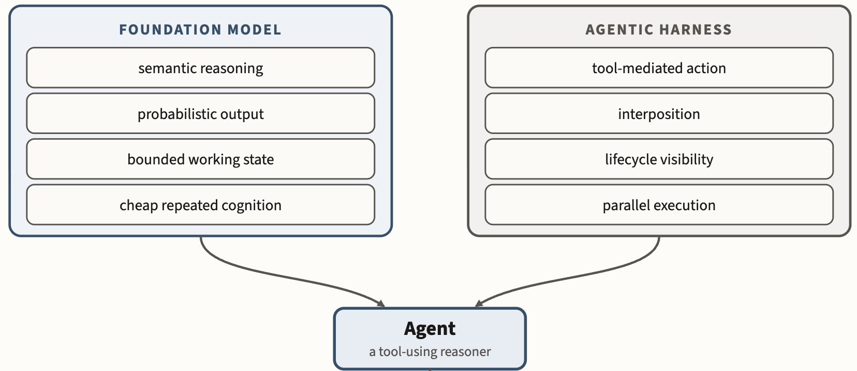
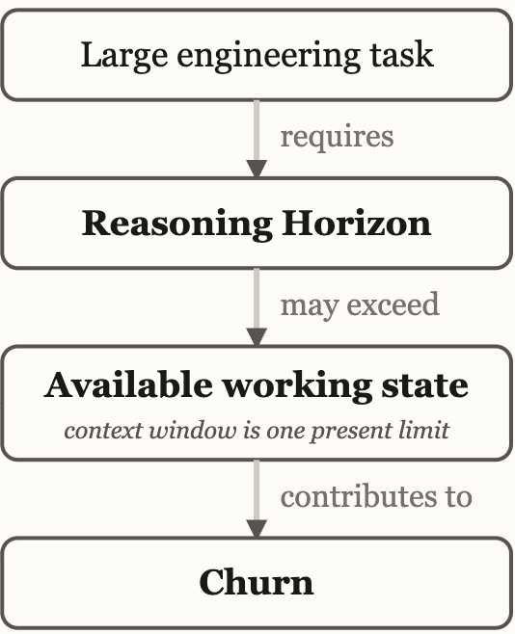
The new technology: “Agents” ~~ “Commodity Intelligence”
Notes:
The foundation model supplies inexpensive semantic reasoning under finite, probabilistic working conditions; the harness turns that reasoning into observable, interceptable action.
This talk is about my understanding of how CODING AGENTS will re-organize engineering work, and what the nature of the relatively scarce resource becomes.

Slide 32
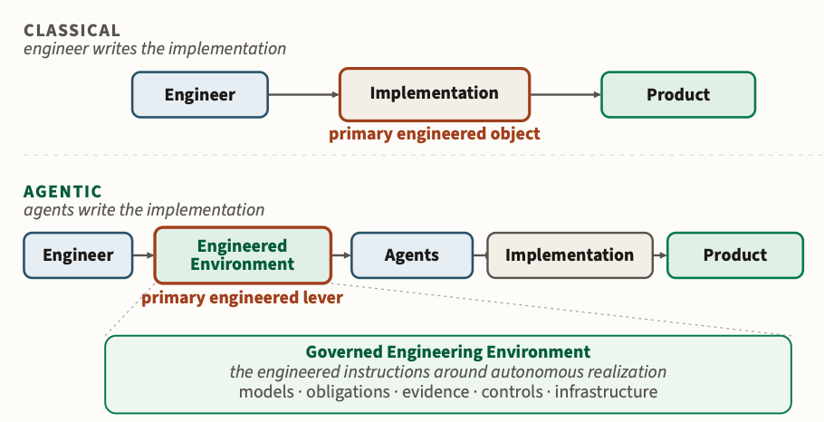
Control & Coordination of GenAI
GenAI moves the engineering effort: Impl. → environment
Notes:
• GenAI moves the engineering effort from implementation into the surrounding environment.
• That's where engineering now lives: controlling and coordinating autonomous work.

Slide 33
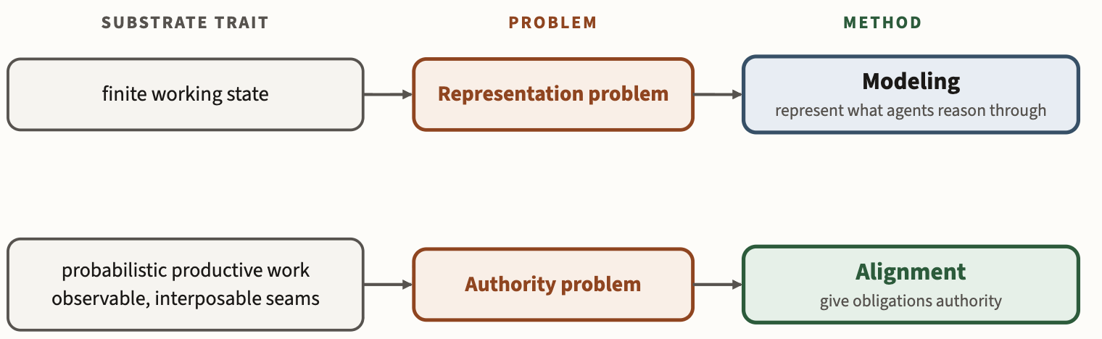
MAGE principles: Modeling and Alignment
Notes:
• Two principles coming: Modeling (externalize the knowledge needed to reason) and Alignment (turn obligations into evidence).

Slide 34
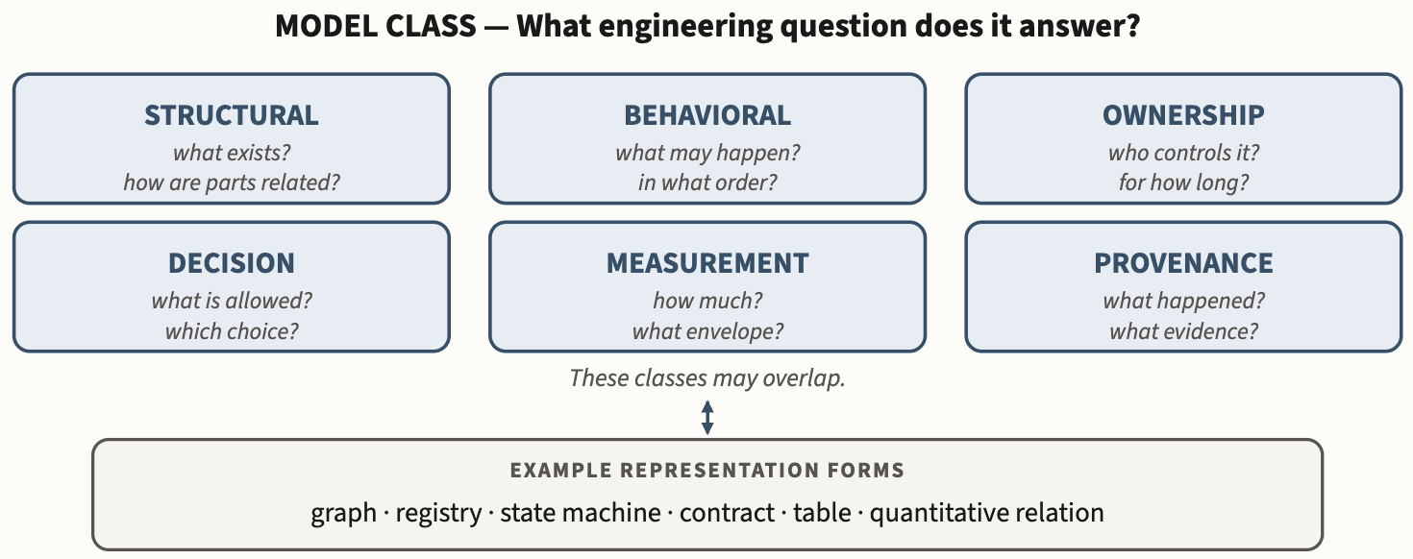
Reason through representations, not artifacts
A useful model preserves the distinctions needed for a particular engineering decision.
types · ASTs / IRs · CFG / DFG · state machines · dependency graphs · contracts · DSLs
Notes:
Figure 2.1-1. MAGE's working model ontology. The six classes distinguish models by the engineering question they answer. Classes may overlap, and each may be encoded using several representation forms.
Connected through shared identity and traceability, these models form the system’s explicit engineering knowledge.

Slide 35
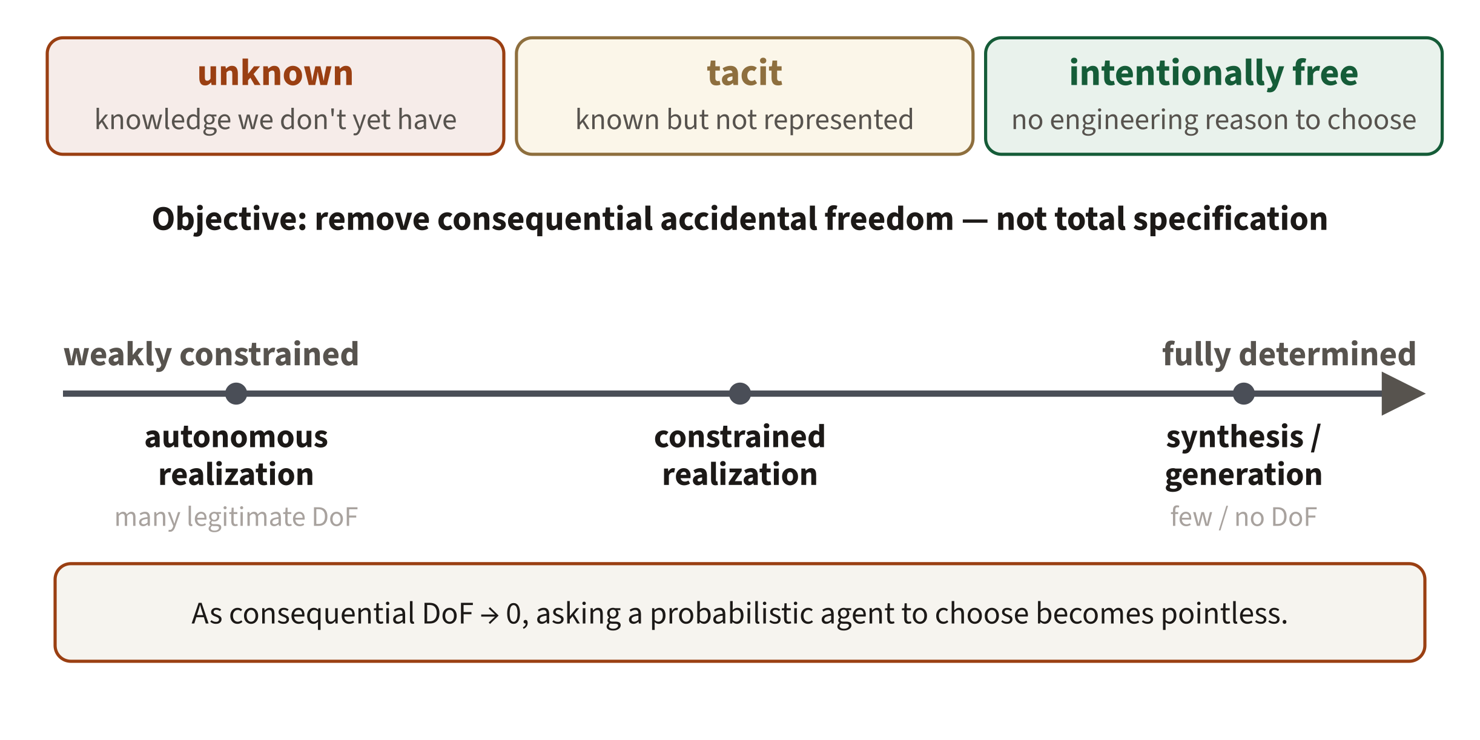
Degrees of freedom
Connects MAGE to synthesis, refinement, DSLs, and constrained IRs — where consequential freedom is already near zero.
Notes:
• Distinguish three kinds of freedom: unknown, tacit, and intentionally free.
• The objective is removing consequential ACCIDENTAL freedom — not full specification.
• As consequential degrees of freedom approach zero, asking a probabilistic agent to choose becomes pointless (synthesis, DSLs, constrained IRs).

Slide 36
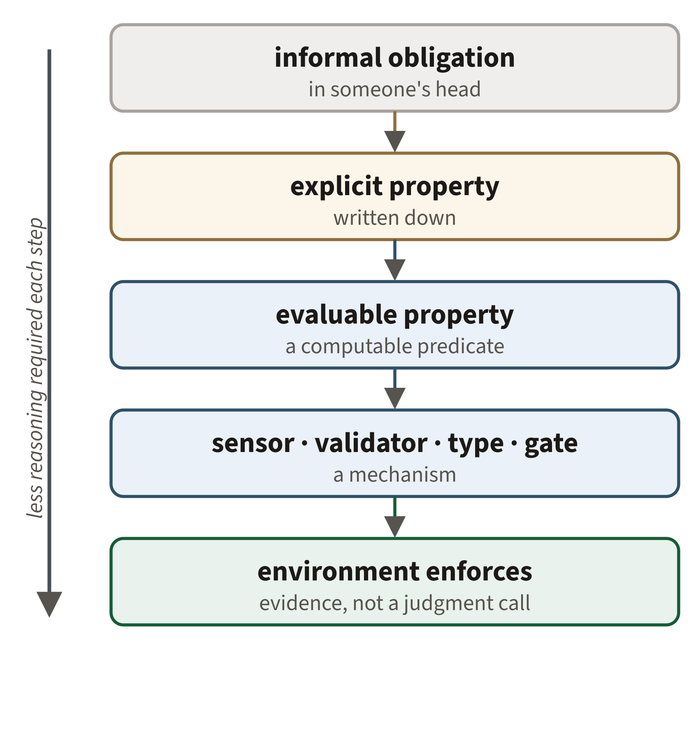
Alignment: move obligations out of probabilistic judgment
Do not repeatedly spend intelligence on a decision that engineering can make durable.
PL’s fifty-year toolkit: type systems · static analysis · proof obligations · capabilities · contracts · validators — not novel to MAGE.
25 modeled controls
13 aim the agent — 11 soft
12 bridge model ↔ environment — 9 hard
Instructions aim the agent. Engineering controls the environment.
Notes:
• The progression: informal obligation -> explicit property -> evaluable -> validator/type/gate -> environment produces evidence.
• Land: don't repeatedly spend intelligence on a decision engineering can make durable.
• Callout from 25 modeled controls: agent-aimed ones are mostly SOFT, model-bridge ones mostly HARD. Instructions aim the agent; engineering controls the environment.

Slide 37
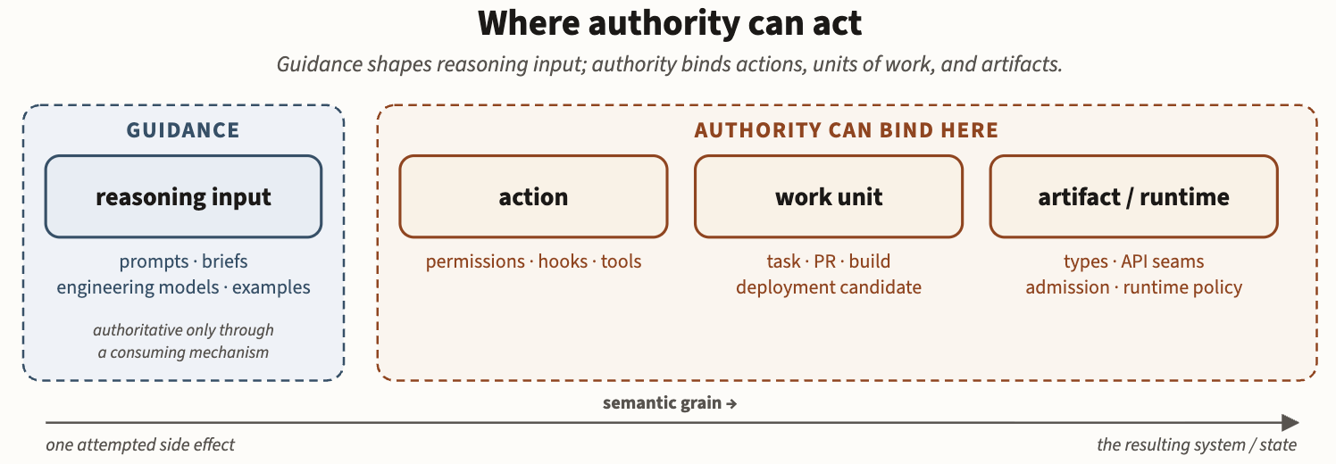
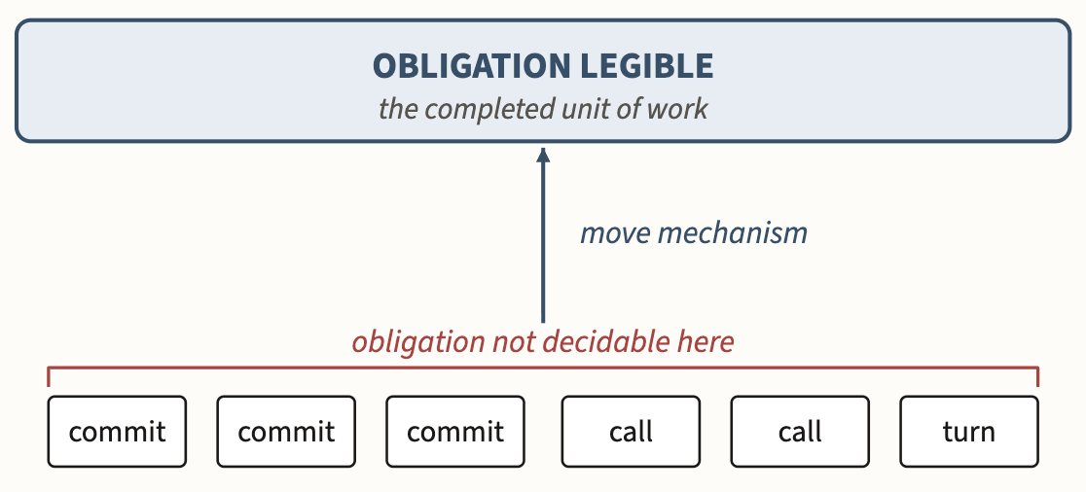
Alignment can act at different points
Semantic gaps
End-to-end principle
Notes:
Figure 3.1-1. Intervention boundaries. Guidance shapes reasoning input; authority can bind actions, completed units of work, or accepted artifact/runtime state. Place a mechanism at the earliest boundary where the obligation is legible and the consequence can be affected.
Semantic gap.

Slide 38
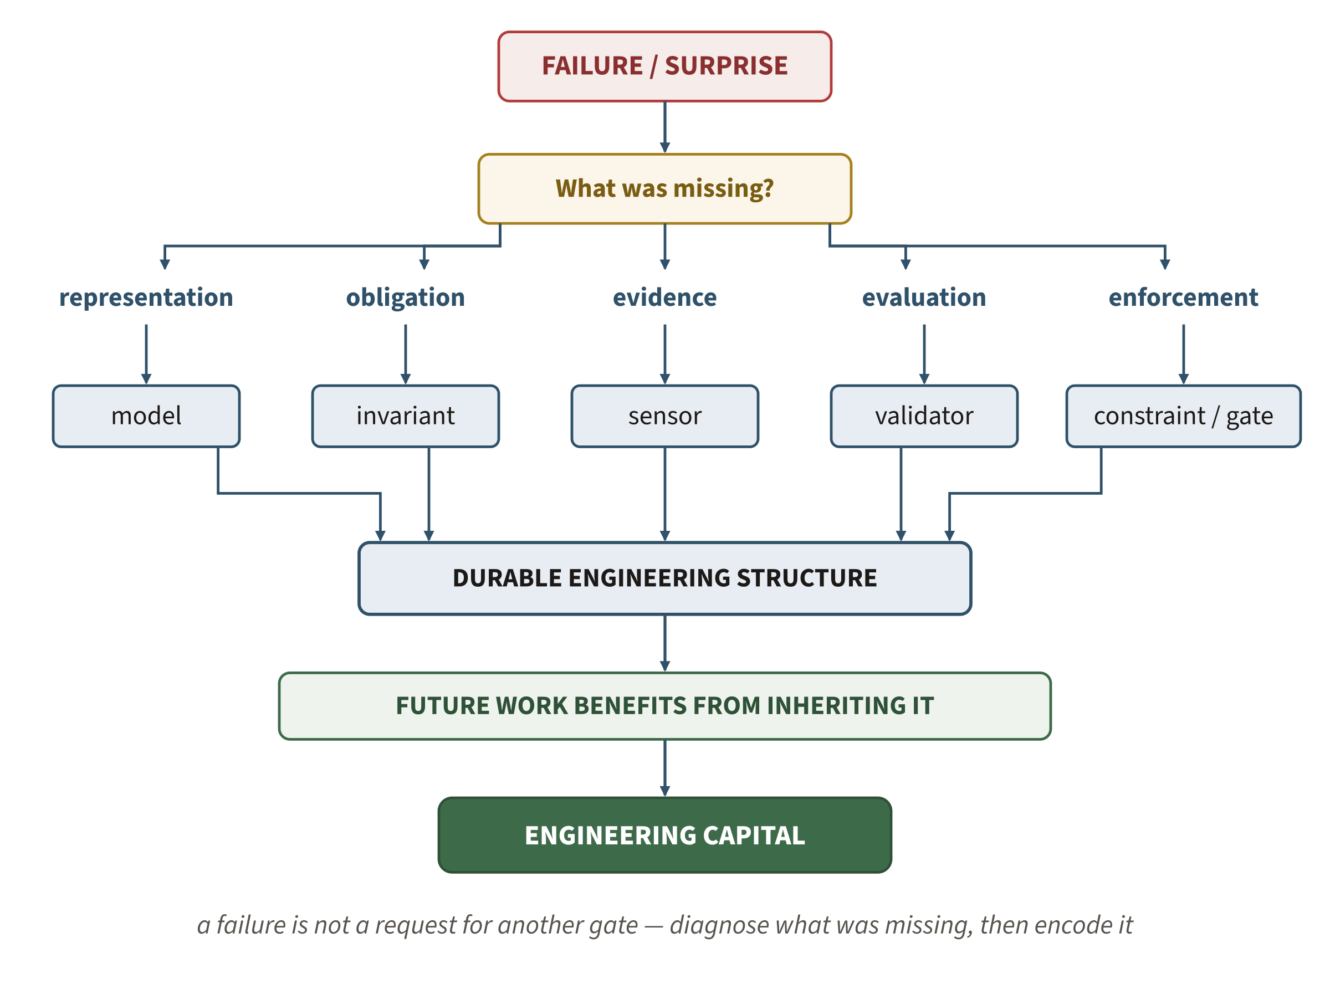
Governance conversion
Engineering capital — judgment paid once, inherited by later work.
Notes:
• The loop: failure / expensive judgment -> diagnosis -> missing model? or missing control? -> add that structure to the environment.
• This is engineering capital: judgment paid once, inherited by later work.
• Foreshadow the ending: education is exactly this — accumulated judgment made durable instead of rediscovered.

Slide 39
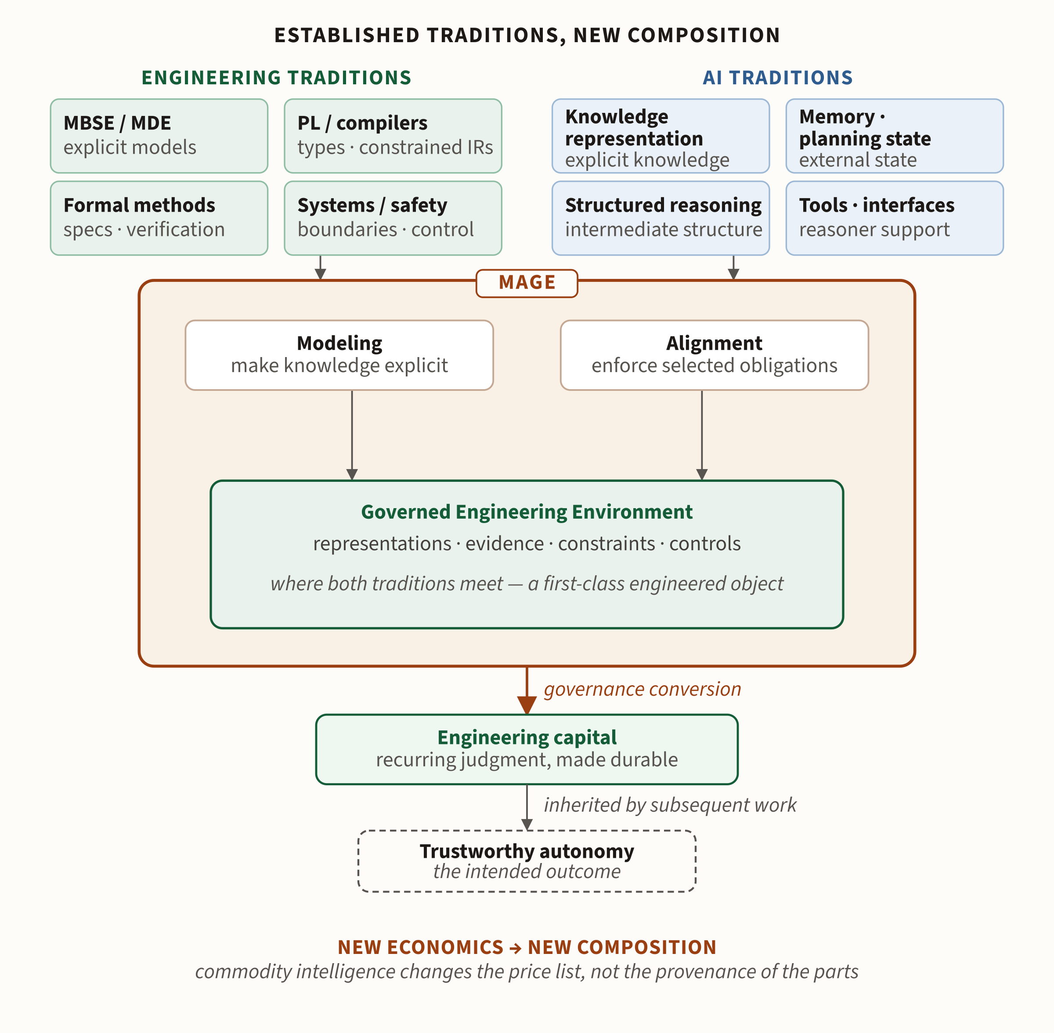
Old machinery, new composition
MAGE doesn’t claim models, types, constraints, or verification are new.
Commodity intelligence changes the economics of composing them around autonomous work.
PL / compilers · formal methods · MBSE · systems
meet
knowledge representation · planning · structured reasoning · tools
Notes:
• Nothing here is new: types, specs, verification, MBSE, systems boundaries.
• What changed is the ECONOMICS of composing them around autonomous work.
• For this room: PL/compilers and formal methods meet knowledge representation, planning, and tools — converging in MAGE.

Slide 40
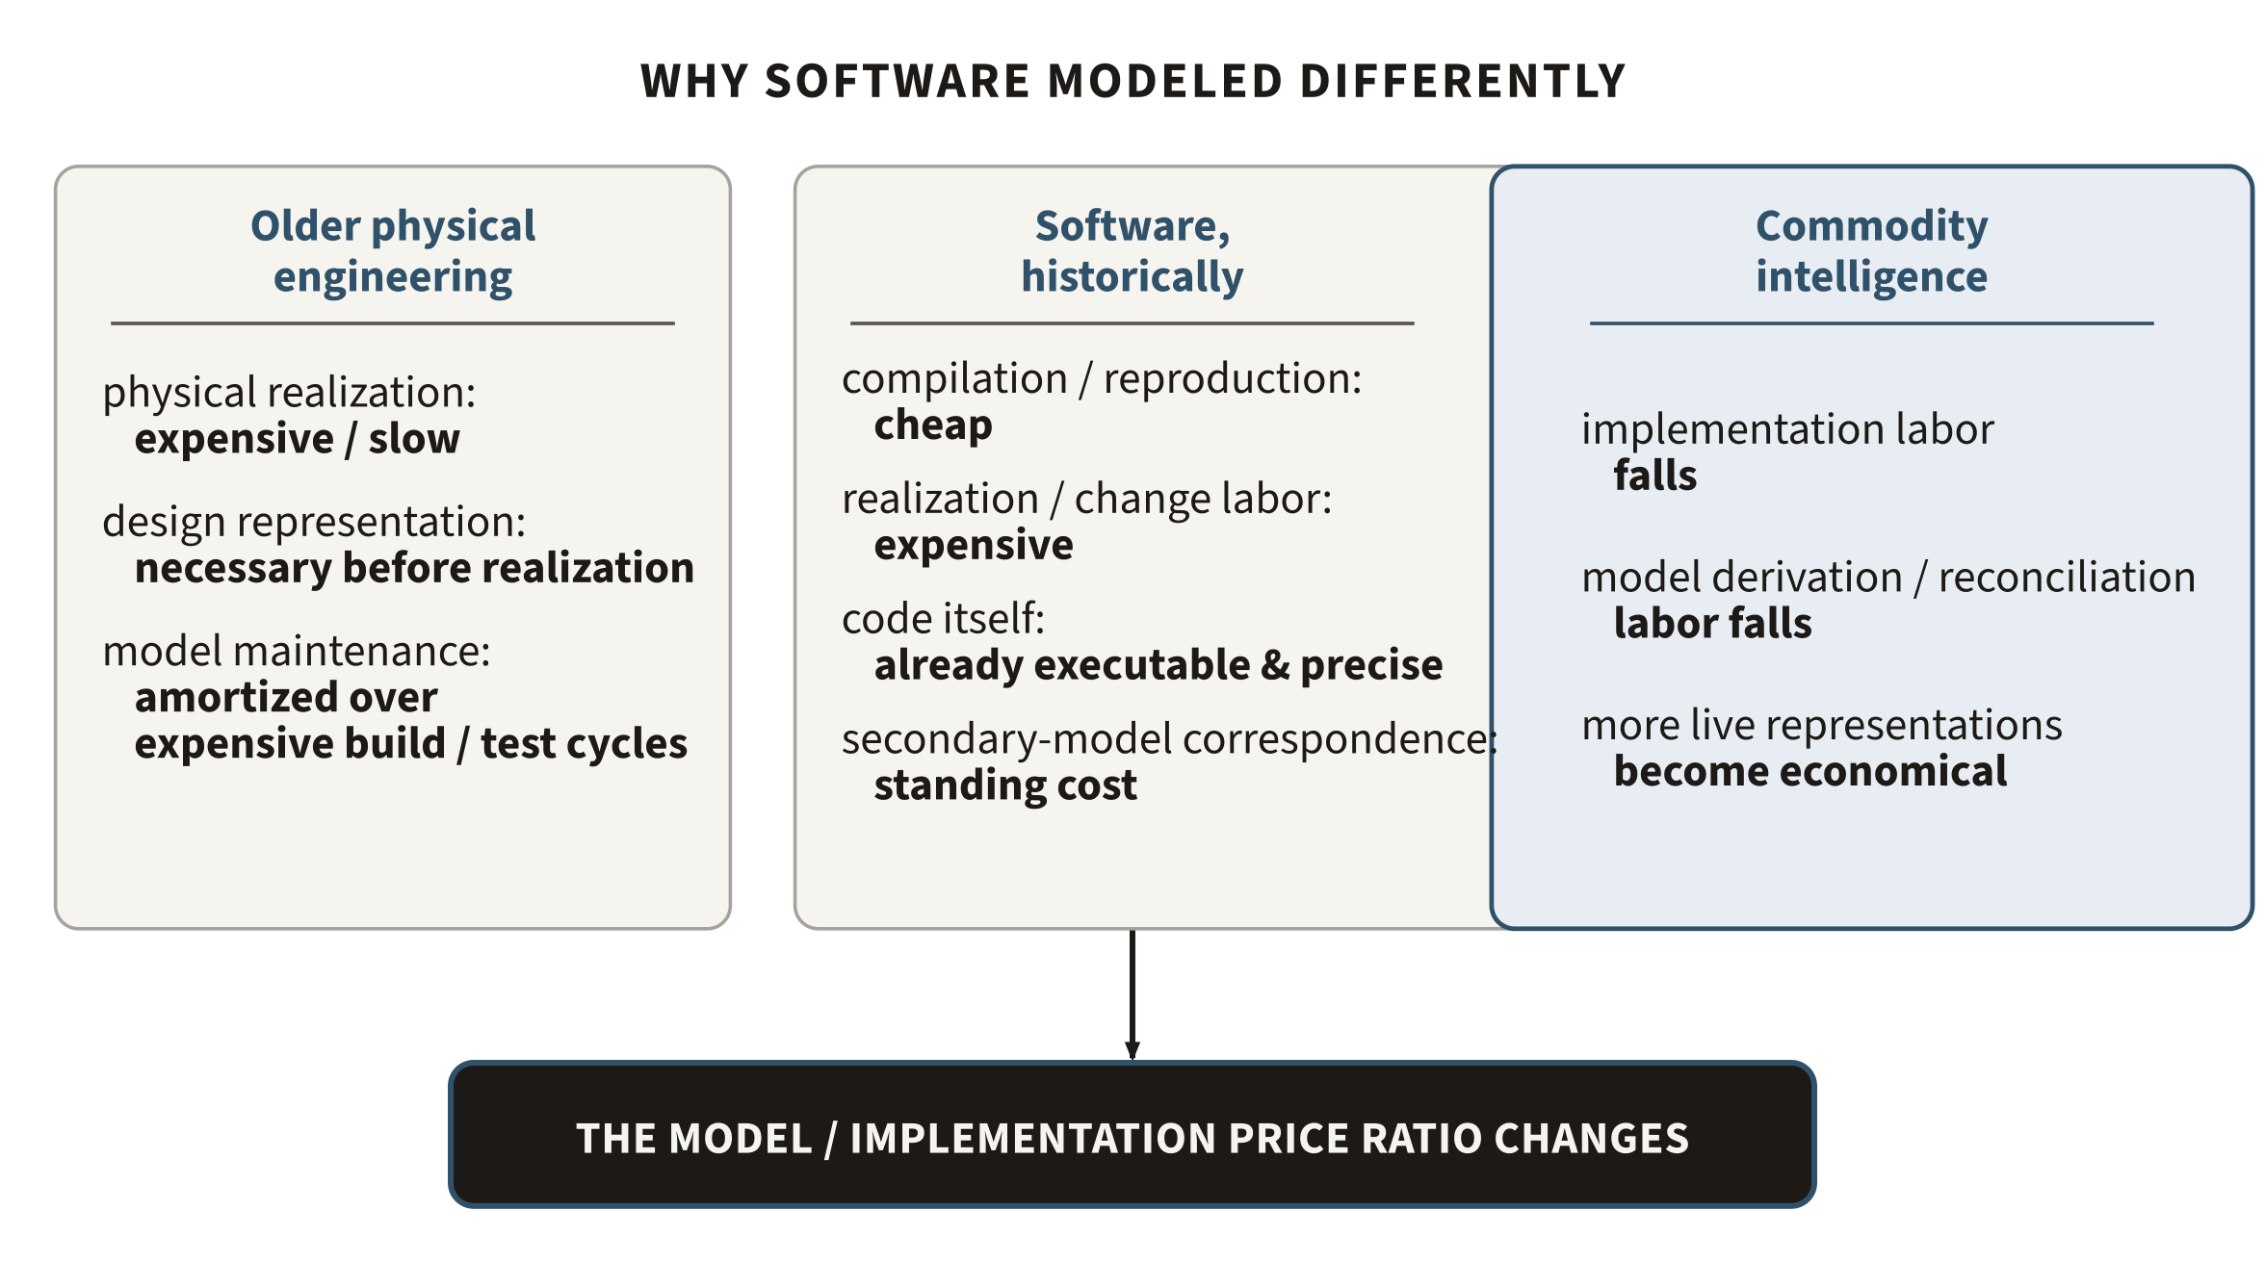
Why didn’t software already work this way?
Code was already precise, executable, and cheap; secondary models cost construction + sync. Commodity intelligence lowers both.
Notes:
• Pre-empt the PL skeptic: if representations are so valuable, why hasn't model-driven engineering already won?
• Because code was already precise, executable, and cheap; secondary models cost construction plus synchronization.
• Commodity intelligence lowers BOTH costs — that's the real shift.

Slide 41
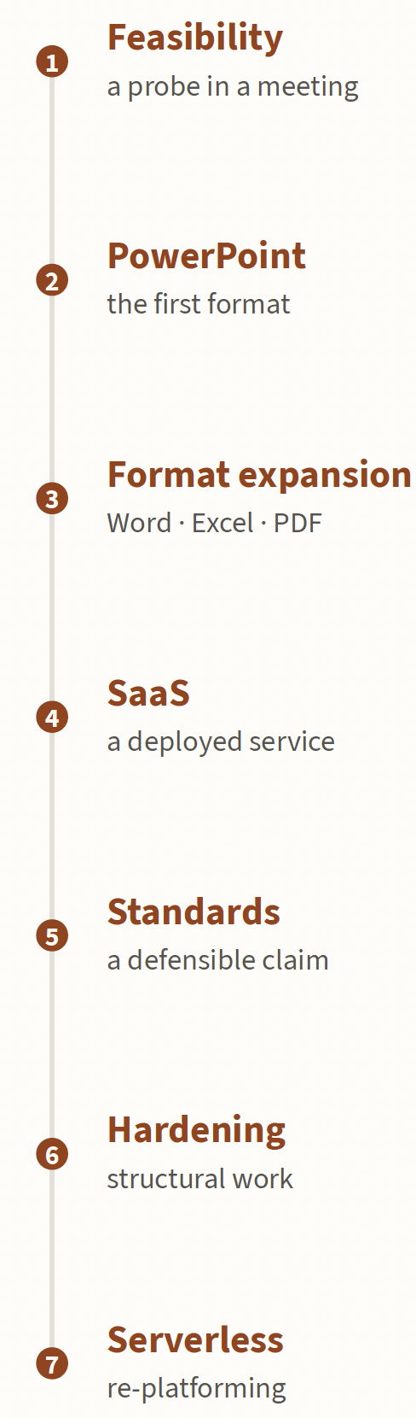
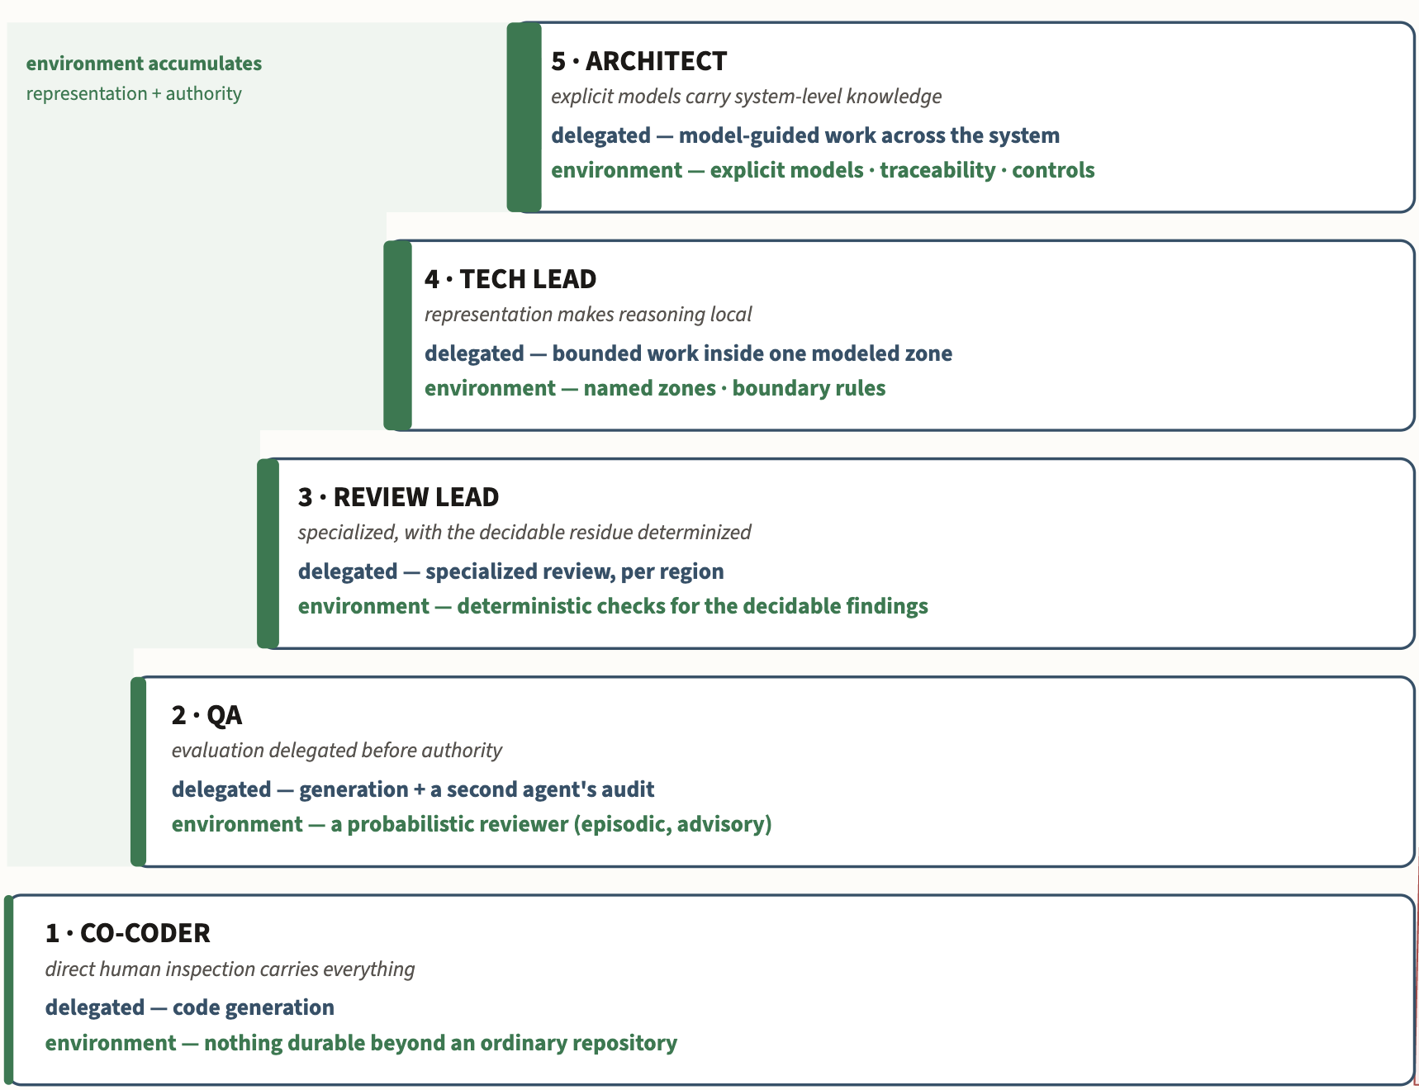
Engineering process
Growth of autonomy
Notes:
• Situate on the autonomy curve: where human judgment sits as autonomy grows.
• Transition toward the payload: what does this mean for what humans must know?

Slide 42
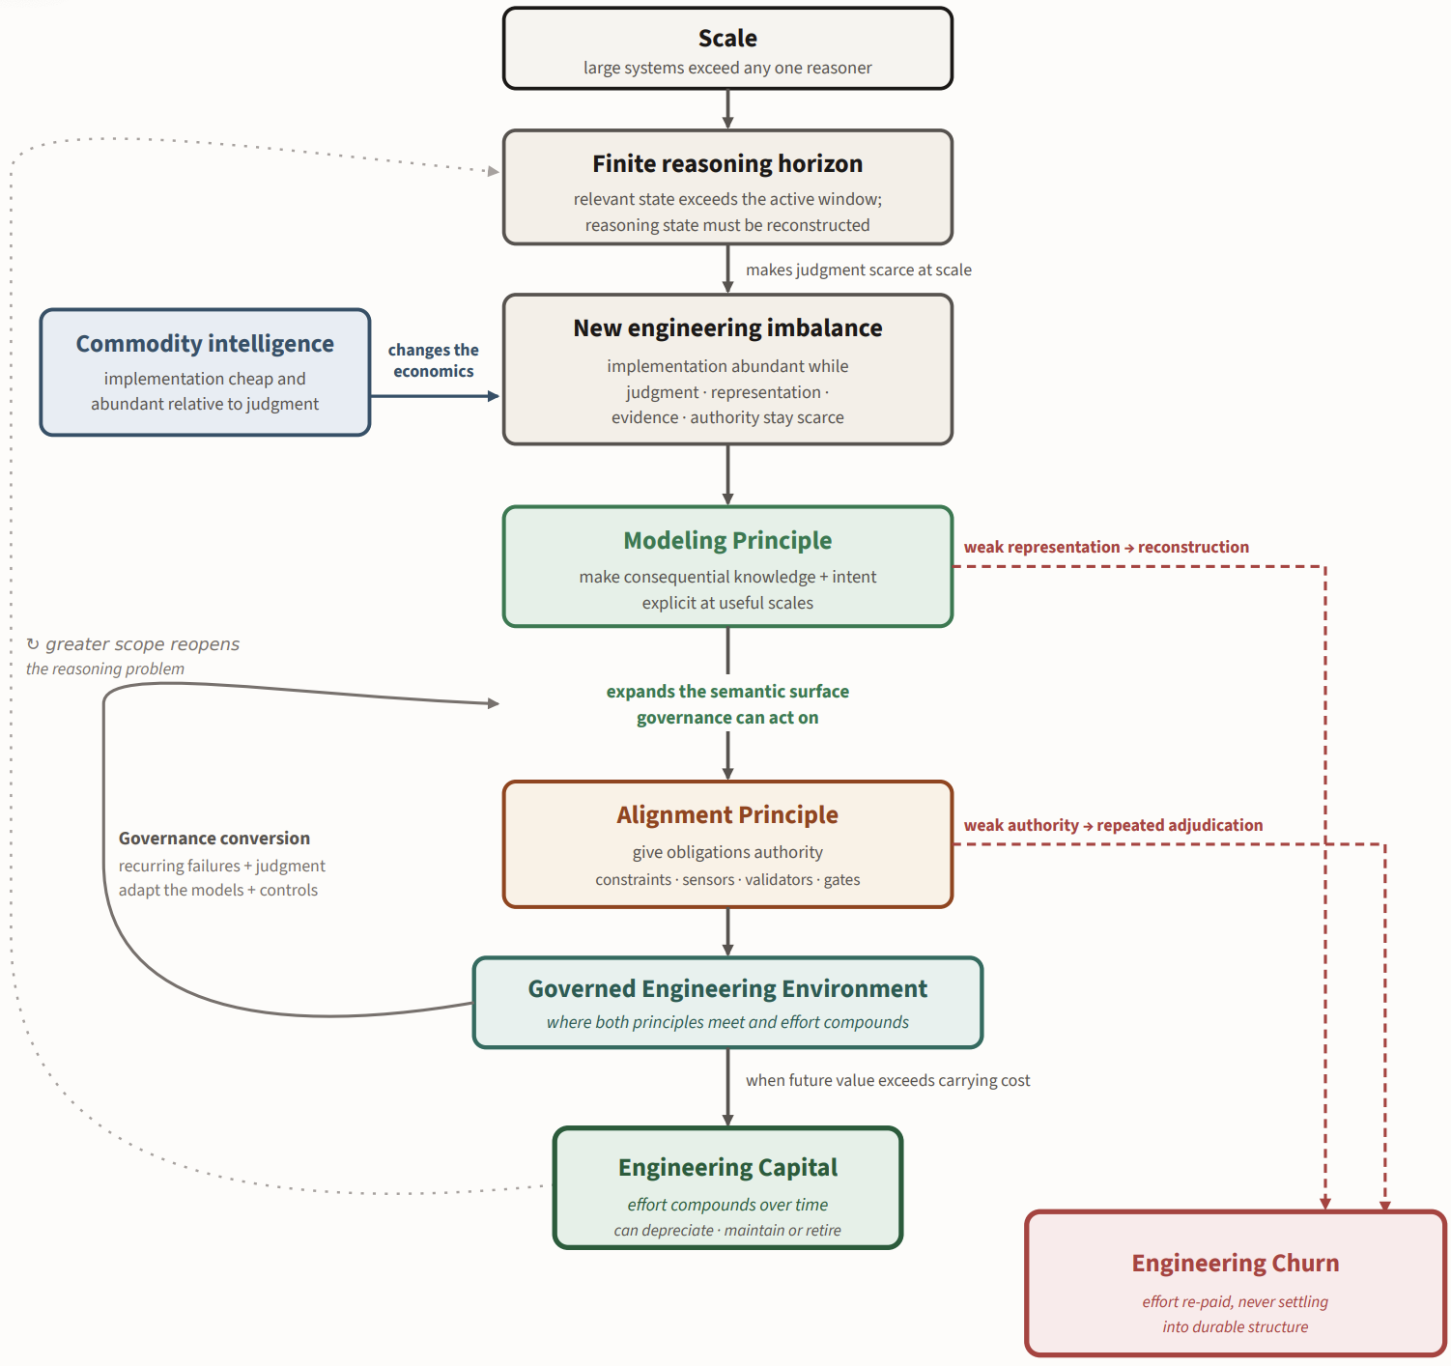
MAGE
Theory
Notes:
• Hold the phrase: MAGE is a theory of the engineering environment.
• Pivot: theory's done — now the uncomfortable question for a room of educators.

Slide 43
Talk outline
Who am I and why am I here
The problem: Trustworthy GenAI for consequential work
The shift: Intelligence changes the engineering bottleneck
MAGE: Model-Based Agentic Engineering
What this means
Notes:
• Section tracker: last beat — what this means for education.

Slide 44
Do we still need to teach this stuff?
Make the strongest opposing case. Give an intelligent person:
a frontier model · agents · documentation · search · executable feedback · cheap experimentation
Why not teach enough foundations to get started —
and let people discover the rest when they need it?
Notes:
• Do NOT open with 'we must change education.' Open with the honest doubt.
• Steelman the opposition: frontier model + agents + docs + search + executable feedback + cheap experiments.
• Ask it and let it breathe: why not teach just enough to get started and discover the rest later?

Slide 45
What can a clever person discover?
A lot.
• a framework API
• a syntax
• how a library behaves
• a deployment recipe
• many algorithms, once the problem is named
• implementation idioms
• unfamiliar tooling
AI makes this discovery dramatically cheaper.
“Students might need this someday” is now a weak curricular justification.
Notes:
• Concede a lot: APIs, syntax, library behavior, algorithms once the problem is named, tooling — AI makes discovery cheap.
• So 'students might need this someday' is now a weak justification. Don't defend curriculum out of habit.

Slide 46
What shouldn’t we make them discover for themselves?
• That a race condition is even a possibility.
• That the chosen abstraction erased the distinction the question needed.
• That passing tests are evidence for a claim — not the claim itself.
• That local correctness does not establish a system-level property.
• That an interface fixes which future changes become expensive.
• That an invariant can be represented so invalid states become impossible.
• That measurement requires defining the construct being measured.
• That requirements mean choosing what to promise.
• That an agent grading its own work is not independent evidence.
• That some freedom is intentional — and some is merely missing knowledge.
Discovery is cheap once you know what question to ask.
Education matters especially for teaching which questions exist.
Notes:
• The pivotal slide: the answer is judgment and problem-recognition, not facts.
• Say a few: that a race condition is even possible; that tests are evidence for a claim, not the claim; that local correctness isn't a system property; that an invariant can be represented so invalid states are impossible.
• Organizing line: discovery is cheap once you know the question — education teaches WHICH questions exist.

Slide 47
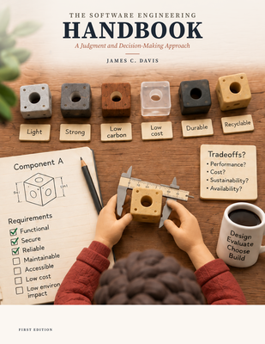
An experiment in teaching the missing judgment
MAGE — how do we engineer when realization can be delegated?
The Handbook — what must an engineer know, and which decisions must they make?
Requirements → What should we promise?
Specification → What exactly does that promise mean?
Architecture → How can competing obligations coexist?
Design → How should the parts actually work?
Validation → What evidence justifies the claim?
Traditional subjects — reorganized around decisions and judgment, not procedures for producing implementation.
Notes:
• Introduce the Handbook — but NOT as 'I wrote another book.'
• The pairing: MAGE asks how we engineer when realization is delegated; the Handbook asks what an engineer must know and decide.
• Walk the 4-5: Requirements/Specification/Architecture/Design/Validation as decisions, not procedures.

Slide 48
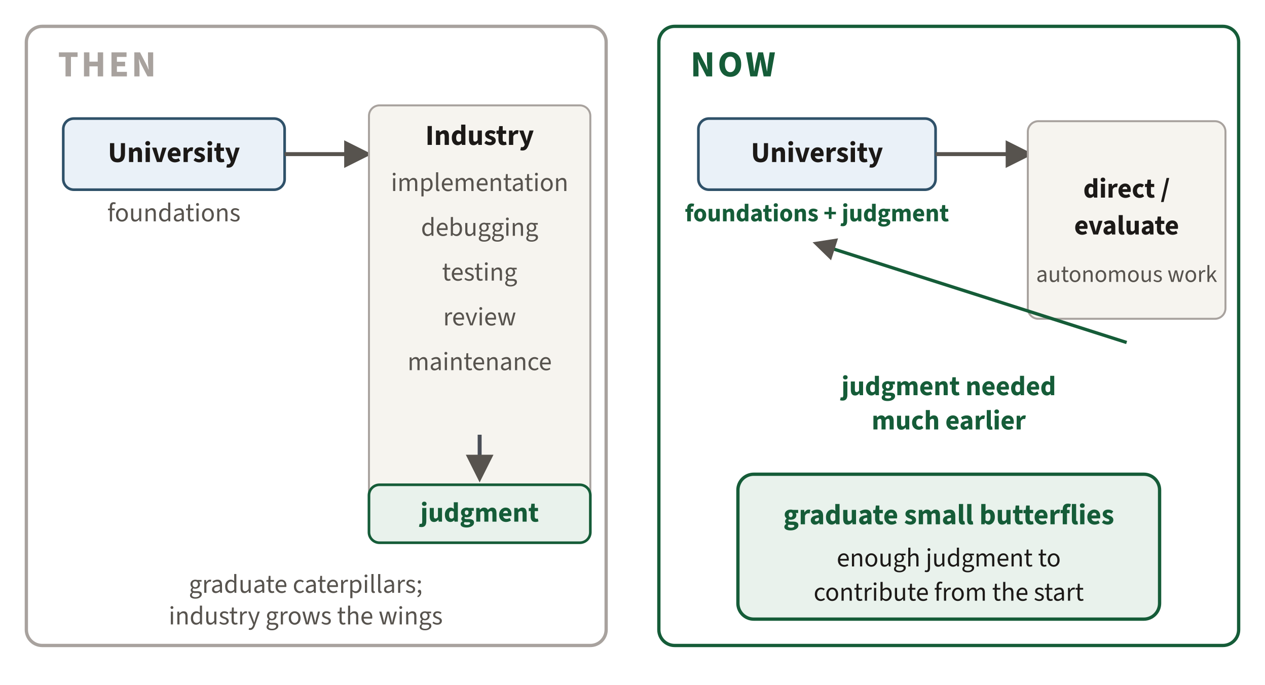
The apprenticeship problem
For years, we could graduate caterpillars and let industry turn them into butterflies. Now we may need to graduate small butterflies.
Graduates don’t need senior judgment — they need enough to contribute from the start, with experience deepening it afterward.
Notes:
• THEN vs NOW: judgment used to be grown in industry; now it's needed much earlier.
• The reveal — land it slowly: we could graduate caterpillars and let industry make butterflies; now we may need to graduate small butterflies.
• Careful framing: not senior judgment — enough to contribute from the start, deepening with experience.

Slide 49
The curriculum may look surprisingly familiar
Programming, algorithms, systems, PL, software engineering — all stay. Change what students practice.
Less scarce | More scarce
routine realization | problem recognition
syntax / API recall | abstraction choice
boilerplate production | specification
one implementation | comparing alternatives
“it passes” | claim → evidence → judgment
remembering rules | deciding what should become a rule
executing a decomposition | choosing the decomposition
PL and formal methods deserve more curricular surface: choosing representations, stating properties, restricting invalid states, separating claims from evidence.
Notes:
• Reassure first: programming, algorithms, systems, PL, software engineering all STAY. No wholesale replacement.
• Shift what students PRACTICE: less routine realization, more problem-recognition, abstraction choice, specification, comparing alternatives.
• The PL sting: PL and formal methods deserve more curricular surface — choosing representations, stating properties, excluding invalid states, separating claims from evidence.

Slide 50
What should a computer scientist know
before the machine can help them discover the rest?
Implementation is becoming abundant.
Judgment is not.
Our curriculum should increasingly teach the knowledge and judgment we cannot safely expect every clever person to rediscover.
MAGE — theory of the engineering environment
Software Engineering Handbook — apprenticeship in engineering judgment
davisjam.github.io/model-based-agentic-software-engineering
Notes:
• End on the QUESTION, not on MAGE branding.
• The two lines: implementation is becoming abundant; judgment is not.
• Leave them asking: what are we currently expecting students to acquire by accident?

