Slide 1
Software Engineering
ECE 30861 / CSCI 45000
Modeling: Purposeful Reduction
What must the model preserve?
Prof. James C. Davis
Prof. Steve France
OBLIGATION
MODEL
TERRITORY
Lecture 1 (today): One model, one question.
Lecture 2: Modeling larger systems
Notes:
Lecture 1 of 2 on Modeling: one model, one question. Lecture 2 turns to systems of many models. Today is learning how to make a model, not a catalogue of model types. [ASSUMPTION per plan section 8.1: deck filename 2-2-Modeling-1-Purposeful-Reduction.pptx pending author ratification.]
Today’s spine is the production equation from the theory chapter. Delegation introduced that picture qualitatively; today we bring it back quantified and point at the one term Modeling acts on; Alignment will return to the same drawing from the other side. Open on it deliberately: the environment picture, the production equation and “Open the box” are the map for the whole of Act II, not a warm-up.

Slide 2
Our delegate, the agent, works inside an engineer-able environment
ENGINEERING ENVIRONMENT
MODELING
changes the reasoning surface
ALIGNMENT
governs what may pass
MODELS
TASK
REASONER
realization
ARTIFACT
consequence
Today: what does Modeling change about this production system?
Notes:
1.5 minutes — We ended Delegation with this picture. The agent does not work alone; it works inside an engineered environment.
- This is the master picture for the rest of Act II, and here it is still entirely qualitative. We are the ones bringing it back and putting numbers on it, starting today.
- The path first. A task enters, a reasoner works, an artifact comes out. Nothing on this row is new — read it back, do not re-teach it.
- Click one. MODELS is the one station drawn with a heavy rim, and its arrow enters the path BEFORE the reasoner runs. Leave the claim open: the arrow lands before the reasoner, and why that should matter is the question this lecture answers. Do NOT say what the models "set" — you have not earned it yet.
- Today we are going to open up the left-hand side. In particular, what does putting a model between engineering intent and the reasoner actually change?
- Click two. ALIGNMENT is the only annotation whose arrow crosses the boundary of the environment. We will return to the blue Alignment boundary later. For now, leave it in the picture but do not explain it — the on-slide gloss "governs what may pass" is all it gets, and declining to open a door you just revealed is a stronger deferral than never drawing it.
- Click three raises the question the rest of the lecture answers. Ask it, then leave it standing: what must a representation preserve for this task?
- The colour code belongs to this PICTURE, not to the deck: red is Modeling's lever, blue is Alignment's, and it returns whenever the picture returns. Nothing here rests on colour alone — the words carry it, and so does the drawing: Modeling's stroke is solid and lands on the path, Alignment's are dashed because passage is conditional, and only Alignment's crosses the boundary.
- Leave the space under the station row empty and do not fill it. On "Open the box", that is exactly where the arithmetic arrives.
- FORWARD HOOK, and you must say it out loud when you get there: on "Open the box", beat two, name this red arrow — "there it is: R is in the first two factors; that is what the arrow was pointing at." The visual rhyme will not connect itself.
- Next we put a number on the production process.

Slide 3
The equation of production
FOR A FIXED ENGINEERING ENVIRONMENT
p(T,M,R,H)
the probability that delegation produces an acceptable result
T
an engineering task or task family
M
the reasoning model
R
the representation available to it
H
the harness and process through which production is organized
Change any one of the four and the probability changes.
Does the engineering system produce the thing?
Notes:
Whole system before the lever. Put the equation up and ask the class to name the four terms before you reveal the labels; give it about a minute, no more.
T is an engineering task or task family, M the reasoning model, R the representation available to it, H the harness and process through which production is organized. For a fixed engineering environment, p(T,M,R,H) is the probability that one attempt produces an acceptable candidate.
Keep the thing they care about on screen: does the engineering system produce the thing? Four levers sit inside that one number, and an engineering organization can reach for any of them.
Modeling is named on the picture behind you, but do not yet say which term it acts on. Naming the lever here spends the move of “Open the box”, which is to open the probability and point at the one term Modeling acts on. About 2.5 minutes including the naming exchange.

Slide 4
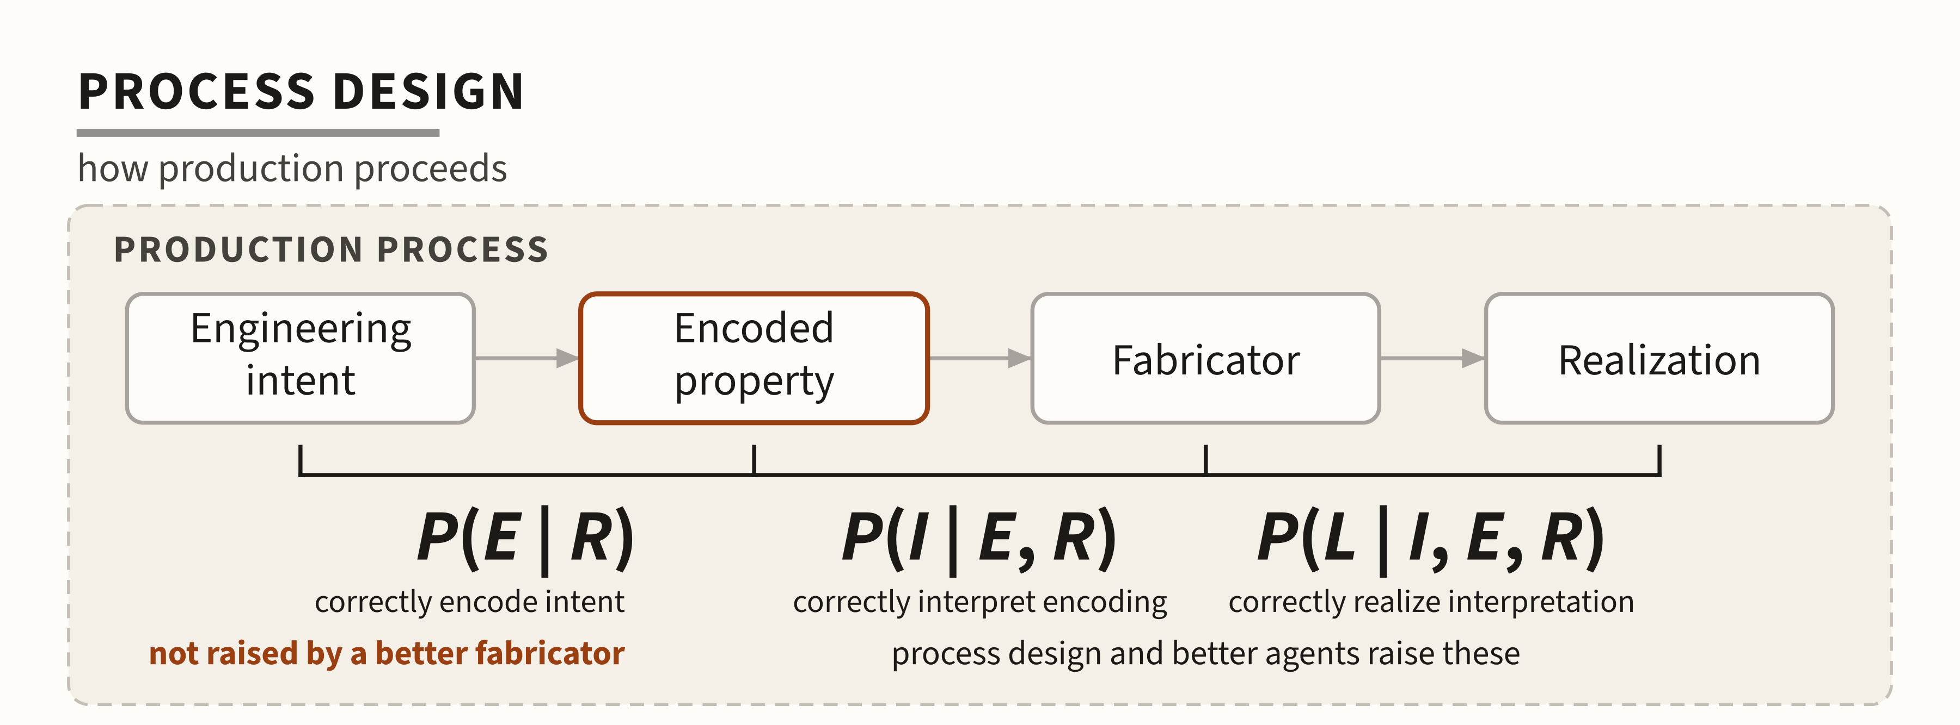
Open the box — where things can go wrong
p_{R} = P(E | R) · P(I | E, R) · P(L | I, E, R)
ENCODE
INTERPRET
REALIZE
a chain decomposition, not an independence assumption
MODELING CHANGES
THE REPRESENTATION
So what makes one representation better than another?
Notes:
That single probability hides several distinct opportunities for failure. Open it: E is correct encoding of consequential intent, I correct interpretation of that encoding, L correct realization of the interpreted intent.
Say the caveat out loud, and say it in these words: this is a chain decomposition, not an independence assumption. The stages will not in general be statistically independent. Students who have had a probability course will otherwise read the product as a claim of independence.
LEVER DISTINCTION — the figure’s own annotations and the red arrow are about different levers, and a careless delivery makes the slide look self-contradicting. A better fabricator cannot raise P(E | R); a better representation can. Say exactly that. “Not raised by a better fabricator” sits under the first term, and the red arrow points at the same term, because the arrow is the representation lever and the annotation is the fabricator lever.
R IN ALL THREE — long form puts an R in every factor, because one representation is held fixed across the whole chain. The overlay boxes only two. Name the asymmetry before a student asks: the lecture’s claim is about the two factors where representation does its work — did we manage to say the consequential thing, and did the agent manage to recover it. Realization is the agent doing work it already understood.
The claim is deliberately twofold. Modeling helps the engineer encode consequential intent (P(E | R): did we manage to say it?) and helps the reasoner recover it (P(I | E, R): did the agent understand it?). After this slide, “we failed to say it” and “the agent failed to understand it” are two different failures with two different names.
Do NOT show the limit equation here. It is held back to the capability slide later in the deck, where every symbol is already known.
Click 2 brings in the red arrow and the closing question: so what makes one representation better than another? That question is the rest of the lecture. About 3 minutes.

Slide 5
Delegation leaves a representation problem
FROM DELEGATION
Implementation is cheap to delegate: an agent can realize a design a hundred acceptable ways.
We cannot specify every realization choice, and we should not try.
So, what must a representation preserve for this task?
DELEGATION
ENGINEER
AGENT
E encode
I interpret
what matters must survive this hop
The gap is a property of delegation, not a failure of the agent.
Modeling answers the question delegation leaves open.
Notes:
Bridge from the Agents unit (2-1): implementation is cheap to delegate, and we cannot and should not specify every realization choice. Delegation therefore creates a problem of representation: what matters must survive the hop from engineer to agent. Modeling is the discipline that answers it.
Retitle rationale: “The production equation” and “Open the box” just named the problem as representational, not merely informational. The hop is not a bandwidth shortage; it is an encode-and-recover chain. The engineer encodes (E), the agent interprets (I), so this picture is the first two factors of the decomposition drawn as people rather than as arithmetic. That is why the gap now carries E and I tags.
The gap is a property of delegation, not a failure of the agent. Keep that line — students reach for “the agent was not smart enough” first, and the whole lecture depends on refusing it.
Leave the question standing and do not answer it here: what must a representation preserve for this task? The rest of the lecture is the answer. About 1.5 minutes.

Slide 6
Representations
SECTION 1
Let’s look at some engineering models
Notes:
Section 1 no longer argues that questions come first. It SHOWS it: five diagrams over one territory, then the thesis, then the reuse slide. The definition is held back to the synthesis at the end of the lecture, where the four sections will have earned it.
State the tour's rule before starting it, so the pace does not read as rushing: the engineering question is the title, the diagram is the slide, and there is almost no prose. Forty-five to sixty seconds each. Five slides, about five minutes.
Do not teach notation syntax on any of them. If the room wants UML mechanics, that is what the reading is for.
The strip is the lecture's own discipline and it returns at every section break. This section is the ENGINEERING QUESTION beat — the highlighted box — because the tour's entire claim is that the question, not the notation, is what selects the model.

Slide 7
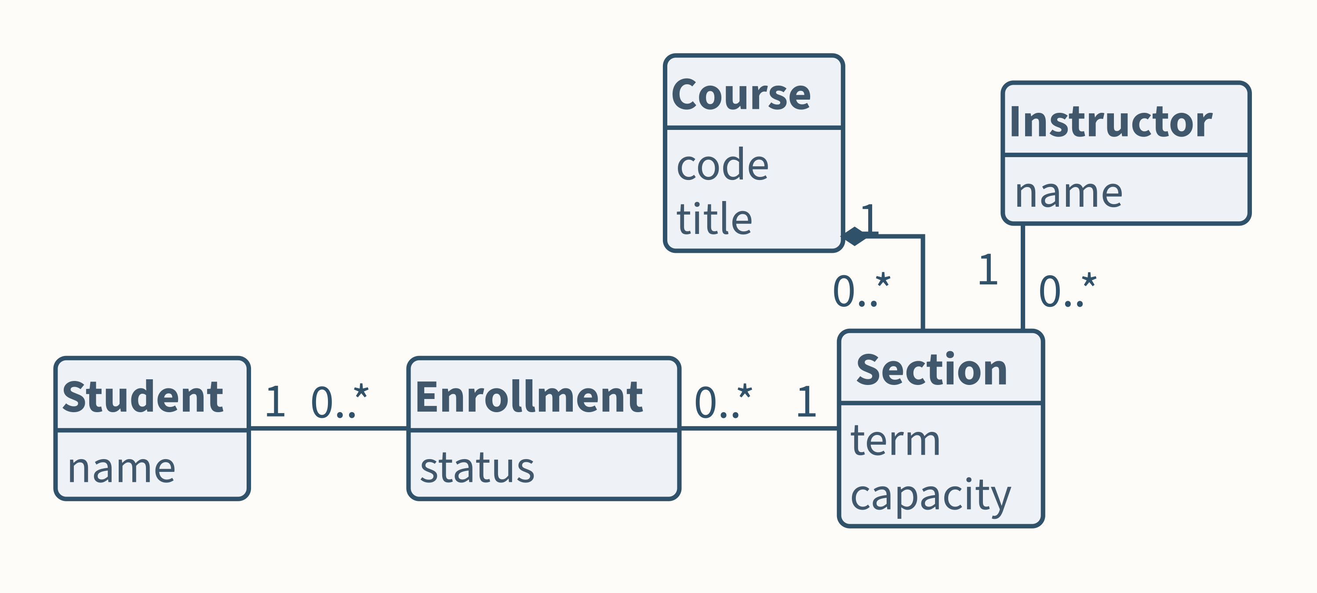
What exists?
What things exist, and how are they related?
Notes:
Twenty to sixty seconds. Name the form aloud once — this is a class diagram, the repertoire's answer to the what-exists question — and then move.
Name the territory once, here, and never set it up again: the course-registration system every person in this room has fought. That is why it was chosen. Zero setup cost per slide is what buys us five diagrams in ten minutes.
Do NOT teach notation. If someone asks what the 0..* means, answer in four words and move on. The tour is an existence proof, not a syntax lesson.
What this diagram preserves: which things exist and how they connect. What it throws away: order, state, branching, who wants what. Every one of those omissions is deliberate, and the remaining four tour slides each rescue exactly one of them.

Slide 8
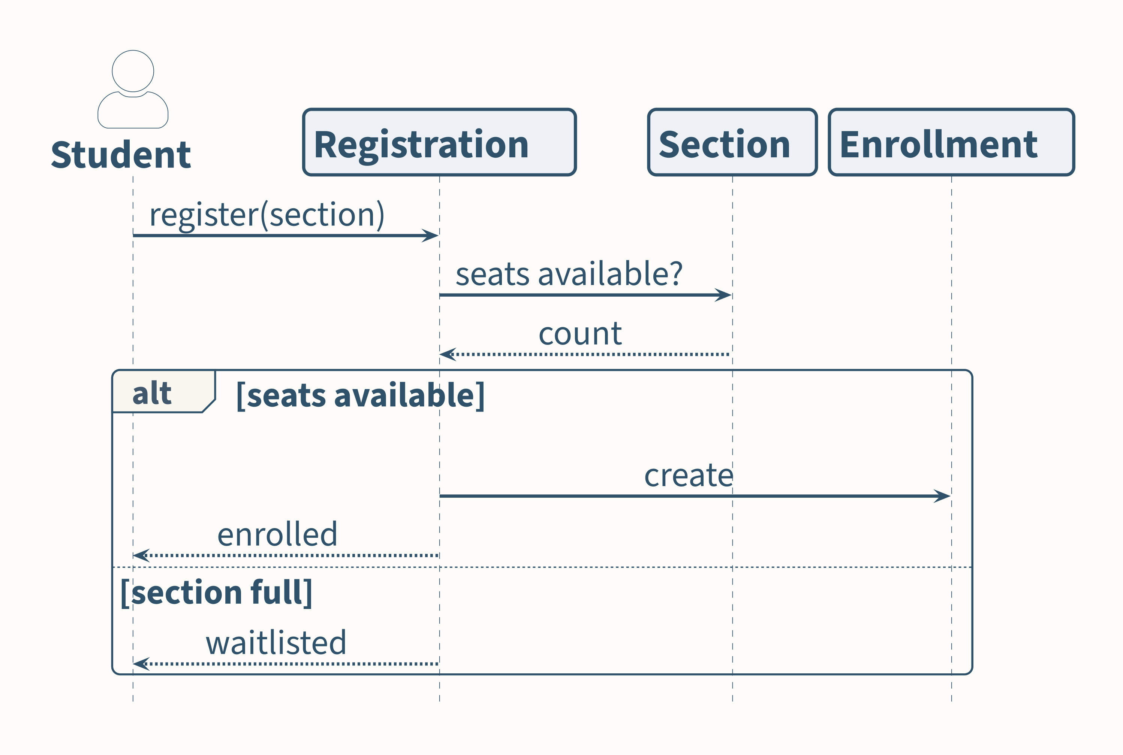
Who talks to whom?
In what order do the parts of one registration happen?
Notes:
Same territory. New question. Say that sentence, because it is the whole argument of the section and this is the first slide where students can verify it themselves.
Nothing about classes survives here. There is no inheritance, no attribute, no multiplicity. The entities appear only as lifelines — names with a timeline attached.
What this preserves that the class diagram could not: ORDER. The capacity check happens before the enrollment is created. That ordering is a fact about the system the previous diagram was structurally incapable of stating.
One breath, then move.

Slide 9
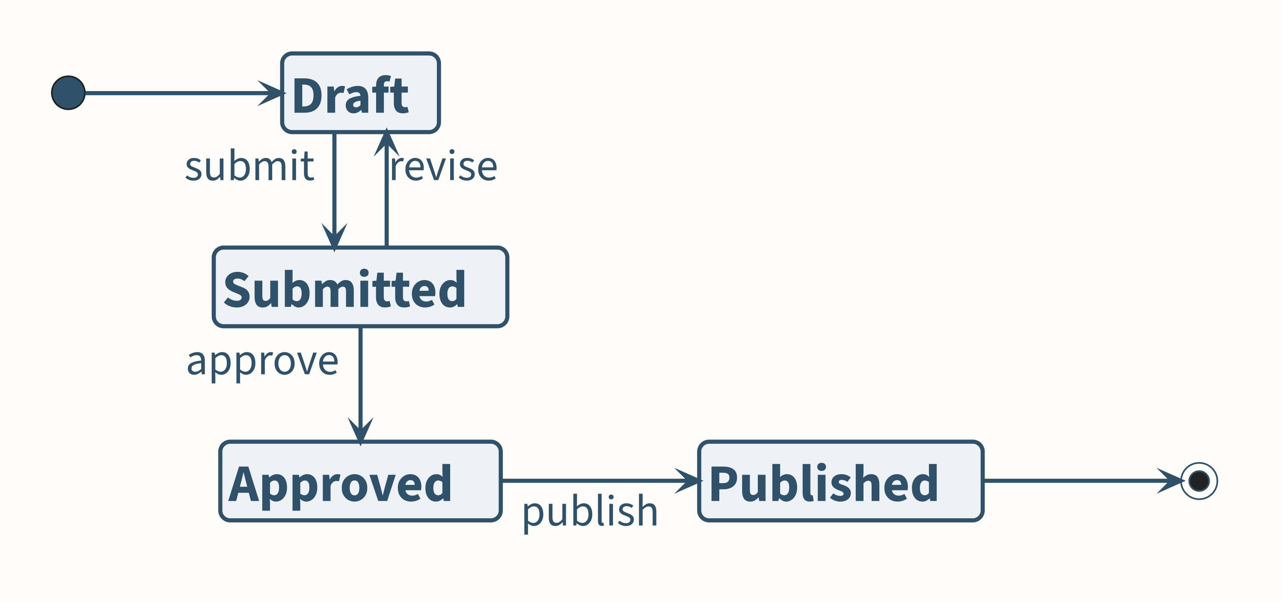
What states?
What states can a course proposal occupy, and which transitions are legal?
Notes:
The territory's catalog side, not its enrollment side: a course proposal moving through registrar approval into the published catalog.
The content is the ILLEGALITY, not the legality. There is no arrow from Draft to Published. A model of states is mostly a statement about what cannot happen, and that is the first hint of Section 3's obligation argument.
The revise edge back to Draft is what makes this a machine rather than a pipeline. Point at it for one second.
BUILD NOTE, not spoken: this exact artwork returns in Section 2 — first on “How would you implement this?”, then as the one-model-many-implementations anchor on “One model, many implementations”. Visual identity between the two placements is required — it is literally the same image file. Do not let a later edit re-draw either one.

Slide 10
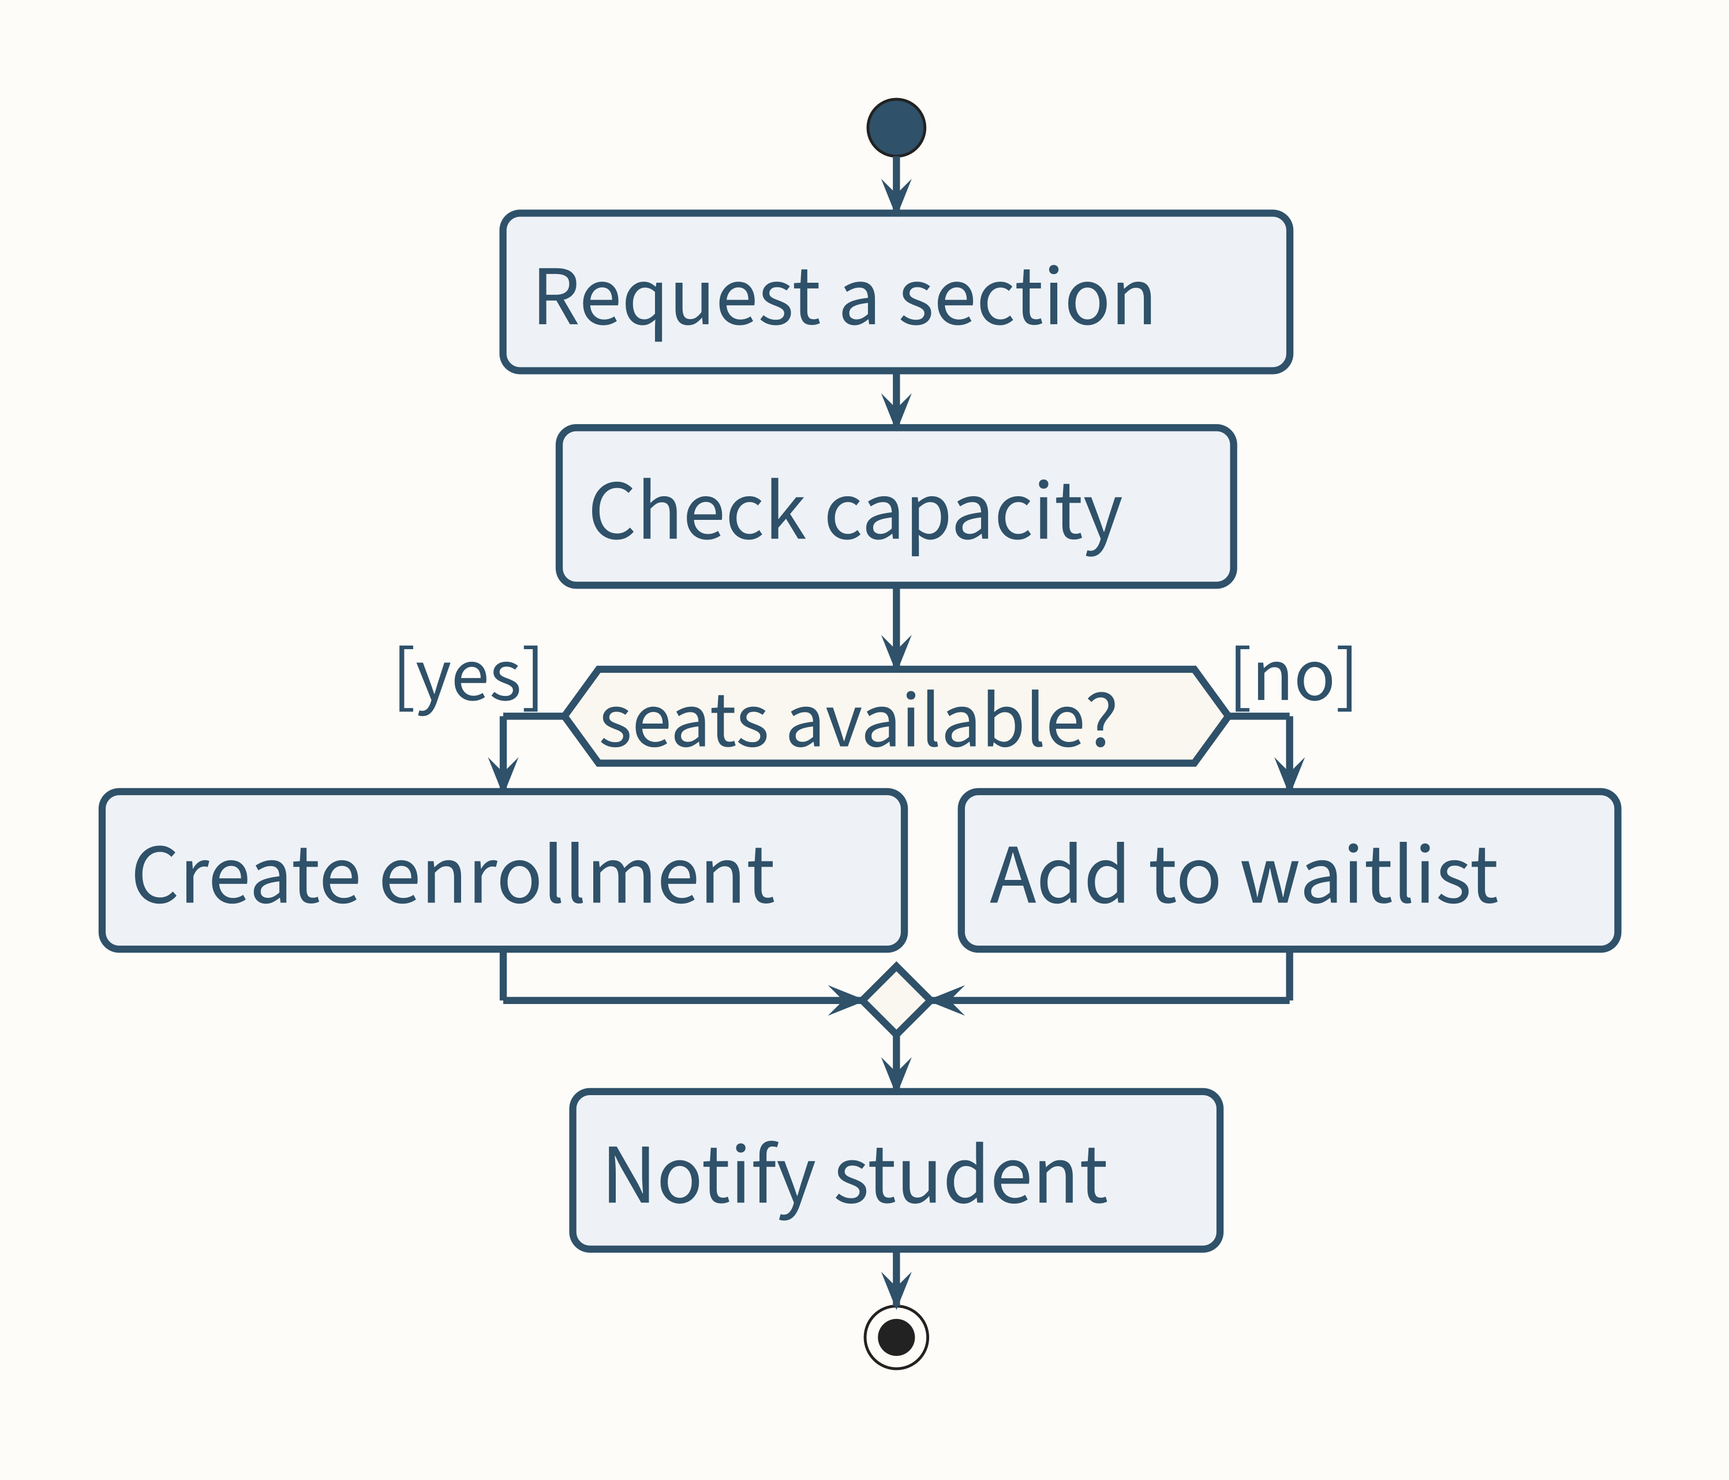
What paths?
What paths can execution take?
Notes:
The BRANCH is the content. Everything else on this slide is scaffolding for the diamond.
One breath on how this differs from the sequence view, because students reliably conflate them: the sequence diagram asked WHO participates and in what order; this asks which PATHS execution can take. Same capacity check, two different questions about it.
Both diagrams are correct. Neither is more true. They preserve different distinctions because they were built to answer different questions — which is the thesis of “Same territory, different questions”, arriving by demonstration rather than by assertion.

Slide 11
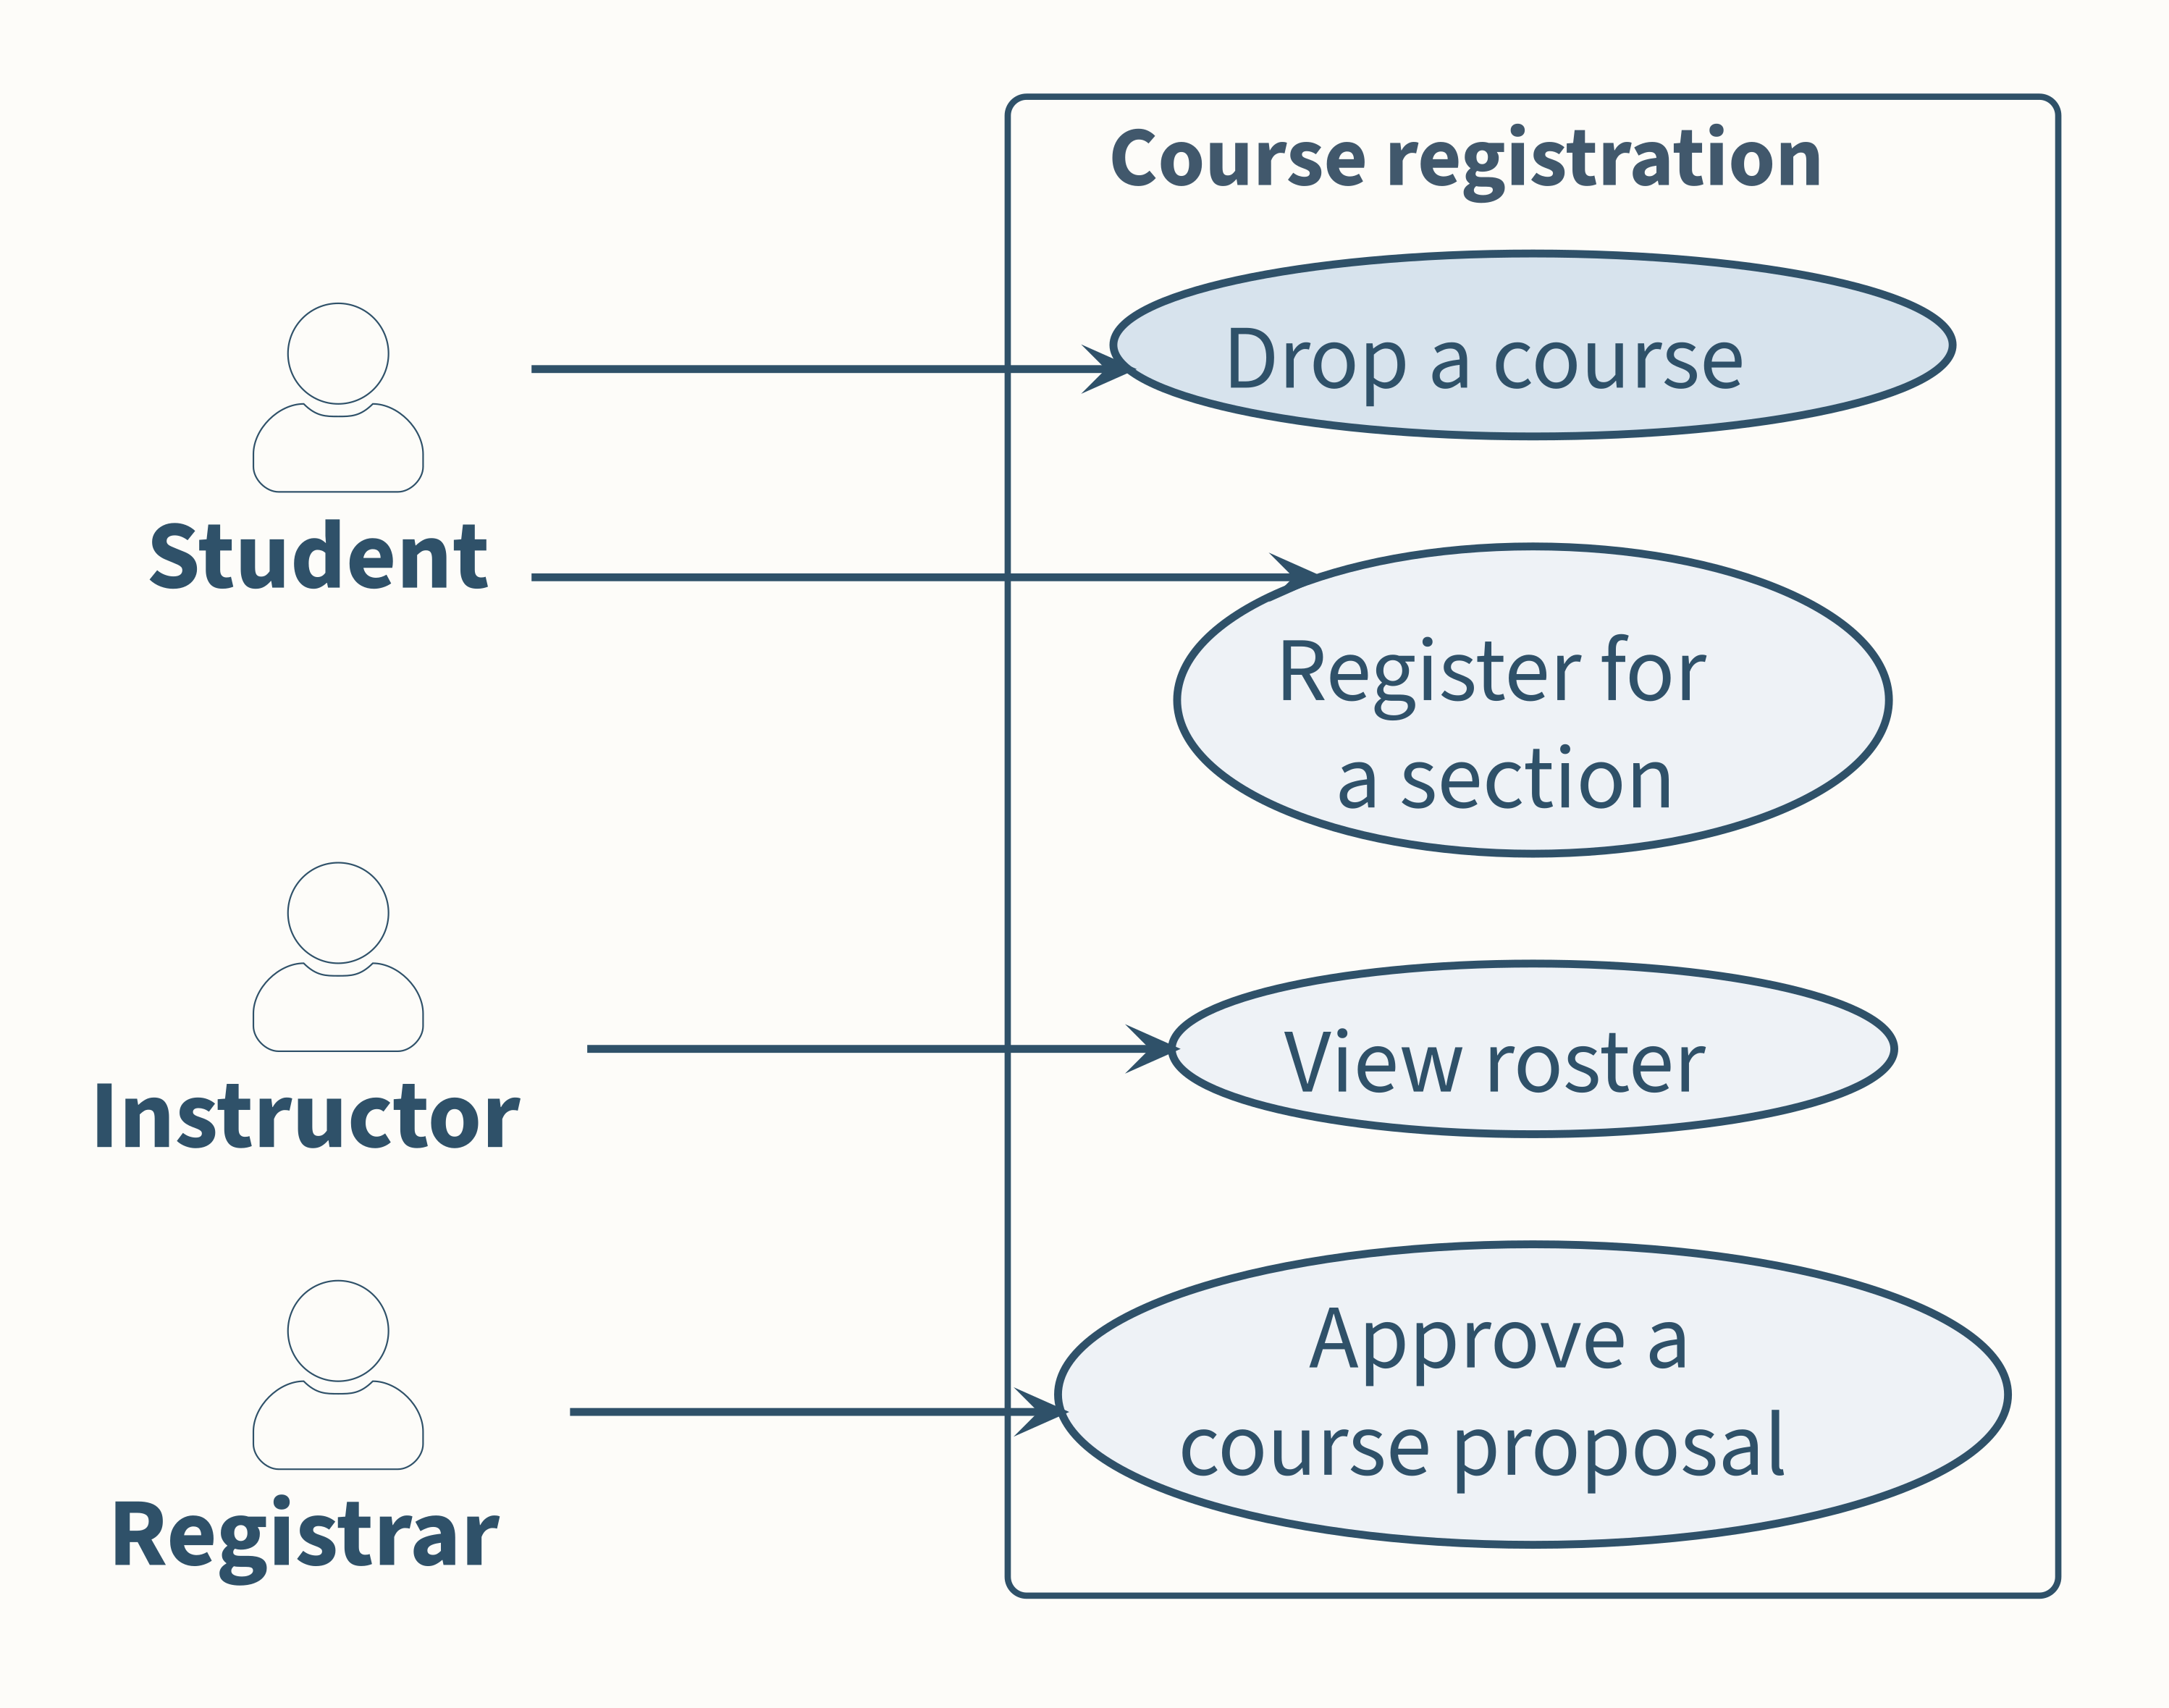
Who needs what?
What does each actor want from the system?
Notes:
Say this explicitly, because it is the beat students most often miss: this is a different ENGINEERING QUESTION, not merely a different notation. The previous four diagrams all described the system's insides. This one steps outside it and asks who wants something from it.
The actors are not classes. Registrar is not a table; it is a role that needs something.
Drop a course is drawn slightly accented on purpose — Section 3 starts its refinement chain from exactly that use case. Do not flag it now; it should feel like a callback later, not a forward reference now.
Last tour beat. “Same territory, different questions” is the punchline — do not deliver it here.

Slide 12
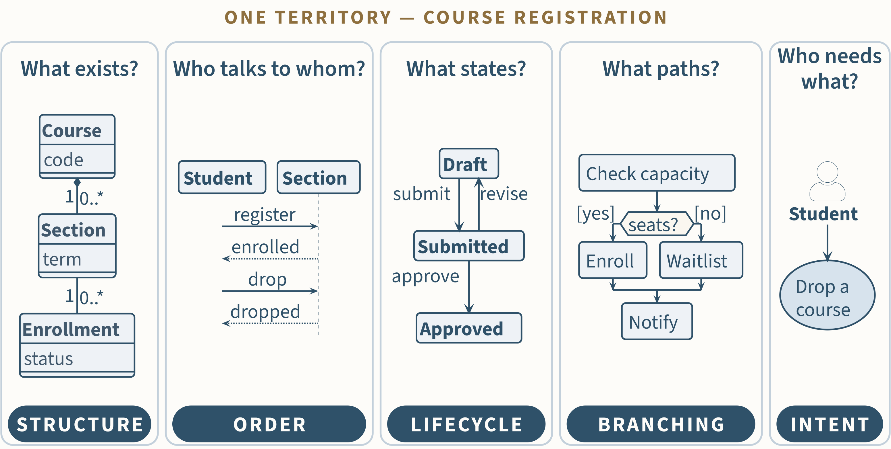
Same territory, different questions
Different questions preserve different distinctions.
Notes:
Five artifacts. One territory. Not one of them is the system, and not one of them is wrong. The spoken line, and it is the section's thesis: hold the system constant, change the question, watch the model change. Different questions preserve different distinctions.
This is where COMPLETENESS stops being a measure of model quality. None of these five is trying to be complete, and a version of any of them that tried would be worse. That point was asserted on a slide in the old deck; here the students have just watched it happen five times, which is why the assertion has been deleted.
The evidence is on the slide now. Each card carries its question and, in the pill beneath it, what that view keeps: STRUCTURE, ORDER, LIFECYCLE, BRANCHING, INTENT. Read the pill row left to right, once — do not walk all five diagrams again. For one concrete beat, contrast the first two cards: the class view records that one Section has many Enrollments and nothing about when; the sequence view records that register precedes enrolled and nothing about how many. The pictures themselves are small on purpose, and their fine labels do not carry past the front rows, so do not ask the room to read them. They are recall of five slides just seen full-size; the pills carry the claim. Forty-five seconds. Point, land the thesis, move.
Callback anchor: this slide is what the embedded battery example later reprises. When the controller's energy model arrives in Section 3, on “Top-down: preserve what the obligation requires”, the line is — you have seen this already, in software, on the tour; here it is on territory you can feel.
Five questions, five things worth keeping, one territory.

Slide 13
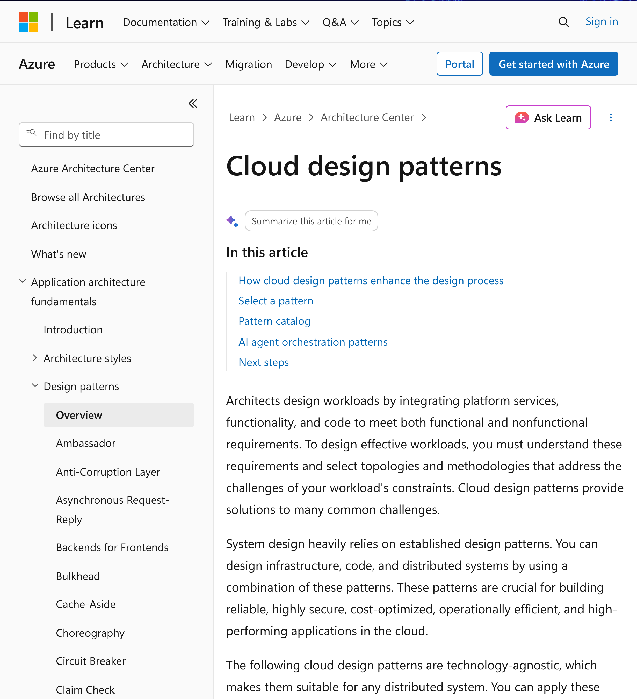
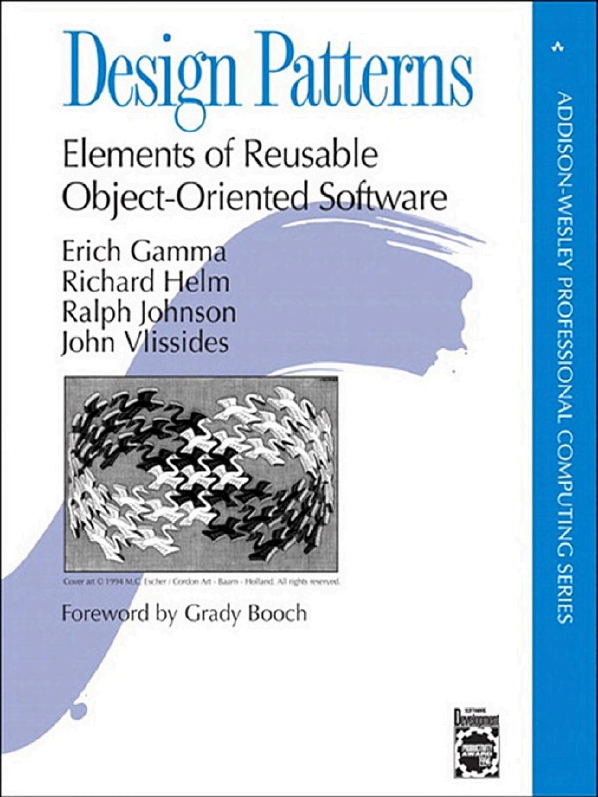
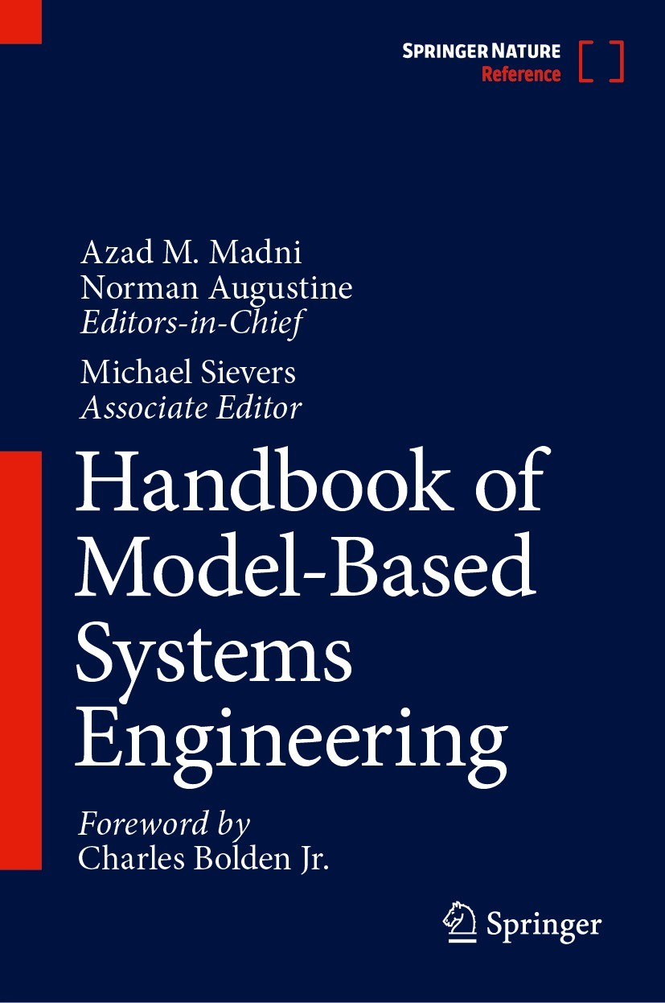
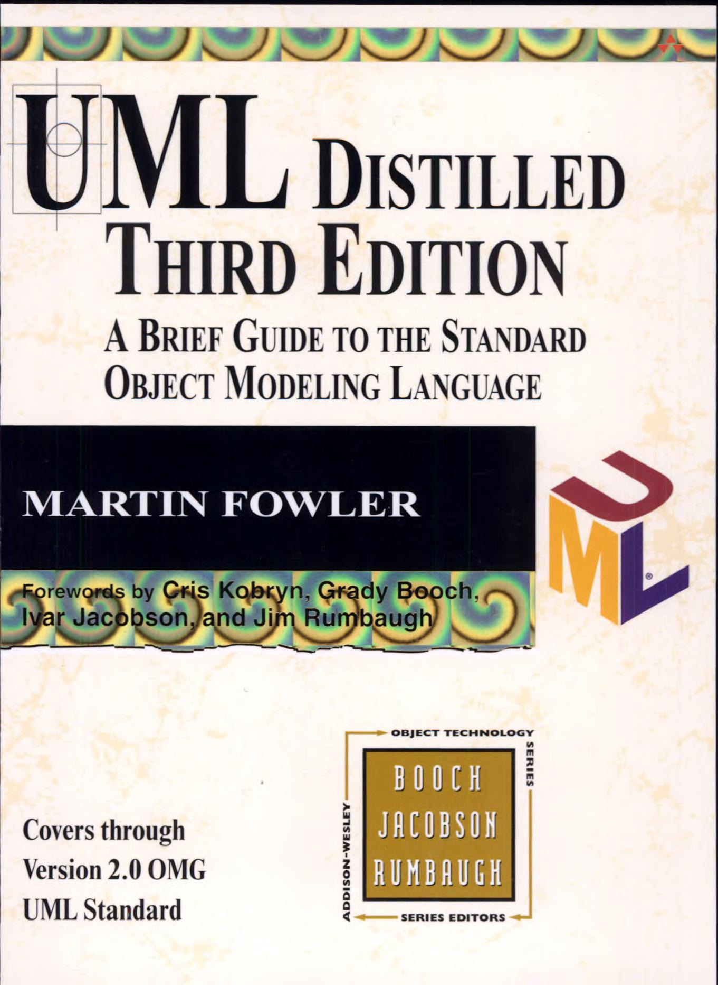
Good engineers reuse wherever appropriate
Do not invent a new kind every time you need a new model.
Patterns
Design vocabulary
Modeling methods
Modeling notation
Covers reproduced for classroom teaching: Addison-Wesley (Design Patterns, 1994; UML Distilled 3e, 2003) · Springer Nature (2023).
Page capture: Microsoft Learn, learn.microsoft.com/azure/architecture/patterns, 2026-10-01. Cover art, Design Patterns: © 1994 M.C. Escher / Cordon Art.
Notes:
One slide, ninety seconds, and a named flex point — this is the first thing to compress if the room is running long.
Beat one: engineering has accumulated reusable ways to represent recurring questions. These four are not a reading list; they are evidence that the representations already exist and are maintained. Azure's catalogue is current practice, the Gang-of-Four book is thirty years old and still cited, the MBSE handbook is a 2023 reference work, and UML Distilled is how most engineers actually learned the notation.
Beat two, and this is the instruction: before you invent your own boxes and arrows, ask whether the profession already has a model for the thing you need to reason about. Read the four captions off the strip — patterns, design vocabulary, modeling methods, modeling notation — and let that be the argument. Do not walk the four items.
Beat three, say it plainly: this is an engineering principle, not an existence proof for tools. Do not teach any of these four, do not recommend them, and do not let the room turn it into a tooling discussion. The students can go find them.
The takeaway on the gold band is the spoken close: the forms already exist, so select before you invent.
Attribution is on the slide, in the two-line source foot. Three publisher covers reproduced for classroom teaching, one page capture from Microsoft Learn, and the Escher cover art on the Design Patterns jacket credited separately — that last one is a second rights holder, which is why it is named.

Slide 14
MODELS ENABLE DELEGATION
SECTION 2
A model constrains implementation without determining it.
Notes:
Section 2 is the hinge between seeing models and designing them. It makes one claim and then tests it on the room: a model fixes what must be true and deliberately leaves the rest free.
Three slides, and the room does most of the work. First they implement a model they already know. Then we show three realizations of it. Then we ask why we do not simply hand the model over and skip the coding — and we leave that question open.
Say the section title and the line under it, and move. Thirty seconds. The claim is not argued here; it is demonstrated on the next three slides.
Budget: eleven minutes, twelve if you take both optional beats on the reveal. Header 0.5, the exercise 4-5, the reveal 1.5 (2.5 with the subtle claim and the correspondence question), the closing questions 4-5.
Spine strip: PROPERTY highlighted — the claim this section makes expressible is that the model's constraints hold across every realization of it. The strip does not advance in section order and is not meant to: each header golds the one cell its section is about, so Section 3 golds MODEL after this one golds PROPERTY.

Slide 15
How would you implement this?
THINK · 1 minute
How would you implement this model? Take a note. Be concrete enough that another engineer could recognize your approach.
PAIR · 1 minute
Compare with your neighbour. Did you choose the same implementation?
SHARE · 1 minute
What did you choose? (two or three)
Notes:
The figure is the same part as the state slide on the tour — literally the same image file, not a redrawing. Open with that: “you have seen this one.” The recognition is the setup. If they think it is a new diagram, the exercise loses its point.
Do not name an implementation. No enum, no State pattern, no transition table — those are the next slide, and naming one here collapses the exercise into a guessing game about what you have in mind. If the room stalls, ask one student what language they would reach for and build from there.
THINK, one minute, silent and written. Insist on the note; students who only think about it will not commit to anything, and the commitment is what makes the reveal land. “Concrete enough that another engineer could recognize your approach” is the bar — a data structure and a place the logic lives, not “I’d use objects.”
PAIR, one minute. The outcome you want is disagreement between neighbours. Walk one row, listen, and remember two names.
SHARE, one minute. Take two or three answers, no more. Write the approach names on the board — you will point back at them on the next slide. Do not evaluate any answer here; the next slide evaluates all of them at once by showing three side by side.
Three minutes of student work; four to five with setup and transitions. Timebox it and move even if the room is enjoying itself — the teaching is in the reveal, not in the share-out.

Slide 16
One model, many implementations
THE MODEL · the one you just worked on
A STATE ENUM
status = Draft
status = Submitted
one field, plus transition logic
B STATE OBJECTS
class DraftState:
def submit(self): …
one class per state
C TRANSITION TABLE
(Draft, submit) → Submitted
(Submitted, approve) → Approved
read by a workflow engine
All are reasonable. All can correspond to the model.
A model constrains implementation without determining implementation.
Notes:
This slide is the answer to the previous one. Before clicking anything, name the approaches the room just gave you and say that they are about to appear. The cards are not new information; they are the room’s own answers, tidied.
Same state machine again — the same image file, not a redrawing. Third sighting: the tour, the exercise, and now the reveal. Say so if it helps: the model has not changed once.
Click one: all three realizations at once, not in sequence. The simultaneity is the claim. A state field plus transition logic; State objects, one class per state; a transition table an engine reads at runtime. None is more correct than the others, and the model does not choose between them.
If a student supplied a fourth approach — a database row with a status column, a workflow service, an event log — credit it out loud and leave the slide alone. A fourth box would say the set is closed, which is the opposite of the point.
OPTIONAL, IF TIME — THE SUBTLE CLAIM, and a sharp student will push on it. We are NOT saying that every implementation compatible with the model’s syntax is good engineering; plenty of them would be bad code. We are saying the model deliberately leaves some realization decisions unconstrained, and that a reasonable engineer exercises judgment inside that space. The model bounds the judgment. It does not replace it.
Click two, then click three: “All are reasonable. All can correspond to the model,” then the footer. Read the footer; do not paraphrase it.
OPTIONAL, IF TIME — the correspondence question, asked orally and held to half a minute: what has to remain true for each of these to correspond to the model? The answers you are fishing for are that the four states exist and are distinguishable, that the legal transitions are exactly those and no others, and that there is no path from Draft to Published. It is off the slide on purpose — the room has just spent three minutes answering one question, and a second open question here costs a minute the section does not have.
This is what makes degrees of freedom concrete. Between the boundaries the model establishes, the implementation has enormous freedom — and that freedom is not sloppiness, it is what the reduction bought.
Hand off by asking the next slide’s own first question, in its words: if this works, why do software engineers draw boxes and arrows for a day, then go code for a week? Do not answer it here.

Slide 17
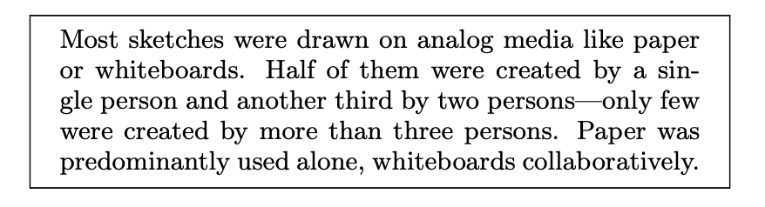
Why don’t we do this already in SWE?
If this works, why do SWEs draw boxes and arrows for a day, then code for a week?
Baltes&Diehl 2014
Why is outsourcing software development so hard?
ENCODE
INTERPRET
ENGINEER A
REPRESENTATION
ENGINEER B
intent · context · judgment
Delegation requires consequential knowledge to survive encoding and interpretation.
And does GenAI change this?
Notes:
First question, and let it sit. We have just argued that a model constrains implementation without determining it — so why does anybody spend a day on boxes and arrows and then a week writing code? Let them answer. Their answers are the content of this slide.
Answers to collect rather than supply: the model leaves out most of what has to be decided; the decisions it leaves free still have to be made by someone competent; the model says nothing about how to make them well; and nothing in the drawing tells you whether what you built actually matches it.
Second question: outsourcing. This one usually lands harder, because several students have lived it. Steer toward specification cost and recovered intent — not toward time zones, not toward language.
Then the figure. It is deliberately the slide-5 picture again, one layer finer. The first engineer’s intent, context and judgment do not travel. Only the representation travels. What arrives is whatever the second engineer can reconstruct from it, and the reconstruction is not guaranteed to recover the part that mattered.
Say the mind-meld line out loud and keep it off the slide: “We cannot merge minds. So we encode what we know, ship the encoding, and hope interpretation recovers the part that mattered.” That is the whole problem of delegation, human or otherwise.
Then the claim, on its own click, once the figure has been narrated: delegation requires consequential knowledge to survive encoding and interpretation. Read it, do not gloss it — the next two sections are its consequences.
Last click brings the GenAI question, and then you STOP. Do not answer “does GenAI change this?” here. The cost discussion and the coda are the answer, and the question earns its weight by staying open for the next half hour. If a student answers it, thank them and write it on the board unresolved.
No equation on this slide, on purpose. The production equation from the opening comes back once, at the cost discussion, where “but you forgot cost” is exactly the objection you want.
About four to five minutes, nearly all of it discussion. These three questions return verbatim at the cost discussion — keep the wording stable.

Slide 18
DESIGNING THE MODEL
SECTION 3
What must remain? What may remain free?
Notes:
The conceptual center of the lecture. One direction of reasoning, worked live on one embedded system: start from the engineering obligation, and let it decide what the model must preserve.
There is no bottom-up section. The question it used to ask - does every distinction we kept earn its place? - returns at the end of the lecture, as the economics of delegation.
Spine strip: MODEL highlighted - the cell this section is about. The strip runs in the discipline's order, not the lecture's, so the highlight steps back left from Section 2's PROPERTY; say so if the room notices. The synthesis slide near the end of the lecture names all four; do not promise it here.
ASSUMPTION (plan section 8.3): spine strip motif ENGINEERING QUESTION - MODEL - PROPERTY - QUALITY per the plan recommendation; author ratification pending.

Slide 19
From requirement to specification
BEFORE THE MODEL
CUSTOMER REQUIREMENT
The controller must operate for a full 8-hour shift without battery replacement.
TOP-LEVEL SPECIFICATION
Under the specified operating profile, battery voltage shall remain above V_min for at least 8 hours.
ENGINEERING QUESTION
Can this design satisfy the 8-hour obligation?
CONTROLLER
BATTERY
The specification states the obligation.
A model is how we find out whether the design meets it.
REQUIREMENT → SPECIFICATION → [ MODELING ] → IMPLEMENTATION
Notes:
Why this slide exists: the next slide drops the room into a controller and an 8-hour question. Without this, that question has no provenance.
Read the three cards in order. The first sentence is what a customer says. The second is what engineers must be able to check. Only the third one is ours.
Say it once: V_min is the minimum safe voltage - the phrase the next two slides use.
The footer is the point: students already know requirement, specification, implementation. Modeling is not a new stage bolted on - it sits between the specification and the design, and it is how the obligation gets answered before anything is built.
Do NOT teach this controller's architecture here. One click per card, then move on. 90 seconds.

Slide 20
Worked: protect the battery
THE DESIGN, BEFORE ANY MODEL
TEMP SENSOR
PWM FAN
WI-FI TELEMETRY
CONTROLLER
one control loop
FLASH LOG
DISPLAY
LOW-POWER SLEEP
BATTERY
minimum safe voltage
Every component draws from the one battery.
One question: can the battery run out before the 8 hours end?
Notes:
The previous slide posed the question. This slide answers 'of what?' - here is the design the 8-hour obligation is about.
Territory an ECE student grasps in thirty seconds - that is why it, and not a software system, carries the method.
Present territory before model; the model does not exist yet.
The footer restates the specification in the room's own words: can the battery run out before the 8 hours end? Same obligation, informal register.

Slide 21
The obligation decides what be modeled
THE PATTERN
THE BATTERY
ENGINEERING OBLIGATION
what the system must guarantee
≥ 8 h above V_min
(minimum safe voltage)
REQUIRED DISTINCTIONS
what the model must preserve
operating mode · power · duration · usable energy
MODEL
the smallest statement that answers the question
Σ P(mode)·t(mode) ≤ E(usable)
LEGITIMATE FREEDOM
everything the distinctions did not require
packet format · task names · PWM internals · display contents
Degrees of freedom are known freedom, not ignorance.
Notes:
This slide teaches the general pattern; the next one instantiates it. Walk the left column and the right rail together, one click at a time - the pattern, then its instance.
Row 1 is not the spine's ENGINEERING QUESTION restated. The question asks whether the design holds; the obligation states what holding means. Say which is which.
The MODEL row is the one to dwell on - it is the only outlined box: the obligation picks the distinctions, and the distinctions decide what the model has to say. Nothing is in the model because it happened to be available.
LEGITIMATE FREEDOM is the complement of row 2, not a product of row 3 - everything the required distinctions did not require. Degrees of freedom, called back from the Architecture/Design unit: the obligation bounds acceptable realizations without choosing one.
DOF is known freedom, not ignorance - we know these choices are open, and we leave them open on purpose.

Slide 22
Let’s preserve what the obligation requires
OBLIGATION: 8 or more hours above minimum safe voltage
temperature sensor
ENERGY MODEL
PWM fan
operating mode
Wi-Fi telemetry
power(mode)
flash logging
duration(mode)
display
usable energy
low-power sleep
NOT: temperature value · PWM internals · packet format ·
flash layout · display contents · task names
PROPERTY: Σ P(mode) · t(mode) ≤ E(usable)
The whole system collapses into four quantities.
Notes:
Everything on this slide is visible on arrival; there is no reveal. The previous slide's rail already named the four quantities, so do not ask the room to guess them - ask how six components became four numbers, and walk the fan-in.
This is the previous slide's pattern instantiated - obligation, required distinctions, model, and an explicit list of what stayed free. Point back at the four-box flow once, then stay here.
The obligation (8+ hours above minimum safe voltage) demands: battery usable energy, power by operating mode, time in each mode, the safety threshold. Nothing else.
The system has become a small quantitative model; keep the math no harder than the sum. This is where the property itself gets written down - point at the line on the slide, not at the spine strip, whose PROPERTY cell belongs to Section 2. Same property, same notation, as the previous slide's rail.

Slide 23
MODEL QUALITY
SECTION 4
How do you find out whether you left in the right things?
Notes:
ROLE CHANGE, stated aloud: Section 3 taught how to reason about a reduction. This section asks how you find out whether you reduced the right things.
The frame: we have spent this lecture telling you to leave things out. Correspondence is the test of whether you left out the right ones. Two cases — one failure, one success.
Both cases use the same three tiers: the facts, then the model itself, then the consequence. The models are deliberately different kinds — a data schema and a behavioural model — so nobody leaves thinking "model" means boxes and arrows.
The two cards at the foot of this slide are the whole section: one failure, one success. Name them on the way past - do not explain them here.
Spine strip: QUALITY highlighted, the fourth of the four questions — is the reduction adequate for the question, and does its representation make the intended interpretation sufficiently likely? That is exactly what correspondence tests, and it is the last cell the lecture lights.
Both cases are self-contained. Neither needs any project background to tell; if you find yourself explaining where they came from, you have added something the case does not need.
TERMINOLOGY GUARD, for your own speech as much as for the slides: this section is about correspondence between a model and whatever realizes it. Model refinement — one model inducing others — is Lecture 2, and this deck no longer promises it. Never use the meta- prefix here.

Slide 24
Too much reduction loses the obligation
Accounts may be metered or unlimited
Metered accounts can become exhausted
These states require different behavior
FACTS
ACCOUNT
quota_type {metered, unlimited}
credits_remaining
renewal
PROPOSED REDUCTION
Yes, this schema is a model.
It constrains the data the system must represent. It does not determine the database design.
credits_remaining
: integer
MODEL
the whole model
INSTANTIATE
THE SCALAR MODEL
Unlimited account
→
0
0
Exhausted account
→
same model state
The model cannot distinguish states the obligation requires to differ.
CONSEQUENCE
CORRESPONDENCE FAILED ✗
The reduction erased a distinction the obligation required.
Notes:
Walk the three tiers in order. FACTS: an account is either metered or unlimited; a metered account can run out; and those two states require different behavior from the system. That last line is the obligation.
MODEL: the point of this tier is that BOTH boxes are models. The richer one names a quota type, a credit balance, and a renewal rule. Someone proposes reducing it to one integer. Say "reduce" out loud as a modeling decision, not a coding decision.
Read the callout aloud, then add the oral line: models don't have to be boxes and arrows — a schema is a model. Hand this schema to two competent engineers and you will get two quite different databases that both faithfully realize it. That is the think-pair-share from Section 2, in a second notation.
The collision is the whole case. An unlimited account has no credit balance to report, so it arrives as 0. An exhausted account has run out, so it arrives as 0. Two states the obligation says must behave differently, one model state. Let the room sit with it for a beat before you say the bottom line.
CONSEQUENCE: name it as correspondence, not as a bug. The model and the obligation disagree about which distinctions exist. Once a distinction is discarded, no amount of downstream reasoning recovers it — a more capable implementer cannot restore what the representation never encoded.
Keep this schema's wording stable: a later slide quotes it as a hypothetical. Nothing to foreshadow here.

Slide 25
Good reduction leaves implementation free
A resource lease has an owner, generation, lifetime, and reclamation rule
A stale generation must never release the current lease
Processing topology is not part of that obligation
FACTS
WORKER
the owner
OWNS
LEASE
generation · lifetime · reclamation
RELEASES
STALE GENERATION
a former owner
✗
realized by
MODEL
BEFORE
AFTER
COORDINATOR
chunk
SERVICE
DOCUMENT
chunk
MERGE
chunk
one service, one pass over the document
fan out across chunk workers, then merge
Topology changed. The model did not.
CONSEQUENCE
CORRESPONDENCE HELD ✓
A good omission survives change.
Notes:
Same three tiers, deliberately a different kind of model. FACTS: a lease records who owns it, a generation, a lifetime, and a reclamation rule. One thing is forbidden outright — a holder on a stale generation must never release the current lease. How the work is spread out is not part of that obligation.
MODEL: this is not a schema, and say so. It is a relationship with a prohibition in it. Worker owns Lease; the lease carries generation, lifetime, reclamation; and the dashed edge is the one move the model forbids. Point at the dashed edge: a model can constrain behaviour, not just data.
Then the two realizations beneath. Both satisfy the same lease model — one service making a single pass, and a coordinator fanning work across chunk workers and merging the results. The dashed "realized by" lines are the claim. This is exactly what one-model-many-implementations asserted back in Section 2, now graded by evidence instead of asserted on a slide.
The topology changed in a dimension the model deliberately left free, and nothing in the model had to move. That is what a good omission looks like after the fact: it was a degree of freedom, not an oversight.
The pair's spoken payoff — say it here, once, as the conclusion of both cases: "Represent no more than the question requires, but no less than the obligation requires."
Keep both cases portable. Neither needs provenance; if you catch yourself saying where these came from, cut it.

Slide 26
Modeling is purposeful reduction
SYNTHESIS
The objective is not another copy of the system.
A model is a representation in which some
consequential question becomes cheap to answer.
It is useful because it leaves things out,
and because it makes explicit what must remain.
ENGINEERING QUESTION
MODEL
PROPERTY
QUALITY
What do we need to know?
What reduction makes it tractable?
What claim becomes expressible?
Is the reduction adequate, and its interpretation likely?
They opened every section — ask all four, every time.
Notes:
The synthesis beat. The definition is no longer an assertion the students have to accept on faith — it is an explanation of the four sections they just sat through. Every diagram in SEE THE MODELS left out almost everything and was useful anyway; MODELS CONSTRAIN IMPLEMENTATION showed what the omissions buy; DESIGNING THE MODEL asked what must remain; CORRESPONDENCE graded the reduction. Say it as an earned summary, not as a new claim.
Read the definition aloud, slowly, once: a model is a representation in which some consequential question becomes cheap to answer. Both halves carry weight. CONSEQUENTIAL — not any question. CHEAP — not merely possible.
The premise line underneath is the pair of claims that used to open the lecture: a model is useful because it leaves things out, AND because it makes explicit what must remain. The four sections earned both.
Say the strip line aloud once, here, as a retrospective. These four questions — engineering question, model, property, quality — opened every section the room just sat through, and this is where they are claimed rather than promised. The strip is deliberately unhighlighted on this slide: the section headers gold the one cell that section is about, and here all four are live. They are also what the students carry out — they organize the cost discussion that follows, and they organize Lecture 2.
A line worth keeping in your pocket if the room needs it: a reduction you can hold in view beats a faithful copy too large to reason through.
About two minutes. This slide closes the four sections and hands off, through the stretch break, to “The cost discussion” — where the production equation returns and the room puts cost back into it.

Slide 27
Stretch break
Notes:
~2-3 minutes. Placed after the synthesis — “Modeling is purposeful reduction” — and immediately before “The cost discussion”. Its original anchor was the mid-lecture Reduce activity, which has been cut, so the break now separates the four sections from the closing cost argument.
[OPEN QUESTION for the author: the content brief never asked for a stretch break. Both its existence and this placement are recommendations, still unratified.]

Slide 28
COST
SECTION 5
We’ve talked about probability. Now let’s add cost.
Notes:
ROLE CHANGE, stated aloud: Section 3 taught how to reason about a reduction. This section asks how you find out whether you reduced the right things.
The frame: we have spent this lecture telling you to leave things out. Correspondence is the test of whether you left out the right ones. Two cases — one failure, one success.
Both cases use the same three tiers: the facts, then the model itself, then the consequence. The models are deliberately different kinds — a data schema and a behavioural model — so nobody leaves thinking "model" means boxes and arrows.
The two cards at the foot of this slide are the whole section: one failure, one success. Name them on the way past - do not explain them here.
Spine strip: QUALITY highlighted, the fourth of the four questions — is the reduction adequate for the question, and does its representation make the intended interpretation sufficiently likely? That is exactly what correspondence tests, and it is the last cell the lecture lights.
Both cases are self-contained. Neither needs any project background to tell; if you find yourself explaining where they came from, you have added something the case does not need.
TERMINOLOGY GUARD, for your own speech as much as for the slides: this section is about correspondence between a model and whatever realizes it. Model refinement — one model inducing others — is Lecture 2, and this deck no longer promises it. Never use the meta- prefix here.

Slide 29
The cost discussion
p(T,M,R,H)
Probability that one attempt produces an acceptable candidate
But engineering does not maximize probability at any cost.
What does modeling cost? What does it buy?
Notes:
Note: Modeling -> Agent costs us when we delegate and then make sure the delegation works

Slide 30
If code gets cheaper, which side of the ledger changes?
WE ASKED EARLIER
If this works, why do software engineers draw boxes and arrows for a day, then go code for a week?
Why is outsourcing software development so hard?
And does GenAI change this?
Suppose implementation becomes dramatically cheaper. How does that change the cost/benefit calculation for modeling?
When is whiteboard + code economically rational,
and when is an explicit model worth maintaining?
Notes:
Open by reading the recall strip back. These are the three questions the room was left holding at the close of Section 2, on “Why don't we just hand off the model?” — word for word, deliberately. Do not paraphrase. The repetition is what makes the next question land as the answer to something they already care about, rather than as a fresh hypothetical.
Then the question, and the honest thing to do with it is to leave it open. It runs both directions. Cheaper implementation makes modeling look less attractive, because “just build it and see” gets cheap. And delegation at vastly higher implementation throughput makes mistakes, rework, communication, and the preservation of consequential intent relatively MORE important. Both are true. Do not resolve the tension — the unresolved tension is the deliverable. If a student resolves it, thank them and write it on the board unresolved beside the other direction.
Point at the whiteboard while they argue: the question is literally which column moves, and by how much. Some costs fall (representation effort, if the model can be generated). Some benefits rise (communication and preserved intent, at higher delegation volume). Nobody in the room, including you, knows the net.
Close on the final question and let it be the last thing they hear on modeling economics: when is whiteboard plus code economically rational, and when is an explicit model worth maintaining? “Worth maintaining” is the whole qualification — not “correct,” not “complete,” worth paying for.
The line to end on, if the room has earned it: a good model is not a small copy of the system. It preserves the distinctions worth paying to preserve.
Then hand off to the coda, which takes the cost argument one step further than the room expects: “We have been asking how much the model costs. Now ask the other side — can we push this further? How cheap can we make the implementer?”

Slide 31
How cheap can we make the implementer?
MORE SCAFFOLDING? →
1 senior
engineer
1 junior
engineer
1 Purdue
intern
1 UIUC or GT
Intern
1 high-school
intern
10 babies
1,000
monkeys
waves hitting
a rock
connected to
a keyboard
✓
✓
✓
?
?
✗
✗
✗
give them
the model
maybe add
some context
add examples
and constraints
add more
examples and
constraints
More scaffolding can compensate for less capability — only up to a point.
Scaffolding does not create capability.
Notes:
Picks up the hand-off from the previous slide: we have been asking what the model costs. Now the other side of the ledger — how cheap can we make the implementer? The title is the answer to the question they were left holding.
Run the row one click at a time, and say the scaffolding out loud as it appears. Senior engineer: give them the model, you get working software. Junior engineer: maybe add some context. Purdue intern: add examples and constraints. Still a check mark each time.
STOP at the IU intern. Let the laugh happen, then let the question mark sit there for a beat and ask the room directly: is more scaffolding still buying us anything? Do not answer it. Then accelerate — high-school intern, ten babies, a thousand monkeys, waves hitting a rock connected to a keyboard — clicking faster as the verdicts go to crosses.
Do NOT explain the babies or the monkeys. The absurdity is doing the work and the slide deliberately says nothing about them. The spoken line is: we cannot get ten babies, or a thousand monkeys, or waves hitting a rock wired to a keyboard to implement our database no matter how exquisite the UML.
Then point at the bars. Scaffolding is rising monotonically across the whole row — every step gets MORE support than the one before it — while the verdicts fall. That opposition is the entire picture; make sure they see it as one shape rather than eight separate jokes.
The callback to human outsourcing: scaffolding humans arbitrarily heavily never manufactures capability they do not have. You can write more detailed requirements, hold more meetings, add more review layers, and past some point none of it helps — eventually you need a competent person. That is what the crosses mean.
So the first line: more scaffolding can compensate for less capability, but only up to a point. And then the claim the rest of the coda depends on: scaffolding does not create capability. Land that one and stop talking.
Hand off into the next slide by turning it around: every rung on that ladder was a human, and cost tracked capability all the way down. Now look at what we actually have.

Slide 32
But this is weird
$0.01–$1 of inference
a foundation model trained on an enormous corpus of human-produced code and technical knowledge
working implementation?
It sure seems like this should work.
How little do we have to specify?
Notes:
This is the quietest slide in the deck and it is sparse on purpose. No boxes, no borders, nothing to read but the three terms. Do not fill the silence — let each one land and let the room do the arithmetic.
ORAL ONLY, and deliberately not on the slide: the middle term is the distilled wisdom of GitHub and the Internet. Say it; do not put it up. The on-slide wording stays the corpus line, because as a technical description of what training produces the catchier phrase is wrong, and the slide is the thing students photograph.
The surprise is economic, not technical. Every rung on the previous slide's ladder was a human, and for humans cost and capability track each other — that is why the continuum declined monotonically. GenAI sits far off that historical curve: a dollar of inference is priced like the bottom of the ladder and performs somewhere near the top. The curve says this point should not exist.
So say the next line with the room's own disbelief in it: it sure seems like this should work. Not that it does work — that it seems like it should, which is a different and more honest claim.
Close on the question, because it is the one the rest of the lecture answers: how little do we have to specify? Everything after this slide is an attempt to answer it, and the answer turns out not to be 'almost nothing.'

Slide 33
GenAI changes the economics of delegation
IMPLEMENTATION
WORKING SOFTWARE
many realization choices
WHAT MUST BE TRUE
PRODUCT MODEL
obligations
key distinctions
AGENT
If implementation is cheap,
perhaps we only need to model what matters.
The agent can supply the realization choices we deliberately left free.
Notes:
This is the optimistic economic story, told straight. Do not hedge it here — the reversal has its own slides and arrives soon enough. For ninety seconds let the good version of the argument stand undefended.
Point at the asymmetry, because the asymmetry is the argument. On the left, a small statement of what must be true: obligations and the distinctions that matter. On the right, a large working implementation full of choices nobody asked us to make. The boxes are deliberately not the same size.
Ground it in Section 2. The state model admitted an enum, State objects, or a transition table — all three satisfied the model, and the model did not care which one you picked. So if all three satisfy it, why pay an engineer to choose? That is a realization choice we deliberately left free, and a competent delegate can supply it.
The genuinely interesting consequence: this could make modeling MORE attractive, not less. You pay for a compact statement of what matters and receive a large implementation cheaply. The leverage ratio between the two boxes is the return on modeling.
GUARD, for the lecturer: do not introduce scaffolding on this slide, and do not pre-empt the catch. Every instinct will be to say 'but of course you have to tell it more than that.' Save it. The next slides take it apart properly, and the reversal only works if the optimism was allowed to sound reasonable first.

Slide 34
How much must we tell the agent?
EVERYTHING ABOUT THE IMPLEMENTATION
SCAFFOLDING — what this agent needs
Obligation boundary
fixed by the product
OBLIGATION
what must be true
Specification boundary
depends on the delegate
DEGREES OF FREEDOM — the rest is the agent’s
Specified region = obligation + scaffolding; outside it, degrees of freedom.
How wide is the gap between what the product requires
and what the agent needs specified?
Notes:
These are different questions. The product may not care whether I use a B-tree index. But my agent might repeatedly make a terrible database design unless I tell it. That information is not an obligation of the product. It is scaffolding for this delegate.
ON ARRIVAL — the container only: EVERYTHING ABOUT THE IMPLEMENTATION. Nothing inside it yet. Scaffolding re-enters the lecture here; the previous slide deliberately did not mention it.
CLICK 1 — OBLIGATION, the inner region, drawn with a SOLID boundary. This inner boundary comes from the product. It is what must be true, and it does not move when we change delegate.
CLICK 2 — the SCAFFOLDING region around it, drawn with a DASHED boundary. What this agent needs in order to realize the obligation reliably: examples, decomposition, intermediate structure. The dash is the point — this boundary depends on the delegate, so it moves.
CLICK 3 — the remainder is DEGREES OF FREEDOM. Everything outside what we wrote down is the realization's to choose. Reading order matters: obligation inside, specification outside. Do not reveal them the other way round — it teaches the reverse of the argument.
CLICK 4 — the question to the room. How wide is the gap between what the product requires and what the agent needs specified? Leave it open; the next slide answers it by making the gap grow, and the one after that asks how small it can get.
Rebuilt from the old 'Obligation and specification are different boundaries' slide, which taught the same two boundaries before the cost discussion existed. It is motivated now by the economics, which is why it sits here and not in Section 4.

Slide 35
What if the agent keeps choosing badly?
ONLY BECAUSE IT KEEPS CHOOSING BADLY — NOT A LIST OF THINGS THAT MUST BE SPECIFIED
MODEL
EVERYTHING ABOUT THE IMPLEMENTATION
each line is scaffolding we added in response to a bad choice
ACCOUNT
quota_type {metered, unlimited}
credits_remaining
renewal
AGENT SUPPLIES
the remaining realization choices
+ Use separate persisted fields
bad persistence choice
AGENT SUPPLIES
the remaining realization choices
+ Add an index for account lookup
bad query performance
AGENT SUPPLIES
the remaining realization choices
+ Use this relationship between…
bad join choice
AGENT SUPPLIES
the remaining realization choices
+ Use this transaction boundary
+ Structure the query this way
+ Put this logic in…
AGENT
AGENT SUPPLIES
the remaining realization choices
+ Name this variable quota_mode
IMPLEMENTATION
AGENT SUPPLIES
the remaining realization choices
Great! Let the agent choose the realization!
Oops. We are writing the implementation again.
Cheap realization only helps while the scaffolding needed to obtain it remains cheap.
Notes:
CONDITIONAL, and it has to stay conditional. The scenario is: this agent keeps making unacceptable choices, SO we respond by constraining them. Nothing here says indexes, joins or transaction boundaries must always be specified — a capable delegate on a well-posed model may need none of them. The kicker and the column header both say so on the slide; say it out loud too.
HYPOTHETICAL, not a third correspondence case. The schema is quoted from the account case on “Too much reduction loses the obligation” so the room recognizes it instantly, but we are not grading its correspondence now. We are asking what happens to the cost of delegation when the realization keeps coming back wrong.
ON ARRIVAL — the optimistic pipeline from the economics slide, instantiated: the tiny model goes to the agent, the agent returns an implementation, and the whole implementation is the agent's to choose. 'Great. Let the agent choose the realization.'
CLICKS 1–5 — each click is a response to a bad choice, and each one takes a bite out of what the agent still supplies. Persistence, then lookup, then the join; then three at once, because by now we are not reasoning, we are dictating; then the variable name. Do not explain the last one — let the room laugh.
Watch the right-hand region, not the list. It gets smaller on every single click, and by the last click the agent is supplying about a third of what it started with. That shrinking region is the argument.
CLICK 6 — 'Oops. We are writing the implementation again.' Let it land. This is the joke and it is also the whole point.
CLICK 7 — the payoff: cheap realization only helps while the scaffolding needed to obtain it remains cheap.
THE OUTSOURCING CALLBACK, spoken. This is the same pathology as outsourcing software development: progressively more detailed requirements, then architecture documents, then meetings, then review — until coordination and specification cost eats the labor arbitrage you were buying. GenAI moves that boundary dramatically. It does not abolish it.

Slide 36
How much should we specify?
Under-specify the delegate — repeated bad realization choices, correction and rework, unreliable outcomes.
Over-specify the delegate — modeling becomes implementation, freedom disappears, delegation savings disappear.
TOO LITTLE product model
code TOO MUCH
What is the least scaffolding this delegate
needs for reliable realization?
PRODUCT QUESTION
What distinctions must the model preserve?
DELEGATION QUESTION
What additional distinctions must this fabricator be given?
MORE CAPABLE
DELEGATE
LESS SCAFFOLDING
NEEDED
MORE LEGITIMATE
FREEDOM
PRODUCT OBLIGATION
unchanged
Notes:
THE ENDING. Nothing follows this slide — no summary, no outro. Land the close and stop.
ON ARRIVAL — the continuum only: too little at one end, too much at the other. Too little is the product model on its own; too much is the code itself.
CLICK 1 — the two failure modes, one at each end. Under-specify and you get the previous slide — “What if the agent keeps choosing badly?”: repeated bad realization choices, correction, rework, unreliable outcomes. Over-specify and modeling becomes implementation, the freedom disappears, and the savings you delegated for disappear with it.
CLICK 2 — the question the whole lecture has been walking toward. Read it out. It is the largest thing on the slide because it is the thing to remember.
CLICK 3 — and these are two different questions, not one. The product question asks what distinctions the model must preserve. The delegation question asks what additional distinctions THIS fabricator must be given. Section 3's per-distinction move — make every distinction earn its place, ask what this one buys us — belongs to the first question; the second is new.
CLICKS 4–7 — the recovered claim, and the only optimistic note in the coda. A more capable delegate needs less scaffolding, which gives back more legitimate freedom. Then the wall: the product obligation did not move. Capability can reduce scaffolding. It cannot reduce what must be true.
Better reasoning cannot recover consequential intent the representation failed to encode.
THE SPOKEN CLOSE. GenAI does not make modeling disappear. It changes the economic question. There are two sets of distinctions now — the ones the product requires, and the extra ones this delegate needs — and if the second set grows until we are specifying every implementation choice, we have lost the economic advantage we were trying to get from delegation. Point back at the center question and leave it with them.
Then one sentence of next time: Lecture 2 moves from one model to systems of models — how models refine into other models, and how a set of them stays trustworthy together. Stop there.
[QR placeholder — the feedback form URL does not exist yet; the void mark stands in. A finisher unit drops in the real QR PNG with alt text = URL. This is the deck's only QR mark: both activity slides' marks were deleted with the activities.]

