Slide 1
Software Engineering
ECE 30861 / CSCI 45000
Modeling 2: Degrees of Semantic Commitment
Prof. James C. Davis
Prof. Steve France
Lecture 1: Purposeful reduction — what must the model preserve?
Lecture 2 (today): Semantics and a modeling laboratory.
Notes:
Lecture 2 of the Modeling unit. Last time: one model, one question — purposeful reduction. Today: a second, independent axis — how much of its meaning a representation carries explicitly — and then we work with a semantically defined model in the MAGE Workbench.

Slide 2

Last time: Purposeful reduction
An engineering model preserves the distinctions required by a question
and deliberately leaves other choices free.
ENGINEERING
QUESTION
MODEL
PROPERTY
QUALITY
Every model starts from a question or property
WHAT THE MODEL PRESERVES
WHAT STAYS FREE
The distinctions the question requires:
States and forbidden transitions
Typed relations
Quantities and bounds
Realization choices the model omits
Algorithms, data structures
Decomposition
Naming
2
Notes:
Thirty-second callback. Bring back degrees of freedom explicitly — slide 7 needs them. The banner is deliberately half a sentence: slide 4 completes it (semantic commitment governs how much the model itself says about what it means).

Slide 3
Today: What does a model mean, anyway?
Every model must be understood in light of TWO QUESTIONS
What distinctions does
the model preserve?
How explicitly does the representation
define those distinctions?
Purposeful reduction — Lecture 1
Semantic commitment — Today
SECTION 1
Degrees of Semantic Commitment
What does the representation mean?
SECTION 2
Engineering with Semantic Models
What can we do because it means that?
SECTION 3
Working with Semantic Models
What is it like to work with one?
→ the lab
SECTION 4
Optional: Reasoning with
SysML and KerML
Reference
4
Notes:
The conceptual thesis of the lecture, plus the map. The arc: what does the representation mean → what can we do because it means that → what is it like to work with one. §4 is optional/reference.

Slide 4
Who uses semantic engineering models? (Some examples)
AEROSPACE & DEFENSE
AUTOMOTIVE & INDUSTRIAL
Boeing · Airbus · Lockheed Martin
Siemens
ENGINEERING-TOOL VENDORS
GOVERNMENT & RESEARCH
Dassault Systèmes · Ansys · PTC
Space and defense agencies
Research laboratories
What do these organizations have in common?
They engineer consequential systems whose software meets hardware, physical resources, timing, safety, power, & other systems.
→ CompE, anyone?
They need models that support engineering reasoning — not just pictures.
3
Notes:
Motivation, not technical argument — which is why this slide lives in the opening. Wording discipline: 'helped develop the standard', not 'use it in production'.

Slide 5
Degrees of semantic commitment
SECTION 1
How much meaning does the representation carry?
Notes:
0.5 minutes — Section break: BOUND.
- We know the delegation problem. First decide what is being delegated.
- This is not merely task sizing. It determines which relationships and degrees of freedom another reasoner must handle.

Slide 6
What does this arrow mean?
A
B
calls?
may call?
depends on?
sends data to?
was observed calling?
Same marks. Different engineering claims.
A diagram that permits five readings licenses none.
Whoever interprets the sketch — teammate or agent — supplies the meaning
the marks do not carry.
The marks are the same; the meaning is supplied by the interpreter.
5
Notes:
Reused from the strongest material of the previous deck. Run the readings quickly; the point lands in one beat. This is the itch §1 scratches: where does the meaning live?

Slide 7
Models carry different amounts of meaning
SEMANTIC COMMITMENT
How much of a representation's meaning is carried explicitly by the representation itself,
rather than supplied by whoever — or whatever — interprets it.
quick sketch
UML
structured schemas
SysML v2 + KerML
examples along one axis — not maturity levels
A quick sketch may be exactly right when several engineers need to communicate an
architectural idea to one another — or to an agent for a prototype.
STRONGER SEMANTICS BUY
AND THEY COST
reliable interpretation · query ·
composition · analysis · validation
authoring effort · expertise · tooling ·
maintenance · sometimes human accessibility
The engineering decision is not “maximize semantics.”
6
Notes:
Folds the draft's cost slide in. No disparagement of informal modeling — the sketch is often the right engineering choice. The question is what the representation must support.

Slide 8
Precision is not completeness
AMOUNT SPECIFIED
DEGREES OF FREEDOM SURVIVE
STRONGER SEMANTICS
an enormous prose
spec — still
ambiguous
A model may precisely define memory,
allocation, units, and a resource
constraint —
a tiny model —
semantically
precise
— while saying nothing about data
structures, algorithms, task
decomposition, naming, or logging.
PRECISION OF MEANING
Those are not gaps. They are
authorized freedom.
The two axes are independent.
Neither corner implies the other.
Precision about modeled decisions does not settle unmodeled decisions.
7
Notes:
The draft wanted this visually strong: the two-axis figure IS the slide. Folds degrees of freedom back in from Lecture 1. Sets up the table's non-monotonic realization-freedom column on slide 8.

Slide 9
Degrees of semantic commitment
Example | Meaning carried by | Interpretation burden | Enables
Informal sketch | Team context | Low if context is shared | Fast communication
UML 2.5.1 | Standardized elements + relations | Notation + project context | Shared interpretation
OpenAPI / JSON Schema | Machine-readable structure + constraints | Domain intent remains contextual | Validation + transformation
SysML v2 + KerML | Language-defined semantics | Language + tool knowledge | Query + analysis + composition
Semantic commitment does not determine realization freedom.
These are examples, not maturity levels. Semantic precision and amount specified are different dimensions.
8
Notes:
The culmination of §1 — the Chapter 2 table (book §2.1.4, label semantic-commitment-spectrum), deck-condensed from six columns to five (row-label and Agentic-implication columns dropped; 'What it enables' added back per the author's deck sketch; cell wording from the landed chapter, including the renamed Interpretation-burden column). The burden column relocates interpretive work — it does not rank informal=human-friendly vs formal=machine-friendly. SysML/KerML appears only as the strongest-commitment row. The red cell is the point: the freedom column is NOT monotonically decreasing.

Slide 10
Engineering with Semantic Models
SECTION 2
What can we do because the model has meaning?
Notes:
0.5 minutes — Section break: BOUND.
- We know the delegation problem. First decide what is being delegated.
- This is not merely task sizing. It determines which relationships and degrees of freedom another reasoner must handle.

Slide 11
Same system, different questions
INFORMAL SKETCH
RESOURCE MODEL
BEHAVIOR MODEL
Sensor
Sensor
Sleep
produces
512 B / 5 s
sample
timer
done
Buffer
Buffer
cap 4 KiB
Sample
tx timer
(30 s)
tx done
drained by
4096 B/s
buffer full
Radio
Radio
Transmit
“What components interact?”
“How much data can we buffer?”
“When can the radio transmit?”
Same components. Different distinctions. Different questions become answerable.
11
Notes:
BUILDS (author these by hand in PowerPoint; shapes are named B1/B2/B3 by build group):
1. Informal column only. “Here's our sensor system. What can I learn?” Then: can I tell whether the buffer is large enough? No. Can I tell when the radio runs? No. Do NOT say “because semantics” — they should experience the limit first.
2. Resource model appears. “Same components. What did I add?” (quantities, units, typed meaning on relationships.) “What question became answerable?” -> How much data can we buffer? Lecture-1 callback: “Did I need to tell you anything about Sleep, Sample or Transmit to answer that?” No. That is purposeful reduction.
3. Behavioral model appears. “Is this model more complete?” Someone may say yes — answer with a question: “Does it tell me the buffer capacity?” No. “So it isn't simply more complete. It preserves a DIFFERENT SET of distinctions.” Then “What can I ask now?” -> When can the radio transmit?
CLOSE: These aren't three stages on the way to the One True Model. They're three representations of the same system constructed for different engineering questions. The resource model knows things the behavioral model doesn't. The behavioral model knows things the resource model doesn't. That is purposeful reduction, now with explicit semantics.

Slide 12
Some questions cross models
“Can the buffer overflow?”
RESOURCE MODEL
BEHAVIOR MODEL
Sensor
Sleep
produces
512 B / 5 s
sample
timer
done
Buffer
cap 4 KiB
Sample
tx timer
(30 s)
tx done
drained by
4096 B/s
buffer full
Radio
Transmit
capacity = 4 KiB · sample = 512 B
radio = 4096 B/s
sample every 5 s · Transmit drains buffer
Transmit depends on state
COMPOSED REASONING
Composition combines meanings without requiring one model to say everything.
12
Notes:
TEACHING MOVE: “Which model answers this?” Wait. Someone nominates the resource model (it has rates and capacity). Challenge: “It knows the sensor produces 512 bytes every five seconds and the radio can transmit 4096 bytes per second. Is that enough?” If needed: “What if the radio isn't transmitting?” Now point at the behavioral model: “Does THIS answer it?” No — it knows when things happen but lacks capacity/rate quantities. Then: “So do we need to throw these away and build one giant complete model?” NO. Animate the arrows from both models into COMPOSED REASONING.
After establishing “neither”: Notice what just happened. Purposeful reduction gave us two useful models. Neither is defective. Each preserves the distinctions needed for a different question. Then: Our new question crosses their boundaries. Animate composition. If those meanings are explicit enough, we can compose them. We don't need every model to become a complete description. Callback: This is why stronger semantics matter. If these arrows and quantities mean whatever a reader happens to think they mean, composition is something the human does in their head. Once selected meanings are explicit, machinery can participate.
Do NOT calculate the answer here — the optional SysML section does it properly later, including why the average-rate comparison is insufficient.

Slide 13
What semantics buys
query
“Which buffers does the radio stack own?”
compose
“Does an optional component feed an essential one?”
SEMANTIC
MODEL
analyze
“Do allocations fit the 256 KiB budget?”
validate
“Is this comparison semantically valid?”
generate
“Emit interface types from the schema.”
Selected meanings become machine-operable.
9
Notes:
One concrete example per operation, not five bare nouns. The examples are drawn from the embedded-sensor-node model students meet in §3 — deliberate foreshadowing.

Slide 14
If machines understand the model, why not generate the code?
Sometimes we should (and do)
Generate what the model determines
And what it does not?
configuration
interfaces and schemas
state-machine fragments
deployment artifacts
"boilerplate"
Want the generator to decide less
The engineering model must decide more
More realization encoded in the model
At the limit: you have built another
programming language
Purposeful reduction says: That may not be what we want.
Why not?
10
Notes:
Animations walk through.
The final animation asks “Why not?” and this is a subtlety well worth drawing out.
Pause at “Why not?” Do not answer immediately.
Ask:
“Suppose we could specify enough that the implementation just falls out. Why wouldn’t we?”
Give them time. Likely first answer: because writing all that specification is expensive / takes too much time.
“Yes. That’s one answer. We don’t want to spend human effort specifying choices we don’t care about. But suppose specification were free. Is there still a reason not to decide everything now?”
This is the important turn. Try to draw out later information.
If necessary, prompt:
“Are we necessarily at the best point in the process to make every implementation decision?”
“What might we know during implementation that we don’t know when we construct the model?”
Look for: actual workload, target hardware, surrounding code, available libraries, measurements, consequences of earlier decisions.
Then sharpen:
“Right. Some decisions are better made later because information arrives later. If I specify them now, I’m not merely doing extra work. I may be making the wrong decision, or at least, a non-optimal decision.”
Then ask the second question:
“But does the realizing agent have to wait passively for information to arrive?”
Draw out experimentation. If needed:
“Suppose it has three plausible implementations. What could it do?”
Look for: implement them, run them, benchmark, test, measure, tune.
Then:
“Exactly. The later decision-maker can also produce information. It can run pilots, compare alternatives, benchmark them, tune parameters, and make the choice using evidence.”
Brief qualification:
“There’s nothing uniquely agentic about that. Human engineers do this. Evolutionary algorithms, autotuners, search procedures, compilers, and optimizers do versions of it too. What commodity intelligence changes is how cheaply and broadly we can do this during ordinary realization.”
Then return to the slide:
“So there are actually two costs to over-specifying. One is obvious: we had to encode decisions we didn’t need to encode. The more interesting one is that we spent degrees of freedom too early. We took a choice that could have been made later, with better evidence, and committed to it now.”

Slide 15
Generate, delegate, or model
purposeful model
Kind of decision | Response
Mechanically determined | Generate it
Open within modeled obligations | Delegate it
Recurring and consequential | Consider modeling it
obligations + freedom
agent
realization choices
implementation
Traditional generator: specify enough to determine the transformation.
Agentic generator: specify what matters; delegate the rest.
MODEL: what matters · obligations · properties
IMPLEMENTATION: one realization · many further decisions
The model is not another implementation.
11
Notes:
The §2 synthesis: machine-operable semantics → generation challenge → the agentic answer. Agents can cross the realization gap a purposeful model deliberately leaves. Don't teach 'agents should extend the language' — teach promotion of recurring consequential knowledge into durable structure.
Some relationships are generation, some delegation, some validation back against the model.

Slide 16
Working with Semantic Models
SECTION 3 – Lab setup
What is it like to engineer with one?
Notes:
0.5 minutes — Section break: BOUND.
- We know the delegation problem. First decide what is being delegated.
- This is not merely task sizing. It determines which relationships and degrees of freedom another reasoner must handle.

Slide 17
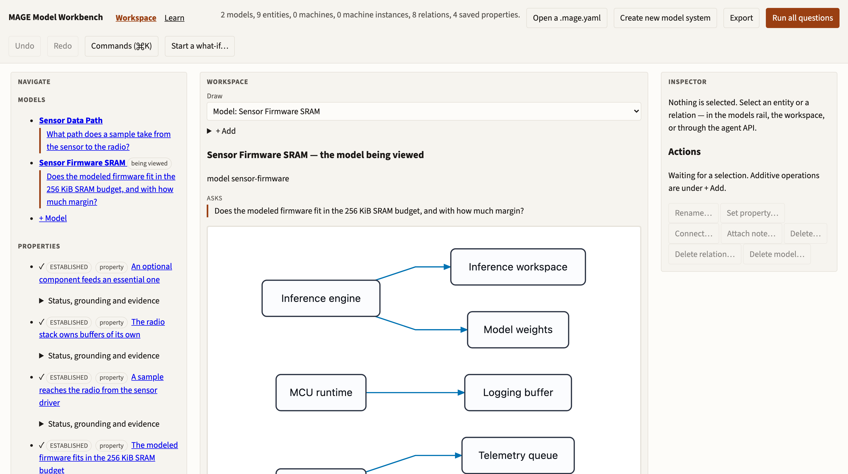
The MAGE Workbench
davisjam.github.io/model-based-agentic-software-engineering/workbench
Models · saved questions · evidence · an agent API — one-minute orientation, then we start from a question.
12
Notes:
Real screenshot: the Embedded Sensor Node example loaded, viewing the Sensor Firmware SRAM model. Orientation only: the models rail and saved properties (left), the drawn model and its declared purpose (center), inspector and actions (right). Don't tour controls — the next slide starts from an engineering question.

Slide 18
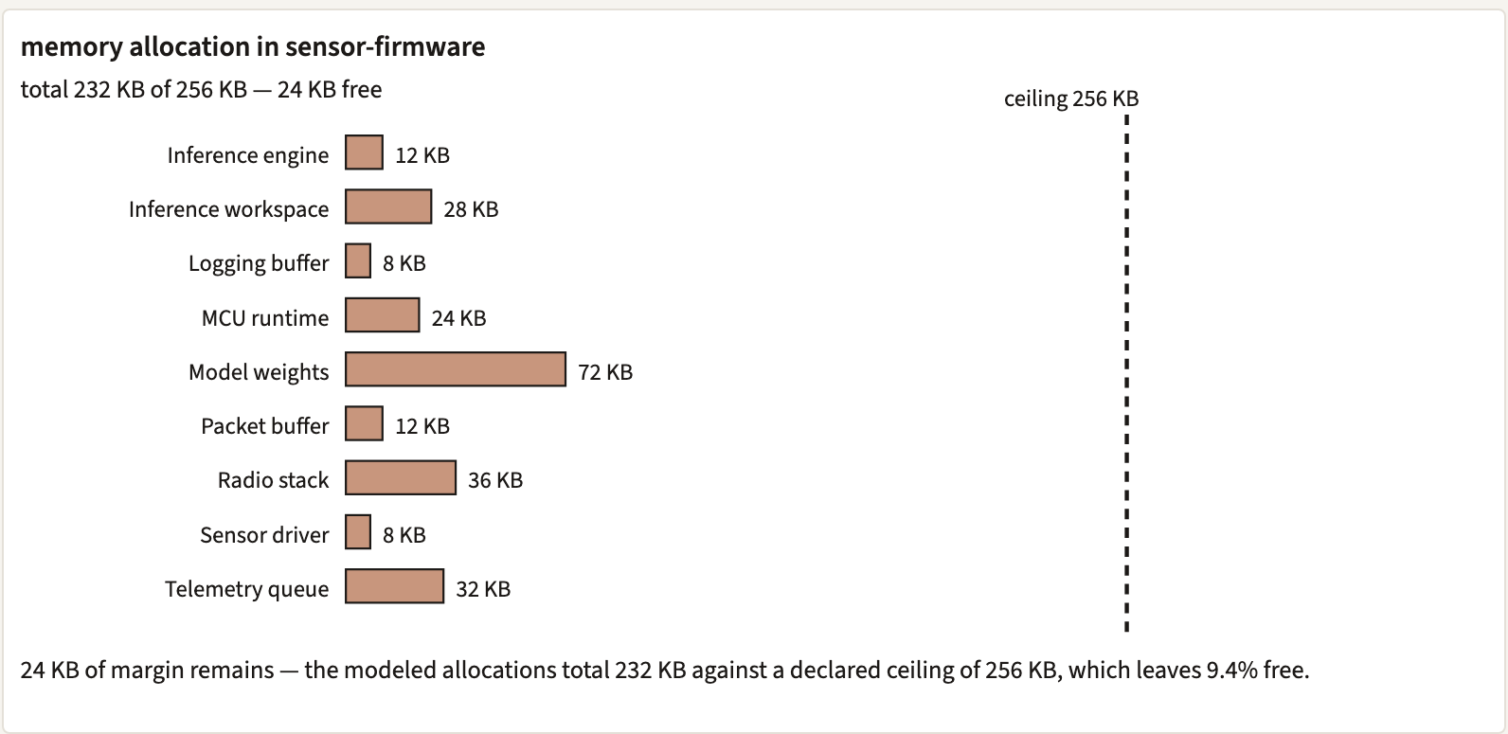
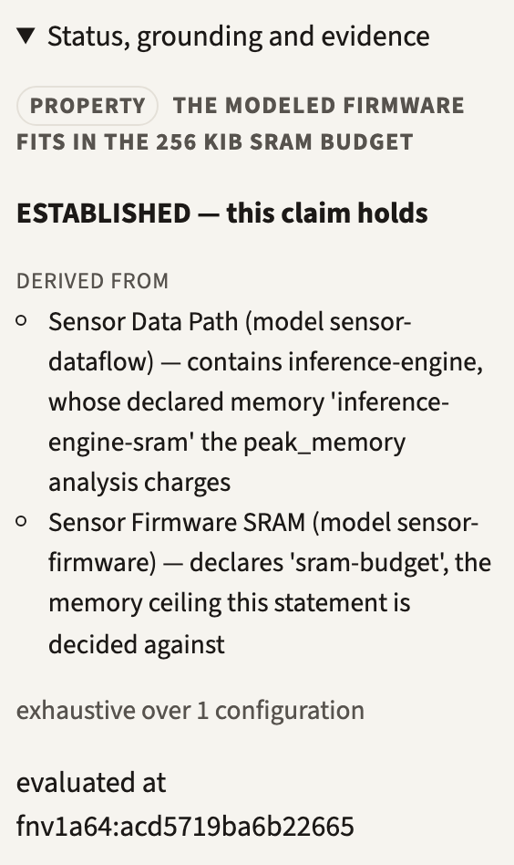
Ask the model
Does this configuration fit within its memory budget?
the saved question, run deterministically
model
semantic machinery
result
No LLM required. Elements, relations, and quantities have
declared semantics; the answer is computed, with provenance.
the verdict carries its evidence:
which models it derives from,
what the analysis exhausts
232 KB of 256 KB — 24 KB of margin. The answer arrives with its evidence.
13
Notes:
Both panels are real Workbench output for the shipped example. Surface honesty: the quantity question runs as a SAVED question ('The modeled firmware fits in the 256 KiB SRAM budget') — the composable ask surface covers graph questions. Provenance is displayed: DERIVED FROM both models, 'exhaustive over 1 configuration', plus an evaluation fingerprint.

Slide 19
Ask through an agent
“What is consuming memory on the sensor node?”
Interacting with models can be tedious: navigate the model, select the operation,
formulate the query. An agent can mediate that interaction.
Engineer
THE AGENT SURFACE
question
window.mage — the Workbench exposes
the model to agents: typed operations,
questions, evidence.
Agent
model operations
Model
semantic result
THE KEY DISTINCTION
Agent
The agent helps interpret the question
and operate on the model.
It need not invent the engineering facts.
explanation
Engineer
Natural questions in — the model's semantics still produce the facts.
14
Notes:
Introduce the agent from the friction, not as a feature checklist. The agent operates the model through window.mage; the semantic result comes from the model's machinery, and the agent explains it.

Slide 20
Lab: model → query → revise
LAB
1
Determine current memory consumption and margin.
WHAT THE MODEL DECLARES
2
Identify the largest consumers.
budget: 256 KiB of SRAM
total: 232 KB → 24 KB margin
pinned: “fits in the 256 KiB SRAM budget”
doubling telemetry (32 → 64 KB) → 264 KB: fails by 8 KB
a ≥20% margin needs ≤ 204.8 KB — several changes achieve it, several near-misses do not
3
Double the telemetry queue.
4
Re-evaluate the budget requirement.
5
Restore a margin of at least 20%.
Tasks, not UI instructions.
Use whichever surface you prefer:
• run the saved questions and read the evidence
• edit in the workspace, or via the agent
• ask the agent — then check it against the model
The search is the design activity, not a lookup.
15
Notes:
Release students into the activity. The numbers come from the shipped model: 9 allocations totalling 232 KB against 256 KiB; doubling telemetry-queue breaks the pinned requirement by 8 KB; restoring a 20% margin needs ≤204.8 KB. Largest single allocation: model-weights at 72 KB (31% of budget).
The model's KB tokens are binary: 256 KB here is exactly 256 KiB.

Slide 21
What can’t the model answer?
What is peak SRAM consumption?
“It answers ‘what if everything is live at once’, and it cannot answer ‘is everything live at once’. The second question needs operating modes — Sleeping, Sampling, Inferring, Transmitting — and resource lifetimes tied to them … That is the earned transition to Behavior, and it is deliberately not in this file.”
— the shipped model's own header, embedded-sensor-node/system.mage.yaml
More prompting cannot create missing engineering knowledge.
The agent can navigate, infer, or propose — but if the answer needs distinctions the purposeful
model does not preserve, stronger prompting does not repair the model.
Lab closing question: what would we need to add to make this question answerable?
— exactly Lecture 1's judgment: which distinctions must the model preserve, and at what cost?
The model states its own boundary — an omission declared on its purpose.
16
Notes:
The lab payoff, and the lecture's punchline — quoted from the shipped artifact itself, not asserted. The model's purpose block lists 'operating modes' as its first declared omission. Students can try the agent first; the boundary holds.

Slide 22
END OF THE CORE LECTURE
Modeling makes knowledge explicit.
Alignment gives it consequence.
The model says the margin stays above 20%.
Next lecture: what happens when reality disagrees?
OPTIONAL · REFERENCE
Section 4 — Reasoning with SysML and KerML
The sensor node named what it was missing: operating modes.
These six slides take a sibling system where modes, flow, and quantities are modeled —
and show what the stronger semantics let us derive. Not “SysML 101.”
17
Notes:
The Alignment handoff closes the core lecture (kept from the previous deck). §4 is optional/reference. The frame: §3's model documented operating modes as its missing distinction; §4 works a sibling system where those distinctions are modeled — in SysML v2, the strongest-commitment row of slide 8's table.

Slide 23
A sensing system — behavior and resources
part def SensorNode {
attribute samplingPeriod = 5 [s];
attribute sampleSize = 512 [B];
attribute bufferCap = 4096 [B];
attribute radioRate = 4096 [B/s];
attribute txPeriod = 30 [s];
state def Modes { … }
}
ONE RICHER EMBEDDED SYSTEM
modes
Sleep / Sample / Transmit
sampling 5 s
sample 512 B
buffer 4 KiB = 8
radio 4 KiB/s
tx timer 30 s
power 0.1 / 5 / 60 mW
avg power ≤ 2 mW
no buffer overflow
SysML v2 textual notation — excerpt, abridged
Exactly the distinctions the sensor node declared as omissions:
operating modes, and resource lifetimes tied to them.
Enough SysML to establish the actual model — the constructs earn their keep on the next slides.
18
Notes:
Introduce the system once, with the actual numbers; slides 19-21 reason over them. The excerpt is abridged notation, not a complete model. Power figures: Sleep 0.1 mW; Sample 5 mW for 50 ms per sample; Transmit 60 mW while draining at 4 KiB/s.

Slide 24
Can the buffer overflow?
Given: avg production rate (512 B / 5 s ≈ 102 B/s) < radio throughput (4096 B/s)
Locally plausible: “then it cannot overflow.”
tx done
Sleep
sample timer
Sample
buffer full
Transmit
done
tx timer (30 s)
Sample produces data. Transmit consumes it. Modes draw different power.
Comparing the two rates cannot answer the question. The radio drains the buffer only while
Transmit is active — transmission availability depends on state behavior, batching, and timing.
The honest answer needs behavior, flow, and quantity composed. That is the next slide.
A locally plausible conclusion can be wrong — now the semantics do real work.
19
Notes:
The trap: average-rate reasoning. The machine: Sleep -sample timer-> Sample -done-> Sleep; Sleep -tx timer-> Transmit -tx done-> Sleep; Sample -buffer full-> Transmit. Data is drained only in Transmit, so the buffer's fate depends on when Transmit runs.

Slide 25
Behavior, flow, and quantity
state
occurrences
sample
production
buffer
capacity
transmission
behavior
quantities
+ units
+
+
+
+
the buffer property
THE BASELINE, DERIVED
samples per cycle: 30 s ÷ 5 s = 6 ≤ capacity 8 → no overflow
transmit time: 6 × 512 B ÷ 4096 B/s = 0.75 s
average power: (60·0.75 + 5·6·0.05 + 0.1·29.0) mW·s / 30 s
≈ 1.65 mW ≤ 2 mW ✓
Every step is licensed by a declared quantity, unit, or state occurrence.
Derived by hand from the model. No tool computed this verdict.
This is where SysML/KerML earns its keep: one property composed across three views.
20
Notes:
Walk the composition slowly. Honesty constraint: the derivation is hand-performed; the language's semantics license it (typed quantities, units, state occupancy), but no available tool executes it — foreshadow slide 22.

Slide 26
Change the sampling rate
Perturbation: sampling period 5 s → 2.5 s.
What changed?
THE BUFFER PROPERTY
THE POWER REQUIREMENT
12 samples per cycle > capacity 8
Overflow? No.
At the 8th sample the buffer-full
transition fires and Transmit
drains early.
STILL HOLDS — because of
behavior, not arithmetic.
transmit: 12 × 512 ÷ 4096 = 1.5 s
avg ≈ (90 + 3.0 + 2.79) mJ / 30 s
≈ 3.2 mW > 2 mW budget
NOW FAILS — the same change,
a different property, the opposite
verdict.
One model modification propagates into multiple engineering properties.
All numbers hand-derived from the model's declared quantities — and the slide says so.
One change, two properties, two different verdicts.
21
Notes:
The numbers are chosen so the answer is nontrivial and mechanically derivable BY HAND: the naive overflow prediction is wrong (behavior rescues it), and the passing power budget flips to failing. Arithmetic: 12 samples per 30 s; transmit 12x512/4096 = 1.5 s -> 60 mW x 1.5 s = 90 mJ; sample 5 mW x 12 x 0.05 s = 3.0 mJ; sleep 0.1 mW x (30 - 1.5 - 0.6) = 0.1 x 27.9 = 2.79 mJ; total 95.79 mJ / 30 s = 3.19 = ~3.2 mW against a 2 mW requirement.

Slide 27
Why can the model answer?
WHAT THE SEMANTICS LICENSE
MEASURED — OCTOBER 2026
typed features + units
512 [B] ÷ 4096 [B/s] is well-defined
state occurrences
Transmit being active determines when the buffer drains
expressions + constraints
the requirement is a claim over model values, not a comment
SysML supplies the systems concepts; KerML the semantic foundation.
SysML v2 Pilot Implementation
(release 2026-08, kernel 0.62.0):
✓ parses + validates these models
✓ name resolution, typed structure
✗ cannot execute state machines
✗ cannot compute a verification verdict
✗ quantity expressions stay unevaluated — it validates silently
“The semantics make it derivable” is a claim about the language — not about a tool run.
22
Notes:
The honesty slide. The derivations of slides 19-21 are licensed by the language's defined semantics and were carried out by hand. Measured ground truth (workbench differential-conformance design, Oct 2026): the Pilot parses/validates but cannot execute machines, produce verification verdicts, or normalize quantities; dimension conformance is unchecked at kernel 0.62.0. Express vs decide.

Slide 28
What still can’t be known?
What is peak SRAM consumption?
Asked of the richer model this time — modes, flow, power, and all.
Still missing: stack depth under interrupt nesting · allocator fragmentation · DMA buffers
· which allocations are simultaneously resident within a mode
Insufficient information — unless we model the distinctions that property requires.
Section 3's model named operating modes as a missing distinction. Section 4 modeled them
and still has a boundary. Every purposeful model does.
The optional section closes where the lecture began: on purposeful reduction and degrees of
semantic commitment — not on SysML syntax.
Stronger semantics sharpen the boundary; they do not remove it.
23
Notes:
Symmetry close: the same question that ended §3 ends §4. Even the strongest-commitment language leaves purposeful omissions; commitment buys precision about what IS modeled, never completeness.

