Slide 1
Software Engineering
ECE 30861 / CSCI 45000
Alignment
How do you know whether an agent
is doing what you want?
Prof. James C. Davis
Prof. Steve France
Notes:
TIMING: 1 minute
- Last time we talked about Modeling: how to make consequential engineering knowledge explicit while leaving irrelevant degrees of freedom open.
- Today we ask the complementary question: once we know something about the work, what should that knowledge control?
- The title question is deliberately broad: "How do you know whether an agent is doing what you want?" We are going to unpack both know and want.
- Start with an agent and essentially no engineered control around it.

Slide 2
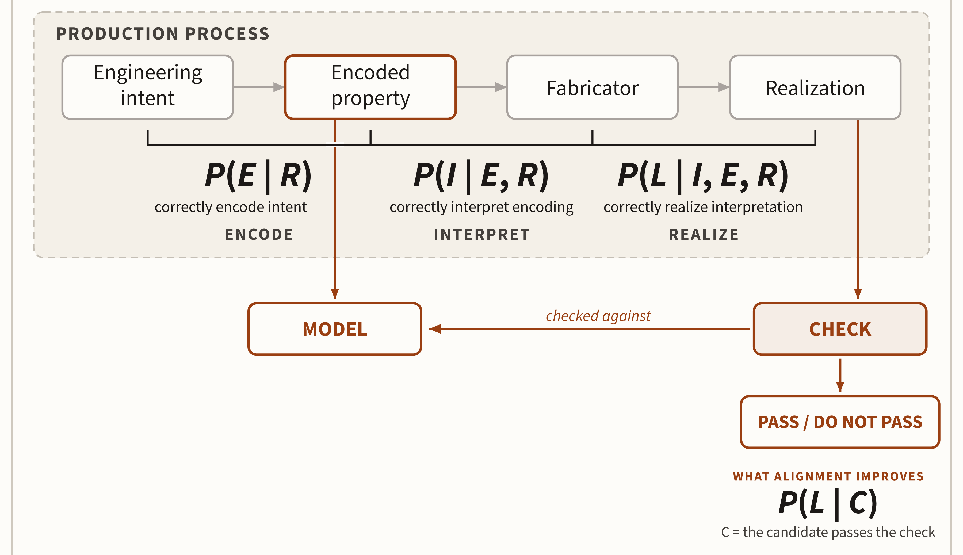
The Master Equation: Alignment adds a check
p_{R} = P(E | R) · P(I | E, R) · P(L | I, E, R)
Modeling raises the probability of a correct realization by improving what is represented and interpreted.
Alignment raises the probability of an accepted implementation being correct by checking the realization against the obligation.
Notes:
TIMING: 2 minutes
- Same equation, same picture as Modeling-1 — say so: you have seen this; nothing in the production band has changed.
- What is new is below the band. The encoded obligation drops down as the MODEL; the realization drops down to the CHECK; the check consults the model; the verdict is PASS or DO NOT PASS.
- The point you must not blur: Alignment does NOT make the fabricator better. P(E | R), P(I | E, R), and P(L | I, E, R) are untouched. Alignment changes the production system by adding SELECTION on the fabricator's output. Modeling works inside production; Alignment acts on its output.
- The quantity that improves is P(L | C). Before Alignment: how likely is the agent to realize the obligation correctly? After Alignment: given that this realization was admitted, how likely is it to be correct?
- Then immediately: let's run the production system. Advance to the vibe-coding exercise; do not belabor the structure — the students are about to experience what happens without the check.
ANIMATION
1. equation + production pipeline
2. fade in Realization → CHECK
3. draw the arrow back from CHECK to MODEL
4. reveal PASS / DO NOT PASS
5. reveal P(L | C)

Slide 3
Vibe-code a todo list
Open Claude Code. Give it the following task.
Create a todo-list web application and make it available at localhost. A user should be able to add a todo item, mark an item complete, edit an existing item, and delete an item. The list should survive a browser refresh. Give the application a clean, usable interface with a text field for adding items and a visible list of current todos. Use whatever implementation approach you think is appropriate. When you are finished, start the application so that I can use it in my browser.
Examine the result and refine it as needed.
You have 5–10 minutes.
Notes:
TIMING: 6 minutes
- This is an experiment, not a programming exercise. Do exactly what the prompt says.
- Give the agent the work. Do not rescue it, redirect it, or improve its choices.
- Notice how much freedom the prompt leaves: language, framework, architecture, persistence mechanism, styling, testing strategy.
- If the agent asks you to choose something that the prompt leaves open, let it choose.
- The interesting part comes after it says it is finished.
ANIMATION
- Reveal the task first.
- Reveal "Examine the result and refine it as needed" only after students have started reading.
- Start the timer after instructions are clear.

Slide 4
Does it work?
Open the application in your browser.
Does it work?
What did you check before answering?
adding · editing · deleting · persistence
appearance · console errors · refresh · multiple tabs
Notes:
TIMING: 3 minutes
- Stop coding. Open what the agent produced.
- Show of hands: does yours work?
- Now the important question: what did you do before you were willing to say yes?
- Take answers from the room before revealing examples.
- Students will usually test adding, deleting, refresh, perhaps editing. Someone may inspect the console. Someone may notice something nobody else checked.
- The phrase "it works" concealed a collection of claims and a collection of evidence.
- Notice also what you probably did not establish. Did anyone test two tabs? malformed input? browser restart? storage exhaustion?
- This is our Validation problem again: a judgment depends on what claim we are making and what evidence bears on it.
ANIMATION
- Start with only "Does it work?"
- Reveal "What did you check before answering?" after collecting yes/no answers.
- Reveal the example checks only after students supply their own.

Slide 5
Alignment: When Validation meets Delegation
VALIDATION
When does evidence justify action?
DELEGATION
What action may the agent take?
ALIGNMENT
How do we enforce what must be true?
Alignment connects engineering obligations
to controls in the environment.
Notes:
TIMING: 3 minutes
- We already have two pieces of the problem.
- Validation asks when evidence justifies a judgment or action.
- Delegation asks what action another actor is permitted to take on our behalf.
- Alignment is where those meet.
- Suppose a test says the implementation is wrong. That is a validation result. What happens now?
- Does the agent merely receive advice? Is the commit rejected? Can the PR merge? Can the artifact deploy?
- Alignment connects the engineering judgment to what the engineered environment permits.
- Sometimes by preventing invalid states; sometimes by producing evidence, evaluating it, and making subsequent action conditional on the verdict.
- "Agent or environment" matters. Often the strongest control is not telling the agent what not to do. It is designing the environment so the consequential action is unavailable.
ANIMATION
- Reveal VALIDATION first.
- Reveal DELEGATION second.
- Reveal ALIGNMENT and its question last.
- Finish with the bottom definition.

Slide 6
Review: Bounding delegated work
SECTION 1
What about the task and process must the engineer control?
Notes:
TIMING: 30 seconds
- Before we can control delegated work, we need to be precise about what we delegated.
- This section builds one structure: delegation bounds two things — the task and the process.
- Everything else in the section is an example of that structure.

Slide 7
Delegation bounds the task and the process
BOUND THE TASK
What outcome is required?
What must remain true?
What is out of scope?
What freedom remains?
BOUND THE PROCESS
Where may the agent work?
What may it change?
What must it inspect or check?
When is the work complete?
What actions require separate authority?
Constrain the result
Constrain how results may be produced
Notes:
TIMING: 2 minutes
- Delegation bounds two things: the task and the process.
- Tie this to degrees of freedom: we are not specifying everything. We are deciding which freedoms are consequential in the RESULT and which are consequential in the PROCESS.
- The task column asks what the artifact must satisfy. The process column asks how the work may be performed and when it is done.
- The next two slides are examples of this structure, not four more things to learn.

Slide 8
Give agent a work order
WORK ORDER: Bulk TODO-owner edit
Goal | Add POST /todo/bulk-edit/owner
Scope | Modify task ownership only
Preserve | Existing single-task API behavior
Do not | Modify authentication, payment, content
Check | Existing tests + new bulk-edit tests
Deliver | Commit changes on your worktree and open a PR
Authority | Do not merge or deploy
TASK
bounds the result
PROCESS
bounds the path
Notes:
TIMING: 2 minutes
- Here is a much more useful delegation than "add bulk refunds."
- Read the fields through the taxonomy: Goal, Scope, and Preserve bound the TASK — what the result must be. Check, Deliver, and Authority bound the PROCESS — how the result may be produced.
- There is some overlap, and that is pedagogically useful: Scope can constrain both the result and the path, and "Do not" reads either way. Mention the overlap rather than forcing every field into exactly one box.

Slide 9
Bound the consequential degrees of freedom
BOUND
worktree
scope
forbidden actions
required checks
delivery boundary
LEAVE FREE
implementation
decomposition
intermediate steps
naming
INSPECT
MODIFY
CHECK
COMMIT
PROPOSE
A process model makes consequential actions, transitions, evidence, and stopping conditions explicit without prescribing internal reasoning.
Notes:
TIMING: 3 minutes
- Recall degrees of freedom from Architecture and Design. Engineering is not about specifying everything.
- We bind choices whose consequences matter: worktree, scope, forbidden actions, required checks, delivery boundary.
- We deliberately leave other choices free: implementation, decomposition, naming, algorithms where no obligation constrains them, the order of intermediate edits.
- If we specify all of those too, we have defeated much of the purpose of delegation. Good delegation is therefore selective reduction of degrees of freedom — it constrains consequential choices without prescribing every move (that line was the slide footer; now spoken).
THE PROCESS STRIP (absorbed from the deleted "The process is a model" slide):
- We can recognize the same move we made in the Modeling lecture: the work order and environment define a model of the delegated process — permitted actions, transitions, stopping conditions, expected evidence.
- Importantly, this is not a model of the agent’s internal chain of thought. We do not need to prescribe how the agent reasons internally; we need enough external structure to reason about consequential behavior. That gives us something against which failure can be defined.
- This is the first Modeling callback of the lecture: the work order and environment DEFINE a model of the delegated process. We will lean on this in the models section.
ANIMATION
- Reveal BOUND first, LEAVE FREE second.
- Reveal the process strip, then the concluding sentence last.

Slide 10
How can delegated work fail?
SECTION 2
The result can be wrong. The process can be wrong.
Notes:
TIMING: 30 seconds
- We bounded the task and the process. Either bound can be violated.
- A violated task bound is a wrong RESULT. A violated process bound is a wrong PROCESS.
- Different failures will require different kinds of control.

Slide 11
Either kind of bound can be violated
WRONG RESULT
WRONG PROCESS
QUESTION
Did the artifact satisfy its obligations?
Was the work performed within the delegated process?
EXAMPLE
Existing API behavior changes
Agent modifies a forbidden dependency
VALIDATION TARGET
Artifact / system state
Actions / evidence / authority
Notes:
TIMING: 2 minutes
- Section 1 bounded the task and the process. This slide says: either bound can be violated.
- Wrong result: the artifact fails an obligation. Validation targets the artifact or system state.
- Wrong process: the work was performed outside the delegated process. Validation targets actions, evidence, and authority.
- The four slides that follow are examples of these two classes, not four new categories.

Slide 12
Wrong result
Requirement: existing clients continue to behave identically.
The agent changes response semantics.
REQUEST
IMPLEMENTATION
✗
required behavior
ARTIFACT FAILURE
The resulting system violates an obligation.
wrong behavior · excessive memory · incompatible API
(measurable – hopefully, you notice before you ship)
Notes:
TIMING: 90 seconds
- First and most familiar: the artifact itself can violate an obligation.
- We asked for bulk refunds while preserving existing client behavior. The new implementation changes response semantics.
- The agent may have followed the requested process perfectly and still produced the wrong system.
- This is ordinary artifact failure.
- Examples include functional behavior, invariants, resource bounds, and compatibility obligations.
ANIMATION
- Reveal requirement.
- Reveal the implementation change and X.
- Reveal ARTIFACT FAILURE definition last.

Slide 13
Wrong process can fail in different ways
SCOPE
Work exceeds the work order
forbidden file · altered test
AUTHORITY
Work exceeds delegated authority
merge · deploy
EVIDENCE
Evidence does not establish the obligation
“all tests pass” without saying what was tested
Can the result be correct while the process is wrong?
Notes:
TIMING: 4 minutes
- One slide, three ways the PROCESS can be wrong: scope, authority, evidence. The comparison is the lesson — Section 2 just simplified the taxonomy; three separate slides made it feel complicated again. Slide "Wrong result" stays as the contrasting artifact failure.
- SCOPE: the path to the result violates the work order. The agent modifies files outside the declared scope, replaces an approved dependency, changes the model instead of satisfying it, or "fixes" a test to make the implementation pass. Some of these can still yield an artifact that appears to pass — final-state validation alone does not capture it.
- AUTHORITY: capability is not authority (from Agents). The agent may be technically capable of pushing, merging, or deploying; that does not mean we delegated those actions. A useful agent often needs broad capability for local work while consequential actions require separate authority. This distinction becomes important when we introduce gates.
- EVIDENCE: "all tests pass" sounds like evidence — evidence of what? Which tests? Against which obligations? In which environment? What wasn't tested? An obligation is a condition against which the work can be wrong; a correct result is not enough if we cannot justify accepting it.
- Then pose the bottom question explicitly and let them argue: can the result be correct while the process is wrong? Suppose the implementation really is correct. Do we care that the agent did not produce the required evidence? Yes. Engineering decisions are made under uncertainty; we cannot condition acceptance on facts we happen, in hindsight, to know were true. We condition acceptance on evidence available at the decision boundary. That separates truth from justified engineering judgment — the sharpest conceptual moment in this section.
ANIMATION
- Reveal the three cards one at a time: SCOPE, AUTHORITY, EVIDENCE.
- Reveal the bottom question last.
- Card wording tightened to parallel one-line failure statements; the earlier phrasings ('Agent changes something outside the work order', 'Agent performs a consequential action it may not take') are spoken, not projected.

Slide 14
From failures to controls
SECTION 3
What should the engineered environment do about them?
Notes:
TIMING: 30 seconds
- We have a failure model. Now the engineering question: what should the environment do about each failure class?
- This section names the control roles and connects verdicts to authority.

Slide 15
Prevent or detect?
ENGINEERING OBLIGATION
the property you must hold
Can the unwanted state be excluded cleanly?
NO
YES
CONSTRAINT
narrows what may happen
typed enum · permission · narrow API
EVIDENCE + EVALUATION
observe what happened and decide whether it satisfies the obligation
metric · trace · call scan · log
Constraints: If you can make the wrong state impossible, do so.
Otherwise, demand Evidence + Evaluation
Notes:
TIMING: 3 minutes
- This now OPENS the section: we know what can fail; the first design decision is whether we can prevent it — and if not, we need evidence. The roles that turn evidence into consequence come next.
- Given an obligation, first ask whether the unwanted state can be excluded cleanly.
- If yes, prefer prevention. A narrow API, type, permission, or constrained representation can make the invalid state unavailable.
- If not, we need evidence about what happened.
- Why might prevention be impossible? The property may emerge only across several actions, after composition, or at runtime.
- For example, a type can prevent some malformed states locally. It cannot generally prove your end-to-end latency under production load.
- Do not force every obligation into a constraint.
- The rule is deliberately asymmetric: if the wrong state can cheaply and reliably be made impossible, do that. Otherwise, collect evidence and evaluate it.
ANIMATION
- Begin with ENGINEERING OBLIGATION.
- Reveal the decision question.
- Reveal YES to CONSTRAINT.
- Reveal NO to SENSOR.
- Reveal examples under each.
- Reveal the gold rule last.

Slide 16
Four roles in a control system
obligation
evidence
verdict
admits
CONSEQUENCE
merge · deploy
WORK
SENSOR
VALIDATOR
GATE
observes what happened and produces evidence
evaluates evidence against an obligation
controls whether work crosses a boundary
CONSTRAINT
narrows what may happen
Notes:
TIMING: 4 minutes
- We can now name four control roles, and they compose into a recognizable pipeline.
- A CONSTRAINT narrows what may happen. A SENSOR observes what happened and produces evidence. A VALIDATOR evaluates that evidence against an obligation. A GATE controls whether work crosses a boundary.
- These are roles, not four required components. One mechanism may play several roles. (This caveat used to be on the slide; it belongs here, spoken once the four roles are visible together.)
- Keep the two sides distinct: constraints and sensors concern work/state; validators and gates concern judgment/admission.
- An obligation enters at the top — it is what the validator judges against. The constraint narrows what the work may do at all.
- The sensor produces evidence; the validator turns evidence into a verdict against the obligation; the gate turns the verdict into an admission decision.
- Ask the class where a type checker sits in this picture. (It plays several roles — which is the point of the role vocabulary.)
- The pipeline ends visibly at the gate controlling the CONSEQUENCE — concretely, merge and deploy:
- Evidence becomes useful when a validator turns it into a verdict. But a verdict alone does not control anything; the gate connects it to authority.
- The agent may modify and propose freely. Merge and deployment are conditional on verdicts.
- This is stronger than telling the agent 'please don't merge broken code.' The environment itself conditions authority on the engineering judgment. A gate makes authority conditional on a verdict.
- Spoken summary (was the footer band): a constraint narrows the work; a sensor observes it; a validator judges the evidence; a gate makes merge and deploy conditional on the verdict.
- This vocabulary gives us a way to design rather than simply say "add checks."

Slide 17
Check it where you can know
SECTION 4
Where can each obligation be decided?
Notes:
TIMING: 30 seconds
- We now know what kinds of controls exist.
- Next question: where should the control operate?
- The answer depends on where enough information exists to decide the obligation.

Slide 18
Where can you decide?
EDIT
COMMIT
PUSH
MERGE
DEPLOY
RUNTIME
type
property
Precommit hook:
Dependency checks
integration
behavior
latency
under load
deployed
configuration
What is the tradeoff between controls and velocity? How to decide?
Notes:
TIMING: 2 minutes
- Think about the boundaries available in ordinary software work: edit, commit, push, merge, deploy, runtime.
- Different obligations become decidable at different points.
- A type property may be decidable during editing or compilation.
- A forbidden dependency may be decidable from a commit or repository state.
- Integration behavior may require assembled work.
- Latency under load may require deployment or runtime evidence.
- There is no universally correct "shift left" answer.
- Check at the earliest boundary where the obligation can actually be decided.
ANIMATION
- Reveal the boundary sequence first.
- Reveal each example property at its appropriate boundary.
- Reveal the rule last.

Slide 19
Earlier is not always possible
OBLIGATION Code and architectural model must agree when the task completes.
commit
commit
commit
commit
✗ not decidable at any individual commit
COMPLETED UNIT OF WORK
✓ obligation decidable here
The obligation is right. The earlier boundary cannot decide it yet.
Notes:
TIMING: 2 minutes
- Why can't we always check earlier?
- Some obligations span a unit of work.
- Imagine several individually valid commits. During intermediate commits, the architecture model and implementation may temporarily disagree because the change is incomplete.
- No individual commit contains enough information to decide the completed-work obligation.
- The correct response is not to weaken the obligation.
- Move the check to the first boundary at which the obligation becomes decidable.
- Earlier detection is usually cheaper, which is why we reach for it first; the constraint is what is decidable, not what is desirable.
ANIMATION
- Reveal individual commits.
- Reveal "obligation not decidable at any individual commit."
- Reveal COMPLETED UNIT OF WORK.
- Reveal "obligation decidable here."
- Reveal the upward movement of the check last.
THE CONCRETE EXAMPLE (absorbed from the deleted boundary-example slide; the obligation bar carries it):
- The obligation is legitimate: when the task is complete, code and architectural model must correspond.
- Enforcing it after every intermediate edit or commit rejects legitimate transitional states; at merge, the task’s work is assembled and the obligation can be evaluated.
- Notice the distinction: the obligation was not wrong; its placement was wrong. This is an Alignment design error, not a reason to abandon the property.
CLOSING BEAT for the section (folds in the deleted "Production is only part of the system" slide):
- Return to where we started. The Master Equation asks about production: how likely is this delegation system to produce an acceptable candidate? We absolutely care — better models, representations, harnesses, and work orders raise that probability. But reliable engineering cannot mean requiring every production attempt to succeed; we need an engineered answer for the other cases too.
- Production and Alignment are related but not the same engineering problem. A better producer raises the probability that we get something acceptable. Alignment governs whether what was produced acquires consequences: production asks what the delegation can produce; Alignment asks what produced work may cause. Callback to Agents: capability and authority are independent.
- Even this control system has to respect information availability: we cannot attach a meaningful consequence to a verdict we cannot yet justify. That is why the boundary follows the property.
- Then stretch break. This is a good Act-II-halfway stopping point.

Slide 20
Stretch break
Notes:
TIMING: 2-3 minutes
- Give them an actual short break.
- Resume by saying: so far, nothing we did required a SysML model, a state machine, or any other explicit engineering model.
- That sets up the next section.

Slide 21
Models as validation surfaces
SECTION 5
How can explicit models help us establish obligations?
Notes:
TIMING: 30 seconds
- We have just built a theory of Alignment without assuming explicit models.
- This section asks what an explicit model contributes: models give validation mechanisms an explicit object to inspect.
- We will use the two models the class built in the Modeling lab — not a new example.
- We are no longer asking how to build or analyze a model. We already did that in Modeling. We are asking how an existing model can participate in Alignment.
- That distinction governs the next several slides.

Slide 22
Recall Modeling Lab, Activity 1
You want to schedule 3 threads on your device but only 2 can fit
DEVICE FIRMWARE
working memory view
Sense · Analyze · Transmit
max working memory 20 / 24 / 27 KB
device ceiling 48 KB
omits: who decides a thread may run?
THREAD ADMISSION CONTROL
lifecycle view
each thread: Asleep ⇄ Awake
asleep holds no working memory; awake holds up to its maximum
the Scheduler admits at most two threads awake
omits: what any thread costs in working memory
THINK · PAIR · SHARE
Quick Chat · How can we use these models in validation?
Notes:
TIMING: 3 minutes
- Last time, we asked what questions these models let us answer. Today the model is already here. The question is: how can we use it to decide whether something the agent built or did is acceptable?
- These are the two models the class built in the Modeling lab: the sensor node with Sense, Analyze, and Transmit threads and a Scheduler.
- Two purposeful reductions over ONE set of entities. The memory view knows what each thread costs and the 48 KB ceiling, and omits who decides that a thread may run. The control view knows who may be awake and who says so, and omits what running costs.
- Neither model answers the budget question alone; the join is entity identity — Sense in one view IS Sense in the other.
- This is now the section's opening DISCUSSION (it absorbs the deleted "We just did Alignment without models" and "What do models buy us?" beats). Frame it: everything in Sections 1-4 used tests, permissions, CI, and ordinary process controls — no explicit model was logically required, so explicit modeling has to earn its cost.
- Pose the footer question and DO NOT answer it immediately. Let them discuss.
- Look for answers about preserving knowledge, making relationships inspectable, enabling analysis, and reducing repeated reconstruction. Push beyond "documentation": what could a control do with a model that is difficult to do with prose or by repeatedly inspecting the implementation?
- The payoff strip under the cards is the answer — reveal it after they talk.
THE REVEAL (absorbs the deleted answer slide; it is the strip under the cards):
- A model preserves consequential distinctions; exposes relationships that would otherwise be inferred; deliberately leaves irrelevant realization choices open; enables evaluation without reconstruction.
- The key point is not that models contain MORE information than the implementation — they contain the right engineering information in a form suited to the question. Multiple analyses can then operate over the same explicit knowledge.
- Spoken gloss for the strip: models give validation mechanisms an explicit object to inspect — that is what makes a model a validation surface.

Slide 23
Key idea: Models give us something to check against
MODEL
REALIZATION
what should be true
lifecycle · memory bounds · admission rule
what was built
source code · configuration · execution
CHECK
Does the realization correspond where the model matters?
VERDICT
A model makes expected structure or behavior explicit so
the realization can be checked against it.
Notes:
TIMING: 3 minutes
- In Modeling, we could analyze this model and ask whether its own states permit three threads to be Awake. That's useful, but it's not Alignment yet.
- Here we have an implementation or execution produced by delegated work. Now the model gives us an explicit surface against which that realization can be checked.
- Walk the picture. The model says what should be true: the lifecycle, the memory bounds, the admission rule. The realization is what was actually built: source code, configuration, execution. The check asks whether the realization corresponds where the model matters.
- There are at least two broad ways to do that. We can inspect the realization without running it, or we can observe it executing.
- Do not introduce OBLIGATION yet; the triangle two slides ahead complicates this picture deliberately.

Slide 24
You can check correspondence statically
MODEL
REALIZATION
lifecycle / bounds
architectural rules
source code
configuration
STATIC CHECK
VERDICT
Is there any declared correspondence between the model and its realization?
Can any code path admit a third Awake thread?
Does the implementation permit a lifecycle transition absent from the model?
Static evidence can show correspondence of structure.
Notes:
TIMING: 3 minutes
- The first broad way: inspect the realization without executing it.
- Say 'static check', not 'static analysis'. 'Static check' is broader and more accurate: correspondence could be established by AST queries, architectural conformance, type checking, dependency checking, conventional static analysis, and more.
- Ground each question in the lab. 'Can any code path admit a third Awake thread?' checks the code against the admission rule the class modeled — at most two awake. 'Does the implementation permit a lifecycle transition absent from the model?' checks the code's transitions against the modeled lifecycle. 'Do implementation resource bounds agree with the modeled bounds?' checks declared limits against the per-thread working-memory maxima and the 48 KB ceiling.
- Note what each question interrogates: the REALIZATION, against what the model makes explicit. We are not analyzing the model; we are using it.
- Careful claim: a green verdict proves neither the model nor the implementation correct. It establishes the selected correspondence property we checked — nothing more. 'Agreement is not correctness', two slides from now, exposes that limitation deliberately.

Slide 25
You can check correspondence dynamically
MODEL
EXECUTION
expected behavior
SENSOR
TRACE
VALIDATOR
VERDICT
Did the Scheduler ever admit three Awake threads?
Did an observed lifecycle transition violate the modeled lifecycle?
Dynamic evidence can show correspondence of observed behavior.
Notes:
TIMING: 3 minutes
- The second broad way: observe the realization executing. The same model defines what a SENSOR must observe at runtime — the model states expected behavior; the trace is checked against it.
- Ground it in the lab's lifecycle machines: every thread is Asleep or Awake, moved by admit and release events. The observation questions (two projected on the slide, the rest spoken): Did the observed transition exist in the model? Did events occur in the required order? Did execution enter a forbidden state? Did a measured quantity stay within its modeled bound — did the awake count ever exceed two, and did working memory stay within 48 KB?
- This prevents students from hearing 'model-based validation' as synonymous with static analysis.
- The takeaway is deliberately narrower than 'the implementation corresponds to the model': a trace cannot establish universal correspondence. Dynamic evidence establishes correspondence over the execution you actually observed — nothing beyond it.
- Close by asking aloud: where should each verdict acquire authority? Notice it lands back in Alignment: a static verdict might gate merge; a runtime verdict might gate deployment or trigger rollback. Where a verdict acquires authority is an Alignment decision, not a modeling one.

Slide 26
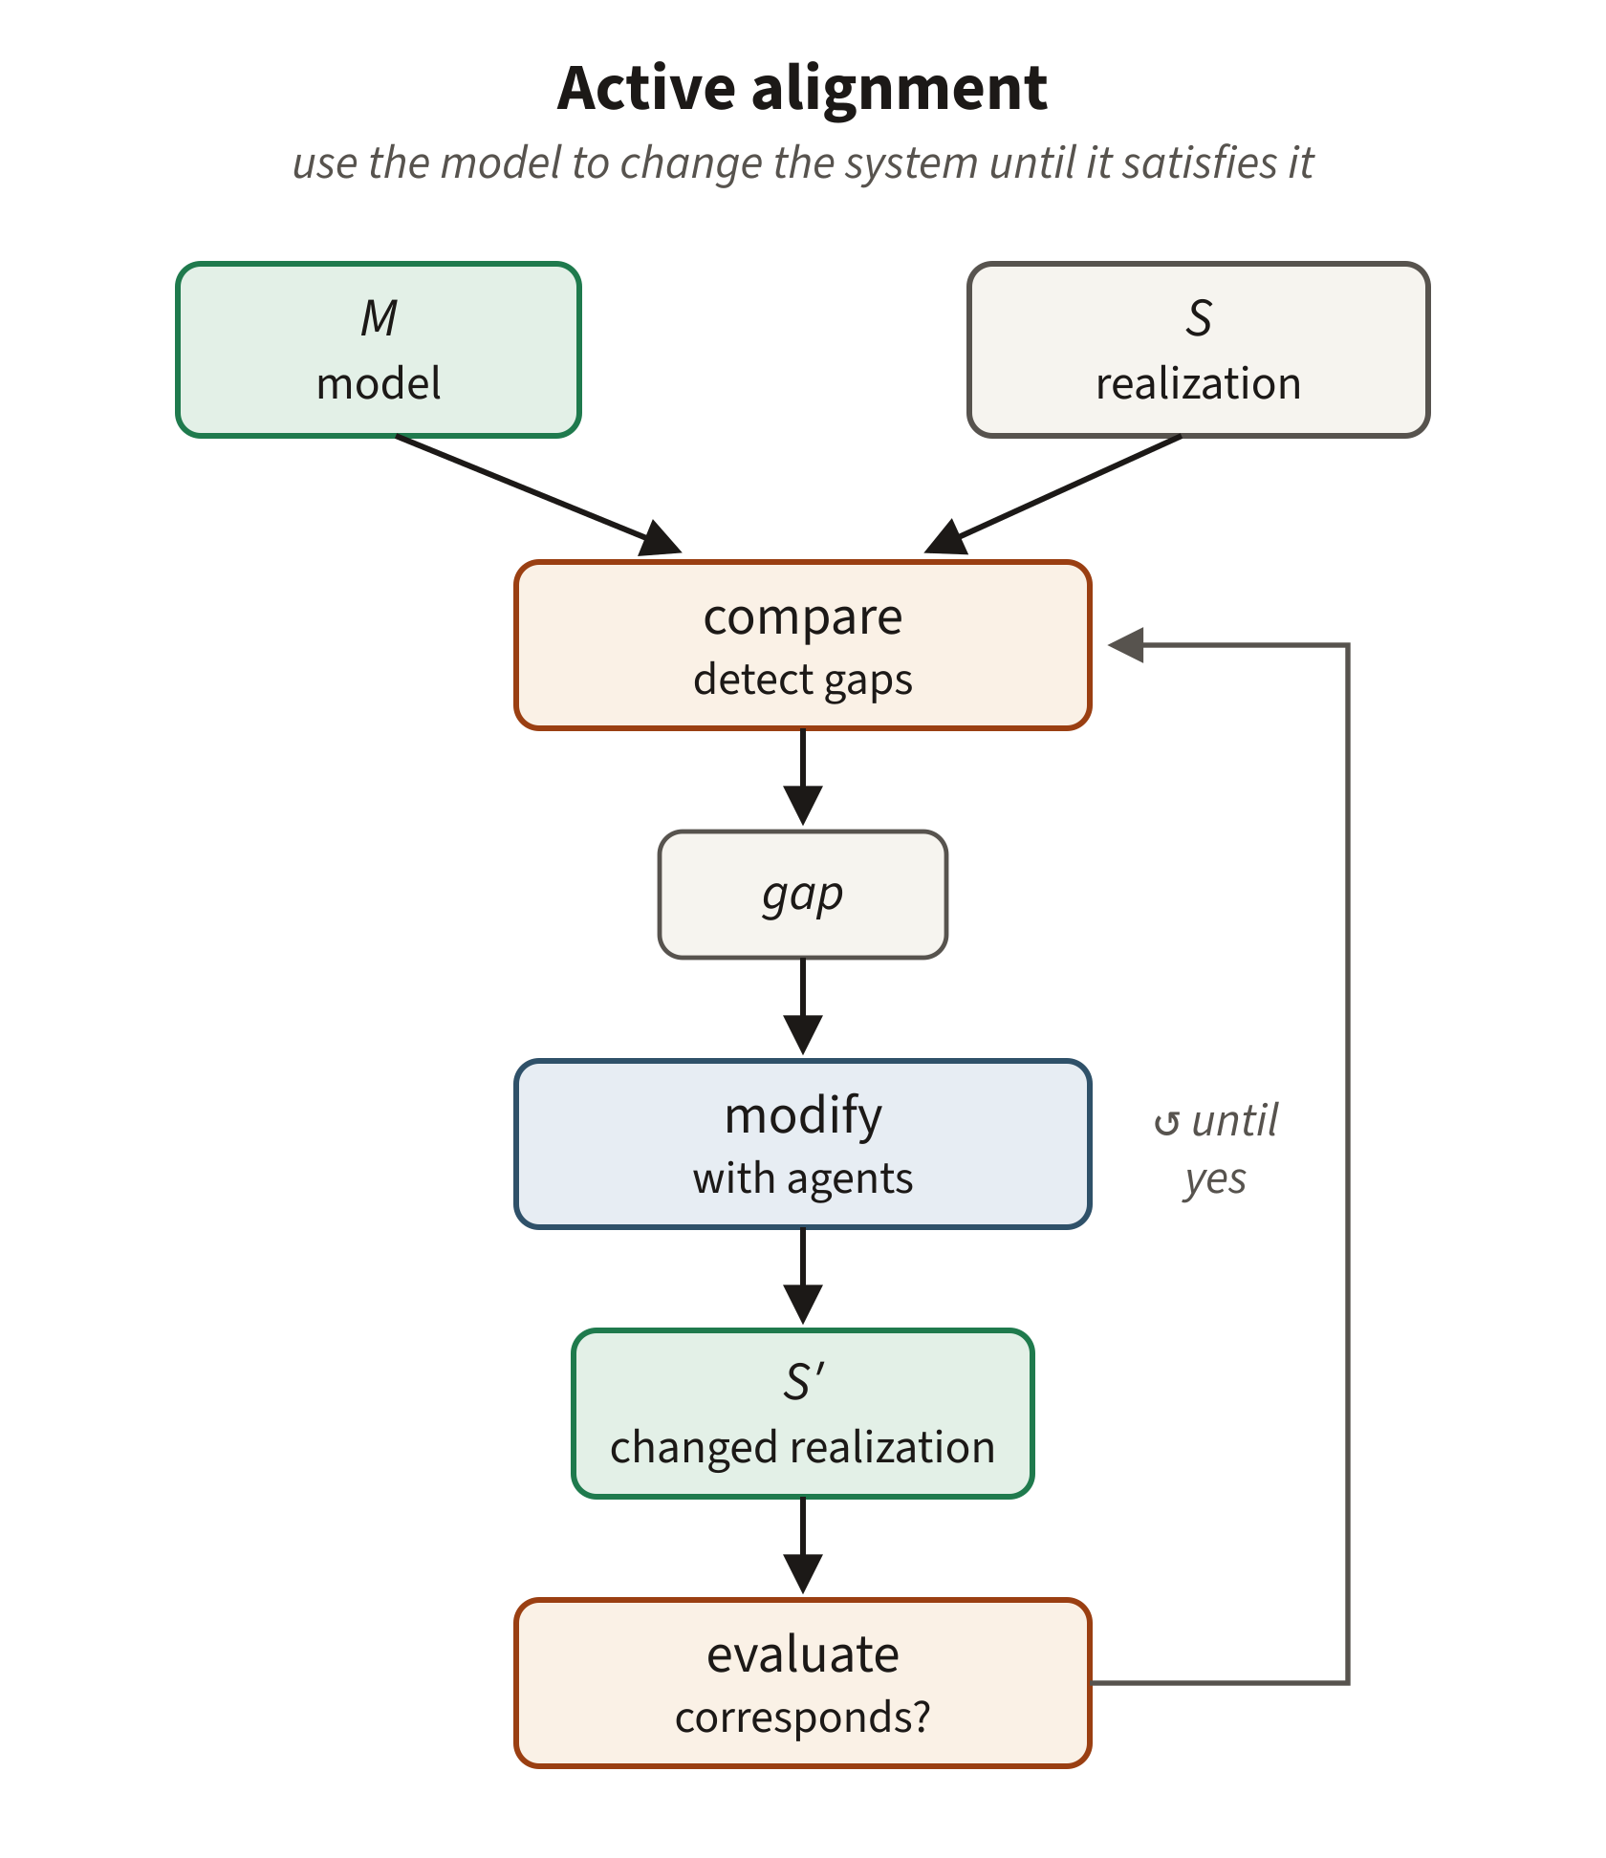
Active alignment: Use model as a loop target
“Oops, I forgot to control memory use. That’s a degree of freedom I should not have left open. Here is the model, retrofit the code.”
ACTIVE | PASSIVE
establish correspondence | preserve correspondence
S → S′ until M agrees | ΔS → check → admit/reject
A model can govern an existing system by first becoming a target for change, then a constraint on later change.
Notes:
Name the gap in the lecture explicitly. So far this lecture has mostly discussed passive alignment, because controls are easiest to explain as checks on proposed work. But alignment is not merely rejection. If an existing realization violates a newly explicit obligation, the environment can expose the disagreement and use agents or other engineering work to change the realization until correspondence is established. After that succeeds, the same obligation can be preserved passively.
Brownfield engineering: this is how a model acquires authority over a system that predates the model — one of the most practically important consequences of the active/passive distinction. And active alignment is not necessarily behavior preserving: satisfying a new model may require substantial changes to the realization, so do not assume it is just a refactor.
Bridge forward to Failure-Aware Engineering, the next unit: a failure reveals something that should become explicit; you model the lesson; active alignment repairs the existing realization to satisfy it; passive alignment prevents later work from silently undoing it. Active alignment produces durable engineering structure — failure analysis tells us what the new evidence justifies changing; active alignment explains how a newly discovered obligation can be imposed on an already-existing realization.

Slide 27
Remember: Alignment answers just one of three questions
captures?
OBLIGATION
satisfies?
ALIGNMENT
MODEL
REALIZATION
corresponds?
Vocabulary
Model ↔ realization — correspondence
Model/Realization ↔ obligation — conformance
Correspondence is one edge, not the whole triangle.
Notes:
TIMING: 3 minutes
- One distinction left: three kinds of judgment. The triangle carries them.
- The previous two slides gave us ways to establish this bottom edge: correspondence between model and realization. But don't confuse agreement with correctness.
- Walk the triangle: 1. Model and realization: does the realization correspond to the model? 2. Model and obligation: did the model capture the thing we actually care about? 3. Realization and obligation: does the resulting system actually satisfy the obligation?
- A perfectly implemented bad model is still wrong.
- We have an obligation, a model, and a realization. Ask what claim each edge makes.
- captures? — does the model actually capture the obligation?
- satisfies? — does the realization satisfy the obligation? That judgment is CONFORMANCE: an artifact against an independent obligation.
- corresponds? — do model and realization agree? That judgment is CORRESPONDENCE: two representations against each other.
- ACCEPTANCE brings in a fourth object, the receiving environment: will it accept the artifact? On the slide it is the third legend line, not a fourth node — name the fourth object aloud.
- None of these edges establishes the other two. A model and implementation can agree and both be wrong against the obligation. Evidence for one claim does not establish the others.
- This matters because model-driven development can otherwise create a false sense of assurance: we can become very good at keeping implementation synchronized with a bad model.
- Correspondence is useful, but it is only one edge of the engineering argument.
- (Demoted from the slide; ask aloud:) What claim does each edge make? What evidence would establish it?
ANIMATION
- Reveal OBLIGATION, MODEL, REALIZATION without edges if possible.
- Reveal the three edge questions, then the legend naming the three judgments.

Slide 28
Exercise
SECTION 6
Design Alignment for the Lab-Activity-1 Models
Notes:
TIMING: 30 seconds
- We have just built a theory of Alignment without assuming explicit models.
- This section asks what an explicit model contributes: models give validation mechanisms an explicit object to inspect.
- We will use the two models the class built in the Modeling lab — not a new example.

Slide 29
Back to the lab:
Design the Alignment
TEAM ACTIVITY · 10 – 12 MINUTES
DEVICE FIRMWARE
working memory view
Sense · Analyze · Transmit
max working memory 20 / 24 / 27 KB
device ceiling 48 KB
Choose one obligation from the lab.
1 · How could the realization violate it?
2 · Can you prevent that failure, or must you detect it?
3 · What would you check, and what evidence would let you decide?
4 · Where is the earliest boundary at which it is decidable?
5 · What should happen if the check fails?
THREAD ADMISSION CONTROL
lifecycle view
each thread: Asleep ⇄ Awake
the Scheduler admits at most two threads awake
OBLIGATION → MODEL → CHECK → DECIDE → CONTROL
Notes:
TIMING: 30 seconds transition + 2 minutes setup + 8-10 minutes work
- This slide is the section transition — the activity title itself is the transition. Setup line: enough vocabulary; now use it.
- This is unmistakably a RETURN TO THE LAB, not a new scenario: the two model cards on the left are the two models the class built in the Modeling lab and saw four slides ago (the working-memory view and the lifecycle view of the sensor node). In Modeling, they built and used the model; now they use that same model as an independent validation surface.
- This lands the Modeling deck's own message that models constrain implementation without determining it: we left realization choices free; now we check that the chosen realization still satisfies what the model preserved.
- Teams choose ONE obligation from the lab — the 48 KB device ceiling, the at-most-two-awake admission rule, a per-thread working-memory maximum — and walk the five questions on the right.
WORKSHEET (keep this slide up while teams work and walk it aloud):
- For each obligation, identify what can fail, what evidence establishes it, where it becomes decidable, and what failure should control.
- The five numbered questions walk that sequence: failure mode; prevent or detect; evidence; earliest decidable boundary; consequence of a failed check. Teams should also ask which of the two views makes the relevant fact explicit, and whether they would validate it statically or dynamically.
- Teams should be ready to defend their boundary choices and what authority the verdict carries.
- Takeaway strip: OBLIGATION → MODEL → CHECK → DECIDE → CONTROL — the triangle has just made the point that the model is not the source of truth; the engineering obligation is.

Slide 30
Report-out: Compare your Alignment approaches
Same obligation, different boundary
Which boundary has enough information?
Constraint vs. evidence
Can the failure be prevented, or must it be observed and evaluated?
Static vs. dynamic evidence
Can the obligation be decided from the realization itself, or only from observed execution?
Different authority
Should this failure block the commit, the PR, the merge, the deployment — or merely produce evidence?
Notes:
TIMING: 4-5 minutes
- Have two or three teams report a control they designed differently.
- Do not search immediately for the one correct design. Compare the engineering tradeoffs.
- If teams chose different boundaries for the same obligation, ask which boundary actually contains enough information.
- If one team chose a constraint and another chose detection, ask whether the invalid state can cleanly be excluded.
- If teams relied on different evidence, ask whether the obligation can be decided from the realization itself — statically — or only from observed execution.
- Finally, if teams attach different consequences, ask whether this failure warrants blocking commit, PR, merge, deployment, or merely producing evidence. This dimension goes last because it returns to the central Alignment question: where does the verdict acquire authority?
- The important thing is that the design is defensible against the failure model and obligation, not that everyone chose identical machinery.
ANIMATION
- Reveal comparison questions one at a time as they become relevant to student answers.

Slide 31
In closing: How do you supervise your delegation?
MODELING
make consequential engineering knowledge explicit while leaving irrelevant choices free
ALIGNMENT
connect selected obligations to consequences in the engineered environment
THE REUSABLE QUESTIONS
How can the delegated work fail?
What must be true?
What evidence bears on it?
Where can it be decided?
How will it be evaluated?
Should failure control what happens next?
Notes:
TIMING: 3 minutes
- Return to the question from slide 1.
- Modeling and Alignment solve different parts of the problem.
- Modeling makes consequential engineering knowledge explicit while leaving irrelevant choices free.
- Alignment decides which obligations have consequences in the engineered environment.
- Then walk the reusable questions in order.
- How can delegated work fail? Start with the failure model.
- What must be true? State the obligation.
- What evidence bears on it? Do not confuse activity with evidence.
- Where can it be decided? Put the mechanism at a boundary with sufficient information.
- How will it be evaluated? Identify the validator or equivalent judgment.
- Should failure control what happens next? Decide the authority of the verdict.
- That last question is what turns Validation into Alignment.
- End there. Do not add another summary or slogan.
ANIMATION
- Reveal MODELING.
- Reveal ALIGNMENT.
- Reveal the reusable questions one at a time.
- Leave the final question, "Should failure control what happens next?", as the last reveal and final image of the lecture.

